Slide 1
Example Logos
Option-1
Option-2
Base Font: semplicita pro medium
Base Font: semplicita pro medium
Option-3
Option-4
Base Font: semplicita pro medium
Base Font: haboro soft norm regular

Slide 2


Other variations (Original)

Slide 3



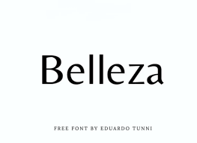
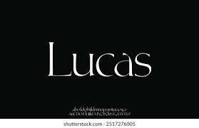
Inspiration

