Slide 1

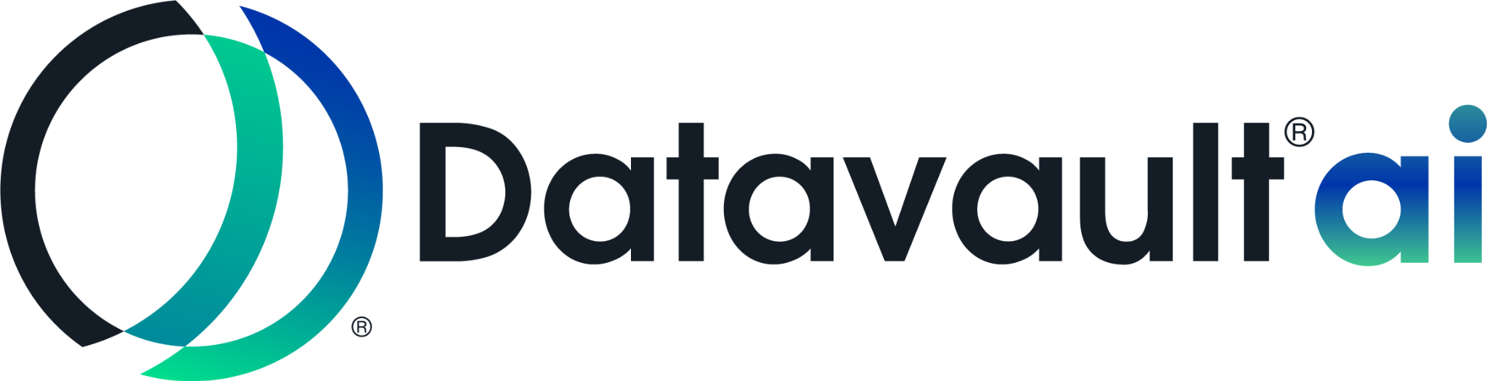
DATAVAULT®
DATAVALUE®
DATASCORE®
ADIO®
DATA QUARTERBACK®
INFORMATION DATA EXCHANGE®
INTERNATIONAL NIL EXCHANGE™
INTERNATIONAL ELEMENTS EXCHANGE™
CAPABILITIES
PRESENTATION 2026
Copyright© 2019-2026. Datavault AI Inc. All rights reserved. See International and Domestic Patents and Patents Pending: www.dvlt.ai. This website page is provided to satisfy the virtual patent marking provisions of various jurisdictions, including the virtual patent marking provisions of the America Invents Act. This page is intended to serve as notice under 35 U.S.C.§ 287(a).

Slide 2
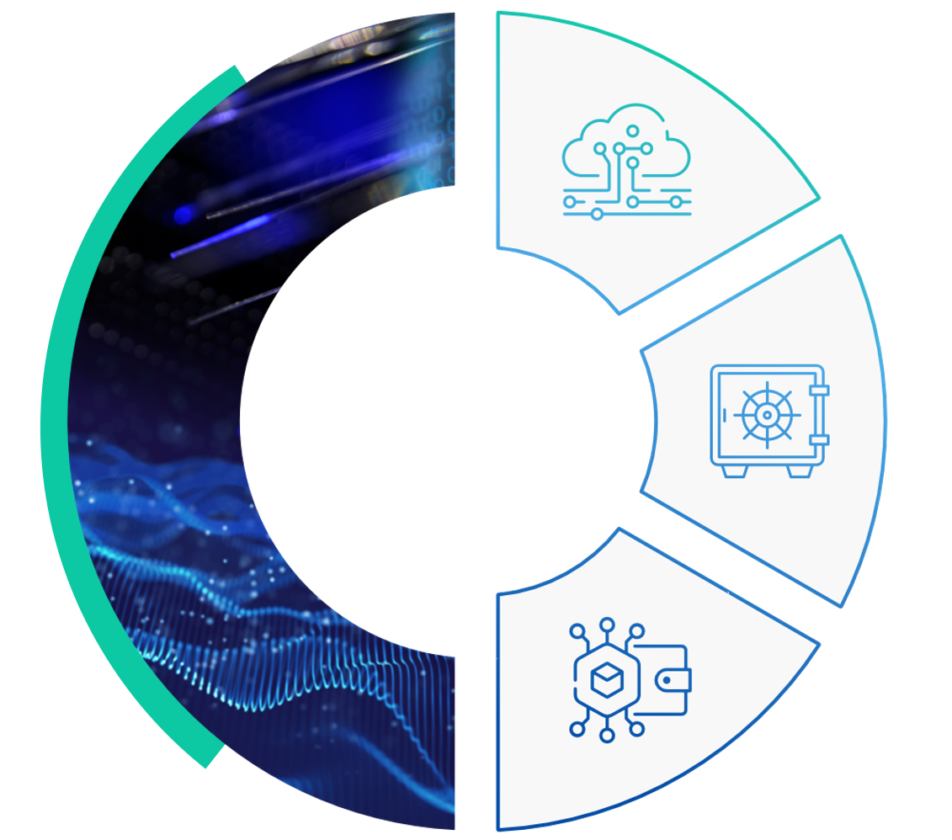
The Problem
Companies and institutions lack a process and platform for identifying, valuating, and monetizing core and derivative data assets.
Organizations and governments have operational risk and lack of fiduciary control over data assets of all types.
Corporations do not have a reliable source for minting cryptocurrencies, data-backed digital assets.
The Solution
The patented Datavault® platform transforms derivative data from a cost driver to a revenue producer with our novel 3-part system.
Data Refinery
Index, categorize, and objectify
data assets.
Datavault®
Get real-time valuation of data
and dynamic visualization of
data assets.
Information Data Exchange®
Buy or sell data on the Information Data Exchange®. Automatically list your data assets in the top tier crypto and digital assets exchanges.

Slide 3
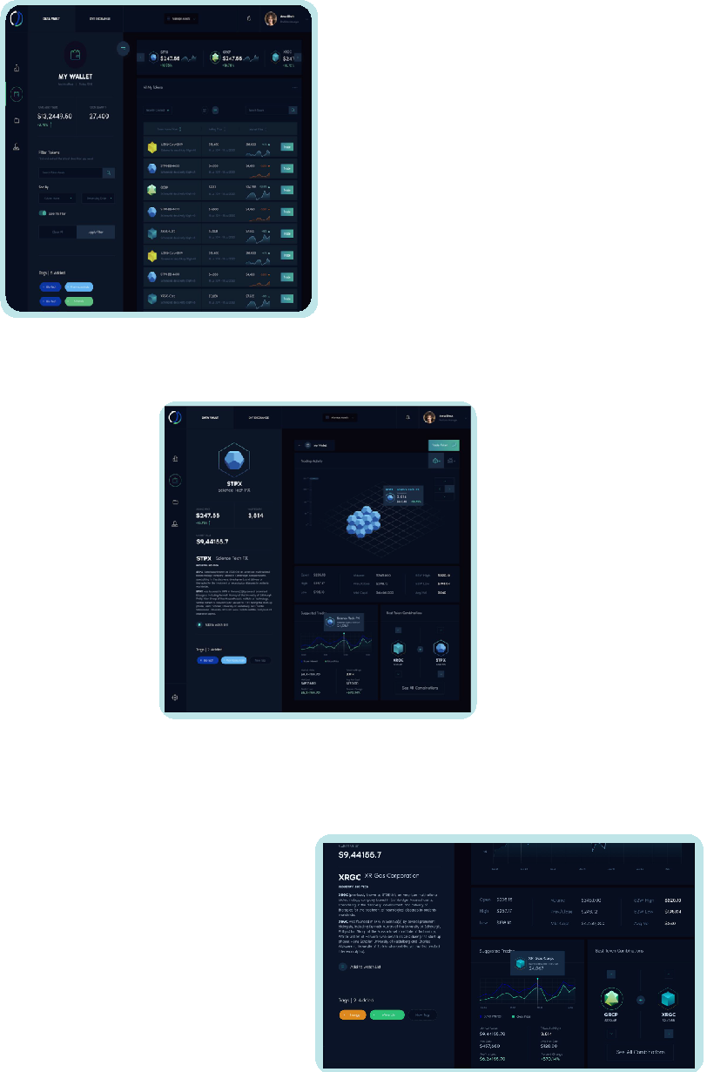

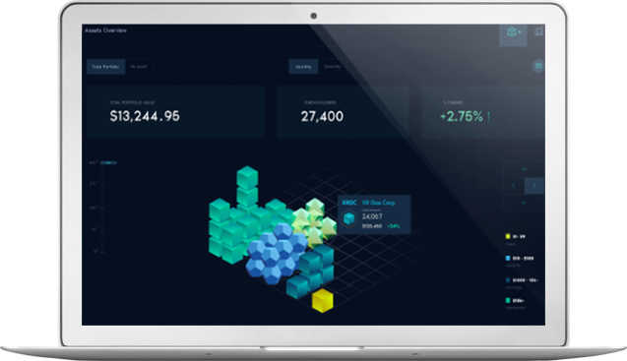
Datavault®
Innovative technology on a highly secure and encrypted platform
An intuitive, gamified user interface
Designed for valuation, collaboration, and trading of data assets on the Information Data Exchange®
Market Data
See market data in your vault and visualize market trends
Review Your Vault
Track assets in your wallet in real time
Combine Your Data Sets
Merge data objects from your wallet to create complimenting data combinations

Slide 4
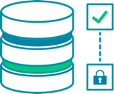


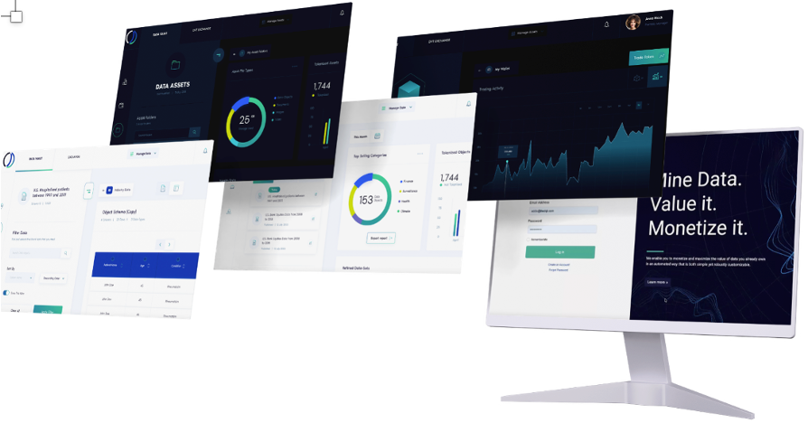
The Datavault® Platform Software Suite
Data Refinery
Cross Platform
File Type Ubiquity
AI Driven Analysis
Data Objectification
Blockchain Integration
Public/Private Data Infusion
DataVault®
Data Value ®
Data Score®
Experiential Data Visualization
Data Drive Outcomes®
Enhanced Analytics
Data Valuation
Collaboration
Information Data Exchange®
Tokenization of Data Assets
Robust Peer-to-Peer Transfer
Security & Compliance
AI Agent: DataScoreⓇ
AI-driven system ensuring data quality, trustworthiness, and accuracy for secure Web 3.0 exchanges.
Provides a standardized benchmark to assess data readiness for analytics, compliance, and monetization.
Enables confident, accelerated decisions in federally funded research.
AI Agent: DataValueⓇ
Converts commercially viable derivative data into financial worth for tokenized DOE assets.
Enables DOE labs to quantify, insure, and transact data as a true asset class.
Unlocks new monetization channels by turning raw information into measurable business value.

Slide 5








Compliance and Security
Datavault® offers seamless integration with your existing systems and processes, such as:
We understand that compliance and risk management are critical, which is why we build solutions that offer greater visibility into and control over cross-border settlement.
Datavault® makes it efficient for your institution to meet compliance requirements while reaping the benefits of reduced operational and risk management costs.
Activate compliance with security, privacy and data sovereignty regulations in global markets including:
Anti-Money Laundering Controls
Fraud
Detection
Sanction
Screening
Regulatory
Reporting
GDPR
CPRA
PCI
PII
KYC

Slide 6


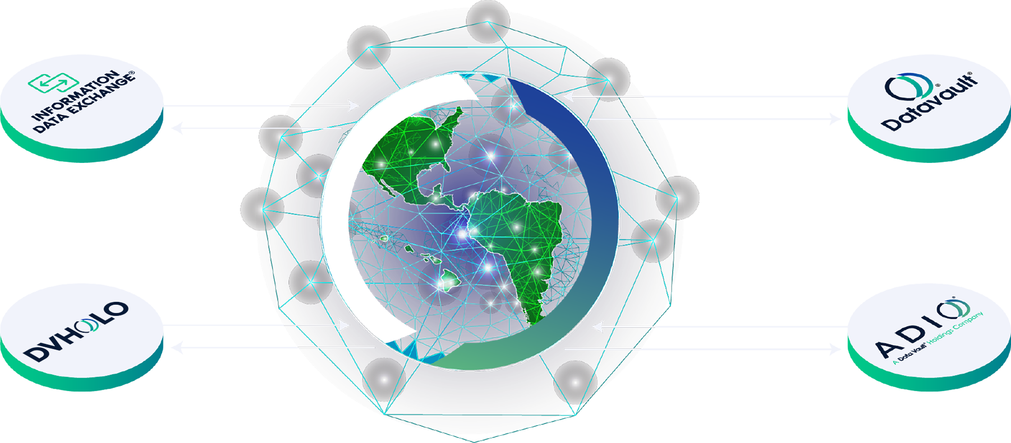
DATAVAULT® PRODUCTS
DATA DRIVES THE WORLD
BUY SELL
TRADE DATA
A global marketplace where vetted contributors buy, sell, and trade data
TOKENIZE & SECURITIZE DATA
Frictionless adoption with
utility tokens
DONATE OR
RECEIVE DATA
Create, share, or donate data to NPO's and NGO's
EMPOWER CONSUMER
CONNECTIONS
A consumer app providing 2 way
communication between you &
your target market
Copyright© 2019-2025. Datavault AI Inc. All rights reserved. See International and Domestic Patents and Patents Pending: www.dvlt.ai. This website page is provided to satisfy the virtual patent marking provisions of various jurisdictions, including the virtual patent marking provisions of the America Invents Act. This page is intended to serve as notice under 35 U.S.C.§ 287(a).

Slide 7
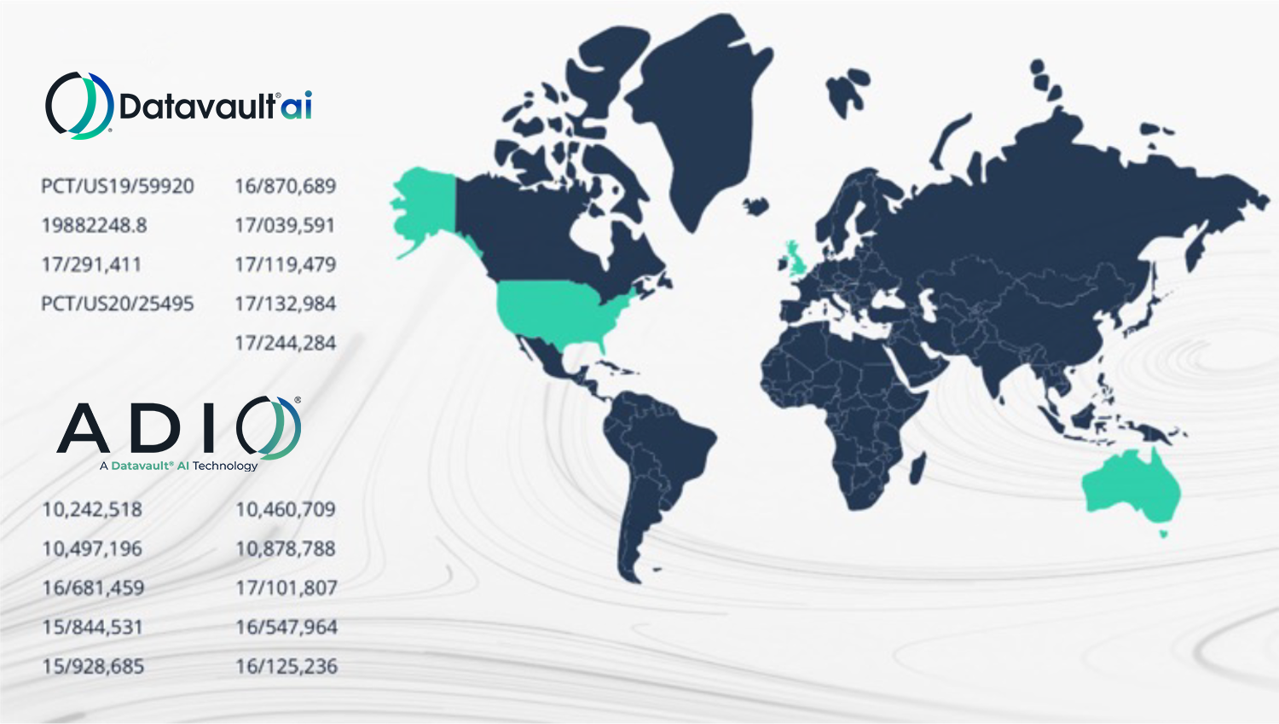

83¹ Patents Providing Substantial Coverage
Groundbreaking International Patent Portfolio
Patents around Artificial Intelligence Using High Performance Computing (HPC) “Supercomputing” | 35 PATENTS²
Decentralized Blockchain Tokenomics/Branded Crypto Tokens | 34 PATENTS²
Redefined Data Ownership PII & Regulatory Compliant Data Systems | 37 PATENTS²
Crypto Anchors Sonic, MicroTransponder & Polymer | 33 PATENTS²
Valued at over $501m by
¹ Include patents filed, pending and issued from Datavault® WiSA and ADIO®
² Patents have multiple uses

Slide 8
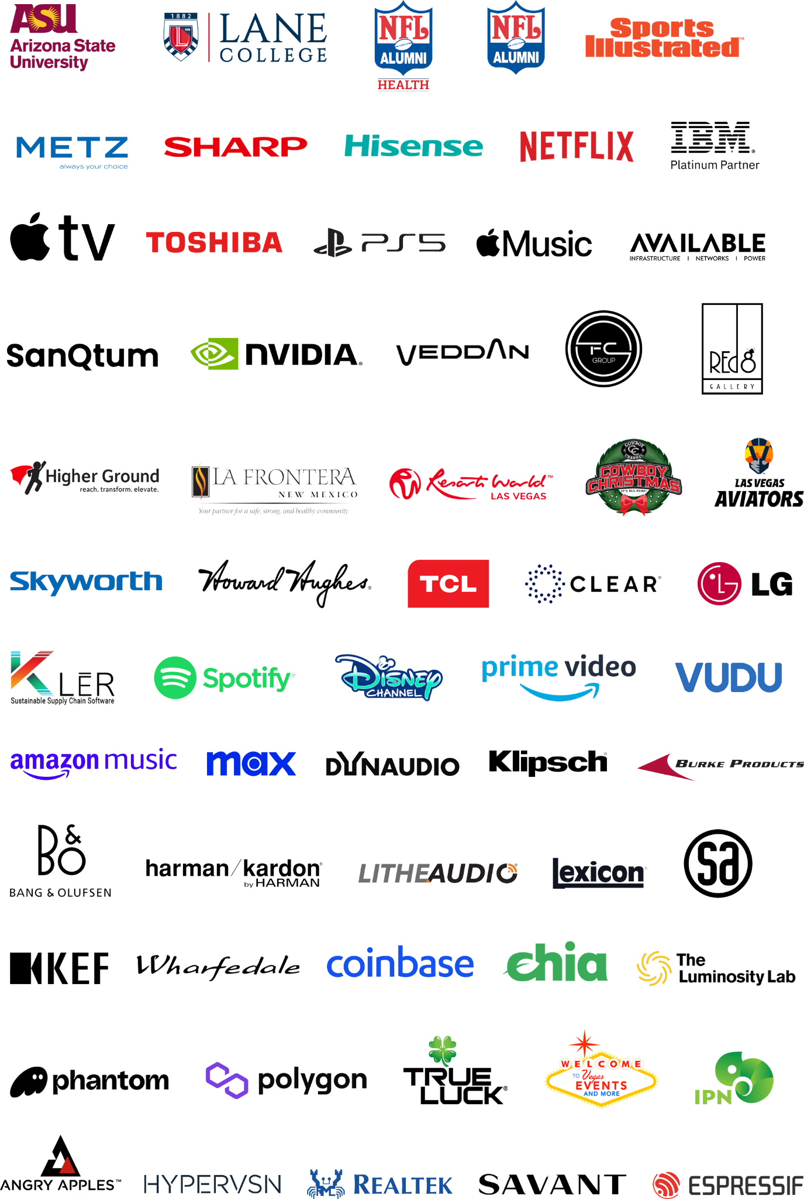
Current Client and Partners with Premium Brands

Slide 9
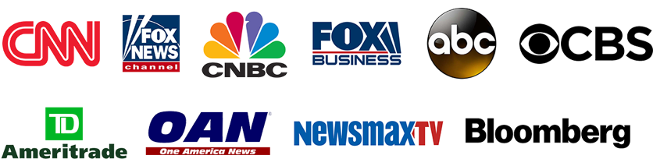








Proven Leadership
Featured in Forbes, Fortune and Entrepreneur
As seen in:
Voice America
7 patents,
100 Employees.
Phoenix, Arizona
Pioneer in Internet Talk Radio
12 patents,
NASDAQ: UPLD $1.566B market cap on 02/2021. “patents acquired BY UPLAND SOFTWARE
16 patents,
NASDAQ: AEYE,
market cap
$258.82M on 12/20.
120 patents,
NASDAQ: MARA,
market cap $3.15B
on 4/21.
8 patents
target market cap
$1B 4/22.
Nathaniel T. Bradley
Founder
Chief Executive Officer
1998
2010
2020
2022
2025
Brett Moyer
Chief Financial Officer
Sonia Choi
Chief Marketing Officer
Jeff Jones
Chief Technology Officer

Slide 10
Thank You Contact:
marketing@dvlt.ai
www.dvlt.ai
CAPABILITIES
PRESENTATION 2026
Copyright© 2019-2026. Datavault AI Inc. All rights reserved. See International and Domestic Patents and Patents Pending: www.dvlt.ai. This website page is provided to satisfy the virtual patent marking provisions of various jurisdictions, including the virtual patent marking provisions of the America Invents Act. This page is intended to serve as notice under 35 U.S.C.§ 287(a).

