Slide 1
2025 Annual Report
Resilience Through Partnership
74 Weber Street West, Kitchener, ON N2H 3Z3
Charitable Registration #: 83077 1127 RR0001

Slide 2

Executive Summary
2025 marked a significant year of growth and stewardship for Charitus. We surpassed $100 million in assets under management—reflecting the trust placed in us and a shared commitment to thoughtful, values-driven generosity.
Together with our fundholders, we facilitated more than $6 million in grants to charities across Canada, supporting work that responds to present needs while contributing to lasting impact.
We deepened our service to the Charitus community by strengthening investment solutions and introducing new bookkeeping supports—practical tools that reduce administrative burden and build capacity across the sector.

Slide 3
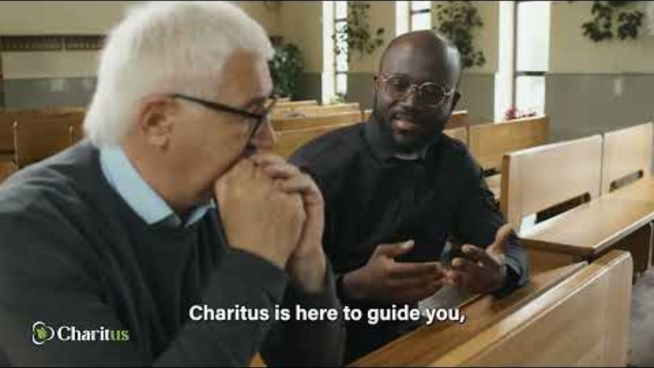
Who We Are
Charitus is a Canadian public foundation committed to the faithful stewardship of generosity. We come alongside donors, families, and organizations to help translate charitable intent into thoughtful, lasting impact through donor-advised funds, disciplined investment management, and purposeful granting.
Rooted in trust, integrity, and care, our approach reflects a long-term perspective—seeking not only to meet present needs, but to cultivate enduring good for generations to come. In all we do, Charitus serves as a steady partner, guiding resources with wisdom and accountability so that each act of giving is aligned with both conviction and meaningful community impact.

Slide 4
Guiding Principles
Charitus subscribes to the Christian understanding that God's economy is based on justice for people and care for creation. Thus, Charitus is committed to stewardship of the assets entrusted in a manner described as "Responsible Investing": weighing environmental, social and governance (ESG) factors alongside financial ones. The universe of ESG issues is broad so Charitus has chosen to focus on issues pertinent to Charitus’ mission and to the investment partners. This approach allows us to exert a greater influence on specific issues relevant to our stakeholders.
Respect human rights and dignity. | Respect workers’ rights.
Enhance economic and social justice. | Operate in an environmentally sustainable manner.
Support a global culture of peace.

Slide 5
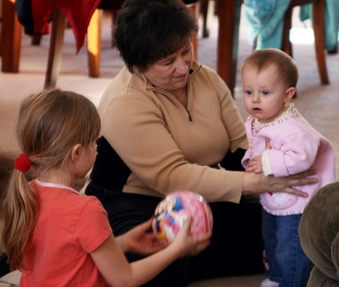
Our Services
3 Ways to Increase Revenue:
Investment support.
Revenue development: Fundraising (including planned giving and donor-advised funds (DAF’s) but also capital campaigns, and alternative revenue opportunities.
Charitus’ charitable grant programs.

Slide 6
Faith Based Responsible Investing
Charitus supports international initiatives that inform responsible investment activity such as the United Nations Principles for Responsible Investment (UNPRI), the Human Capital Management Coalition, the Workforce Disclosure Initiative and the United Nations Declaration on the Rights of Indigenous Peoples.
This means:
Incorporating ESG issues into investment analysis and decision-making processes, ownership policies and practices.
Being active owners and seeking appropriate disclosure on ESG issues by the entities in which Charitus.
Promoting acceptance and implementation of the Principles within the investment industry.
Working with other organizations to enhance effectiveness in implementing the Principles.
Reporting on Charitus’ activities and progress towards implementing the Principles.

Slide 7
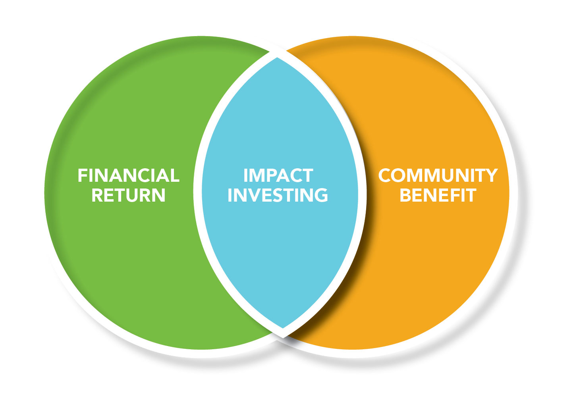
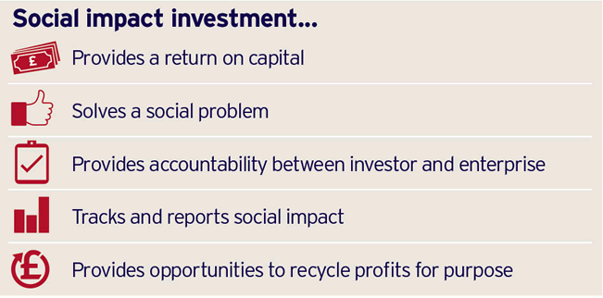
Social Impact Investing
While many goals are worthwhile, Charitus has chosen to prioritize specific outcomes for its impact investments.
Elimination of poverty in Canada.
Reconciliation with Indigenous peoples and advancement of Indigenous social and economic goals.
Promotion of the sustainable use of our environment.

Slide 8
Revenue Development
Charitus is proud to offer a number of resources to support and encourage philanthropy. Charitus’ experts offer strategic planning and tactical planning for annual and capital fundraising donor and stakeholder engagement efforts and have increasingly been called up to resource fundraising efforts through a cost-recovery arrangement.
Historically, Charitus has offered counsel and support for those looking to consider charitable giving as part of their estate planning. Be it bequests, gifts of securities, gifts or insurance or other estate or planning giving vehicles Charitus has the professional expertise to assist. These services delivered through our Charitus (LPG) effort are offered free-of-charge.

Slide 9

Alternative Revenue Opportunities
Alternative revenue strategies take many forms, one that is growing in popularity are “community bonds”. Available to NGOs, community bonds are interest bearing bonds typically intended for small-scale, e.g., <$100MM, social investment projects, non-accredited investors. Similar in many ways to a traditional bond, they are an interest-bearing loan from an investor, which has a set rate of return and a fixed term.

Slide 10
Charitus 2025 Highlights
New Money Market Portfolio
Reached $100 million in assets
Granted $6 million to partners
New Case Studies Series
Launched Booking Keeping Services

Slide 11

Grants and Giving
Grants are designed to support projects that address critical social and environmental needs, aligning with our mission to create meaningful change.
Charitus administers a growing number of charitable programs including Partner Grants programs, the David Pfrimmer Social Justice Fund and the Jeff Pym Legacy Fund.

Slide 12
Charitable Grants Programs

Slide 13

New Money Market Portfolio
The Charitus Money Market Portfolio, launched in 2025, provides churches and charities with a prudent, accessible solution for stewarding short-term funds. Focused on capital preservation, stability, and liquidity, it offers a reliable place to hold resources needed in the near term—while aligning with Charitus’ commitment to faithful, values-based investing.
As the most conservative option within the Charitus investment suite, the portfolio supports organizations in managing reserves, preparing for future ministry initiatives, and navigating seasons of discernment. It reflects a thoughtful balance of financial discipline and mission alignment, advancing the long-term flourishing of the communities our partners serve.
74 Weber Street West, Kitchener, ON N2H 3Z3
Charitable Registration #: 83077 1127 RR0001

Slide 14

$100 Million in Assets
In 2025, Charitus surpassed $100 million in assets under management—an important milestone grounded in donor trust and a shared commitment to generosity.
We steward these funds with a long-term perspective, seeking to preserve and grow capital so that today’s giving continues to have impact well into the future. Through disciplined investment and thoughtful oversight, we support sustainable charitable disbursements that respond to both current needs and emerging opportunities.
Each fund reflects the values of those we serve, and we manage them with integrity, care, and a commitment to lasting impact.
74 Weber Street West, Kitchener, ON N2H 3Z3
Charitable Registration #: 83077 1127 RR0001

Slide 15

New Case Studies Series
In 2025, Charitus released a new series of case studies that reflect the heart of our work—faithful stewardship expressed through thoughtful and purposeful giving. These stories offer a window into the ways donor intent is carefully discerned and carried forward, resulting in tangible and lasting impact across communities.
Each case study highlights not only the outcomes achieved, but the relationships, trust, and shared vision that make such work possible. Together, they bear witness to a quiet but profound truth: when generosity is guided with care and integrity, it has the power to shape lives, strengthen communities, and leave a legacy that endures.
74 Weber Street West, Kitchener, ON N2H 3Z3
Charitable Registration #: 83077 1127 RR0001

Slide 16

Launched Booking Keeping Services
In 2025, Charitus thoughtfully expanded its service offering with the introduction of dedicated bookkeeping services—an extension of our commitment to faithful and holistic stewardship.
Recognizing that sound financial practices are foundational to sustainable ministry and charitable impact, this service was designed to come alongside organizations with care, clarity, and trusted expertise.
Through diligent oversight and attentive support, we aim to bring order and confidence to day-to-day financial management, enabling our partners to focus more fully on the work they are called to do. In all of this, Charitus remains guided by a desire to serve with integrity, ensuring that every resource is stewarded well and aligned with the purposes it was entrusted to fulfill.
74 Weber Street West, Kitchener, ON N2H 3Z3
Charitable Registration #: 83077 1127 RR0001

Slide 17

Investment Solutions
Charitus offers congregations and faith-based charitable organizations the opportunity to pool their investments with ours. Choose from 3 different portfolios.
Our partners benefit from professional investment management in accordance with an Investment Policy that emphasizes preservation of capital, generation of reasonably predictable streams of income, capital growth while ensuring Responsible Investing policies are followed.
The Charitus difference: Philanthropy is at our core.
Faith Based Investing
Ethical Investing
Responsible Investing
74 Weber Street West, Kitchener, ON N2H 3Z3
Charitable Registration #: 83077 1127 RR0001

Slide 18

Donor Advised Funds
Charitus Donor Advised Funds (DAFs) offer a flexible and thoughtful approach to giving, enabling donors to steward their resources with intention. Through a DAF, donors make a contribution, receive an immediate tax receipt, and recommend grants to charities over time—creating space for discernment rather than urgency.
These funds serve as a central hub for charitable giving, a vehicle for family and legacy philanthropy, and a platform for investing assets to grow future impact.
Rooted in relational stewardship, Charitus supports donors in aligning their generosity with their values and connecting to meaningful opportunities—fostering a more intentional, enduring, and mission-aligned expression of generosity.
74 Weber Street West, Kitchener, ON N2H 3Z3
Charitable Registration #: 83077 1127 RR0001

Slide 19
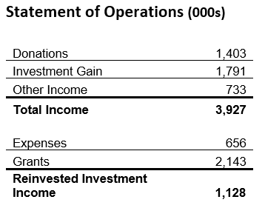
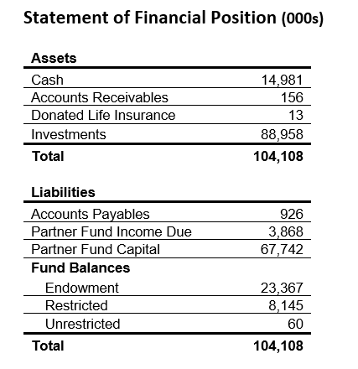
Foundation Financial Highlights
In keeping with our commitment to financial accountability and transparency, full audited financial statements prepared by RLB LLP are available at www.charitus.ca.
*As of Dec 31, 2025
74 Weber Street West, Kitchener, ON N2H 3Z3
Charitable Registration #: 83077 1127 RR0001

Slide 20
2025 Financial Metrics
In keeping with our commitment to financial accountability and transparency, full audited financial statements prepared by RLB LLP are available at www.charitus.ca.
*As of Dec 31, 2025
74 Weber Street West, Kitchener, ON N2H 3Z3
Charitable Registration #: 83077 1127 RR0001

Slide 21




Contact Us
info@Charitus.ca
888.308.9461
www.Charitus.ca
74 Weber Street West, Kitchener, ON N2H 3Z3
Charitable Registration #: 83077 1127 RR0001

