Slide 1
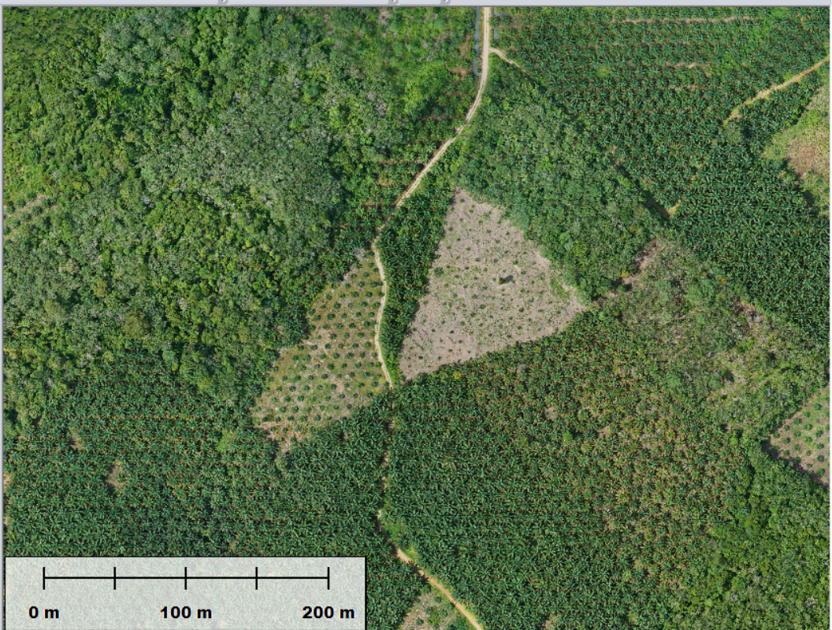
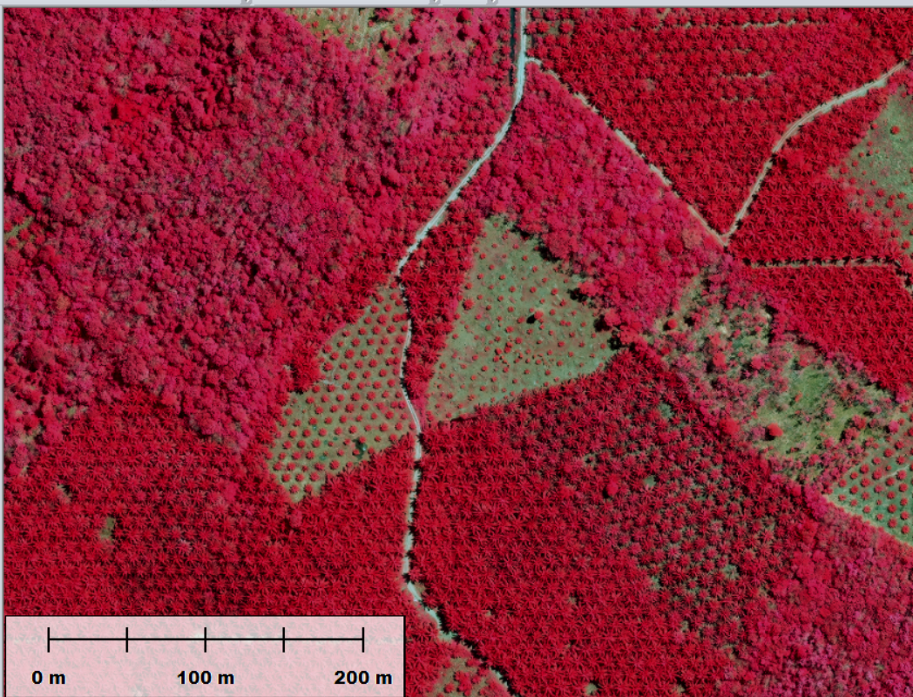
EarthLine, figures you can trust at an affordable price
8 cm drone
15 cm satellite
Resolution comparison
Every palm counted with 100% accuracy

