Slide 1
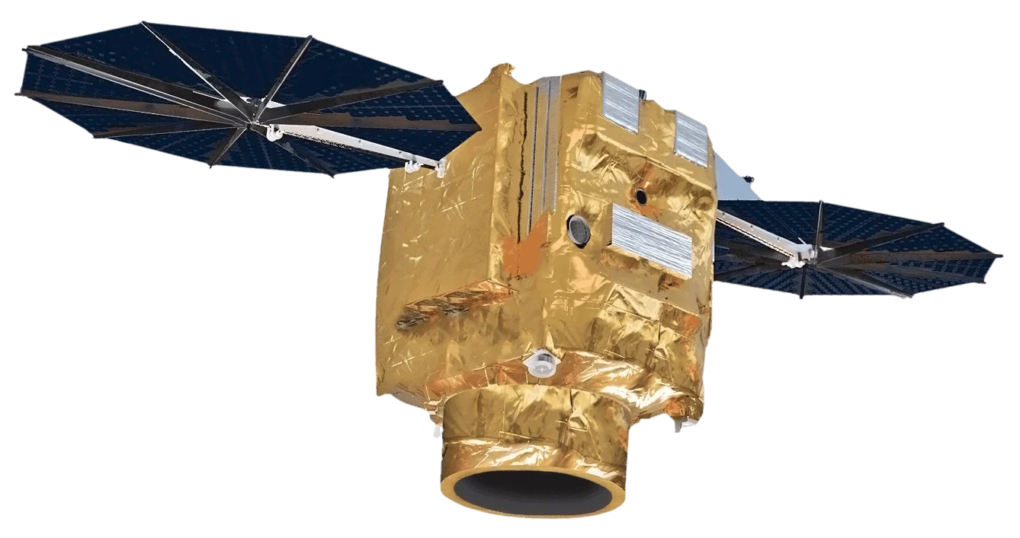
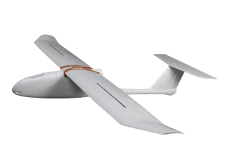
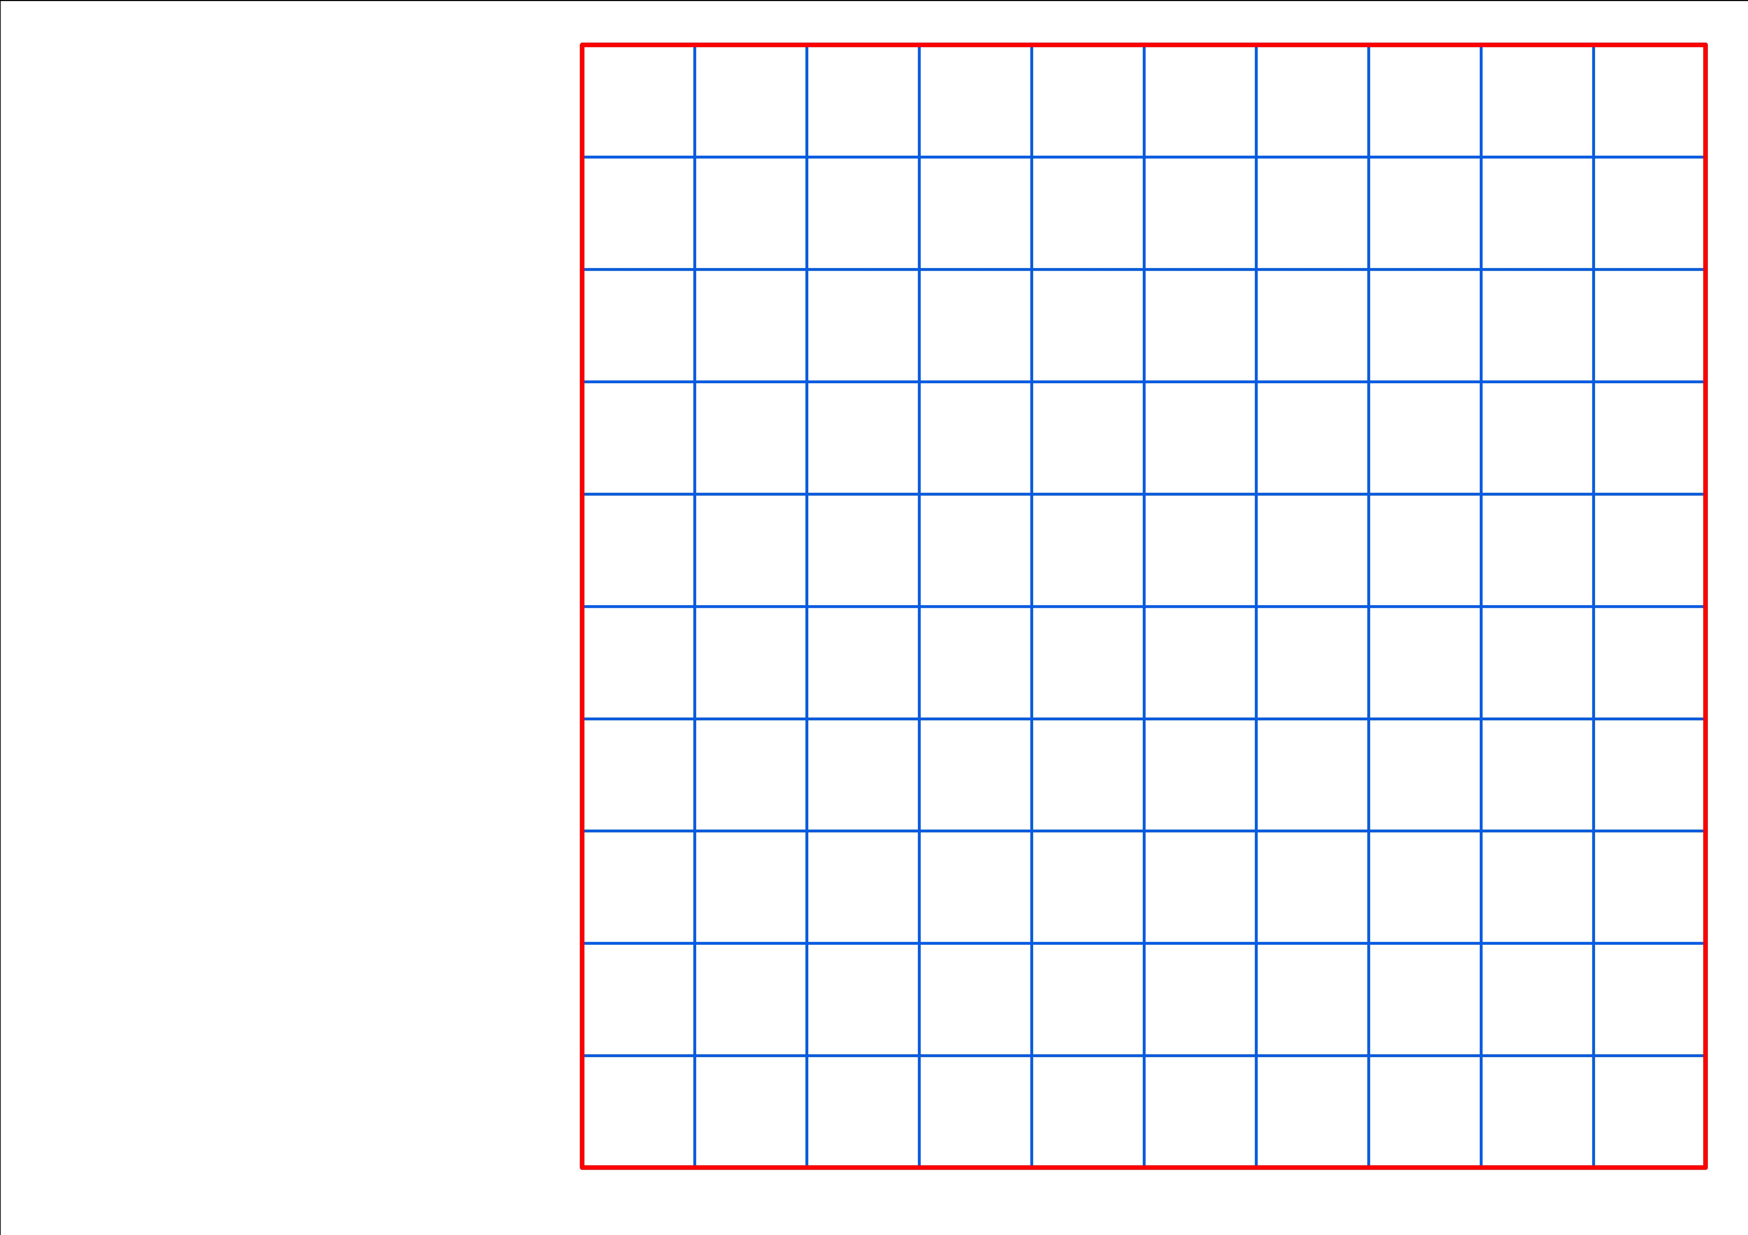

Pleaides Neo from AirBus
One satellite image
One drone flight
~ 200 Ha
One satellite image covers 100 times more than one drone flight
~ 20.000 Ha

