Slide 1
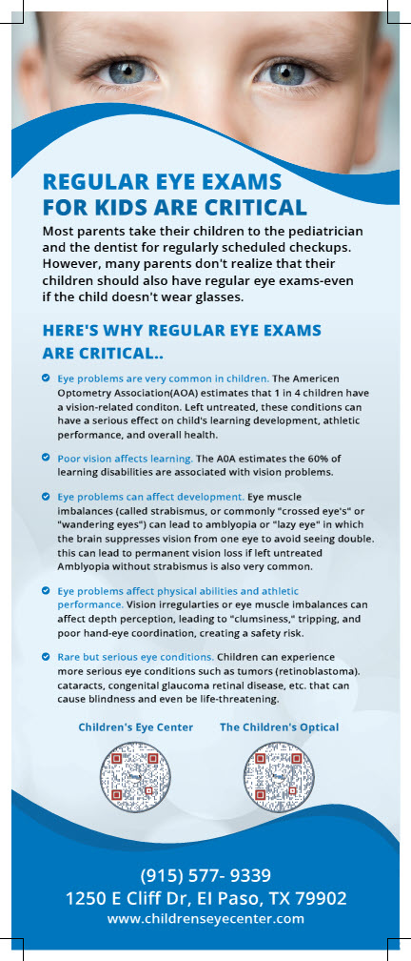
REPLACE THIS PHOTO
WITH WOMAN HOLDING 4-YEAR OLD CHILD
WHY YOUR CHILD’S EYECARE MAY TAKE LONGER THAN EXPECTED
🟡 DILATION TIME
Eye drops need time to work
👉 20–45 minutes is normal
🟡 PATIENT TESTING
Kids don’t always answer right away
👉 We repeat tests to be sure
🟡 MORE THAN A VISION TEST
We check much more than eyesight
👉 Health • Tracking • Alignment • Focus
🟡 MULTI-STEP VISIT
Your child sees more than one provider
👉 Tech → Drops → Doctor
🟡 EXTRA CARE WHEN NEEDED
Some conditions take more time
👉 Lazy eye • Crossed eyes • Strong Rx
🟡 WE ANSWER YOUR QUESTIONS
We take time so you fully understand
👉 Results • Treatment • Next steps
🟡 ACCURACY FIRST
We double-check to get it right
👉 Your child’s vision is changing
❤️ YOUR CHILD DESERVES THE BEST
👉 Thank you for your patience!
"FRONT SIDE"

Slide 2
REPLACE THIS PHOTO WITH THE TWO COMPANY LOGOs. PLACE "CHILDREN'S EYE CENTER" LOGO ON LEFT AND THE OPTICAL LOGO ON THE RIGHT.
PLACE BACK SIDE COPY THIS IN TJOS SPACE USING COPY PROVIDED IN ATTACHED MSWORD DOC.
[Stages of Visual Development]
Stages of Visual Development
"BACK SIDE"

