Slide 1

GROWTH POWERED BY SHOP
Investor Presentation
March 2026

Slide 2

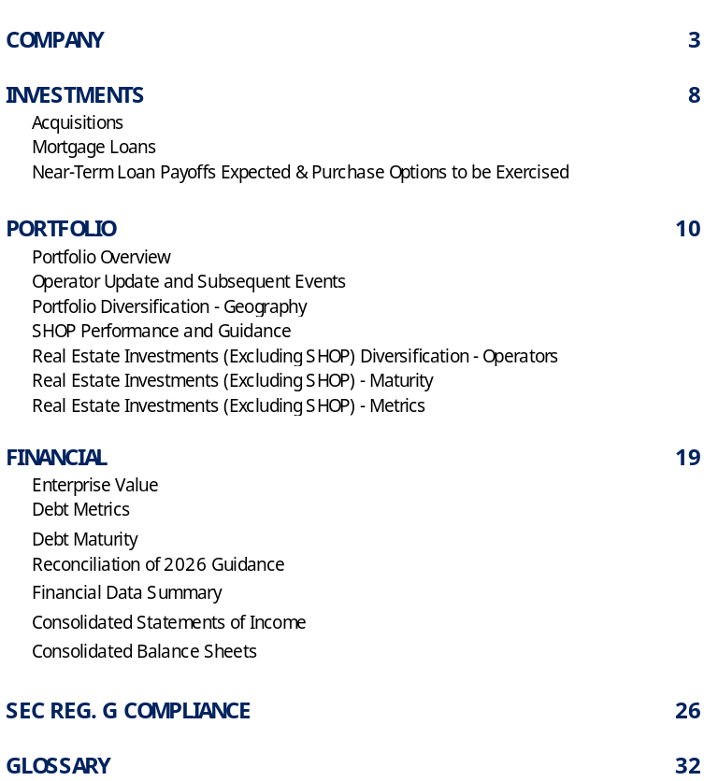


LEADERSHIP
TABLE OF CONTENTS
BOARD OF DIRECTORS
ANALYSTS
CONTACT INFORMATION
LTC PROPERTIES, INC.
3011 Townsgate Road,
Suite 220
Westlake Village, CA 91361
805-981-8655
www.LTCreit.com
TRANSFER AGENT
Broadridge Shareholder Services
c/o Broadridge Corporate Issuer Solutions
1155 Long Island Avenue
Edgewood, NY 11717-8309
ATTN: IWS
866-708-5586
Any opinions, estimates, or forecasts regarding LTC’s performance made by the analysts listed above do not represent the opinions, estimates, and forecasts of LTC or its management.

Slide 3
Ltc at-a-glance
LTC Properties, Inc. (NYSE: LTC) is a real estate investment trust (REIT) focused on seniors housing and health care properties, investing through SHOP, triple-net leases, joint ventures, and structured finance solutions. Our portfolio includes nearly 200 properties throughout the US - approximately 60% seniors housing and 40% skilled nursing properties.
AS OF DECEMBER 31, 2025
Established 1992
NYSE: LTC
Investment Grade ⁽¹⁾
NAIC 2C rating
Total Liquidity
$650.0M
Debt to Annualized Adjusted EBITDAre
4.5x
Dividend Yield ⁽²⁾
5.9%
Market Value ⁽²⁾
$1.9B
Enterprise Value ⁽²⁾
$2.8B
Debt to Enterprise Value ⁽²⁾
30.1%
Insurance industry’s rating agency for debt investments
Closing stock price of $38.84 on March 10, 2026. Dividend is paid monthly.
3
Notes:
~ As of June 30, 2025, we had $640.4 million in liquidity as follows (amounts in thousands, except per share amounts): Cash and cash equivalents-$ 7,609 + Available under unsecured revolving line of credit $256,450 + Available under Equity Distribution Agreement $376,378. Total Liquidity $640,437
⁽²⁾

Slide 4
Strong Growth at a Compelling Value
External Growth Strategy Off Small Asset Base: Since YE24 acquired ??? SHOP assets at low to mid teen IRRs. 2026 Guidance of 600M
Transformational Acceleration of Internal Growth: SHOP NOI To 40% of Portfolio By YE26 Transforming Annual Portfolio NOI Growth from 2.5% YE 24 to 5%+
De-Risking: Reducing exposure to older skilled nursing assets, government reimbursement, individual tenant risks, and short-term loans
Solid Balance Sheet: 4.5x Debt to EBITDAre with $800 million credit facility providing significant liquidity
Strategy Benefits Not Fully Priced Into Shares: FAD multiple below peers

Slide 5
Recent Highlights (Q425 & Q126)
Q42025 | Q12026
Acquired three SHOP communities for $84.2 million, with an expected unlevered IRR in the low teens. Converted two seniors housing communities in Oregon from our NNN into SHOP Sold seven skilled nursing centers for $123 million and recorded a total gain on sales of $78 million. Received cash proceeds of $8.2 million, inclusive of a 12% exit IRR of $1.8 million, from the redemption of a preferred equity investment in a joint venture. Received $16 million from the payoff of a mortgage loan secured by a seniors housing community. | Acquired a seniors housing community within its SHOP segment for $108 million, with an expected unlevered IRR in the low teens. Converted two seniors housing communities in Texas from our NNN portfolio into SHOP. Sold $65 million SNF properties

Slide 6
Compelling Value
High SHOP Concentration Yet Amongst Lowest 2026 AFFO Multiple
Source: WELL, NHI, LTC Proforma 2026 Per Earnings Calls / Business Update. All Others YE25
Source: S&P Global, LTC Calculations

Slide 7
Focused Portfolio Strategy To Enhance Shareholder Returns
Increasing Internal Growth Through SHOP
Uniquely strong Seniors Housing fundamentals
Recycling short duration slow growth assets (10%-12% 5 Yr IRRs) into high growth long duration assets (15% +/- 5 Yr IRRs)
Accelerating External Growth
Opportunistically acquiring Seniors Housing assets at IRRs above WACC and below replacement cost
Reducing Portfolio Risk
Actively reducing SNF exposure
Acquired $565million SHOP YTD
2026 Guidance Midpoint ??? At 15% +/- IRRs
Increasing tenant / operator diversification
Reducing reinvestment risk from purchase options / loan repayments
Reducing average age of portfolio, improving asset quality and long-term performance
5 Yr underwritten IRRs are expected to be in the low teens
7

Slide 8
Solid Balance Sheet
Liquidity: $542.0 million*
$16 million cash on hand.
$240 million available under the Company’s unsecured revolving line of credit with $360 million outstanding.
$286 million available under the Company’s ATM
*Proforma

Slide 9
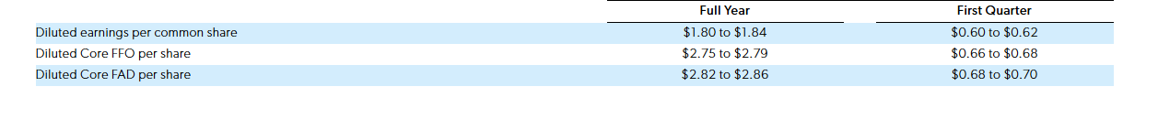
Guidance maybe not here
Assumptions:
Gross investments for the full year in the range of $400 million and $800 million, including transactions closed to date or expected to close over the next 60 days
Asset sales and loan payoffs of $265.9 million for the 2026 full year and $73.5 million for Q12026
SHOP NOI, inclusive of expected net investments, in the range of $65.1 million to $77 million for the full year, and $12 million to $13 million for Q12026
SHOP FAD capital expenditures in the range of $4.6 million to $4.9 million for the full year, and $890,000 to $910,000 for Q12026
G&A costs for the full year in the range of $31.7 million to $33.9 million, and $8.4 million to $8.7 million for Q12026

Slide 10
“Our strategic shift toward SHOP is delivering higher growth and fundamentally reshaping our long‑term earnings profile. With a more resilient portfolio consisting of newer assets and a focused approach to capital allocation, we ended 2025 with momentum and confidence in our ability to continue creating long‑term value for shareholders.”
- Pam Kessler
Co-CEO
“The transformation of our portfolio to a material composition of higher-growth SHOP investments will drive better risk adjusted returns of our shareholders. We are executing on our SHOP strategy with speed, determination and conviction, with a goal of SHOP representing 45% of our investment portfolio by the end of 2026 to further enhance our growth profile.”
- Clint Malin
Co-CEO

Slide 11
SHOP Spotlight
9 years
Average Age
$468 Million
SHOP Acquisitions Since May 2025
22% NOI Growth
over 2024 proforma NOI for the original 13 property SHOP conversions
14%
Projected 2026 Growth*
7 Operators
5 New to LTC
27%
SHOP as a % of Gross Investments
Up from 0% in May 2025
X Units
……
“With SHOP now comprising 27% of our real estate portfolio and a robust pipeline in front of us, we’re positioned to scale quickly and convert that momentum into sustained NOI growth by continuing to add newer, high-quality assets.”

Slide 12
SENIORS HOUSING OPERATING PORTFOLIO (“SHOP”) transformation
2025 SHOP ACTIVITIES SINCE MAY ($565M)
$353M in SHOP acquisitions
$212M - Three SHOP conversions
Seven SHOP operators, five new to LTC
SHOP GROWTH
(dollar amounts in millions)
116%
GROSS ASSET VALUE
2026 SHOP CONVERSIONS ($58M)
$26M completed in 1Q26
$32M expected over the next 60 days
Two SHOP operators new to LTC
Proforma 2026 assumes $600M in SHOP investments (mid-point) and $58M in SHOP conversions
2026 INVESTMENT FUNDING STRATEGY
~ $266M proceeds from SNF sales and loan prepayments
Proceeds from untapped opportunities within our portfolio, borrowings under our revolving line of credit, and sales under our ATM
2026 SHOP INVESTMENT GUIDANCE AND ACQUISITIONS COMPLETED TO DATE
(~$400M - $800M)
$108M SHOP acquisitions completed in 1Q26
$157M SHOP acquisitions over the next 60 days
$135M - $535M SHOP acquisitions expected to close through the end of 2026

Slide 13
Portfolio transformation: decreasing snf and loan exposure
(proforma 2026 assumes $600M in shop investments (MID-POINT) and $58M in SHOP conversions)
ASSET TYPE TRANSFORMATION: 2024 - PROFORMA 2026
Seniors Housing asset value concentration increases to 77%
Skilled Nursing asset value concentration decreases to 22%
INVESTMENT TYPE TRANSFORMATION: 2024 - PROFORMA 2026
Owned investments asset value concentration increases to 91%
Mortgage Loans investment asset value concentration decreases to 8%
2026 PROFORMA GROSS ASSET VALUE BY ASSET TYPE
2026 PROFORMA GROSS ASSET VALUE BY INVESTMENT TYPE
1%
4%
1%
1%
2026 PROFORMA NOI BY ASSET TYPE
2026 PROFORMA NOI BY investment TYPE
SENIORS HOUSING - NNN
OWNED PORTFOLIO - NNN
SENIORS HOUSING - SHOP
OWNED PORTFOLIO - SHOP
OWNED ACCOUNTED
FOR AS FINANCING RECEIVABLES
SKILLED NURSING
OTHER/UDP
MORTGAGE LOANS
NOTES REC & UNCONS JV

Slide 14
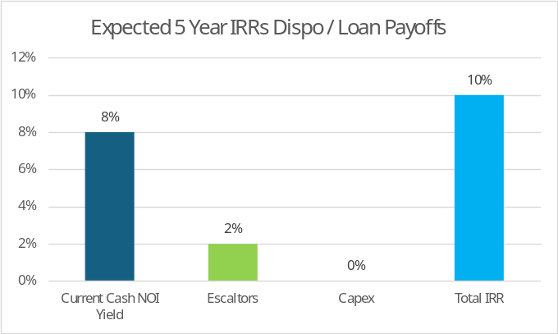
Portfolio Recycling + SHOP Acquisitions =
Powerful Driver of Earnings & Value Creation
SHOP 500 BP Spread To Dispo IRR
SHOP 700 BP Spread To WACC

Slide 15
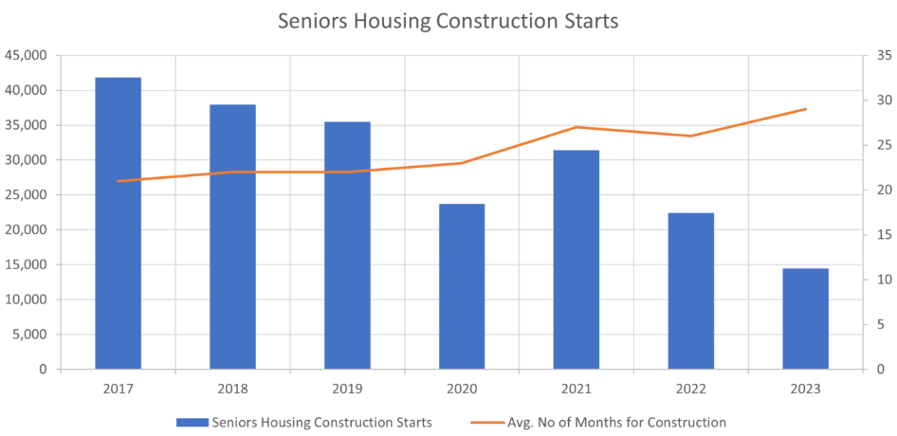
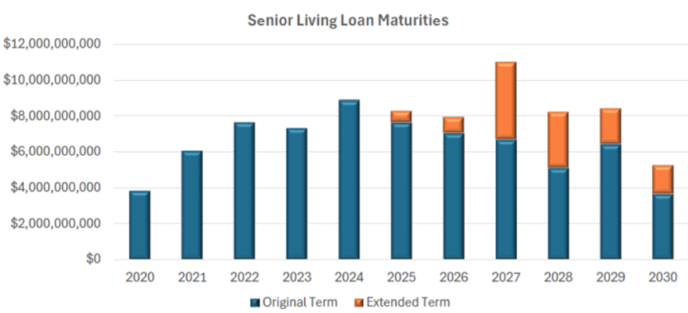
favorable industry fundamentals
DEMOGRAPHICS DRIVE DEMAND⁽¹⁾
U.S. Senior Population Growth Projections by Age Bracket
Demographics and relatively low supply drives occupancy highs and above average rate growth. Demand now exceeds new supply.
Construction starts are at historical lows.
Years 2025 through 2029 represent acquisition opportunities as owners look to monetize ahead of loan maturities.
Millions
Source: U.S. Census Bureau, Population Division. “Projected Population by Age Group and Sex for the United States, Main Series: 2022 - 2100.” November 2023
THE STATE OF SENIORS HOUSING STARTS⁽²⁾
SECTOR SEEING EXTENDED LOAN MATURITIES⁽³⁾
Senior Living Loan Maturities by Original Loan Maturities - Projected
Source: https://www.nicmap.com/blog/construction-starts-falling-behind-needed-demand
Source: Cushman and Wakefield Research; MSCI Real Capital Analytics data, 1Q 2025
Notes:
2/19/25 – SOURCE: https://www.census.gov/data/tables/2023/demo/popproj/2023-summary-tables.html

Slide 16
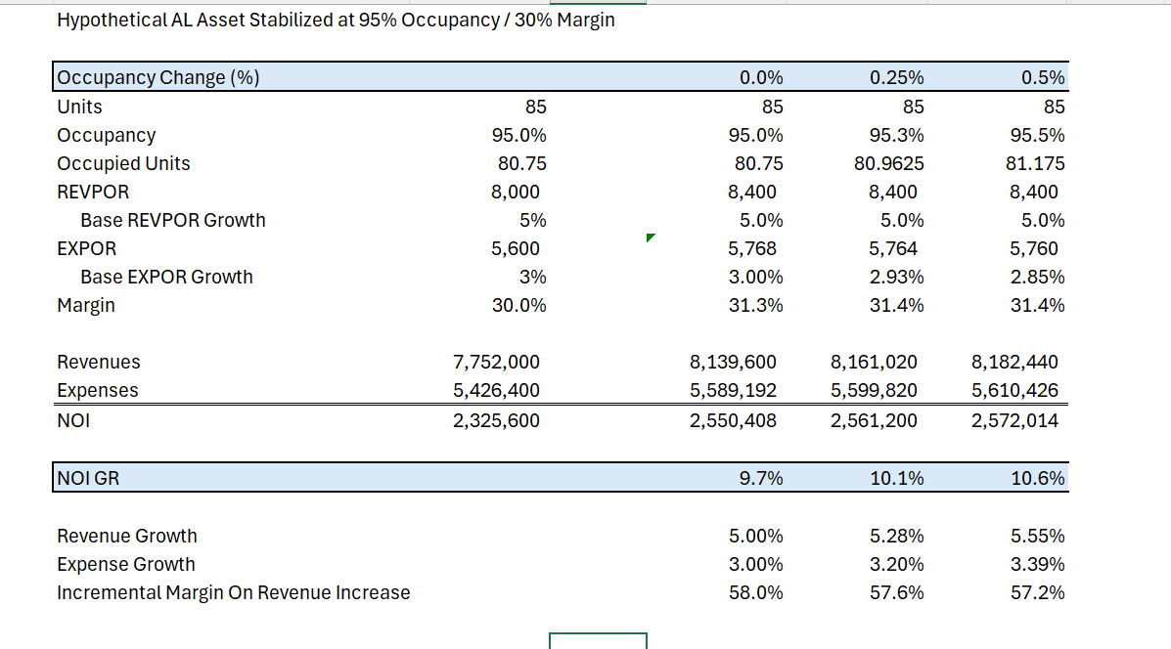
Hypothetical Case Study ????
For top‑tier, high‑occupancy assets, REVPOR is materially outpacing EXPOR, widening operating spreads. A ~200 bp rate‑over‑expense delta supports durable high‑single‑digit to low‑double‑digit NOI growth with no reliance on occupancy lift.

Slide 17
APPENDIX

Slide 18
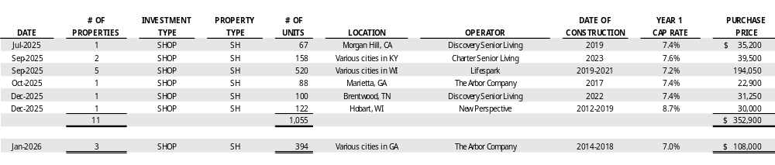
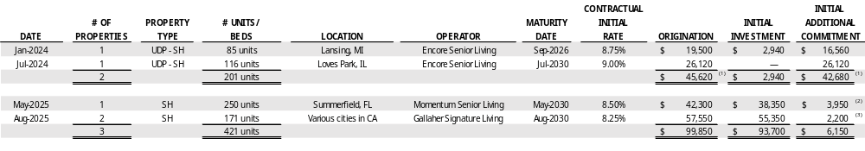
Real Estate Activities – INVESTMENTS
(dollar amounts in thousands)
ACQUISITIONS
MORTGAGE LOANS
100-1285 Delta Township
227-1287 Loves Park (Rockford)
100-1288 Highpoint at Stonecrest
100-1289 Oakmont of Covina/Moorpark
Represents mortgage loans commitment to construct seniors housing communities and to fund working capital and interest reserve. The borrowers contribute equity, which initially funds the construction. Once all of the borrower’s equity has been drawn, we fund the additional commitment.
The initial additional commitment includes interest reserve of $2,000 and additional loan proceeds of $1,950 which are available between June 2026 and November 2027, based on debt service coverage.
The initial additional commitment includes interest reserve of $2,200.

Slide 19
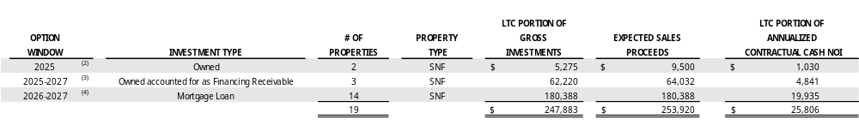
Real Estate Activities – near-term LOAN payoffs EXPECTED AND PURCHASE OPTIONs
anticipated to be exercised⁽¹⁾
(dollar amounts in thousands)
See our Form 10-K for a list of all of our purchase options. Expected sales proceeds are subject to change.
In 3Q25, the operator provided notice of its intent to exercise its purchase option.
These properties were acquired through a sale-leaseback transaction, subject to a lease agreement that contains a purchase option. In accordance with GAAP, the purchased properties are presented as a financing receivable on our Consolidated Balance Sheets. In 4Q25, the operator provided notice of its intent to exercise its purchase option. In connection with the sale, we expect to receive approximately $1,500 of exit IRR. See Operator Update on page 9 for further discussion.
The Prestige $179,885 mortgage loan secured by 14 skilled nursing centers in Michigan has an option to prepay the loan without penalty during a 12-month window starting in July 2026, subject to customary conditions and contingent on Prestige’s ability to obtain replacement financing. See Operator Update on page 9 for further discussion.
Subsequent to December 31, 2025, the operator provided notice of its intent to payoff a mortgage loan accounted for as an unconsolidated joint venture. We expect to receive the payoff in 2Q26. See Operator Update on page 9 for further discussion.

Slide 20
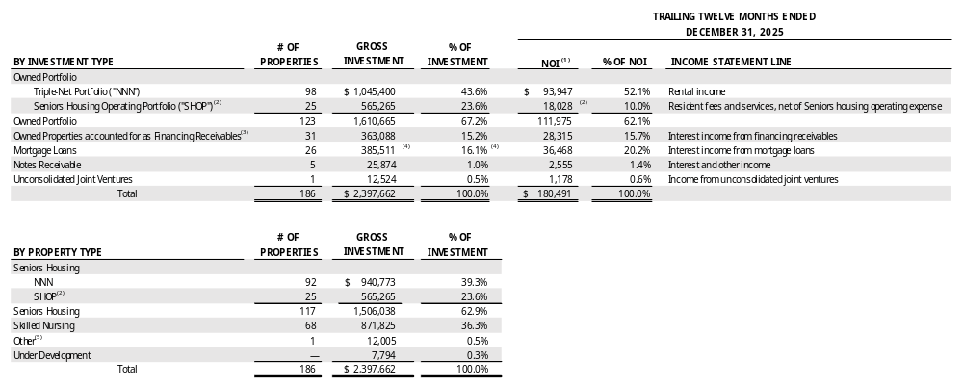
PORTFOLIO overview
(AS OF DECEMBER 31, 2025, dollar amounts in thousands)
LONG-TERM INVESTMENTS include our Owned Portfolio, Owned Properties accounted for as Financing Receivables and Long-Term Mortgage Loans (Prestige) which represent 93% of our Gross Investments.
SHORT-TERM INVESTMENTS represent investment durations shorter than 10 years and include our Notes Receivable, Unconsolidated Joint Ventures and Short-Term Mortgage Loans which represent 7% of our Gross Investments.
See Trailing Twelve Months NOI definition in the Glossary.
Subsequent to December 31, 2025, we acquired three seniors housing communities and converted two seniors housing communities from our NNN portfolio into our SHOP segment. See Subsequent Events on page 9 for further discussion.
Financing receivables represent acquisitions through sale-leaseback transactions, subject to lease agreements that contain purchase options. In accordance with GAAP, the purchased assets are presented as financing receivables on our Consolidated Balance Sheets and the rental income received is presented as interest income from financing receivables on our Consolidated Statements of Income.
Mortgage loans include short-term loans of $131,526 or 5.5% of gross investment and long-term loans (Prestige) of $253,985 or 10.6% of gross investment. The weighted average maturity for our mortgage loans portfolio and long-term mortgage loans (Prestige) at December 31, 2025 is 13.3 years and 18.3 years, respectively. See Operator Update on page 9 for further discussion on a Prestige loan.
Includes one behavioral health care hospital and three parcels for land held-for-use.

Slide 21
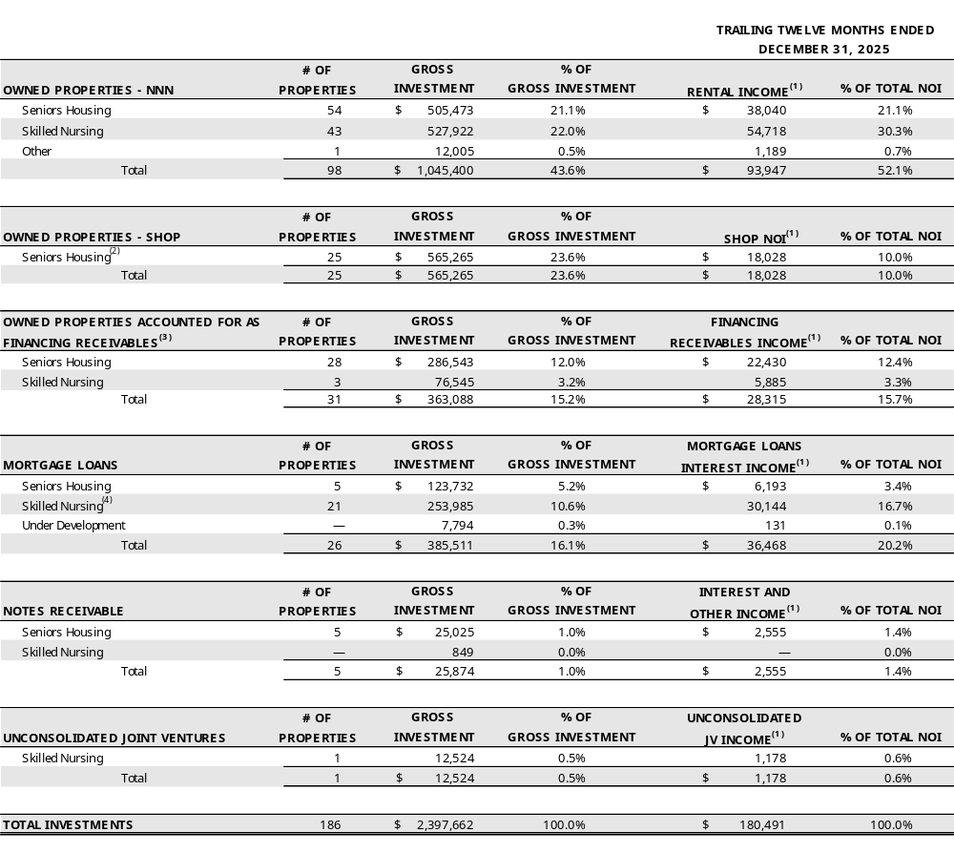
PORTFOLIO overview - DETAIL
(AS OF DECEMBER 31, 2025, dollar amounts in thousands)
rental income (as % of Total NOI)
Shop NOI (as % of Total NOI)
FINANCING RECEIVABLES INCOME (as % of Total NOI)
MORTGAGE LOANS interest income (as % of Total NOI)
interest & other income (as % of Total NOI)
See Trailing Twelve Months NOI definition in the Glossary.
Subsequent to December 31, 2025, we acquired three seniors housing communities and converted two seniors housing communities from our NNN portfolio into our SHOP segment. See Subsequent Events on page 9 for further discussion.
Financing receivables represent acquisitions through sale-leaseback transactions, subject to lease agreements that contain purchase options. In accordance with GAAP, the purchased assets are presented as financing receivables on our Consolidated Balance Sheets and the rental income received is presented as interest income from financing receivables on our Consolidated Statements of Income.
Skilled nursing long-term loans (Prestige) of $253,985 or 10.6% of gross investment. The weighted average maturity of Prestige loans is 18.3 years. See Operator Update on page 9 for further discussion on a Prestige loan.
Unconsolidated JV income (as % of Total NOI)

Slide 22
portfolio OVERVIEW - OPERATOR UPDATE
(dollar amounts in thousands)
MARKET-BASED RENT
Market-Based Rent Resets: Received $5,625 of revenue from a 14-property portfolio in 2025 vs. $3,448 in 2024 (63% increase). Two of the 14 properties were converted into SHOP in January 2026, with plans to convert two additional properties with a total of 159 units in the next 60-days. See below for further discussion of the SHOP conversions. Anticipated rent on the remaining 10 properties in 2026 is $4,880, vs. $4,140 in 2025 (18% increase).
Operator Update (Genesis): As previously discussed, Genesis filed for Chapter 11 bankruptcy on July 9, 2025. Since filing, Genesis has made all contractual rent payments through February 2026.
Purchase Option Exercised (TN): $9,500 under a master lease for two skilled nursing centers. The sale is expected to close in the next 60-days with an anticipated gain of approximately $7,400.
Purchase Option Exercised (FL): $64,032, inclusive of an exit IRR of approximately $1,500, under a master lease for three skilled nursing centers expected to close by the end of 1Q26. These properties are presented as a financing receivable on our Consolidated Balance Sheets, since they were acquired through a sale-leaseback transaction, subject to a lease agreement. We expect to record one-time income of approximately $1,300, which represents the exit IRR of $1,500, offset by $200 of effective interest receivable balance previously recognized over the term of the financing receivable through payoff.
Genesis
CLC-community
Pruitt
SUBSEQUENT EVENTS
ARBOR 3-GA
Previously Announced SHOP Acquisition: Three seniors housing communities in Georgia for $108,000, with a year-one yield of approximately 7% and expected unlevered IRR in the low teens, operated by the Arbor Company, an existing SHOP relationship.
SHOP Conversion (TX): Two seniors housing communities, operated by Pegasus Senior Living, an operator new to us. These properties comprised of 88 units were previously included in the portfolio of market-based rent resets discussed above.
Mortgage Loan Prepayment Option: Prestige Healthcare provided a prepayment notice on its $179,885 mortgage loan secured by 14 skilled nursing centers. Prestige has the option to prepay without penalty during a 12-month window starting in July 2026, subject to customary conditions and contingent on the ability to obtain replacement financing.
Mortgage Loan Extension (MI): We intend to extend a $17,104 mortgage loan secured by an 85-unit seniors housing community, currently set to mature in 2026, to 1Q27.
Loan Payoff Notice (TX): The operator provided notice of its intent to pay off a $12,524 mortgage loan secured by a 104-bed skilled nursing center. The mortgage loan is accounted for as an unconsolidated joint venture. We expect to receive the payoff in 2Q26.
Anticipated SHOP Conversions (GA and SC): We anticipate converting two seniors housing communities with an operator new to us in April 2026. These properties are currently included in the portfolio of market-based rent resets discussed above.
PEGASUS (OXFORD-TX)
PRESTIGE
Encore –Delta MI
Ignite-Katy JV
Conversion
(Legacy to Vitality)
Notes:
Go to: H:\Loan Summaries\Loan Amort Schedules\100.1260 Prestige Healthcare - Current Pay

Slide 23




PORTFOLIO DIVERSIFICATION – GEOGRAPHY
(AS OF DECEMBER 31, 2025)
186
16,276
30
23
PROPERTIES
UNITS/BEDS
OPERATORS
STATES
WA
ME
ND
1
OR
MT
2
3
ID
MN
WI
NY
1
WY
SD
1
7
21
3
NV
5
3
MI
1
IL
6
PA
NJ
NE
IA
1
OH
WV
3
CA
UT
CO
1
4
IN
2
1
KS
MO
4
2
8
4
2
1
2
VA
6
2
2
KY
AZ
1
2
NC
33
NM
OK
4
AR
TN
3
SC
2
5
AL
GA
3
SH– NNN (92)
TX
MS
1
1
1
SH– SHOP (25)
LA
SNF (68)
21
8
FL
OTH* (1)
UDP (1)
1
LAND (3)
5
* Behavioral health care hospital
Notes:
Use By State by Type with Lease Term report - IL includes 1 UDP-Encore Rockford/LovesPark

Slide 24
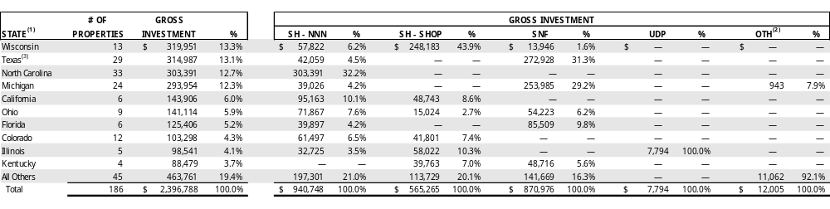
PORTFOLIO DIVERSIFICATION – GEOGRAPHY
(AS OF DECEMBER 31, 2025, DOLLAR AMOUNTS IN THOUSANDS)
Due to master leases with properties in various states, revenue by state is not available. Also, working capital notes are provided to certain operators under their master leases covering properties in various states. Therefore, the working capital notes outstanding balance totaling $874 is also not available by state and is excluded from the table above.
Includes one behavioral health care hospital and three parcels for land held-for-use.
Subsequent to December 31, 2025, we converted two seniors housing communities from our NNN portfolio into our SHOP segment. See Subsequent Events on page 9 for further discussion.
Gross Portfolio by MSA ⁽¹⁾
Average SENIORS HOUSING Portfolio Age ⁽¹⁾
Years
The MSA rank by population as of July 1, 2024, as estimated by the United States Census Bureau. Approximately 65% of our properties are in the top 100 MSAs. Represents our real properties, properties accounted for as financing receivables, and properties secured by our mortgage loans.
As calculated from construction date or major renovation/expansion date. Represents our real properties, properties accounted for as financing receivables, and properties secured by our mortgage loans.

Slide 25
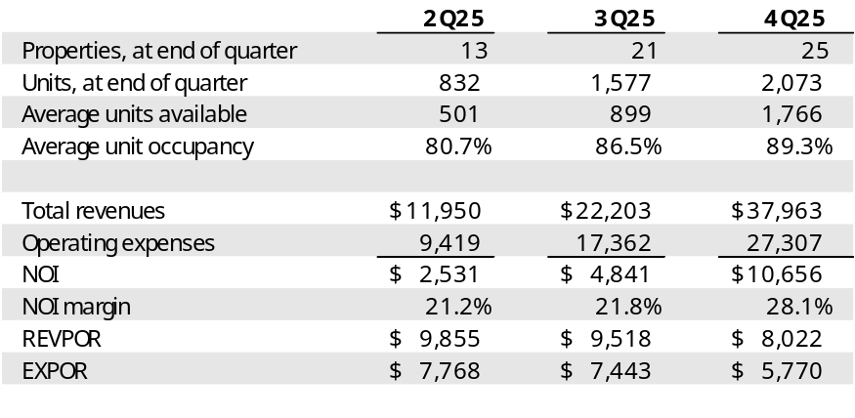
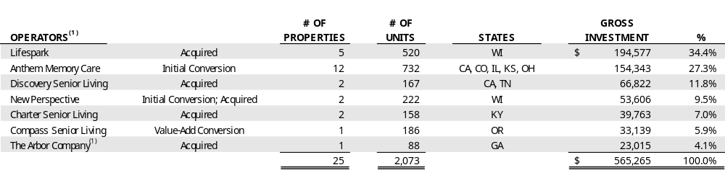
SHOP PERFORMANCE AND GUIDANCE
(AS OF DECEMBER 31, 2025, dollar amounts in thousands)
TOTAL SHOP PERFORMANCE
SHOP GUIDANCE
2026 PROJECTED NOI
(millions)
Low
$53
High
$57
Represents 27 properties (2,281 units) that include Initial Conversions (13) and Acquired SHOP properties (14) through January 31, 2026; excludes Value-Add Conversions and additional acquisitions
Guidance at the midpoint:
  NOI growth: ~14% over 2025 Proforma NOI
  Occupancy growth: ~150 basis points from 2025 Proforma Ave Occupancy ~89.7%
  Projected Increases: REVPOR ~5%; EXPOR ~2.5%
  Projected margin: ~27.5%
  2025 Proforma NOI and occupancy include results reported under prior owners; adjusted for current management fee structure
2026 Total SHOP Capex Guidance:
  FAD: ~$1,500 per unit, annually
  Non-FAD: $9M; $4M announced for Initial Conversions; $4M underwritten for Acquired SHOP properties to date; $1M for Value-Add Conversions for three (3) properties
Operator DIVERSIFICATON
Subsequent to December 31, 2025, we acquired three seniors housing communities with a total of 394 units and converted two seniors housing communities (Value-Add Conversions) with a total of 88 units into our SHOP segment. See Subsequent Events on page 9 for further discussion.

Slide 26
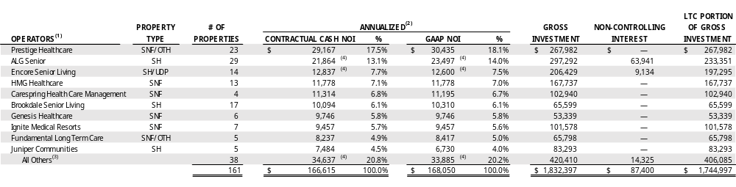
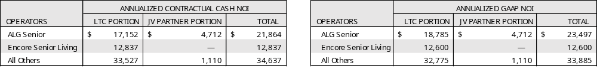
Real estate INVESTMENTs portfolio (excluding shop) diversification -operators
(AS OF DECEMBER 31, 2025, dollar amounts in thousands)
See Operator Update on page 9 for further discussion.
See Glossary for definition of Annualized Contractual Cash NOI and Annualized GAAP NOI.
Subsequent to December 31, 2025, we converted two seniors housing communities from our NNN portfolio into our SHOP segment. See Subsequent Events on page 9 for further discussion.
Includes the consolidated income from our joint ventures. The non-controlling member’s portion of the annualized contractual cash and annualized GAAP NOI are as follows:
PRESTIGE | Privately Held | SNF/SH Other Rehab | 82 Properties | 4 States
ALG | Privately Held | SH | 118 Properties | 6 States
ENCORE | Privately Held | SH | 34 Properties | 5 States
HMG | Privately Held | SNF/SH | 37 Properties | 2 States
CARESPRING | Privately Held | SNF/SH Transitional Care | 18 Properties | 2 States
BROOKDALE | NYSE: BKD | SNF/SH Continuing Care | 584 Properties | 41 States
GENESIS | Privately Held | SNF/SH | Nearly 200 Properties | 19 States
IGNITE | Privately Held | SNF/SH Transitional Care | 27 Properties | 6 States
FUNDAMENTAL | Privately Held | SNF/SH Hospitals & Other Rehab | 69 Properties | 7 States
JUNIPER | Privately Held | SH | 26 Properties | 5 States

Slide 27
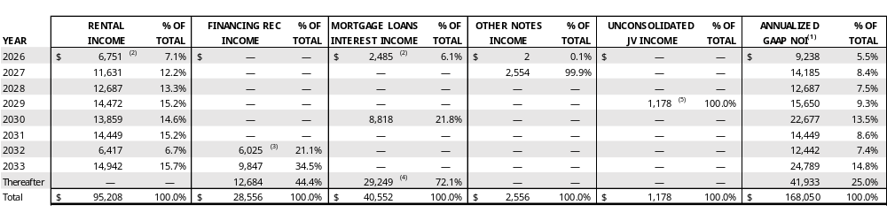
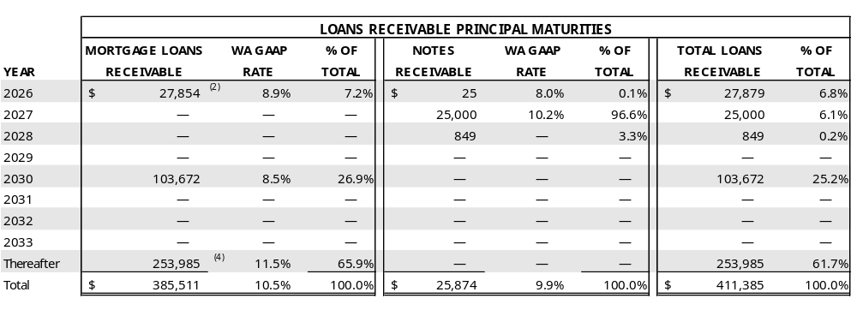
Real estate INVESTMENTs portfolio (excluding shop) - maturity
(AS OF DECEMBER 31, 2025, dollar amounts in thousands)
Near Term Lease and Loan Maturities:
Six leases and three loans in 2026 with an annualized GAAP NOI totaling $9.2 million.⁽²⁾
Three leases and one loan in 2027 with an annualized GAAP NOI totaling $14.2 million.
Three leases and one loan in 2028 with an annualized GAAP NOI totaling $12.7 million.
As of December 31, 2025, approximately 95% of owned properties are covered under master leases and approximately 95% of rental revenues come from master leases or cross-default leases.
See Annualized GAAP NOI definition in the Glossary.
One of the six lease maturities is a master lease covering two skilled nursing centers in Tennessee which represents 15% of rental income and 11% of annualized GAAP NOI maturing in 2026. In 4Q25, the operator provided notice of its intent to exercise its purchase option. Another of the six 2026 maturities is a master lease that was terminated subsequent to December 31, 2025. The master lease, which covered two seniors housing communities in Texas converted into our SHOP segment. Additionally, we expect to terminate another master lease that was scheduled to mature in 2026 and covers two seniors housing communities in Georgia and South Carolina. The properties will convert into our SHOP segment. Lastly, we intend to extend one of the three loans maturing in 2026 to 1Q27. See page 9 for further discussion.
Represents income from three skilled nursing centers in Florida acquired through a sale-leaseback transaction, subject to a lease agreement that contains a purchase option. In accordance with GAAP, the purchased properties are presented as a financing receivable on our Consolidated Balance Sheets. The operator provided notice of intent to exercise the purchase option.
The Prestige $179,885 mortgage loan secured by 14 skilled nursing centers in Michigan has an option to prepay the loan without penalty during the 12-month window starting July 2026, subject to customary conditions and contingent on Prestige’s ability to obtain replacement financing. This loan represents $20,313 of annualized GAAP interest income. See Operator Update on page 9 for further discussion.
Subsequent to December 31, 2025, an operator provided notice of its intent to payoff the mortgage loan, which is accounted for as an unconsolidated joint venture. We expect to receive the payoff in 2Q26. See Subsequent Events on page 9 for further discussion.

Slide 28
Real estate INVESTMENTs portfolio (excluding shop) - metrics
(TRAILING TWELVE MONTHS THROUGH SEPTEMBER 30, 2025 AND JUNE 30, 2025)
Same Property Portfolio (“SPP”) Coverage Statistics ⁽¹⁾
SENIORS HOUSING
Skilled nursing
SH metrics exclude Coronavirus Stimulus Funds (“CSF”) as allocated/reported by operators. See Coronavirus Stimulus Funds definition in the Glossary. Occupancy represents the average TTM occupancy. See Normalized EBITDAR and Normalized EBITDARM definitions in the Glossary.
SNF metrics exclude CSF, as allocated/reported by operators. Occupancy represents the average TTM occupancy. See Normalized EBITDAR and Normalized EBITDARM definitions in the Glossary.
Information is from property level operator financial statements which are unaudited and have not been independently verified by LTC. The same store portfolio excludes properties re-tenanted or sold after July 1, 2024; and excludes properties transitioned to LTC’s SHOP portfolio prior to December 31, 2025.

Slide 29

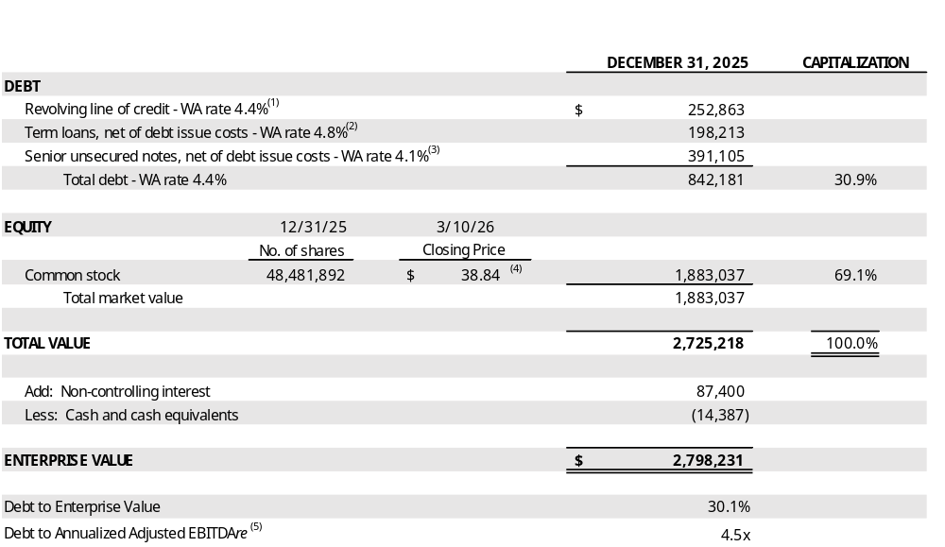
ENTERPRISE VALUE
(amounts in thousands, except per share amounts and number of shares)
Subsequent to December 31, 2025, we borrowed $107,000 under our unsecured revolving line of credit. Accordingly, we have $359,863 outstanding and $240,137 available for borrowing under our unsecured revolving line of credit.
Represents outstanding balance of $200,000, net of debt issue costs of $1,787.
Represents outstanding balance of $392,000, net of debt issue costs of $895. Subsequent to December 31, 2025, we repaid $5,000 in scheduled principal paydown on our senior unsecured notes.
Closing price of our common stock as reported by the NYSE on March 10, 2026.
See Reconciliation of Annualized Adjusted EBITDAre on page 21.

Slide 30
DEBT METRICS
(dollar amounts in thousands)
LINE OF CREDIT LIQUIDITY
(1)
Subsequent to December 31, 2025, we borrowed $107,000 under our unsecured revolving line of credit. Accordingly, we have $359,863 outstanding and $240,137 available for borrowing under our unsecured revolving line of credit.
Leverage Ratios – found in
Fin Data Summary Tab
LEVERAGE RATIOS
COVERAGE RATIOS
Coverage Ratios – found in
Annlzd EBITDAre Tab

Slide 31
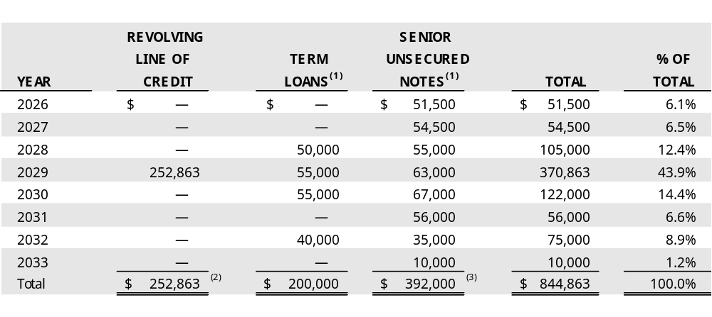
DEBT MATURITY
(AS OF DECEMBER 31, 2025, dollar amounts in thousands)
DEBT STRUCTURE ⁽²⁾
Reflects scheduled principal payments and excludes debt issue costs on our term loans and senior unsecured notes, which are netted against the principal outstanding balances on our Consolidated Balance Sheets.
Subsequent to December 31, 2025, we borrowed $107,000 under our unsecured revolving line of credit. Accordingly, we have $359,863 outstanding and $240,137 available for borrowing under our unsecured revolving line of credit.
Subsequent to December 31, 2025, we repaid $5,000 in scheduled principal paydowns on our senior unsecured notes.

Slide 32
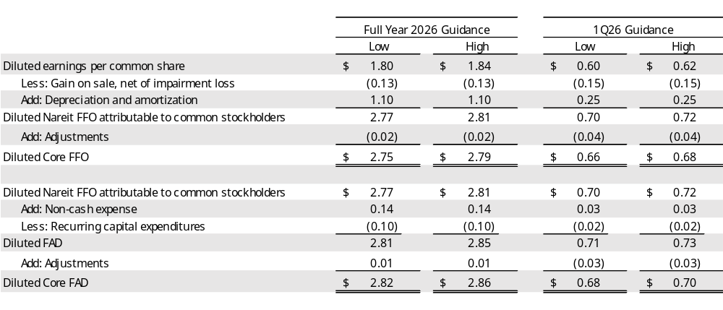
Reconciliation of 2026 GUIDANCE
(UNaudited, amounts in thousands, except per share amounts)
Guidance
The Company is introducing guidance for the 2026 full year, and is providing 1Q26 guidance. The following guidance ranges reflect management's view of current and future market conditions. There can be no assurance that the Company's actual results will not differ materially from the estimates set forth below. Except as otherwise required by law, the Company assumes no, and hereby disclaims any, obligation to update any of the foregoing guidance ranges as a result of new information or new or future developments.
The assumptions underlying the full year and 1Q26 guidance are as follows:
  Gross investments for the full year in the range of $400,000 and $800,000, including transactions closed to date or expected to close over the next 60 days;
  Asset sales and loan payoffs of $265,941 for the 2026 full year and $73,532 for 1Q26;
  SHOP NOI, inclusive of expected net investments, in the range of $65,100 to $77,200 for the full year, and $12,100 to $13,000 for 1Q26. See SHOP guidance on page 12 for further discussion.
  SHOP FAD capital expenditures in the range of $4,600 to $4,900 for the full year, and $890 to $910 for 1Q26;
  General and administrative costs for the full year in the range of $31,700 to $33,900, and $8,400 to $8,700 for 1Q26; and
  Adjustments to Core FFO and Core FAD include the following:
    One-time exit IRR income of $1,500 that we expect to receive in connection with the sale of three skilled nursing centers accounted for as a Financing receivable on our Consolidated Balance Sheets; See Operator Update on page 9 for further discussion.
    Transaction costs in the range of $1,900 to $2,400 for the full year, and $400 to $500 for 1Q26;
    Recovery of provision for credit losses related to loan payoffs.

Slide 33
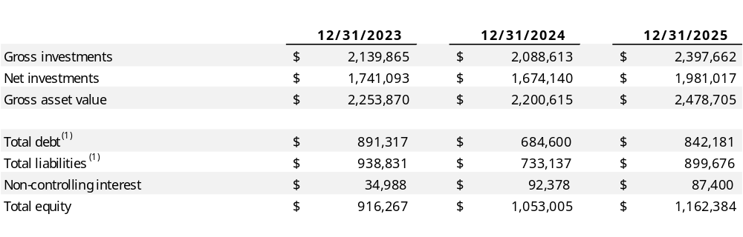
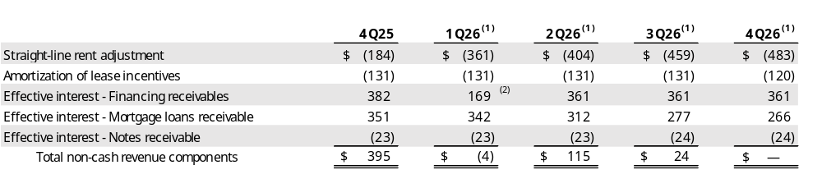
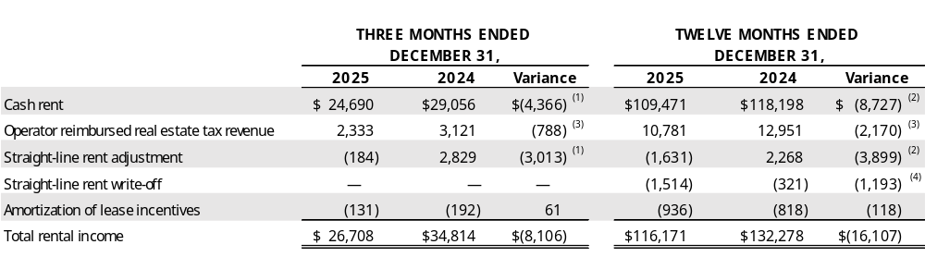
Financial data summary
(DOLLAR amounts in thousands)
Includes outstanding gross revolving line of credit, term loans, net of debt issue costs, and senior unsecured notes, net of debt issue costs.
Non-cash revenue components
For leases and loans in place at December 31, 2025 and adjusted for the anticipated activities listed on the Operator Update on page 9.
Decrease of $200 due to the expected write-off of effective interest related to the anticipated 1Q26 sale of three properties in Florida accounted for as a financing receivable. See Operator Update on page 9.
COMPONENTS OF RENTAL INCOME
Decrease primarily due to the conversion of 15 communities from triple-net to our new SHOP segment and lower rent due to property sales, partially offset by rent increases from fair-market rent resets, escalations and capital improvements.
Decrease primarily due to the repayment of $2,377 rent credit received in 2024 and (1) above.
Decrease due to the conversion of 15 communities from triple-net to our new SHOP segment and property sales.
Due to Genesis’ on-going Chapter 11 bankruptcy filing, we wrote off the Genesis master lease straight-line rent receivable balance of $1,271 and we also wrote off a straight-line rent receivable of $243 in connection with the termination of two existing leases with the same operator, combining them into a single master lease.

Slide 34
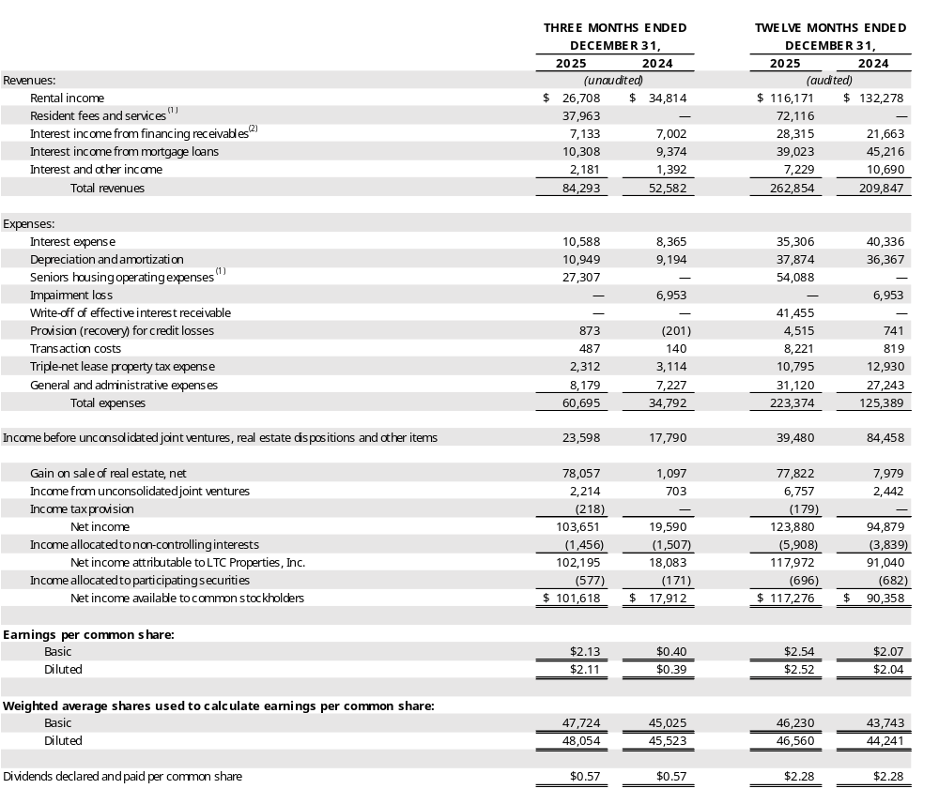
CONSOLIDATED STATEMENTS OF Income
(amounts in thousands, except per share amounts)
Represents our seniors housing operating portfolio (“SHOP”) operating income and expense.
Represents rental income from acquisitions through sale-leaseback transactions, subject to leases which contain purchase options. In accordance with GAAP, the properties are required to be presented as Financing receivables on our Consolidated Balance Sheets and the rental income to be presented as Interest income from financing receivables on our Consolidated Statements of Income.

Slide 35
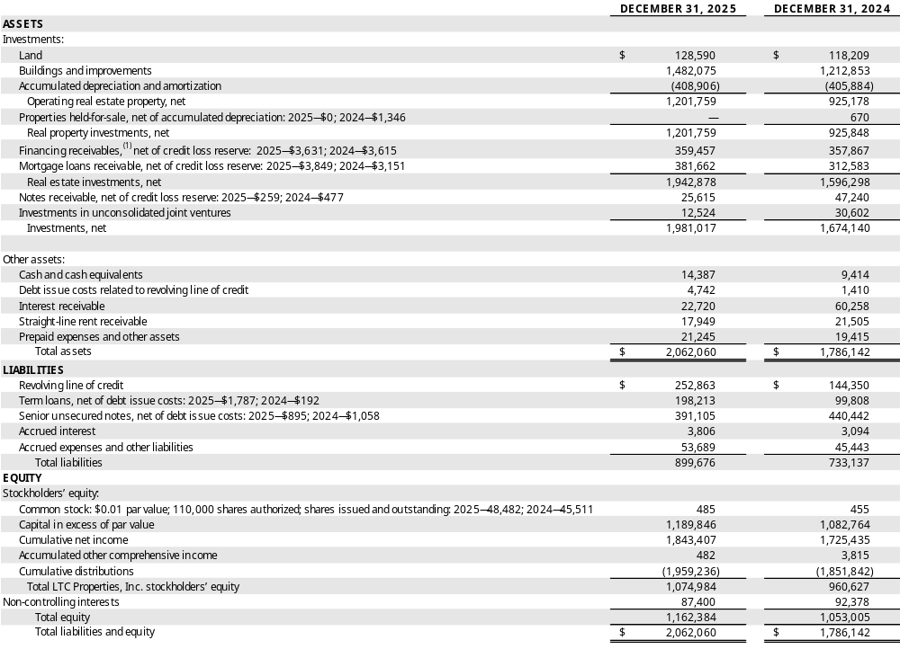
Consolidated Balance sheets
(AUDITED, amounts in thousands, except per share amounts)
Represents acquisitions through sale-leaseback transactions, subject to leases which contain purchase options. In accordance with GAAP, the properties are required to be presented as financing receivables on our Consolidated Balance Sheets.

Slide 36
Appendix A:
SEC Reg. G Compliance

Slide 37
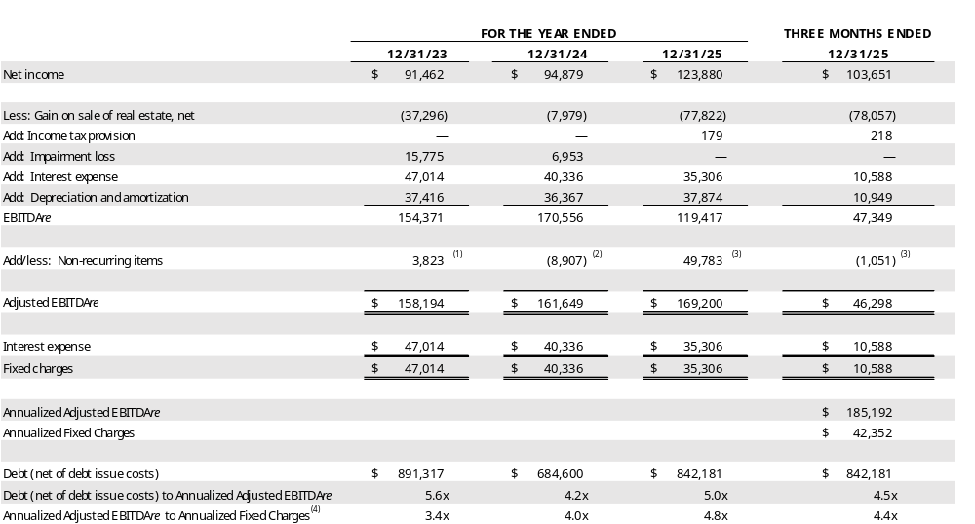
Appendix a: sec reg. g compliance
(dollar amounts in thousands)
Reconciliation of Annualized adjusted EBITDAre and Fixed Charges
Includes the $3,561 note receivable write-off related to the sale and transition of 10 seniors housing communities, $1,832 of provision for credit losses related to the acquisition of 11 seniors housing communities accounted for as financing receivables and two mortgage loan originations, partially offset by the $1,570 exit IRR and prepayment fee received in connection with the payoff of two mezzanine loans.
Represents $4,052 of one-time income received from former operators, $3,158 of one-time additional straight-line income related to restoring accrual basis accounting for two master leases, $2,818 of rental income received in connection with the sale of two properties, and $1,738 recovery of provision for credit losses related to the payoffs of five mortgage loan receivables, partially offset by $1,635 of provision for credit losses related to acquisitions totaling $163,460 accounted for as financing receivables, $613 of effective interest receivable write-off related to the partial paydown of a mortgage loan receivable, and the write-off of straight-line rent receivable ($321) and notes receivable ($290).
See the reconciliation of non-recurring items on page 26 for further detail.
Given we do not have preferred stock, our fixed charge coverage ratio and interest coverage ratio are the same.

Slide 38
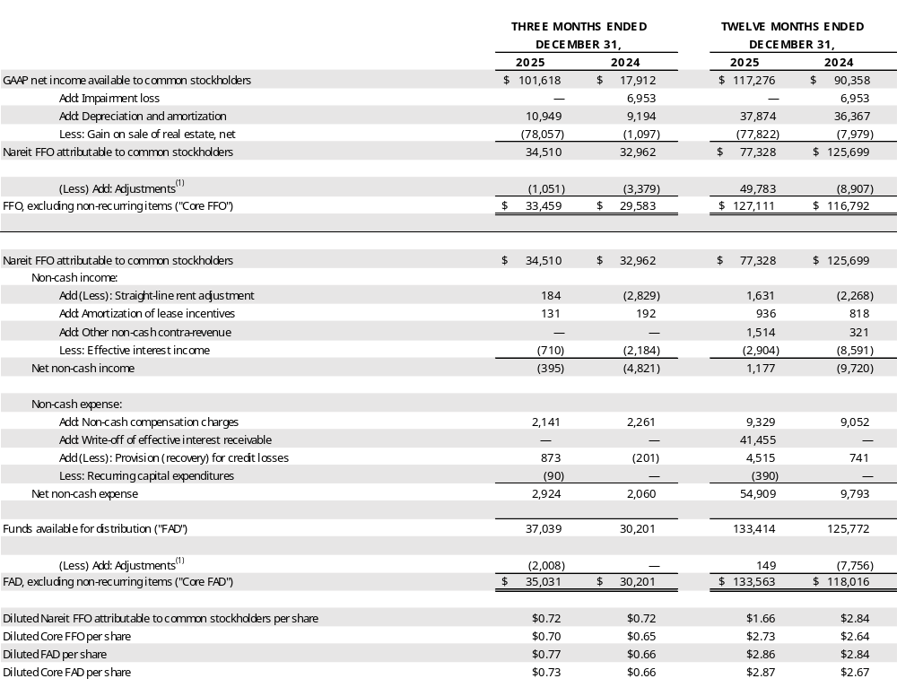
Appendix a: sec reg. g compliance - Reconciliation of FFO and FAD
(UNaudited, amounts in thousands, except per share amounts)
See the reconciliation of non-recurring items on page 26 for further detail.

Slide 39
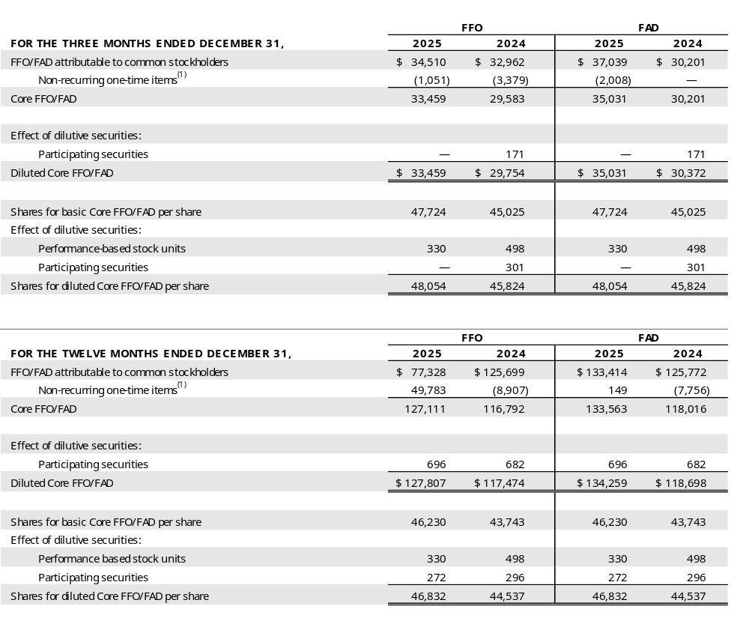
Appendix a: sec reg. g compliance - Reconciliation of FFO PER SHARE
(UNaudited, amounts in thousands)
See the reconciliation of non-recurring items on page 26 for further detail.

Slide 40
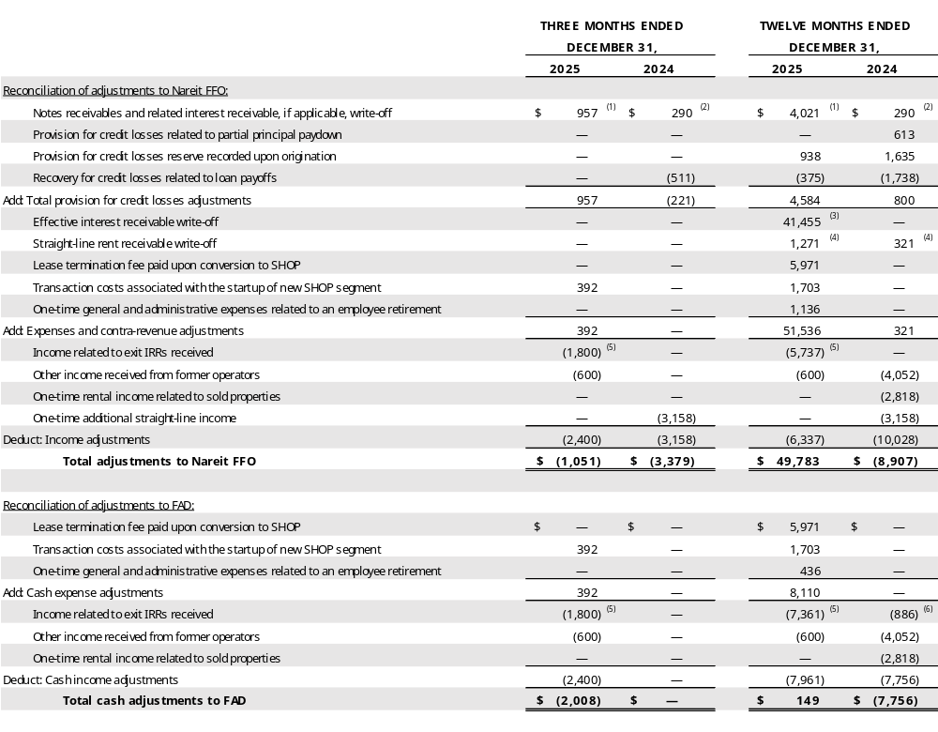
Appendix a: sec reg. g compliance - Reconciliation of FFO and FAD (NON-RECURRING ITEMS)
(UNaudited, amounts in thousands)
Represents the write-off of a working capital note and related interest receivable balance, if applicable, in connection with the transition to SHOP.
Represents a note receivable write-off in connection with the pending closure of a 56-unit seniors housing community located in Texas. The property was sold during 3Q25.
During 2025, we wrote off $41,455 of effective interest receivable related to a mortgage loan amendment that permits penalty-free early payoff within an allowable window.
During 2025, we wrote off $1,271 of straight-line rent receivable due to an operator’s ongoing bankruptcy filing. During 2024, we wrote off $321 of straight-line rent receivable related to a lease that converted to fair market rent. The straight-line rent write-offs are recorded as contra-revenue on the Consolidated Statements of Income.
The exit IRR income adjustment includes the following:
  a. $1,800 received in connection with the redemption of our preferred equity investment in a joint venture during 4Q25. The 12% exit IRR was not previously recorded;
  b. $2,599 received upon the early payoff of a mezzanine loan during 3Q25. The FFO adjustment represents the $2,599 offset by $1,624 of effective interest receivable balance previously recognized over the term of the loan through payoff; and
  c. $2,962 received in connection with the redemption of our preferred equity investment in a joint venture during 1Q25. The 13% exit IRR was not previously recorded.
The exit IRR income was received upon the payoff of three mortgage loans in 2024. The exit IRR was previously recorded ratably over the term of the loan through effective interest income.

Slide 41
Appendix a: sec reg. g compliance - Reconciliation of noi
(UNaudited, amounts in thousands)
NEED TO UPDATE
NEED TO ADD:
Based on the NOI provided, we’ll need to reconcile TTM NOI and Annualized NOI. I suspect we’ll need something like this lay out for each of the categories:
Rental income per 10Q
Less: revenue from properties sold/payoffs
Less: property tax revenue
Rental income NOI

Slide 42
GLOSSARY
Annualized Contractual Cash NOI: Represents annualized contractual cash rental income (prior to abatements & deferred rent repayment and excludes real estate tax reimbursement), interest income from financing receivables, mortgage loans, mezzanine loans and working capital notes, and income from unconsolidated joint ventures for the final month of the quarter reported herein.
Annualized GAAP NOI: Represents annualized GAAP rent which includes contractual cash rent, straight-line rent and amortization of lease incentives and excludes real estate tax reimbursement, GAAP interest income from financing receivables, mortgage loans, mezzanine loans and working capital notes, and income from unconsolidated joint ventures for the final month of the quarter reported herein.
Assisted Living Communities (“ALF”): The ALF portfolio consists of assisted living, independent living, and/or memory care properties (see definitions for Independent Living and Memory Care Communities). Assisted living properties are seniors housing properties serving elderly persons who require assistance with activities of daily living, but do not require the constant supervision skilled nursing properties provide. Services are usually available 24 hours a day and include personal supervision and assistance with eating, bathing, grooming and administering medication. The facilities provide a combination of housing, supportive services, personalized assistance and health care designed to respond to individual needs.
Contractual Lease Rent: Rental revenue as defined by the lease agreement between us and the operator for the lease year.
Coronavirus Stimulus Funds (“CSF”): CSF includes funding from various state and federal programs to support healthcare providers in dealing with the challenges of the coronavirus pandemic. Included in CSF are state-specific payments identified by operators as well as federal payments connected to the Paycheck Protection Program and the Provider Relief Fund. CSF is self-reported by operators in unaudited financial statements provided to LTC. Specifically excluded from CSF are the suspension of the Medicare sequestration cut, and increases to the Federal Medical Assistance Percentages (FMAP), both of which are reflected in reported coverage both including and excluding CSF.
Earnings Before Interest, Tax, Depreciation and Amortization for Real Estate (“EBITDAre”): As defined by the National Association of Real Estate Investment Trusts (“Nareit”), EBITDAre is calculated as net income (computed in accordance with GAAP) excluding (i) interest expense, (ii) income tax expense, (iii) real estate depreciation and amortization, (iv) impairment write-downs of depreciable real estate, (v) gains or losses on the sale of depreciable real estate, and (vi) adjustments for unconsolidated partnerships and joint ventures.
EXPOR: Average expenses per occupied room per month
FAD Capex: Recurring capital expenditures that extend the useful life of a property
Financing Receivables: Properties acquired through a sale-leaseback transaction with an operating entity being the same before and after the sale-leaseback, subject to a lease contract that contains a purchase option. In accordance with GAAP, the purchased assets are required to be presented as Financing receivables on our Consolidated Balance Sheets and the rental income to be presented as Interest income from financing receivables on our Consolidated Statements of Income.
Funds Available for Distribution (“FAD”): FFO excluding the effects of straight-line rent, amortization of lease costs, effective interest income, provision for credit losses, non‑cash compensation charges, non-cash interest charges and recurring capital expenditures required to maintain and re-tenant our properties.
Funds From Operations (“FFO”): As defined by Nareit, net income available to common stockholders (computed in accordance with U.S. GAAP) excluding gains or losses on the sale of real estate and impairment write-downs of depreciable real estate plus real estate depreciation and amortization, and after adjustments for unconsolidated partnerships and joint ventures.
GAAP Rent: Total rent we will receive as a fixed amount over the initial term of the lease and recognized evenly over that term. GAAP rent recorded in the early years of a lease is higher than the cash rent received and during the later years of the lease, the cash rent received is higher than GAAP rent recognized. The difference between the cash rent and GAAP rent is commonly referred to as straight-line rental income. GAAP rent also includes amortization of lease incentives and real estate tax reimbursements.
Gross Asset Value: The carrying amount of total assets after adding back accumulated depreciation and loan loss reserves, as reported in the company’s consolidated financial statements.
Gross Investment: Original price paid for an asset plus capital improvements funded by LTC, without any deductions for depreciation or provision for credit losses. Gross Investment is commonly referred to as undepreciated book value.
Independent Living Communities (“ILF”): Seniors housing properties offering a sense of community and numerous levels of service, such as laundry, housekeeping, dining options/meal plans, exercise and wellness programs, transportation, social, cultural and recreational activities, on-site security and emergency response programs. Many offer on-site conveniences like beauty/barber shops, fitness facilities, game rooms, libraries and activity centers. ILFs are also known as retirement communities or seniors apartments.
Initial Conversion: 13 properties converted to SHOP in 2Q25.
Interest Income: Represents interest income from financing receivables, mortgage loans and other notes.
Licensed Beds/Units: The number of beds and/or units that an operator is authorized to operate at seniors housing and long-term care properties. Licensed beds and/or units may differ from the number of beds and/or units in service at any given time.
Memory Care Communities (“MC”): Seniors housing properties offering specialized options for seniors with Alzheimer’s disease and other forms of dementia. These facilities offer dedicated care and specialized programming for various conditions relating to memory loss in a secured environment that is typically smaller in scale and more residential in nature than traditional assisted living facilities. These facilities have staff available 24 hours a day to respond to the unique needs of their residents.
Metropolitan Statistical Areas (“MSA”): Based on the U.S. Census Bureau, MSA is a geographic entity defined by the Office of Management and Budget (OMB) for use by Federal statistical agencies in collecting, tabulating, and publishing Federal statistics. A metro area contains a core urban area of 50,000 or more population. MSAs 1 to 31 have a population of 19.5M – 2.2M. MSAs 32 to 100 have a population of 2.2M – 0.6M. MSAs greater than 100 have a population of 0.6M – 58K. Cities in a Micro-SA have a population of 264K – 12K. Cities not in an MSA have a population of less than 100K.
Mezzanine: Mezzanine financing sits between senior debt and common equity in the capital structure, and typically is used to finance development projects, value-add opportunities on existing operational properties, partnership buy-outs and recapitalization of equity. Security for mezzanine loans can include all or a portion of the following credit enhancements: secured second mortgage, pledge of equity interests, and personal/corporate guarantees. Mezzanine loans can be recorded for GAAP purposes as either a loan or joint venture depending upon loan terms and related credit enhancements.

Slide 43
GLOSSARY
Micropolitan Statistical Areas (“Micro-SA”): Based on the U.S. Census Bureau, Micro-SA is a geographic entity defined by the Office of Management and Budget (OMB) for use by Federal statistical agencies in collecting, tabulating, and publishing Federal statistics. A micro area contains an urban core of at least 10,000 population.
Mortgage Loan: Mortgage financing is provided on properties based on our established investment underwriting criteria and secured by a first mortgage. Subject to underwriting, additional credit enhancements may be required including, but not limited to, personal/corporate guarantees and debt service reserves. When possible, LTC attempts to negotiate a purchase option to acquire the property at a future time and lease the property back to the borrower.
Net Real Estate Assets: Gross real estate investment less accumulated depreciation. Net Real Estate Asset is commonly referred to as Net Book Value (“NBV”).
NNN – Triple-net lease which requires the lessee to pay all taxes, insurance, maintenance and repair capital and non-capital expenditures and other costs necessary in the operations of the property.
Non-cash Revenue: Straight-line rental income, amortization of lease inducement and effective interest.
Non-cash Compensation Charges: Vesting expense relating to restricted stock and performance-based stock units.
Non-FAD Capex: Capital expenditures, including significant renovations, to bring a property to a marketable and functional standard.
Normalized EBITDAR Coverage: The trailing twelve month’s earnings from the operator financial statements adjusted for non-recurring, infrequent, or unusual items and before interest, taxes, depreciation, amortization, and rent divided by the operator’s contractual lease rent. Management fees are imputed at 5% of revenues.
Normalized EBITDARM Coverage: The trailing twelve month’s earnings from the operator financial statements adjusted for non-recurring, infrequent, or unusual items and before interest, taxes, depreciation, amortization, rent, and management fees divided by the operator’s contractual lease rent.
Occupancy: The weighted average percentage of all beds and/or units that are occupied at a given time. The calculation uses the trailing twelve months and is based on licensed beds and/or units which may differ from the number of beds and/or units in service at any given time.
Operator Financial Statements: Property level operator financial statements which are unaudited and have not been independently verified by us.
Payor Source: LTC revenue by operator underlying payor source for the period presented. LTC is not a Medicaid or a Medicare recipient. Statistics represent LTC's rental revenues times operators' underlying payor source revenue percentage. Underlying payor source revenue percentage is calculated from property level operator financial statements which are unaudited and have not been independently verified by us.
Private Pay: Private pay includes private insurance, HMO, VA, and other payors.
Purchase Price: Represents the fair value price of an asset that is exchanged in an orderly transaction between market participants at the measurement date. An orderly transaction is a transaction that assumes exposure to the market for a period prior to the measurement date to allow for marketing activities that are usual and customary for transactions involving such assets; it is not a forced transaction (for example, a forced liquidation or distress sale).
Real Estate Investments: Represents our investments in real property, financing receivables, mortgage loans receivable and other notes receivables.
Rental Income: Represents GAAP rent generated by our owned properties under triple-net leases.
REVPOR: Average revenues per occupied room per month
RIDEA: Real Estate Investment Trust (REIT) Investment Diversification and Empowerment Act of 2007
Same Property Portfolio (“SPP”): Same property statistics allow for the comparative evaluation of performance across a consistent population of LTC’s leased property portfolio and the Prestige Healthcare mortgage loan portfolio. Our SPP is comprised of stabilized properties occupied and operated throughout the duration of the quarter-over-quarter comparison periods presented (excluding assets sold, assets held-for-sale and SHOP assets). Accordingly, a property must be occupied and stabilized or a minimum of 15 months to be included in our SPP. Each property transitioned to a new operator has been excluded from SPP and will be added back to SPP for the SPP reporting period ending 15 months after the date of the transition.
Seniors Housing (“SH”): Consists of independent living, assisted living, and/or memory care properties.
Seniors Housing Operating Portfolio (“SHOP”): Includes Seniors Housing properties generally structured to comply with RIDEA.
SHOP Net Operating Income (“NOI”): Total SHOP revenues (resident fees and services) less total SHOP expenses (seniors housing operating expenses).
Skilled Nursing Properties (“SNF”): Seniors housing properties providing restorative, rehabilitative and nursing care for people not requiring the more extensive and sophisticated treatment available at acute care hospitals. Many SNFs provide ancillary services that include occupational, speech, physical, respiratory and IV therapies, as well as sub-acute care services which are paid either by the patient, the patient’s family, private health insurance, or through the federal Medicare or state Medicaid programs.
Stabilized: Properties are generally considered stabilized upon the earlier of achieving certain occupancy thresholds (e.g. 80% for SNFs and 90% for ALFs) and, as applicable, 12 months from the date of acquisition/lease transition/restructure or, in the event of a de novo development, redevelopment, major renovations or addition, 24 months from the date the property is first placed in or returned to service, or properties acquired in lease-up.
Trailing Twelve Months NOI: For the owned portfolio under triple-net leases, rental income excluding real estate tax reimbursement, straight-line rent write-off and rental income from properties sold during the trailing twelve months. For the owned portfolio under our SHOP segment, represents SHOP NOI during the trailing twelve months. For owned properties accounted for as financing receivables, mortgage loan receivables and notes receivables, NOI includes cash interest income and effective interest during the trailing twelve months and excludes loan payoffs during the trailing twelve months. For Unconsolidated JV, NOI includes income from our investments in joint ventures during the trailing twelve months.
Under Development Properties (“UDP”): Development projects to construct seniors housing properties.
Value-Add Conversion: Properties converted to date, or planned to be converted, from our market-based rent reset portfolio – 1 campus converted in 4Q25 (previously disclosed as 2 properties); 2 properties converted in 1Q26; and 2 properties expected to be converted in 2Q26.

Slide 44

Founded in 1992, LTC Properties, Inc. (NYSE: LTC) is a self-administered real estate investment trust (REIT) investing in seniors housing and health care properties primarily through RIDEA, triple-net leases, joint ventures and structured finance solutions including preferred equity and mezzanine lending. LTC’s portfolio encompasses Skilled Nursing Facilities (SNF) and Seniors Housing (SH) consisting of Assisted Living Communities (ALF), Independent Living Communities (ILF), Memory Care Communities (MC) and combinations thereof. Our main objective is to build and grow a diversified portfolio that creates and sustains shareholder value while providing our stockholders current distribution income. To meet this objective, we seek properties operated by regional operators, ideally offering upside and portfolio diversification (geographic, operator, property type and investment vehicle). For more information, visit www.LTCreit.com.
Forward-Looking Statements
This supplemental information contains forward-looking statements within the meaning of Section 27A of the Securities Act of 1933, as amended, and Section 21E of the Securities Exchange Act of 1934, as amended, adopted pursuant to the Private Securities Litigation Reform Act of 1995. Statements that are not purely historical may be forward-looking. You can identify some of the forward-looking statements by their use of forward-looking words, such as ‘‘believes,’’ ‘‘expects,’’ ‘‘may,’’ ‘‘will,’’ ‘‘should,’’ ‘‘seeks,’’ ‘‘approximately,’’ ‘‘intends,’’ ‘‘plans,’’ ‘‘estimates’’ or ‘‘anticipates,’’ or the negative of those words or similar words. Examples of forward-looking statements include the Company’s 2025 full-year guidance and statements regarding the Company’s SHOP pipeline, anticipated growth, and future strategy. Forward- looking statements involve inherent risks and uncertainties regarding events, conditions and financial trends that may affect our future plans of operation, business strategy, results of operations and financial position. A number of important factors could cause actual results to differ materially from those included within or contemplated by such forward-looking statements, including, but not limited to, our dependence on our operators for revenue and cash flow; government regulation of the health care industry; changes in federal, state, or local laws limiting REIT investments in the health care sector; federal and state health care cost containment measures including reductions in reimbursement from third-party payors such as Medicare and Medicaid; required regulatory approvals for operation of health care facilities; a failure to comply with federal, state, or local regulations for the operation of health care facilities; the adequacy of insurance coverage maintained by our operators; our reliance on a few major operators; our ability to renew leases or enter into favorable terms of renewals or new leases; the impact of inflation, operator financial or legal difficulties; the sufficiency of collateral securing mortgage loans; an impairment of our real estate investments; the relative illiquidity of our real estate investments; our ability to develop and complete construction projects; our ability to invest cash proceeds for health care properties; a failure to qualify as a REIT; our ability to grow if access to capital is limited; and a failure to maintain or increase our dividend. For a discussion of these and other factors that could cause actual results to differ from those contemplated in the forward-looking statements, please see the discussion under ‘‘Risk Factors’’ and other information contained in our Annual Report on Form 10-K for the fiscal year ended December 31, 2025 and in our publicly available filings with the Securities and Exchange Commission. We do not undertake any responsibility to update or revise any of these factors or to announce publicly any revisions to forward-looking statements, whether as a result of new information, future events or otherwise. Although our management believes that the assumptions and expectations reflected in such forward-looking statements are reasonable, no assurance can be given that such expectations will prove to have been correct. The actual results achieved may differ materially from any forward-looking statements due to the risks and uncertainties of such statements.

