Slide 1
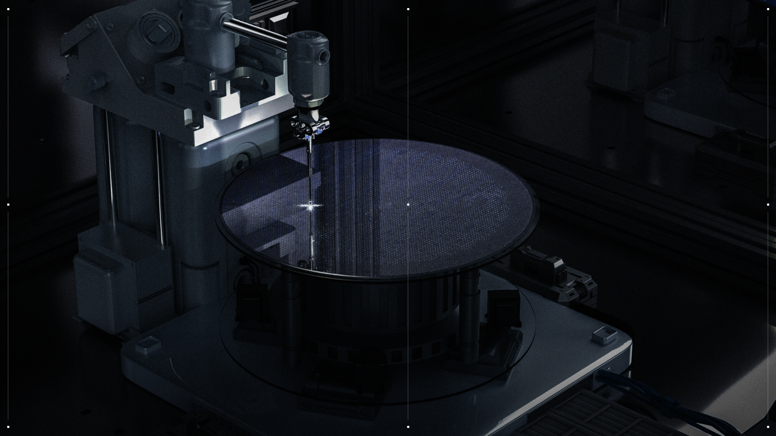





HALO / NOVEMBER 2025
CONFIDENTIAL AND PROPRIETARY

Slide 5
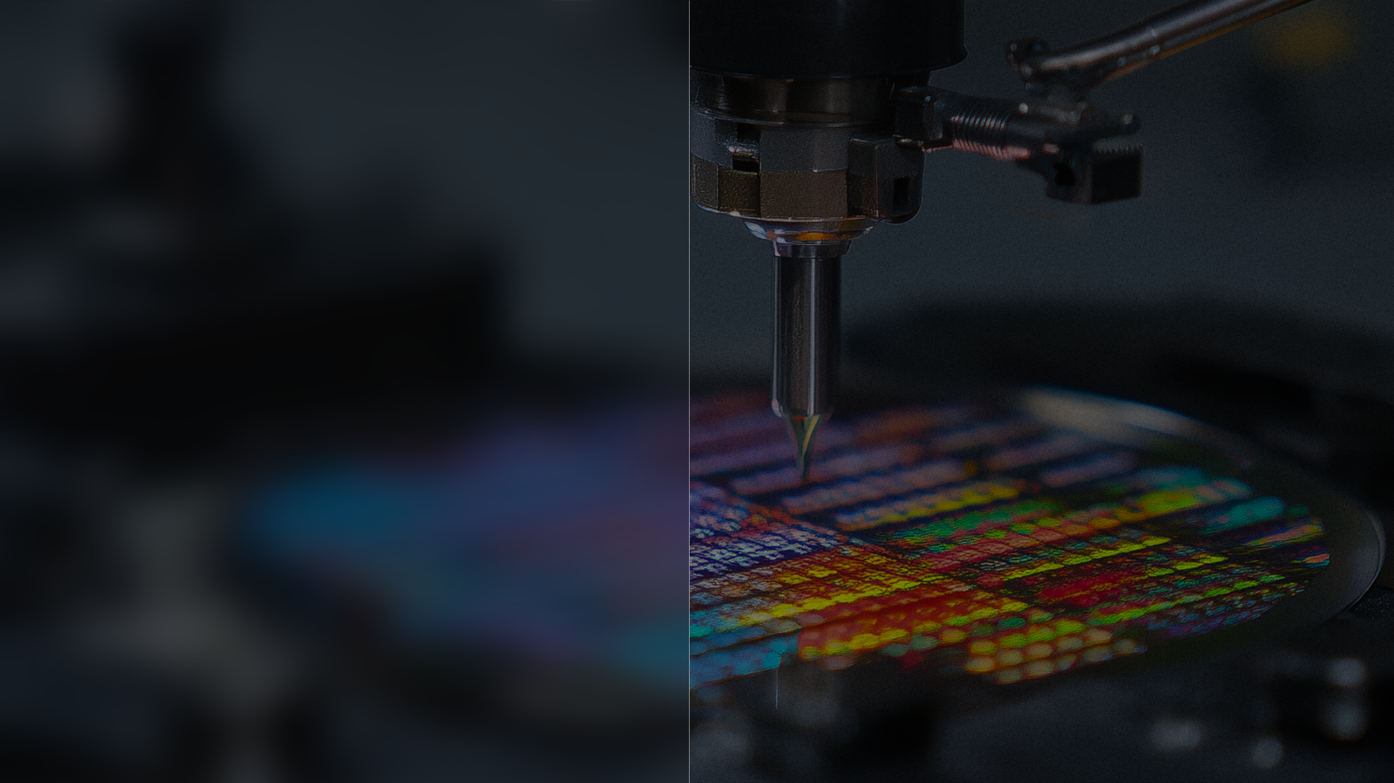





Title
Content 1
Content 2
Content 3
Content 4
HALO / DECEMBER 2025
11

Slide 6
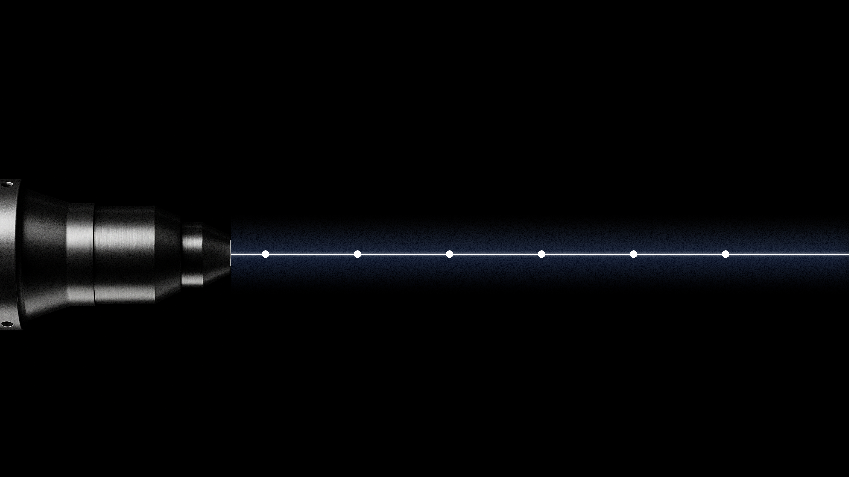
Halo Industries Overview
2014
2024
2026
Spin out from Stanford University. Silicon Valley Headquarters.
Top tier US VC Series B $80M USD funding. 200mm production capability.
Initial production manufacturing with Tier 1 automotive customer out of California production line.
2022
2025
2027
Initial SiC laser slicing tool demonstrated and Santa Clara CA production site build out.
Key customer qualification and IATF automotive quality certification.
High-volume production scale-up In Malaysia.
HALO / DECEMBER 2025
5

Slide 7

In the near future, all semiconductor wafering will be light-based. Halo is at the vanguard of a sustainable semiconductor manufacturing revolution.
Laser is the future of wafering
HALO / DECEMBER 2025
7

Slide 8
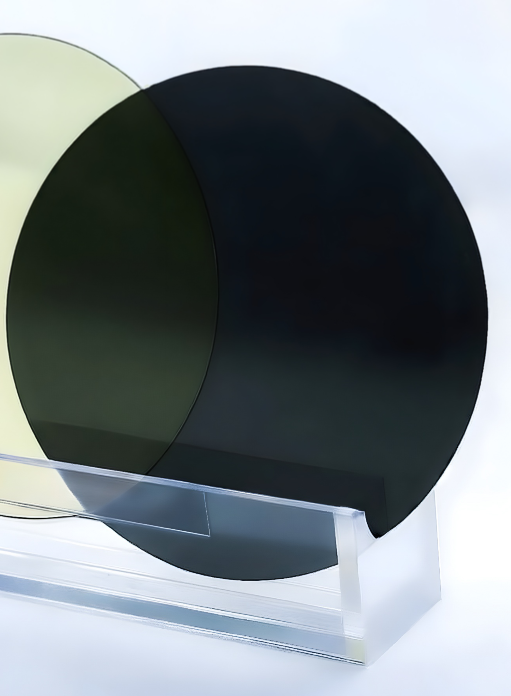
EXECUTIVE SUMMARY ● THE ASK
Halo Summary
Line 1: blah blah
Line 1: blah blah
Line 1: blah blah
Line 1: blah blah
Line 1: blah blah
Line 1: blah blah
Line 1: blah blah
Line 1: blah blah
Line 1: blah blah
HALO / DECEMBER 2025
3

Slide 10
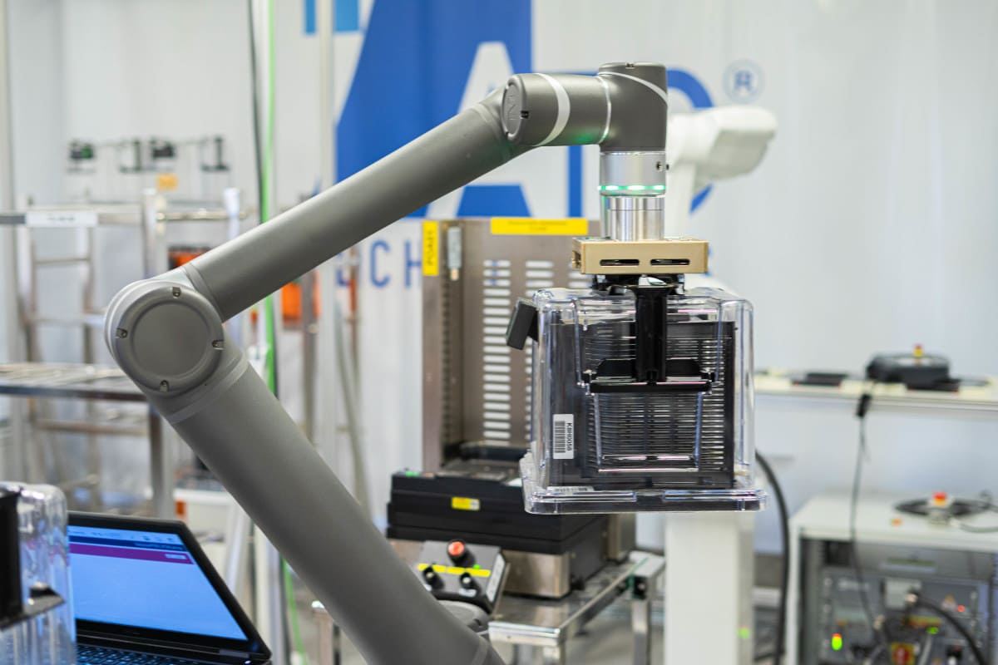
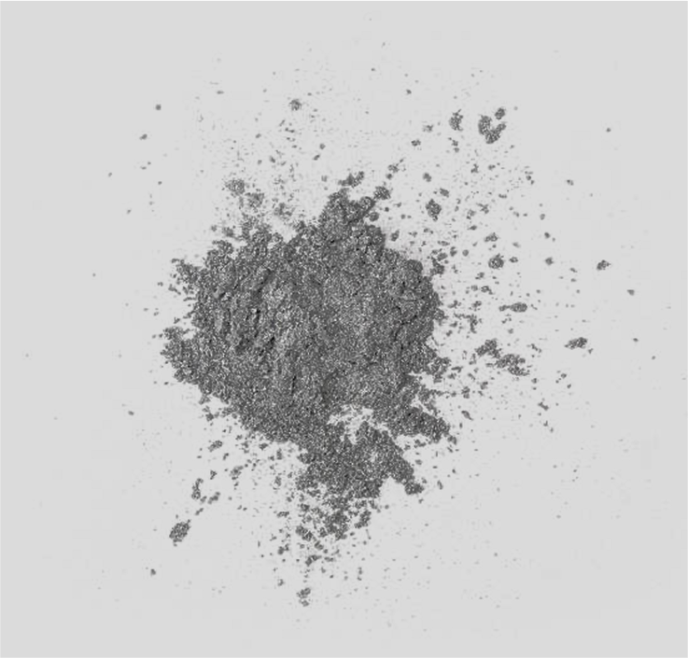
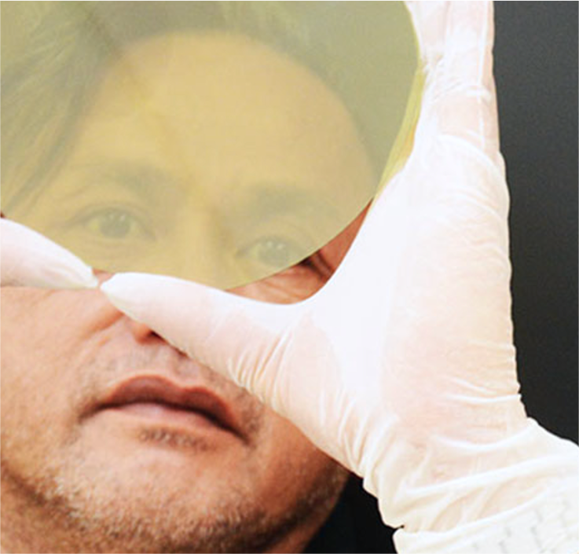
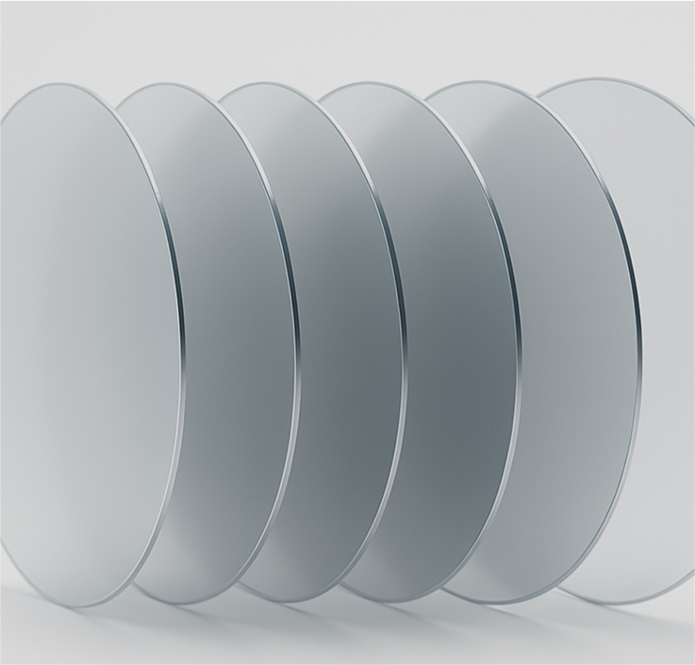
Why laser-based wafering?
01
02
03
04
Minimizing cost
Reducing material waste
Improving quality
Increasing yields
Eliminating consumables from wafering process while enabling end-to-end, high-throughput automation
Minimum amount of targeted energy used in process enables extreme precision without any residual damage
﻿﻿Precise, gentle, zero-contact manufacturing reduces opportunity for failures
More sellable wafers from same starting workpiece
HALO / DECEMBER 2025
8

