Slide 1
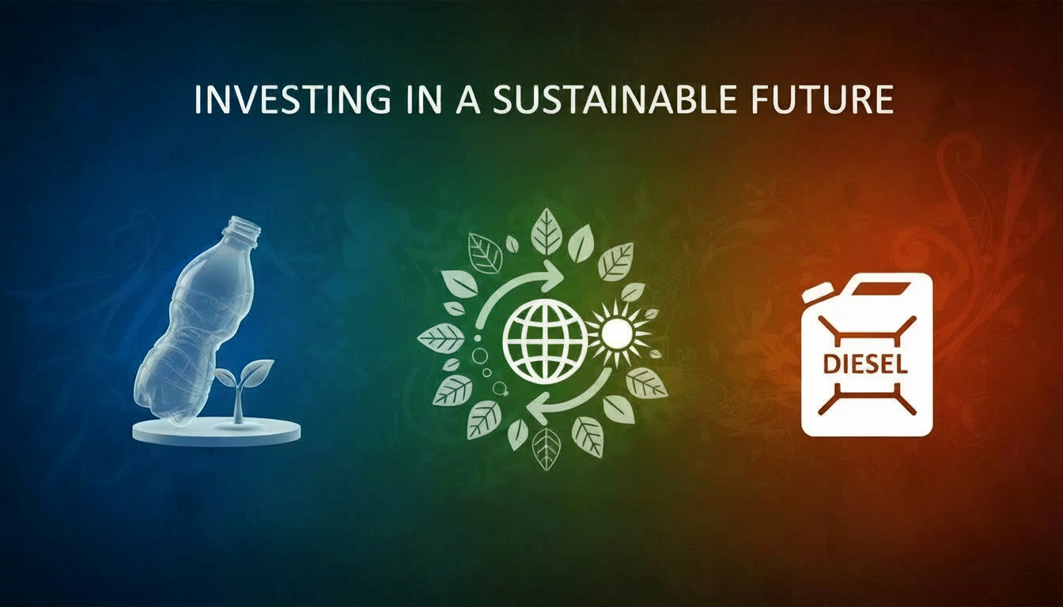

Slide 2
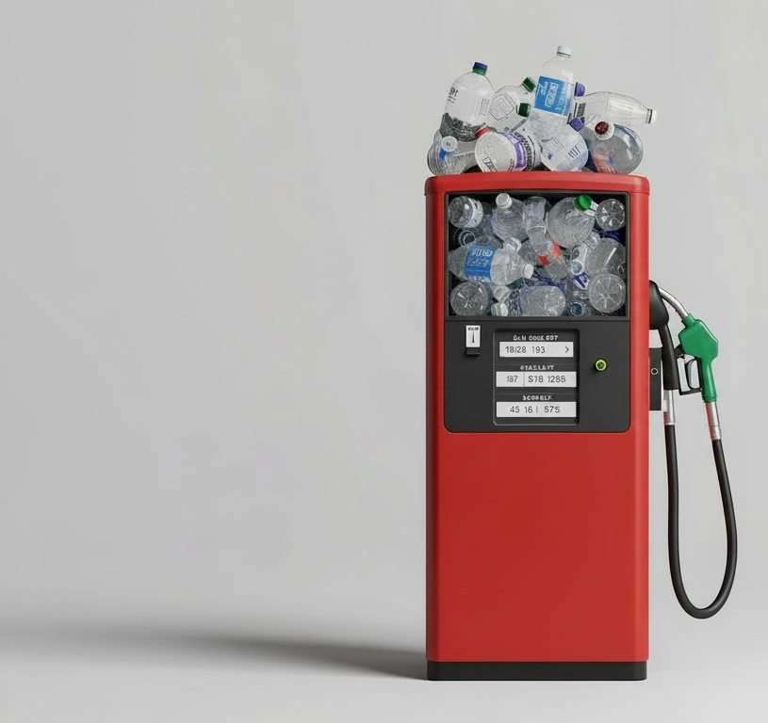
Executive Summary

Slide 3






Invest in Clean Diesel: High Output, High Impact
Compelling Value Proposition
A proprietary, continuous-flow technology that converts plastic waste into high-grade diesel, addressing two global challenges simultaneously: waste management and clean energy supply.
Proven, Scalable Unit Economics
Each US$4 million modular unit processes 1 ton of plastic per hour, producing approximately 16,800 liters of diesel per day through 24/7 continuous operations, enabling predictable and repeatable returns.
Attractive Financial Returns
With annual gross revenue potential of US$ 2.5-4.5 million per unit, EBITDA margins of 30–45%, IRR of 28.5% and an indicative payback period of 5 years, the model offers strong downside protection and rapid capital recovery.
Low Execution Risk
Backed by secured feedstock supply chains and confirmed diesel offtake partners, ensuring operational continuity, revenue visibility, and reduced market risk from day one.

Slide 4



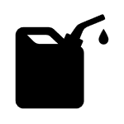

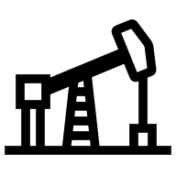

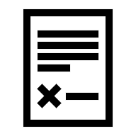
About the Company
Operational Snapshot
Strategic Highlights
Location snapshot
Location snapshot
Core Services
Leased Land – 20,000 Sq. Ft.
An integrated plastic waste conversion entity in the US.
Secured feedstock supply chains and confirmed offtake partners, ensuring consistent operation and reliable revenue
Dual benefit opportunity - powerful environmental impact combined with strong, repeatable profitability.
♻️ Waste Management & Recycling
Diverting plastic waste from landfills
Location snapshot
Manpower – 8 Employees
One Machine working 24* 7
🏗️ Fuel Production
Output – a commercial grade diesel fuel
One ton of plastic transformed into 700 liters of fuel
Clientele/Industries Served
⚙️ Scalable Technology
Modular, Independent units used in operations
Founder Profile
Location snapshot
Mayer Green is a proven entrepreneur who has founded and scaled consumer brands, including lilacandcreme.com and blueterry.com, from concept to commercialization, bringing a strong execution focus and hands-on experience across early-stage growth and scale-up.
Logistics & Transportation
Industrial Operations
🌱 Sustainability Solutions
Clean Fuel and Environmental impact
Municipalities / government contracts
Power Generation

Slide 5




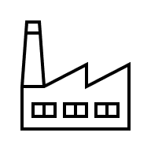

Unique Selling Propositions (USPs)
24/7 High-Utilization Revenue Engine
Sustainability Focus
    Continuous operation (24/7) maximizes throughput, stabilizes unit economics, and significantly improves ROA compared to batch or intermittent system.
    A structurally sustainable model delivering measurable waste diversion and emissions reduction alongside commercial performance. Each module diverts ≈ 24 tons of plastic waste from landfill daily.
Low CAPEX, Modular Replication Model
Global Reach with Local Strength
    Each module operates independently and can be deployed incrementally. Growth does not depend on billion-dollar centralized plants or long construction timelines.
    A globally scalable platform executed through strong local feedstock, regulatory, and offtake partnerships.
Industry Experience
Feedstock & Offtake De-Risked Upfront
    The platform is built and operated by a team with hands-on experience across waste management, industrial operations, and energy markets, ensuring realistic plant design, disciplined execution, and operational reliability from day one.
    With plastic feedstock supply and diesel buyers already secured, the two biggest risks in waste-to-energy projects—input availability and output monetization—are already addressed.

Slide 6
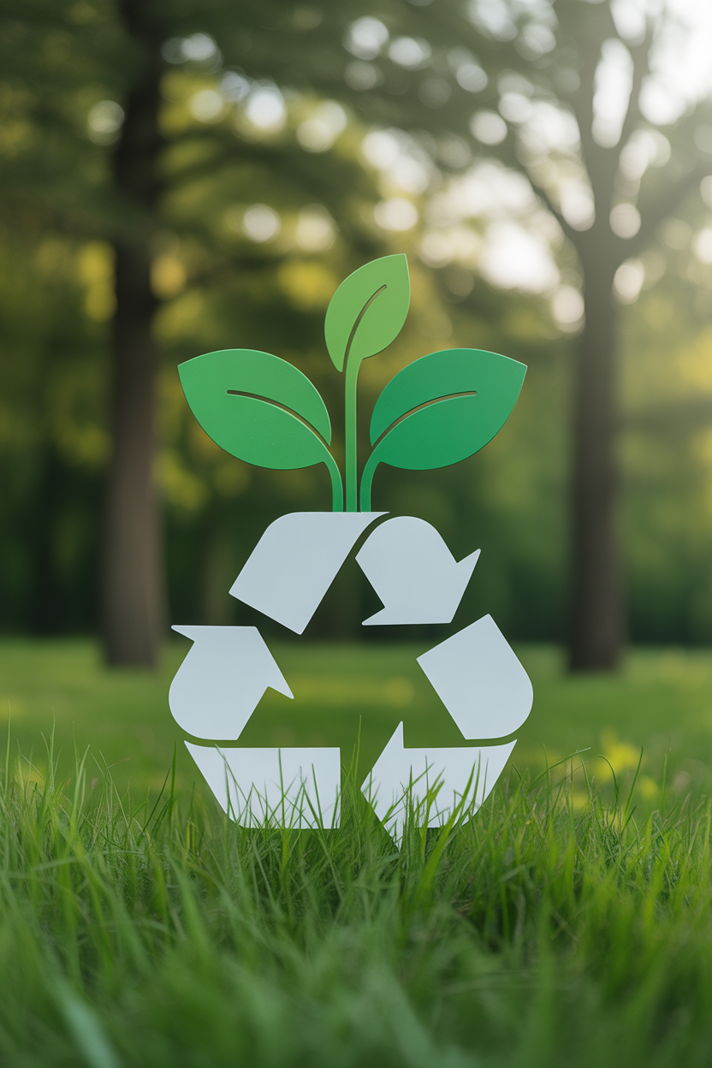
Financial Highlights

Slide 7

Technology Overview

Slide 8
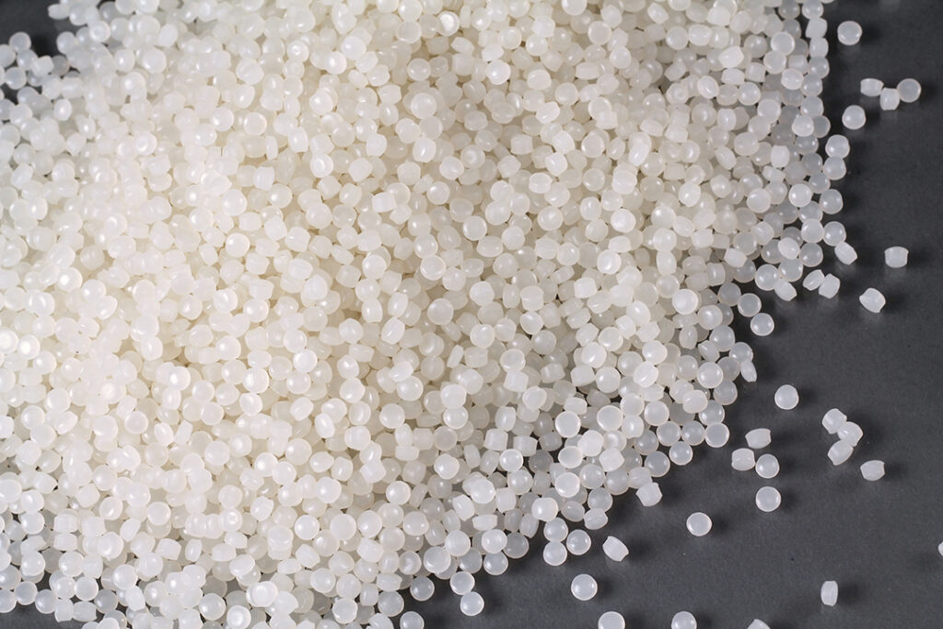

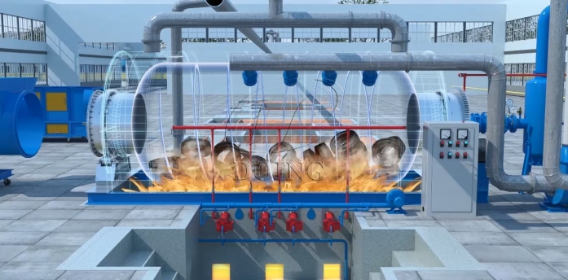
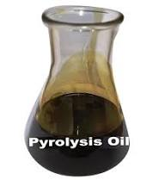
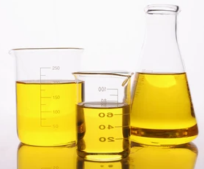
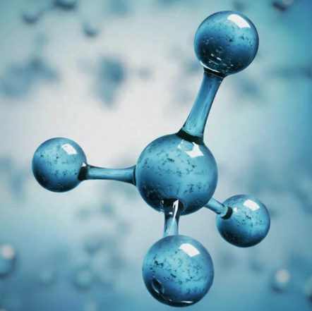
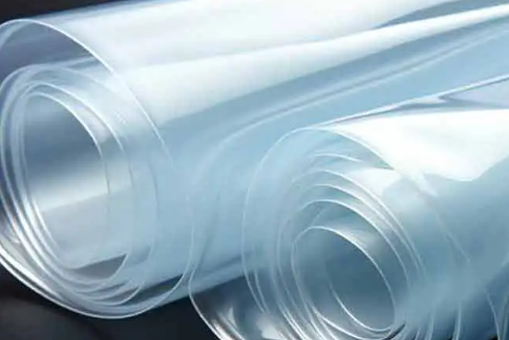

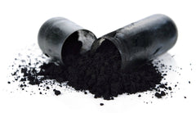
Technology Overview | Product Lifecycle
Feedstock Segment
Conversion Process
Output Product Segment
Distillation
Pyrolysis Oil
Commercial Grade Diesel
Low Density Polyethylene (LDPE)
Polystyrene (PS)
Incondensable Pyrolysis Gas (Syngas)
High-calorific gases such as methane, ethane, propane, butane, and hydrogen
High temperature conversion process used called “Pyrolysis Process”
Benefit from automatic temperature regulation
Using advanced heating methods such as indirect heating or electromagnetic heating
Enhanced stirring mechanisms to ensure better heat distribution
High Density Polyethylene (HDPE)
Polypropylene (PP)
Solid residual by-product
Char/Carbon black

Slide 9
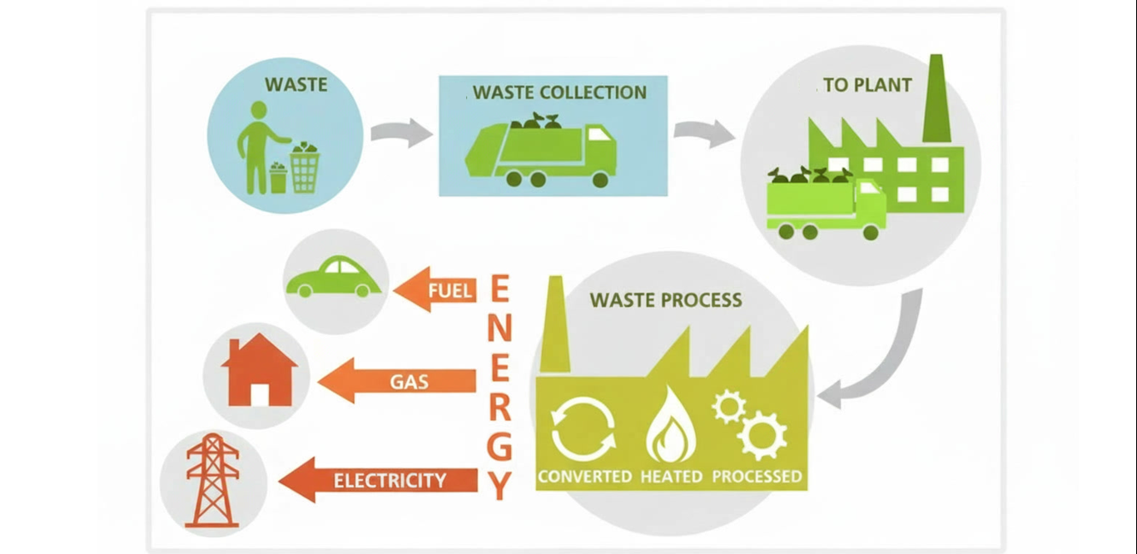
Technology Overview | Product Lifecycle

Slide 10
Technology Overview | Process Flow Chart
Plastic
Waste Collection
Sorting and Segregation
Cleaning and Drying
​
Shredding / Size Reduction
Feedstock Storage
Stored
Fractional Distillation
Crude Pyrolysis Oil
Condensation System
Pyrolysis Reactor
Commercial Diesel Dispatched

Slide 11



Technology Overview | Independent Emissions & Gas Tests
Emission Test – Key Takeaways
Gas Test – Key Takeaways
Independent Testing & Validation
Independent Gas Composition testing
Emissions testing was conducted on an operational plastic-to-diesel conversion system under real operating conditions (Appendix A).
Tests were carried out by Ecological Laboratories, an independent industrial testing agency.
Gas composition testing was conducted by Chemical testing laboratory as part of the operational validation process. (Appendix A)
Regulatory & Environmental Performance
Process Gas characteristics
Key regulated emission parameters including Carbon Monoxide (CO), Sulphur Dioxide (SO₂) and Hydrogen Chloride (HCl) were measured.
Recorded emission levels were within applicable industrial environmental limits, indicating compliance with standard air-quality norms.
Results confirm stable emissions during continuous operation, supporting 24/7 plant design.
Incondensable process gas contains high-calorific hydrocarbon components generated during pyrolysis.
Gas is safely reused within the system, supporting internal energy requirements.
Environmental Performance Indicators
Environmental Performance Indicators
CO levels recorded at ~45% below the permissible threshold.
SO₂ levels recorded at ~98% below allowable limits
No abnormal fluctuations observed during test period.
Emission profile consistent with controlled pyrolysis combustion systems
Presence of methane (CH₄)
Presence of ethane (C₂H₆)
Presence of propane (C₃H₈)
Presence of butane (C₄H₁₀)
Trace hydrogen (H₂) detected

Slide 12




SWOT Analysis
Strength:
The plant is designed to operate continuously, enabling maximum utilization of installed capacity and ensuring stable and predictable revenue generation.
With feedstock suppliers and diesel buyers already secured, the project minimizes supply-chain risk.
The project monetizes plastic waste by converting it into usable fuel, directly addressing a critical environmental challenge while creating a commercially viable revenue stream.
Weakness:
Operational performance relies on consistent quality and quantity of plastic waste supply.
There is a general lack of widespread public and industry recognition of the environmental and economic advantages of recycling, along with limited awareness of regulatory compliance requirements.
The organization is vulnerable to abrupt changes in government policies related to waste import/export regulations and local recycling mandates.
W
S
T
O
Threat:
The recycling sector faces several external challenges, including policy delays or shifts in waste segregation and landfill regulations, as well as potential favoritism toward government-backed entities.
International trade restrictions, like those under the Basel Convention, can limit cross-border waste processing.
Additionally, fluctuations in global commodity prices affect the resale value of recovered materials.
Opportunity:
Rapidly growing waste-to-energy market is emerging for waste-to-energy solutions.
Governments are restricting landfills and tightening waste disposal rules.
These policies support long-term demand and investment visibility.

Slide 13
Global and US Industry Analysis

Slide 14
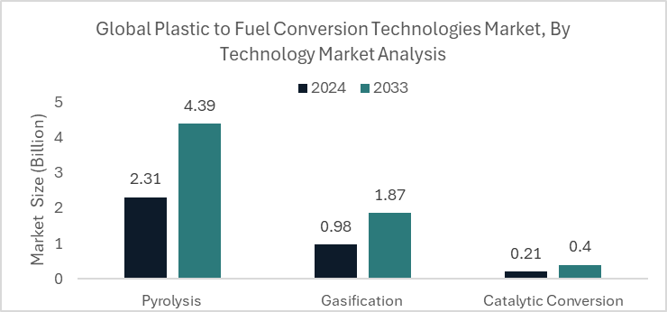
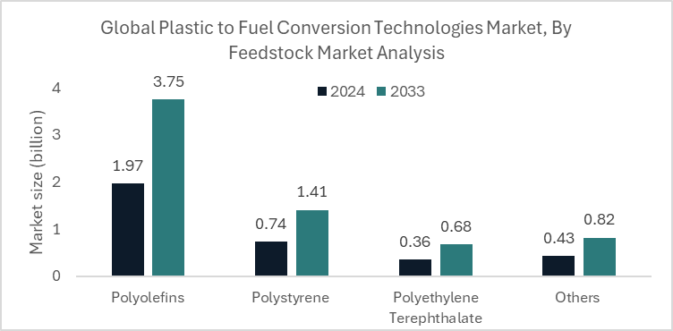
Industry Analysis | Global Plastic to Fuel Conversion Technologies Market
Market Overview and Growth Potential
Global Plastic to Fuel Market – By Technology and Feedstock
The global waste to diesel market size was ~$3.5 B in 2024 and is projected to reach $6.66 B by 2033 at a CAGR of ~7.2%.
This market is witnessing growing adoption due to increasing concerns over landfills, plastic pollution, and the global push for alternative fuels.
Market reflects strong long-term growth and increasing commercial viability of converting waste into diesel-grade fuel.
Market expansion backed by supportive government policies and regulatory incentives for recycling and carbon reduction.
Regional Market Outlook
Europe holds the largest regional share (~45.80%), supported by strong regulatory frameworks and circular economy policies.
North America—particularly the US—is gaining momentum due to stricter EPA regulations and demand for alternatives to fossil diesel. South America shows gradual adoption, with the market expected to grow from 0.13 units in 2024 to 0.25 units by 2033.
Meanwhile, the Middle East & Africa and Latin America remain at earlier stages of market development, with growing awareness and pilot projects beginning to shape future opportunities.

Slide 15
Industry Analysis | United States Market
United States - Waste to Energy (WtE) Market
US Waste to Energy Market Size
Technological Advancements in Waste Processing
Construction and Industrial Boom driving Waste Volumes
Stricter Environmental Regulations
Export Dependency and Regional Recycling Gaps
Public-Private Partnerships
The United States waste-to-energy market was valued at US$ 3.1 Billion in 2024 and is expected to register a CAGR of 5.2% over the forecast period and reach US$ 4.9 Billion in 2033.
Technological improvements such as traditional thermal processes (incineration, gasification, pyrolysis) dominate today.
Advances in automation, digital controls, and emissions reduction technologies further improve operational efficiency and regulatory compliance.
Rising construction and industrial activity in the U.S. continues to increase solid and industrial waste volumes, creating more feedstock for WtE facilities. As municipal solid waste grows, WtE solutions help mitigate landfill pressures while providing a renewable energy source.
The U.S. Environmental Protection Agency (EPA) and state regulators have tightened emissions and waste management rules, encouraging alternatives to landfilling and promoting cleaner WtE operations with modern emission controls.
Collaboration between government bodies and major industry players (e.g., Covanta, Wheelabrator) supports project development, technology adoption, and risk sharing, helping municipalities overcome investment barriers.
While not as prominent as in some other sectors, the U.S. still exports a large share of recyclable materials due to limited domestic recycling capacity, which highlights gaps in regional recycling infrastructure.

