Slide 1
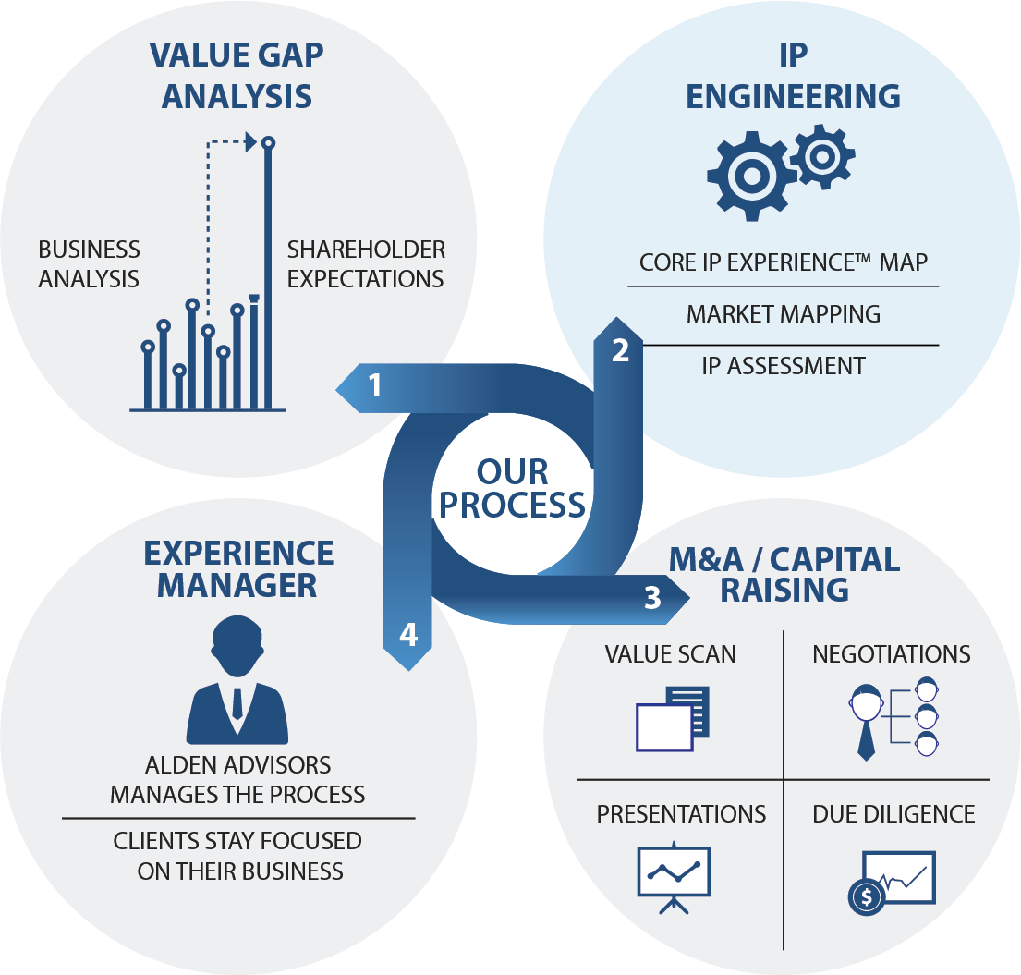
AA Core IP experience to Strategic Reframing 02272026

Slide 2
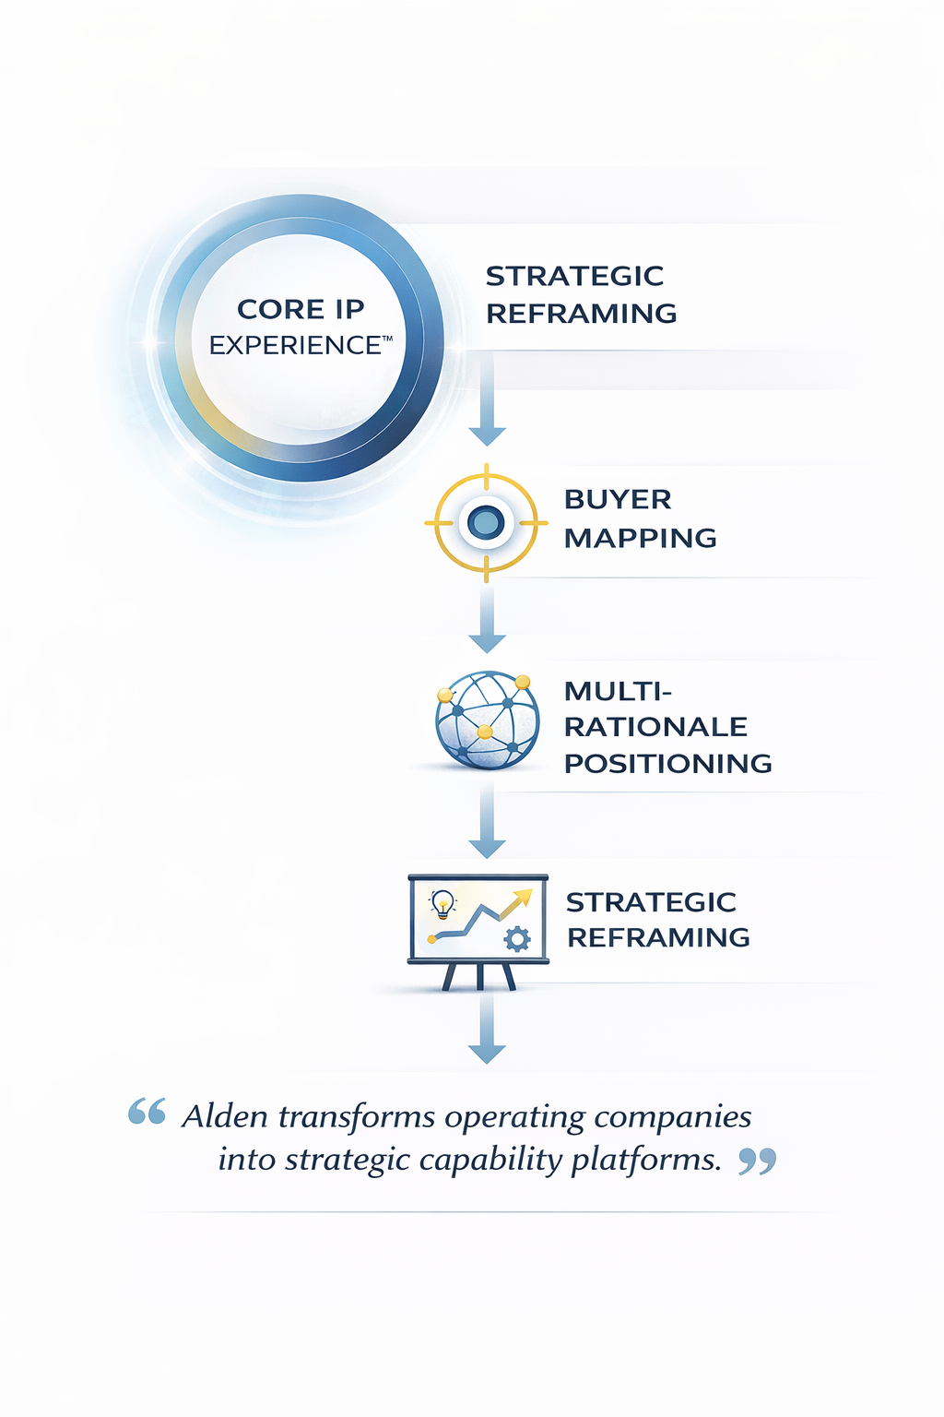
AA Core IP experience to Strategic Reframing 02272026

Slide 3
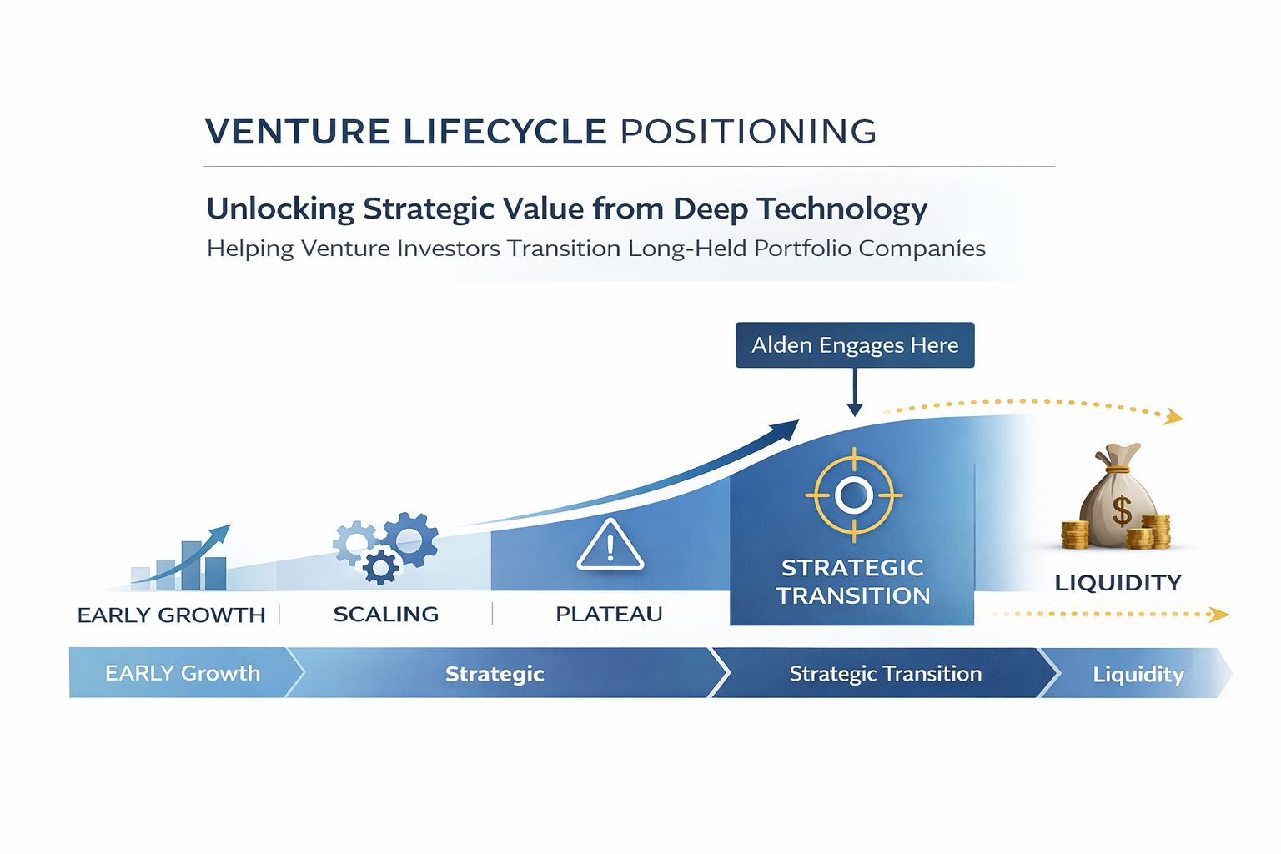
AA Venture Lifecycle Positioning 02272026
“Alden Engages Here”
Should be moved

Slide 4
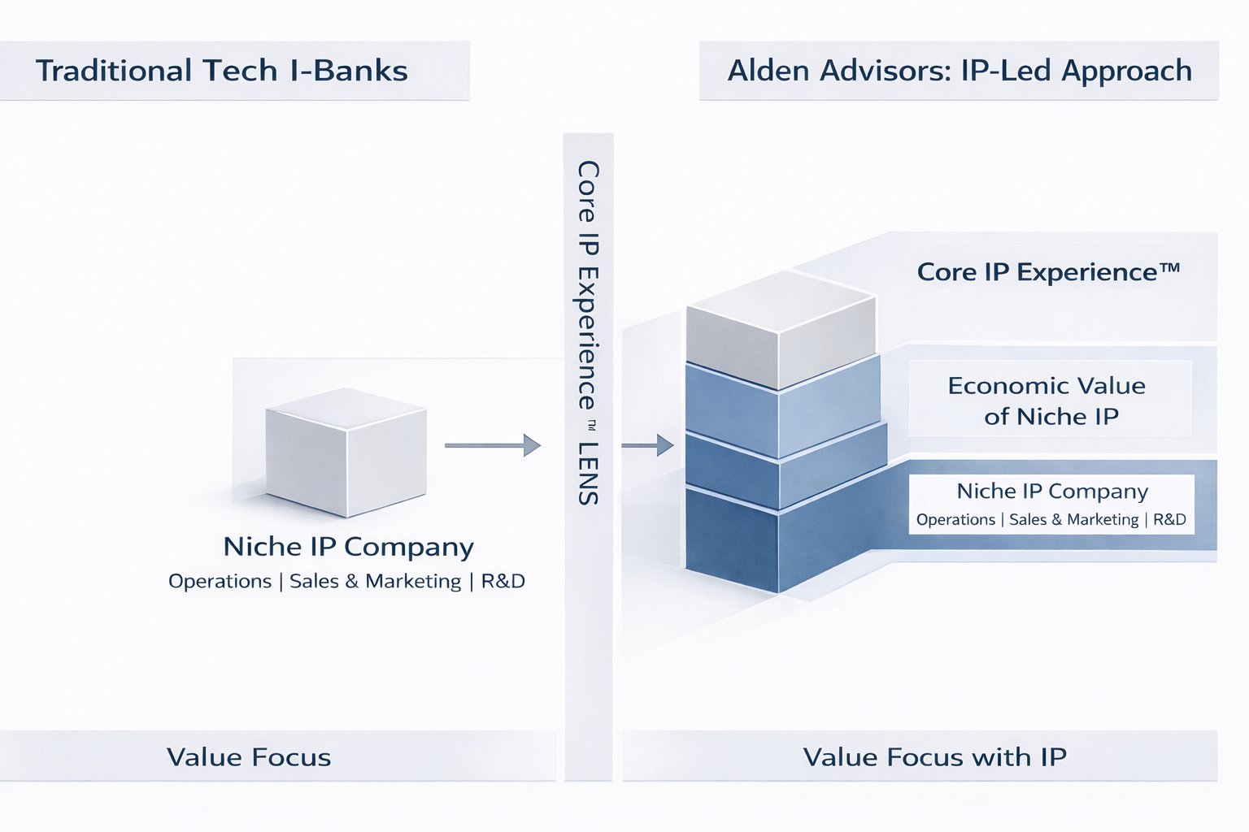
AA vs Trad I-Banks - Idea 2
Should be 1 box

Slide 5
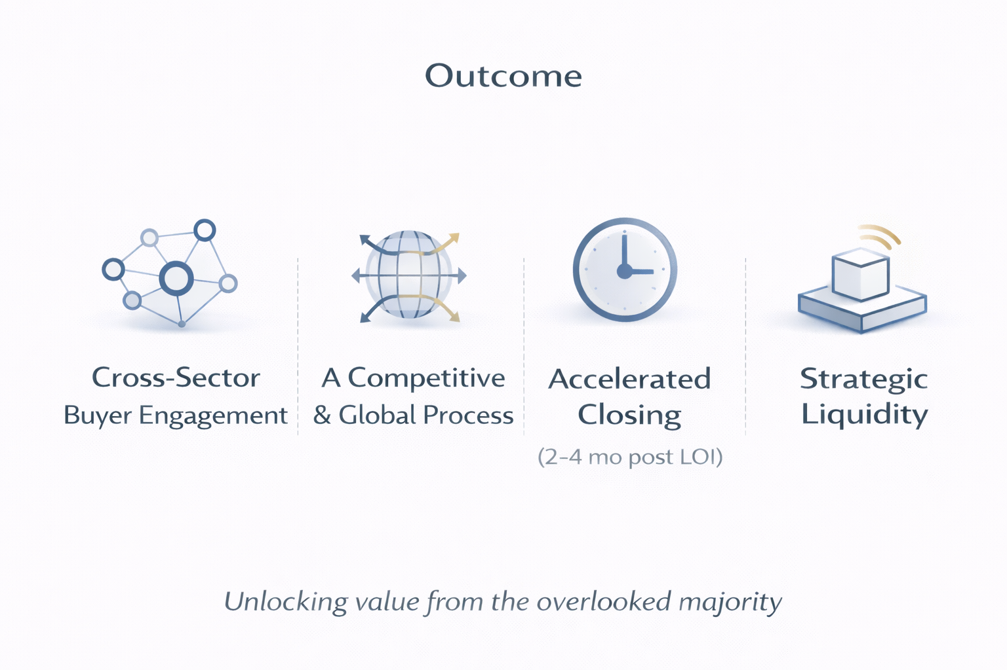
Venture Outcomes with AA 02282026

Slide 6
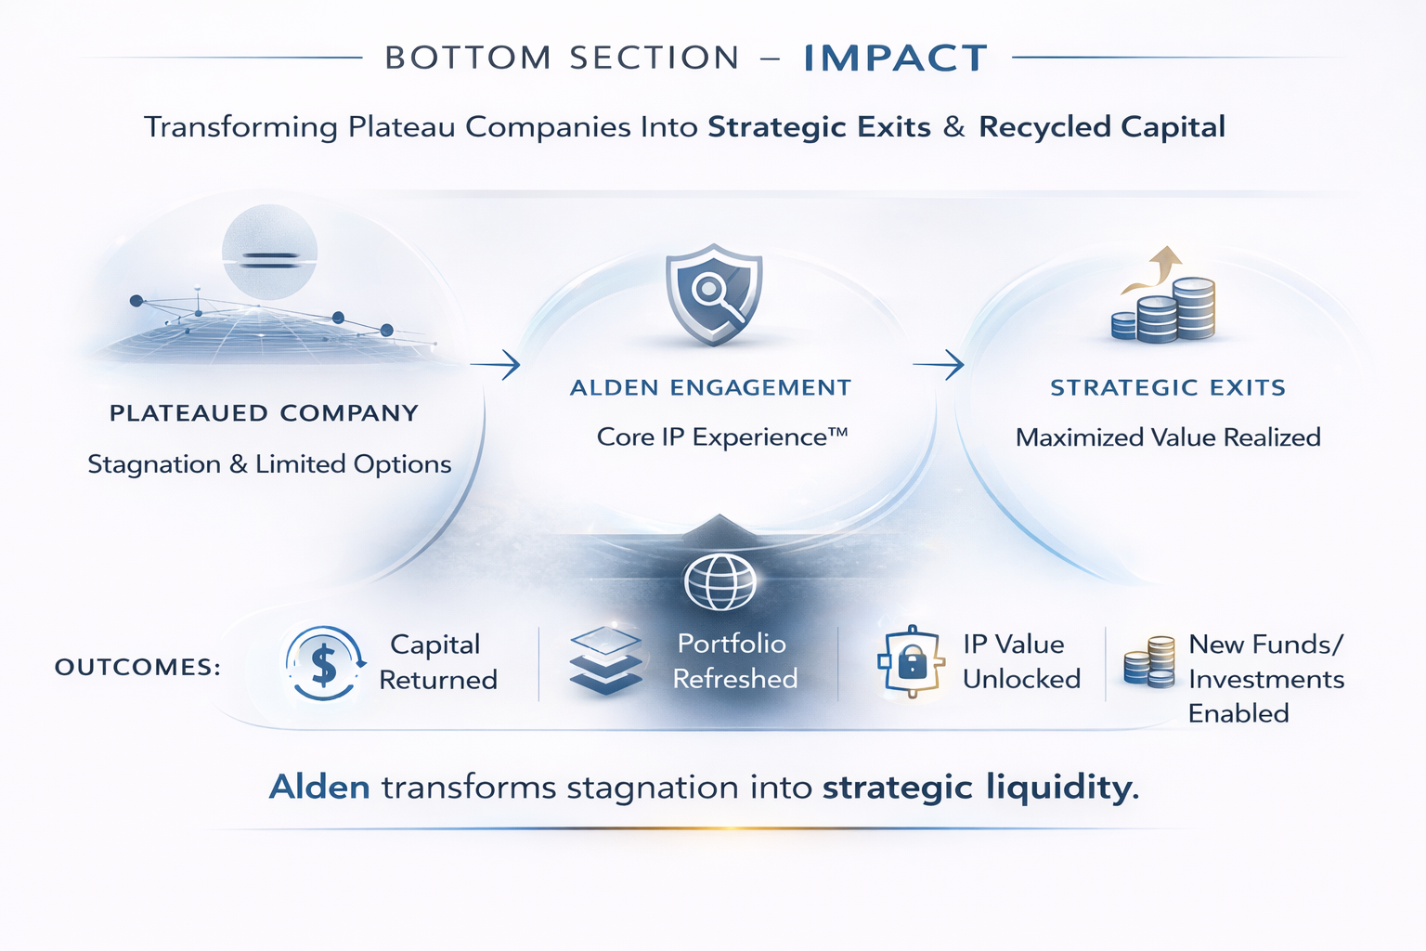
Venture outcomes Conclusion 02282026
This may not be the best image
The base image is good; the fading and shadows aren’t needed.

Slide 7
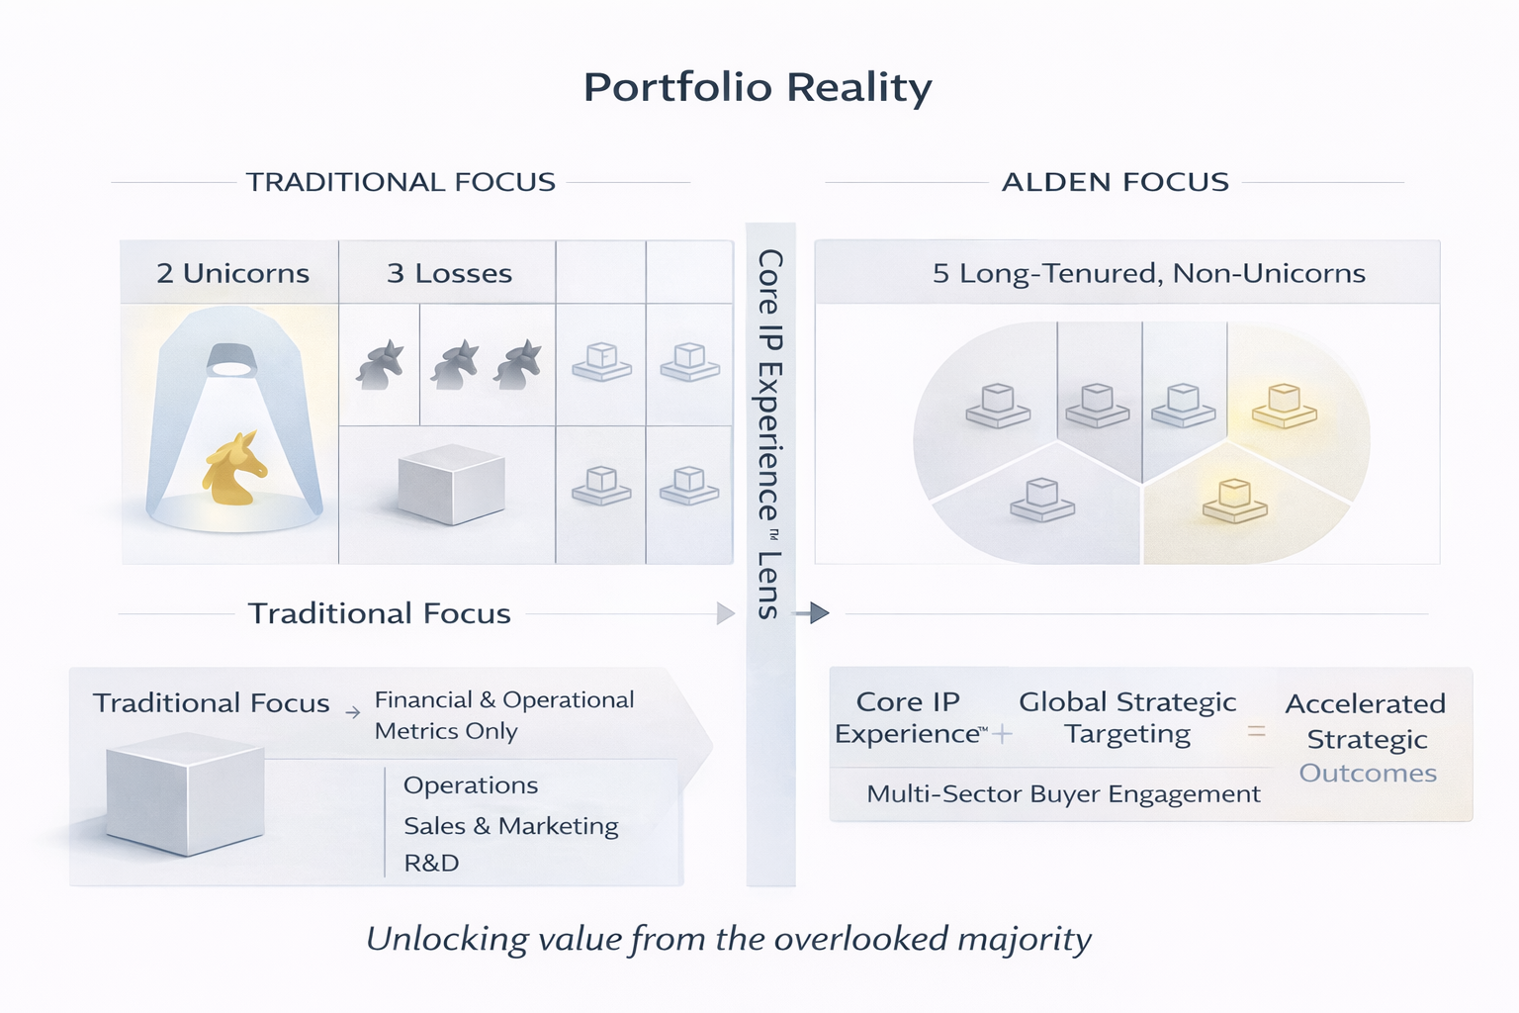
VC Portfolio Reality and AA Focus 02272026
Ideally a creative way of representing the 3 loser investments that go out of business and the 5 that are non-unicorns
This is really where the other banks focus, i.e. on the 2 unicorns
I’m not sure what this box is

Slide 8

Focus on IP Value is the Alden Advisors Difference
This is the original image and messaging that is client focused. The revised is Venture Capitalist Focused
How We Unlock Value Others Overlook
#274D7E
Core IP Experience™
Proof Point - Xterprise
(A Niche RFID Software Platform)
The distinctive customer and partner experience created by your formal and informal IP that drives real strategic and financial value.
#4C97D2
Starting point:
Xterprise, a niche RFID software vendor, initially viewed as a small tools provider.
Alden Advisors:
An IP-Led Approach
#F7F8F8
Traditional Tech I-Banks
Core IP Experience ™ Lens
Value Focus with IP
Alden’s IP lens:
Reframed around its Core IP Experience™—patented RFID workflows, proprietary data models, and deployment playbooks for large-scale asset tracking.
#7E7E7E
Economic Value of the Niche IP Experience
Economic Value of the Niche IP Experience
#242323
Value Focus
Outcome:
Attracted strategic buyers who valued the IP platform, not just revenue, leading to a competitive global process and multiple growth offers.
Niche IP Co
(Operations, Sales & Marketing, R&D)
Niche IP Co
(Operations, Sales & Marketing, R&D)
Traditional banks stop at the financials of the operating company.
We make your Core IP Experience™ central to the value story and buyer targeting.

Slide 9
#274D7E
#4C97D2
#F7F8F8
#7E7E7E
#242323

