Slide 1
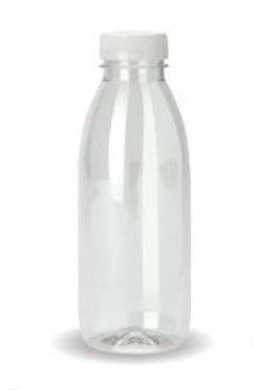






(1)
Boracay
Distributed
&
Supplied by

Slide 2
An example of earning profits:
Plastics 60% of Production : to make and supply 50,000 units of Water Bottles for Reserve Storage (b4 the daily productions allocations to shops/bars/hotels/etc)
2,200,000 tourist per year /52 wks = 42,307 per week /7days a week = 6043 people per day – 25% consumption = 4,532.25 (6043-4532 =1511 water bottlers per day)
Boracay Island consumes 1500 plastic water bottles a day from 6043 people per day
Garbage Truck picks up all recycled bins and drops to Recycling Plant
Recycling plant makes 1500 rebottled + 1500 reserve water bottles per day = 3000 bottles per recycled re-designed and re-labelled (See attachment for our Bottle logo)
3000 per day x 7 days a week = 21,000 per week @ .25c per bottle @ cost stock and sell back to shops / bars/hotels for public at 100pesos per bottle
21,000 bottles per week @ 100 pesos per bottle = $2,100,000 pesos per week converts to $35,901.77 usd per week
$35,901.77 x 52 = $2,074,892.04 usd year
$2,074,892.04 x 5 islands = $10,374,460.20 usd per year
(2)
and this is not counting the Distribution profits of Smkas Projects supplying bottles to mainland island for re-softdrink refilling with :
@ 30% chargable fee from Smkas Proejcts P/L to assist in cutting costs for Soft Drink companies bringing their costs down from China-Manila and shipping it daily to the islands of Philippines….Approximate yearly profits $10m+ per year
Glass is 35% of production
and its recyclable for 30% Chargable to Smkas Projects P/L for Bricks / Paver / Building Products Etc to Civil Constructors / Building Supplies /Gov’mt…….. Approximate yearly profits $5-$10m per year
(4) Paper / Cardboard is 5% of Production …..and non-chargeable for Charaties suchs as Schools / NGO (Full Tax Exemption)
and is 15% chargeable for Offices Supplies / Stationary /Business offices
(Reduced Tax Exemption) Approximate yearly profits… $1-3m per year
(5) And we are not counting other profits from Endorements / Government Contracting / TV Reality Show Airing / Voting Text messaging ... $5-10m+ per year
(6) Total profits from TV Reality Show creating Recycling Plant per island ….Approximate yearly profits …..$ 15m per island Recycling Plant x 5 islands = $ 75m+ usd

Slide 3
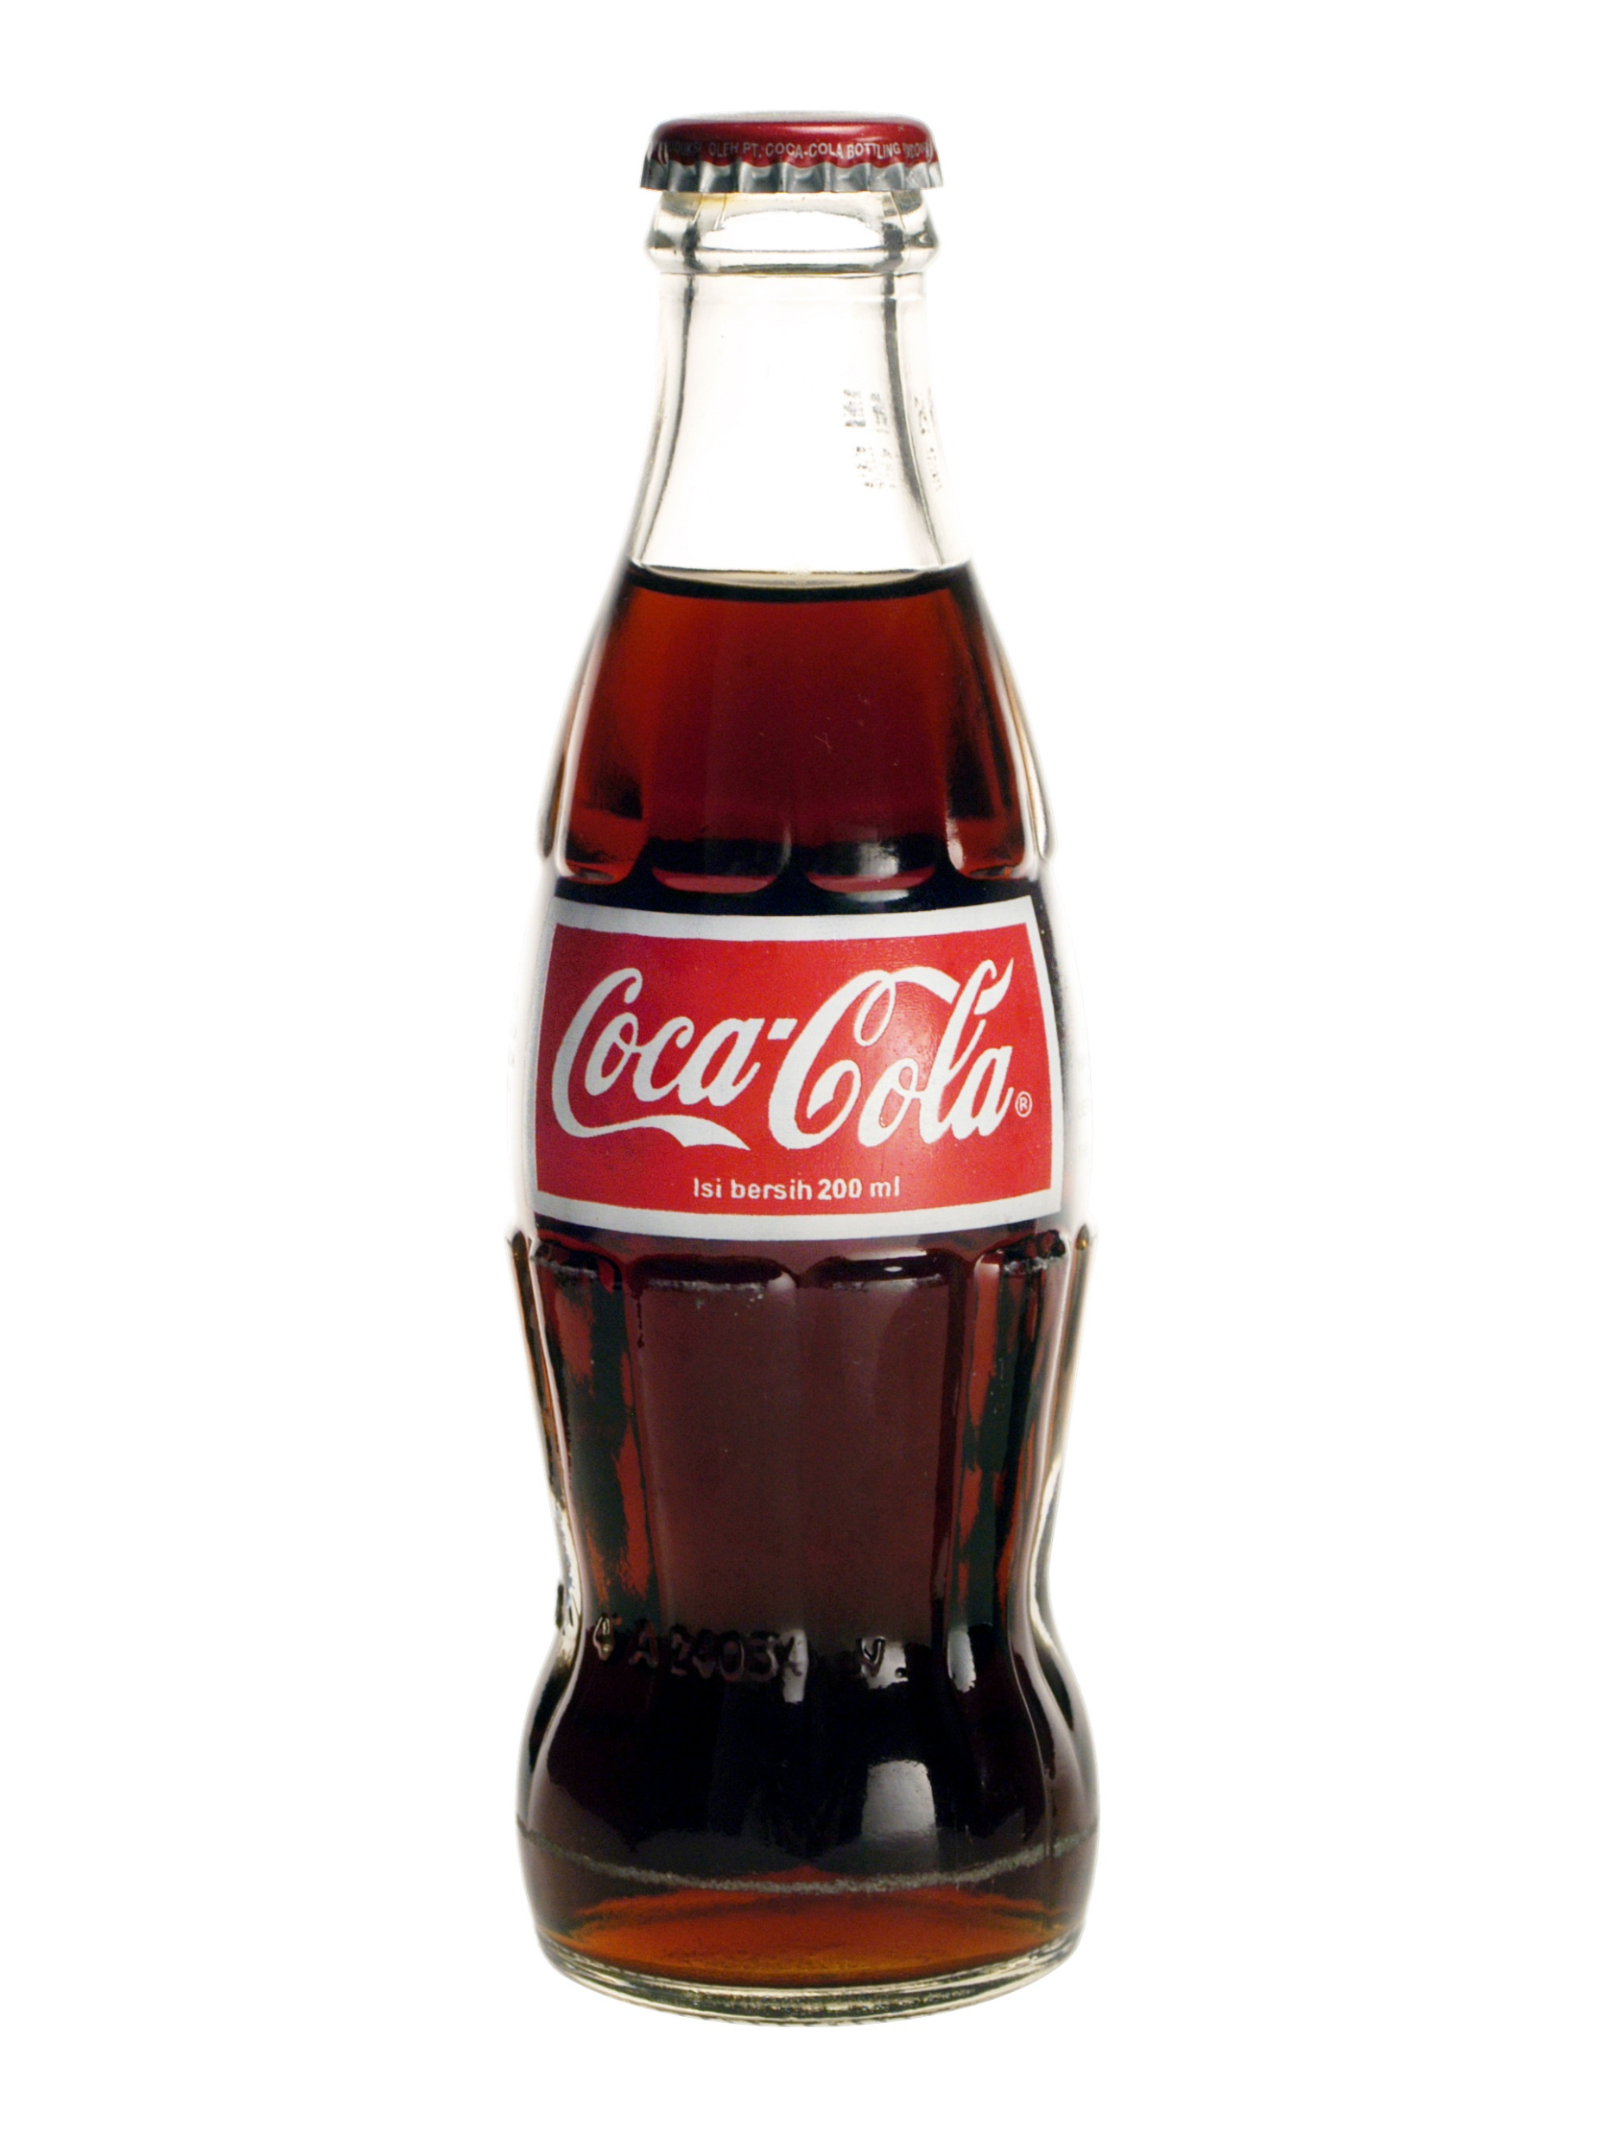
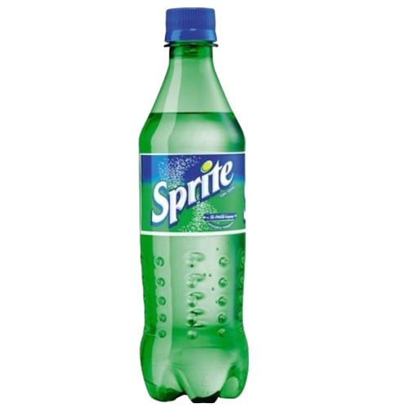
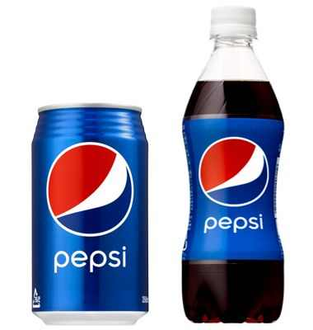
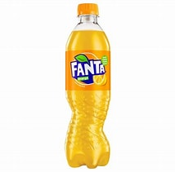
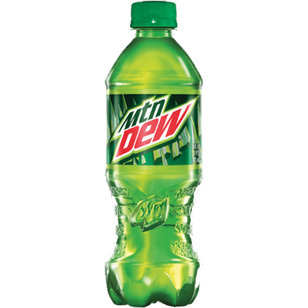
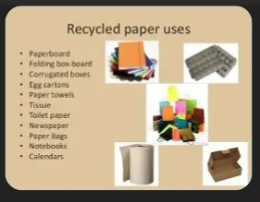

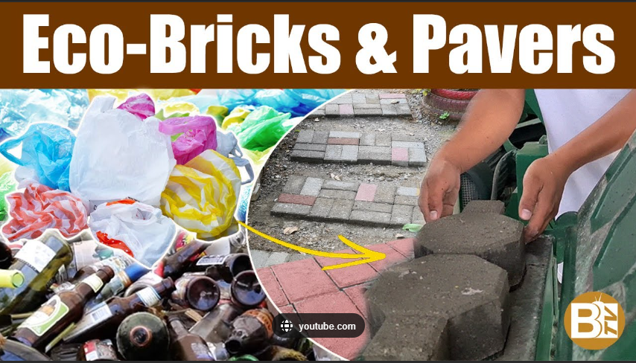
(2)
4
Truck
Boracay
Logistics
Shed
3
Boracay
Recycling Plant
2
2
Distribution
Refilling
Factory
1
375mls
Truck
1
(30%)
Water Bottles
Boracay City Centre
(Station 1/2/3)
Hotels Bars Shops
Truck
(3)
School
&
Office
Supplies
Truck
(4)
Civil Construction
Building
Suppliers
Government
Contractors

