Slide 1

Cyber Insurance the Way It Should Be

Slide 2
Executive Summary - Overview
Navasana is an Insurtech policyholder-centric cyber insurance MGA providing services to US small and middle-market organizations with revenues up to $500m. We combine disciplined underwriting with proprietary AI-enabled technology and services to help policyholders actively reduce cyber risk over time.
Founded by a team with deep expertise in cyber insurance and cybersecurity, Navasana was built to address the shortcomings of the first-wave Insurtech MGAs: static risk assessment, limited post-bind engagement, and weak feedback loops between underwriting and claims. Our platform integrates across the entire insurance lifecycle, enabling precise risk selection, continuous risk posture improvement, and streamlining the cyber claim response process.
By aligning risk transfer with risk improvement, Navasana is building a scalable, durable cyber insurance business designed to deliver sustainable performance for policyholders, distribution partners, and reinsurers.

Slide 3






FOUNDING TEAM
Manu Singh
Chief Executive
Matthew Zeier
AI/ML
Brett Anderson
Strategy
Brian Hurd
Operations
Joel Fehrman
Underwriting
Shree Atreya
Engineering
Notes:
We have an exceptionally strong team of builders and advisors
Significant career experience spent at Beazley, AIG, startups, large consultancies and tech firms
Also time spent on the inside of a number of first wave cyber MGAs, seeing firsthand what they’ve done well and where they’ve fallen short

Slide 4
‹#›
Notes:
Embedded Global TAM:
70M formal Micro-SME & SMEs in OECD Economies (under $10M in revenue)
15% participation rate in affinity groups offering embedded policy structure (e.g., already offering BOP, professional liability)
75% penetration rate with “opt-out” structure
$350 average premium for $250K limit
Open Market Global TAM: $64B
$16B GWP
25% weighted global penetration rate against all segments
Embedded US TAM:
30M formal Micro-SME & SMEs per SBA and US Census (under $10M in revenue)
15% participation rate in affinity groups offering embedded policy structure (e.g., already offering BOP, professional liability)
75% penetration rate with “opt-out” structure
$350 average premium for $250K limit
Open Market US TAM: $64B
$10B GWP
40% weighted global penetration rate against all segments

Slide 5
Executive Summary - Differentiation
Our platform, tools, services, and insurance expertise can win micro-middle market clients now and enable enterprise expansion in years 2-3.
Differentiators |  | Value Proposition
End-to-End Cyber Risk & Insurance Platform | Navasana’s platform streamlines the entire policy lifecycle, incentivizes and empowers policyholders to actively reduce their risk, and elevates brokers as trusted cyber advisors. | Policyholders mitigate and even avoid costly breaches with a clear sense of the dollar value of their efforts. Brokers win and retain more business by delivering measurable client value at the speed the market demands.
Proprietary Tools & Rapid Response | Productized cyber risk tools on-platform, plus deployable incident response experts — technology and talent when you need them. | Policyholders strengthen their security posture cost-effectively using institutional-quality tools (including AI-powered penetration testing and risk assessments). Brokers deepen client relationships by unlocking price relief and tangible security value, not just coverage.
Insurance DNA + Tech Execution | Navasana’s leadership team brings core expertise in cyber insurance underwriting and risk engineering—understanding policyholder and broker needs—paired with cybersecurity knowledge, rapid scaling capability, and proven exit success. | Policyholders work with a team that speaks both insurance and security fluently. Brokers partner with operators who understand how deals get done and business gets won.

Slide 6


Underwriting – Program Overview
Program Overview
Our Insurtech platform helps make small & medium sized businesses more secure, provides technical tools to prevent cyber events, and responds when attacks happen.

Slide 7

TECHNOLOGY & OPERATIONS STRATEGY

Slide 8
NAVASANA ADDRESSES DIGITAL RISK FROM ALL SIDES
Small-to-Medium Enterprises (SME) deserve a way to comprehensively balance their cyber risk.
How?
An AI-native platform that combines:
We have built an AI-native full stack cyber risk platform to help the SME clients:
Transfer cyber risk
Reduce losses
Reduce or reallocate cybersecurity spend
We also enable brokers to support their clients at each step of the cyber policy lifecycle.
Continuous Cyber Risk Assessment
Active Cybersecurity
Dynamic Insurance Coverage
All in one integrated solution
Notes:
1. Real-Time Cyber Risk OS (Discovery + Intelligence Layer)
Our platform continuously ingests structured and unstructured signals (endpoint data, email security posture, DNS anomalies, CVE exposure, dark web mentions). Using an ensemble of AI models, we score risks dynamically at both the organizational and vector level (e.g., “identity hygiene,” “cloud exposure”).
Think of it as: CrowdStrike-level telemetry + actuarial context.
2. Security-First Insurance Layer (Protection + Incentives)
Rather than just selling a policy, Navasana provides live security tools, vulnerability insights, and behavioral nudges. We use a “core credits” system to reward posture improvements with immediate policy adjustments, not just during renewal.
Imagine if your car insurance premium dropped because you started parking in a garage instead of on the street.
3. Cybersecurity Translation Layer (Babel Fish UX)
The vast majority of businesses don’t speak “cyber.” Navasana’s interface translates technical risk into plain language, showing CFOs and CISOs how posture maps to dollars, premiums, and incident risk. Our AI-driven assistant can explain why coverage changed, why an action matters, and what to prioritize next.
It’s what Stripe did for payments—clear, composable, and accessible.
4. Integrated Lifecycle Platform (End-to-End Workflow)
From broker submission to quote, from binding to claims, from posture improvement to renewal, the platform works as a closed-loop system:
Brokers get faster quoting and tailored risk reports.
Policyholders get a single pane of glass to track risk and coverage, plus incentives and guidance to improve their posture.
Underwriters get better signals and automation.
AI models improve with every cycle.
We’re not bolting AI onto insurance. We’re building insurance on AI.

Slide 9






PLATFORMS & DATA COLLECTED
We are currently adding API connection workflows related to identity, endpoint security, developer platforms, and cloud environments.
Identity Platforms: Google Workspace, Okta, Azure AD – User Accounts, MFA Status, Group Membership
Endpoint Security: Crowdstrike, Microsoft Defender, Cortex XDR – Device Inventory, Threat Detections
Developer Platforms: GitHub, GitLab – Access Controls, Repository Permissions, MFA Enrollment
Cloud Infrastructure: AWS, Azure, Google Cloud – IAM Roles, Resource Access, Configuration Compliance

Slide 10
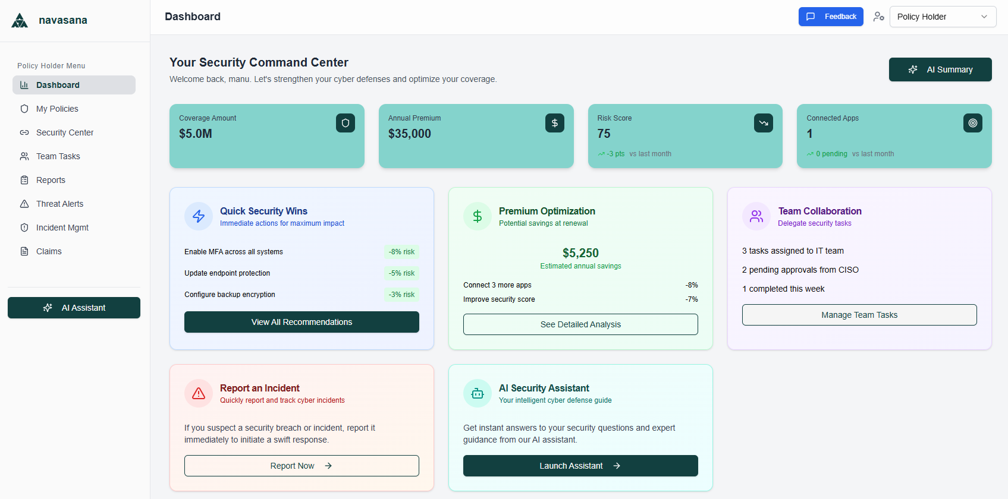
PLATFORM | Policyholder Dashboard
Our platform’s Policyholder User Interface features a dashboard designed to maximize functionality and display key metrics related to insurance coverage, risk, and security.

Slide 11
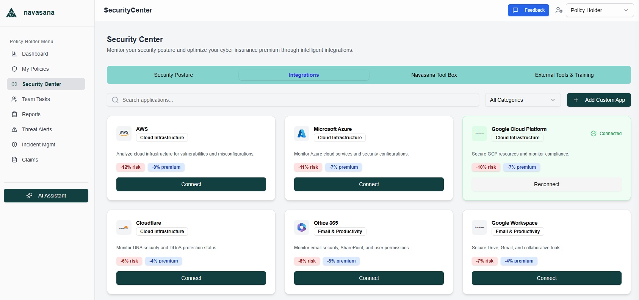
PLATFORM | Policyholder SaaS & Cloud Integrations
The Policyholder User Interface features clear incentives and click-button simplicity for policyholders to evaluate and execute read-only data integrations via API.

Slide 12
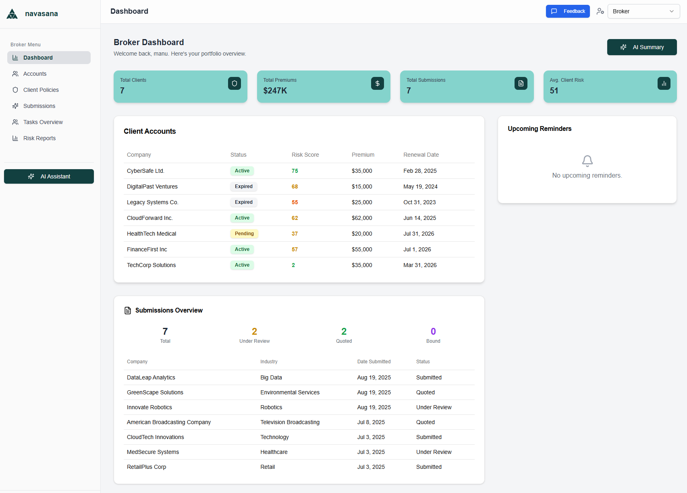
PLATFORM | Broker Dashboard
Our platform’s Broker User Interface features a dashboard designed to simplify the submission and renewal workflow and help brokers unlock more value for their customers.

Slide 13
APPENDICES

Slide 14
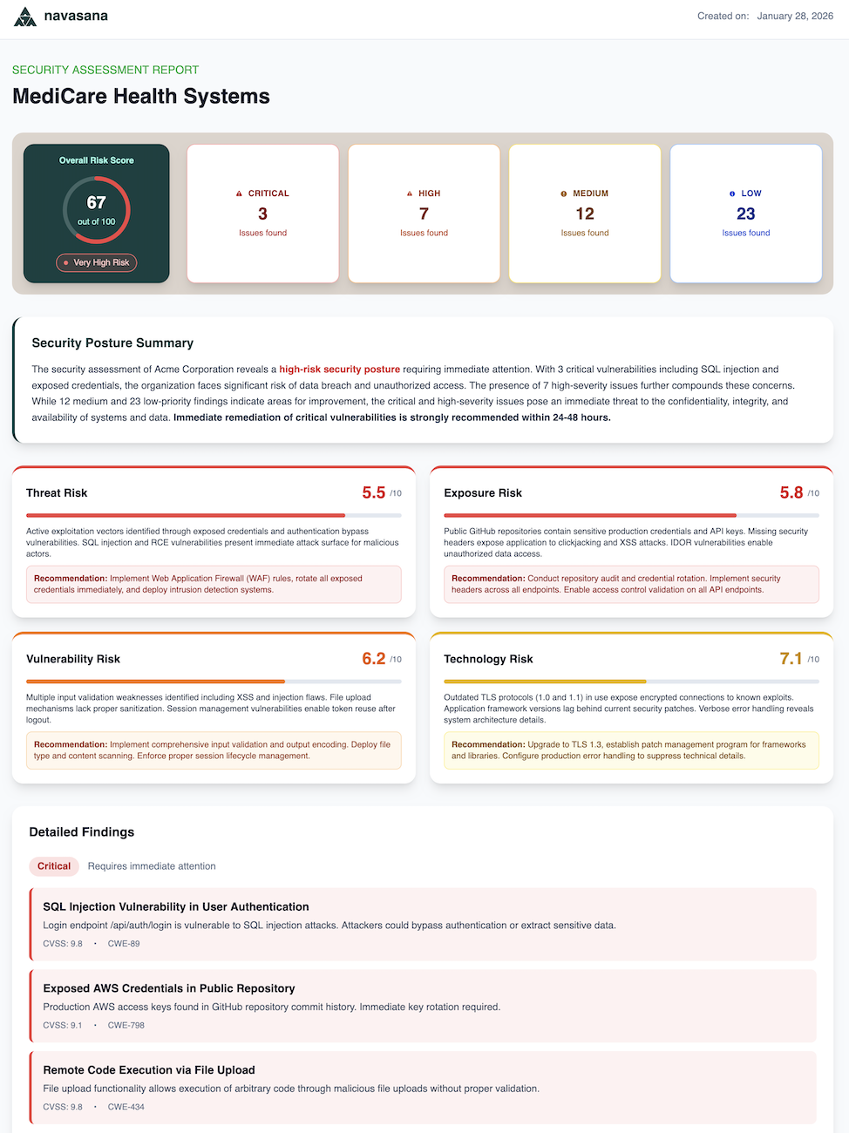
Appendix 1: Policyholder Security Assessment Report
The Security Assessment Report (“Scan”) evaluates a prospect/policyholder's external network, showing what an attacker would see
The Scan informs underwriting risk evaluation and provides feedback on cybersecurity posture
The Scan is shared with the broker at the time of quoting, helping them establish expertise with their clients and identify vulnerabilities

Slide 15
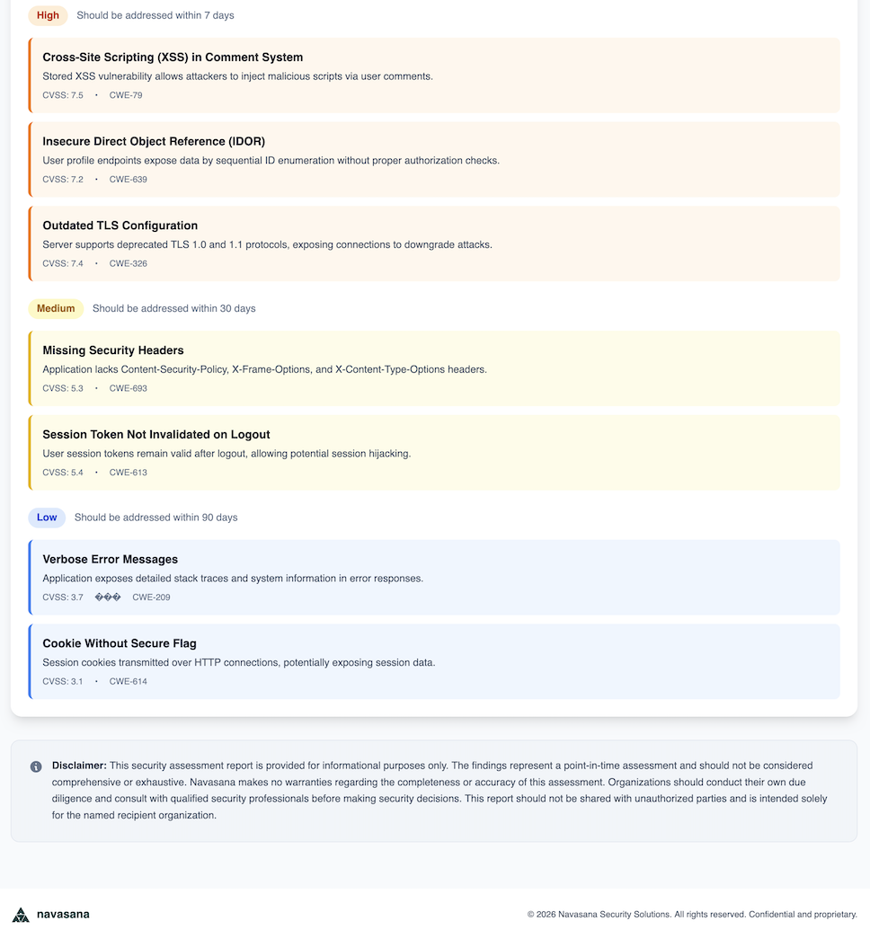
Appendix 1 (cont.):
Vulnerabilities are clearly listed in order of priority for the broker to address with their client
The overall Scan score is used to credit the best risks and debit or decline those with lagging controls or critical vulnerabilities
Prospects/policyholders who address vulnerabilities are incentivized for their improved security posture

Slide 16
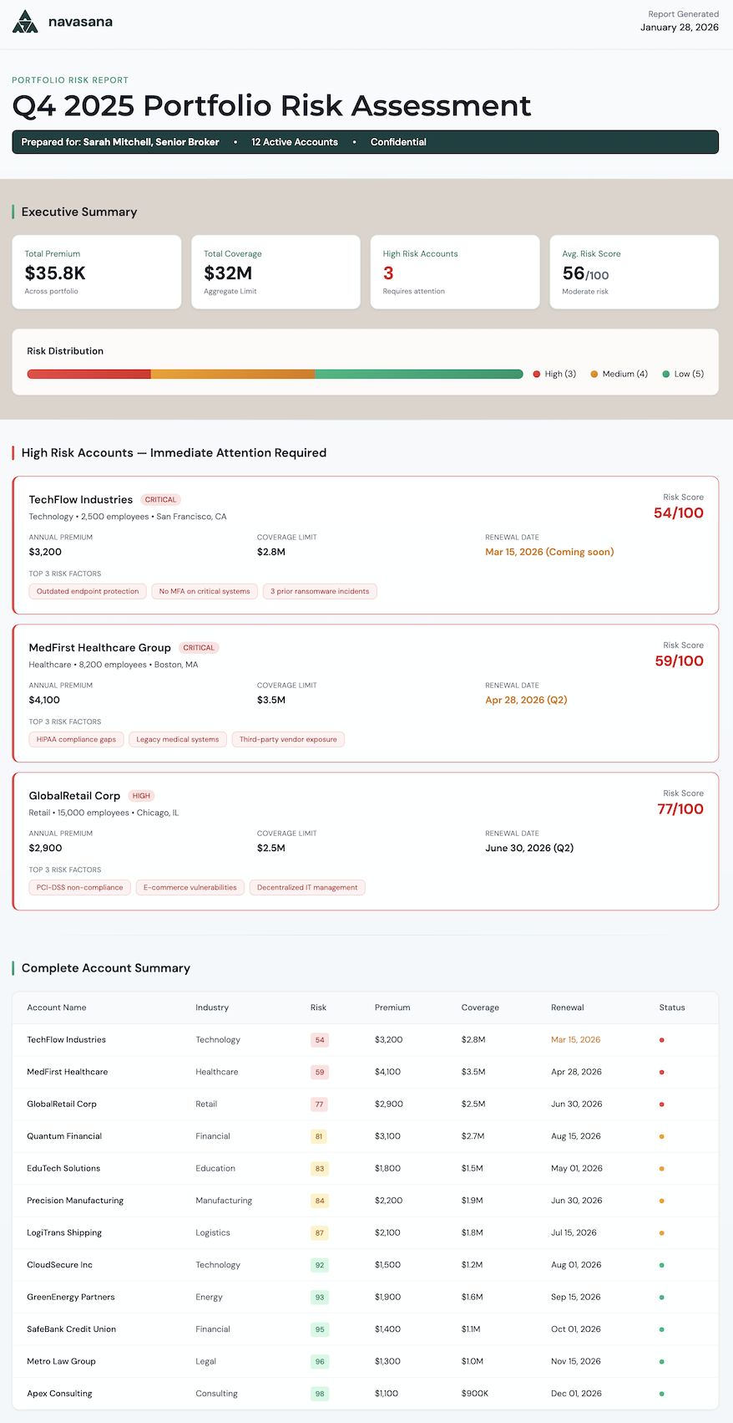
Appendix 2: Broker Portfolio Risk Report
Provides the broker with a comprehensive dashboard where they can view their full Navasana portfolio
Executive Summary shows total premium and limits, average scan score, and high risk accounts
The critical vulnerabilities pushing accounts into high risk status are detailed and marked for immediate action
Improved security posture can result in policyholder incentives that help the broker retain accounts

Slide 17
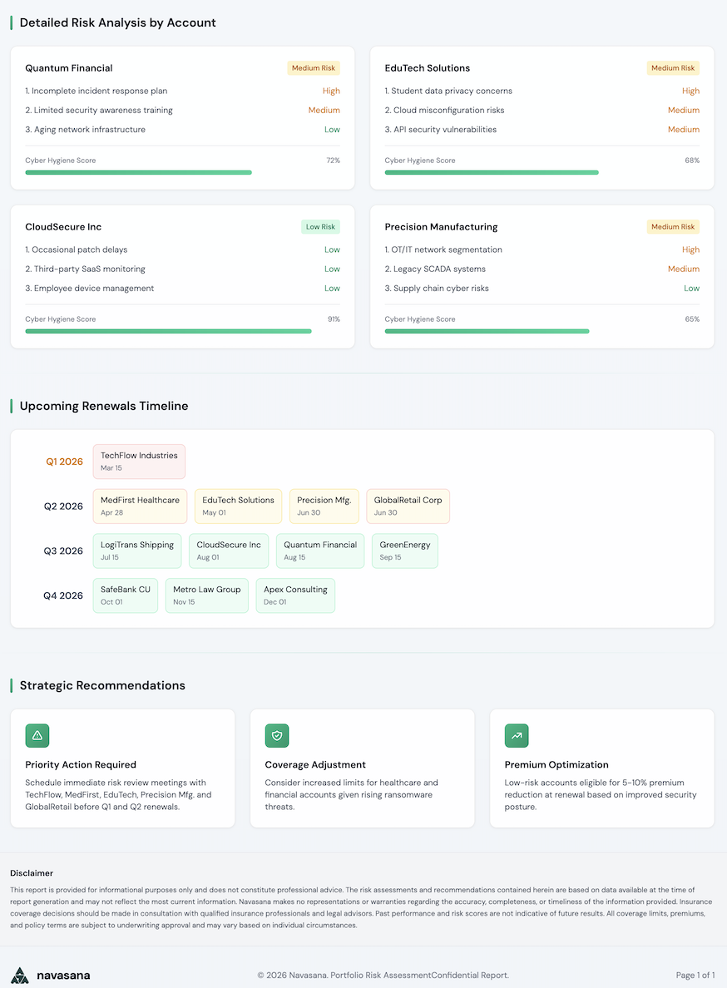
Appendix 2 (cont.):
The upcoming renewal timeline provides an at-a-glance overview of which policies the broker has renewing soon
Early outreach on renewals allows the policyholder to review their security recommendations prior to renewal quotation

