Slide 1
TN MATRS Logo

Slide 2
TN MATRS
Tennessee Materials and Advanced Technology for Recycling Solutions

Slide 3
Design Thoughts Summary
Font logo where the letters fit the state boundary profile for the state of Tennessee
Bold italics for the ‘TN in Dark Blue
Bold for the MATRS in Dark Green or Orange
Bold outline for the state boundary in Green or Orange (opposite of what the font color is for MATRS)
Font on the next page is Termina. Another bold font can be used if desired.

Slide 4
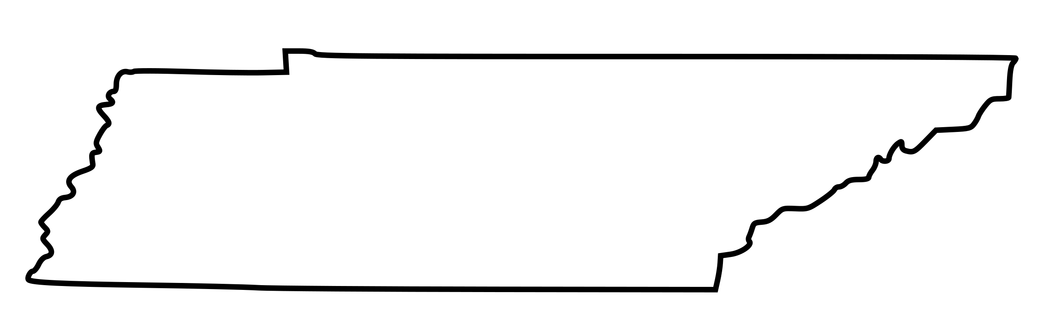



Crude example
Ideally, I’d like the Ts to cover the N & the A
T
S
R
N
The border of the state
should be dark green
and maybe a bit heavier
Also, ideally, the letters would have the same thickness, even at different sizes. There may be limits
to how well that works with the smaller letters, though.

