Slide 1

Acceleo Matemática - Grade 6
MVP Landing Page Wireframe
Dr. Gabriel Toichoa
Founder & Lead Teacher
Info@acceleomatematica.com
www.acceleomatematica.com
CONFIDENTIAL INFORMATION

Slide 2

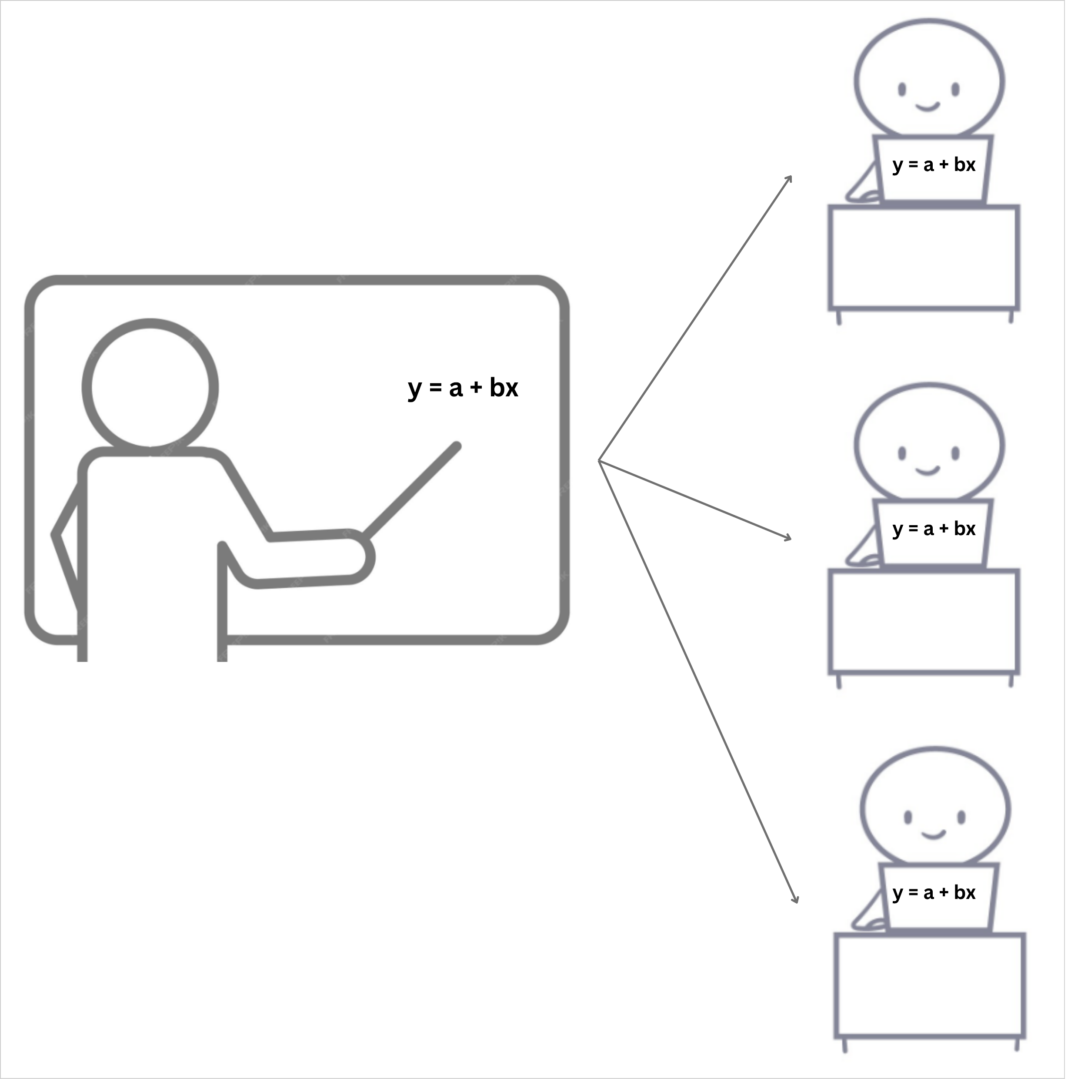
[Home]
Features
Program
Tuition
About Us
Contact Us
Register a Student
Free Consultation
Acceleo Matemática – accelerated educational outcome is a comprehensive online math curriculum teaching service for independently schooled students in grades 6 through 12 worldwide. Teaching is done through our math academy, a one-on-one, virtual adaptive classroom that uses integrated, interactive digital whiteboards for both teachers and students. Acceleo Math Academy will open its virtual doors for the first cohort of grade 6 students in September 2026.
Registration for Term One math classes opens on June 1, 2026 and closes in the middle of August 2026.
Acceleo Matemática is designed to help students from all socioeconomic backgrounds master mathematics. We teach comprehensive grade 6-12 math curricula to independently schooled students.
ACCELEO
MATH ACADEMY
90+ lessons, 20+ homework questions and answers per lesson, and 20+ assessment tests per grade program.
Online, interactive math sessions are delivered in secure virtual classrooms with integrated digital whiteboards for both teacher and student. Real-time one-on-one synchronous math sessions led by qualified experts.
We teach modular math lessons that use an incremental development methodology, grounded in continuous practice and review. Our math lessons are designed in small 1 ½-hour units, each covering a new math concept that can be taught in 20 minutes, allowing students ample time to practice the newly introduced math skills daily.
Register a Student
Free Consultation
Page 1

Slide 3
[Home]
PROFICIENCY
Making math education engaging, effective, and within everyone’s reach.
Teaching math to independently schooled students is not easy. We know the challenges:
Limited subject expertise
Struggling with advanced topics, forgotten knowledge, and specialized methods.
Ensuring conceptual understanding
Over-reliance on procedures. Bridging the “why” of math and real-world applications.
Curriculum challenges
How can I choose the right curriculum and supplementary materials? Can I successfully adapt pre-made plans?
Preparing for advanced math
Am I preparing my child for advanced math and for successfully transitioning into higher
education, skilled jobs, or entrepreneurship?
Assessment and feedback
Am I using the proper evaluation process to assess my child’s progress and identify their weaknesses? Am I providing timely feedback to my child?
Keeping math fun and engaging
Creativity struggles, gamification challenges and overcoming math fatigue.
Page 2

Slide 4
[Home]
How Acceleo Matemática Works
Teaching comprehensive math curricula to independently schooled students in grades 6-12 through secure virtual classrooms.
Pedagogical Methodology
Effective Curriculum
Innovative Lesson Design
Time-tested and proven pedagogical methodology with three pillars: (1) new math concepts built on previously taught ones; (2) daily review of earlier math concepts to increase understanding; and (3) frequent, cumulative assessments to ensure students master each math skill as new ones are added.
Standard, modular 1 ½ hour lesson workflows designed to accelerate students’ mastery of math skills and concepts.
Learn more
Virtual Classroom
Personalized Whiteboards
Interactive Sessions
Every student gets an individual digital whiteboard, where they can draw, write text and equations, work on practice problems, homework, and tests. The students only see the teacher and their whiteboard.
Engage with dynamic content, real-time problem solving and feedback, and interactive tools that make math concepts come alive.
Page 3

Slide 5
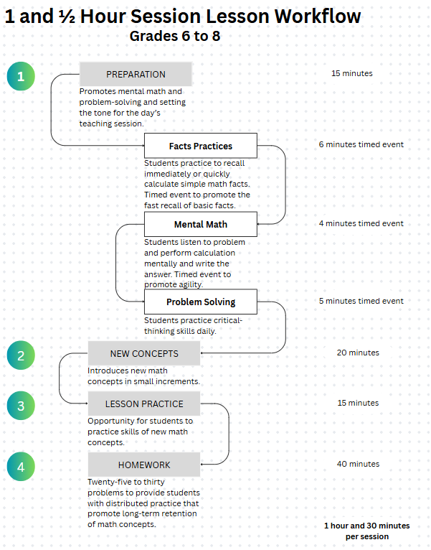
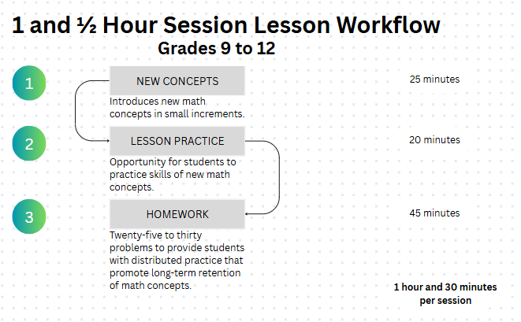
[Home]
Innovative Lesson Design
Free Consultation
Page 4

Slide 6
[Features]
Why Choose Acceleo Matemática?
Innovative approach to teaching mathematics makes learning engaging, effective and accessible to all.
Engagement and Mastery
Curriculum + Virtual Classroom
We are invested in your child's long-term success. We are not a tutoring service that provides a patchwork of sessions without a clear vision or goal. We are a complete online math curriculum and virtual classroom teaching service. We aim to have your child master mathematics, build their confidence, problem-solving skills, and love of learning.
We teach comprehensive grade 6-12 math curricula each containing over 90 complete lessons per grade program through secure virtual classrooms.
Incremental Development
Frequent Assessments
We teach math lessons designed in sequential modules using an incremental development methodology, grounded in continuous practice and review.
Access to over twenty cumulative tests per grade. Tests are scheduled so that students have 5 days to practice the concepts before being assessed. Each test comes with a Facts Practice given at the beginning.
Page 5

Slide 7
[Features]
Modular Math Lessons
Flexible Scheduling
Our lessons are designed for 1 ½-hour sessions, each covering a new math concept that can be taught in 20 minutes, allowing students ample time to practice the newly introduced math skills daily.
Book sessions for your child at times that work for you, with consistent time slots and terms to accommodate any schedule.
Learn more
Progress Tracking
Qualified Expert
Monitor your child’s improvement with detailed analytics and regular progress reports.
Your child will learn from a former university professor and math educator with years of experience in teaching and a passion for student success.
Page 6

Slide 8
[Features]
Modular Math Lessons
Module 1: Preparation
(15 minutes)
Acceleo Matemática’s lessons/sessions are designed in small, one-and-a-half-hour units, each covering a new math concept that can be taught in twenty minutes. This allows students ample time to practice the newly introduced mathematical skills daily.
This time-tested and proven pedagogical methodology has three pillars: (1) new math skills built on previously taught ones; (2) daily review of earlier math concepts to increase understanding; and (3) frequent, cumulative assessments to ensure students master each math skill as new ones are added.
As a result, our middle school and high school math curricula help students become more confident, more willing to learn math, and ultimately more successful in their educational journeys and lives.
Prep is the first module at the beginning of all grade 6-8 lessons/sessions. It promotes mental math and problem-solving and sets the tone for the day’s teaching session. It consists of three activities:
1.1 Facts Practices
(6 minutes)
1.2 Mental Math
(4 minutes)
1.3 Problem Solving
(5 minutes)
Students practice to recall immediately or quickly calculate simple math facts (+, -, x, ./.). Timed activity to promote the fast recall of basic math facts.
Students listen to a problem and perform calculation mentally and write the answer. Timed activity to promote agility.
Students practice critical-thinking skills daily.
Module 2: New Concepts
(20 min)
Module 3: Lesson Practices
(15 min)
Module 4: Homework
(40 min)
This module introduces the new math concept in small increments.
This module provides students with opportunities to practice the skills associated with new math concepts.
This module presents math problems to give students distributed practice, promoting the long-term retention of math concepts.
Page 7

Slide 9
[Features]
Class Session Schedule
Acceleo Math Academy class sessions are offered Monday through Friday each week for a six-month term. The school year at Acceleo Math Academy consists of a six-month term: Term 1, from September to February, and Term 2, from March to August. Students can register for only one term per grade.
Math class sessions are offered in seven different sections or slots per day. These sections are made available on a first-come, first-served basis. Once the first student is registered in a section, that section is open only to 9 more students in the same grade as the first, for a maximum of 10 students per section.
This class scheduling process reinforces Acceleo Matemática’s structured approach for teaching mathematics.
Academic Terms
Class Sections
TERM 1: September through February
Monday | Tuesday | Wednesday | Thursday | Friday
7:00 am to 8:30 am | 7:00 am to 8:30 am | 7:00 am to 8:30 am | 7:00 am to 8:30 am | 7:00 am to 8:30 am
9:00 am to 10:30 am | 9:00 am to 10:30 am | 9:00 am to 10:30 am | 9:00 am to 10:30 am | 9:00 am to 10:30 am
11:00 am to 12:30 pm | 11:00 am to 12:30 pm | 11:00 am to 12:30 pm | 11:00 am to 12:30 pm | 11:00 am to 12:30 pm
1:00 pm to 2:30 pm | 1:00 pm to 2:30 pm | 1:00 pm to 2:30 pm | 1:00 pm to 2:30 pm | 1:00 pm to 2:30 pm
3:00 pm to 4:30 pm | 3:00 pm to 4:30 pm | 3:00 pm to 4:30 pm | 3:00 pm to 4:30 pm | 3:00 pm to 4:30 pm
5:00 pm to 6:30 pm | 5:00 pm to 6:30 pm | 5:00 pm to 6:30 pm | 5:00 pm to 6:30 pm | 5:00 pm to 6:30 pm
7:00 pm To 8:30 pm | 7:00 pm To 8:30 pm | 7:00 pm To 8:30 pm | 7:00 pm To 8:30 pm | 7:00 pm To 8:30 pm
Section 1
TERM 2: March through August
Section 2
Section 3
Section 4
Section 5
Section 6
Section 7
Free Consultation
Page 8

Slide 10

[Program]
Our Math Program
Comprehensive curricula designed to build strong mathematical foundations and mastery
Grade 6 math curriculum
In Grade 6 Math, students will explore exciting ways to work with numbers, shapes, and patterns. They’ll learn how to use math to solve real-life problems, think logically, and explain their ideas clearly. We’ll dive into topics like fractions, decimals, percentages, geometry, data, and even a bit of algebra. This course focuses on building student confidence, trying new strategies, and exploring how math connects to the world around them.
Comparing Whole Numbers
Missing Addens
Greatest Common Factor (GCF)
Dividing by Two-Digit Numbers
Problems with No Solutions or Many Solutions
Learn More
Page 9

Slide 11
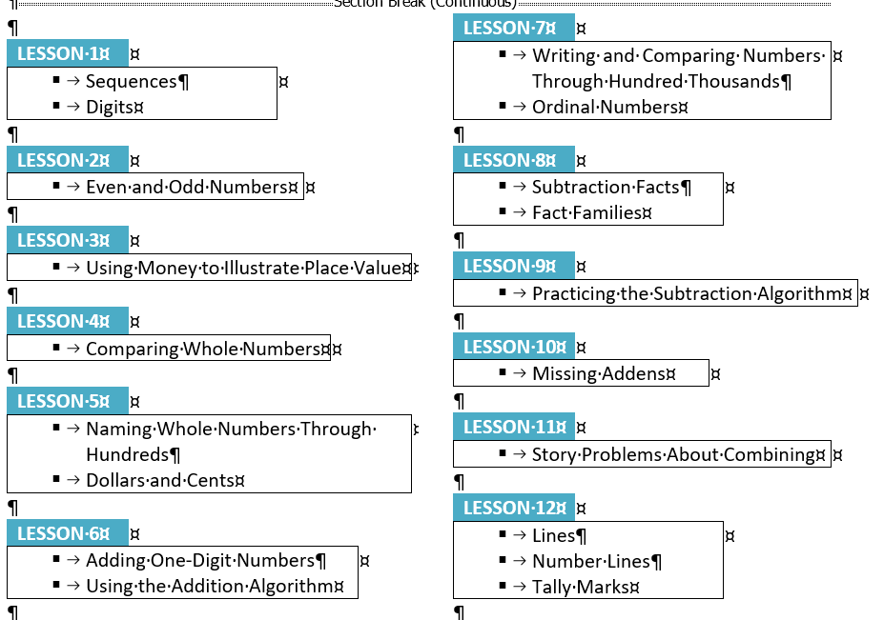
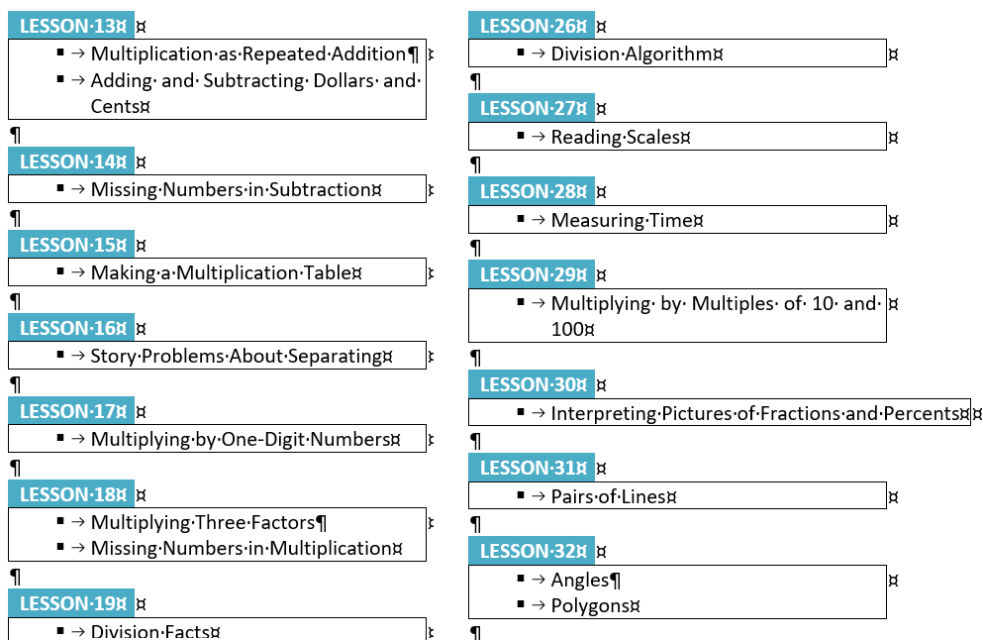
[Program]
Grade 6 math curriculum – Learn More
LESSONS
Page 10

Slide 12
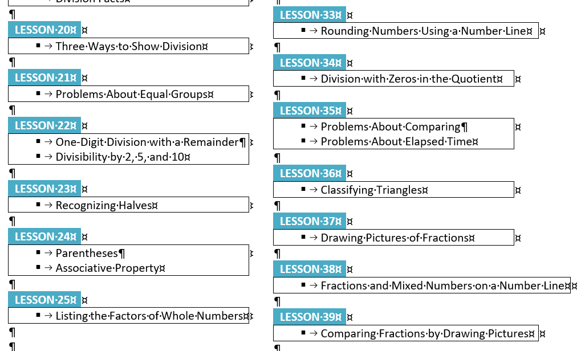
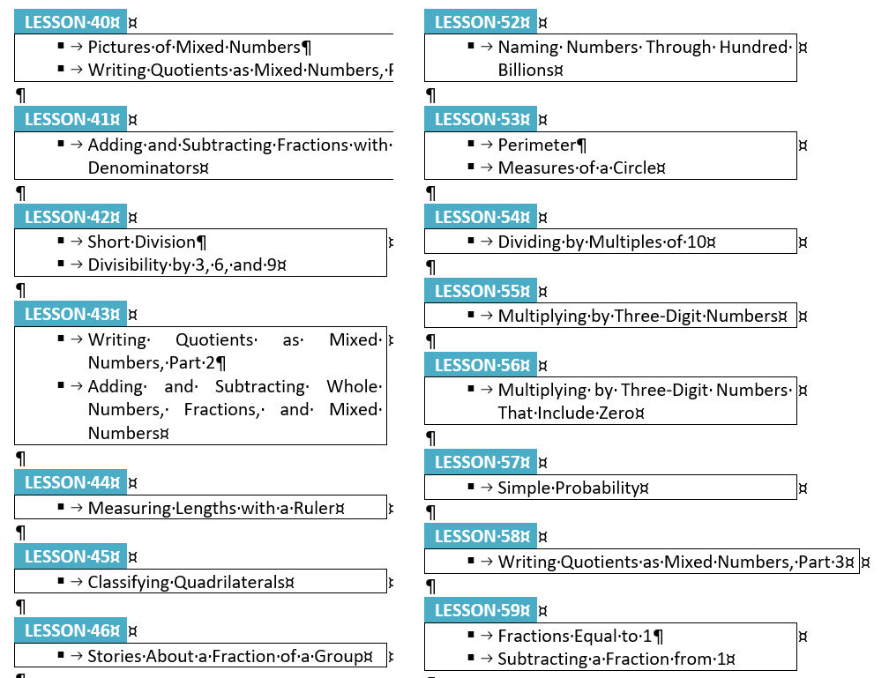
[Program]
Page 11

Slide 13
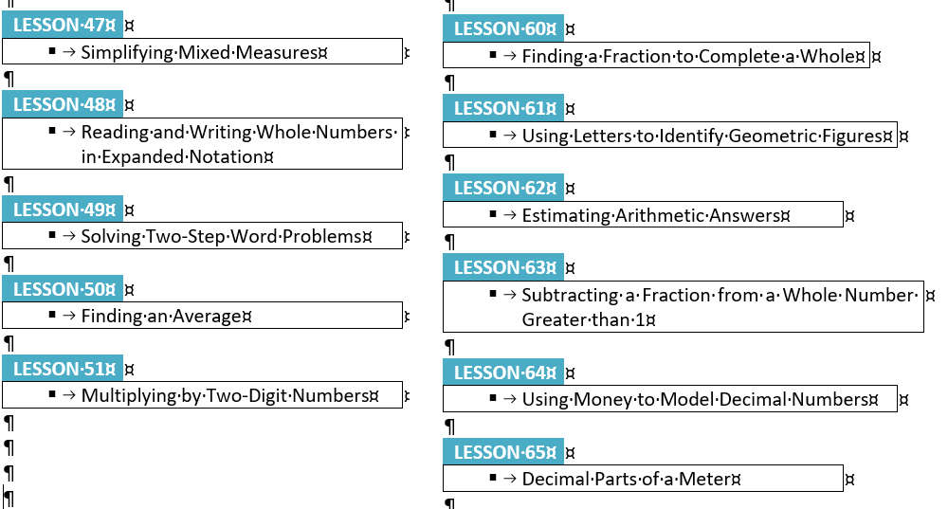
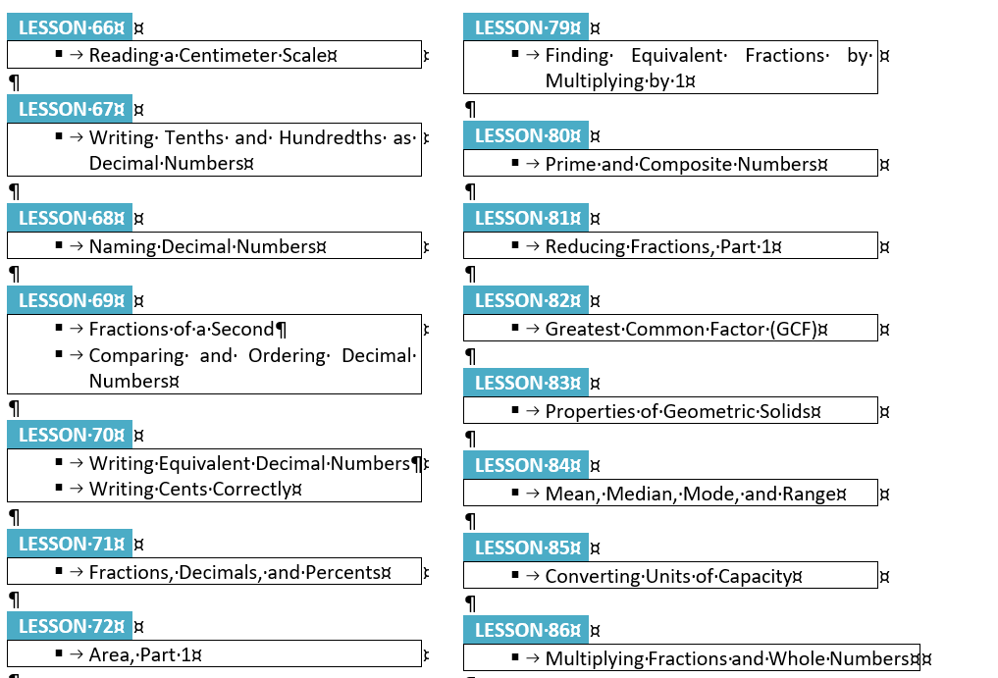
[Program]
Page 12

Slide 14
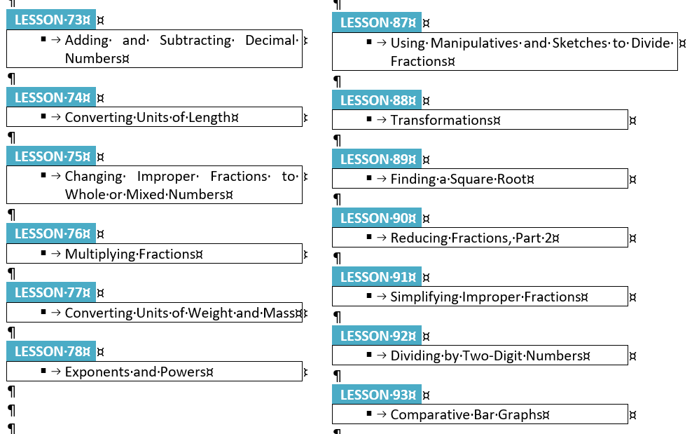
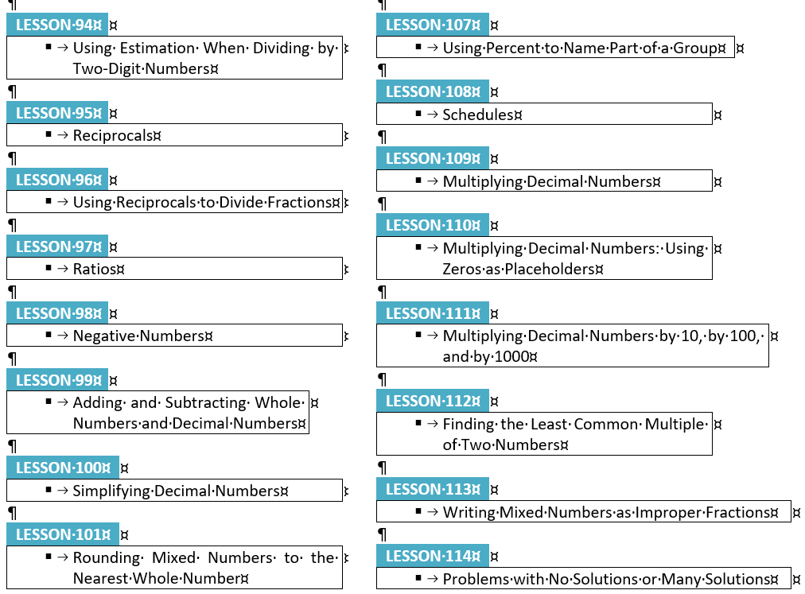
[Program]
Page 13

Slide 15
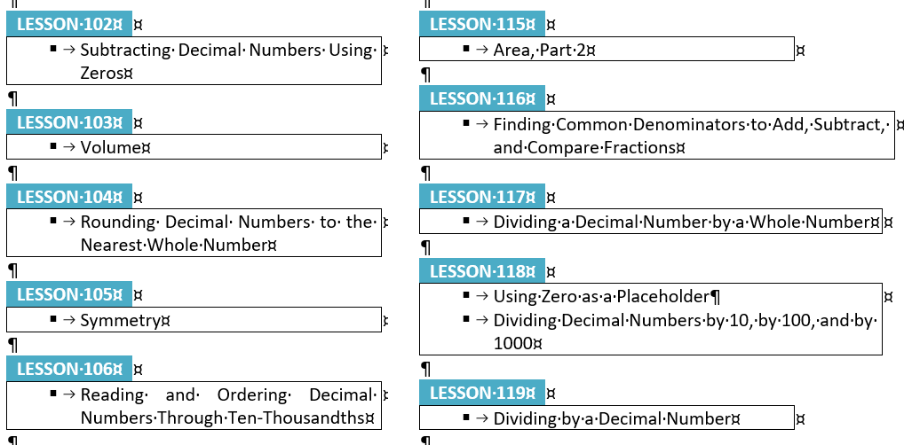
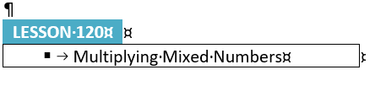
[Program]
Page 14

Slide 16
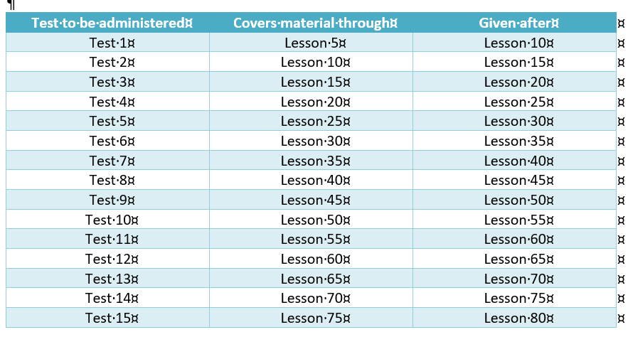
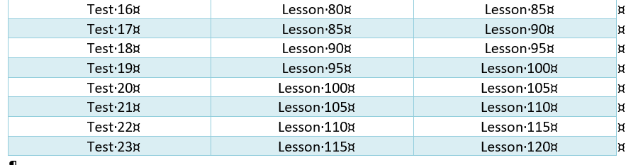
[Program]
Grade 6 math curriculum – Learn More
TESTING SCHEDULE
Free Consultation
Page 15

Slide 17
[Tuition]
Simple, Transparent Pricing
Acceleo Matemática’s tuition fees cover the entire grade curriculum for a six-month term (Term 1: September to February or Term 2: March to August).
Monthly billing
Term billing
Grade 6 (six-month Term)
Dive into topics like fractions, decimals, percentages, geometry, data, and even a bit of algebra.
CAN
USD
$30 / session
Billed monthly as $600 0r per term as $3,600
Register a Student
WHAT’S INCLUDED
120 complete lessons
5 lessons/sessions per week
1 ½ hour session per lesson
4 standard modules per lesson: Preparation (Facts Practice, Mental Math, and Problem Solving); New Concepts; Lesson Practice; and Homework.
25 homework questions and answers per lesson
23 cumulative tests with 20 questions and answers
Page 16

Slide 18
[Tuition]
PDF copies of all lessons
1 end-of-term report card
1 day per week office hours for students and/or guardians’ questions
6 monthly performance tracking reports
Free Consultation
Page 17

Slide 19
[ABOUT]
About Us
Why We Created Acceleo Matemática
Our vision with Acceleo Matemática is to create a world where all children, regardless of background or community, have equal opportunity to excel in mathematics in middle and high school. We believe that mastery of mathematics is the key to success in middle school and high school, and our approach is designed to make this mastery accessible to all. We want to inspire every student to reach their full potential in math, regardless of their starting point, and we invite you to join us in this mission.
Acceleo Matemática is a comprehensive online math curriculum teaching service for students in grades 6 through 12 worldwide. Teaching is done through our math academy, a one-on-one, virtual adaptive classroom that uses integrated, interactive digital whiteboards for both teachers and students, with a standard modular lesson workflow for mastering math. Acceleo Matemática is designed to help students from all socioeconomic backgrounds master mathematics.
Page 20

Slide 20
[ABOUT]
Value Proposition
Acceleo Matemática offers time-tested, comprehensive curricula designed to help students master mathematics skills. Over one hundred lessons per grade are delivered in one-and-a-half-hour, one-on-one online teaching sessions.
Acceleo Matemática offers modular lesson plans that enable students to learn new math concepts and practice math skills on a cumulative basis each day. This novel pedagogical approach includes frequent and cumulative assessments to ensure students master each math skill as new ones are taught.
Acceleo Matemática delivers a pedagogical approach for rapid mastery of mathematical concepts and skills. Grades 6 to 12 math lessons are taught online through one-and-a-half-hour teaching sessions, divided into small modules. Engaging teaching sessions are structured to provide the discipline and consistency required to master a STEM subject like mathematics.
Acceleo Matemática offers a flexible and affordable tuition plan for registering in its comprehensive math curricula. Curricula are developed and taught by experienced and highly qualified individuals holding master's and doctoral degrees.
Page 21

Slide 21
[ABOUT]
Dr. Gabriel Toichoa
Founder and Lead Teacher
Dr. Gabriel Toichoa is a dedicated and values-driven educator with extensive experience teaching mathematics at the elementary, high school, and university levels. He is passionate about helping students understand and appreciate mathematics through clear explanations, patience, and a supportive learning environment. With strong values and a commitment to fostering student character, confidence, and curiosity. He has over 20 years of professional leadership experience, bringing strong communication, problem-solving, and mentoring skills to the classroom.
For nearly two decades, Dr. Toichoa have taught mathematics to his own children in a homeschooled program while also tutoring other high school students in algebra, geometry, trigonometry, and calculus. These experiences have strengthened his ability to explain complex concepts with patience and clarity, adapt lessons to individual learning needs, and foster a positive, encouraging environment for young learners. His earlier academic experience as an Assistant Professor further shaped his instructional approach, emphasizing conceptual understanding, analytical reasoning, and student engagement.
Throughout Dr. Toichoa’s professional career, which has included senior leadership roles in analytics, education systems, and technology, he has consistently leveraged his expertise to teach, mentor, and support teams. Whether guiding analysts, developing learning frameworks, or explaining technical ideas to non-technical audiences, teaching has remained central to his work. Dr. Toichoa is a strong communicator with a calm, supportive presence and the ability to inspire confidence in learners of all ages.
An educator at heart, Dr. Toichoa values compassion, integrity, and service. He believes that teaching mathematics is not only about developing skills but also about cultivating perseverance, curiosity, and a sense of wonder.
Free Consultation
Page 22

Slide 22
[Contact Us]
CONTACT
Infor@acceleomatematica.com
+1 780-394-2335
www.acceleomatematica.com
We are a complete online math curriculum and virtual classroom teaching service. We are invested in the long-term success of all students. We aim to help students master mathematics, build their confidence, problem-solving skills, and love of learning.
Free Consultation
© 2025 Acceleo Matemática
Page 23

Slide 23
[Register a Student]
Register a Student
Acceleo Math Academy
Parent/Guardian Information
Full Name (Parent/Guardian)
Email Address
Phone Number
Relationship to Student
Mother
v
{Mother, Father, Legal Guardian, Other]
Preferred Language of Communications
City/Country
English v
Edmonton/Canada v
{English, Spanish}
Page 24

Slide 24
[Register a Student]
Student Enrollment Details
Full Name (Student)
Date of Birth
Current Schooling
Grade Registering For
Home Schooling
Grade 6
v
v
{Home Schooling, Public School, Private School}
{Grade 6, Grade 7, Grade 8, Grade 9, Grade 10, Grade 11, Grade 12}
Preferred Term
Preferred Schedule
Term 1: September to February
M-Th SLOT 1 7:00 am to 8:30 am
v
v
{Term 1: September to February, Term 2: March to August }
{M-Th SLOT 1 7:00 am to 8:30 am; M-Th SLOT 2 9:00 am to 10:30 am}; M-Th SLOT 3 11:00 am to 12:30 pm; M-Th SLOT 4 1:00 pm to 2:30 pm; M-Th SLOT 5 3:00 pm to 4:30 pm; M-Th SLOT 6 5 pm to 6:30 pm; M-Th SLOT 7 7:00 pm to 8:30 pm]
Consent and Policies
I agree to the Terms of Service and Privacy Policy.
I authorize the use of anonymized student performance data for educational improvement.
I consent to my child participating in online learning sessions through Acceleo Math Academy.
Page 25

Slide 25
[Register a Student]
Register Student
You will receive a confirmation email with your registration details and next steps.
Other design feature:
Progress bar (if the form spans multiple steps).
Confirmation modal or success page with a summary and “Add Another Student” option.
Page 26

Slide 26
[Free Consultation]
Free Consultation
Fill out the form to request a free consultation call or virtual meeting to learn more about Acceleo Math Academy, programs, and the registration process.
Parent/Guardian Information
Full Name (Parent/Guardian)
Email Address
Phone Number
Best Time to Contact You
Morning (8 AM - - 12 PM)
v
{Morning (8 AM – 12 PM), Afternoon (12 PM – 4 PM), Evening (4 PM – 8 PM)]
Preferred Language of Communications
Child’s Current Grade
English v
Grade 6 v
{English, Spanish}
{Grade 6, Grade 7, Grade 8, Grade 9, Grade 10, Grade 11, Grade 12}
Page 27

Slide 27

[Free Consultation]
Consultation Preferences
Preferred Consultation Type
Preferred Time
Virtual Meeting
(Zoo / Google Meet / WhatsApp)
[time picker]
v
Phone Call
Preferred Date
[date picker]
Additional Questions or Comments
v
[text area]
I agree to be contacted by Acceleo Math Academy regarding program information and enrollment opportunities.
I agree to the Privacy Policy.
Book My Free Consultation
Page 28

Slide 28
[Free Consultation]
Thank you for your interest! Our team will contact you shortly to confirm your consultation time and address any questions you may have.
Other design feature:
Progress Indicator (if multi-step)
Auto-calendar Integration (for scheduling directly)
“Learn More Before Booking” link opens info about programs
Page 29

