Slide 1

Need: modern slide that identifies our brand as cloud & digitial & Asian HQ
Everyone Talks about Cloud & Digital Transformation
We do it differently

Slide 2
Consulting Services Offerings 12 Dec 2025
Need: Better Title Page

Slide 3
Discussion Topics
Need: Some type of agenda slide for each section we create
Branding
Offerings
Competitor Market
Organizational Structure
People Development
Timeline
Budget

Slide 4

Public Cloud is our Focus
Need: Heading with text slides – larger fonts rather than lots of text
All Icon’s Services encompasses Public Cloud S/4
We focus on the journey to achieve digital transformation on the cloud
S/4 Hana Public Cloud is the central backbone
Our focus is on APAC and EMEA
Our free assessments provide insights into your key challenges to move to the cloud
We transform your business processes to standardize on core S/4

Slide 5
Cloud Assessments & Advisory Services
Need: Some type of visual to build our services (8 tiers)
ROI Realization
Business Transformation
Design Authority
Architecture & Transition State
Data Strategy & Governance
Operational Stability & Efficiencency
Operational Stability

Slide 6
Cloud Assessments & Advisory Services
Need: Some type of table format. This is a table will match slide 5
Description | Who | Q1 | Q2 | Q3 | Q4
Project Startup (Internal) | Siewyoong
Operational Stability & Efficiency (LeanIX / AMS/ Test) | Nikhil
Threat Assessment & Security | Mark
Discovery / Process Mapping / Optimization | Alex
Data Strategy & Governance | Chait
Enterprise Architecture & Transition State | Jon
Design Authority – SAP | Graham
Business Transformation – Finance | Graham
Business Transformation – Logistics | Jon, Hayato
ROI Realization / Board Level Advisory | CH, Mok

Slide 7
Model for Each Country
Need: Some type of org chart that is different than std powerpoint options
Managing Director
HR Advisor
Sr Project Director
Finance Business Architect
Supply Chain Architect
Experts

Slide 8
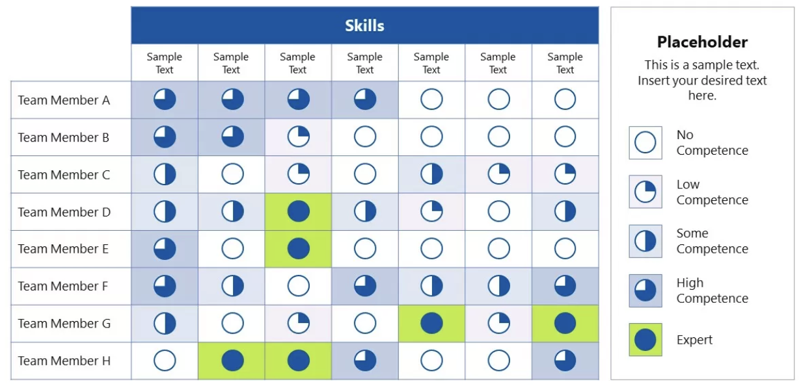
Skills Matrix
Need: Modern table with Harvey balls

Slide 9
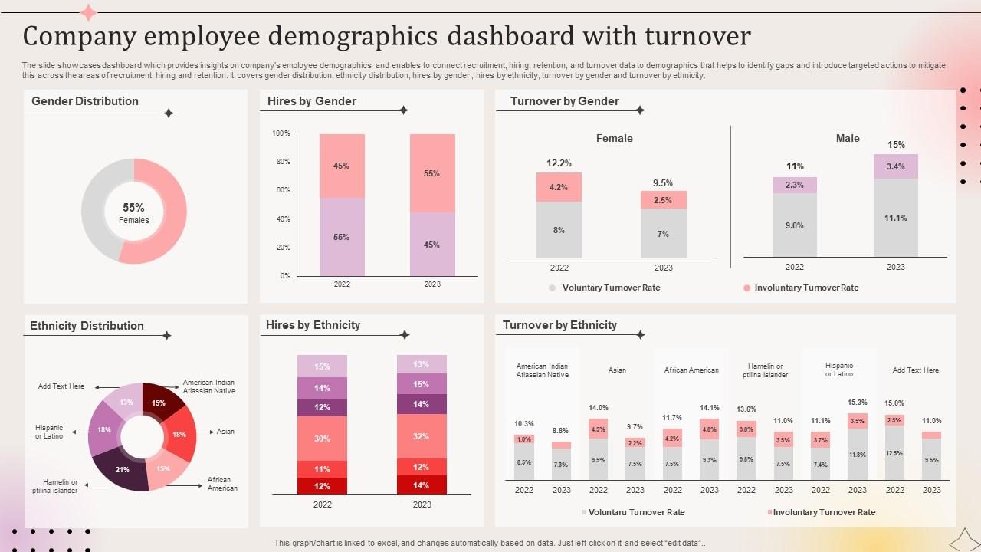
Employee Demographics
Need: we use a lot of excel to create dashboards
Measure what is important to us

Slide 10
2026 High-level Timeline
Need: not this but a better graphic for timeline. Ideally 12 months & 4 qtrs.
Q1
Icon Toolkit
Q2
Target Japanese companies for assessment to prepare for 2027budget cycle
Q3
First Public Cloud mid-market in Australia
Q4
Second Public Cloud in Australia
Assessments Ready
Translate to Japanese
New Japan MD hired
Onboard Australia MD
Deliver 1 Assessment / Mth by Australia
Deliver 1 Assessment/ Mth by Japan
Build Methods and Standardize Delivery Model
Establish Career Path & Skills Matrix
Sell 1 Advisory Services in Australia
Sell 1 Advisory Services in Japan
Sell 1 Advisory Service in Australia
Sell 2 Advisory Services in Japan
Sell 1 Advisory Services in Australia

