Slide 1




Introductie HP Workspace ProConnect

Slide 2


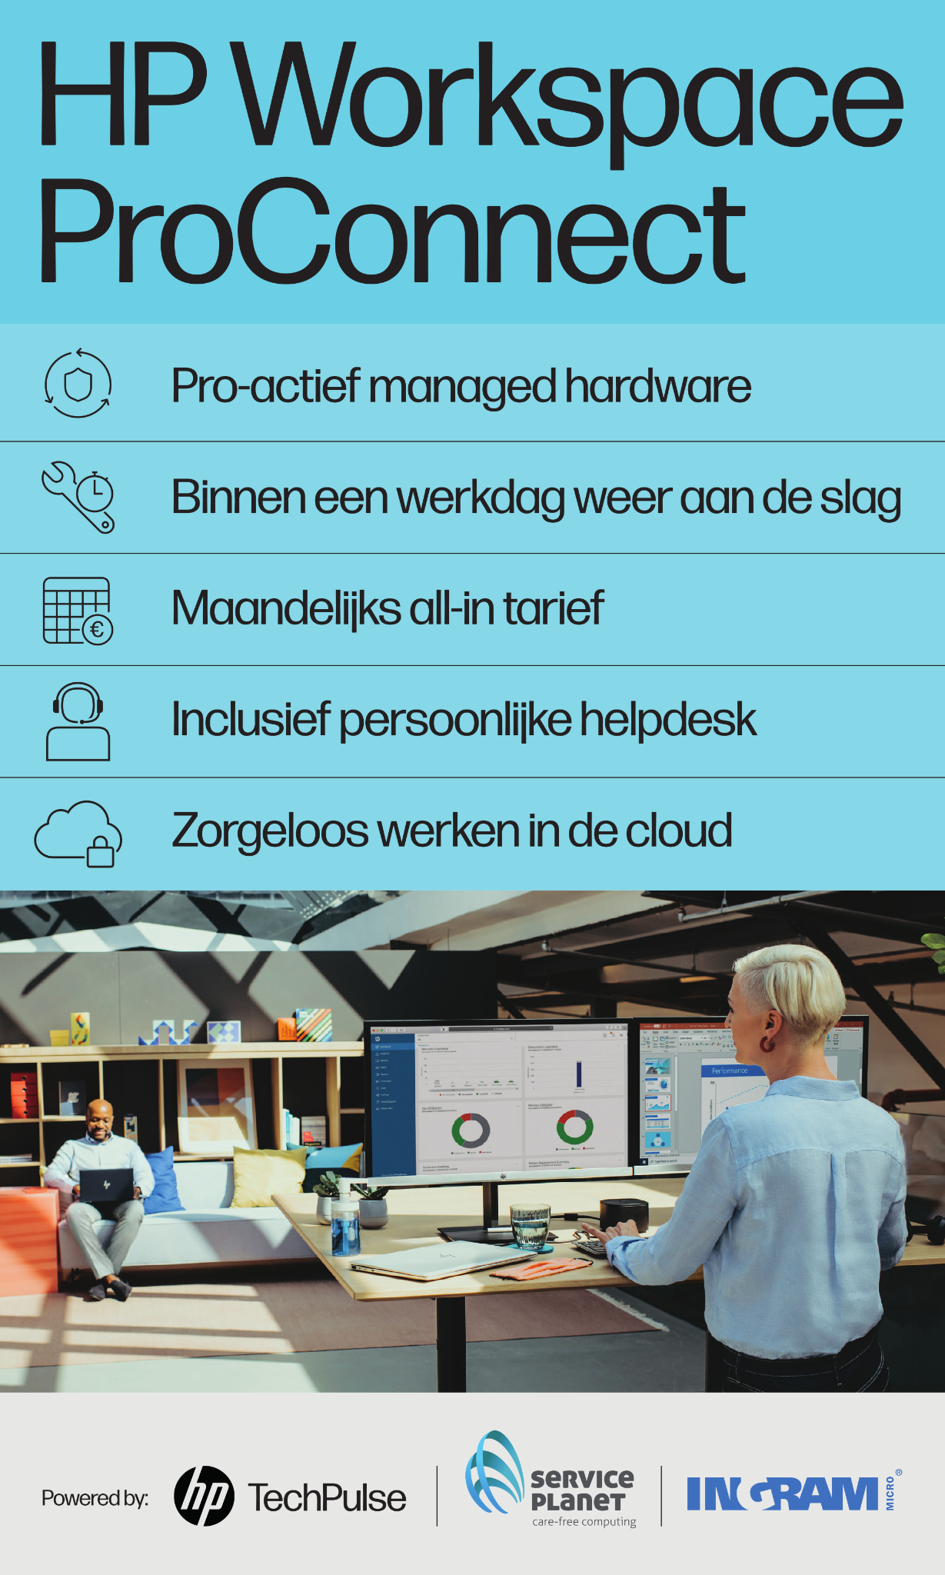
HP Workspace ProConnect
Introductie HP Workspace ProConnect
‘’As a Service
Innovator’’
2024
Complete end-to-end Device as a Service solution covering all elements of Lifecycle Management in a fixed monthly fee and with Accidental Damage Protection

Slide 3
































Deploy
Once the order has been approved, the order can be packed and shipped to the end customer. The product are also loaded and linked in the end customers MS Intune environment before they are delivered. “You only have one chance to make a good impression.”
Check
Is the device defective? Through extensive testing by means of professional tooling, the problem with the product is extensively mapped. This is to ensure that the device can be repaired as soon as possible! “A fast turnaround time and first time fix starts with a detailed and correct diagnosis!”
Use
The device is put into use by the employee. Because the product is pre-installed with the necessary applications and is fully enrolled
within the end customers environment, the employee enjoys a carefree experience. “You focus on the core business, we take care of the hardware.”
Repair
In the event of a defect, Service Planet will repair the product within the full term of the contract. Accidental damage? Don’t worry. The product is insured! “Regardless of the defect, we will ensure that the product will function properly again.”
Monitor
Each device is equipped with HP Insights. with Service Planet as support partner, all metrics are extensively monitored and reported to the reseller once a month.
“We see problems coming before you do!”
Refurbish
After repair, the product is extensively tested, cleaned and repackaged. The unit is integrated in the standby pool. “Clean, stain-free and neatly package. Ready for new deployment.”
Order
The reseller sets up a contract and places an order with Ingram. Once this is in place the end user organization is set up in the Ingram ecosystem. Later orders can be added.
Store
The product is stored in the Service Planet warehouse in Rotterdam. “Guaranteed a working product on the shelf!”
Defect
If the active monitoring shows that the product is defective, the end user will be contacted for a comprehensive check. By means of remote support, the customer receives support.
“Don’t worry, the replacement device was shopped yesterday and will be delivered to you this morning!”
Contract
HP Workspace ProConnect finance contract and initial setup is done by Ingram.

Slide 4
HP Workspace ProConnect
Benefits
For your customer
Monthly all-inclusive rate
HP Commercial good/better/best notebooks
Three-year term and from five notebooks
Continuous hardware monitoring
Helpdesk
Hardware replacement in case of hardware incident within one business day
Including repair and damage coverage
For you:
Insight and full control of your customer
Easy ordering within the Ingram environment
Focus on your primary service without hardware problems to solve
Monthly analysis of your customers' hardware trends and usage
Good margin

Slide 5

HP Workspace ProConnect
Setup
Service Planet Rotterdam B.V.
Support Partner
Onboarding & offboarding
(Existing seats)
Monitoring
Hardware support desk
Defect swap service
Repair service
Insurance handler
HP Inc.
Ingram Micro
wholesale
Onboarding
(New seats)
OS updates
Pre-provisioning
Deploying hardware
Financing handler
HP PROACTIVE INSIGHTS
MELISSAN ERP
Service Planet
Ingram Micro
CYRIC TOOLSET

Slide 6
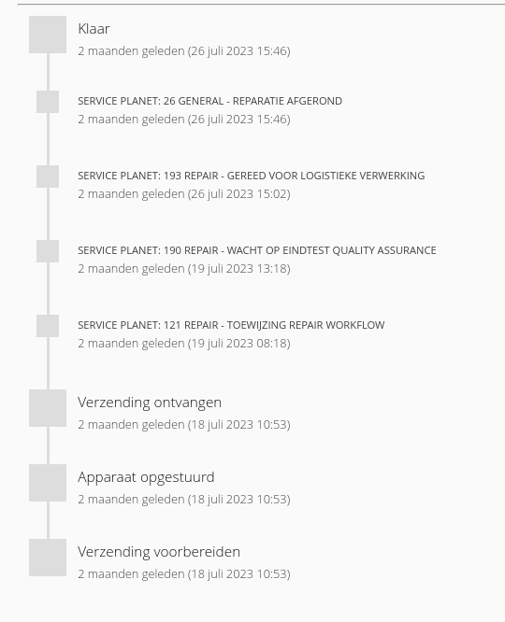
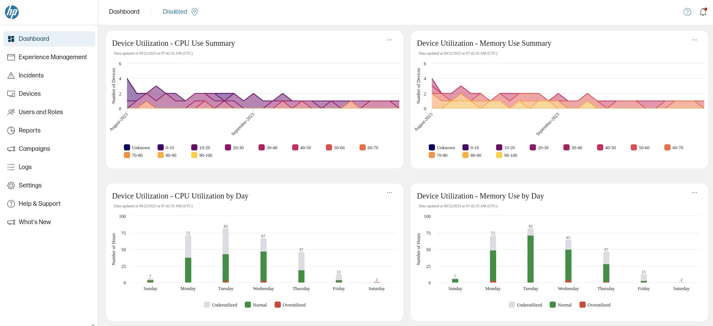
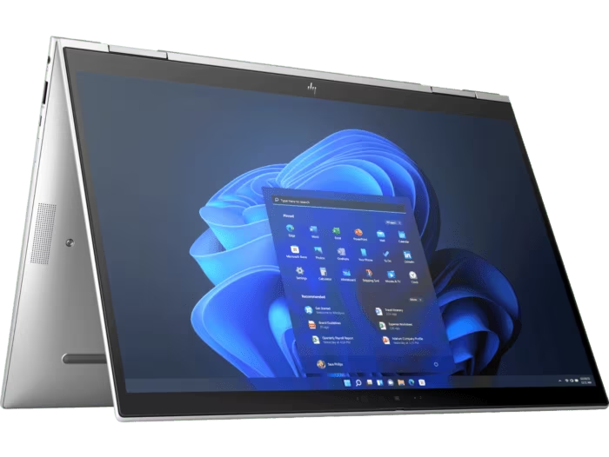
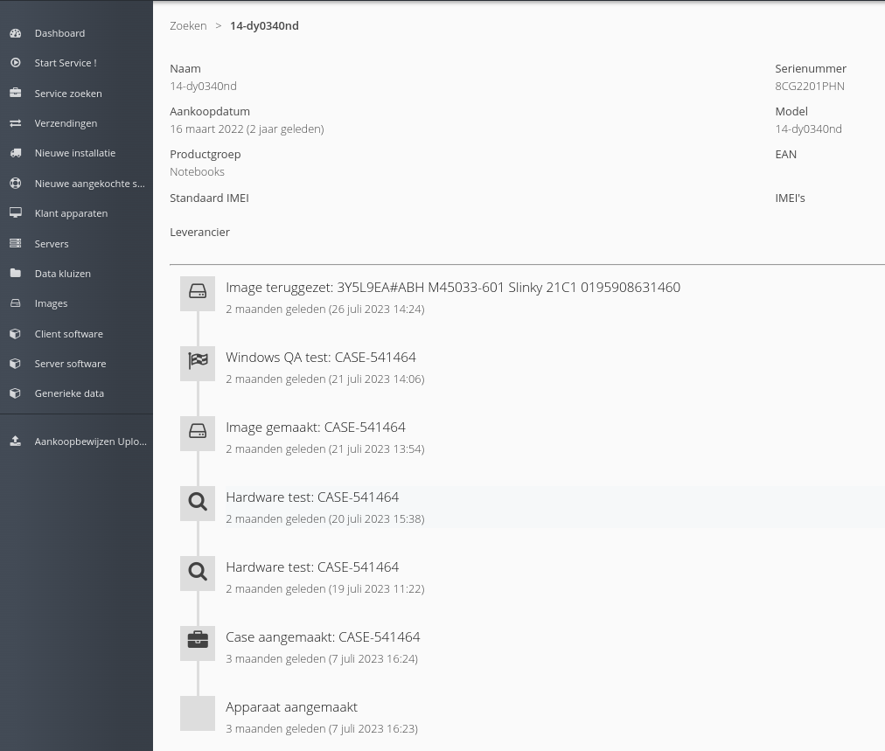
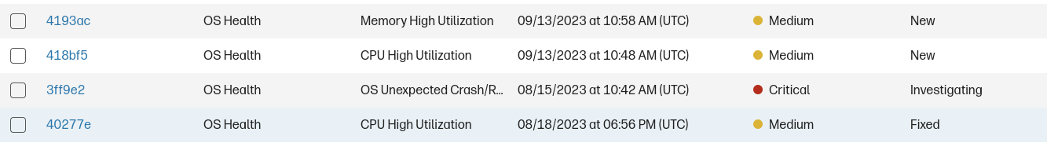
Business case
HP Workspace ProConnect
Pro active management
Incident
Pro active management
Performance

Slide 7
