Slide 1
















Marketing Technology
We offer mobile marketing solutions that connect advertisers with more interested prospects via texting.
Our Partners

Slide 2

Our Products Work TOGETHER
We deliver more high-quality opportunities because our programs facilitate an equitable exchange of information at instant speed between the dealer and consumers.
Email
Design
Data
TEXTiUM
Direct Mail
TEXTiUM
Textium enhanced direct mail is all the things you love about direct mail plus integration with the number 1 form of communication used today. All leads are sent directly to your CRM with accurate cell phone numbers.
TEXTiUM enhanced email goes beyond open and clicks reporting. We deliver actionable leads directly to CRM. Staying in contact with large numbers of buyers is critical. Adding text to uncover the hand raisers makes email a ROI powerhouse.
Direct mail is one of things anyone can do but only some can do well. We design our mailers from in the outside in making sure your mailer get opened and the action you want consumers to take is clear.
We use a combination of registered owners, credit, bankruptcy, collision, sales database, service database, and CRM to insure we are staying in contact with current customers and cross selling with relevant messaging while adding conquest opportunities. .

Slide 3
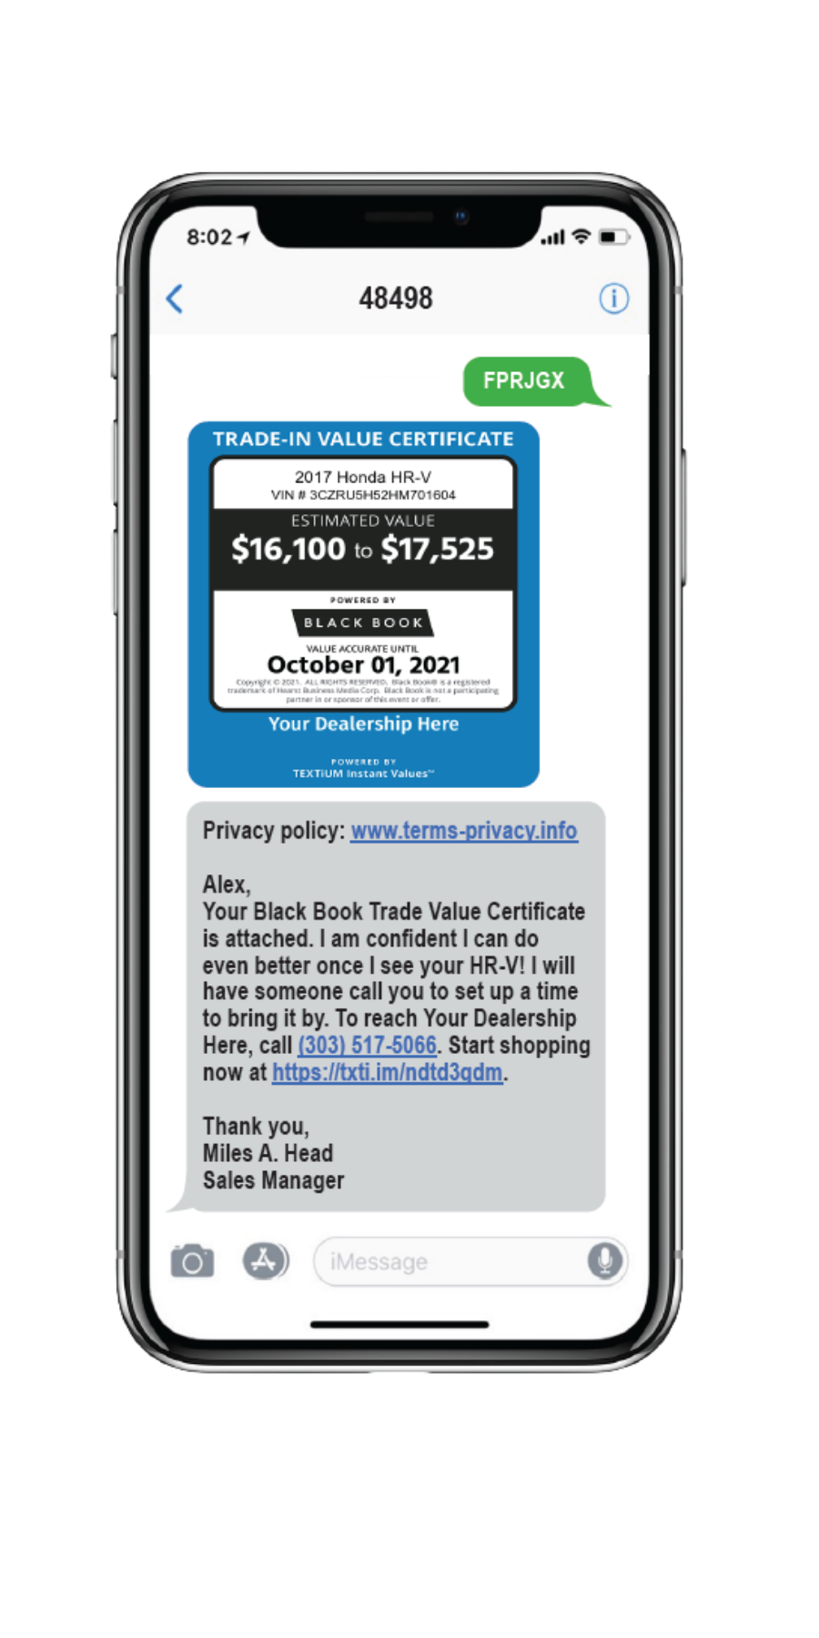
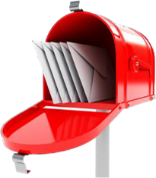
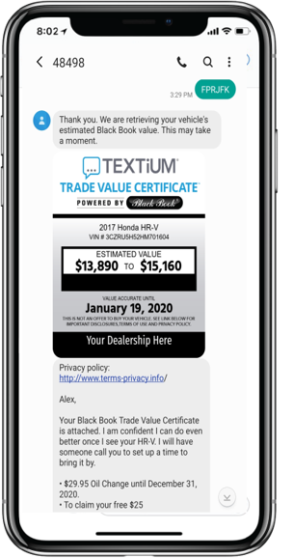

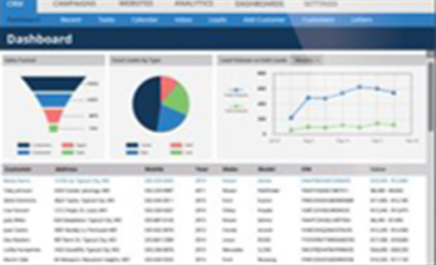
Traditional Marketing Has Been Upgraded
272 million smartphone users
Reaching out to consumers virtual and physical mailboxes have been a cornerstone of marketing for decades. The tangible, targeted, trackable nature of direct mail and speed and low cost of email keep these marketing programs part of most industries’ budgets.
77 percent use texting more than any other communication
However, these more traditional marketing staples in the past have failed to take advantage of the mobile age.
TEXTiUM direct mail and email are at the forefront using texting to get the absolute most out of your database and conquest efforts.
If you want your clients to engage your dealership you must incorporate texting.
FPRJGX

Slide 4


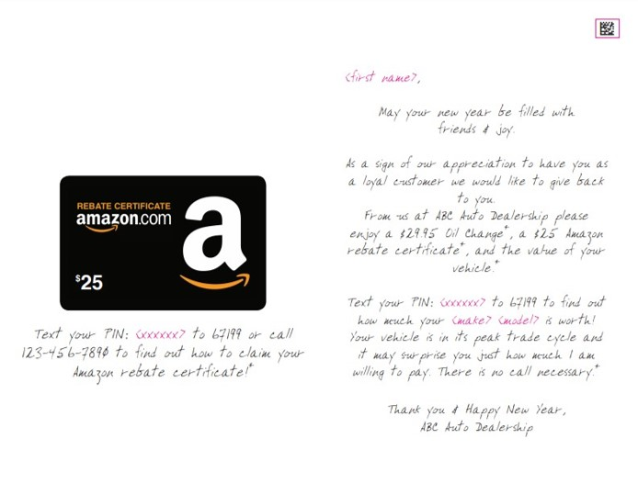
The Number One Mailer In The Automotive
Industry
beckett@becketthyde.com
Try It Now: Text FPRJFX To 48498
The Who We target a combination of past sales and service customers based on geography, age of the vehicle, and the last time they did business with your store. In addition, we target likely in-market conquest owners based on the profiles your current customers provide us.
The What This is a heavy card stock mailer just like any greeting card you have ever bought. Inside is a plastic additional incentive card used to help motivate the recipient to text. This invitation-style letter is mailed in a non-windowed envelope with a live stamp to help ensure the open rate.

Slide 5
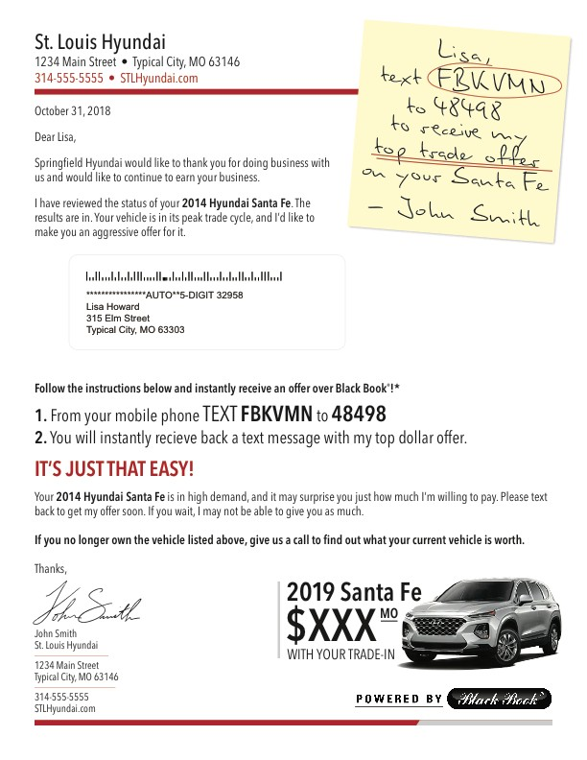
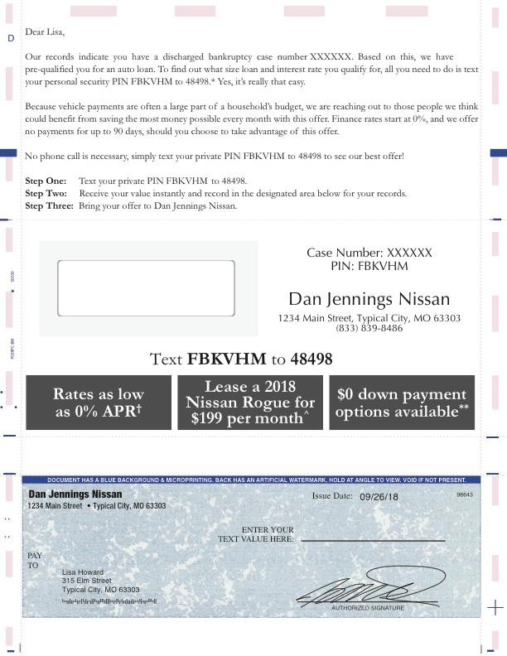
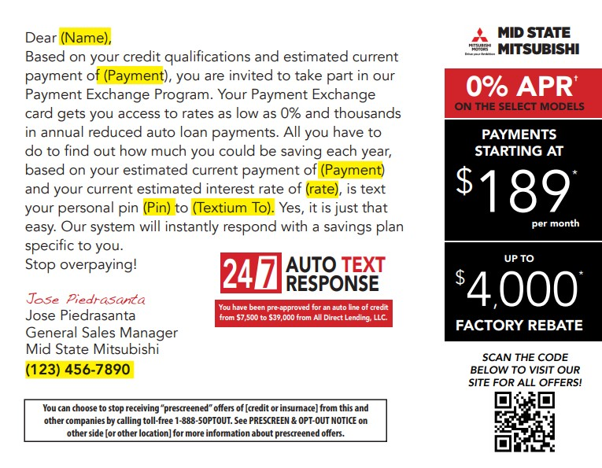
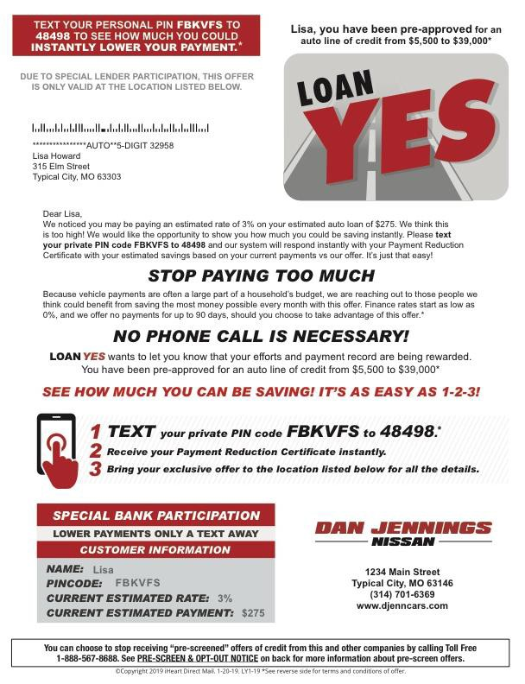
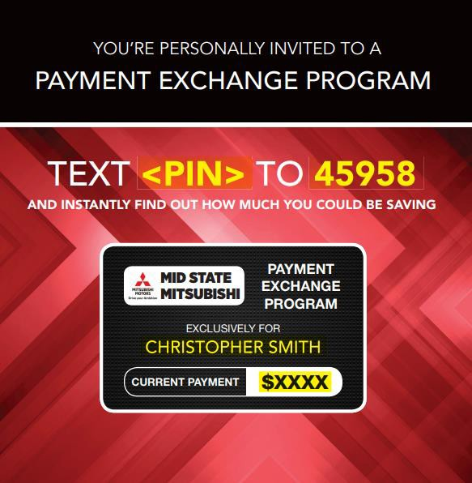
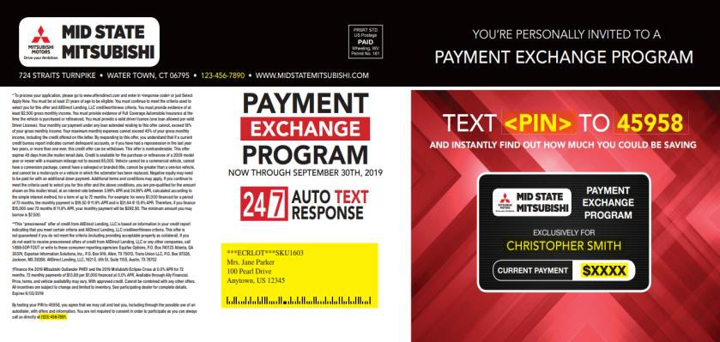
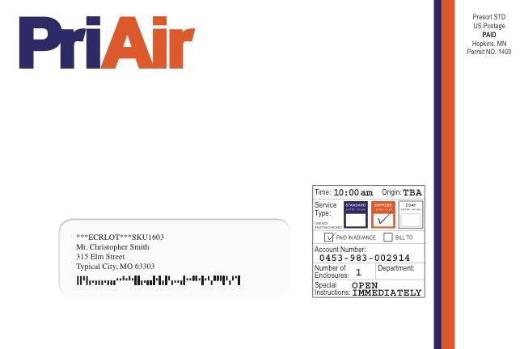
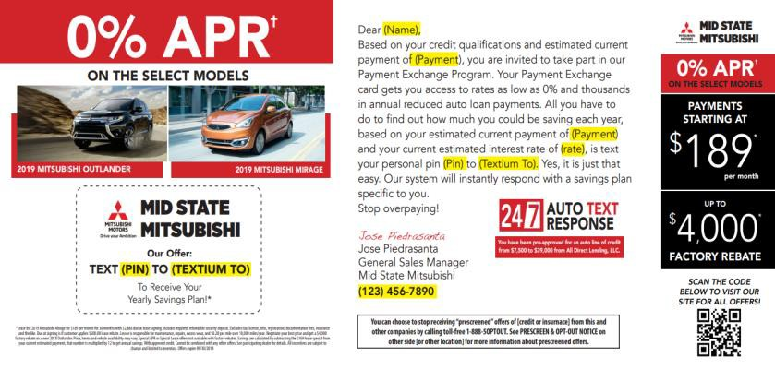
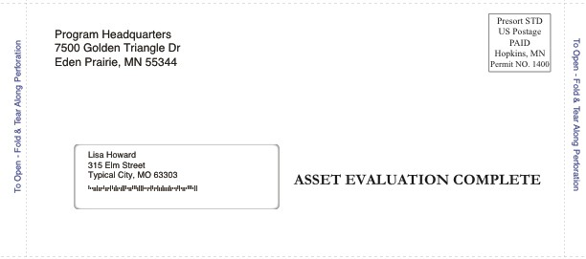

TEXTiUM Mail For Any Target
Registered Owners
Bankruptcy
Prime Credit
Sub-Prime Credit
Sub-Prime Credit

Slide 6







Email Features
Try It Now: Text FPRJFX To 48498
Themed and Targeted
The Who We target a combination of past sales and/or service customers based on your dealership’s unique goals. It includes filters such as current payment or interest rate, lease expiration date, and last service date to create a personalized message specific to those customers.
Four Monthly Deployments
Direct Response Leads
The What The creative is customized per audience. All creative will include the dealership’s sale theme or OEM event, along with the specific unique selling propositions for the dealership.
Elegant Interface with CRM
Extensive List Filtering

Slide 7



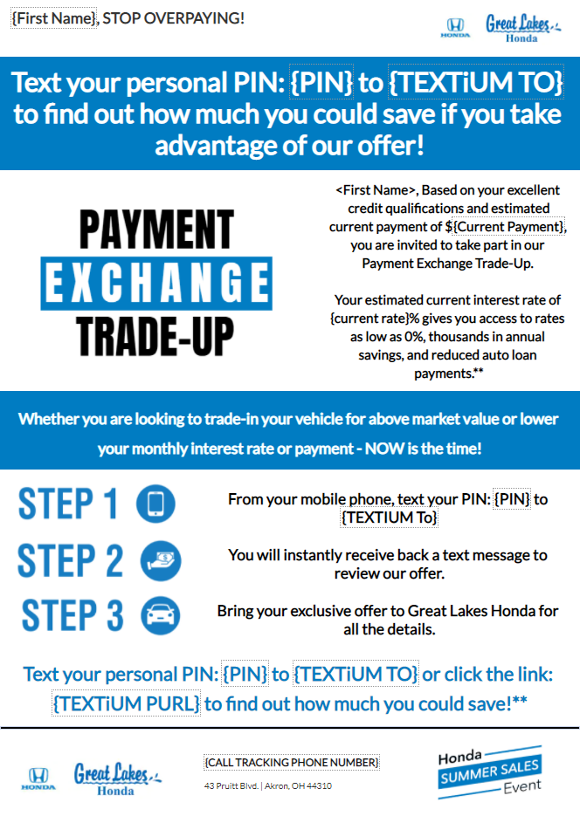







Email Marketing For a Mobile World
Sales, Service, Credit
Combination of offers to suit any recipient
Event Matching
Artwork matching other marketing
Credit Targets
Designed to push traffic to Q2C
Trade Targets
Drives traffic to Q2T
Service Offers
Re-engage lost service prospects

Slide 8
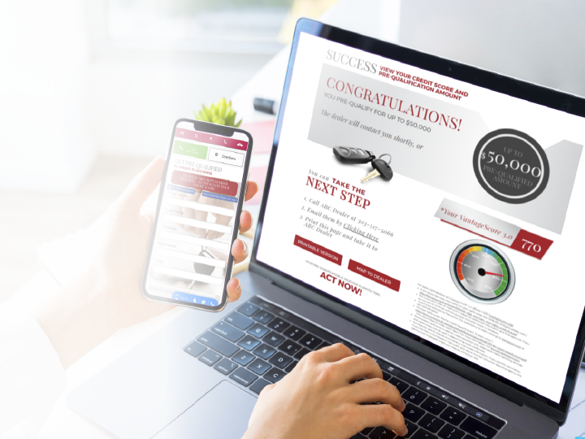

Powered by TransUnion, Quick2Credit allows you to offer your web visitors their Free Credit Score and an automotive pre-qualification instantly based on the 8 pre-set tiers.
No SS# required! No impact on their credit score!
The applicant is prompted to either print their prequalification or communicate directly with the dealer via email or tracking phone number.
This applicant may also get turn-by-turn directions via Google Maps if this was done on a mobile device.

Slide 9
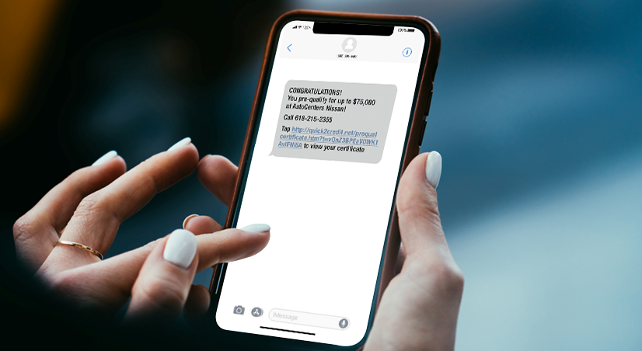

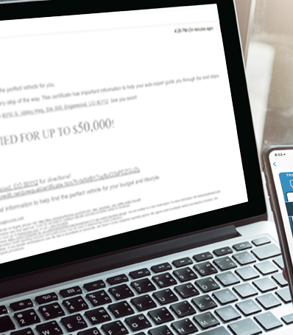
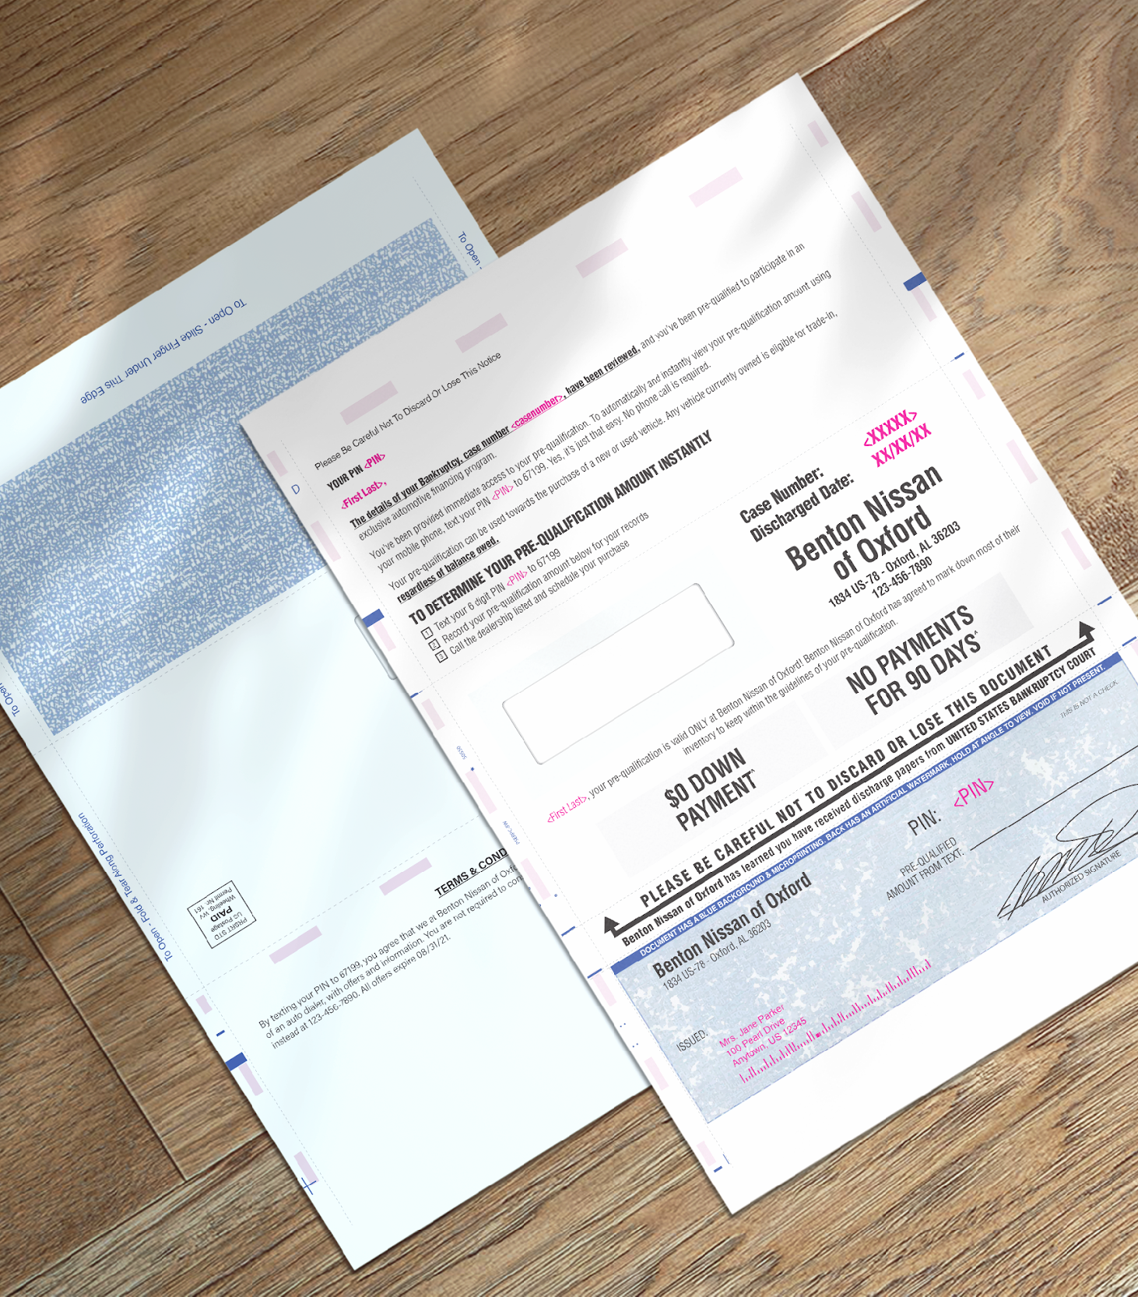
Four Response Verticals
We can all agree that if you want to get consumers to take action you must target them in more than one format. Quick2Credit targets consumers in 4 verticals. While we can’t be in four places at once, Quick2Credit can.
Instantly on screen
With email
Text with click to dial, custom links, and cadence
Our most productive direct mail format

Slide 10
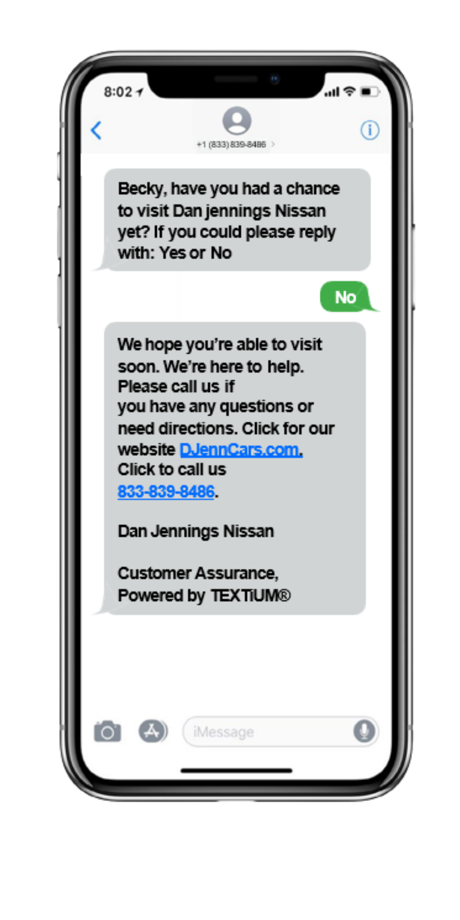
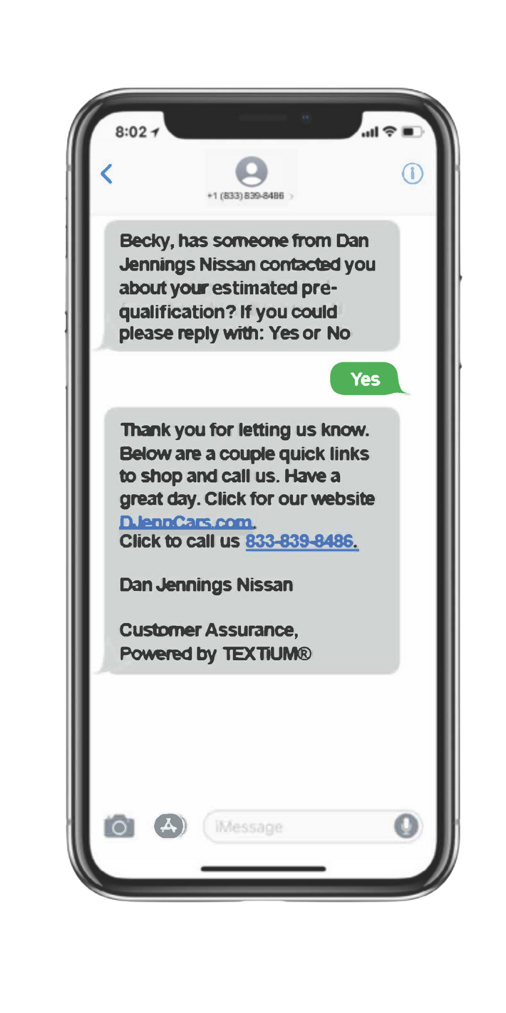
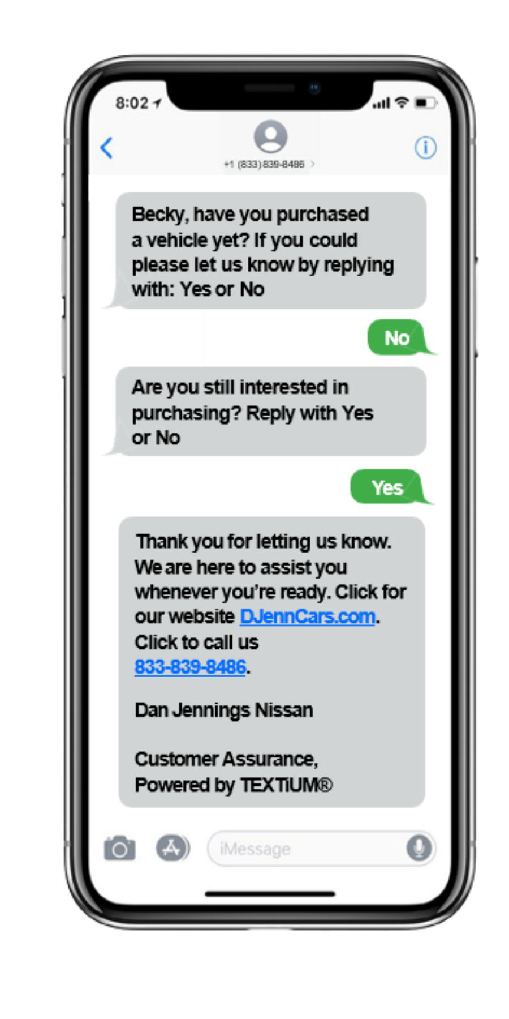
Triggered Cadence Designed to Help Your Team Engage
Day 3
Day 30
Quick2Credit can’t sell the car for you, but it can help with the follow-up. This cadence is designed to help engage your pre-qualified consumers. It also provides valuable data on how efficiently the BDC or Sales team is working these leads.
Day 7

Slide 11
Example Lead: Auto Summary
Data Enhancements
1
Include up to five of the most recent auto trades (open and closed)
Your competitive edge just got stronger. No other prequalification tool offers such a robust set of follow up technology and customer financial buying power for the money.
2
Generates estimated of APR for each auto loan, with a historical accuracy rate of 99.8%.
3
Calculates total revolving credit which provides insight to possible down payment requirements
Account Status: Open
Account Type: Auto Loan
Co-Signer?: No
Current Balance: $5,000
4
Provides name, subscriber code and contact information for each auto creditor
Payment Amount: $500
Estimated APR: 3.375%
Months Remaining: 10
Times Late in Past 24 Months: 4
Account Status: Open
Account Type: Auto Loan
Co-Signer?: No
Current Balance: $54,000
5
Summarizes payment, balance, months remaining and delinquencies for auto loans
Payment Amount: $1,500
Estimated APR: NA
Months Remaining: 36
Times Late in Past 24 Months: 2
Total Available Revolving Credit Amount: $7,500

Slide 12


Product Performance Dashboard
EMAiL
PROJECT OBJECTIVE
PROJECT OBJECTIVE
PROJECT OBJECTIVE
Quick2Credit’s objective is to convert your web traffic into high quality leads using TransUnion data. In addition, it’s designed to follow up with all leads using multiple marketing verticals to assist with conversions. Finally, Quick2Credit gathers feedback directly from the customers on your dealership’s progress.
Tangible high-quality direct marketing used to re-engage current sales and service consumers that are in their prime trade cycle. Our exclusive format is far more welcoming and presents itself as a friendly touch point vs a stark sales pitch.
TEXTiUM-enhanced email is email with purpose and delivers leads unlike any other emails in the market. Clicks and opens can’t be solicited by your sales and BDC teams. Our emails deliver real leads to your CRM. These interested parties are identified through their actions and delivered with 100% accurate cell phone numbers.
KEY DELIVERABLES
KEY DELIVERABLES
KEY DELIVERABLES
High quality leads sent directly to your CRM.
Provides consumer feedback on dealership efforts in contact, appointment setting, and sales.
Leads sent directly to your CRM based on a text response.
All phone calls are tracked as well as link clicks imbedded in our personalized variable response text.
Leads sent directly to CRM based on a text response
We also track opens and clicks but our goal is REAL leads.
Monthly Average Top Dealer | 261 Leads / 6.731 Million In Pre-Quals Per Month
Monthly Average All Dealers | 45 Leads / 1.29 Million In Pre-Quals Per Month
Last 500,000 Mailers | 6.25% Engagement
Last 100 Campaigns | 57.2 Average Engagements

Slide 13
Marketing Technology
We offer mobile marketing solutions that connect advertisers with more interested prospects via texting.

