Slide 1





RoboOp365 BRAND GUIDELINES
Practical, real-world automation for operators.
www.roboop365.com

Slide 2

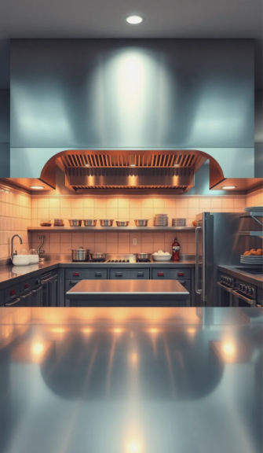




BRAND OVERVIEW
RoboOp365 is built for operators who need practical, reliable automation. Our identity reflects clarity, trust, and real-world usefulness, not tech hype or overstatement.
Restaurant Automation
Senior-Care Assistance
Hospitality
Solutions
2

Slide 3
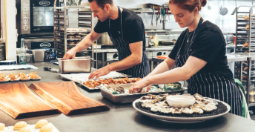
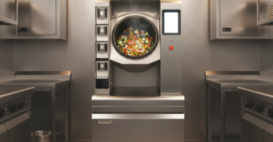
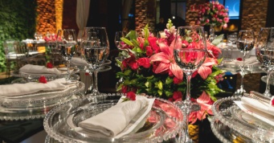

Brand Principles
These principles guide every visual and verbal decision. They ensure the brand feels consistent and well-defined across every channel.
Practical automation that solves real problems
Clear communication without jargon
Real environments, real value
Consistency across platforms and teams
Clean, functional design choices
3

Slide 4




COLOR PALETTE
Our palette is intentionally simple. Each color plays a distinct functional role in expressing the brand and supporting readability.
Primary colors are Orange (#F68C50) for CTAs and Deep Blue (#002E5B) for backgrounds.
Secondary colors include Red-Orange (#EF3A37), Medium Blue (#416E9C), and Grey (#756F78) for accents, charts, and text.
Orange
#F68C50
Deep Blue
#002E5B
Medium Blue #416E9C
Red-Orange #EF3A37
www.roboop365.com
4

Slide 5


Color System Overview
The secondary colors support the primary palette and should be used in moderation.
Primary Colors
Secondary Colors
Medium Blue - #416E9C
Used for calls to action, highlights, and moments of energy. It signals forward motion and warmth without overpowering the design.
A functional support color for backgrounds, charts, and modular content areas.
Red-Orange - #EF3A37
A high-attention accent used sparingly for emphasis. Appears in the primary logo mark.
Our grounding color. Used for backgrounds, hero areas, and structural elements that need stability and trust
Grey - #756F78
Our neutral anchor for text, dividers, and understated elements.
5

Slide 6
TYPOGRAPHY
Aa123
The typography suite uses Montserrat for strong headlines, Oswald for readable subheads, and Philosopher or Poppins for body text, ensuring clarity and a modern feel.
Montserrat
Philosopher
Aa Bb Cc Dd Ee Ff Gg Hh Ii Jj Kk Ll Mm
Nn Oo Pp Qq Rr Ss Tt Uu Vv Ww Xx Yy Zz
1234567890!@#$%^&*
Aa Bb Cc Dd Ee Ff Gg Hh Ii Jj Kk Ll Mm
Nn Oo Pp Qq Rr Ss Tt Uu Vv Ww Xx Yy Zz
1234567890!@#$%^&*
Oswald
Poppins
Aa Bb Cc Dd Ee Ff Gg Hh Ii Jj Kk Ll Mm Nn Oo Pp Qq Rr Ss Tt Uu Vv Ww Xx Yy Zz
1234567890!@#$%^&*
Aa Bb Cc Dd Ee Ff Gg Hh Ii Jj Kk Ll Mm
Nn Oo Pp Qq Rr Ss Tt Uu Vv Ww Xx Yy Zz
1234567890!@#$%^&*

Slide 7
Typography System
The type system was designed to make information easier to scan and understand. Each font reinforces a hierarchy that helps the reader move naturally through the content.
Headline Font
Body Fonts
Montserrat
Philosopher
Modern, clean, and easy to read at all sizes.
Used for H1/H2 and hero statements to create a confident, contemporary tone.
Used for long-form reading experiences such as articles, guides, and resource pages.
Provides warmth and legibility for narrative content.
Subhead Font
Oswald
Poppins (alternate)
Modern, clean, and easy to read at all sizes.
Used for H1/H2 and hero statements to create a confident, contemporary tone.
Used for UI elements, checklists, and presentations.
Its geometric structure improves clarity at small sizes.

Slide 8





THE LOGO
Full-Color Logo (Default)
The full-color logo features a red 'Robo', white 'Op', and an orange gradient '365'. This is the preferred version for light or neutral backgrounds.
A reverse version is available for dark backgrounds; The orange gradient "365" remains unchanged to retain recognizability.
Reverse Logo
App/Thumbnail Logo
Logo Usage Rules
These rules protect logo integrity and ensure it renders consistently.
Maintain clear space equal to the height of the “R”
Do not stretch, distort, recolor, or place on complex backgrounds
Minimum size: 120 px width for digital use
Social watermark should be 4–6 percent of the total canvas width

Slide 9

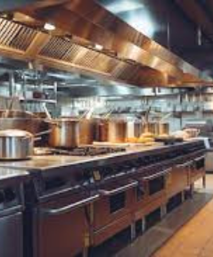




VOICE & TONE
Our voice reflects how we support operators: clear, practical, and respectful of their time and challenges.
Direct, grounded, and confident.
We communicate in a way that acknowledges real operational pressures without exaggeration.
Writing Rules
These guidelines maintain consistency across all written content.
No emojis
Short, structured sentences
Focus on real outcomes and clear explanations
Avoid hype or overly technical language unless required

Slide 10
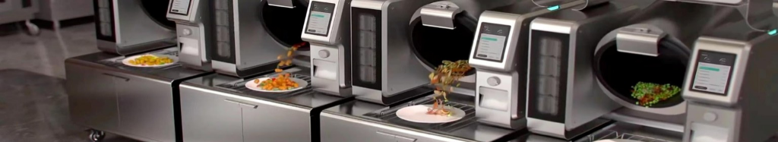
IMAGERY OVERVIEW
Imagery should capture real operational environments and convey useful, human-centered automation.
Image Composition
Our composition style supports clarity and focus.
Keep backgrounds simple and uncluttered
Emphasize a clear subject
Use subtle brand-colored overlays (40–60 percent opacity)
Ensure text contrast is strong and readable
Photography Guidelines
Use authentic kitchen, restaurant, hospitality, and senior-care settings
Avoid cartoon robots, sci-fi styles, or unrealistic lighting
Favor warm tones and clean, approachable compositions
Always use approved images of Robby and Servi+

Slide 11
SOCIAL MEDIA STANDARDS
Social content should be easy to recognize and consistent across platforms.
Each post should reflect the brand’s balance of clarity and operational value.
Layout Requirements
Text Overlay Rules
Instagram/Facebook: 1080×1080
LinkedIn: 1200×627
Twitter/X: 1600×900
Watermark the logo bottom-right at a minimal, unobtrusive size
Maintain consistent spacing, padding, and layout hierarchy
Overlay copy must remain legible across formats.
Limit text to 6–10 words
Use Montserrat or Poppins
Keep generous line spacing
Avoid heavy gradients or noisy backgrounds

Slide 12




LAYOUT &
Design Structure Overview
A consistent grid and spacing system create a clean, professional visual experience across the brand.
STRUCTURE
Spacing & Grid System
Button Styles
Primary CTA
Orange #F68C50 background, white text
Used for the highest-priority actions
Secondary CTA
White background, orange text
Used for secondary or supporting actions
White Text
Use spacing increments of 24, 32, or 48 px
Maintain generous padding around all text and images
Use left-aligned text for readability
Reserve center alignment for major hero statements only
Our button system establishes consistent CTA visual standards.
Rounded corners and medium-weight typography should be used for both.

