Slide 1
Introducing Horizon: The Next Generation of Adhesive Technology
A revolutionary adhesive engineered to outperform in every metric that matters to your customers—durability, speed, reliability, and ease of use.

Slide 2






Horizon Changes Everything for Customers
This isn't an incremental improvement—it's a complete reimagining of what professional-grade adhesives can achieve. Customers demand reliability, speed, and durability. Horizon delivers all six, with the integrity and performance that is known and expected from Integra.
Excellent Adhesive
Performance
All-Weather Performance
High UV Resistance
Suitable for both indoor and outdoor applications without compromising
reliability under any conditions.
High bond strength, 10:1 ratio, and 250mL. No-sag formula enables vertical surface bonding without dripping.
Maintains color and integrity in sunlight where standard adhesives discolor or degrade over time.
Extended Durability
Faster Cure Time
Color Consistency
Resists cracking, yellowing, and delamination even after years of continuous use and exposure.
Speeds up installation and allows earlier finishing, boosting job-site productivity and throughput.
Achieve a consistent color match
every time with ease, enabled by
the precision of Integra color match tools.

Slide 3
The Numbers Tell the Story
Horizon's performance advantages aren't marketing hype —
they're backed by rigorous testing and real-world validation.
2x
10x
100+
230+
Bond Strength
Less Yellowing
Color Options
Temp Cycle Hours
Higher tensile and shear
strength on premium
surfaces
Compared to leading
competitors in
outdoor UV weathering
tests
(as measured by ∆E)
Expertly matched to
popular surface
decors
ASTM D1183-03
Resistance of
Adhesives to Cyclic Laboratory
Aging (each cycle)

Slide 4
Product Transition: Simplify Your Inventory
Horizon represents a strategic SKU rationalization that benefits both distributors and their customers. We're replacing Zero and Ultra with a single, superior product that outperforms both predecessors across every metric.
1
2
3
Zero to Horizon
Ultra to Horizon
The Result
Part number changes
Part number changes
One premium product that
eliminates confusion, reduces
inventory complexity, and delivers
superior performance.
SDS/TDS updates
SDS/TDS updates
New label design
New label design
Important: All product transitions include updated part numbers, safety data sheets, technical data sheets, and
packaging. Plan accordingly for inventory management.

Slide 5
Engaging Your Team
Your sales team is our most important partner in making Horizon a market success. We're committed to providing comprehensive training and support to ensure they're confident, knowledgeable, and excited to sell.
01
02
Training Availability
Online Training Information
Comprehensive product training launches in early January, with both online and in-person options tailored to your team's needs and schedule.
Self-paced digital courses will be available 24/7,
featuring product demonstrations, competitive
comparisons, objection handling, and selling strategies.
03
04
In-Person Training Sessions
Partnered Execution
We're scheduling regional workshops for hands-on product experience. Contact your regional manager to schedule a session for your territory.
A coordinated marketing plan that aligns campaign development, cadence, collateral and social media
assets, and incentive programs.

Slide 6
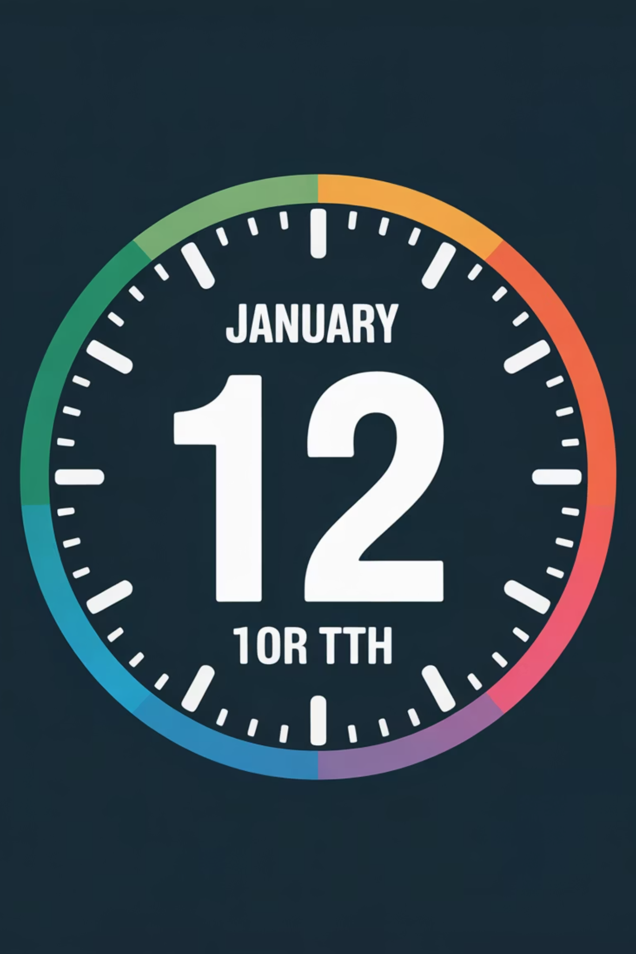

Critical Launch Timeline
Timing is everything. Here are the key dates you need to hit to maximize Horizon's launch impact
and ensure you're stocked before TISE.
Stocking PO- December 3rd
Shipping 16 of the most popular colors first- mid December
Remaining colors early January
Social Media Assets
Complete content package including copy, images, and graphics for coordinated multi-channel announcement. Timing ensures maximum visibility during launch window and drives traffic to distribution partners.
Product Photography
High-resolution product images for website, and marketing materials.
Integra Brochure
Comprehensive sales collateral showcasing Horizon.
Press Release Distribution
Industry press release announcing Horizon availability, positioned to generate trade publication coverage before TISE, building anticipation.

Slide 7
Our Next Steps- Partnership
Horizon is ready to transform your surface bonding business. Now it's time to act. Here's exactly what you need to do to capitalize on this launch opportunity.
1. Place Your Order
2. Schedule Training
Order by December 3 to guarantee full inventory before TISE. Contact your account manager today.
Register your sales team for online or in-person training sessions. Early training means early sales.
3. Plan Your Promotion
Coordinate with our marketing team to leverage launch materials, social media support, and co-branded campaigns.

