Slide 1
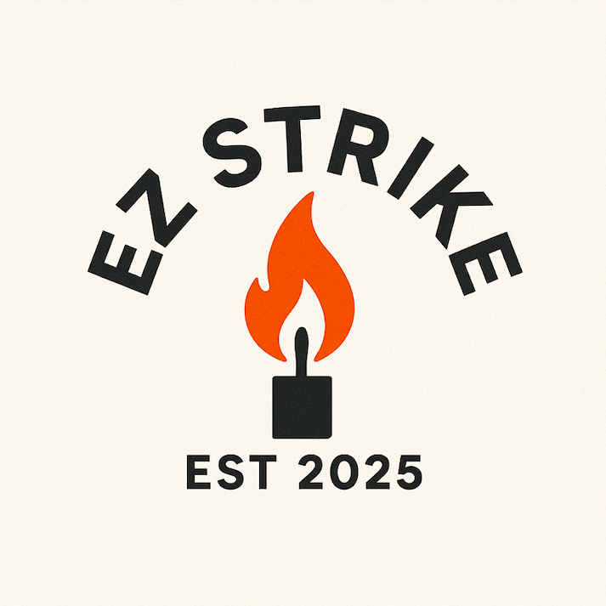
EZ STRIKE Candles
Self-Striking Emergency Candles

Slide 2


Vision
BECOME THE LEADING BRAND FOR SELF-STRIKING EMERGENCY CANDLES IN NORTH AMERICA THEN CONTINUE INNOVATION
EXPAND GLOBALLY INTO OUTDOOR AND DISASTER PREPAREDNESS MARKETS, NOVELTY CANDLES, MULTIPLE USE

Slide 3
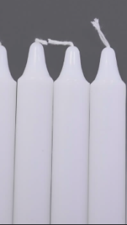
Why EZ Strike?
Power outages leave people in the dark
Candles need lighters/matches to work
Emergency situations cause stress & delays

Slide 4

Our Solution
Pre-wicked with match powder
Self-striking: no lighter or matches needed
Reliable light source in emergencies

Slide 5
Market Opportunity
-Global candle market: $10+ billion
-Growing emergency preparedness market
-Target: households, campers, survivalists, retailers

Slide 6
Competitive Advantage
Unique self-striking feature
Dual-purpose: everyday & emergency use
Compact, easy to store
First To Market

Slide 7




Business Model
RETAIL PRICE: $19.99 –2 PER CANDLE BOX
MULTIPACKS FOR HOME KITS
ONLINE SALES: WEBSITE, AMAZON
WHOLESALE TO HARDWARE & OUTDOOR STORES

Slide 8
Go-To-Market Strategy
Test out Product and refine
Sell on Amazon
Survival/outdoor influencers
Emergency-preparedness expos
Retail partnerships

Slide 9
12 Month Strategy
First 6 Months
Establish the Business as a Legal Business in USA and Canada
Create Sample
Make1 10+ sale and receive feedback
Secure supply Chaine
Patent Product in USA and Canada
Establish Amazon Account and Website
Receive Seed Money: start up funds
No Salary to founder or payout to investors
Hire accountant after cash flow positive
Hire Influencer to kick start sales

Slide 10
Financials -12 month look ahead
Year 1: $82,000 revenue (4200 boxes candles)
Year 2: $175,000 revenue (retail expansion)
Year 3: $150,000+ revenue (distribution deals)
Funding Needs: $10k-20k

Slide 11
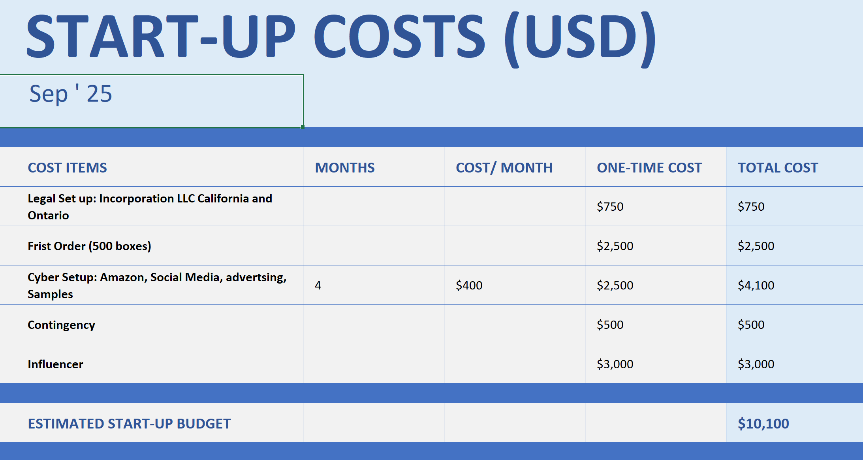
Financials Stat-up Capital Requirements

Slide 12
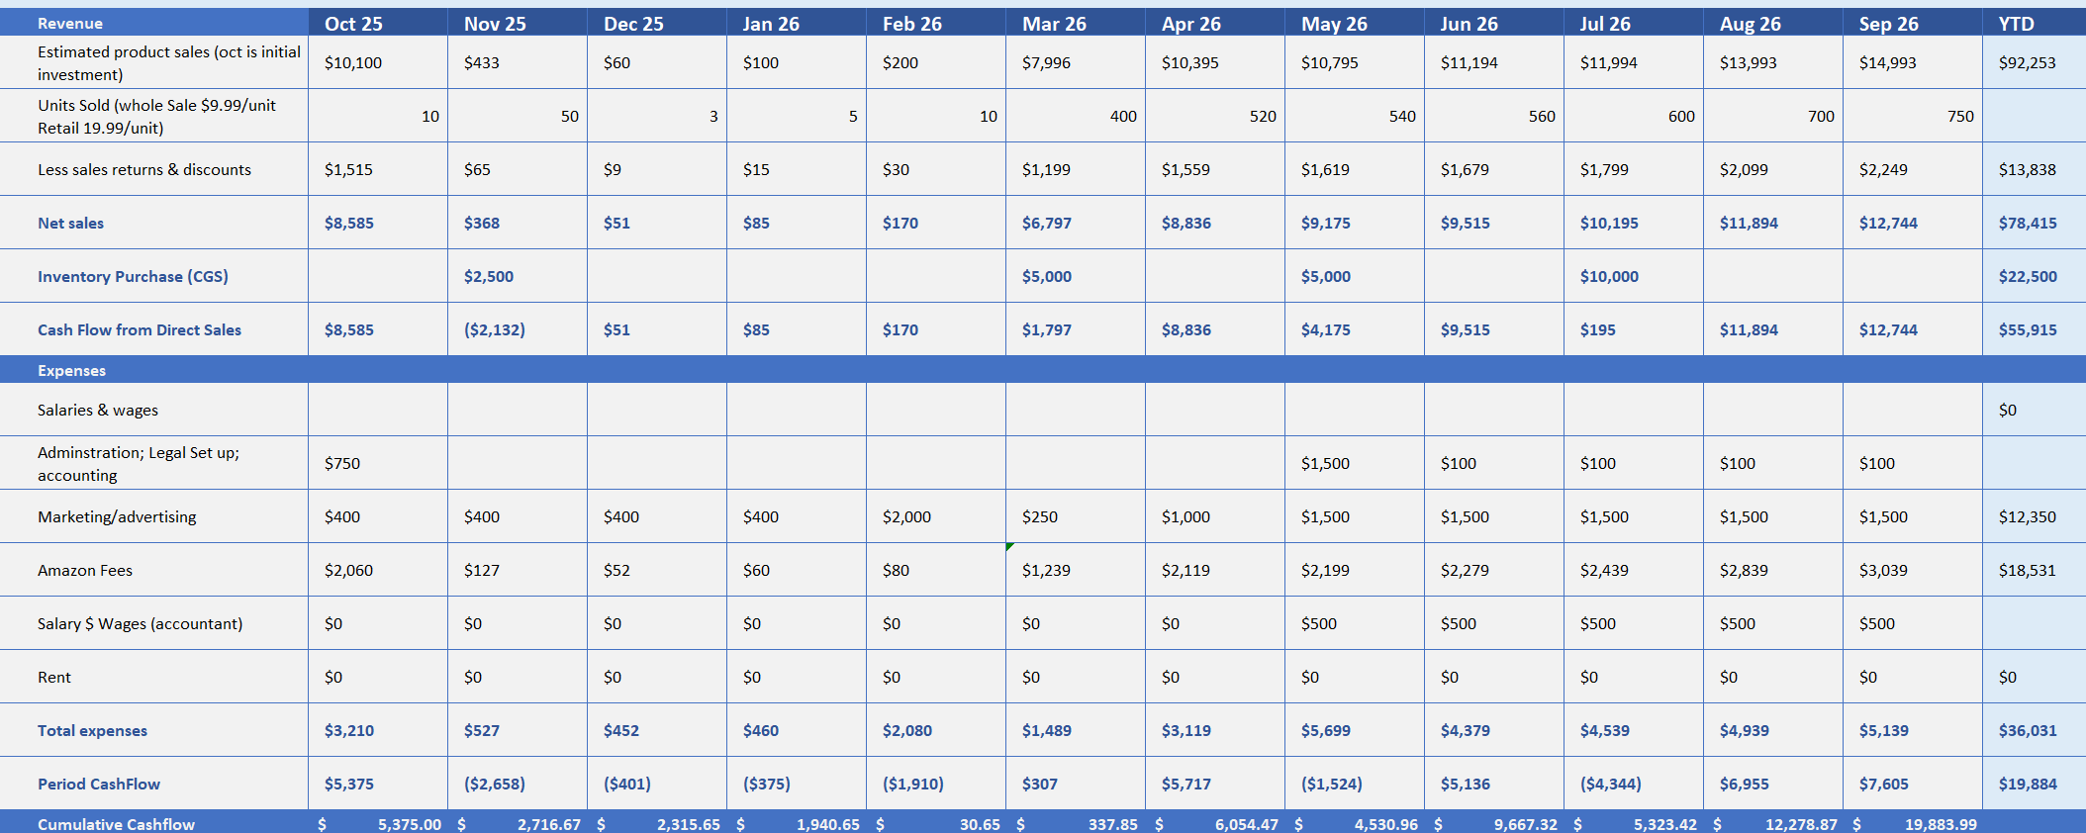
Financials -12 month look ahead

Slide 13
Ownership
- Sammy Abu Hana: 50%
- Ghassan Sleiman: 43%
- Investor: 7% @ $10,000 USD

