Slide 1
Design Overview
We are designing a poster for a forthcoming Trade promotion for Narva Lights. Narva make car lights and other electrical products. Their main audience are men so design should be masculine
Refer to their website www.narva.com.au to see colour tones and style you should follow.
The concept is presented on the next few slides. Use the exact copy on slide 2 and emulate the powerpoint design I did.
It’s a Spin Tio Win mechanic so you will also need incorporate a Spin Wheel into the design. Refer to slide 3 & 4 for info on how to present and design the wheel.
As the theme is a Vegas promotion and the main feature of the brand is lights and lighting, utlise light effects into design Eg: Spotlights on prizes, neo lighting effects etc.
I have provided example images. Feel free to find other images that may be of high res but make sure its an image of the same thing. Images should ideally contain lights ie: night shots or brightly lit up things etc.
Show the Narva logo prominently and include the range of Narva products (images provided) next to the entry text of “Spend $50 or more on any Narva product for your chance to WIN!”
Make the headline of “NARVA SPIN THE WHEEL & LIGHT UP A DEAL PROMOTION” punch out and make the Vegas major prize image the hero image

Slide 2
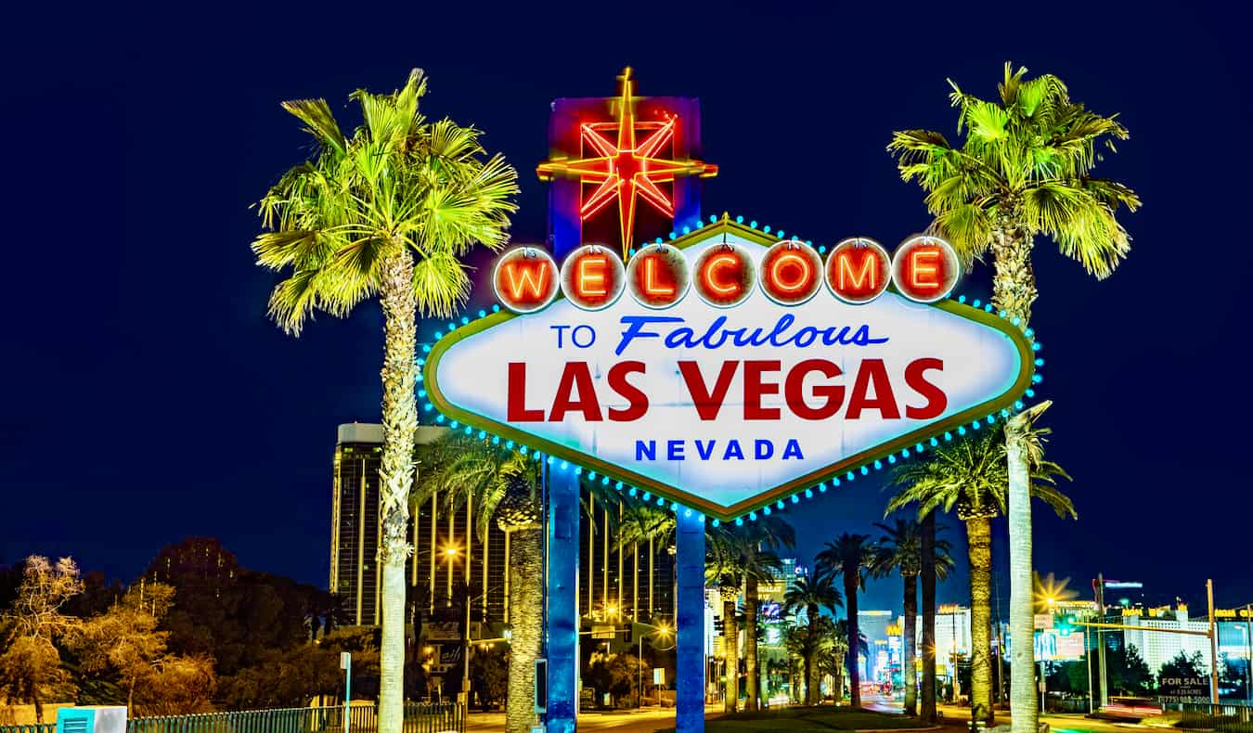
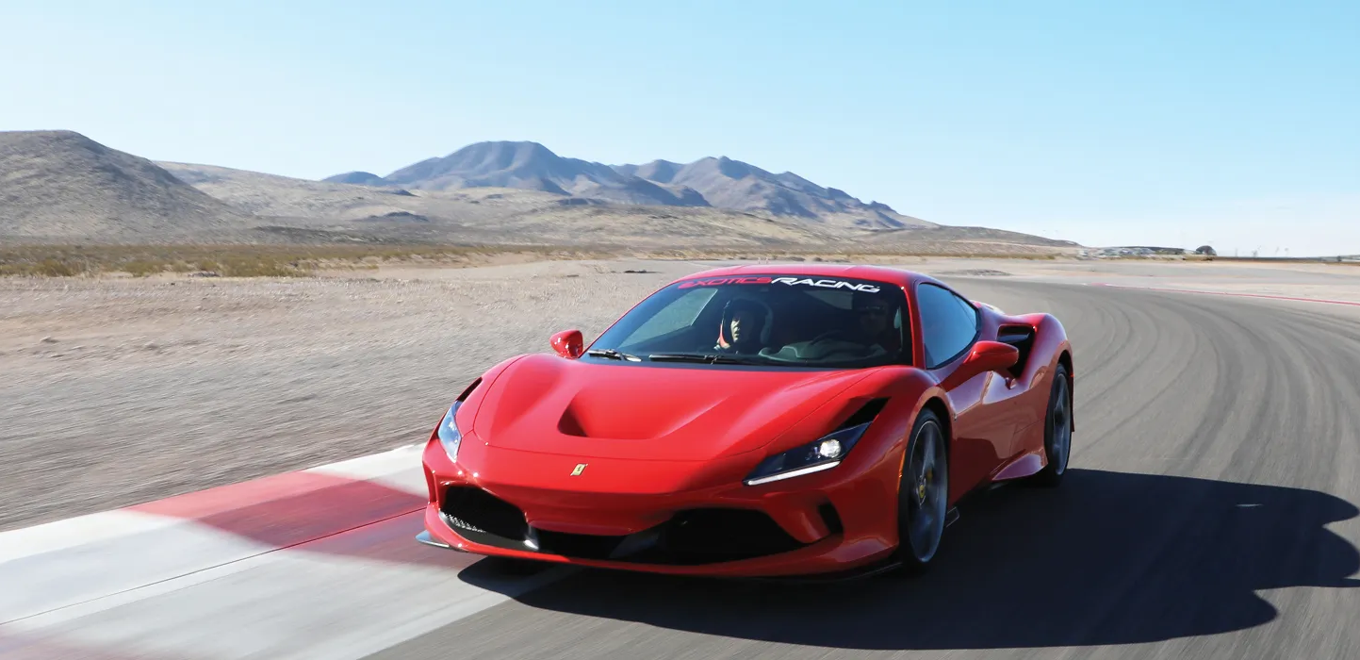
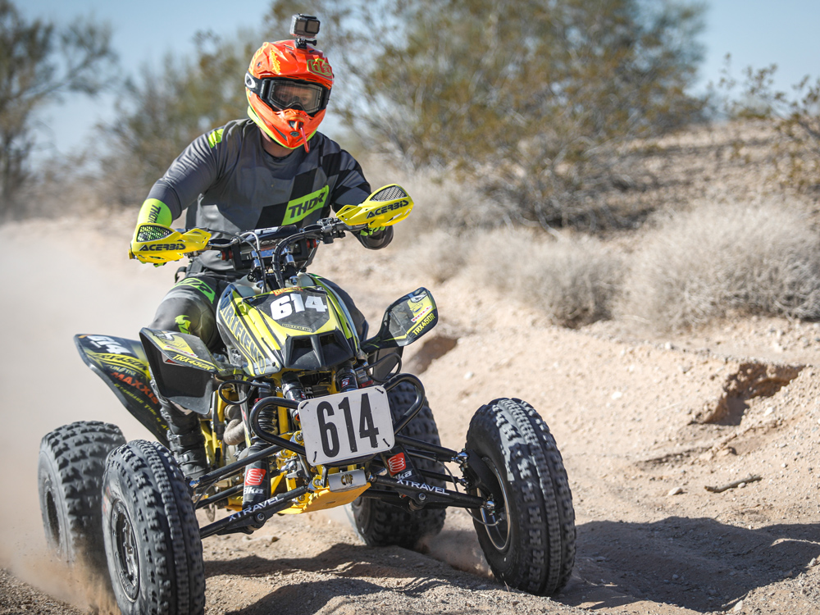
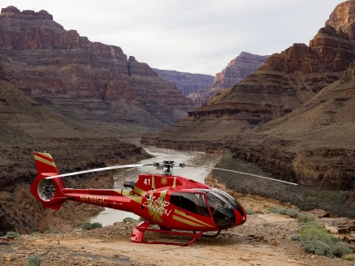
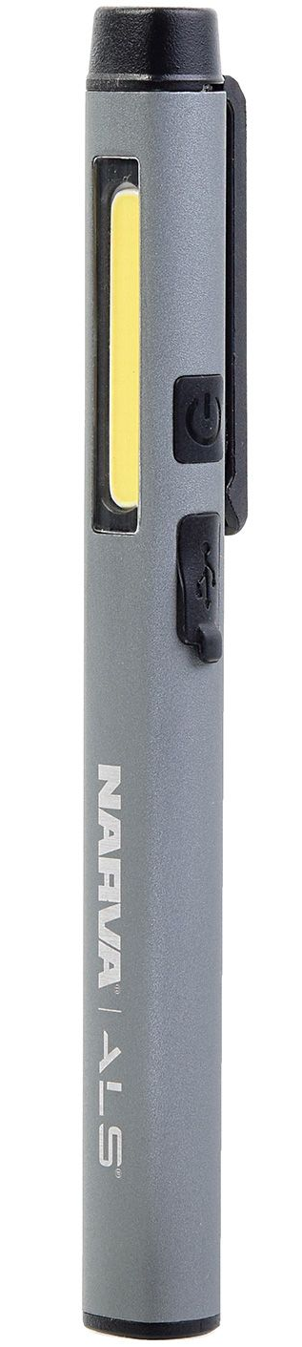
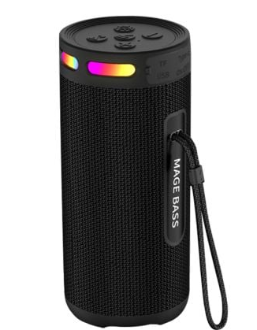
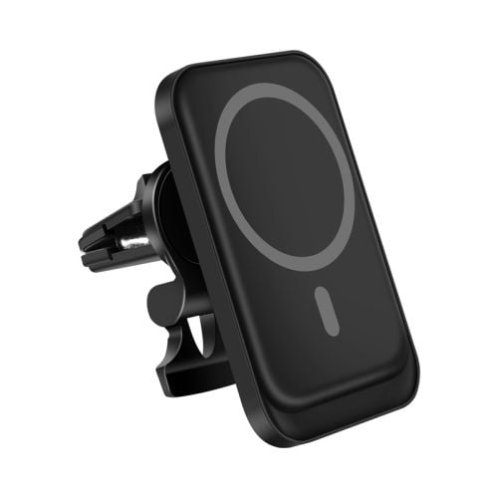
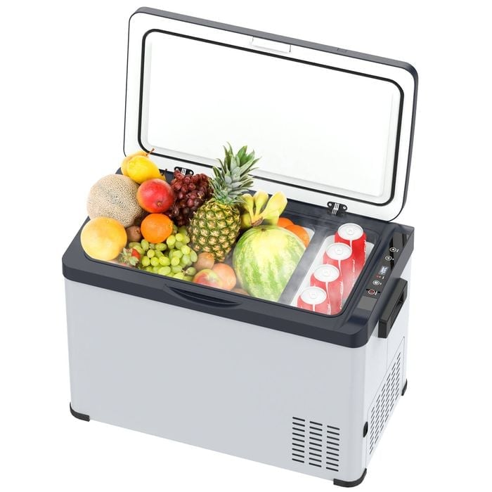
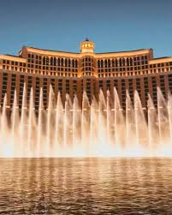
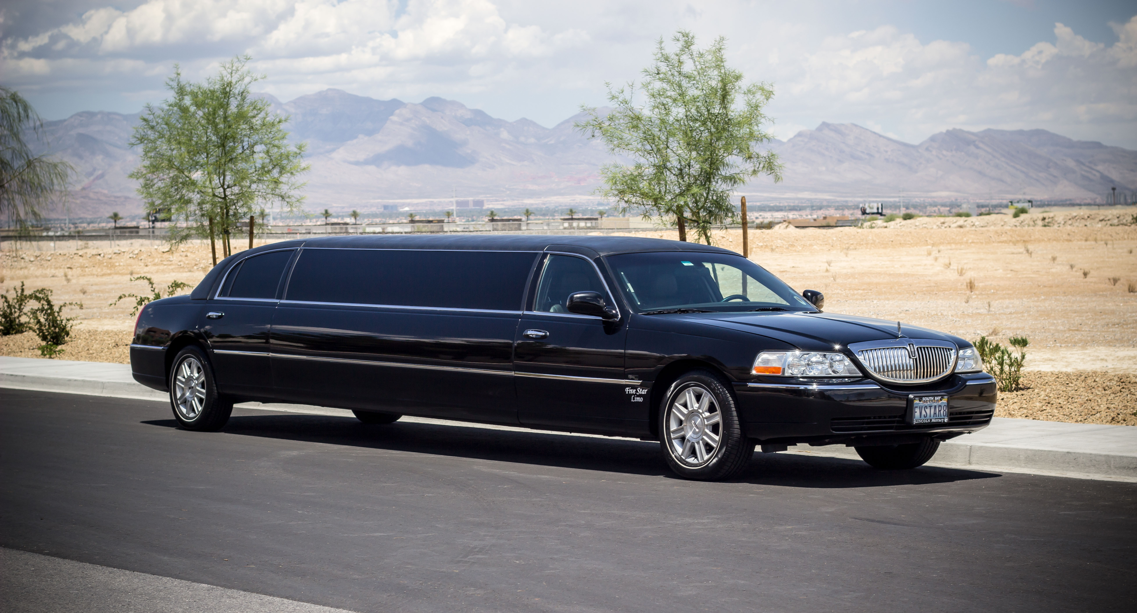
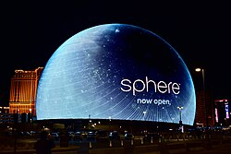
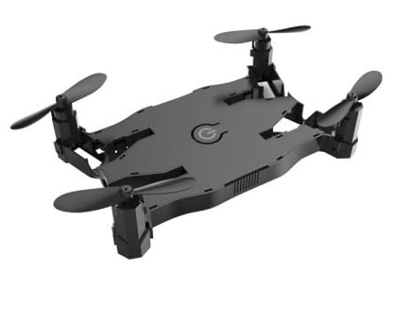
NARVA SPIN THE WHEEL & LIGHT UP A DEAL PROMOTION
SPIN TO WIN
THE ULTIMATE VEGAS ESCAPE
FOR YOU & 3 MATES.
Prize Includes: Return airfares to Vegas, Limousine Transfers, 8 x Nights staying at The Bellagio, Breakfast daily, Mojave Desert ATV Tour, Ferrari Hot laps,
Grand Canyon Helicopter Tour, A show at The Sphere & $5,000 Spending Money
PLUS
HUNDREDS OF OTHER COOL PRIZES TO BE WON INSTANTLY!
Spend $50 or more on any Narva product
for your chance to WIN!

Slide 3
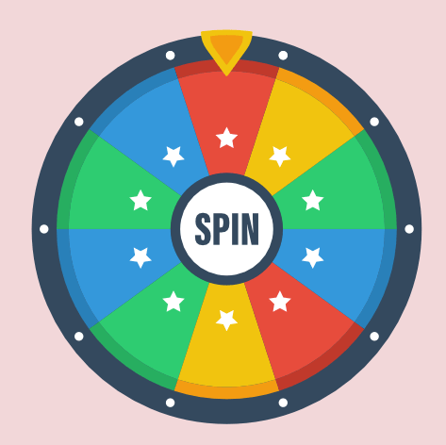
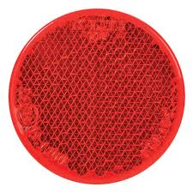
Need to incorporate the spin wheel into the design. Refer to next slide for example.
The above is an example of a 10 segment wheel. The 4 x minor prizes to take up 2 x segments each with the Vegas Prize to take up the remaining two segments. In each wheel segment include image & text of the prize ie:
- Two segments to the Narva Torch - (segments not next to each other)
Two segments for Narva BT Speaker - (segments not next to each other)
Two segments for Narva Drone -(segments not next to each other)
Two segments for Narva Car Charger - (segments not next to each other)
Two segments for Narva Car Fridge - (segments not next to each other)
Two segments for the Vegas Prize – Use Vegas icon for the image - (segments not next to each other)
Place a round Narva light in the middle of the wheel

Slide 4
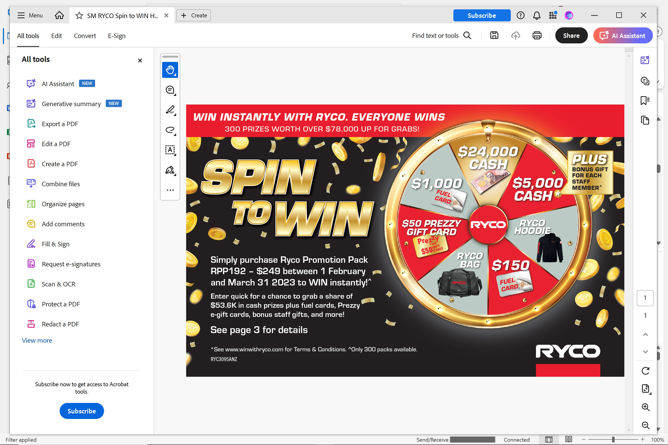
SPIN TOP WIN DESIGN EXAMPLE
The above is a good layout example to follow.
It shows the headline & Spin To Win wheel clearly
We need to include the other images (slide 2 detail) so suggest we put that info on the left hand side under headline with the wheel on the right though feel free to exercise creative license.
You may need to reduce things to make everything fit as we don’t it looking too cluttered
Use different colours to the above as the client has seen the above example. Also use a different icon to the coins if you can find something similar that represents vegas and winning otherwise use coins in a different way.

