Slide 1
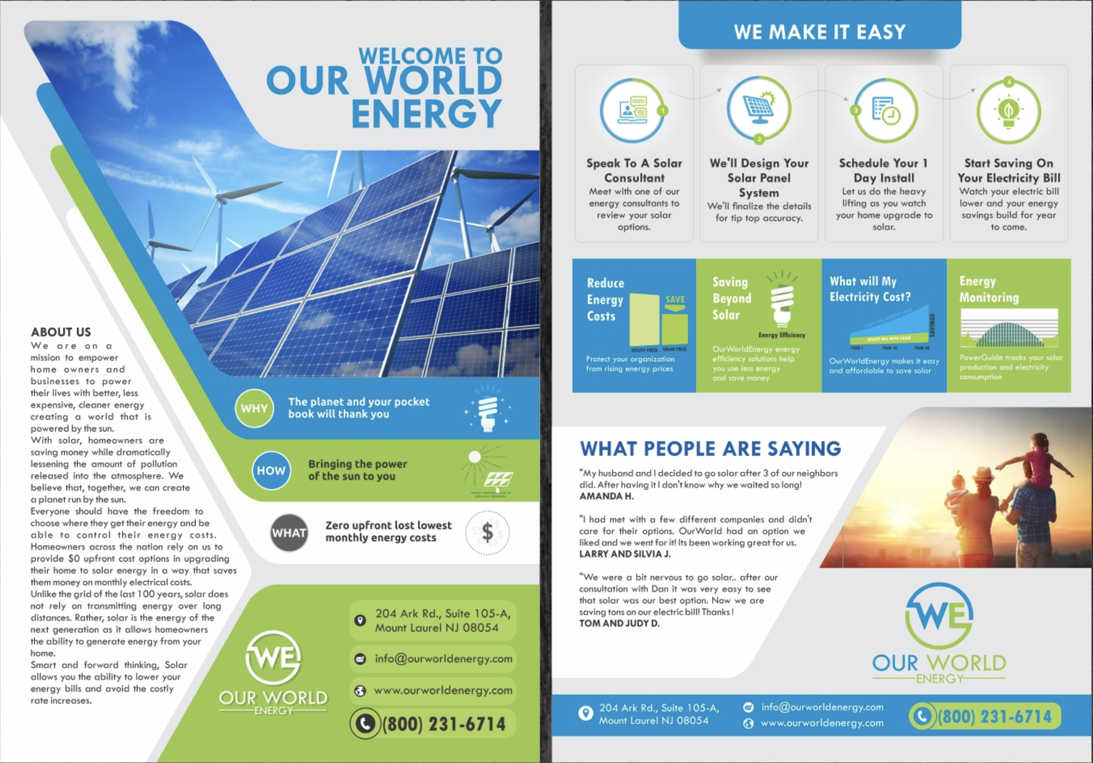
4
8
6
5
1
2
2.1
3 or 7
7 or 3

Slide 2
Instructions :
We would like to have a catchy yet professional looking flyers (we are engineers running a solar installation company),
We would like that the reader understands easily (visualy) what we do by looking at the front page (so maybe the general layout of the elements could be modified to this means)
In previous slide, I added numbers in the different zones of your template, each number refering to a slide with the specified text we want.
As we are very bad in design we would like you to suggest designs or visual layouts that serve the best to the marketing purpose (the flyer should be clear, visual and engaging for the consumer - the consumer should understand directly what we do and our added-value compared to other installators).
For example, for we think it must be on front page, and we feel that it is better to have a beautiful layout with icons, but we are not capable of doing it ourselves.
Thank you so much !!!
6

Slide 3
1
At CGS Énergies, we believe it’s time to regain control over the way we produce and use energy.
In a context shaped by the energy transition and price fluctuations, producing and managing your own energy is both a responsible and intelligent choice. It’s a concrete way to reduce your bills, add value to your home, and gain independence.
Founded by two civil engineers with expertise in sustainable energy systems, CGS Énergies brings together the precision of an engineering office and the know-how of an installation company, going well beyond the simple supply of equipment.
We design custom energy systems involving solar panels, batteries, heat pumps, EV chargers, and thermodynamic water heaters, based on your actual consumption data, using an in-house optimization tool that makes the most of every kilowatt-hour produced and consumed.
We work with homeowners, businesses, and co-ownerships, providing clear advice, reliable technical studies, and transparent quotations, without oversizing or unnecessary costs.
Choosing CGS Énergies means more than investing in an installation. It means choosing sustainable energy autonomy, supported by dedicated engineers and technicians who design with precision, install with care, and stand by their clients over time.

Slide 4
2
BUSINESSES & CO-OWNESHIPS
CGS Énergies design and install reliable collective infrastructures that meet the latest technical and regulatory standards.
Our engineers carry out comprehensive design studies for your projects, including:
• Certified charging and fire detection infrastructures, fully compliant with current fire safety regulations
• Collective electricity and heat production systems, combining solar panels with heat pumps and hot water storage
• Implementation and management of energy sharing between dwellings and electric vehicles
With extensive experience working alongside co-ownership associations, we understand the specific challenges of collective projects and provide clear and pedagogic guidance at every decision stage.
From design to commissioning, we ensure full project control to turn your buildings into active contributors to the energy transition.

Slide 5
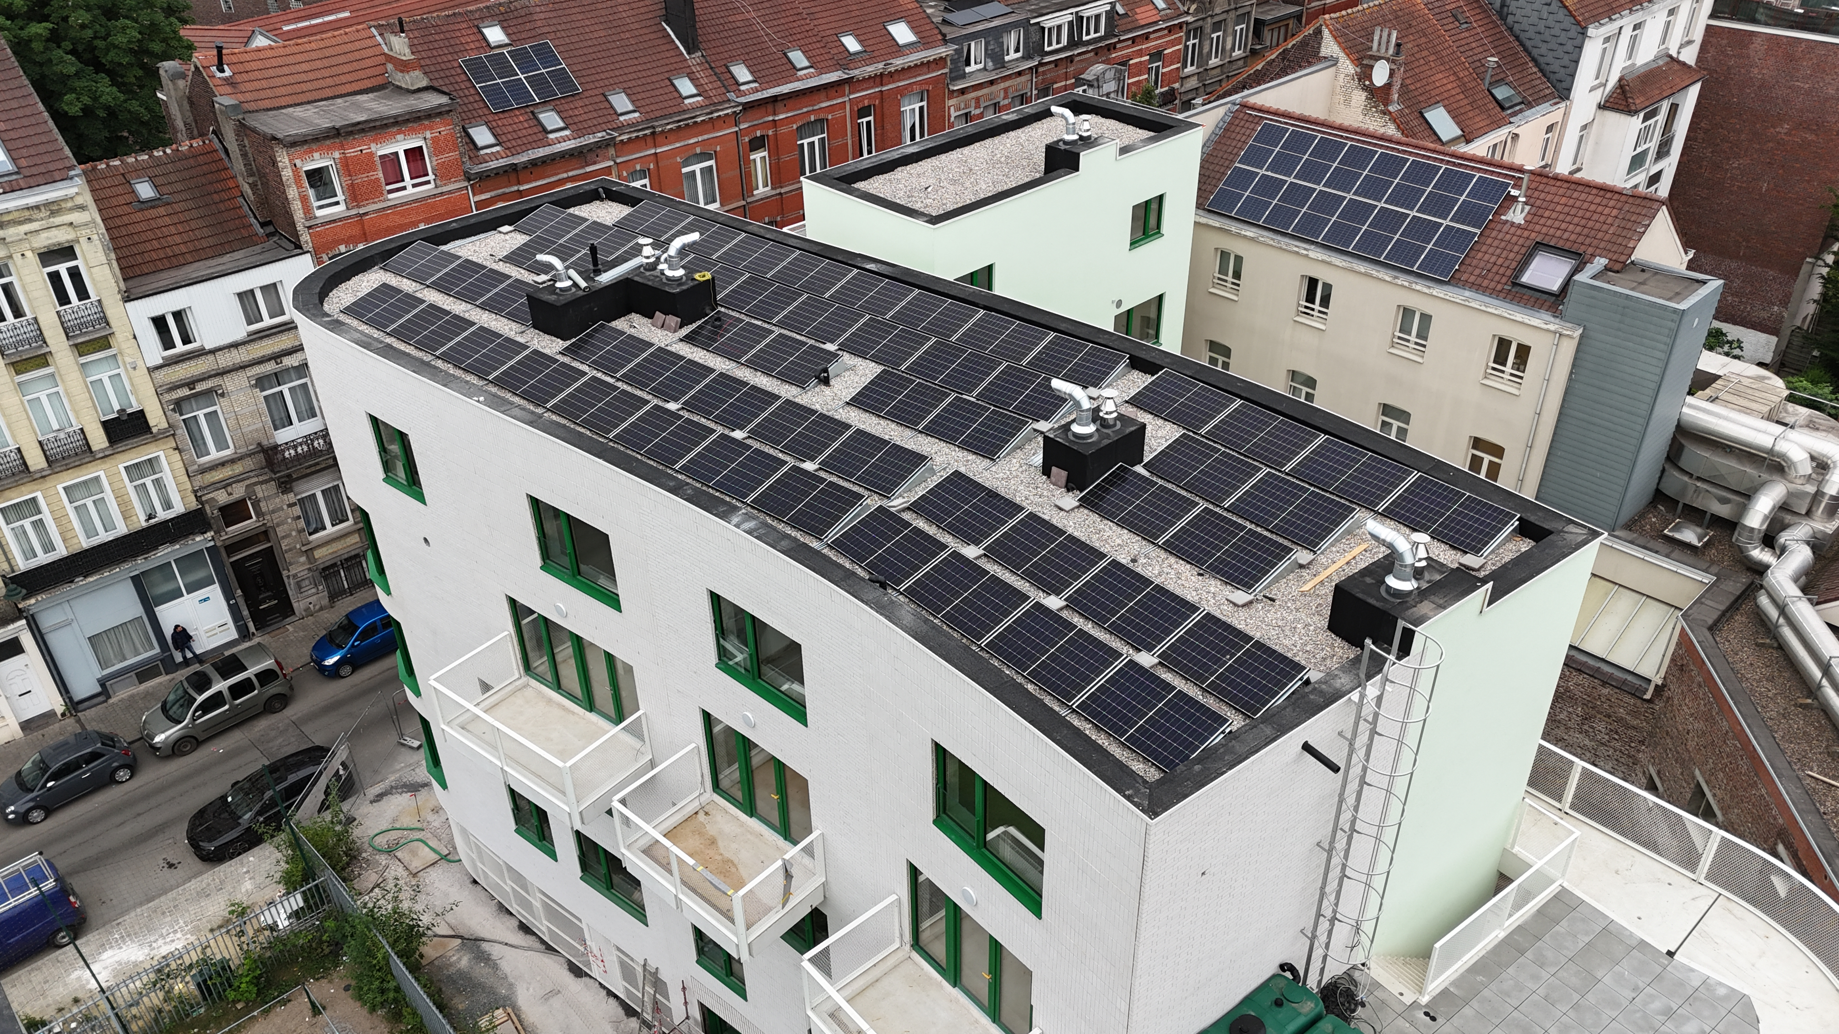
2.1
This picture

Slide 6
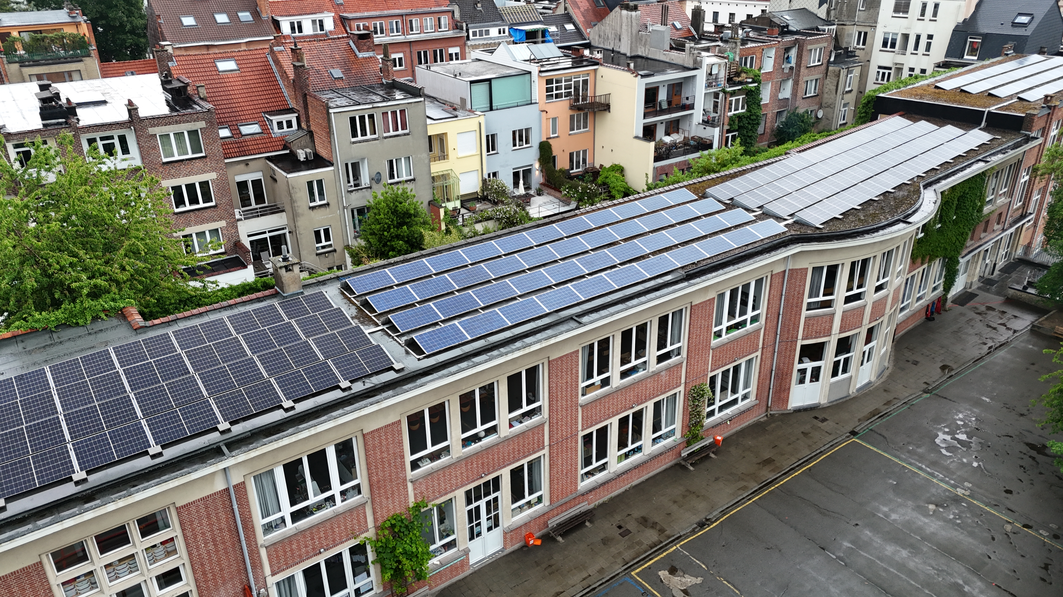
2.1
Or that picture

Slide 7




3
Did you know ?
With CGS Énergies, you can choose a third-party investment model to enjoy solar energy without covering the initial cost.
When values matter as much as the wallet, choose Belgian-made solar panels — a guarantee of quality, durability, and support for the local economy.
(can you please do this in a more proper way please?)
Belgian solar energy for all

Slide 8
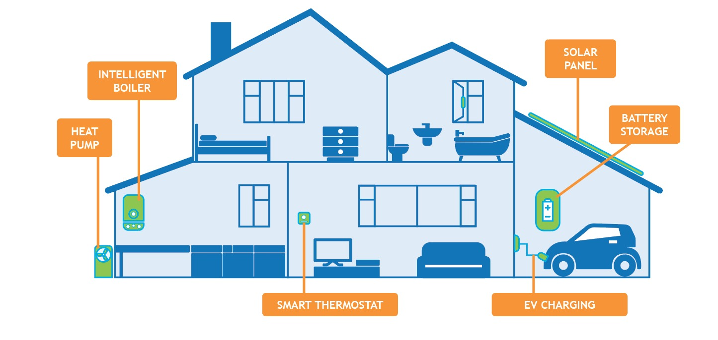
4
NOS SERVICES
(a better version of this picture will be generated but you can start with this one)

Slide 9
5
-
Our mission: Analyze with rigor. Design with precision. Install with excellence.
Your goals: Lower your energy bills. Improve your energy rating. Gain autonomy.
The vision: Decarbonize buildings. Promote local energy. Accelerate the transition.

Slide 10
6
Cut your energy costs, for good. | Take control of your power. Generate your own electricity and lower your bills by up to 80% with high-performance solar systems tailored to your needs.
Store smart, use wisely. | Get the most out of every kilowatt with our smart batteries and optimized hot-water management solutions.
Decarbonize heating, not comfort. | Say goodbye to fossil fuels. Our air-to-water heat pumps harness clean energy from ambient air and the sun to keep you warm efficiently and sustainably.
Heating during winter, cooling during summer. | When the heat rises, the sun becomes your best ally. Paired with an air-to-air heat pump, it keeps your home cool without driving up your bills or your footprint.
-

Slide 11
6
-
Reduce your energy bills. | Save up to 80% on electricity with efficient, high-performance systems.
Smart storage and flexibility. | Maximize self-consumption with intelligent battery systems.
Comfort meets efficiency. | Enjoy efficient heating with heat pumps and thermodynamic water heaters.
Monitoring and optimization. | Monitor your installation remotely and manage your energy in real time.

Slide 12



7
-
Tomorrow’s energy today
Parlez-nous de votre projet !
+32 478 99 52 99
info@cgs-energies.be
cgs-energies.be

Slide 13
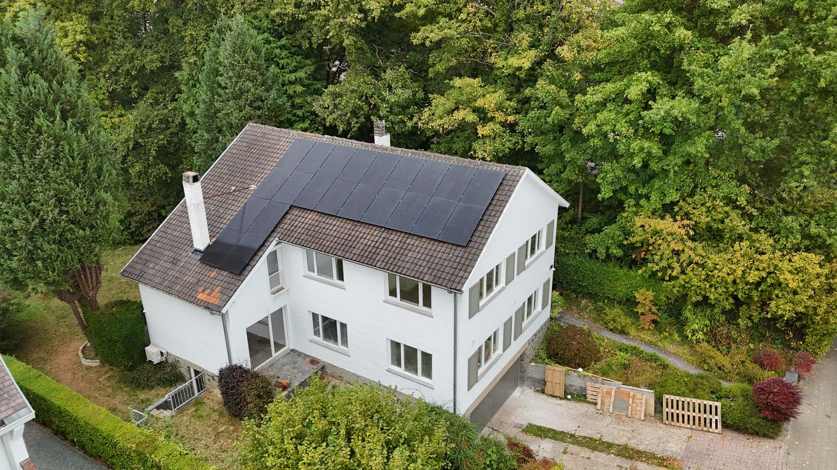
8
-

Slide 14
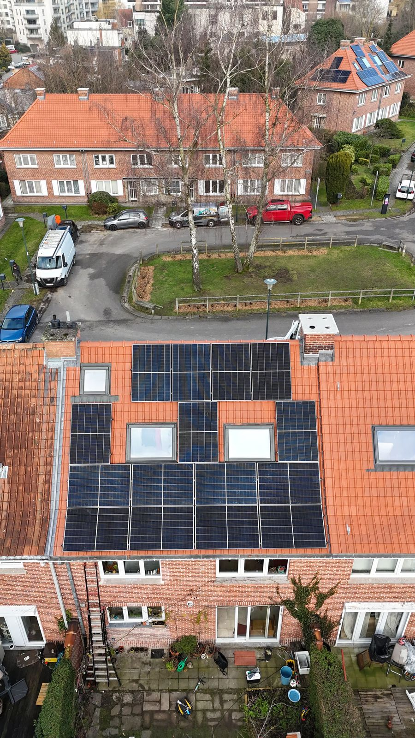
8
-

Slide 15
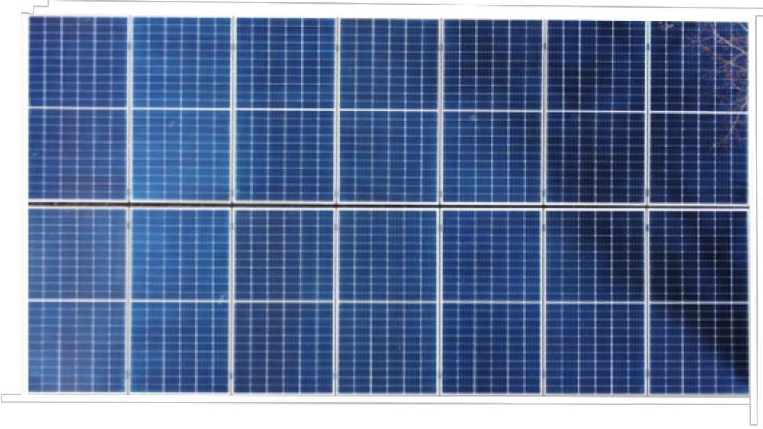
-
Tomorrow’s energy today

