Slide 1
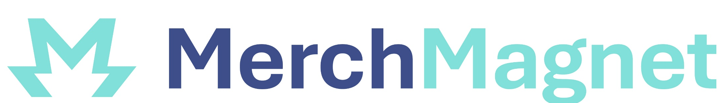
Custom Merchandise. Powerful Partnerships.

Slide 2
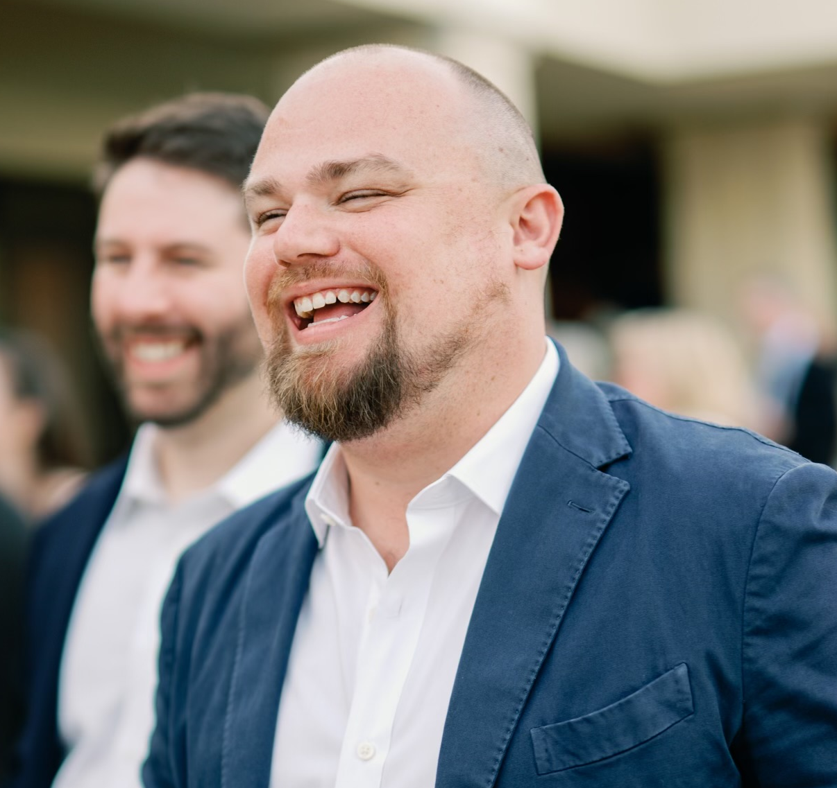
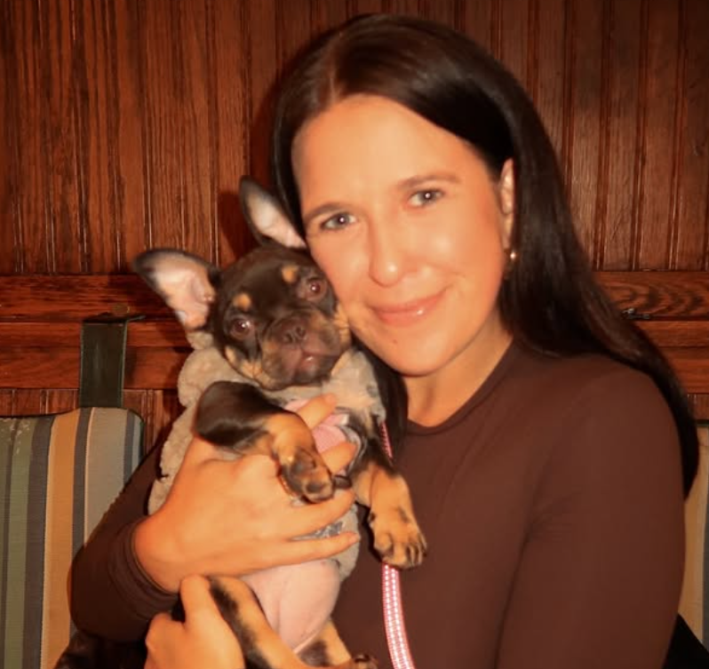
Who We Are
MerchMagnet partners with brands and nonprofits to design, produce, and manage impactful merchandise programs that build engagement, raise awareness, and drive revenue.
We work with clients across corporate, nonprofit, and entertainment sectors transforming their vision into tangible, memorable products that resonate with their audiences.
We are two Retail & Data Executives with a combined 25 years experience looking to streamline and perfect the merch experience.
Ross Vigeant
Chelsea Corrado

Slide 3
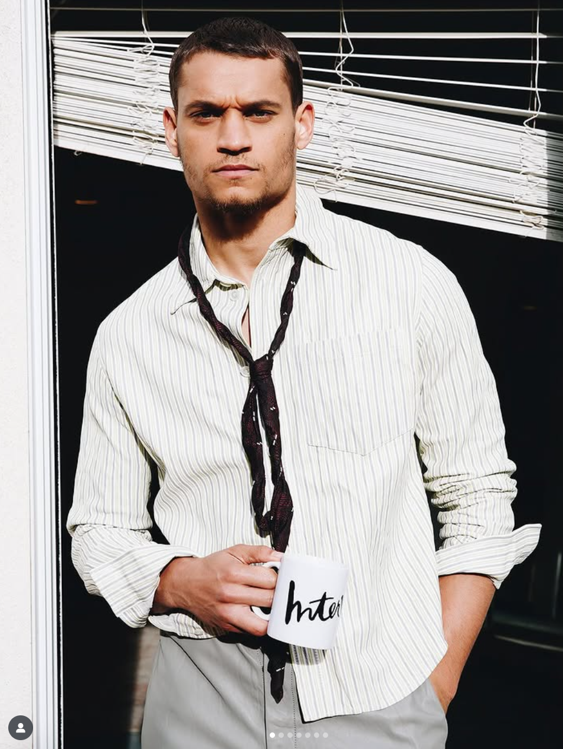
What We Do
Design & Sourcing
Creative concepts and strategic product selection tailored to your audience
Custom Branded Merchandise
Production of high quality, custom products that reflect your brand identity
Ecommerce & Fulfillment
End-to-End management of online stores and global shipping logistics
Cause-Based Campaigns
Fundraising merchandise that drives revenue and amplifies your mission
Event Activations
Large-scale event merchandise and branded experiences

Slide 4
Our Process
Discover
Understand your brand, goals and audience through collaborative consultation
Design
Create visuals and product concepts that authentically tell your story
Produce
Manage sourcing, decoration and rigorous quality control
Deliver
Handle fulfillment, shipping and logistics globally with precision

Slide 5
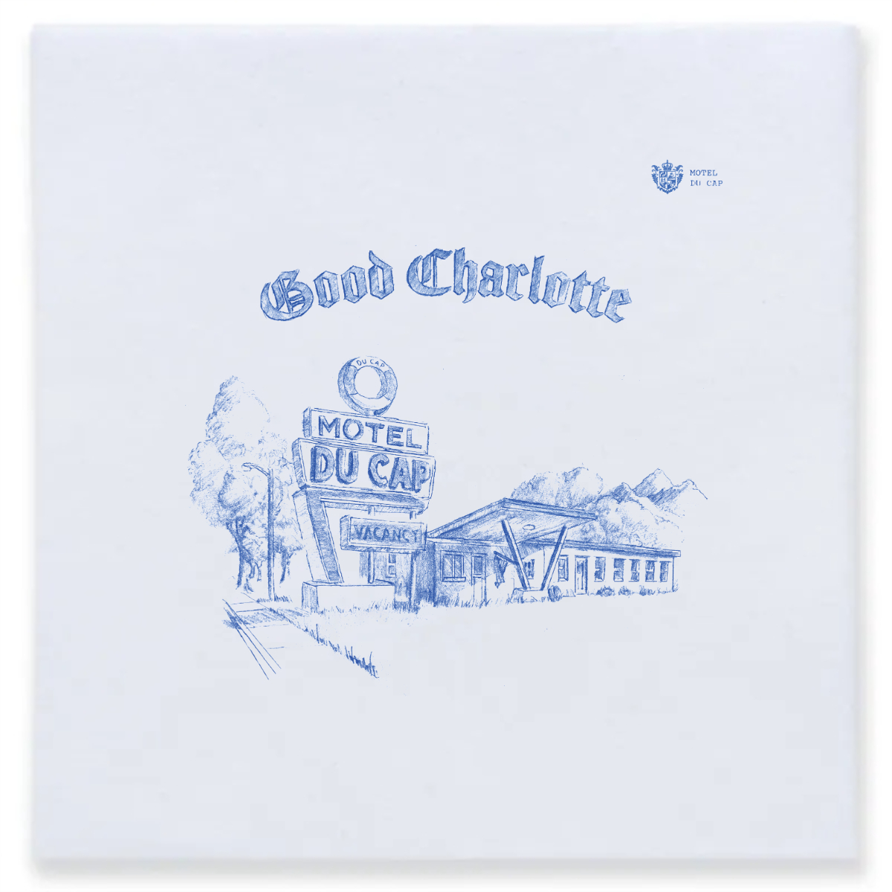
Why MerchMagnet
Hands On Service
Premium Product Access
Fast & Transparent
No automated portals or impersonal vendors, just dedicated partnership and personalized attention to your unique needs
Curated selection of sustainable, trending and high-quality product lines that elevate your brand
Quick turnaround times with clear, upfront pricing and no hidden fees or surprises
Proven Track Record
Trusted experience working with Fortune 500 companies and national non-profit organizations

Slide 6
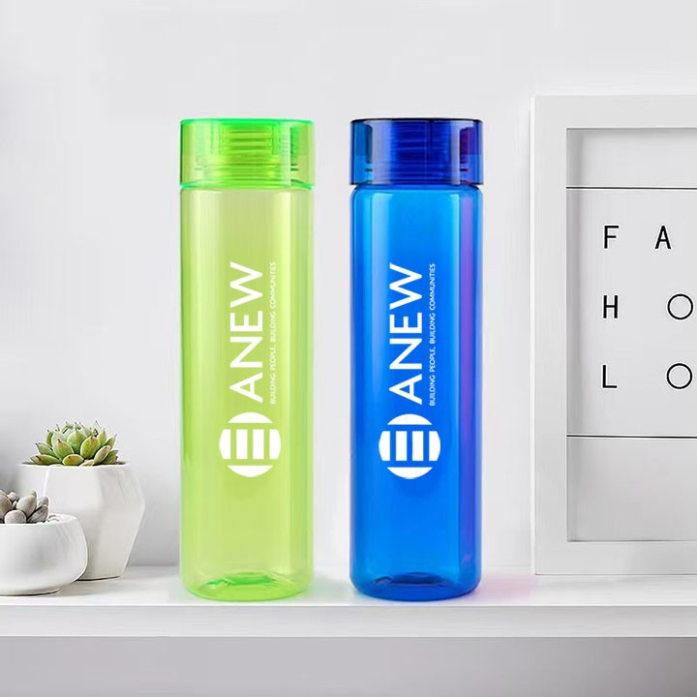
Industries We Serve
Corporate/Employee Engagement
Strengthen company culture with branded merchandise and recognition programs
Music & Entertainment
Artist merchandise and fan engagement products that tbuild lasting connections
Non-Profits & Fundraisers
Mission-driven merchandise that amplifies awareness and generates revenue
Events & Conferences
Memorable branded experiences and promotional items for attendees
Eduction & Alumni Relations
School spirit products and alumni engagement merch
Consumer Brands
Retail-quality branded products that extend your brands reach

Slide 7
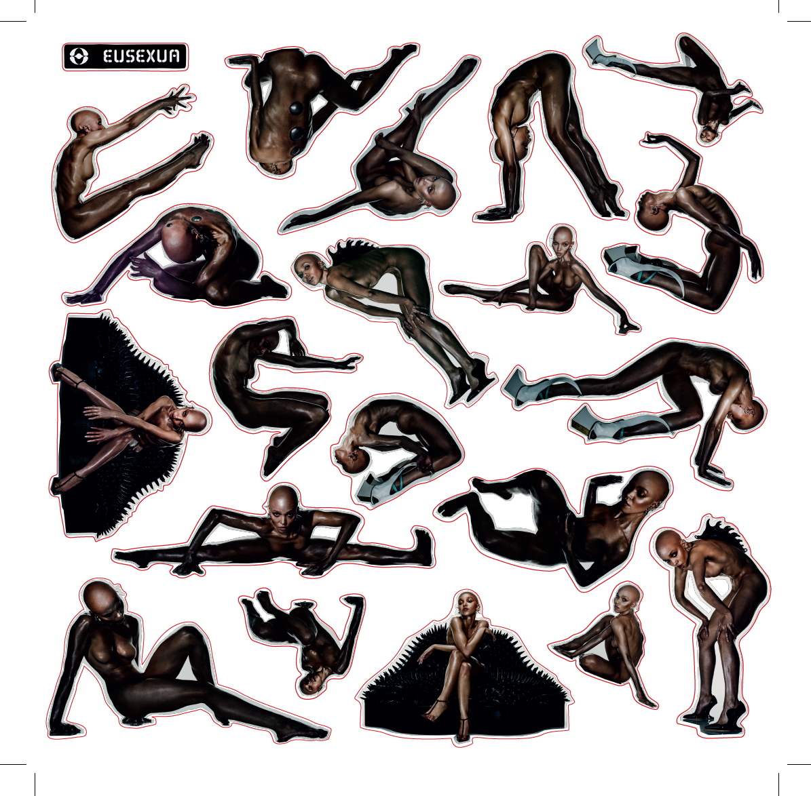
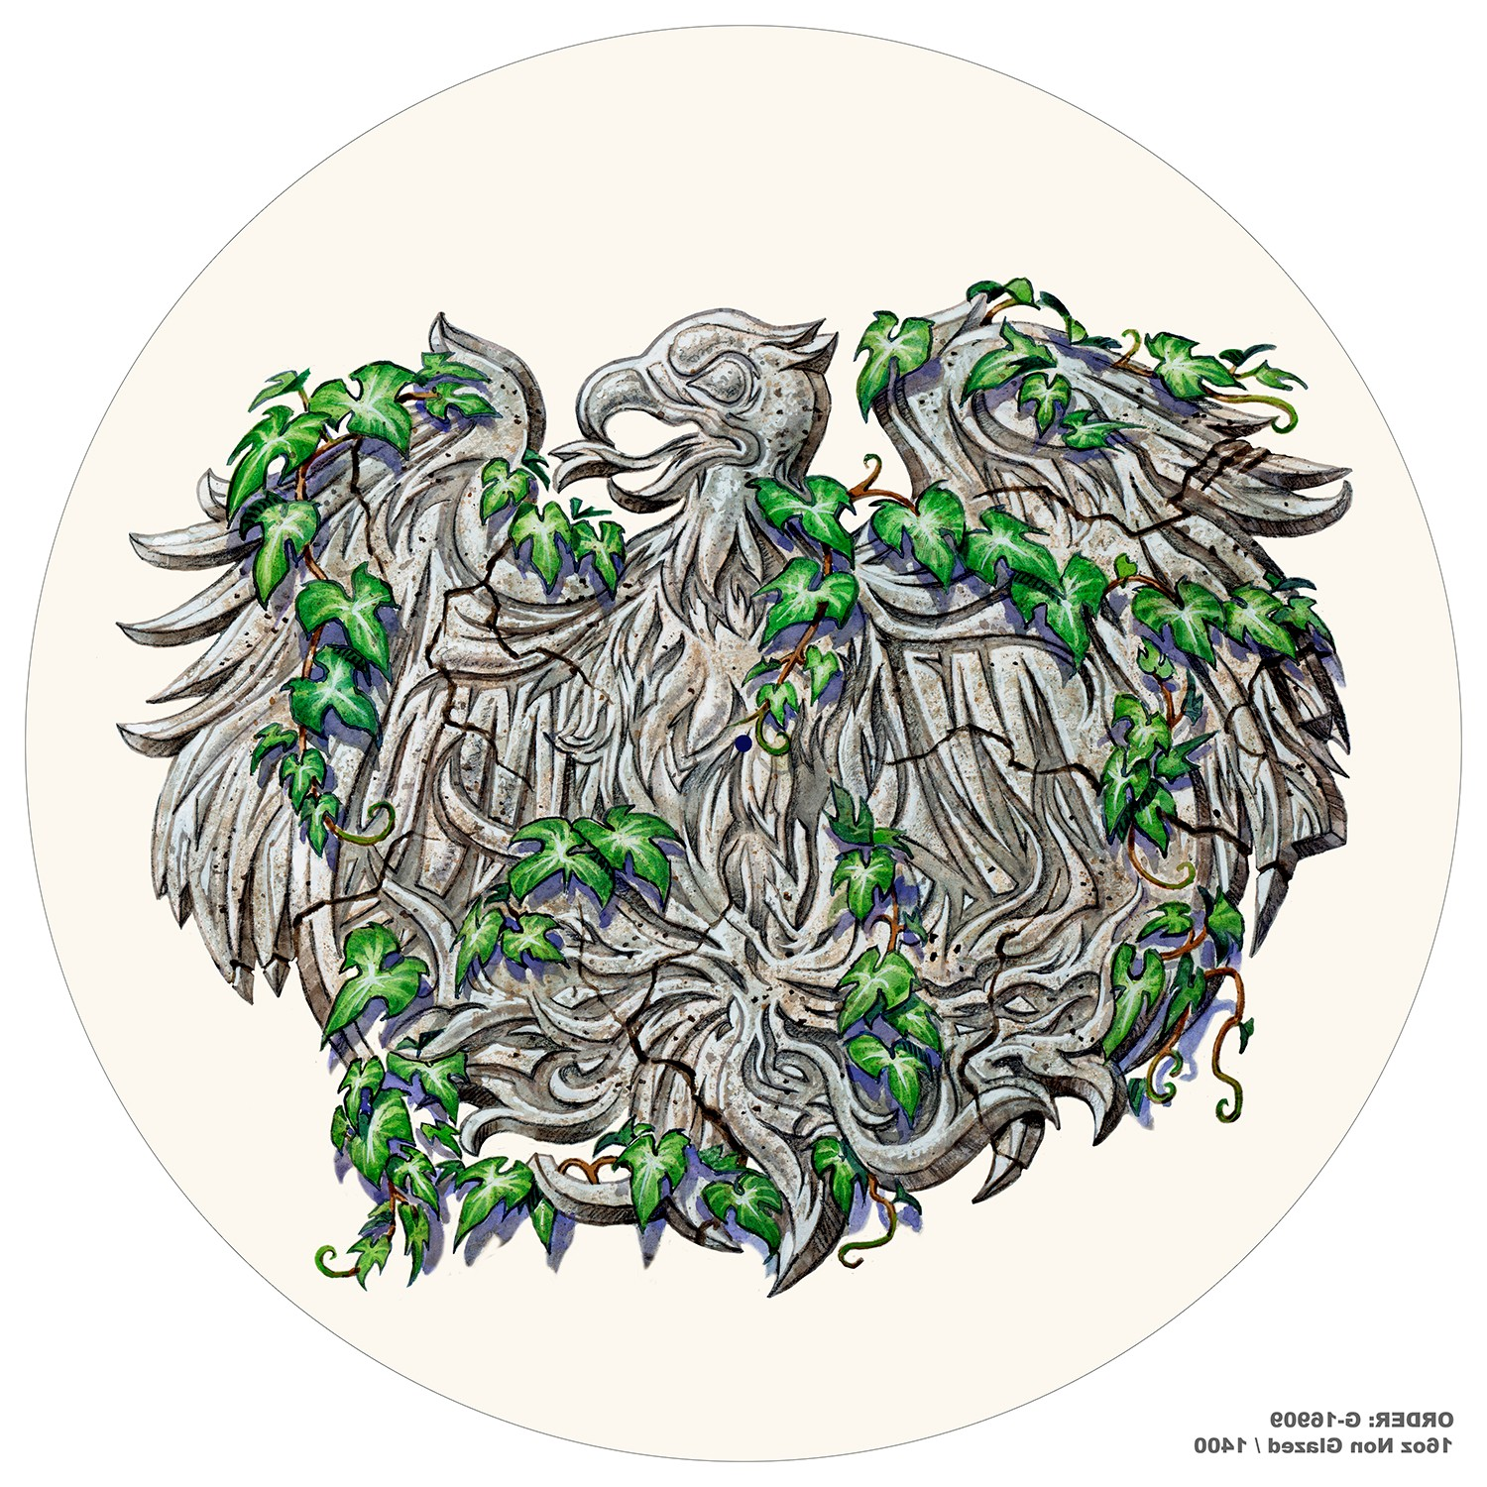
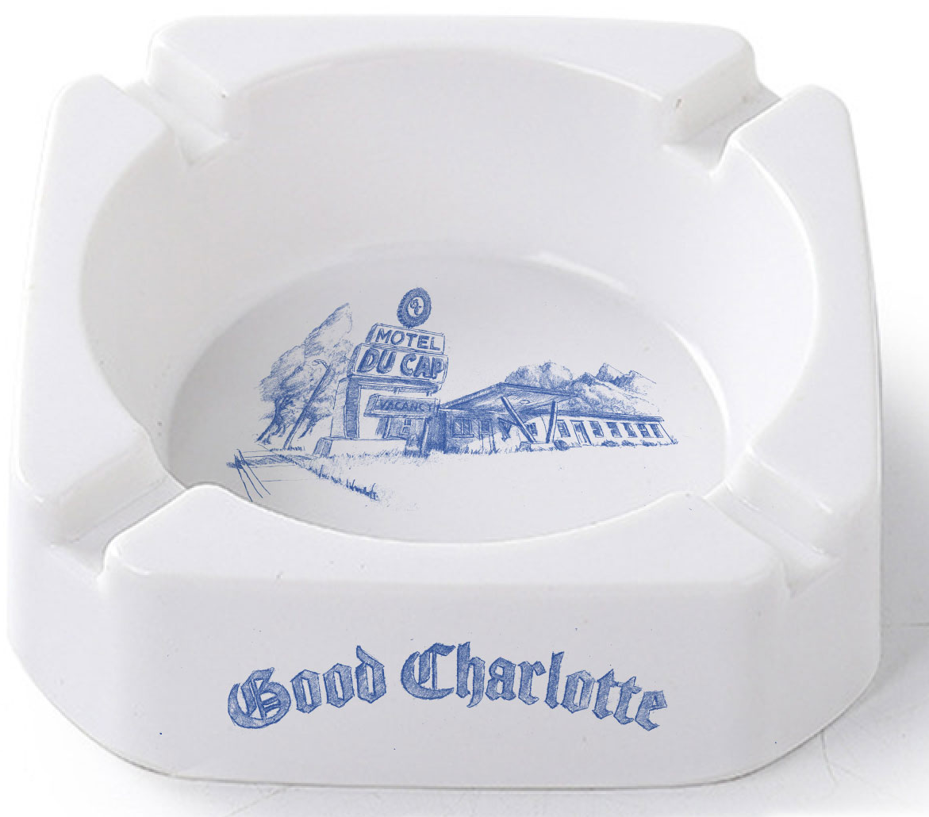
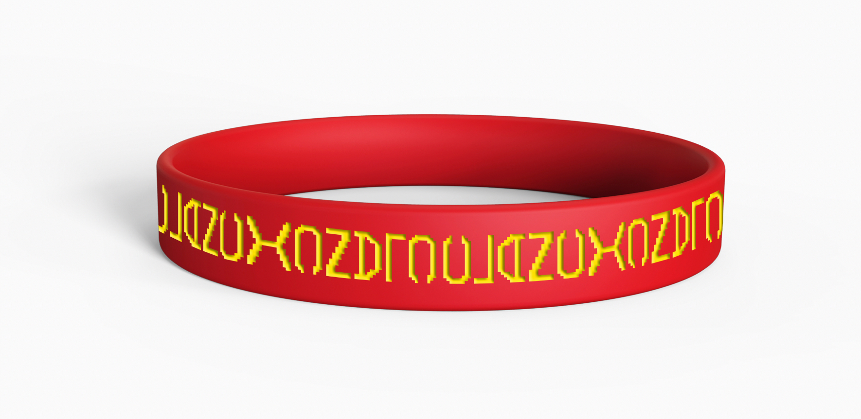
Warner Music Group
WMG partnered with MerchMagnet to develop custom, high-quality merchandise that reflected the individuality of its artists and elevated fan engagement. With overlapping launch timelines and rapid production needs, Warner required a reliable creative partner who could deliver quickly without sacrificing brand integrity. MerchMagnet managed design, sourcing, and fulfillment for apparel, accessories, and event merch - including limited-edition drops and influencer kits - ensuring on-brand, retail-quality products that deepened fan connection and amplified artist visibility.

Slide 8
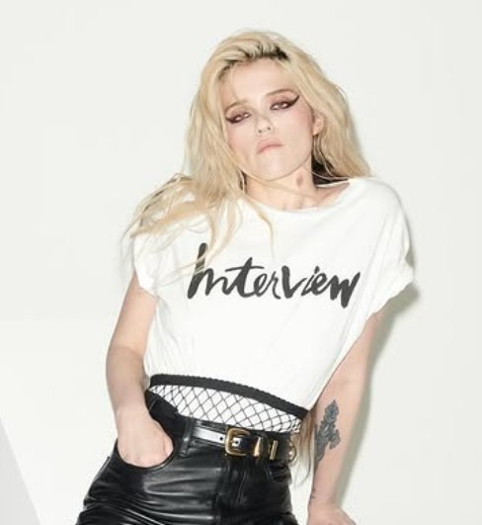
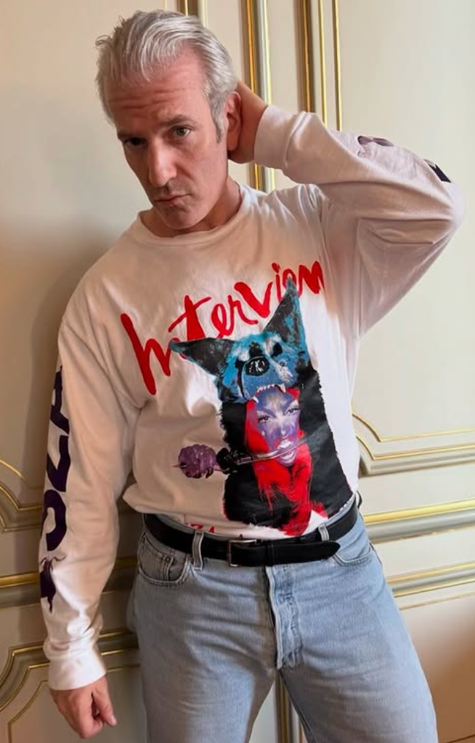
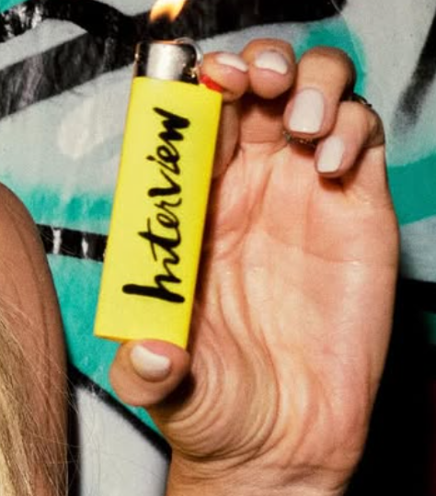
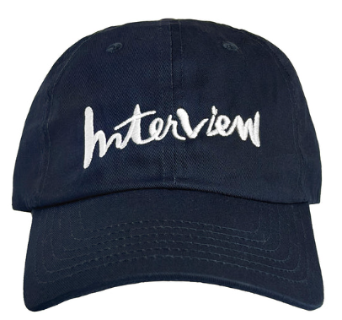
Interview Magazine
Interview Magazine partnered with MerchMagnet to design and produce stylish, brand-aligned merchandise that reflected the publication’s creative and cultural influence. From limited-edition apparel and event giveaways to media collaborations, we delivered products that captured Interview’s bold visual identity while meeting demanding timelines. The result was a curated collection that resonated with readers, artists, and advertisers - turning the magazine’s distinct editorial voice into a tangible brand experience.

Slide 9
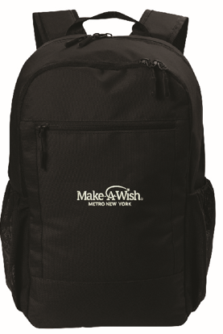
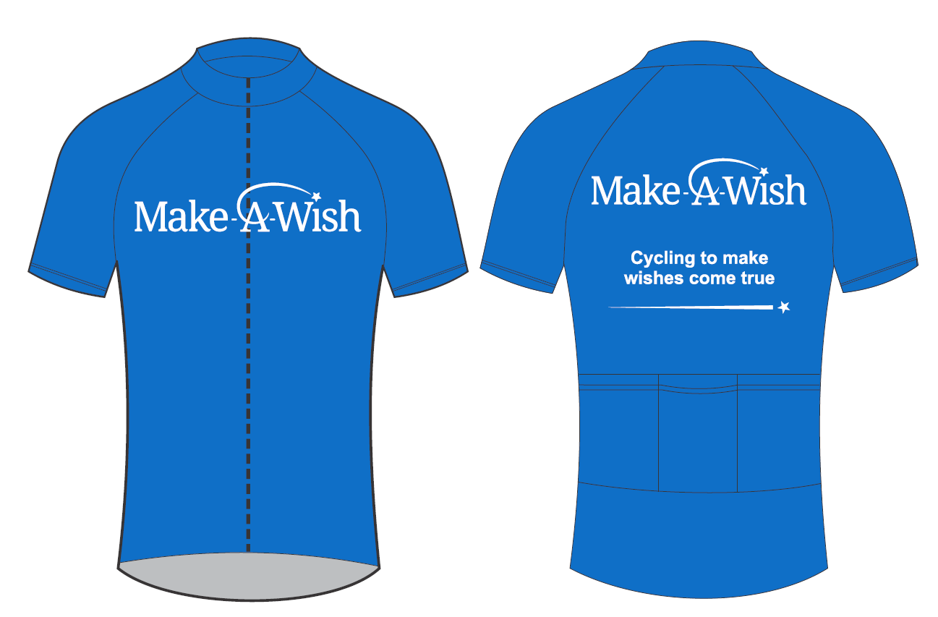
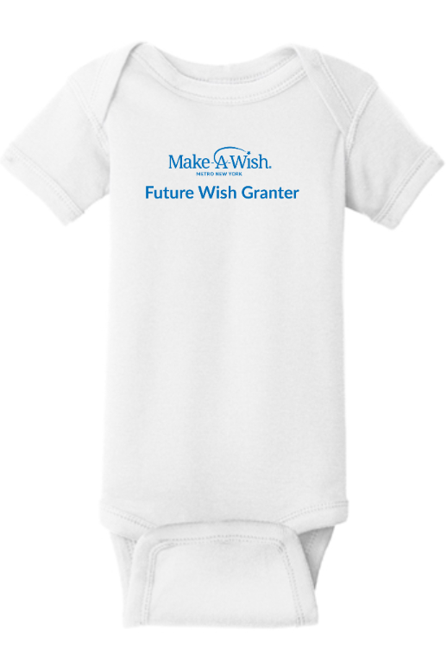
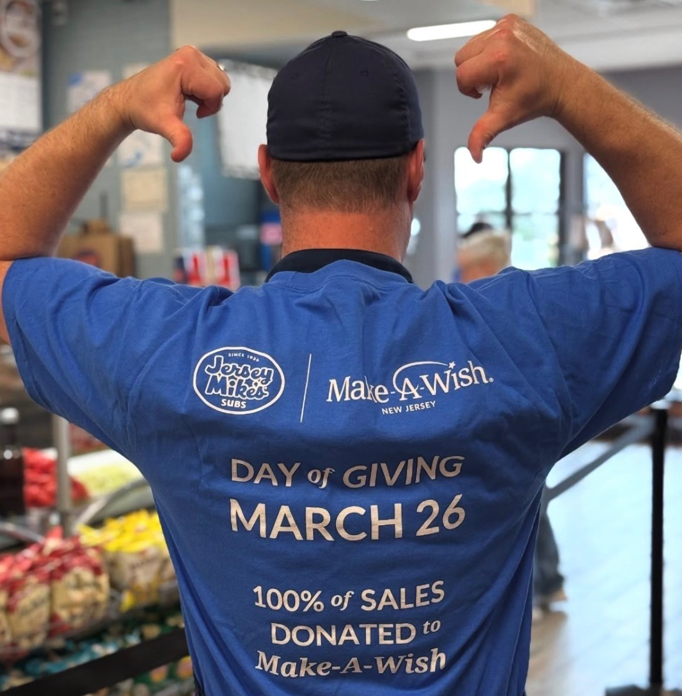
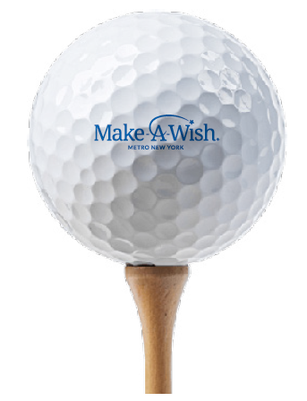
Make-A-Wish
MerchMagnet collaborated with Make-A-Wish to create custom-branded apparel, volunteer gifts, and event giveaways that celebrated the organization’s mission while maximizing value through thoughtful sourcing and production. We provided fast turnarounds, reliable delivery, and white-glove service, ensuring every piece reflected the organization’s uplifting spirit. The result: meaningful merchandise that inspired donors and volunteers alike, helping Make-A-Wish amplify its message of hope.

Slide 10
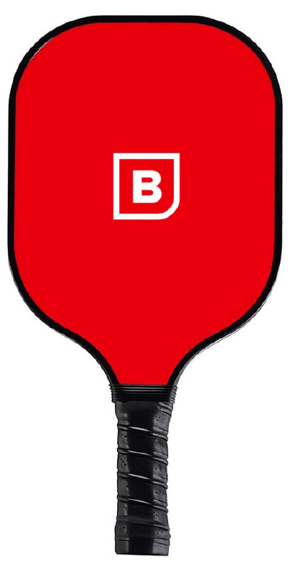
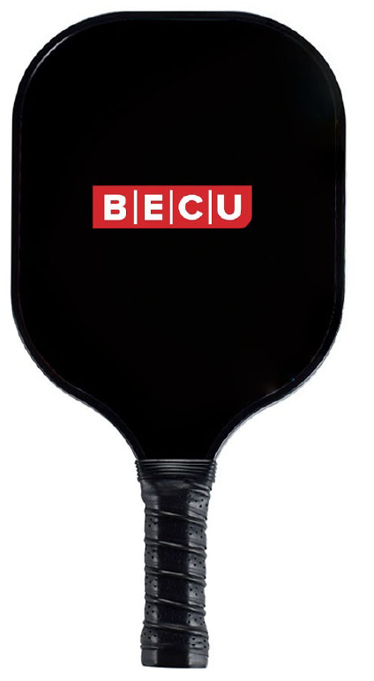
Product Range
Apparel
T-Shirts, hoodies, headwear and more in premium fabrics and styles
Drinkware
Tumblers, bottles and mugs for everyday use and sustainability
Tech Accessories
Phone cases, chargers and gadgets that keep your brand top of mind
Premium Gifts
High-end products that make a lasting impression
Eco-Friendly Lines
Sustainable and USA-made products for conscious brands
Event Displays
Eye-catching displays and custom packaging solutions

Slide 11

Let’s create together
Ready to elevate your brand with custom merchandise?
Contact us to start your next program!
Ross Vigeant
ross@merchmagnet.us
Chelsea Corrado
chelsea@merchmanget.us
https://merchmagnet.us/

