Slide 1
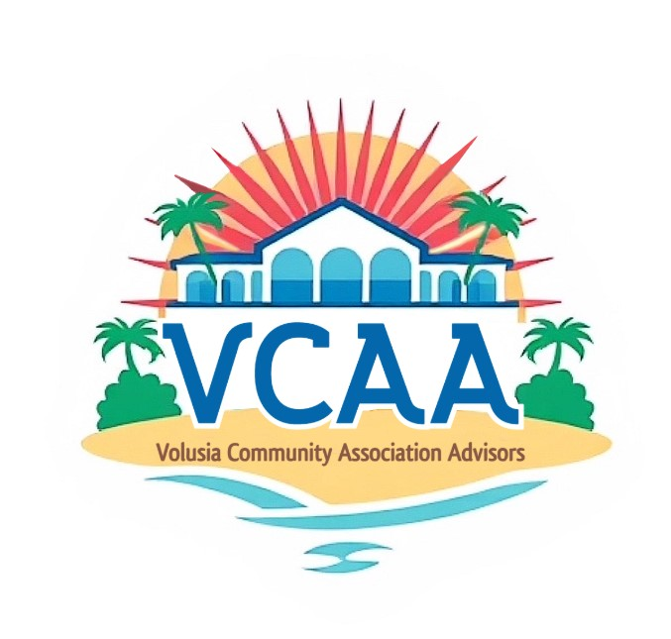

Slide 2
Welcome
Guiding Associations & Empowering Community Leadership Together
2025 Board of Directors:
Christopher Ersson, President
Andrea McCarthy, Vice President/Founder
Dara Haggerty, Secretary
Elizabeth Mandeville, Treasurer
Kelly Moyer, Director
VolusiaCAMAdvisors@gmail.com

Slide 3
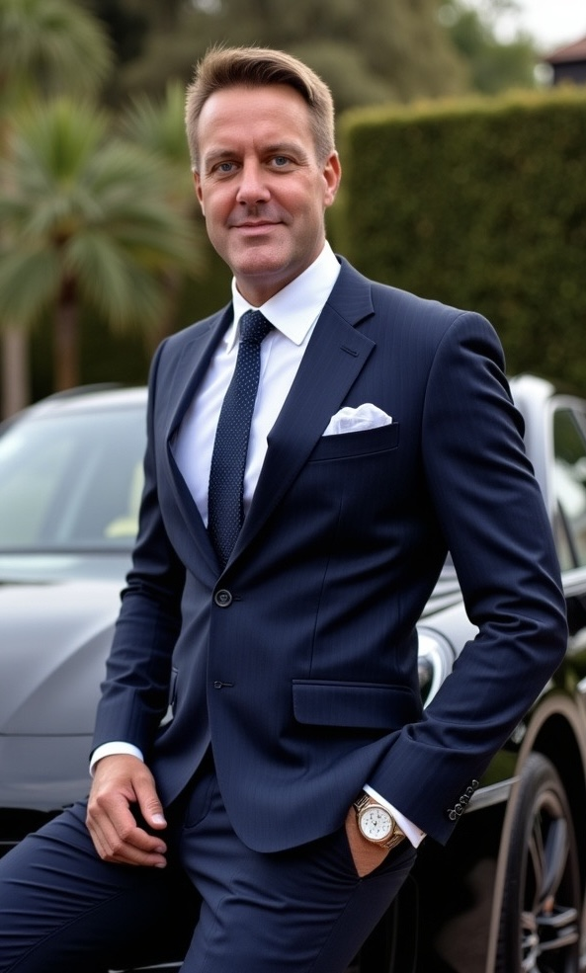
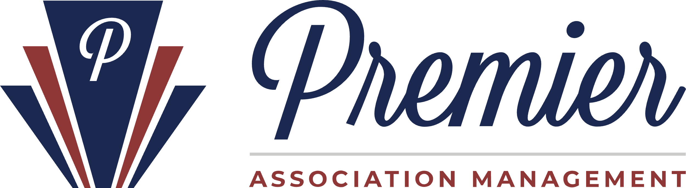
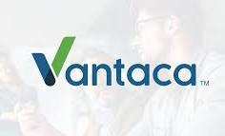
The community partner in maintaining, enhancing, protecting and preserving your community. We are advisors to your Board of Directors and implementers of decisions made by your Board.
Ormond Beach 🏝️ Lake Mary 🏖️ Clermont ⛱️ Kissimmee
Christopher Ersson
Community Association Manager

Slide 4
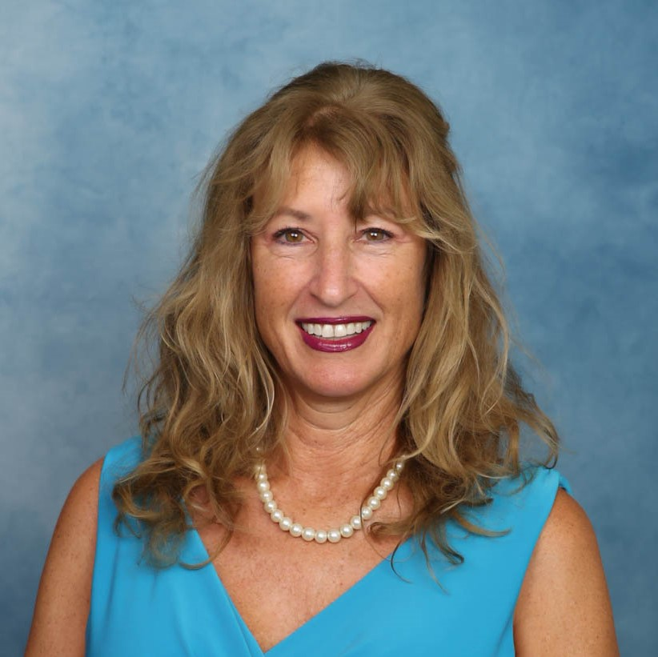
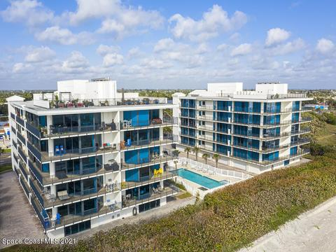
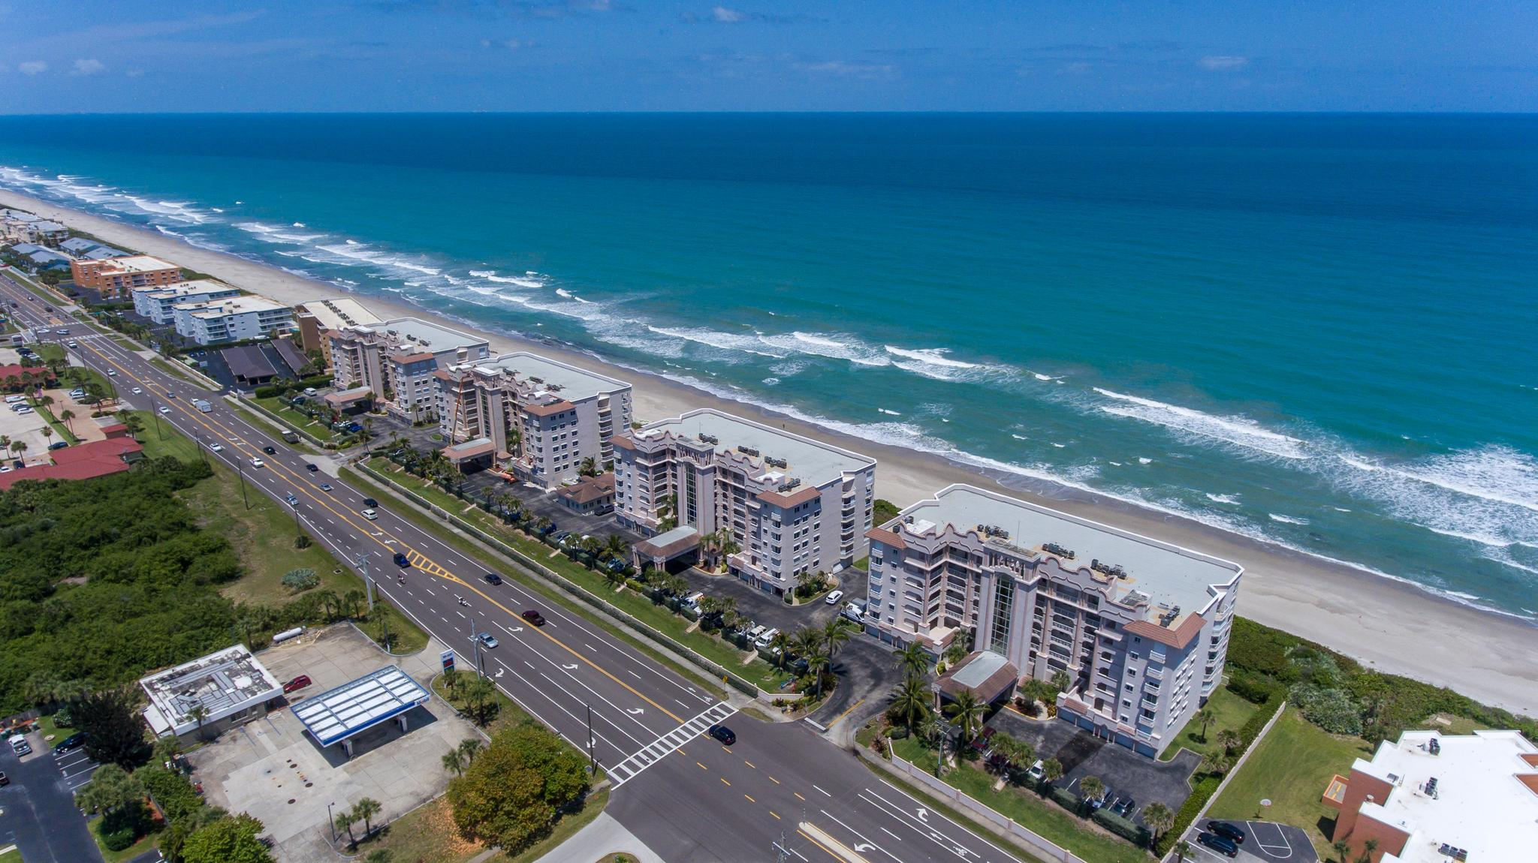

Anchor Painting Company
Andrea McCarthy
Condominium & Homeowners
Painting Experts

Slide 5

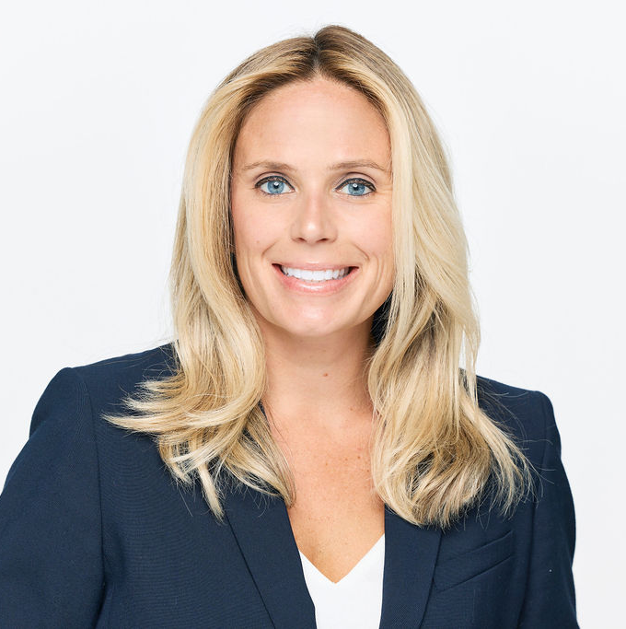
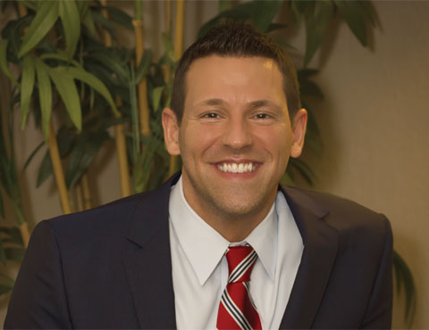
Dara Haggerty & Jason Martell
Martell & Ozim, P.A.
Martell & Ozim, P.A. dedicates 100% of its practice to the representation of condominium and homeowners’ associations. We proudly assist and support community associations with all their day-to-day legal needs and value efficient and cost-effective representation.

Slide 6

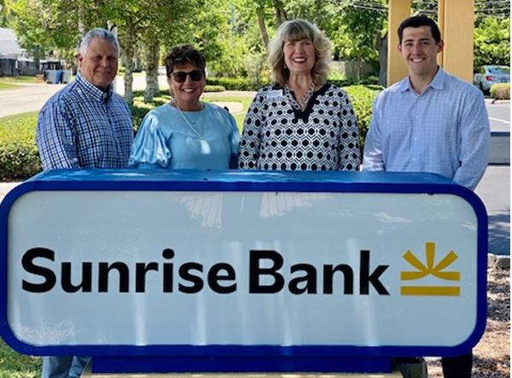
Sunrise Bank is a community Bank dedicated to working with Associations and Property management companies, we customize our products to fit your specific needs.
We are staffed with a local and experienced team of bankers within the Orange County/Central Florida Region, Volusia County and Brevard County demographic.
Some services offered via Association Banking are but not limited to:
  Payment Solutions
  Association Lending
  FDIC Covered Products
Proud member of SCCA (Space Coast Community Association), CAI (Community Associations Institute) and Chamber of Commerce, to keep up to date with the concerns and trends of today's associations. We offer the services of a large bank with the customer service of a Community Bank.

Slide 7
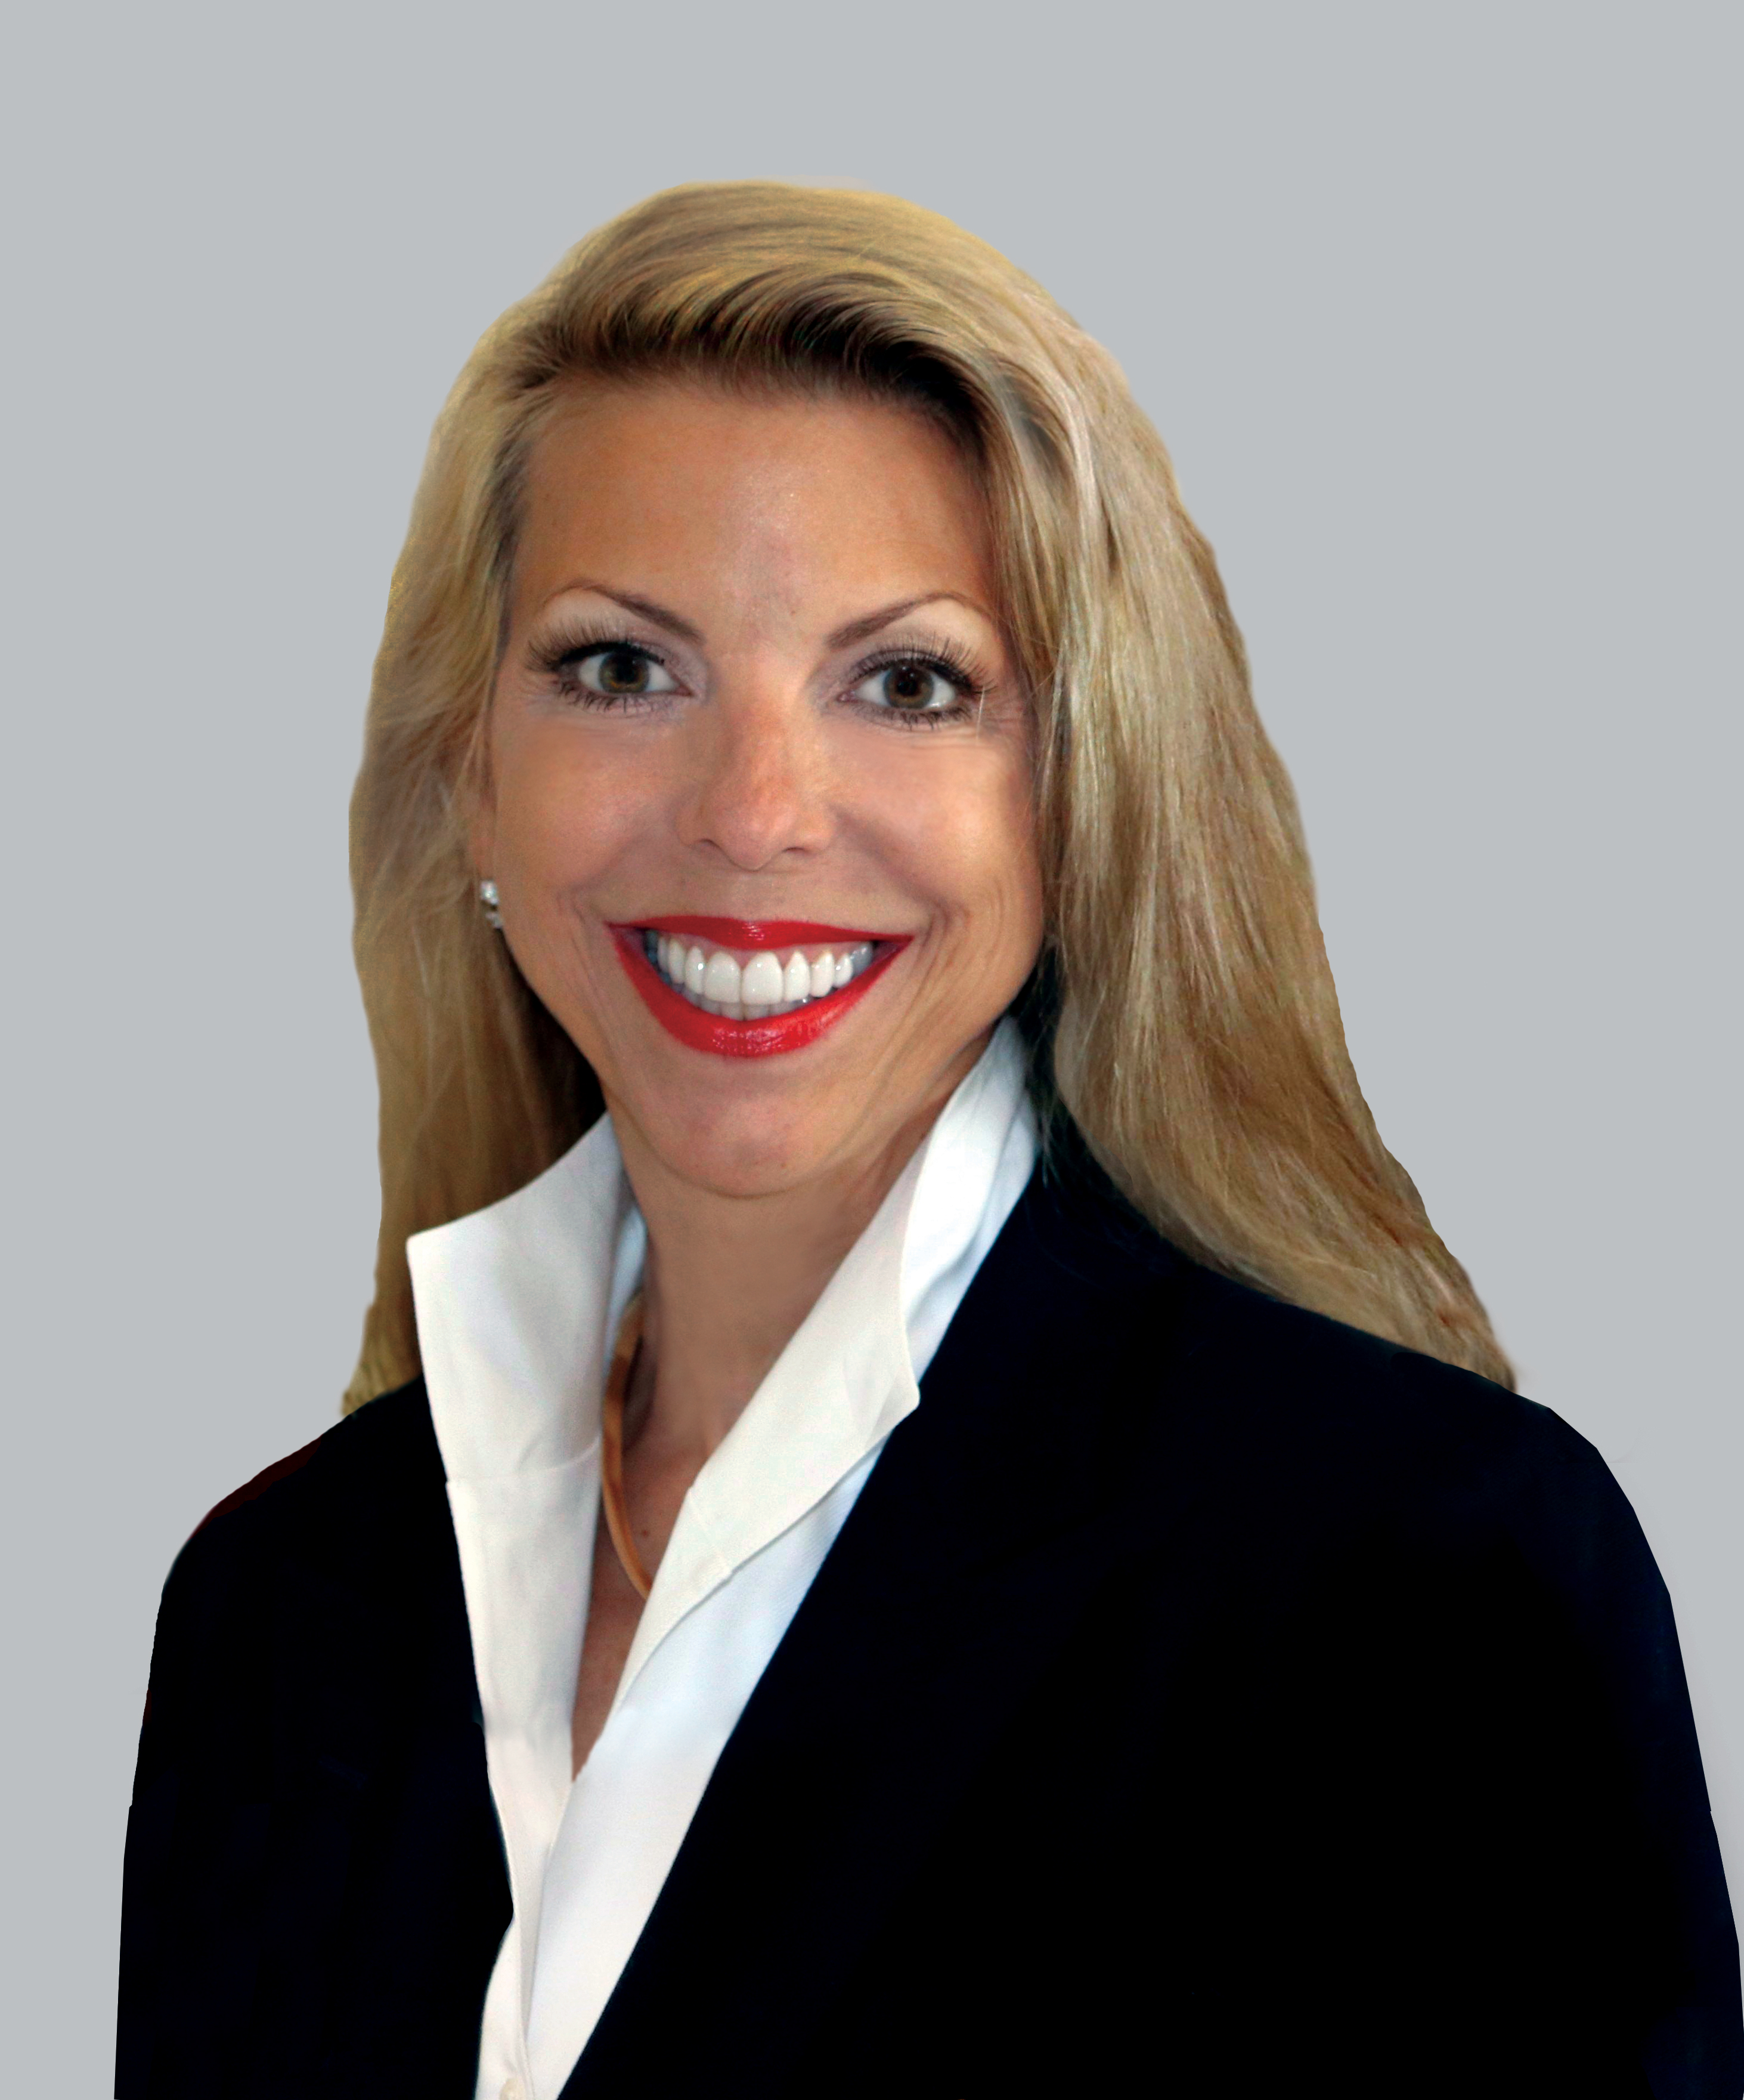
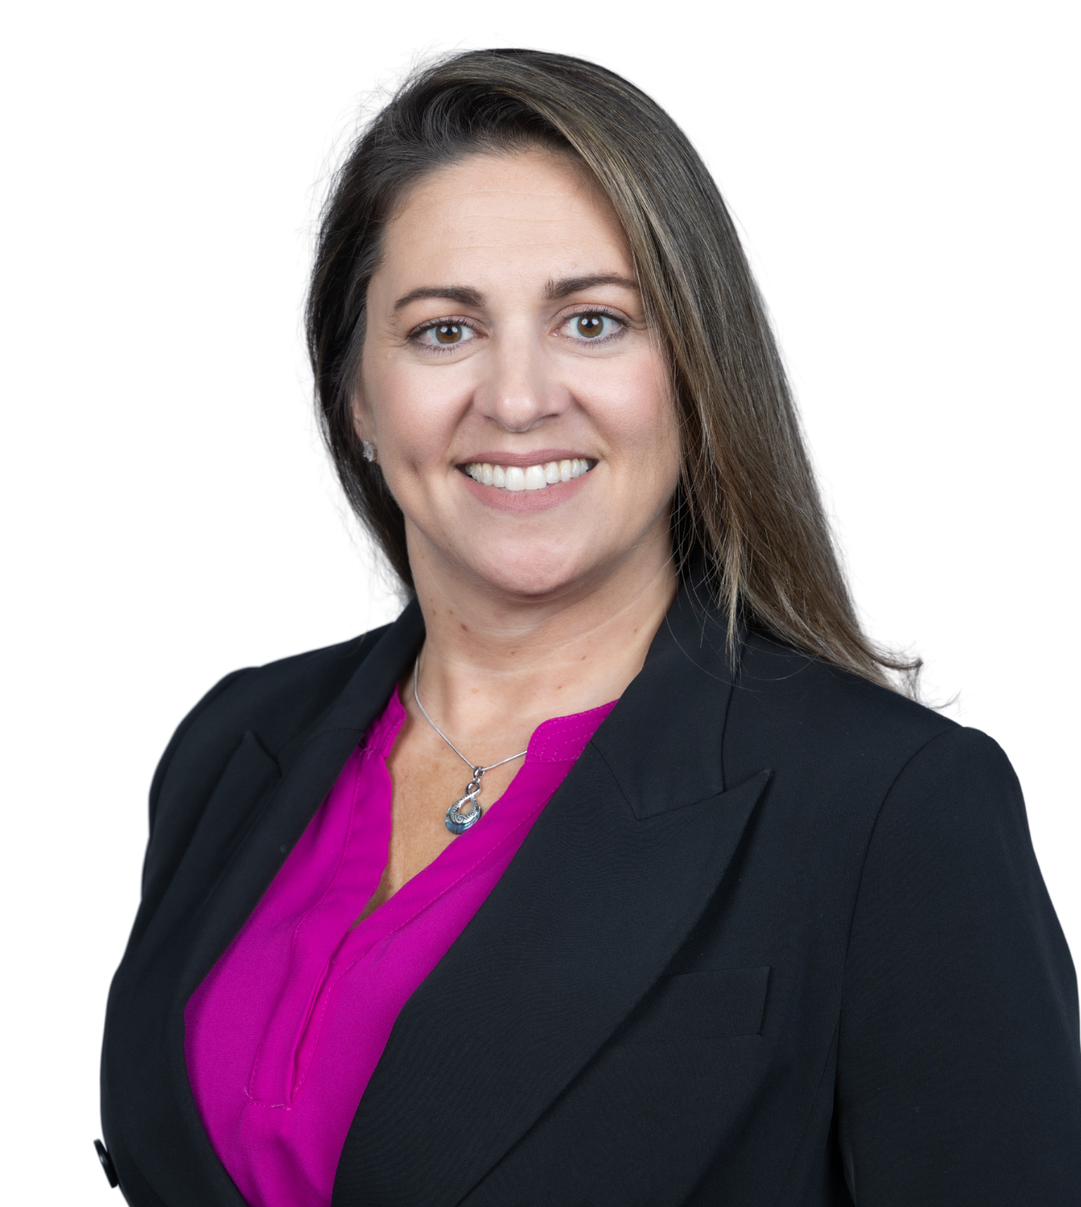
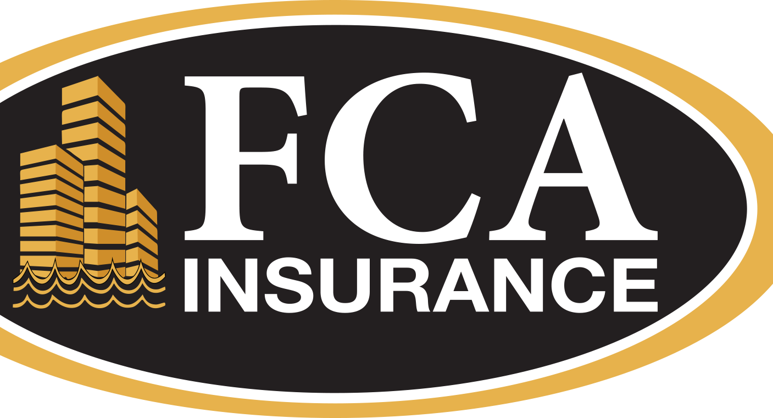
Kelly Moyer & Star Herbig
FCA is one of the largest condominium and homeowner association insurance and certified risk management firms in Florida and honored to win the prestigious "Diamond Level Choice Award" for 8 consecutive years. FCA is recognized for their high ethical and transparent business practices and has formed strong alliances with the largest national and regional brokerage firms and insurance carriers. This enables building the most effective and comprehensive customized association insurance programs designed with indisputable protection for the board of directors, association property, liability and other essential coverage. In addition to offering customized affordable insurance programs, FCA also assists with managing claims. Handling association claims is one of the most difficult events for a property manager or board member to handle. FCA provides claims assistance through their exclusive Emergency Management Team (EMT) claims support program and works closely with property managers, boards and residents to seamlessly manage the claims process.

Slide 8
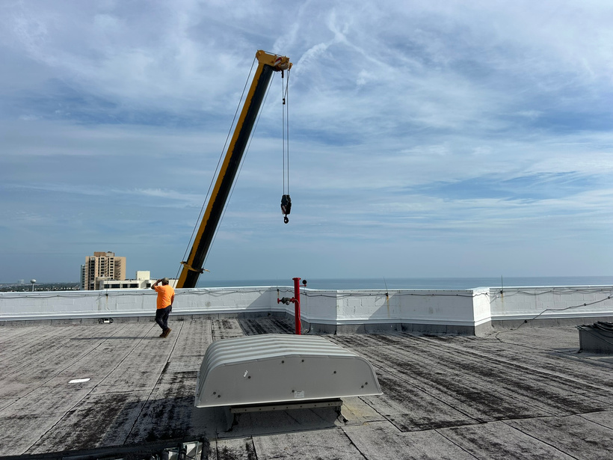
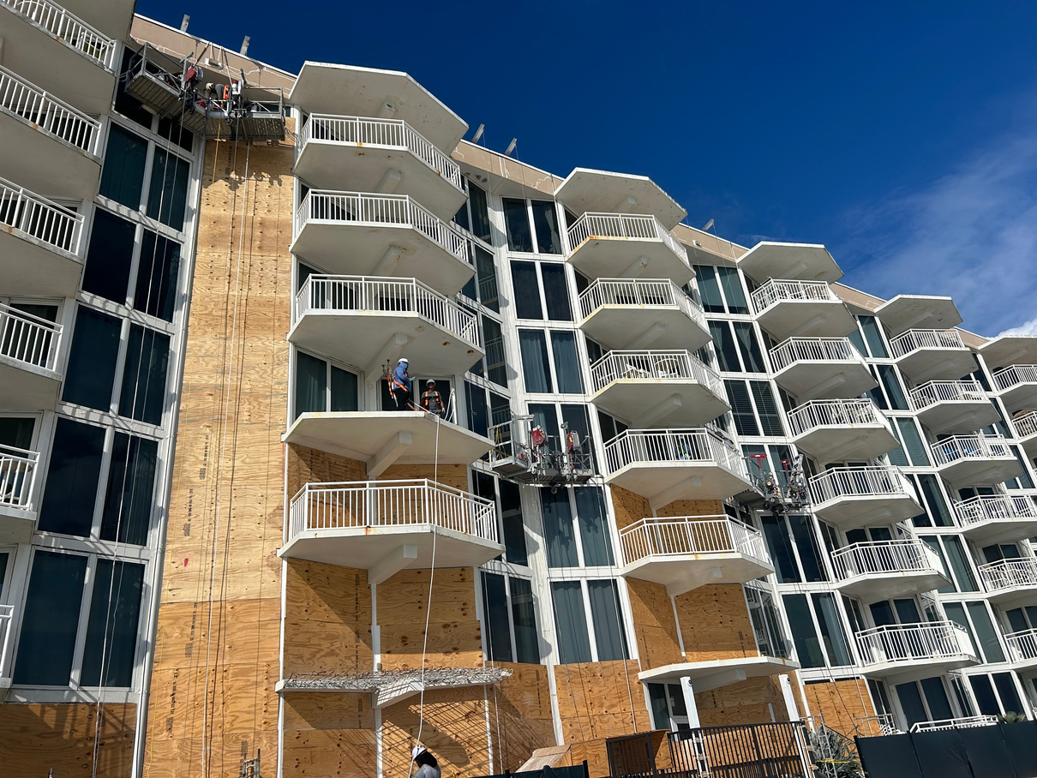
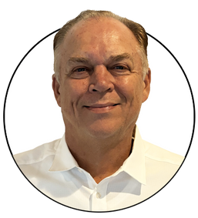

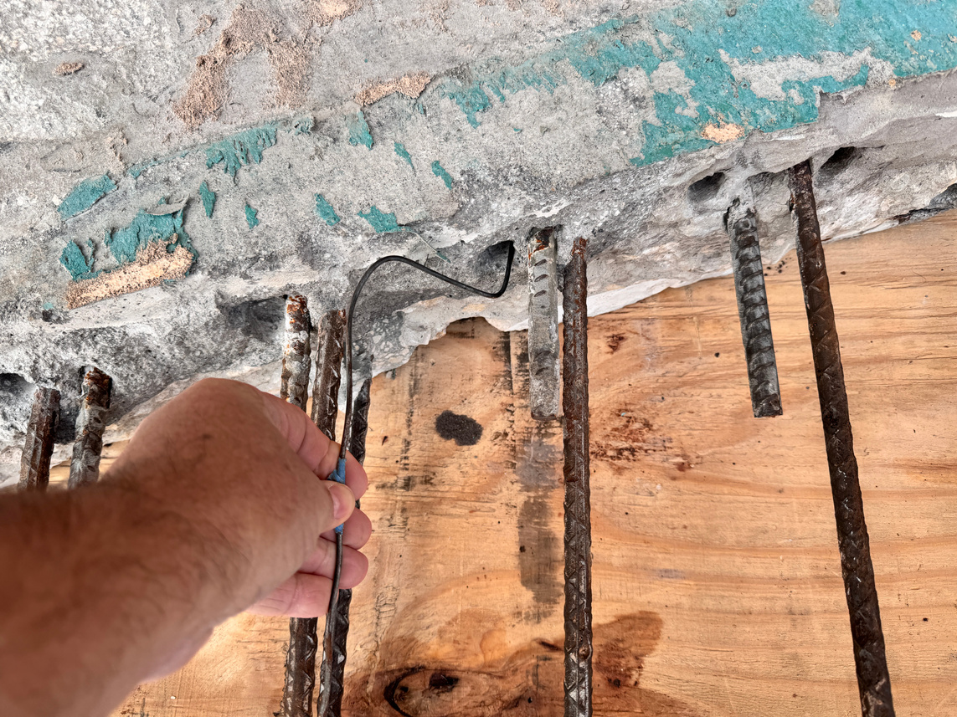
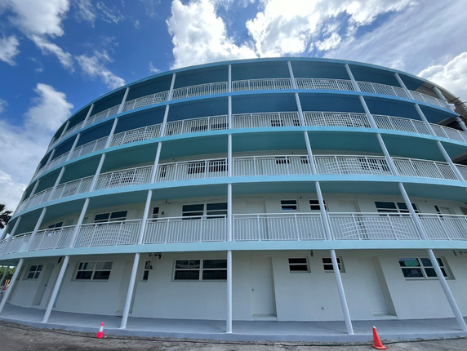
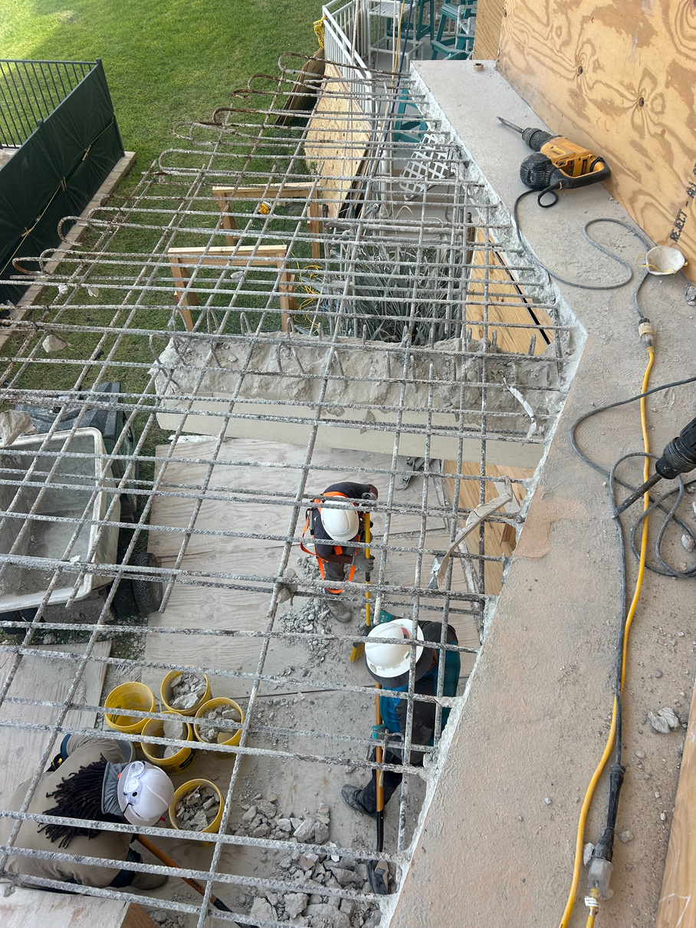
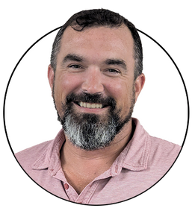
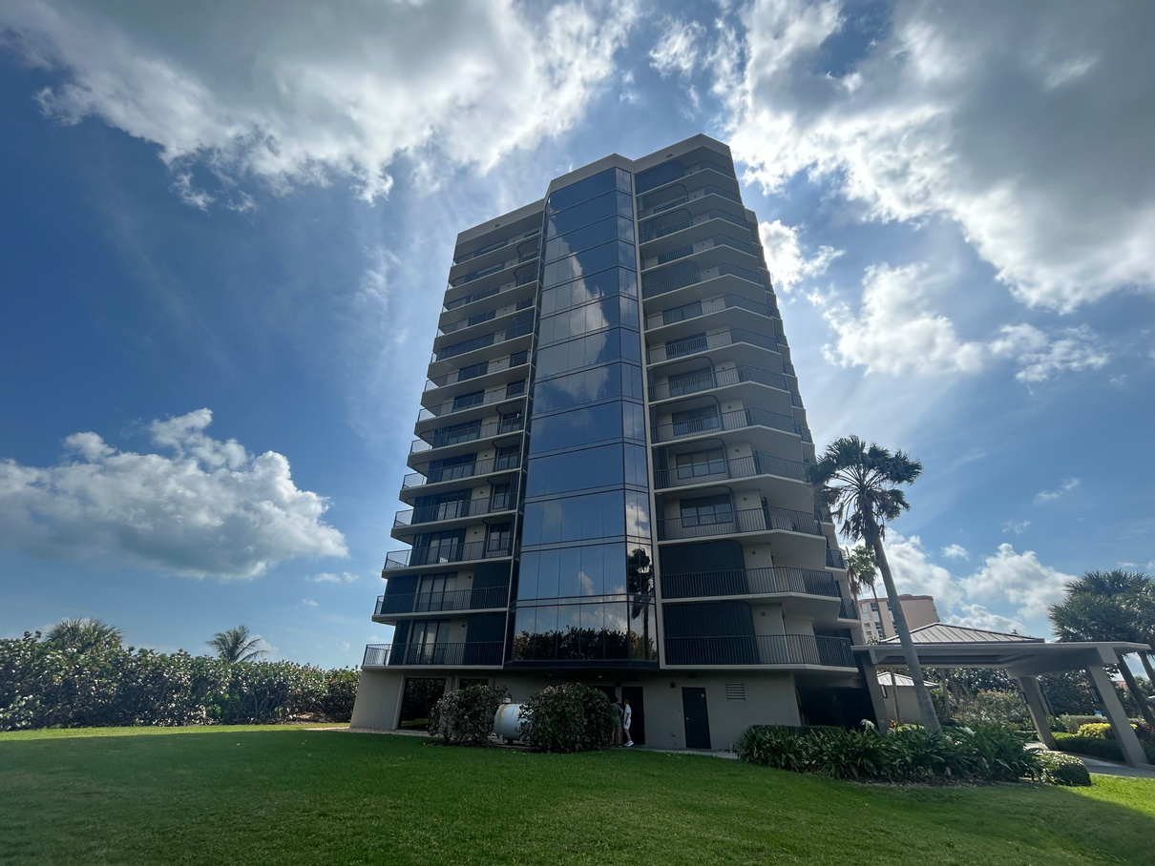
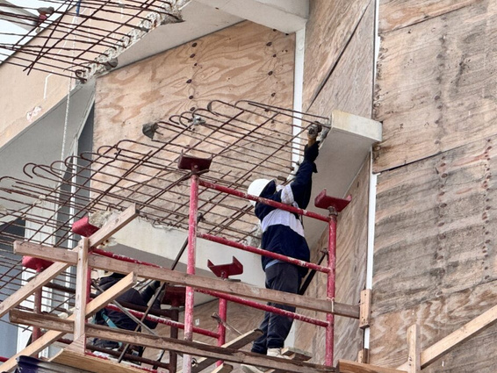
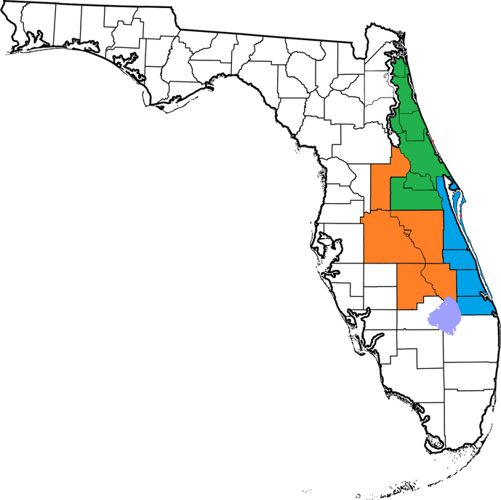

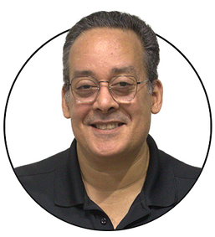
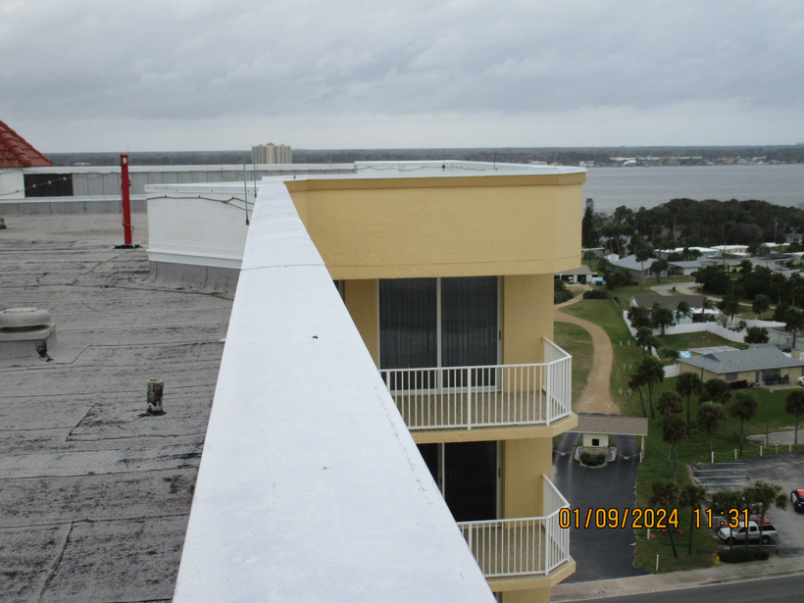
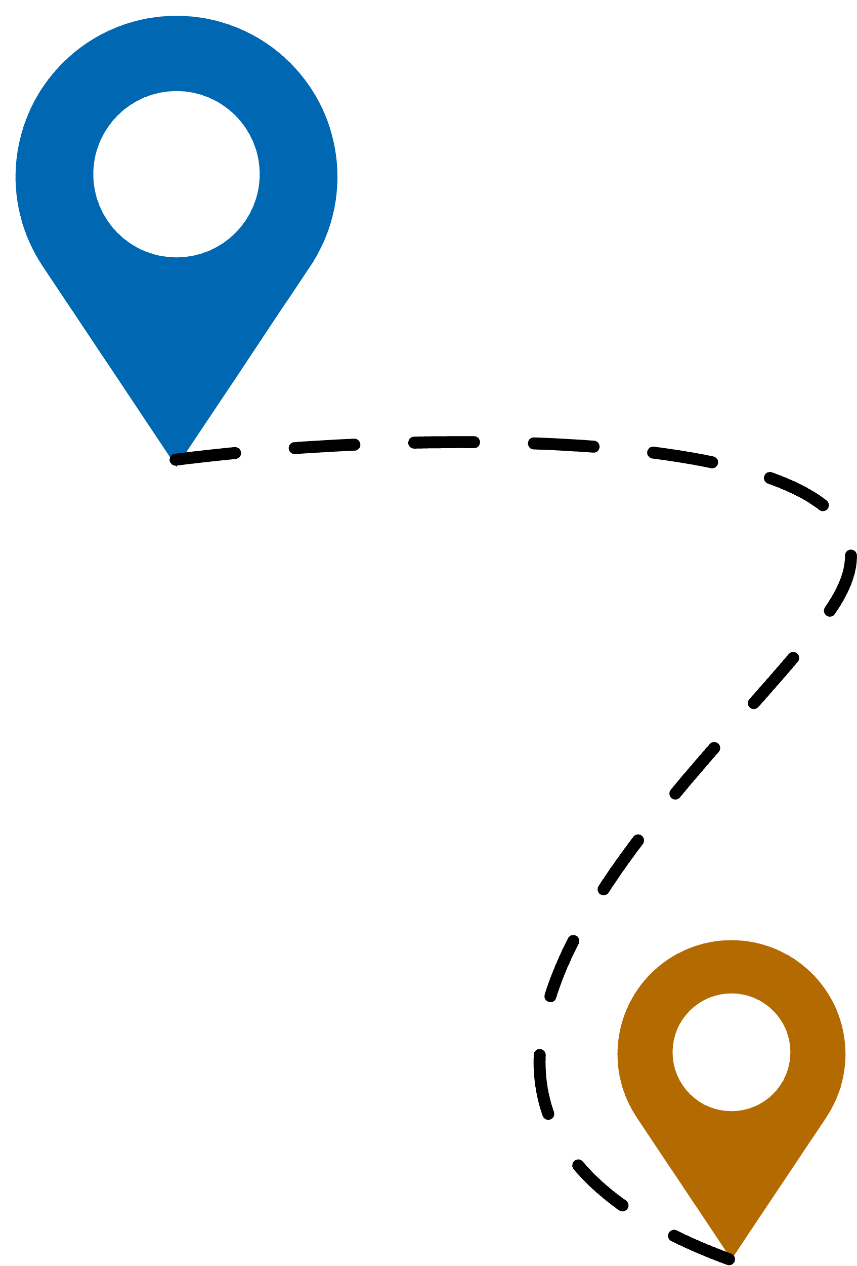
Florida's Most Trusted
Engineering Firm for:
James Emory
P.E.
Special Inspector #60965
Owner and Principal Engineer
  Coastal Structure Maintenance
  Rehabilitation
  Project Management
  Roofing
Jason Boatright
P.E., CEM, CGBE
Structural Engineer
SINCE 2003
150 YEARS
OF COMBINED
ENGINEERING EXPERTISE
LOCATIONS
Tomas Ponce
MSCE, P.E.
Structural Engineer
Headquarters: 25 North Brevard Avenue, Suite 101 • Cocoa Beach, FL 32931
Branch Office: 434 Halifax Avenue,
Suite 3 • Daytona Beach, FL 32118

Slide 9


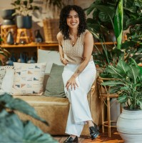
Maggie Nahmens Sierra
Ball Janik LLP
With a team of over 30 dedicated attorney’s, Ball Janik LLP is Florida’s premier construction defect and insurance attorneys. Boutique services. Towering Capabilities.

Slide 10
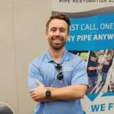

Our niche is restoring aged and/or failing piping and plumbing systems to their original operating condition.
Give Pipe Restoration Solutions a Call &
Let the Pipe Restoration Experts Work for You
Through our process of pipe inspection, pipe cleaning, pipelining or pipe replacement we can make small work of big problems. We pride ourselves on the big jobs but work just as hard on the small jobs.
Stephen Barrett

Slide 11
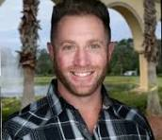

I&E Construction
Dan Bond
I&E Construction is a full-service general contractor specializing in large scale restoration projects. We focus on multi-family communities in need of exterior cladding replacements, waterproofing, and structural concrete repairs.

Slide 12
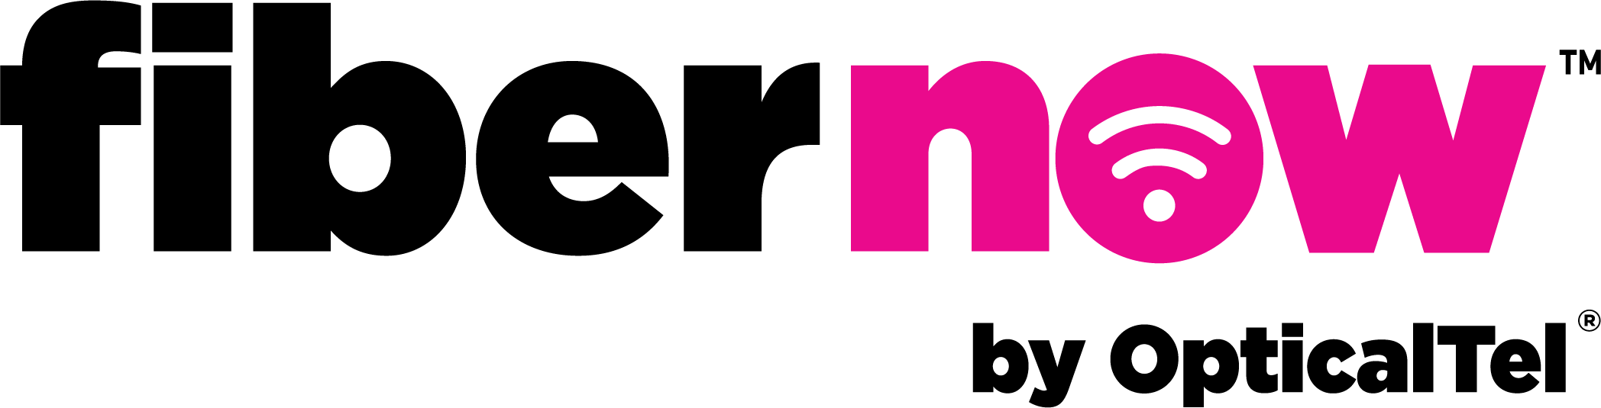
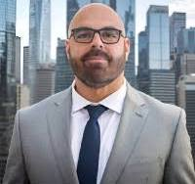
Joseph Antonelli
We offer top-notch fiber-optic internet and telecommunications services for HOAs, COAs, neighborhoods, and luxury apartments. With our cutting-edge fiber-optic internet, every resident enjoys lightning-fast speeds and unbeatable reliability. By entering into a community-wide contract, residents can experience exceptional service and enjoy increased cost savings. Elevate your community's connectivity to new heights with Fision Residential by Hotwire Communications.

Slide 13
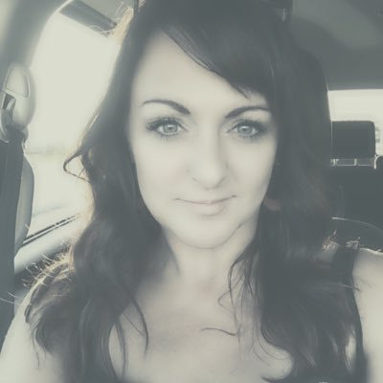
Ki Frontario
Homeowner & Condominium Landscape Specialist
BrightView is the nation’s leading commercial landscape company.
We take pride in delivering consistently excellent results for clients across the country, throughout the lifecycle of their landscapes.

Slide 14
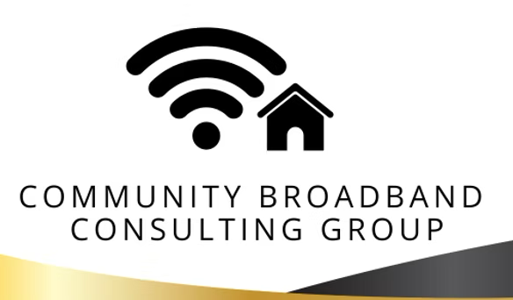
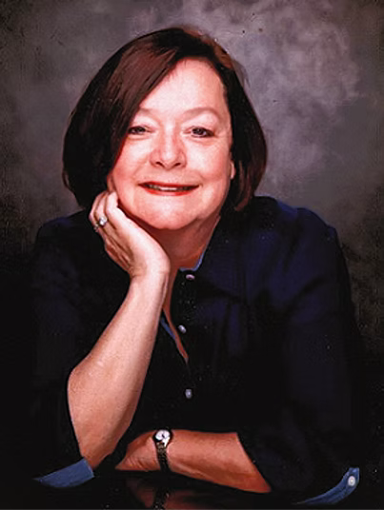
With over 100 years of combined experience negotiating cable, data, and telephone service agreements, we founded Community Broadband Consulting Group, Inc. (CBCG) to exclusively advocate for communities like yours. Our mission is clear: to secure the most favorable terms for you, ensuring a range of benefits, including:
  Lower Bulk Pricing
  Enhanced Equipment and Service Levels
  Complimentary Services
  Financial Incentives; signing bonuses and/or revenue-sharing components
Our performance-based services guarantee that you only pay when you secure an agreement with a Provider, ensuring zero upfront costs for your community.
Backed by our extensive industry expertise, we leverage our knowledge and influence on secure superior terms that go beyond what you could achieve independently.​
Unlock the full potential for improved terms and increased value with our complimentary contract review and renegotiation assessment.​

