Slide 1
GROWTH + DISCIPLINE + DEMOGRAPHICS = VALUATION UPSIDE
Multiple Expansion Opportunity – SHOP growth, demographic tailwinds, and disciplined execution create a path to multiple re-rating.
SHOP = Growth Engine – Quickly pivoted into SHOP investments, accelerating external growth and NOI.
Financial Strength – Conservative leverage, ample liquidity, and flexibility support growth
Attractive Shareholder Returns – Reliable monthly dividend supported by stable cash flows, with potential upside from growth.
Experienced & Transparent Leadership – A stable management team with decades of senior housing experience, long tenure, and a culture of transparency, consistently delivering on commitments.
Demographic Tailwinds – The 85+ population surge drives durable, long-term need for senior housing.
Disciplined Capital Allocation – Proven history of prudent capital deployment and thoughtful recycling to strengthen the portfolio.
Operator Relationship– Long-standing partnerships and the ability to offer SHOP have unlocked attractive deals we wouldn’t win otherwise.

Slide 2
EXECUTION FUELS SHOP
21
properties
1,580
units
5 Operators
3 New to Ltc
18% Total LTC
Portfolio
LAUNCHED SHOP
Q2 ’25
$270 million
PIPELINE
Q4 ‘25
Expect to close an additional $90 million in SHOP acquisitions by the end of 2025
ACQUISITIONS
Q2 – Q3 ‘25
Cooperative Conversions (Anthem and New Perspective)
2 Operators
832 Units
13 Properties
8 properties
3 operators new to LTC (Charter, Discovery, Lifespark)

Slide 3
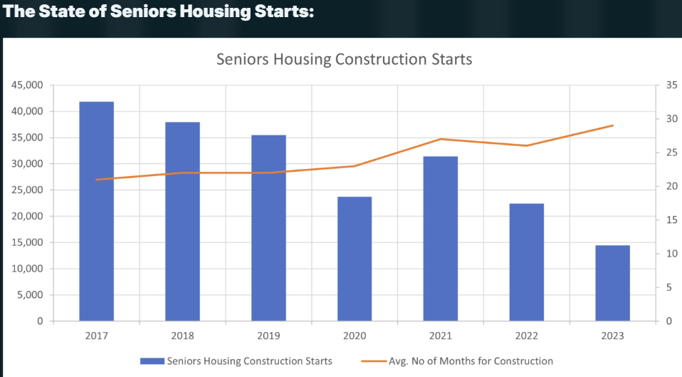
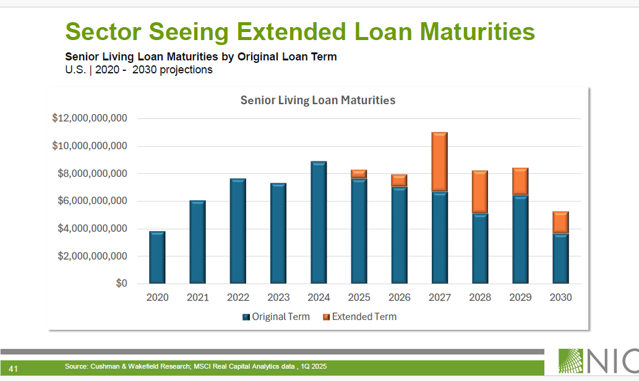
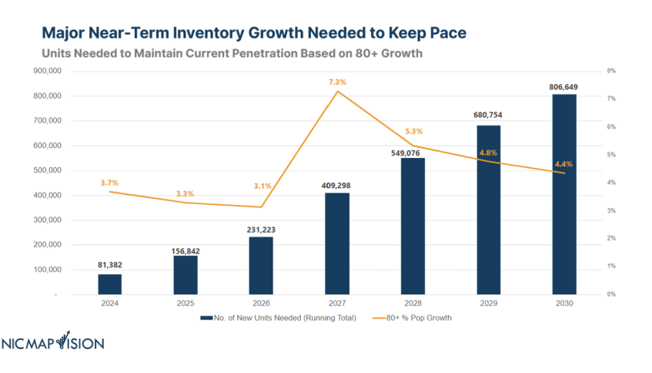
WHY SENIOR HOUSING? WHY NOW?
DEMOGRAPHICS DRIVE DEMAND
U.S. Senior Population Growth Projections by Age Bracket
United States | 2022 – 2060 ⁽¹⁾
Millions
U.S. Census Bureau, Population Division. “Projected Population by Age Group and Sex for the United States, Main Series: 2022 - 2100.” November 2023
Notes:
2/19/25 – SOURCE: https://www.census.gov/data/tables/2023/demo/popproj/2023-summary-tables.html

Slide 4

Portfolio SNAPSHOT
(as of JUNE 30, 2025)
GROSS INVESTMENT BY PROPERTY TYPE
Diversified portfolio
By operator, geography, property
and investment type
188
Properties
25
States
29
Operating Partners
Independent Living
Skilled Nursing
Assisted Living
Memory Care
4

