Slide 1
Short Interval Control in Mining: From Data to Action
Brad Jewson
Outliers Mining Solutions

Slide 2
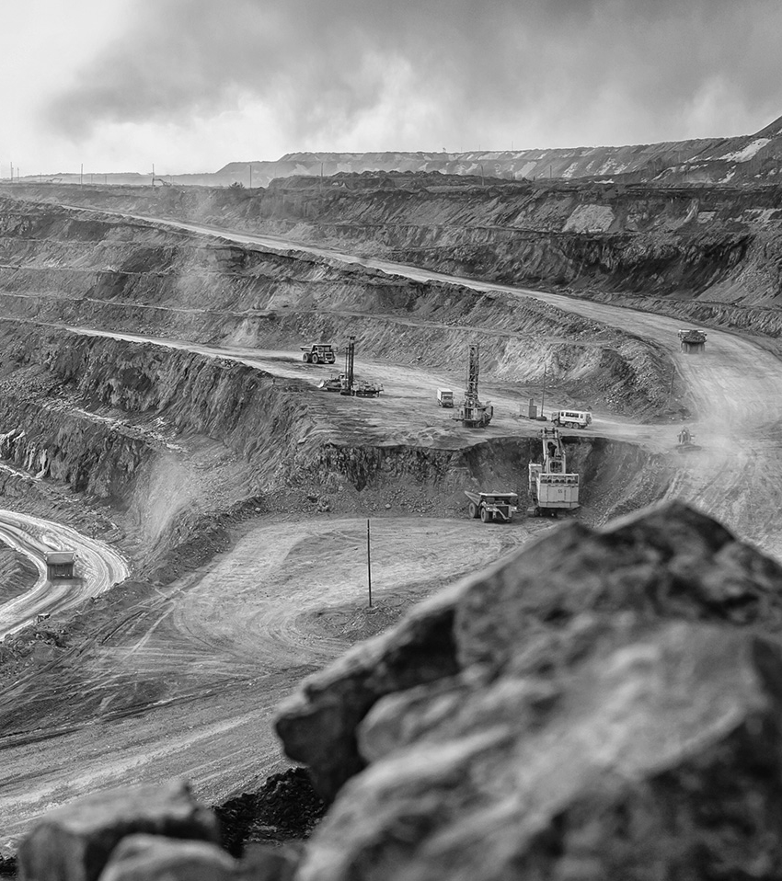

Who
We Are
What
We Do
We are mining professionals with broad expertise in engineering, operations, and technology—gained through global experience.
We help mining organizations succeed by empowering them
to meet or exceed production and productivity targets.
© 2025 Outliers Mining Solutions Inc. Strictly Confidential

Slide 3

We help you build better execution processes
We optimize the processes that impact how your people
and assets interact and perform.
We help your leaders be more effective
We coach and mentor your production leadership team
to maximize their effectiveness.
How
We Do It
We train your team to do their job well
We train your team to use the tools and skills they possess
to their maximum potential.
Our solution engineers know your job
Designed by production experts, our solutions inform,
empower, and enable your production team.
3

Slide 4






Short Interval Control
Key Benefits
  Mining operations face high costs and high variability.
  Traditional reporting delivers information too late.
SIC VALUE:
Short Interval Control gives frontline leaders real-time visibility to act immediately, reduce variability, and close the gap between plan and execution—driving higher tons, lower costs, and consistent performance.
  Teams are forced to stay reactive instead of proactive.
  Delays in communication lead to missed opportunities during the shift.
  Disconnect between planning and execution.

Slide 5
The Keys to Effective SIC
KEY #1 : Detailed Inoformation
KEY #2 : Clear accountability by role
KEY #3 : Operating Philosy & Scenario Well Understood
KEY #4 : Leadership trained to intervene correctly

Slide 6
Key #1: Real-Time Information
Issue: Short interval feedback on Outcomes doesn’t drive action
Short interval control focused on compliance to daily target
  Hourly updates
  ‘we are 10% below our daily projected TMM target for the day’
  ‘Shovel 3 is planned to do 120KT but is only projected to do 95KT’
This can frustrate supervisors who want to address the root issues of underperformance but don’t’ have a clear understanding of whats driving the shortfall or what action to take

Slide 7
Key #1: Real-Time Information
To be useful and actionable, data must be:
  Real-time
  Visual
  Granular and high detail (not averages or quarterly/hourly)
  Location Specific
  Role-specific inputs to production
These need to be available to supervisors throughout the operations are in the light vehicle

Slide 8
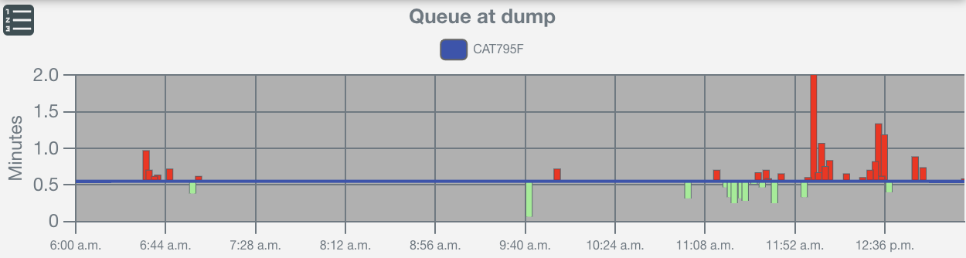
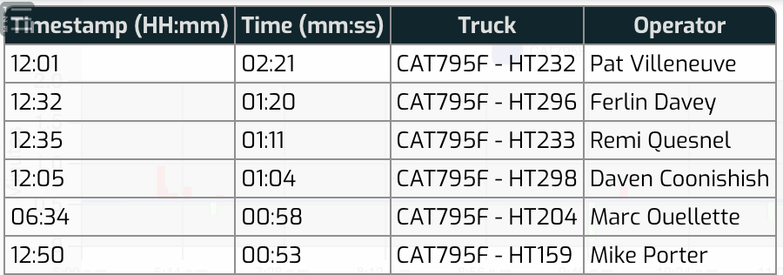
Key #1: Real-Time Information
To be useful and actionable, data must be:
  Real-time
  Visual
  Granular and high detail (not averages or quarterly/hourly)
  Location Specific
  Role-specific inputs to production

Slide 9
Key #2: Clear Accountability by Role
All supervisor roles are responsible for production. Responsibility for the drivers of production have accountable owners:
Dispatcher → shovel hang, truck queues @ shovel, dumps & crusher
Shovel Supervisor → Load times, spot times payload
Dump Supervisor → wait/queue at dump, haul speeds on dump
Haul Road Supervisor → Stopped Empty Times
Senior Supervisors → cross-functional SIC accountability
Creates clarity and straightforward expectations for supervisors and dispatchers

Slide 10
Key #2: Clear Accountability by Role
Dispatcher → shovel hang, truck queues @ shovel, dumps & crusher
Shovel Supervisor → Load times, spot times payload
Dump Supervisor → wait/queue at dump, haul speeds on dump
Haul Road Supervisor → Stopped Empty Times
Senior Supervisors/General Foreman → Compliance to plan
Clarity of expectations and accountability extremely beneficial as each role has clear expectations of KPIs and areas they are expected to monitor.
Checking real-time trends 1/hour is easy with pit connectivity- significantly reduce the necessity to ‘visit’ areas to monitor performance which is crucial for large, spread operations

Slide 11
Key #3: Operating Philosophy & Scenarios
Define what “good” looks like → normal operating targets
Align mine ops + plant/mill expectations
Example:
  Normal → max shovel utilization, minimal queues
  Low coarse ore stockpile → accept truck queues at shovel to keep mill fed
Common playbook avoids confusion & conflict

Slide 12
Key #4: Training & Action Playbooks
Information is useless without actionability
Supervisors must know: “What can I do right now?”
Examples:
  Dump: Clear dozer from active area, direct trucks to free zones
  Shovel: Enforce full payloads, minimize cleanup delays
  Crusher: Monitor feeder, reassign trucks to balance queues
Training builds decision confidence → faster interventions

Slide 13
The SIC Coaching Model
Champion coaching → supervisors → dispatchers
Daily/shift review cycle → reinforce learnings
Competency matrix → track progress by role
Goal: self-sustaining SIC culture
(Visual: coaching cascade diagram)

Slide 14
Key #3: Operating Philosophy & Scenarios
KPIs alone aren’t enough — true value comes from scenario-based response.
Decisions must reflect the why behind the KPI (stockpile, roads, congestion).
Frontline leaders align actions with the broader operating philosophy.
Shared playbooks ensure consistent, scenario-driven interventions

Slide 15
Key #3: Operating Philosophy & Scenarios
Supervisors tracking and responding KPIs will provide only limited benefit.
True value comes from scenario-based response.
Decision-makers need to understand which metrics are important when and why
When dispatchers and frontline leaders align actions with the broader operating philosophy, short interval control can deliver production gains in all operating scenarios
Shared playbooks ensure consistent, scenario-driven interventions focused on the bottleneck or constraint in the mine operation.

Slide 16
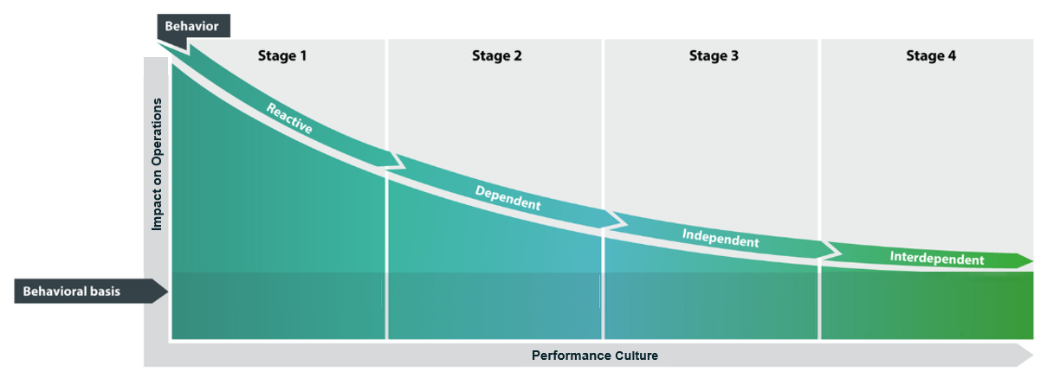
Key #3: Operating Philosophy & Scenarios
BEFORE SIC
INITIAL IMPLEMENTATION
SCENARIO & OPERATIONAL AWARENESS
SIC INTEGRATED ACROSS VALUE CHAIN
Reacting to immediate issues, firefighting
Responding to KPIs as Directed
Proactive management based on true understanding
Collaborative, optimizing overall productivity and consistency

Slide 17
Key #4:
Overtrucked (shovels are the bottleneck)
Priorities & Actions
Maximize shovel utilization & Productivity:
  Prioritize double-side loading and reduce hang/spot times.
  Run shovels through breaks (hot seating).
  Move loading units to higher-productivity dig faces if situation persists .
Leverage Excess Truck Hours
  Lengthen cycle times with in-plan long hauls (e.g., TMF).
  Use excess truck hours for training, project work, or maintenance.
  Park trucks strategically if queue times remain excessive .
Support equipment & operators:
  Assign best operators to shovels and clean-up machines.
  Prioritize dozer support at shovels to reduce delays.
  Delay non-critical shovel servicing until undertrucked periods .
KEY SIC Metrics
Minimize Shovel Hang Time
Maximize Shovel Utilization
Break coverage (hot seating)
Spot time – Double Backup where possible
Maximize bucket Fill

Slide 18
Key #4:
Key SIC Metrics
Truck utilization → Hot seat, move operators from support equipment if necessary
Truck travel time → monitor slow spots, road conditions, bunching
Truck queue times at shovels dumps and crusher
Payload compliance → critical when trucks are short, avoid underloading (<95% nominal)
Cycle times → target shortest haul/dump combinations
Undertrucked (trucks are the bottleneck)
Description: More shovel capacity than truck capacity. High shovel hang times.
Priorities & Actions
Maximize truck utilization:
  Shorten cycle times by using shortest haul routes.
  Address poor road conditions and slow travel spots quickly.
  Minimize truck queue at crusher, dumps, and stockpiles .
Optimize loading productivity:
  Focus on full payload compliance (10-10-20 rule).
  Coordinate clean-ups and shovel moves with dispatch to avoid trucks waiting.
  Use undertrucked periods for low-priority dig faces or opportunistic shovel maintenance .
Support equipment & maintenance:
  Reassign support operators to haul trucks where possible.
  Coordinate fueling/lube for trucks and shovels during delays.
  Defer or reschedule road maintenance that disrupts haulage .

Slide 19
Key #4: Operating Philosophy & Scenarios
BEFORE SIC
INITIAL IMPLEMENTATION
SCENARIO & OPERATIONAL AWARENESS
SIC INTEGRATED ACROSS VALUE CHAIN
Reacting to immediate issues, firefighting
Responding to KPIs as Directed
Proactive management based on true understanding
Collaborative, optimizing overall productivity and consistency

Slide 20

Operating Scenarios
Direct Feed to CHPP no Reclaim
Direct feed from Bin 1 into CHPP
No reclaim from Raw
Can overflow to Raw if Bin exceeds CHPP Requirement
Secondary Product Stockpile
BIN 1
CHPP
Primary Product Stockpile
Reclaimer
KEY CONSIDERATIONS
Ore feed rate set by bin rate
No reclaimer – Any impact on coal feed will reduce/stop feed to CHPP
Maintain full bin at all times despite impact on truck queue
Have loader ready on ROM for weather or shift change
Communicate contingency if coal digger is lost
If the Raw Stockpile is full, the bin rate can’t exceed the CHPP rate
Raw Coal Stockpile
Reject
Targets & Triggers
Coal Target | Bin Level | Wait at Bin Target
Rate from 24hr Plan | Maintain Bin > 80% | <3.0 min
Responsible
Accountable
Consult
Inform
RACI
Section Home
Table of Contents

Slide 21
Key #4: Training, Coaching and Action
Information is useless without actionability
Supervisors must know: “What can I do right now?”
Examples:
  Dump: Clear dozer from active area, direct trucks to free zones
  Shovel: Enforce full payloads, minimize cleanup delays
  Crusher: Monitor feeder, reassign trucks to balance queues
Training builds decision confidence → faster interventions

Slide 22

Key #4: Training, Coaching and Action on Dumps
To ensure efficient loading, trucks should never wait; loading must start as soon as a truck arrives in the pit.
The shovel operator should avoid unnecessary tasks, like face adjustments or cleanup, when a truck is backing in or is already positioned for loading.
The shovel's primary focus should always be on loading trucks, not on other tasks or cleanups that could cause delays.
If no truck is in the pit, the shovel can handle cleanup tasks or minor repositioning, but only if it notifies dispatch first.
Shovels should provide dispatch with a five-minute advance warning before any move, allowing time for planning and adjustments.
This advance notice enables dispatch to optimize fleet flow, reassign trucks as needed, or refuel trucks, keeping fleet operations efficient.

Slide 23
Coaching & Direction on Dumps
Ensure trucks are dumped efficiently with no waiting time, following the planned sequence.
Dozer operators should signal trucks at a sufficient distance to allow them to maintain engine revs without slowing down, preventing lost time.
Trucks should receive a clear signal to approach and begin backing up smoothly without needing to re-engage the throttle.
The dozer operator’s primary focus should be on getting the trucks off the dump.
After dumping, trucks should leave the site smoothly by slowly descending the berm with the box still elevated, using appropriate speed control until the box is down.
Efficiency is maximized by using the shortest travel paths, anticipating multiple trucks, and having multiple dump locations ready to avoid delays.
The dump dozer operator should maintain full control of the area, prioritizing smooth, continuous operations.

Slide 24
Closing & Call to Action
SIC = real-time decisions → real productivity gains
Four requirements: information, accountability, philosophy, training
When embedded → SIC becomes culture, not a program
“Don’t just measure. Act.”

Slide 25
Q&A

