Slide 1
INSTRUCTIONS
We need to create a single WORDPRESS Testimonial Page for our health supplements that consolidates all UGC Videos, UGC Selfie Photos, Before and After Pictures PER PRODUCT in a very user friendly way. So the design, look and feel is most important. The details of the what we need on this Testimonial page are on the following pages. Current website is here and can complement the other product pages: https://www.jjsmithonline.com/supplements/
Here are some reference samples that I like the way their UGC/testimonials are displayed. Please note, you have to view on mobile to see them best as most people view our website from a mobile device:
https://avaestell.com/
https://doctorssupplementstore.com/testimonials/

Slide 2
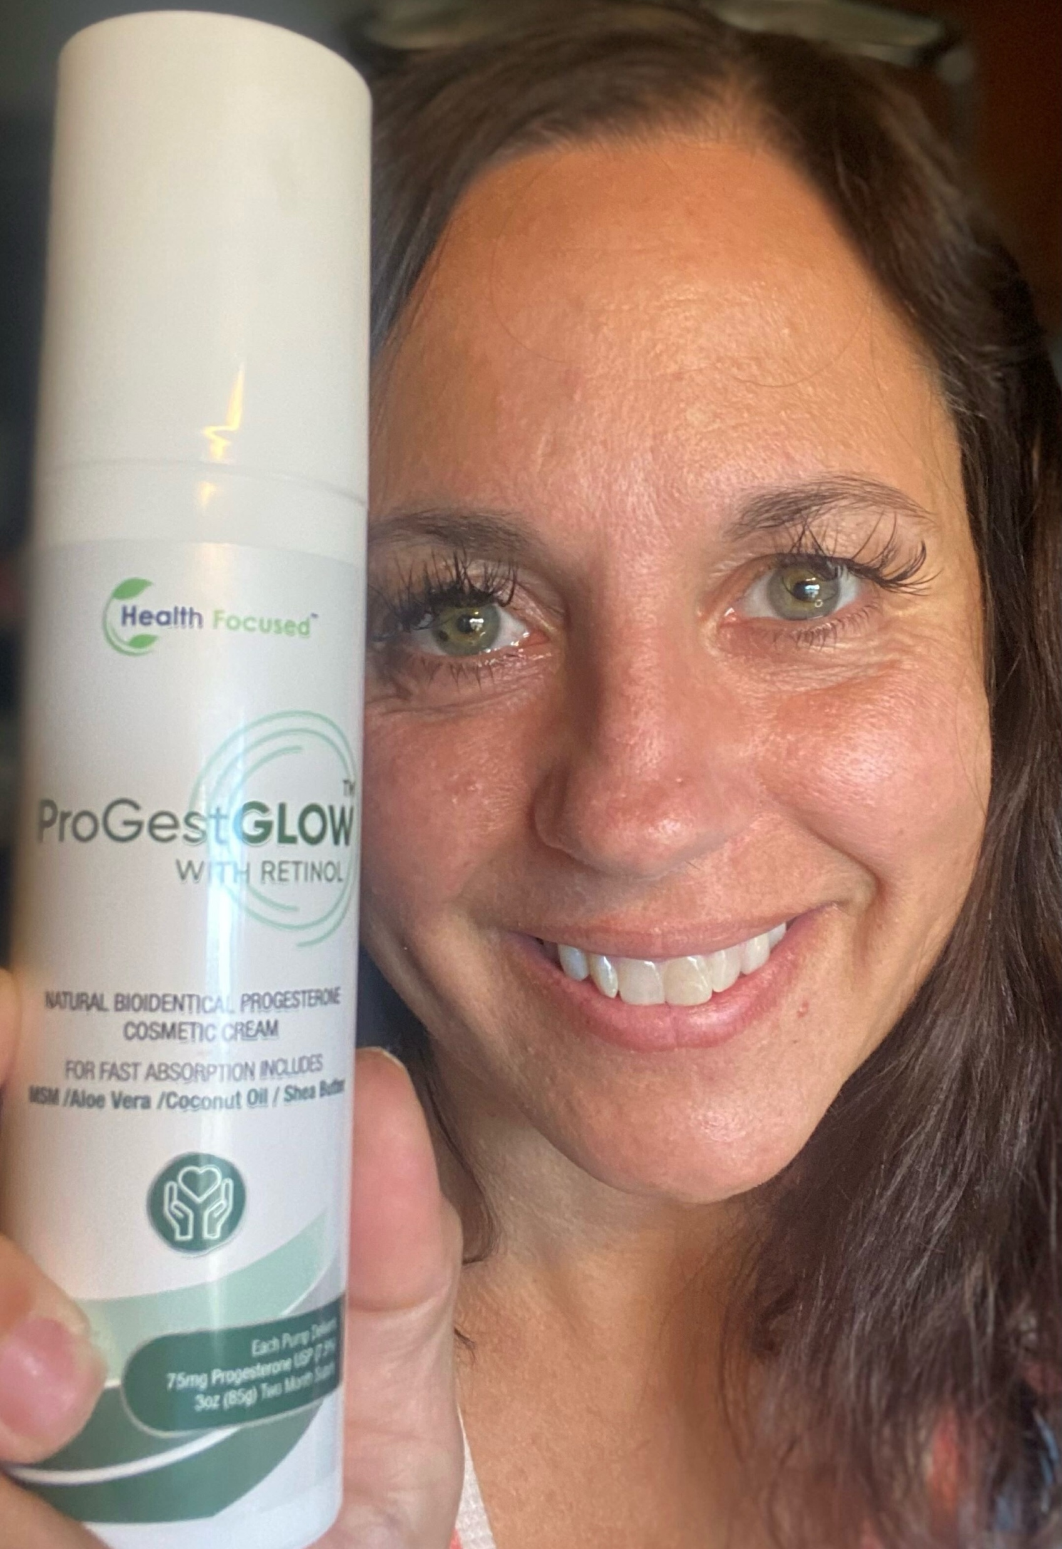
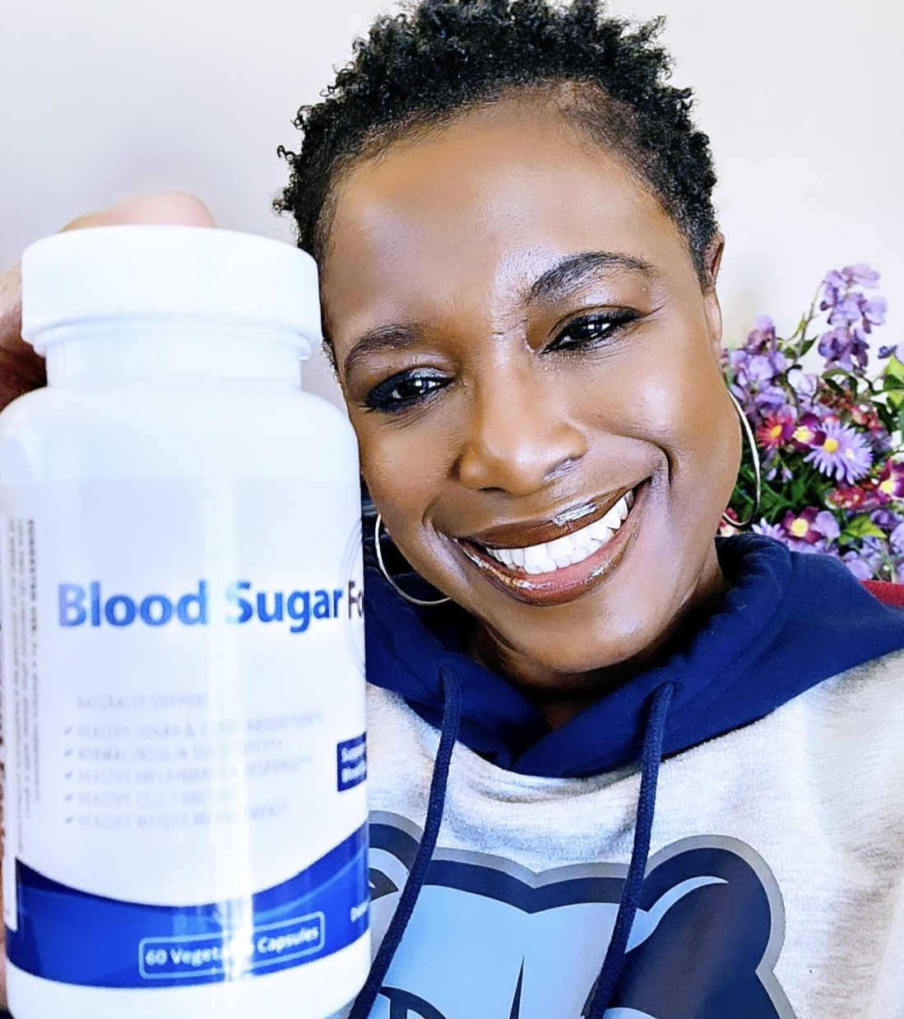
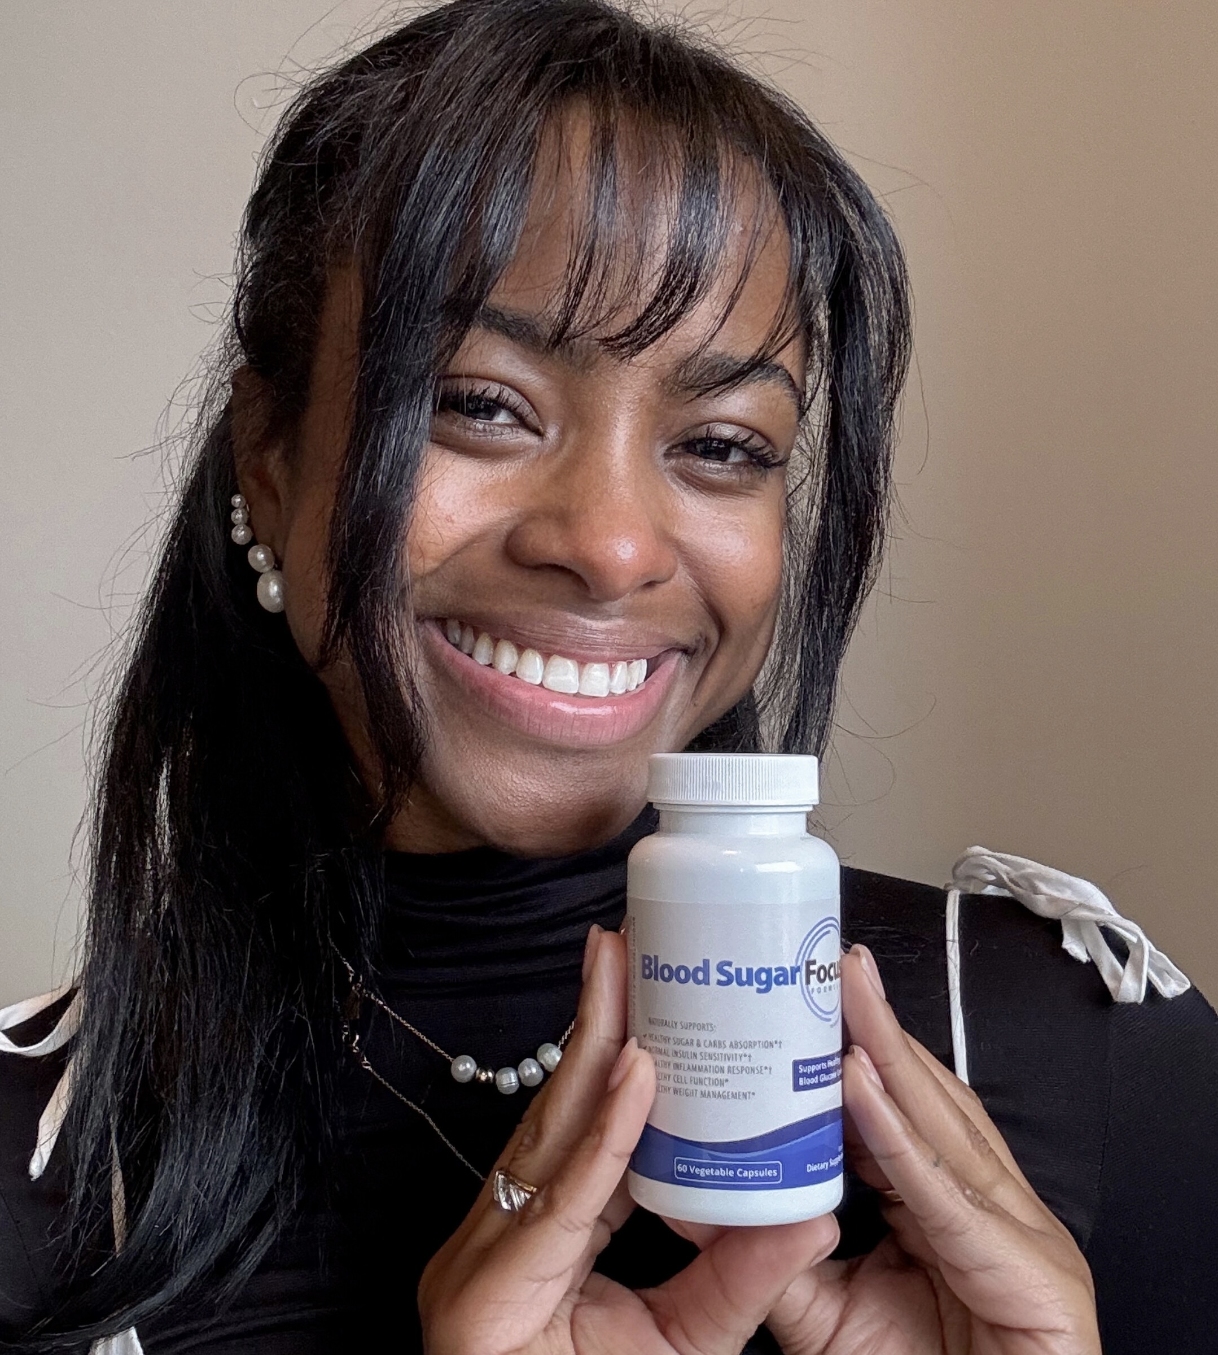
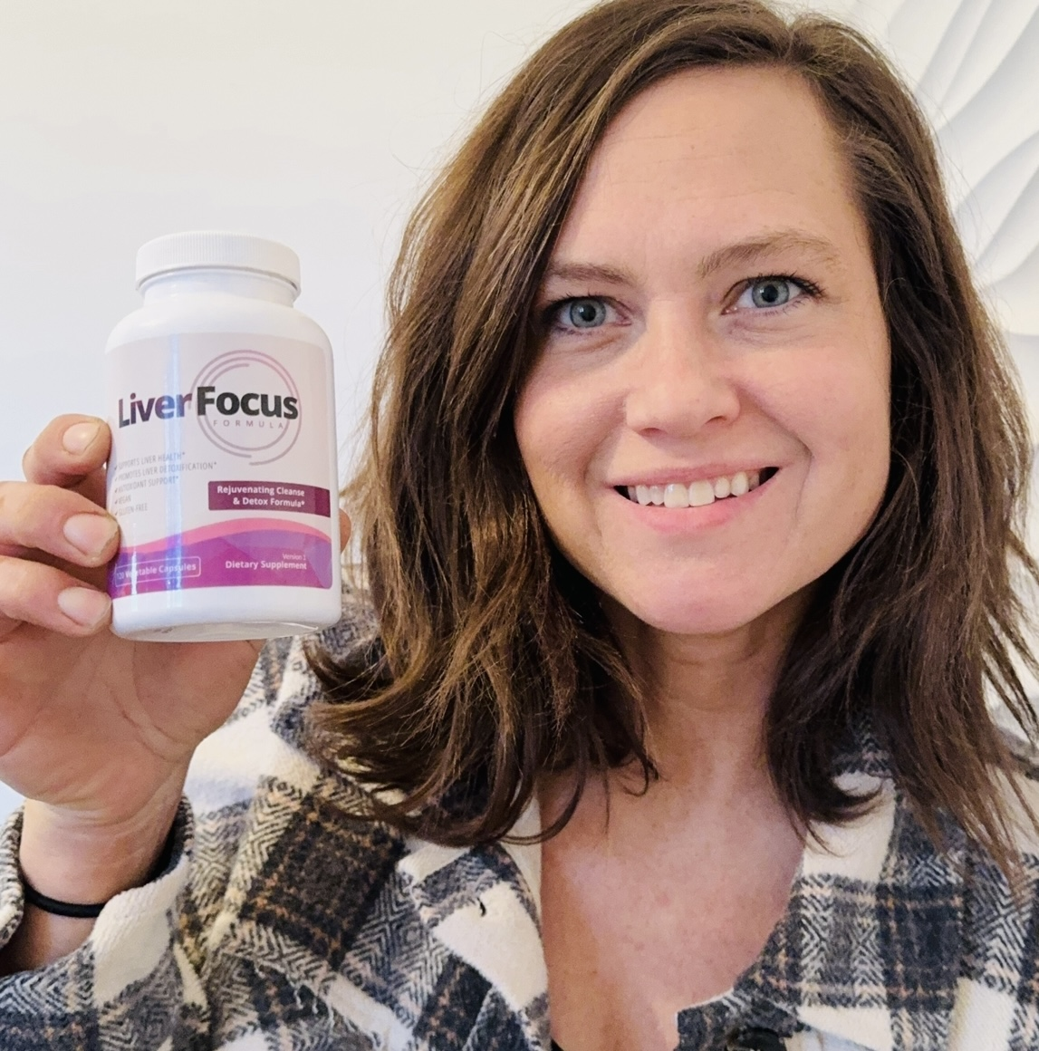
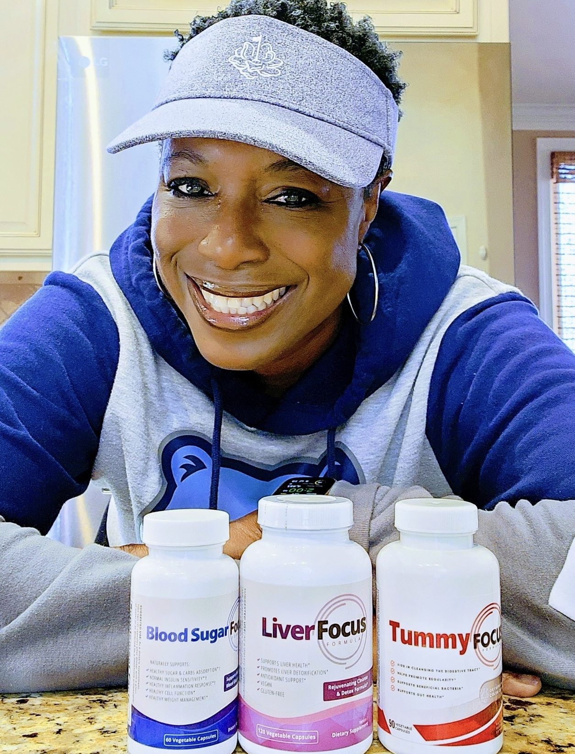
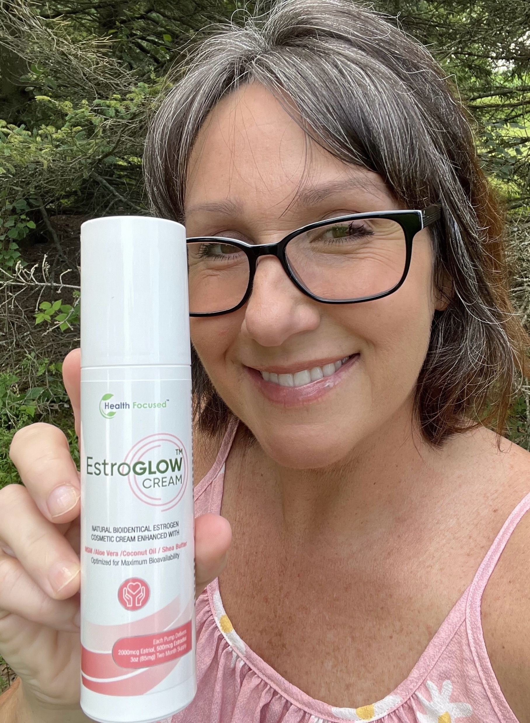
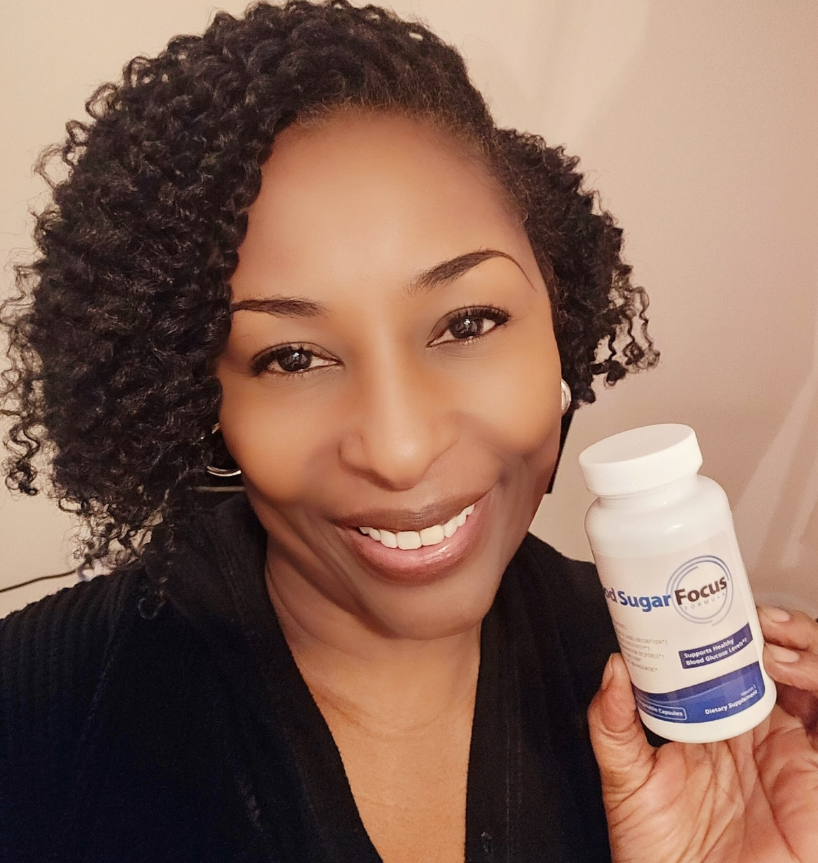
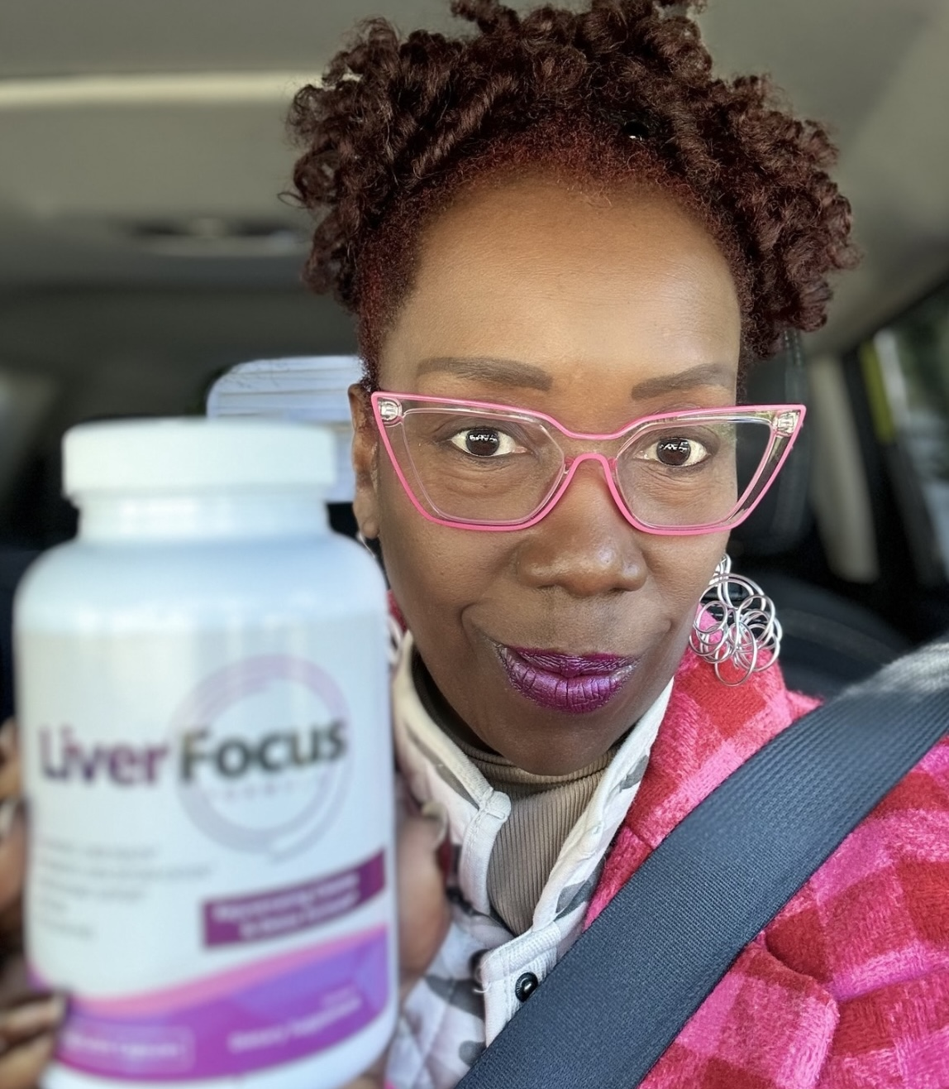
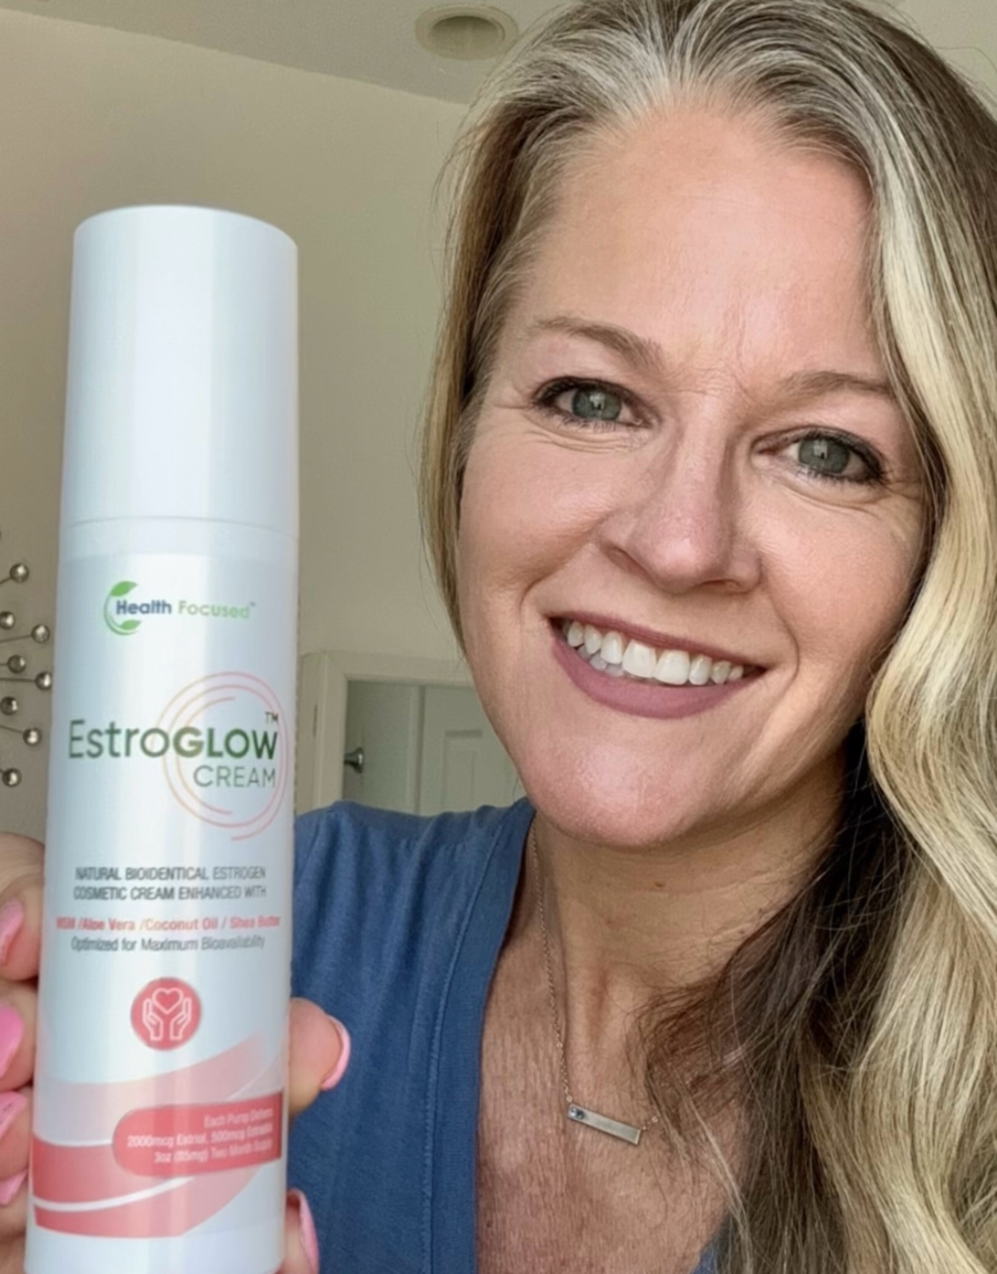
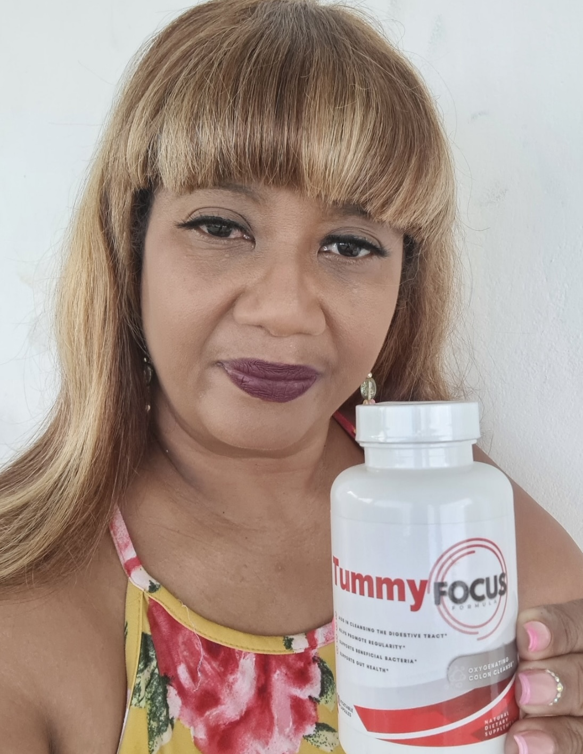
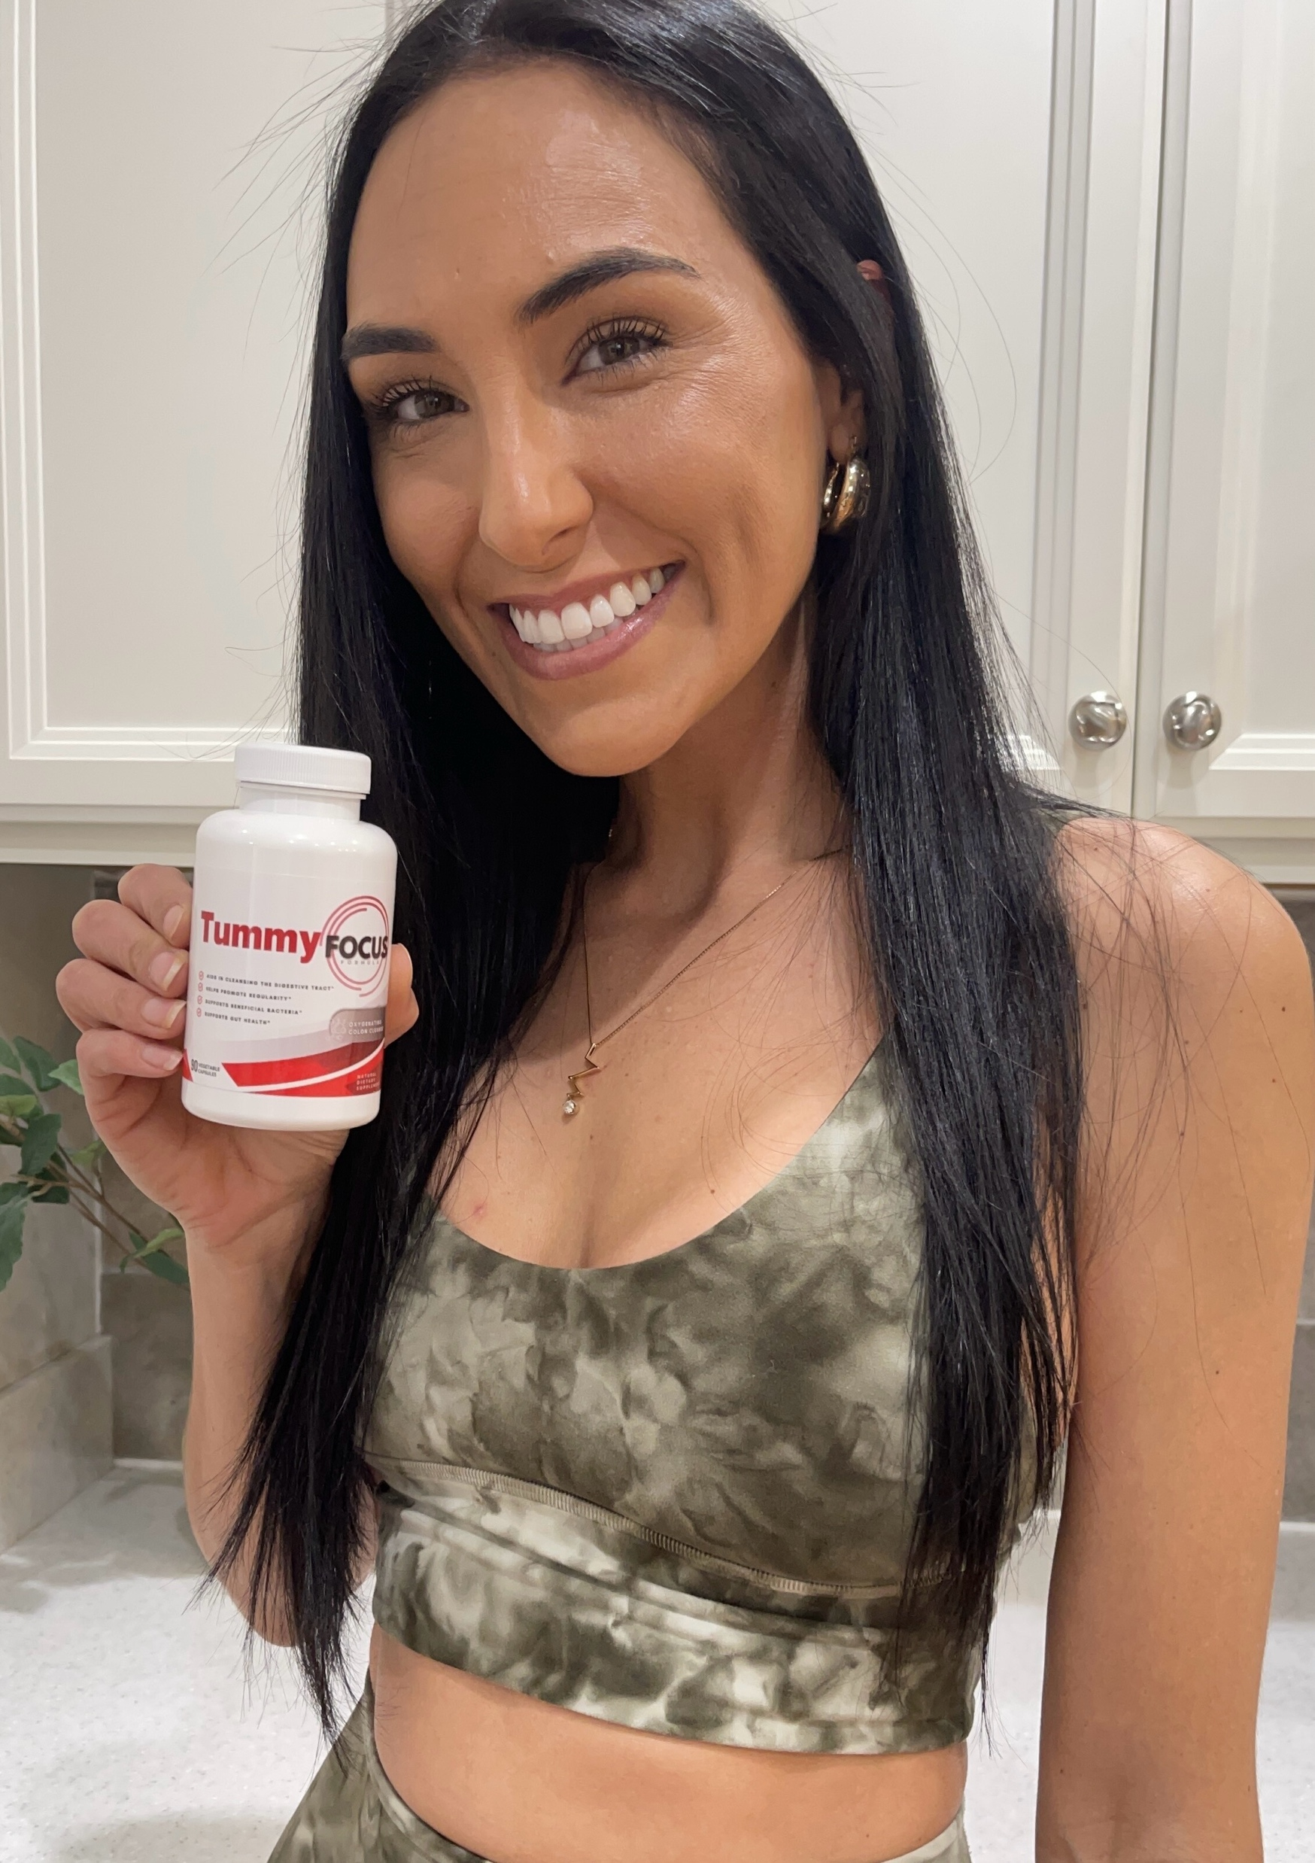
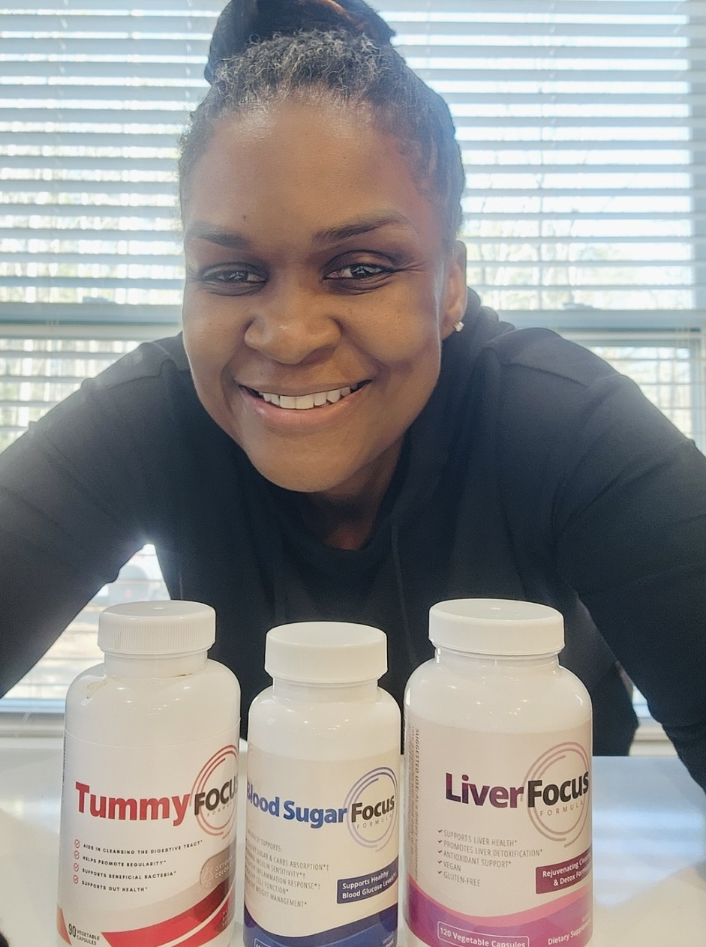
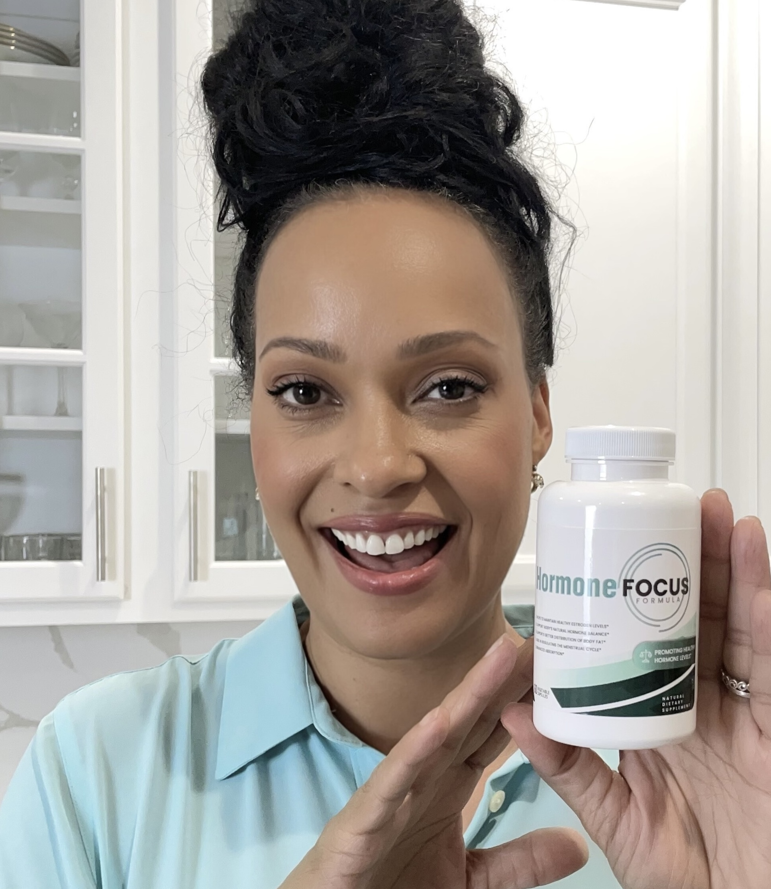
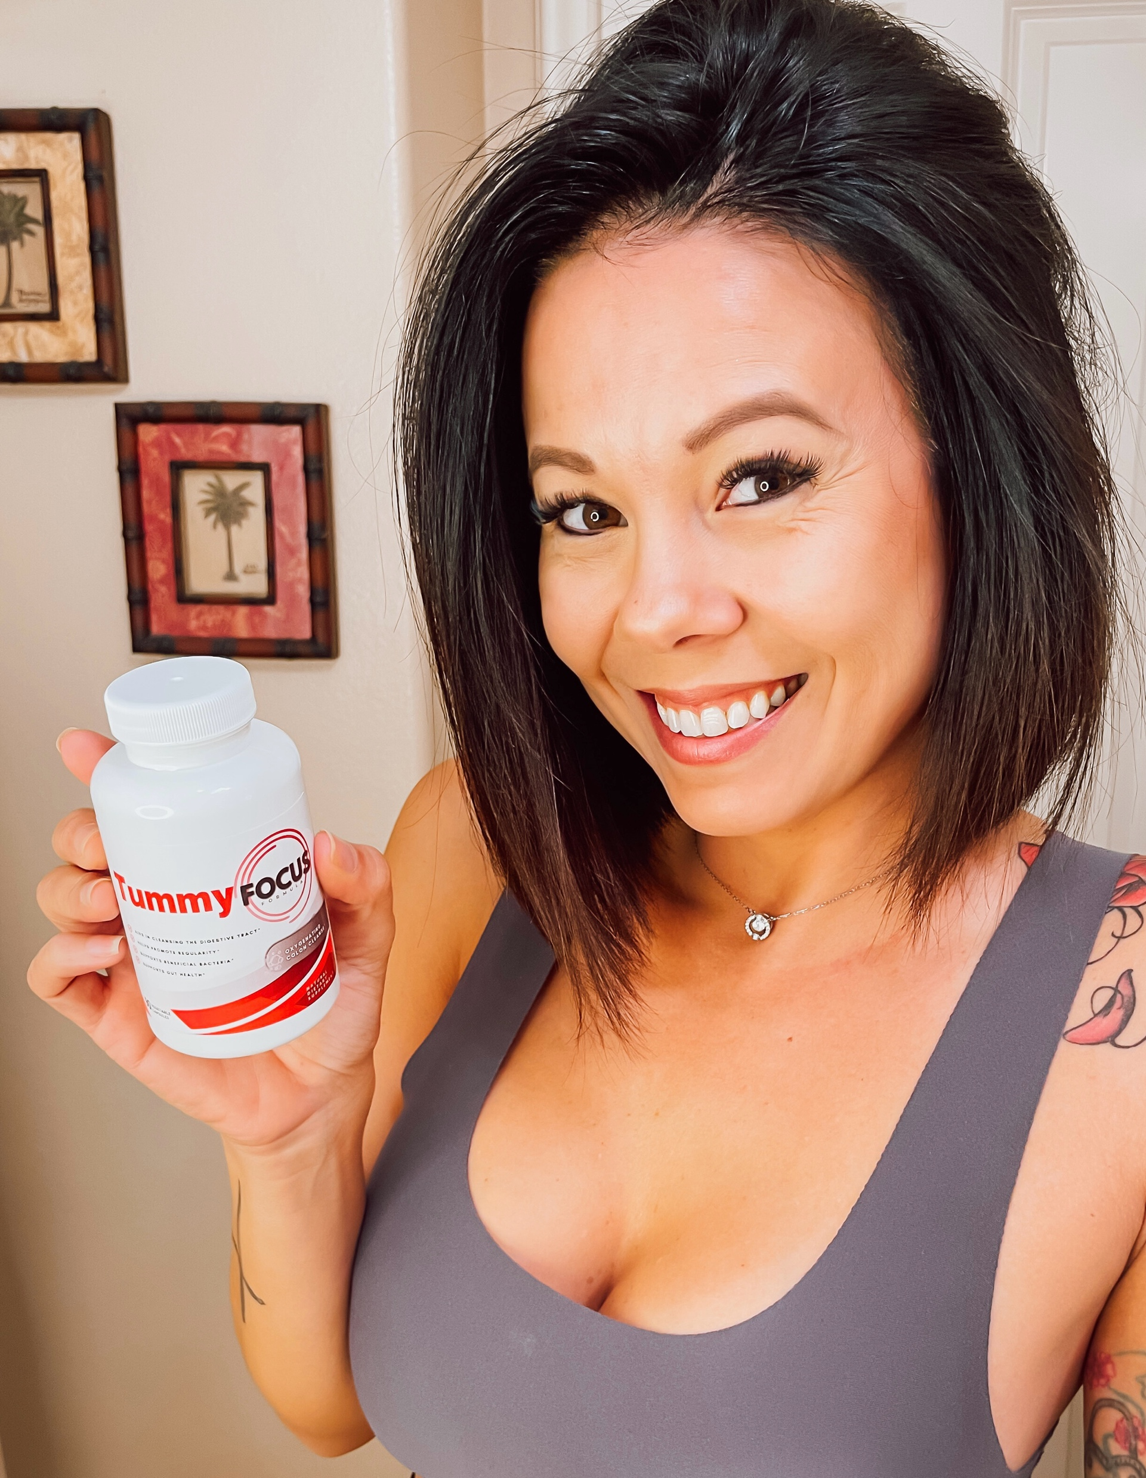
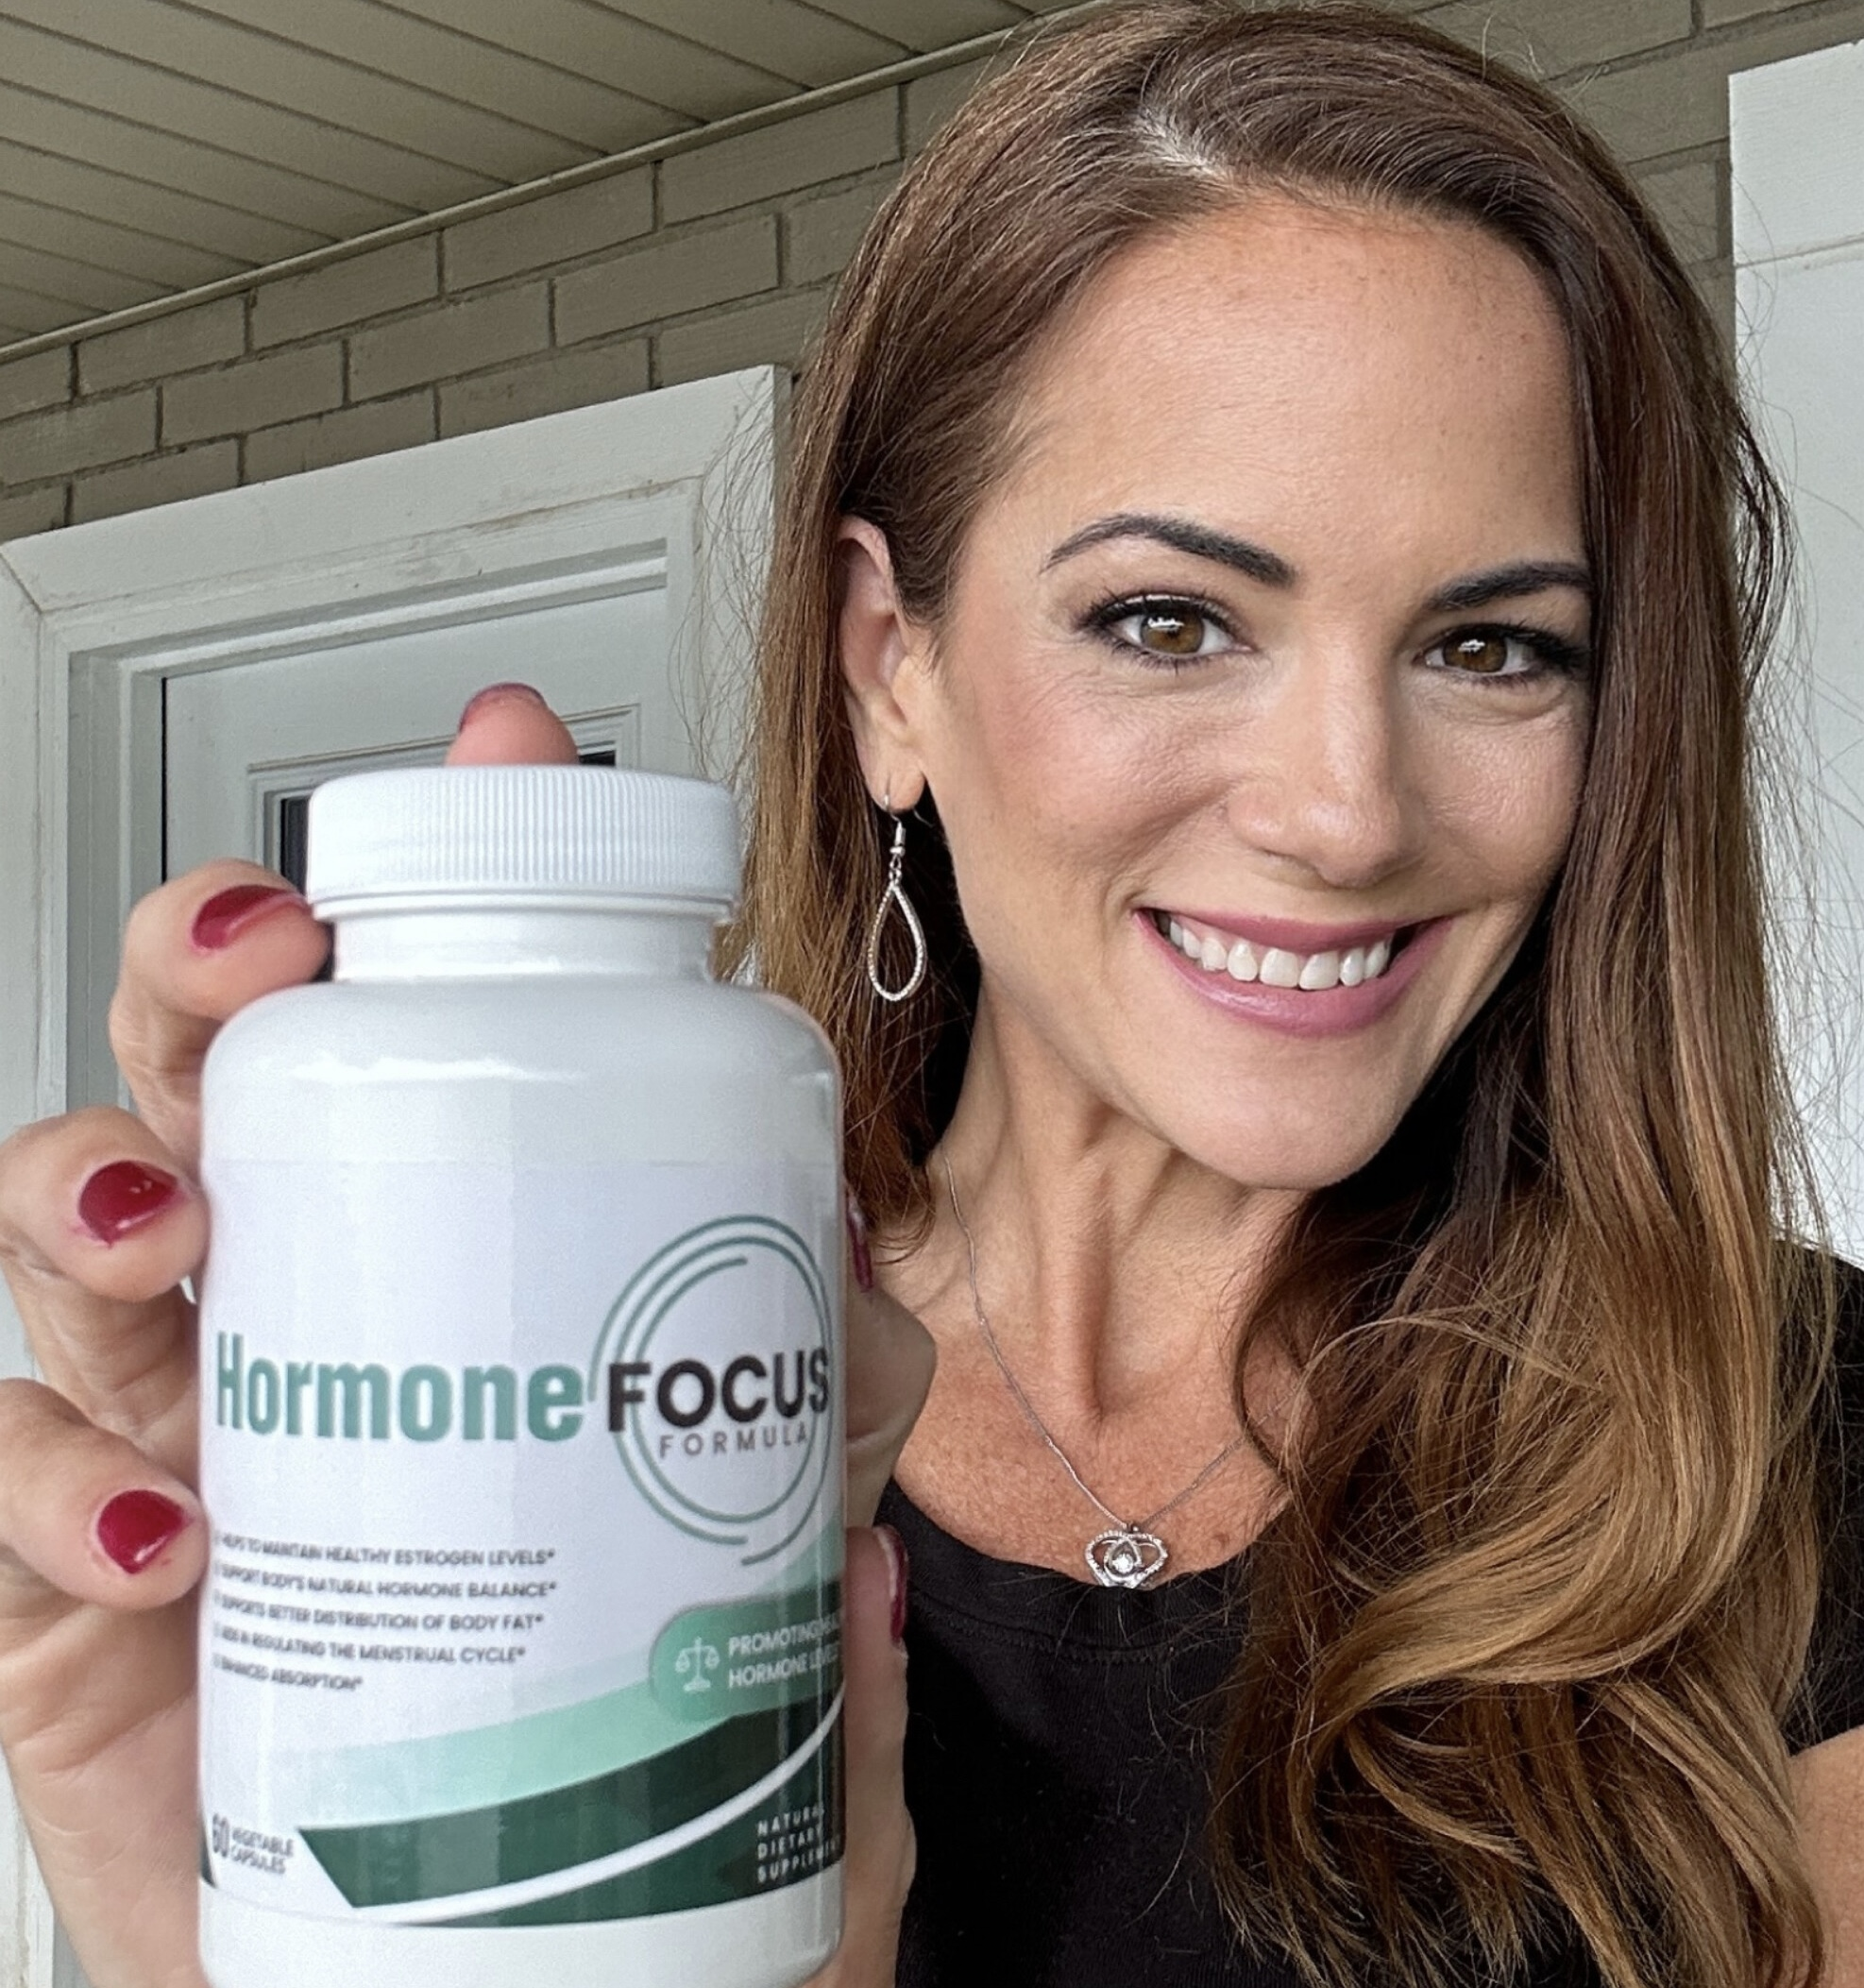
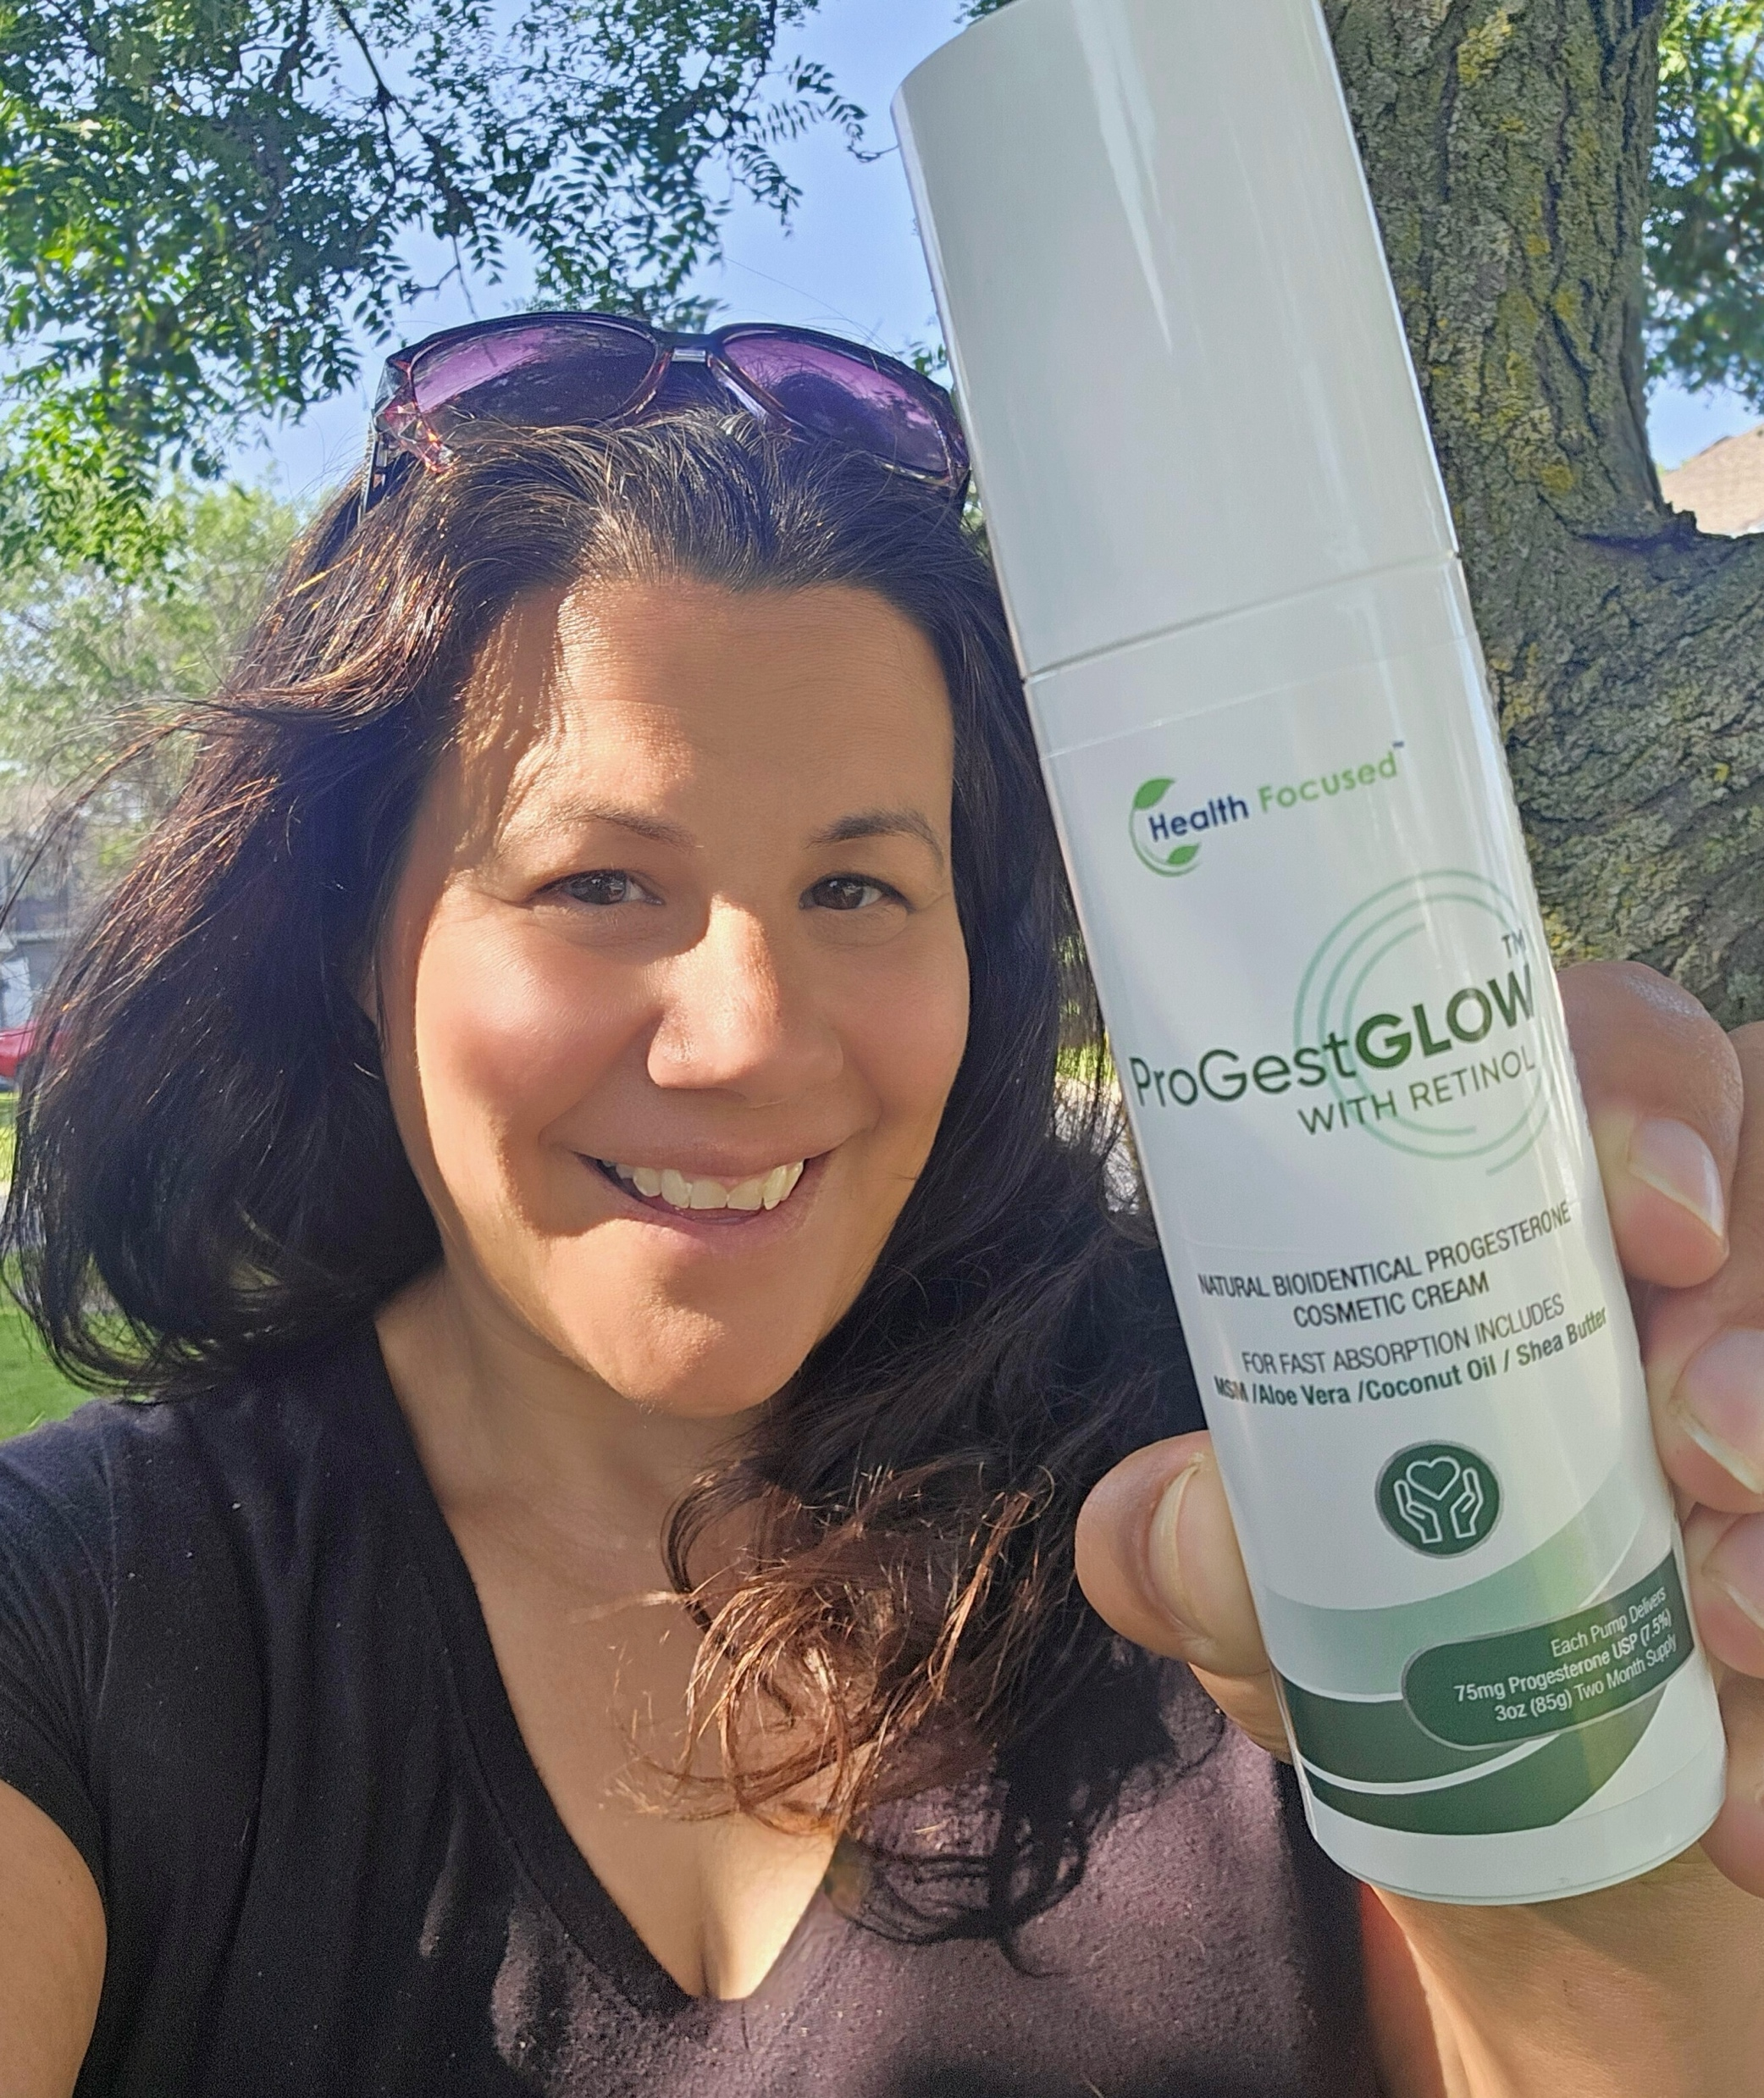
Create a collage of these UGC photos to display on headline/main banner area

Slide 3

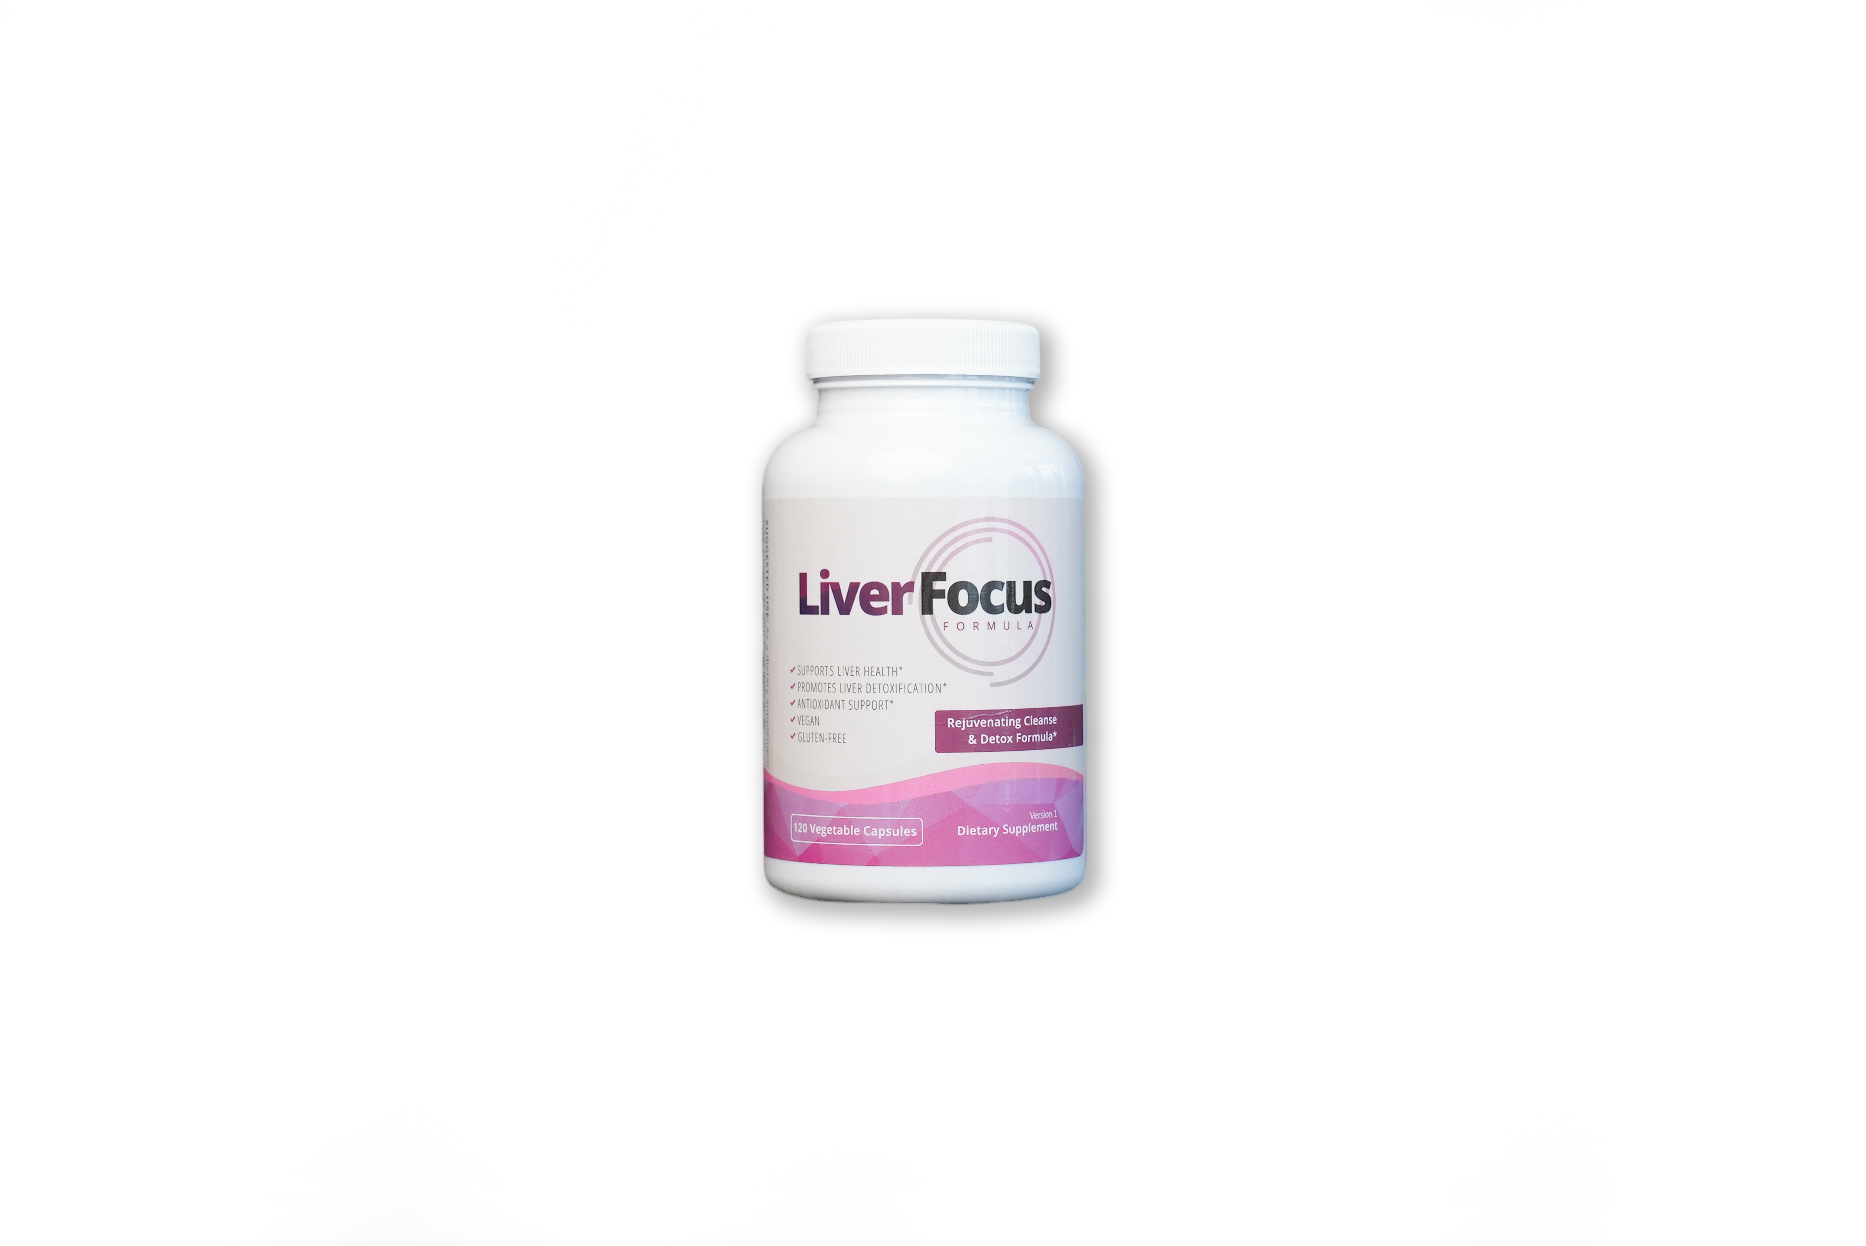
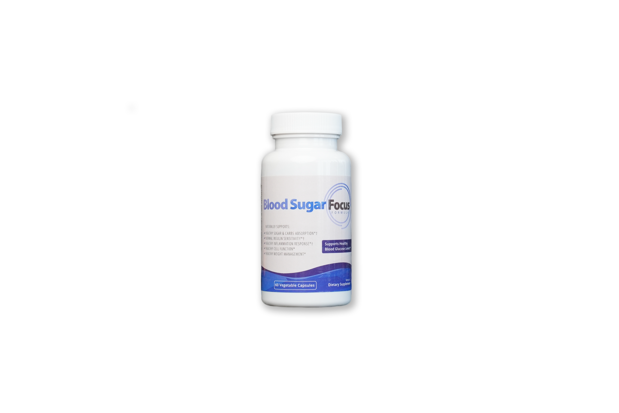
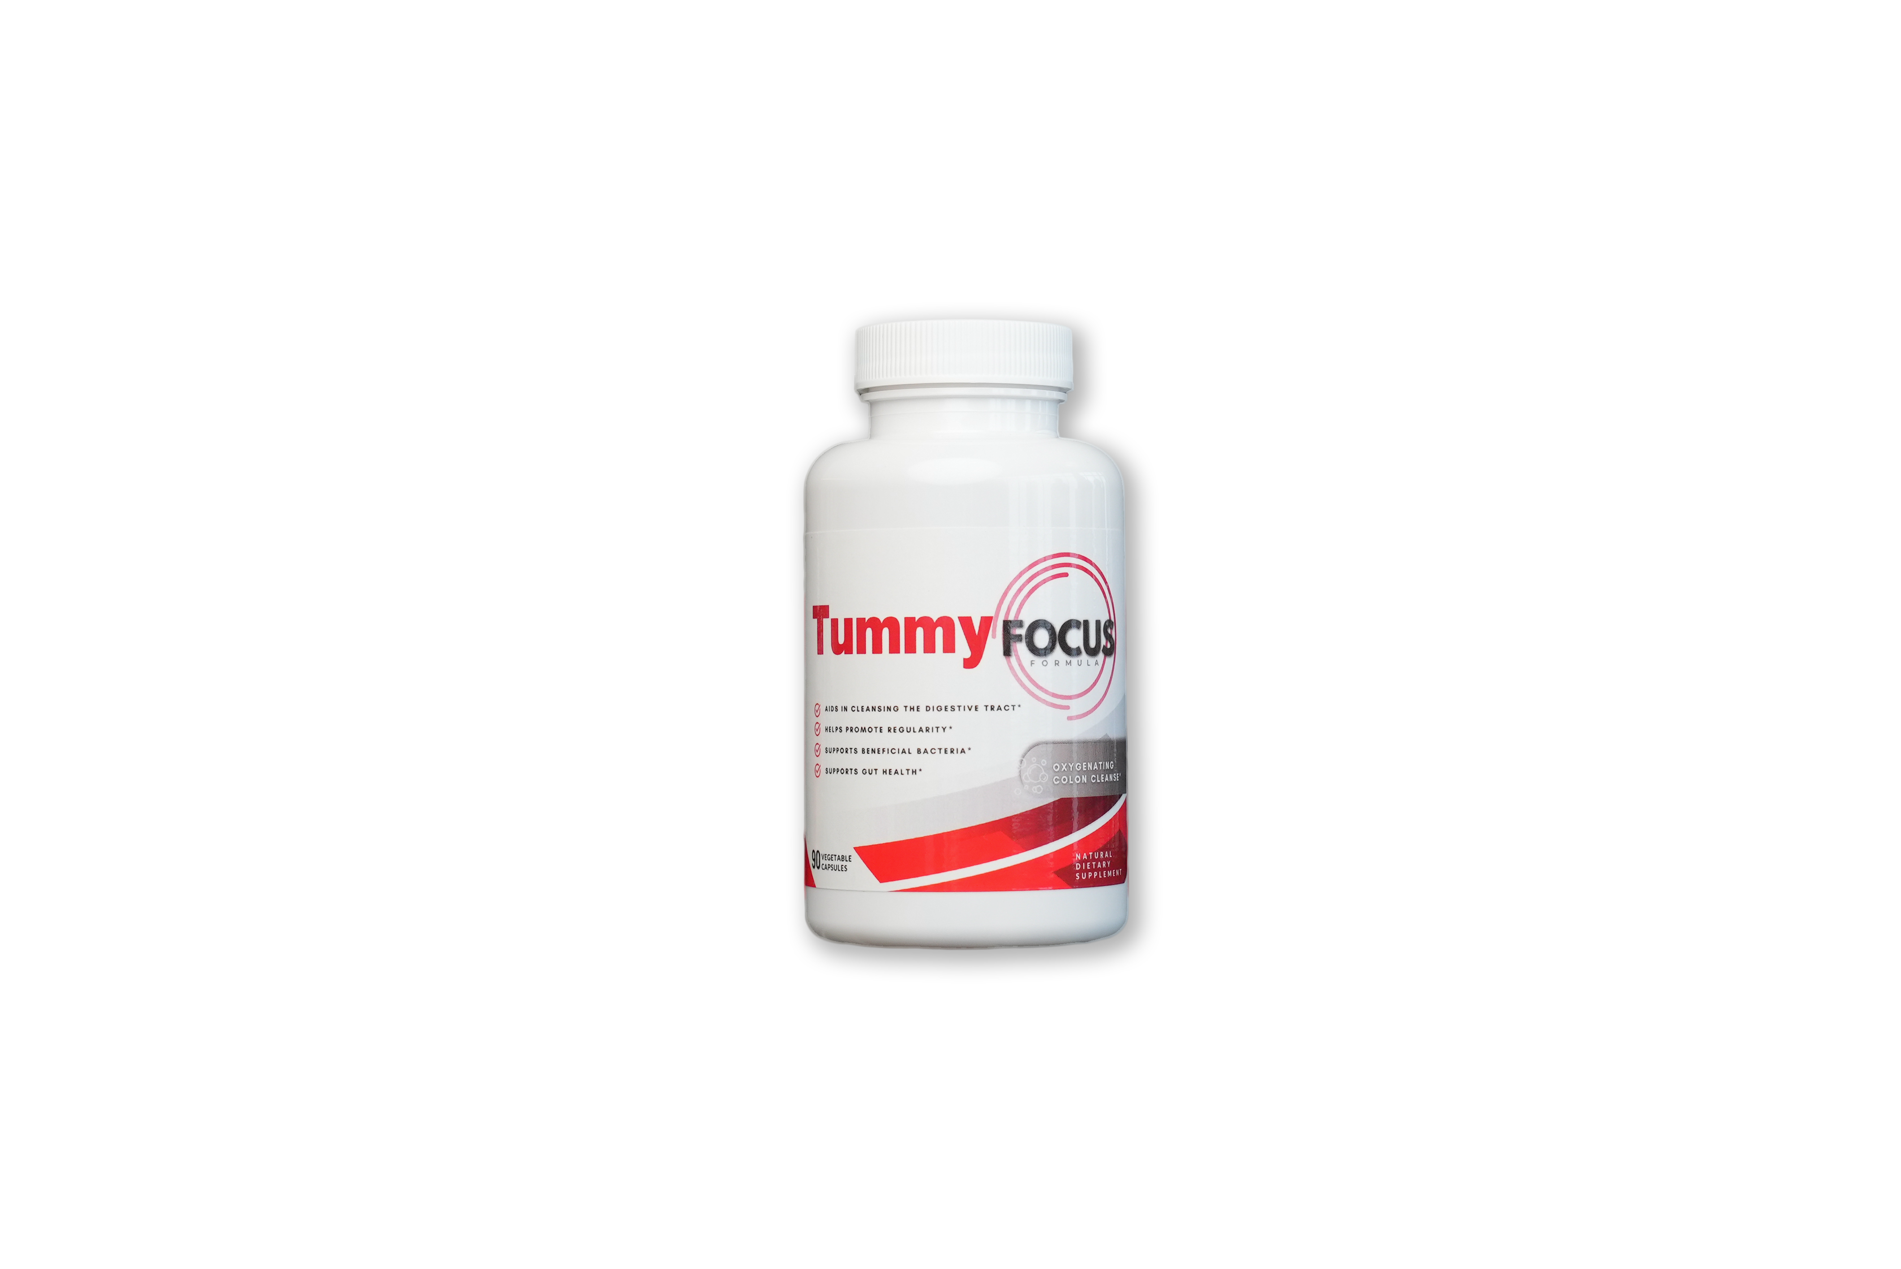
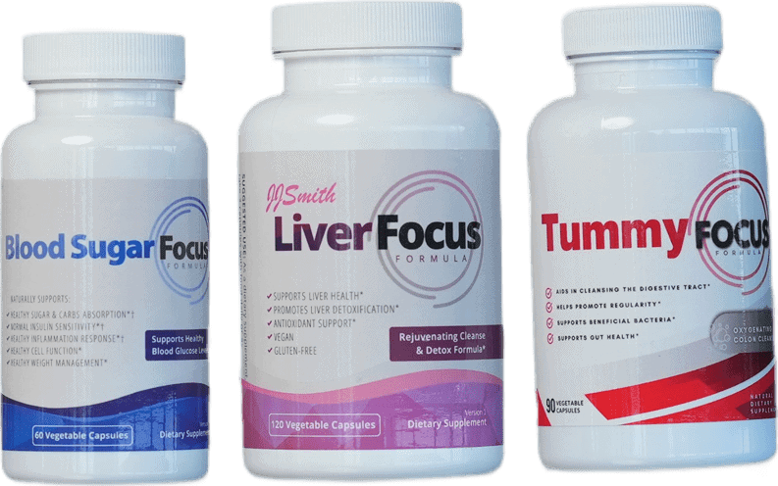
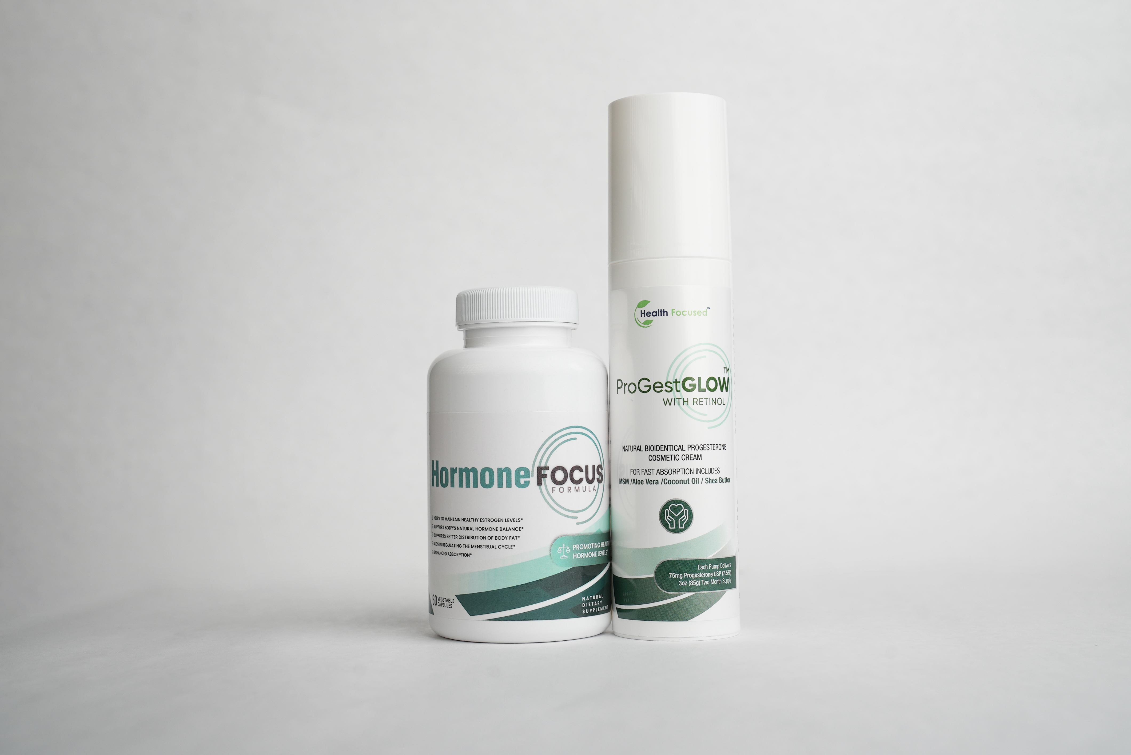
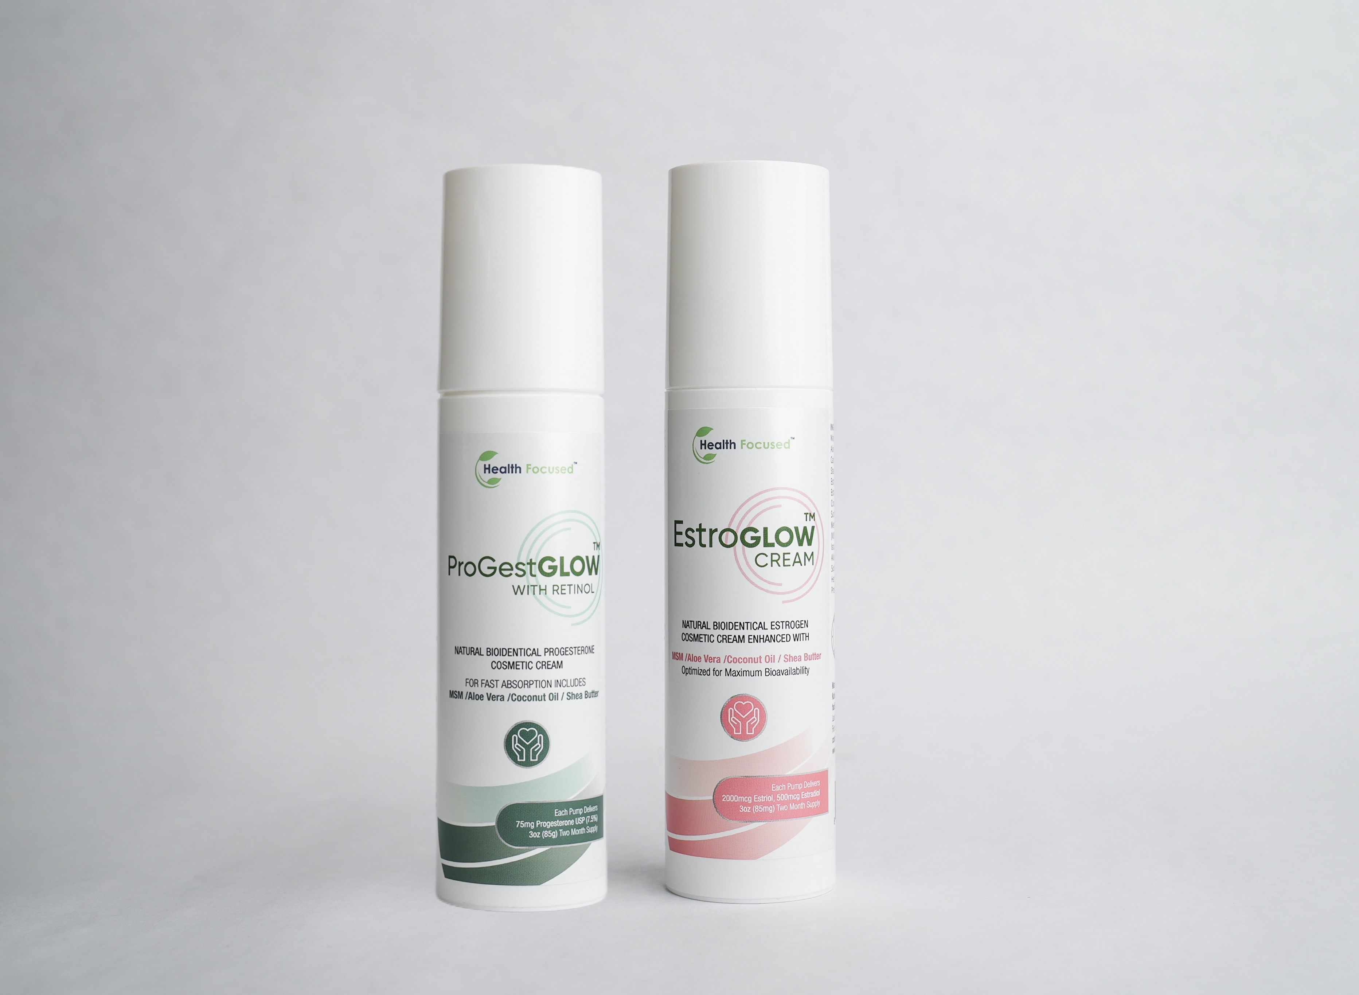
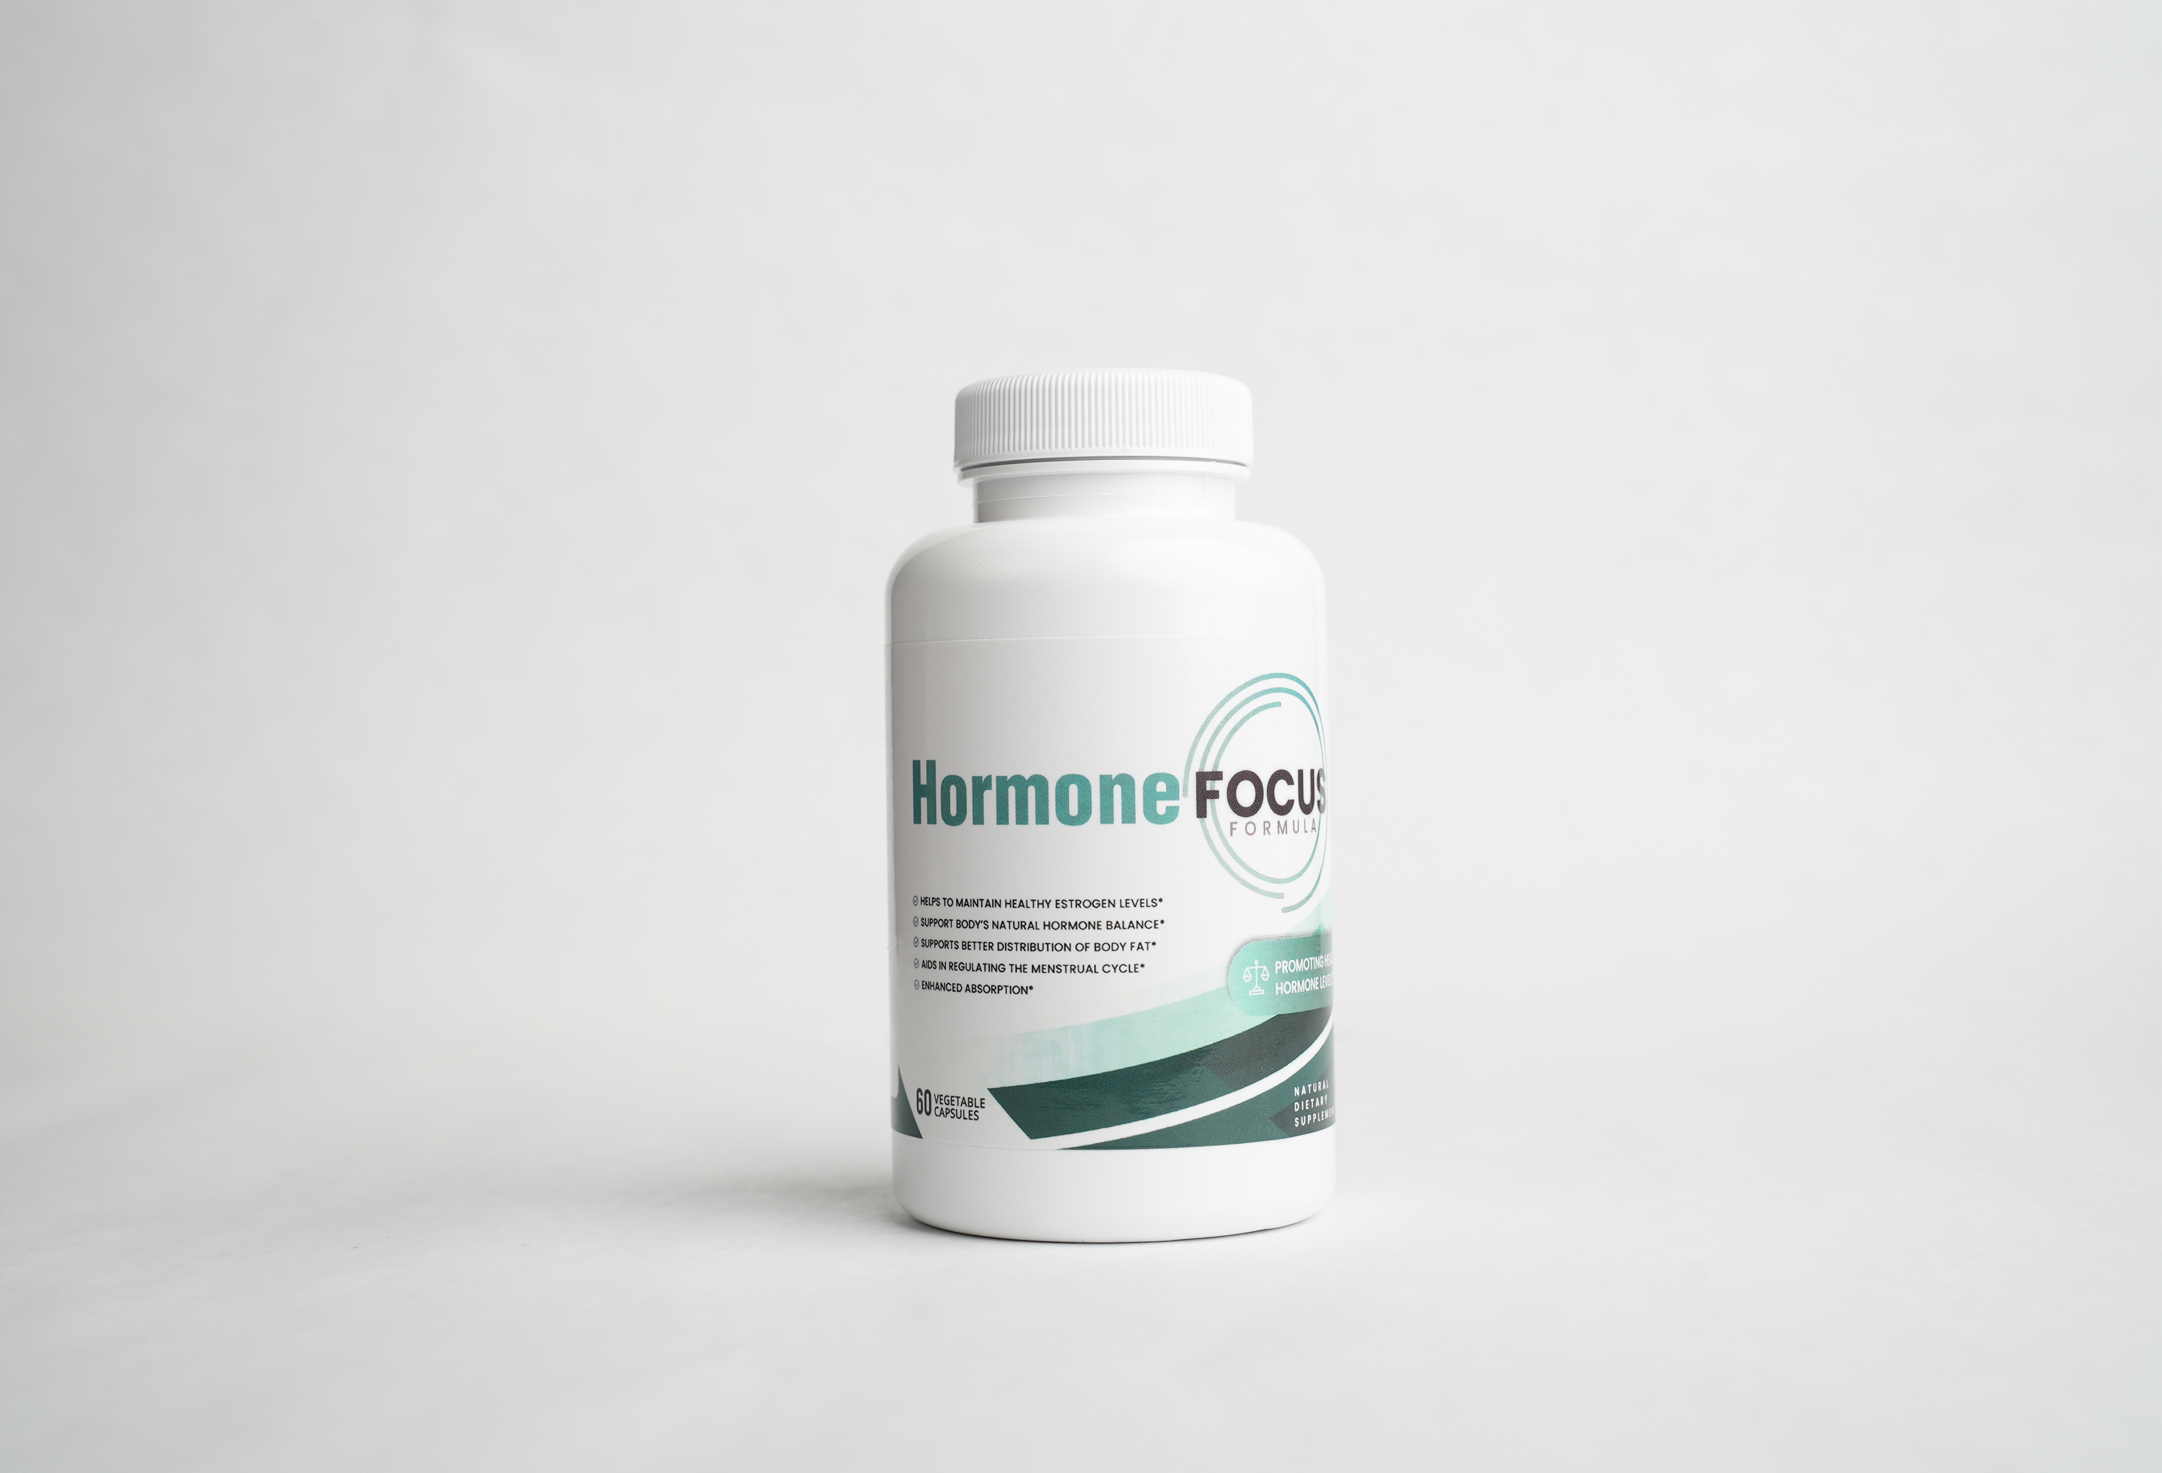
Why So Many Customers Love Our Products!
Do You Need to Accelerate Weight Loss, Reduce Bloating and Feel AMAZING?
Try our Best Selling Weight Loss Products!
Change number to Over 372,000+ Happy Customers
Liver Focus
Blood Sugar Focus
Tummy Focus
Weight Loss Bundle
Accelerate Fat Burning in the Body!*
Natural GLP-1 Support to Reduce Cravings & Appetite*
Support a Healthy Gut and a Flatter Tummy*
Slim Down, Reduce Belly Bloat and Feel Amazing – Naturally!*
Do You Need to Balance Your Hormones and Feel Like Yourself Again?
Try our Natural Hormone Products!
Hormone Focus Bundle
Menopause Support Bundle
Hormone Focus
Total Relief for Perimenopause — Restore Calm, Flatten Belly & Sleep Through the Night*
Complete Menopause Relief — Beat Hot Flashes, Sleep Better & Flatten Belly Bloat*
Relief for PMS & Perimenopause -Reduce Belly Fat, Bloating & Fatigue*

Slide 4
Sp for all the gray buttons on the previous page, when they click it, it will go FURTHER DOWN the page to the specific product details on the following pages.
Also note that you can pull the before and after pics, UGC Selfie Pics and UGC Videos directly from the Dropbox here (per product):
https://www.dropbox.com/scl/fo/1m464dcd8l1o45fpmtw0e/ADUZpBEaX1boQv7BuH5nrh0?rlkey=wr6t14afdn5dk5gx0gpu8nhw1&st=vh9jyote&dl=0

Slide 5
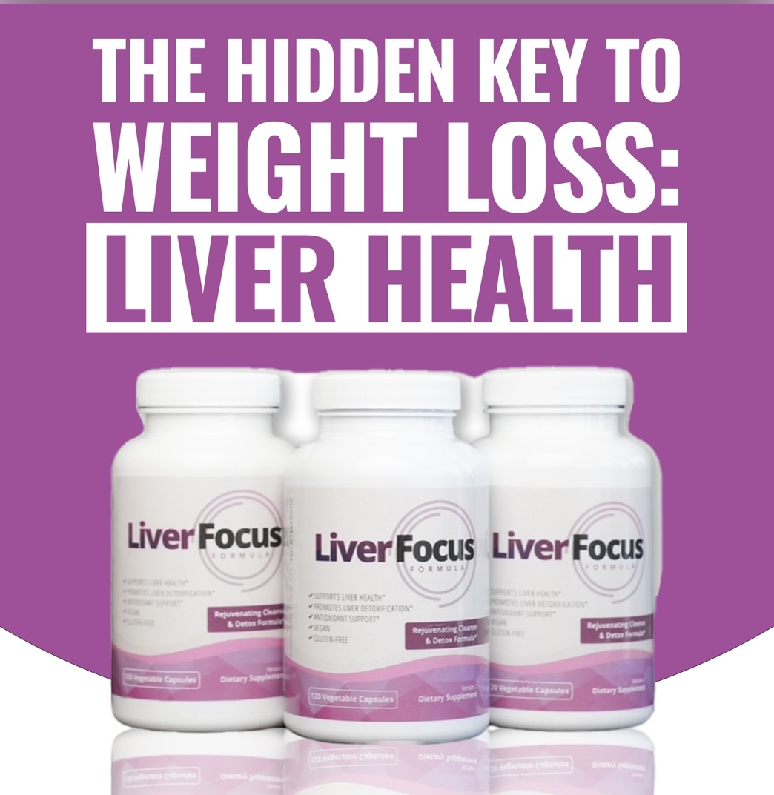

A Liver Detox That Helps Accelerate Fat Burning in the Body!*
ADD Liver Focus BEFORE AND AFTER Photos from Dropbox (scrolling)
ADD Liver Focus UGC Selfie Photos from Dropbox (scrolling)
ADD Liver Focus UGC VIDEOS from Dropbox (scrolling)
CLICK HERE to Read More Reviews (this will click to Okendo reviews)

Slide 6
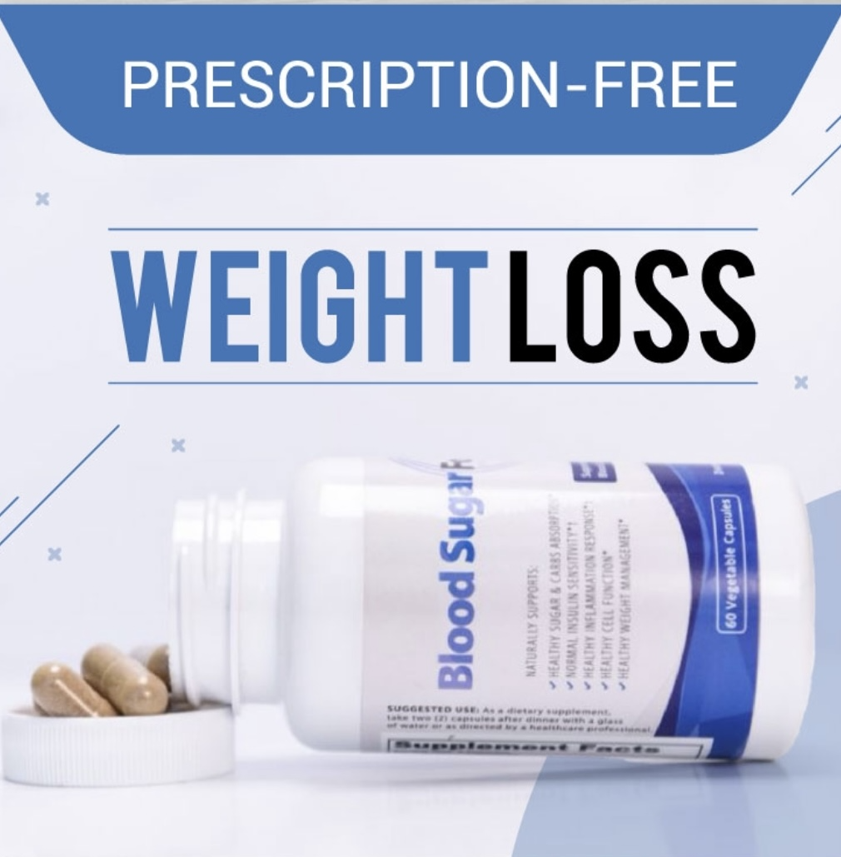
Natural GLP-1 Support to Reduce Cravings & Appetite and Support Fat Loss*
ADD Blood Sugar Focus BEFORE AND AFTER Photos from Dropbox (scrolling)
ADD Blood Sugar Focus UGC Selfie Photos from Dropbox (scrolling)
ADD Blood Sugar Focus UGC VIDEOS from Dropbox (scrolling)
CLICK HERE to Read More Reviews (this will click to Okendo reviews)

Slide 7
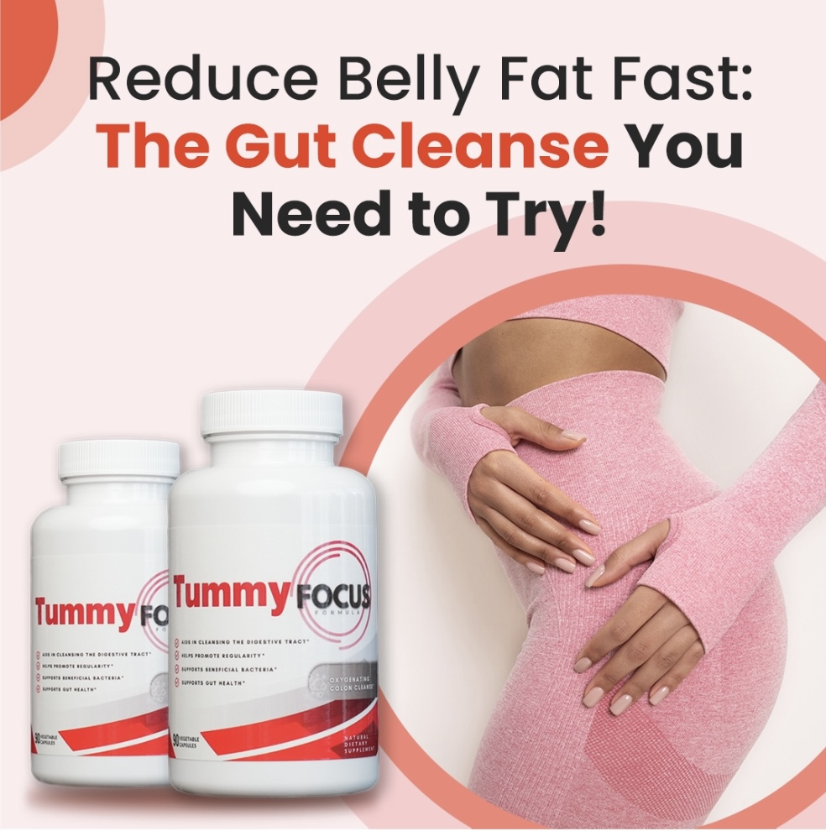
Support a Healthy Gut and a Flatter Tummy*
ADD Tummy Focus BEFORE AND AFTER Photos from Dropbox (scrolling)
ADD Tummy Focus UGC Selfie Photos from Dropbox (scrolling)
ADD Tummy Focus UGC VIDEOS from Dropbox (scrolling)
CLICK HERE to Read More Reviews (this will click to Okendo reviews)

Slide 8
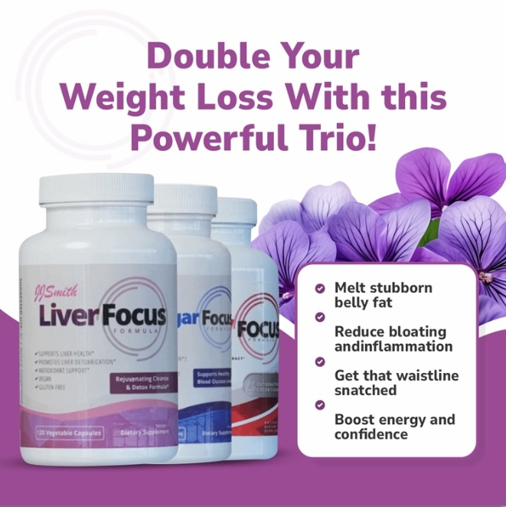
Slim Down, Reduce Belly Bloat and Feel Amazing – Naturally!*
ADD Weight Loss Bundle BEFORE AND AFTER Photos from Dropbox (scrolling)
ADD Weight Loss Bundle UGC Selfie Photos from Dropbox (scrolling)
ADD Weight Loss Bundle UGC VIDEOS from Dropbox (scrolling)
CLICK HERE to Read More Reviews (this will click to Okendo reviews)

Slide 9
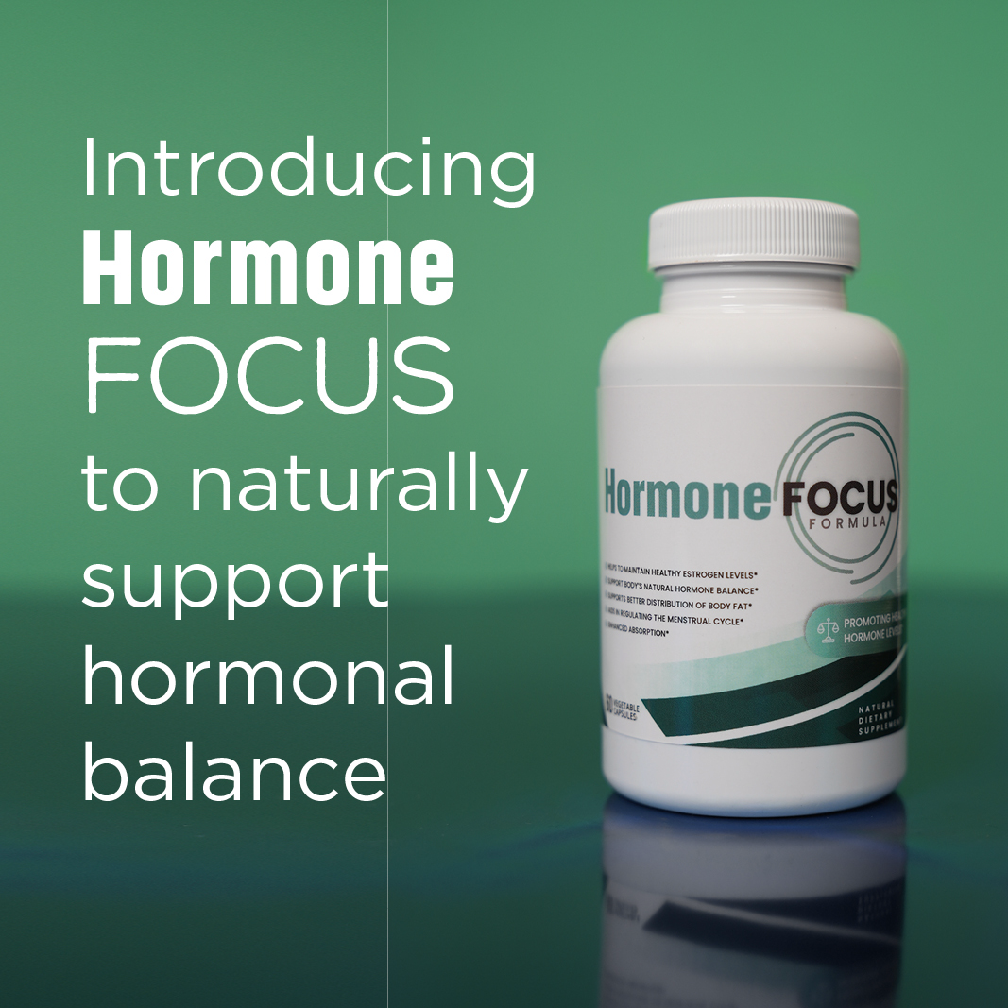
Relief for PMS & Perimenopause -Reduce Belly Fat, Bloating & Fatigue*
*Note: for all Hormone products, there are NO Before and After Pics
ADD Hormone Focus UGC Selfie Photos from Dropbox (scrolling)
ADD Hormone Focus UGC VIDEOS from Dropbox (scrolling)
CLICK HERE to Read More Reviews (this will click to Okendo reviews)

Slide 10
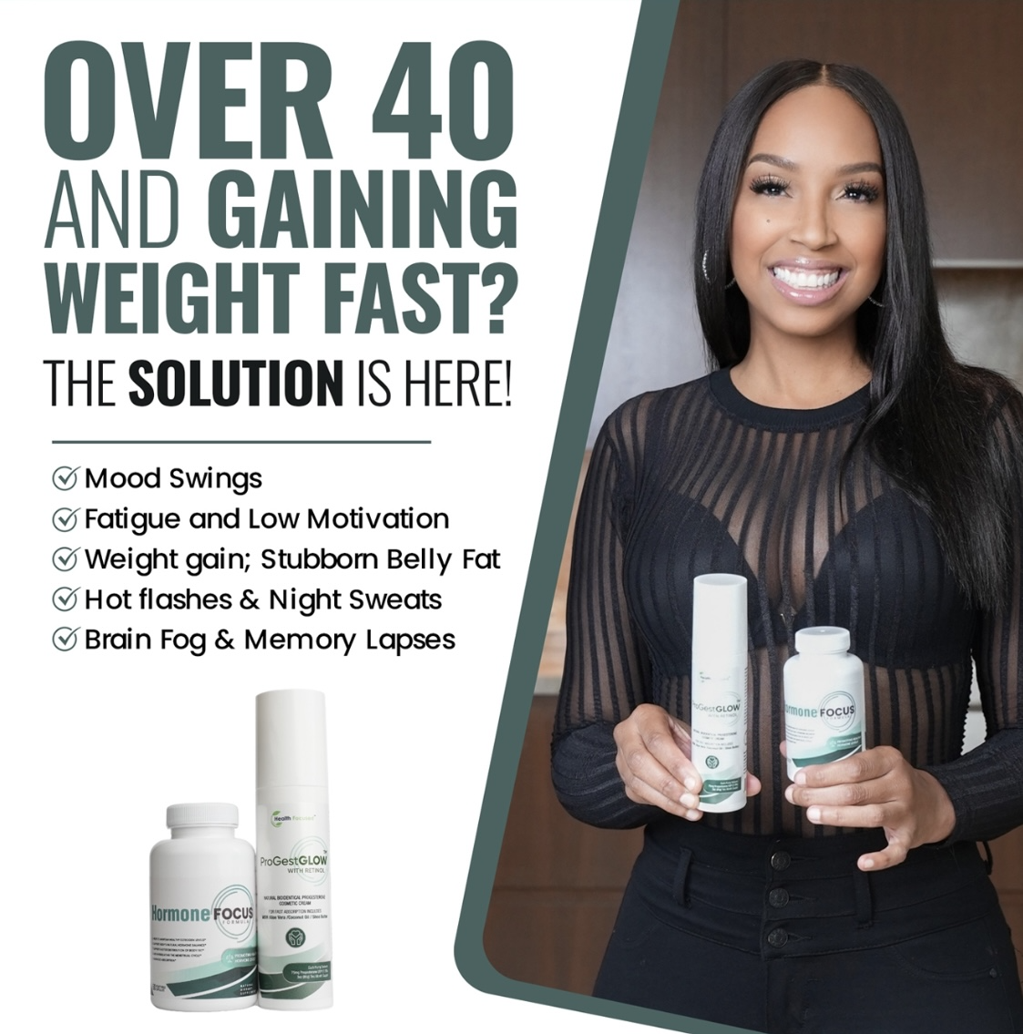
Total Relief for Perimenopause — Restore Calm, Flatten Belly & Sleep Through the Night*
*Note: for all Hormone products, there are NO Before and After Pics
ADD Hormone Focus BUNDLE UGC Selfie Photos from Dropbox (scrolling)
ADD Hormone Focus BUNDLE UGC VIDEOS from Dropbox (scrolling)
CLICK HERE to Read More Reviews (this will click to Okendo reviews)

Slide 11
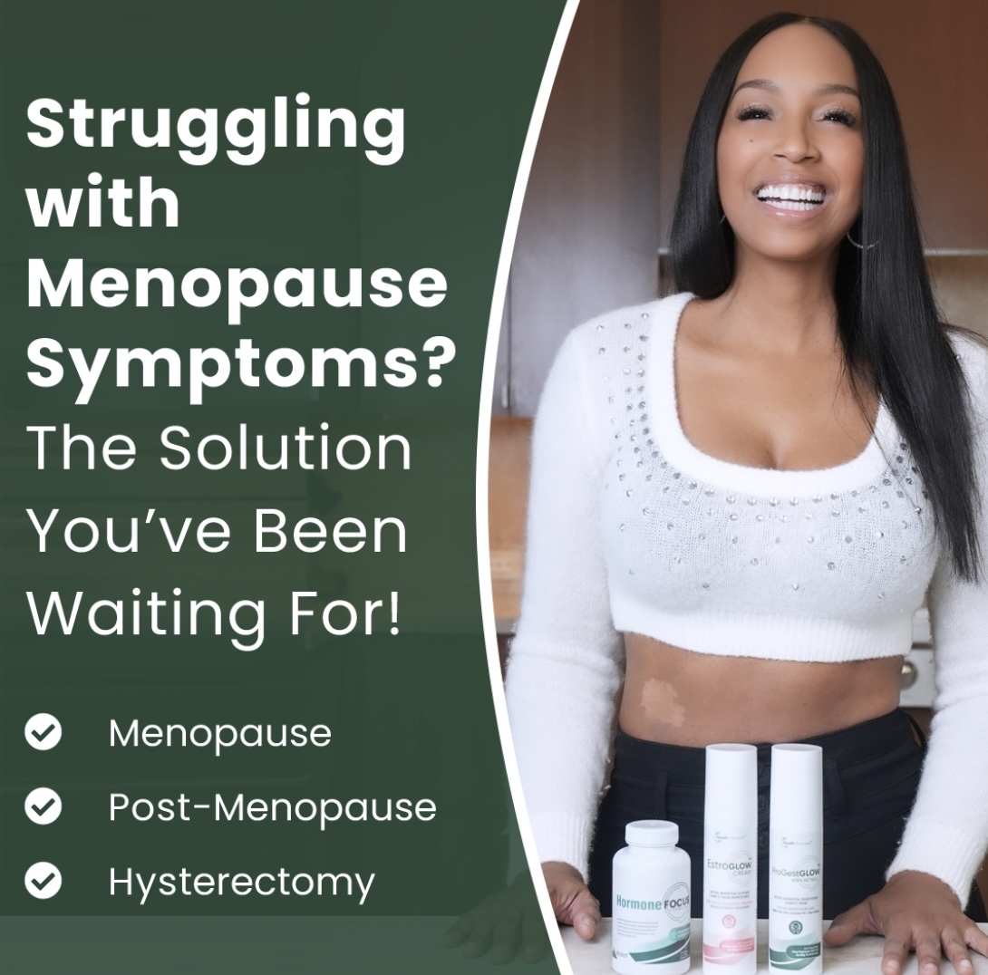
Complete Menopause Relief — Beat Hot Flashes, Sleep Better & Flatten Belly Bloat*
*Note: for all Hormone products, there are NO Before and After Pics
ADD Menopause Support Bundle UGC Selfie Photos from Dropbox (scrolling)
ADD Menopause Support Bundle UGC VIDEOS from Dropbox (scrolling)
CLICK HERE to Read More Reviews (this will click to Okendo reviews)

