Slide 1











Marketing Technology
We offer mobile marketing solutions that connect advertisers with more interested prospects via texting.

Slide 2

Our Products Work TOGETHER
We deliver more high-quality opportunities because our programs facilitate an equitable exchange of information at instant speed between the dealer and consumers.
Email
Design
TEXTiUM
Direct Mail
TEXTiUM
Data
Textium enhanced direct mail is all the things you love about direct mail plus integration with the number 1 form of communication used today. All leads are sent directly to your CRM with accurate cell phone numbers.
TEXTiUM enhanced email goes beyond open and clicks reporting. We deliver actionable leads directly to CRM. Staying in contact with large numbers of buyers is critical. Adding text to uncover the hand raisers makes email a ROI powerhouse.
Direct mail is one of things anyone can do but only some can do well. We design our mailers from in the outside in making sure your mailer get opened and the action you want consumers to take is clear.
We use a combination of registered owners, credit, bankruptcy, collision, sales database, service database, and CRM to insure we are staying in contact with current customers and cross selling with relevant messaging while adding conquest opportunities. .

Slide 3
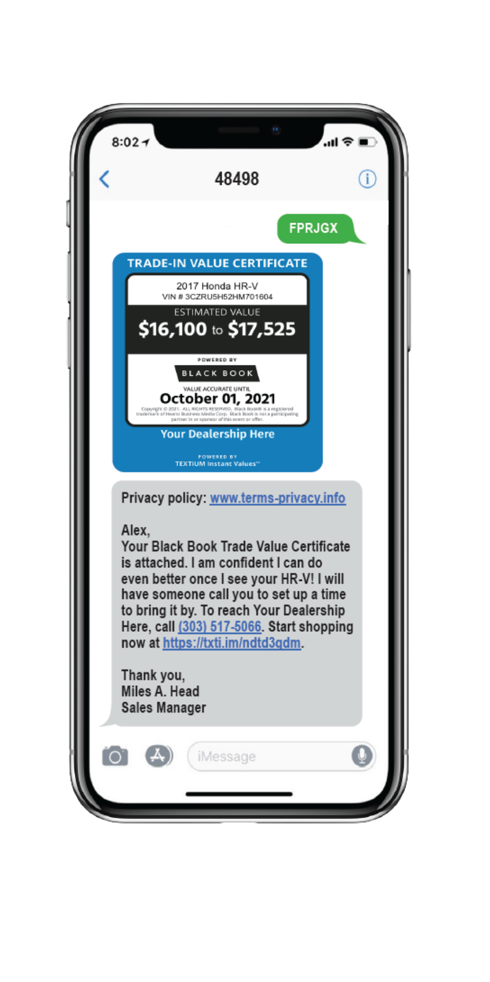
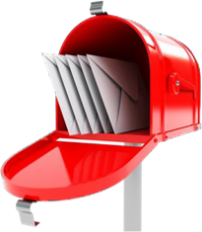
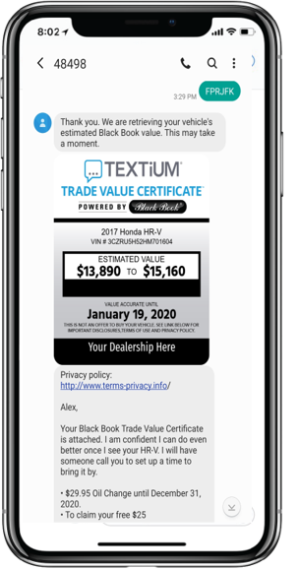

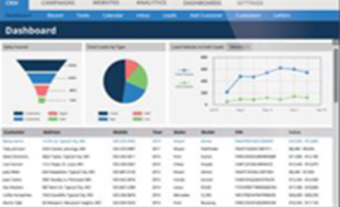
Traditional Marketing Has Been Upgraded
272 million smartphone users
Reaching out to consumers virtual and physical mailboxes have been a cornerstone of marketing for decades. The tangible, targeted, trackable nature of direct mail and speed and low cost of email keep these marketing programs part of most industries’ budgets.
77 percent use texting more than any other communication
However, these more traditional marketing staples in the past have failed to take advantage of the mobile age.
TEXTiUM direct mail and email are at the forefront using texting to get the absolute most out of your database and conquest efforts.
If you want your clients to engage your dealership you must incorporate texting.
FPRJGX

Slide 4
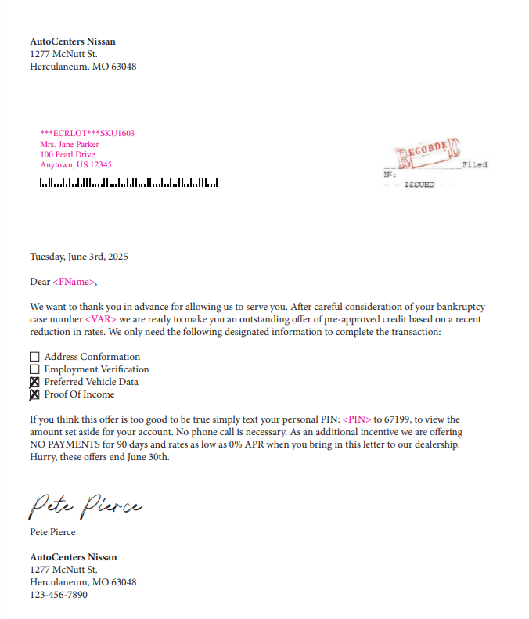

Official Recording Letter with new Attention Getter Envelope
Try It Now: Text FPRJFX To 48498
The Who We target people that have a discharged BK within the last five years. These people are mix of credit profiles. Some are ready to start rebuilding and some have already rebuilt their credit but are looking for better cars and loan terms.
The What This is an 8.5x11 letter designed around an official notice. We want them to text! The pitch is the dealer is ready to arrange financing. This letter is mailed in a windowed envelope designed to hide the fact it’s a solicitation.
$10

Slide 5
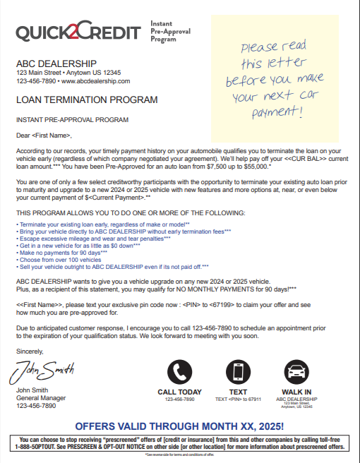
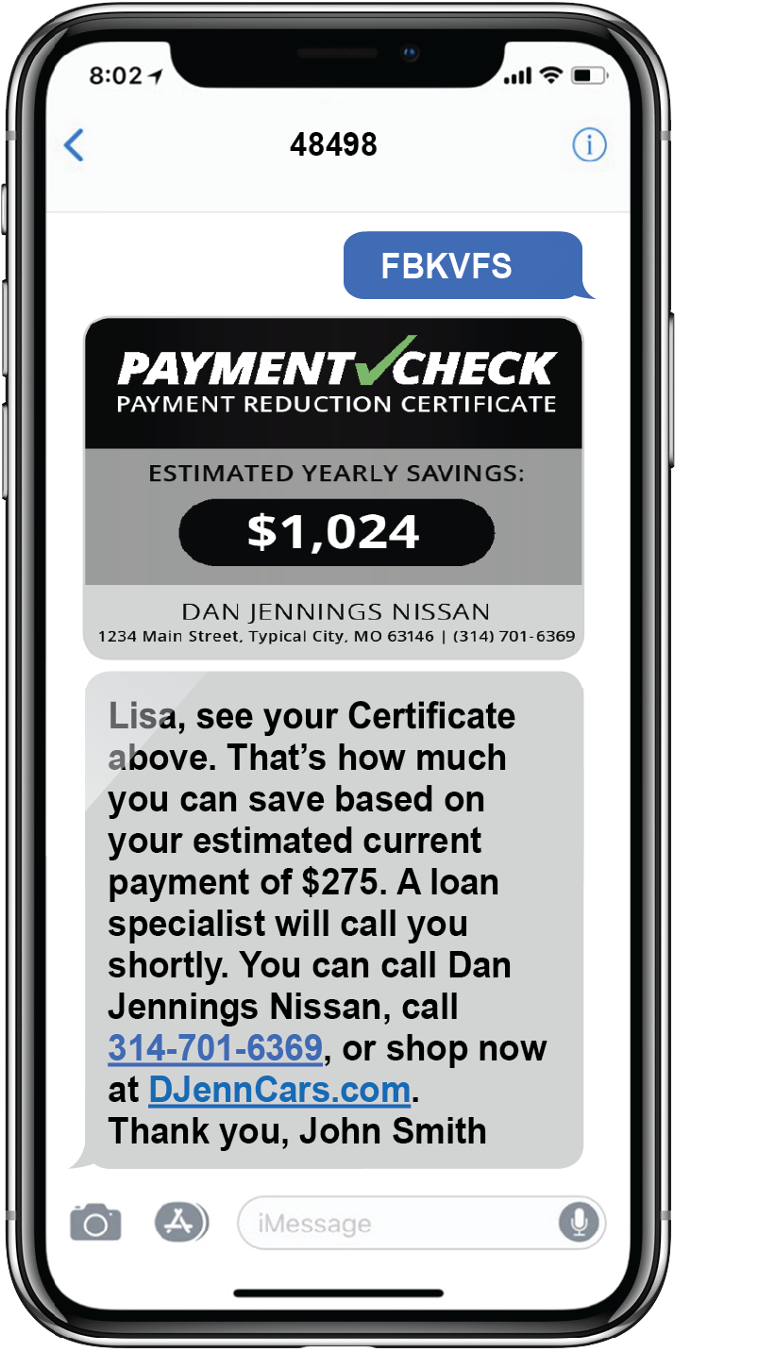
The Loan Termination Letter Is the Perfect Mailer For Credit Targets
Try It Now: Text FBKVFS To 48498
The Who We target any credit filters the dealer is interested in. This can include and current score, rate, and payment.
The What This is an 8.5x11 letter loaded with variables and an attached post-it-note.. We have dozens of envelope options that are perfect for this letter.

Slide 6
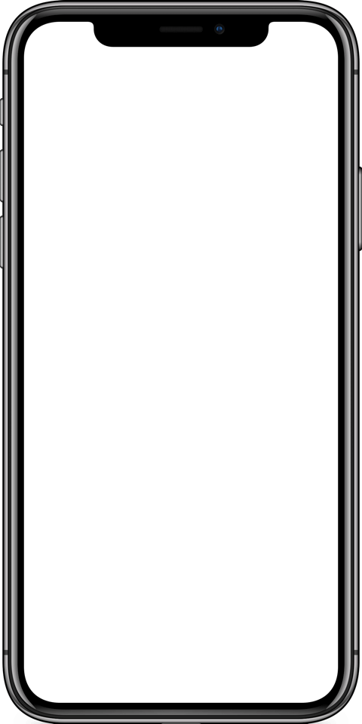






Email Features
Try It Now: Text FPRJFX To 48498
Themed and Targeted
The Who We target a combination of past sales and/or service customers based on your dealership’s unique goals. It includes filters such as current payment or interest rate, lease expiration date, and last service date to create a personalized message specific to those customers.
Three Monthly Deployments
Direct Response Leads
The What The creative is customized per audience. All creative will include the dealership’s sale theme or OEM event, along with the specific unique selling propositions for the dealership.
Elegant Interface with CRM
Extensive List Filtering

Slide 7










Email Marketing For a Mobile World
Sales, Service, Credit
Combination of offers to suit any recipient
Event Matching
Artwork matching other marketing
Credit Targets
Designed to push traffic to Q2C
Trade Targets
Drives traffic to Q2T
Service Offers
Re-engage lost service prospects

Slide 8
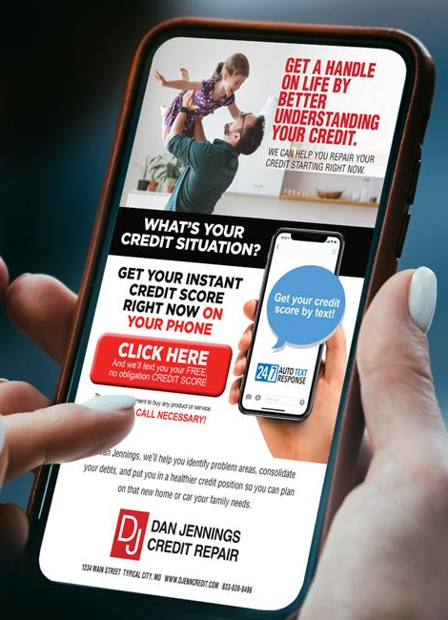

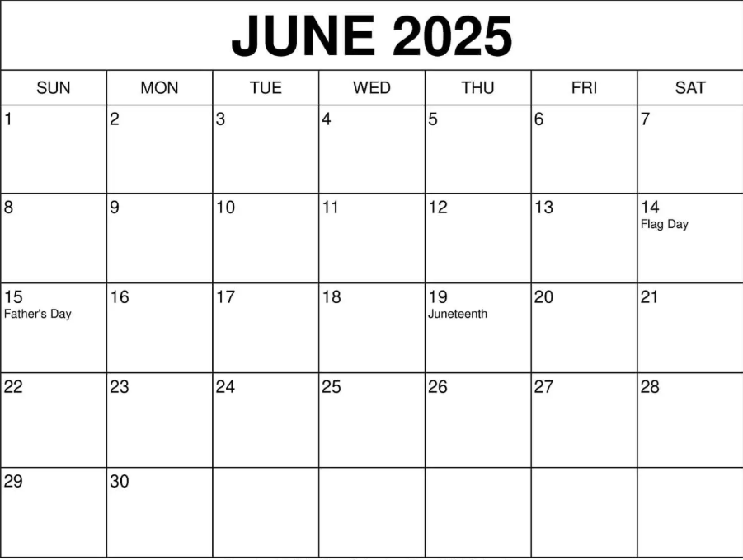
June Calendar & Budget
Date | Type | Audience | Quantity | Budget
6/11 | Sales Email | Previous Sold/Previous Service | Max Emails
6/16 6/17 | Sales Email Credit Mail | Unsold Leads Conquest Owners /In Equity Previous Sold Credit Data | , Max Emails 5,000 Mailers
6/23 | Sales Email | All List Combined | Max Emails
6/24 | Discharged Mail | BK Data (Credit Offer) | 5,000 Mailers
Total |  |  |  | $ 10,990
Email
Email
Credit Mail
Email
BK Mail
*MAIL, EMAIL, INCENTIVES, INSURNACE, CALL CENTER INCLUDED.

Slide 9
Marketing Technology
We offer mobile marketing solutions that connect advertisers with more interested prospects via texting.

