Slide 1

#AlwaysOnOpportunity Capture
Turn Market Volatility into Growth –
the “Blackweek & Christmas Revenue Accelerator” package
Notes:
Be more relevant,
and your business will follow.

Slide 2
About novuter
We live in an #AlwaysOnOpportunity economy, where market volatility is the only constant. 60% of revenue opportunities now occur outside of planned marketing campaigns.
Our How: Our AI platform daily analyses 20,000+ brands across 15 channels to identify
what your audience is actually interested in right now.
Our Claim: novuter makes you the first to know, first to act.
The Result: Brands capturing #AlwaysOnOpportunities see 2.8x higher revenue growth^{*)}
“With novuter MarketWatch, we were able to spot and act on new market trends days before our competitors. The speed and clarity of insights transformed our clients’ Blackweek campaigns into true revenue drivers.”
— Roland Bredschneider, CEO xperify
^{*)} Panel of 260 German retail brands with revenue up to 250 mln. €, August 2025.
Notes:
PAIN // HELL is a cold place

Slide 3
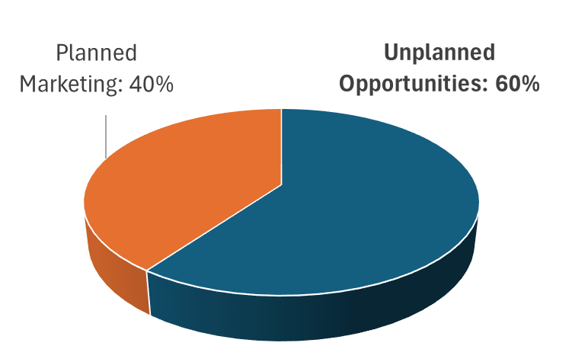
Executive Summary: 60% of Opportunities are missed
Often, marketing is capturing less than 40% of potential
business. What if you could capture the other 60%?
Key Business Impact of #AlwaysOnOpportunity capture:
10-15% higher conversion rates
15-20% increase in audience engagement
20-25% higher marketing team effectiveness
up to 2.8x higher revenue growth
Avoid the cost of inaction, get prepared for Blackweek & Christmas 2025
Timeline to Value: operational within 6 weeks,
Investment: 2-3 of your marketing experts, 15.000 € for novuter platform & support,
Expected results: +5..10% revenue.
Notes:
PAIN // HELL is a cold place

Slide 4
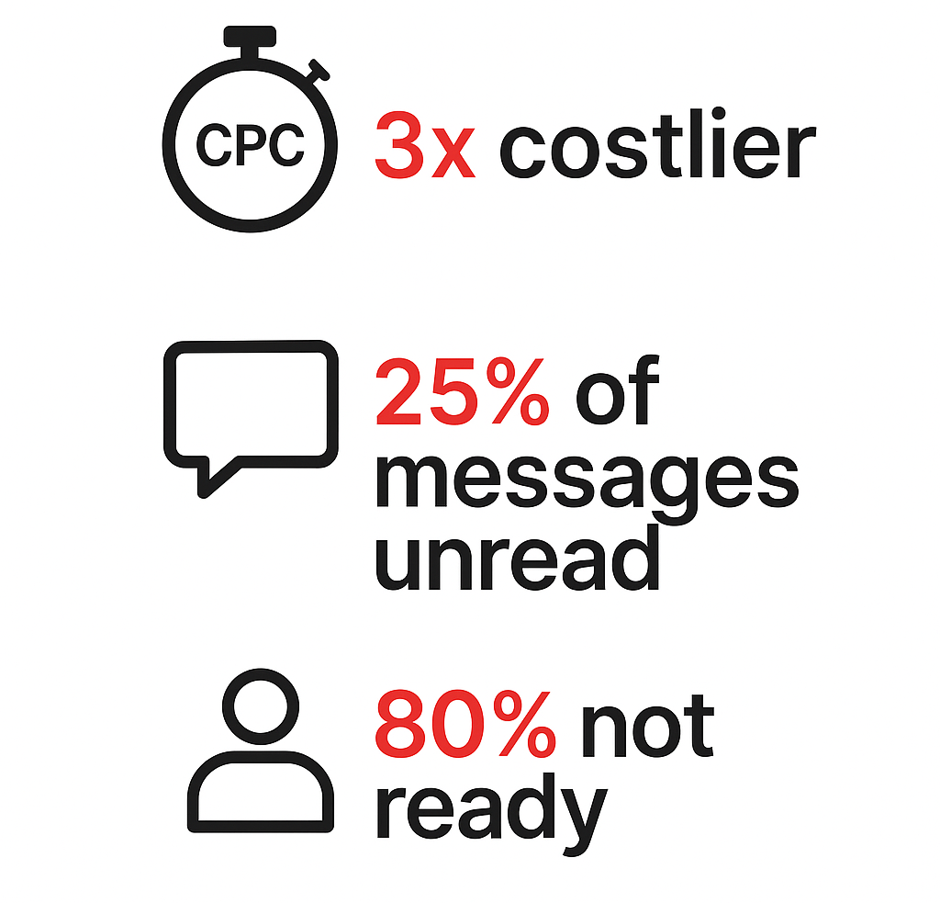

Attention is now the #1 Line-Item Cost
Marketing Reality Check: Attention costs are skyrocketing –
Generating qualified leads at scale cost 3x more than 2020.
Incomplete cross-channel messaging reaches only 20% of your potential Audience.
Fragmented storytelling does not fit with current audience Interest.
80% of audience is not in “Buy-Now” mode when your campaign hits.
Reacting to market dynamics (instead of driving them) leads to lost revenue, missed new customers, higher marketing cost.
Notes:
PAIN // HELL is a cold place

Slide 5



From Reactive to Pro-active: turn Volatility into Growth
Traditional Planning
Always-On Opportunity Capture
Internal Signals
Weekly tweaks to annual roadmap; few real-time signals from hypes, competitors, events.
Manual ex-post competitor screening.
Manual Orchestration
Break campaigns into messages by hand. Cross-channel coordination depends on complex sync and sign-of.
Speed: Weeks
Yearly master plan, monthly sprints, weekly refinements.
2-4 weeks
2-day fast-lane
360° Signals
Plan + audience sentiment + trends + competitors +upcoming events. Overnight scans = fresh insight briefs by morning.
Auto-orchestrated planning
Campaign building and channels mapping.
Daily re-calibration based on live performance.
Speed: Days
2-Day fast-lane activities addressing market volatility & short-term opportunities. Automated 10-day / 70-day mid-term updates.
Early Revenue
Notes:
We empower you with Always-On Opportunity Capture, ensuring your messaging maintains Continuous Relevance with your audience.

Slide 6
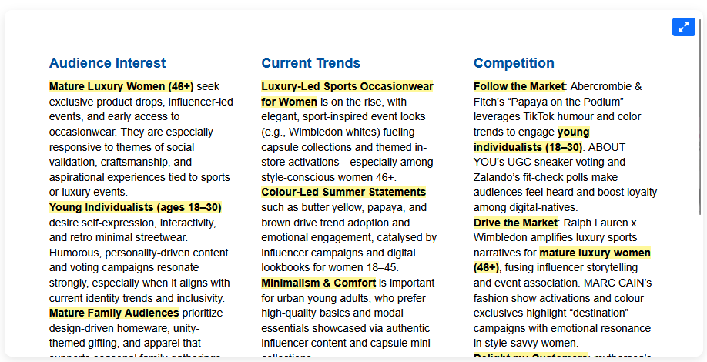
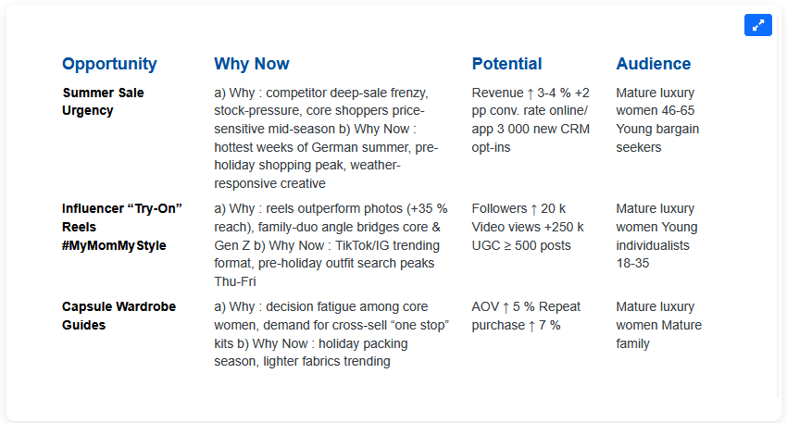
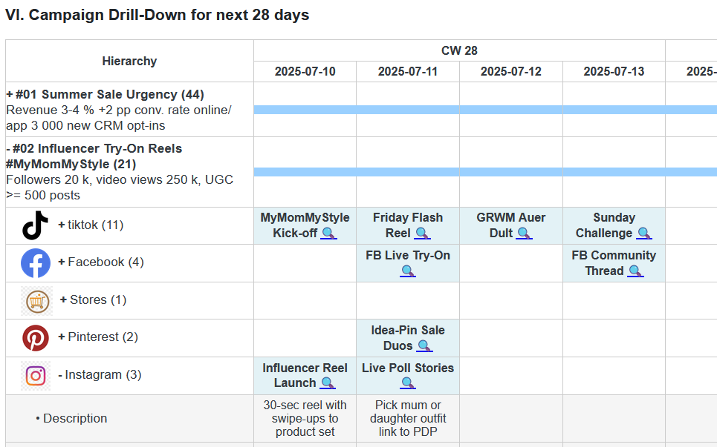
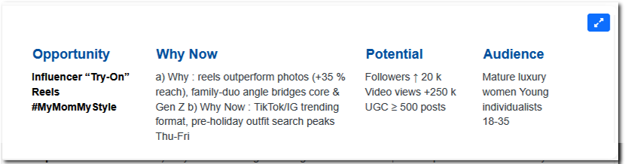
How #AlwaysOnOpportunity drives Growth
Always-On Opportunity Capture ensures your messaging maintains timely and Continuous Relevance with your audience.
Market Forensics Prioritise Opportunities Campaign Planning
Spot
Detect a rising „mother-daughter fashion“ trend on tiktok.
Validate
High-potential, low-competition angle for my brand.
Act
Suggest a 5-day campaign across tiktok, Instagram, Facebook

Slide 7

Results through #AlwaysOnOpportunity
3x faster^{*)} trend identification: First‑Mover advantage.
10 - 15% higher conversion rates through Gap‑First ideation.
15 - 20% increase in audience engagement = larger qualified pipeline & higher Lifetime Value.
20 - 25% higher marketing team effectiveness = 2-3 free specialists.
Leaders’ revenue grows 2.8x faster^{*)} than trailing brands.
^{*)} Panel of 260 German retail brands with revenue up to 250 mln. €, August 2025.

Slide 8
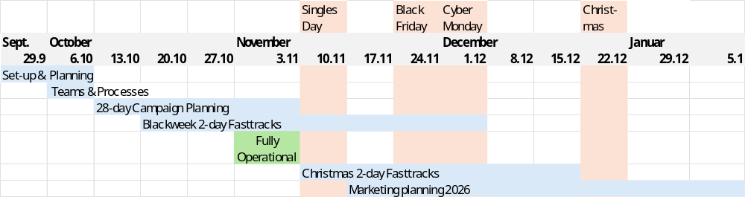
“Blackweek & Christmas Revenue Accelerator” package
Invest
pilot channel slots
dedicated team (8-12 weeks)
15.000 € platform & support fee
Deliveries
daily insight brief
Fast-lane campaign planner
1:1 expert alignment sessions
priority slots for 2026 programs
Results
5-10% Revenue uplift
higher reach, Conversion, AOV
a proven Playbook for 2026
Notes:
PAIN // HELL is a cold place

Slide 9


novuter.
Makes you the first to know,
first to act.
Secure 1 of 12 “Revenue Accelerator” packages – book your alignment call here:

