Slide 1

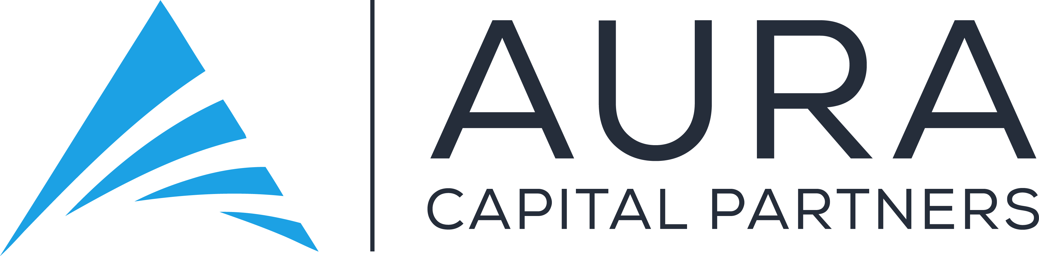

Slide 2
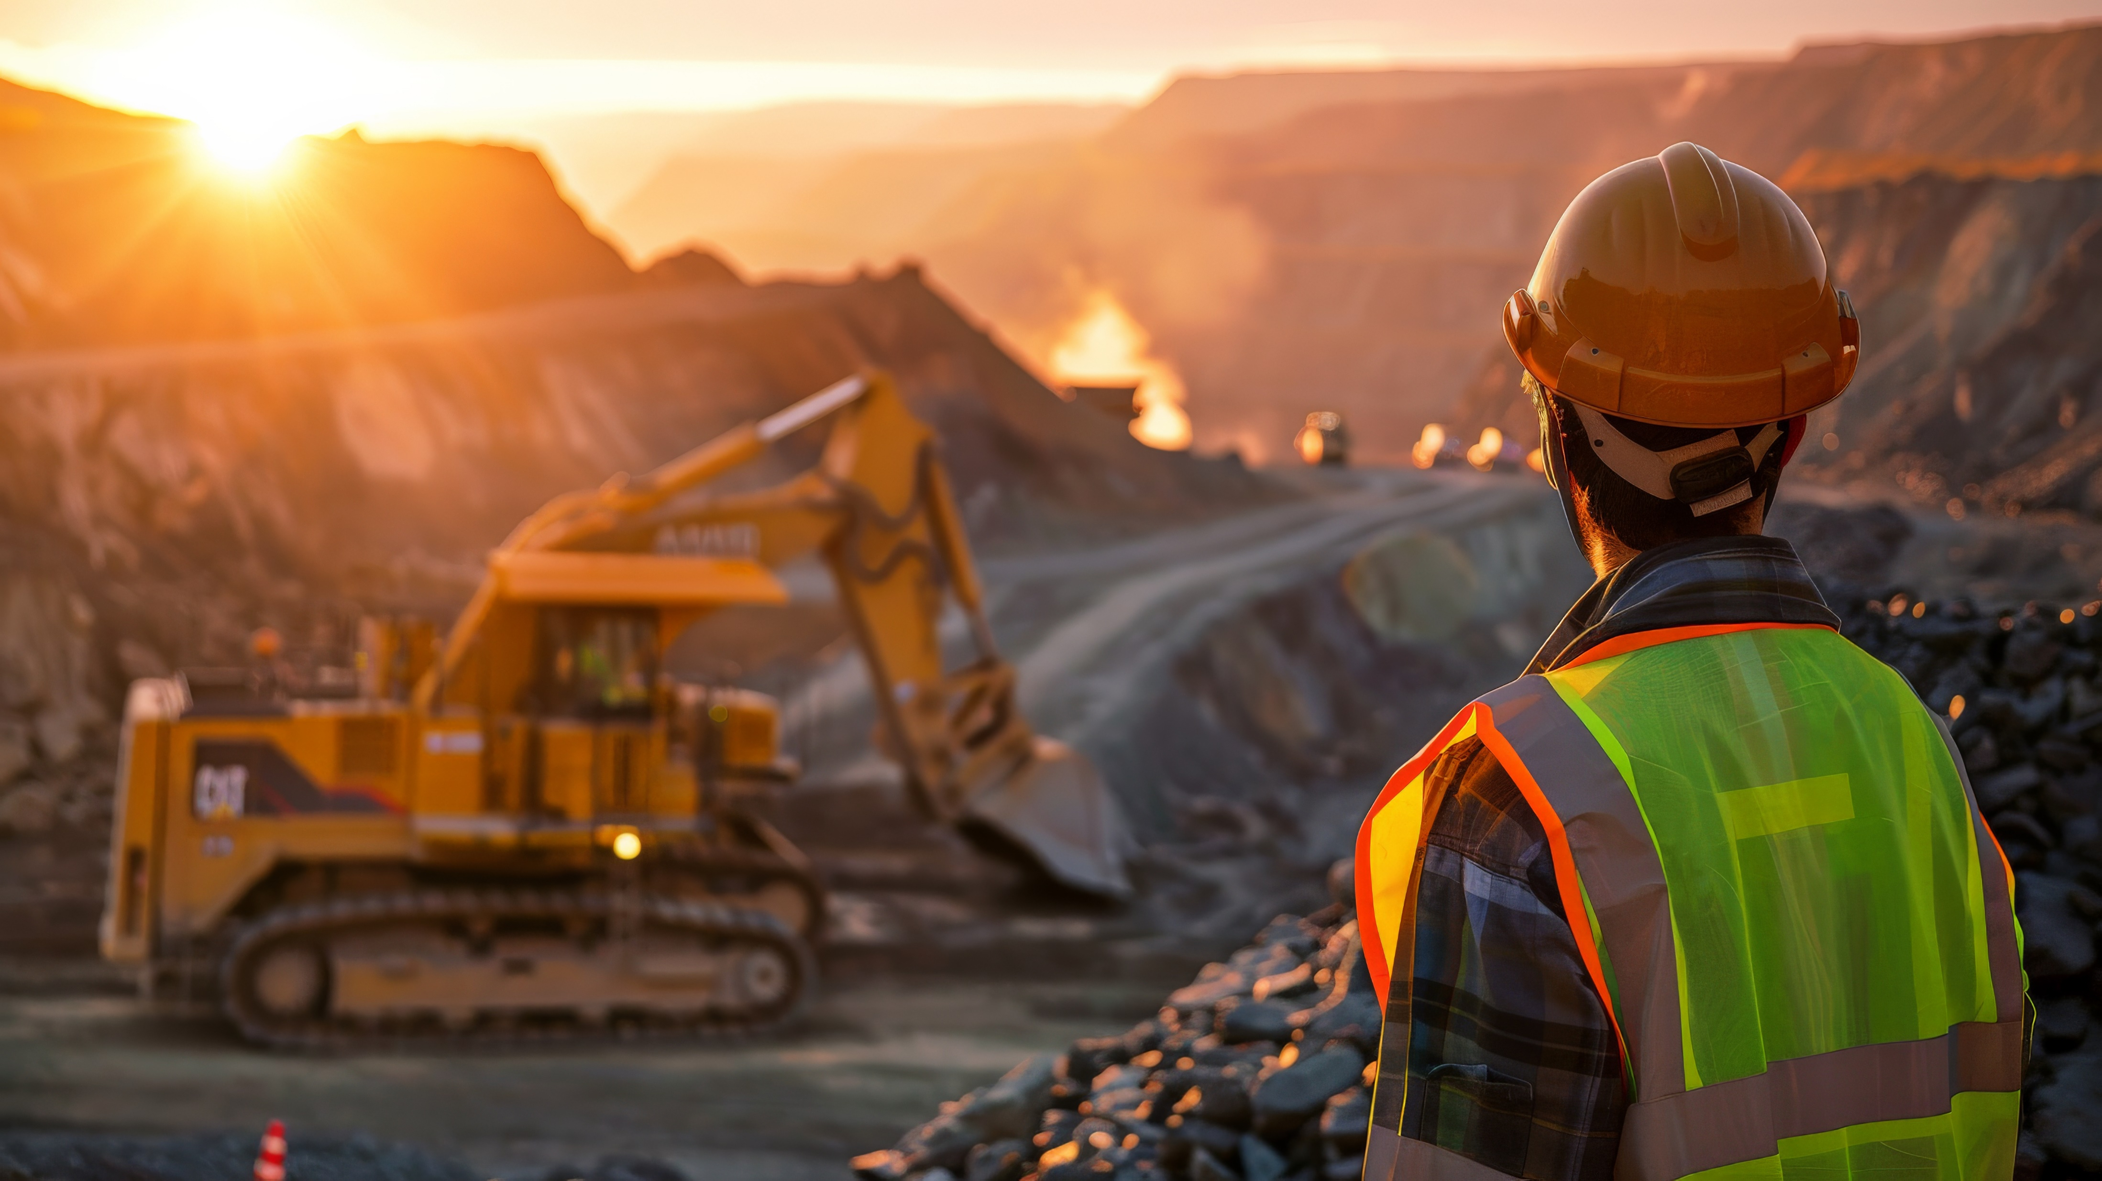
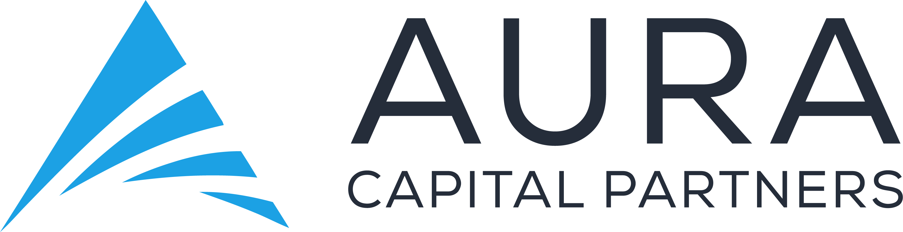
ABOUT US
WHAT WE DO
CONTACT US
OUR VISION
To be a leader in Gold asset development with innovative management and organization solutions, we aim to provide solutions from the investment to the production and the value creation of Gold Assets around the globe.
About Us
OUR MISSION
Our mission is to responsibly discover, develop, and operate high-quality gold mining assets that deliver sustainable value for our shareholders, employees, communities, and the environment. We are committed to operational excellence, ethical business practices, and long-term growth through strategic investment, innovation, and the development of world-class mining projects.

Slide 3
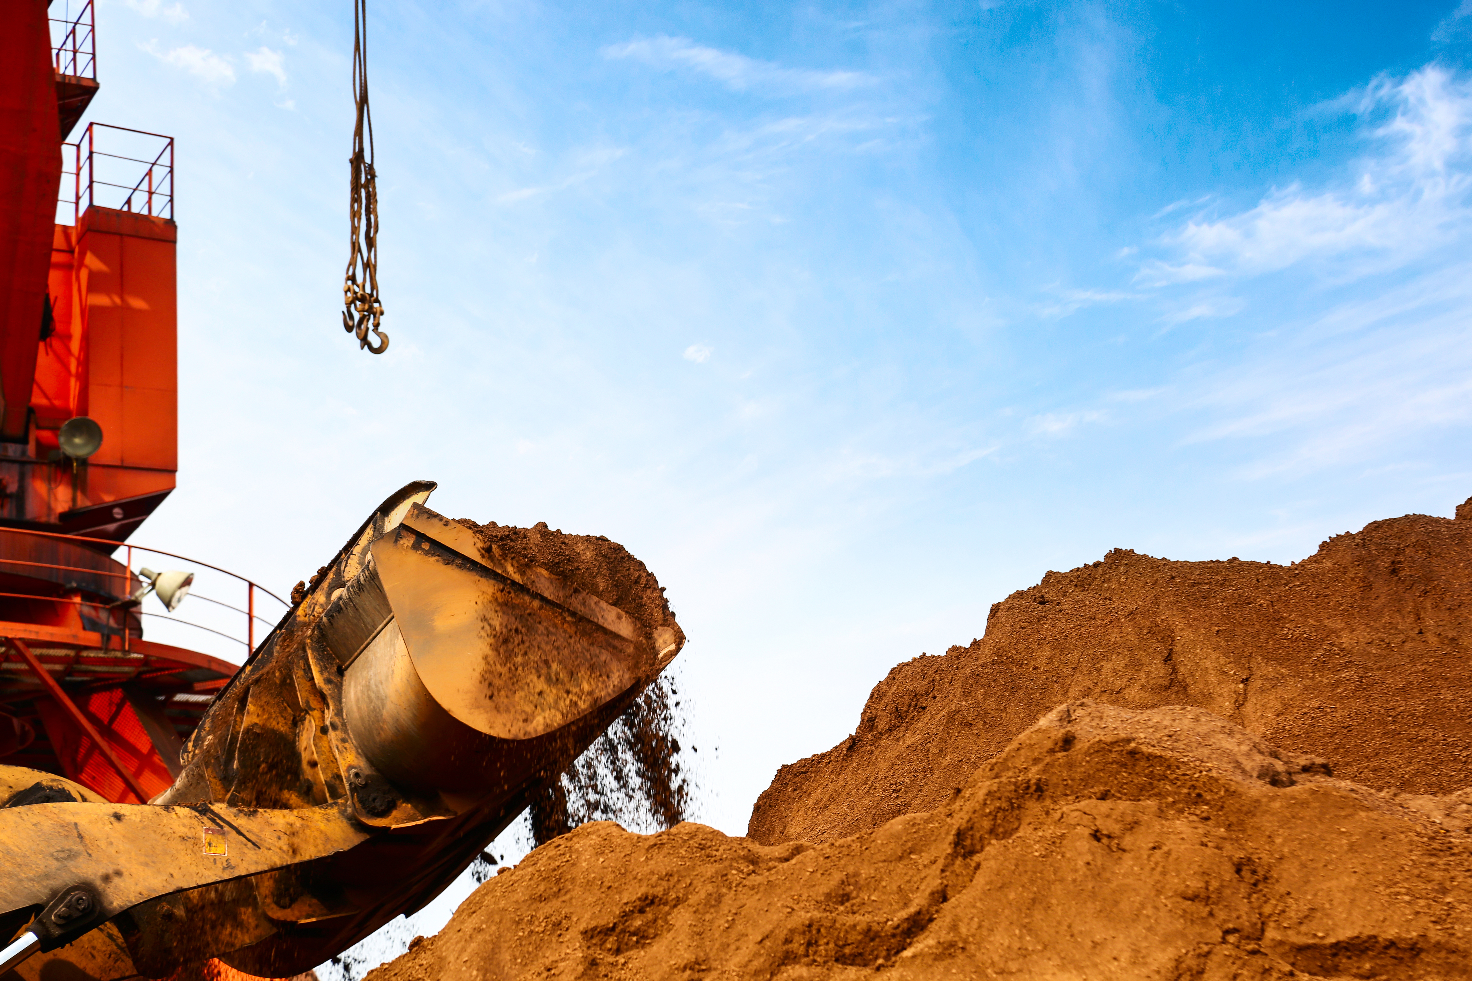







ABOUT US
WHAT WE DO
CONTACT US
About Us
We are committed to safe and responsible mining that creates enduring value. Guided by integrity, we operate with excellence, protect the environment, and invest in the communities where we work. We respect our people, foster innovation, and pursue sustainable growth to benefit our shareholders, partners, and future generations."
OUR VALUE
Safe. Responsible. Innovative
We mine with integrity, protect our world, and create lasting value for all.
Safety First
Our Core Principles
Long-Term Value
Protecting our people and communities above all else.
Creating enduring economic and social benefits for all stakeholders.
Integrity
Respect For People
Acting with transparency, ethics, and accountability.
Valuing diversity, fairness, and inclusion.
Operational Excellence
Community Partnership
Driving efficiency, innovation, and quality in every project.
Sustainability
Building strong, respectful, and mutually beneficial relationships.
Minimizing environmental impact and managing resources responsibly.

Slide 4

ABOUT US
WHAT WE DO
CONTACT US
What We Do
WE DEVELOP 4 VERTICAL BUSINESSES:
01
INVESTMENT
We are a strategic investor in the gold mining sector, committed to partnering with companies where our involvement creates measurable impact. Beyond capital, we bring deep industry expertise, technical insight, and a global network to enhance project value, improve operational performance, and accelerate growth. We invest selectively, focusing on opportunities where our skills, experience, and relationships can unlock the full potential of mining assets — delivering sustainable returns for all stakeholders."

Slide 5
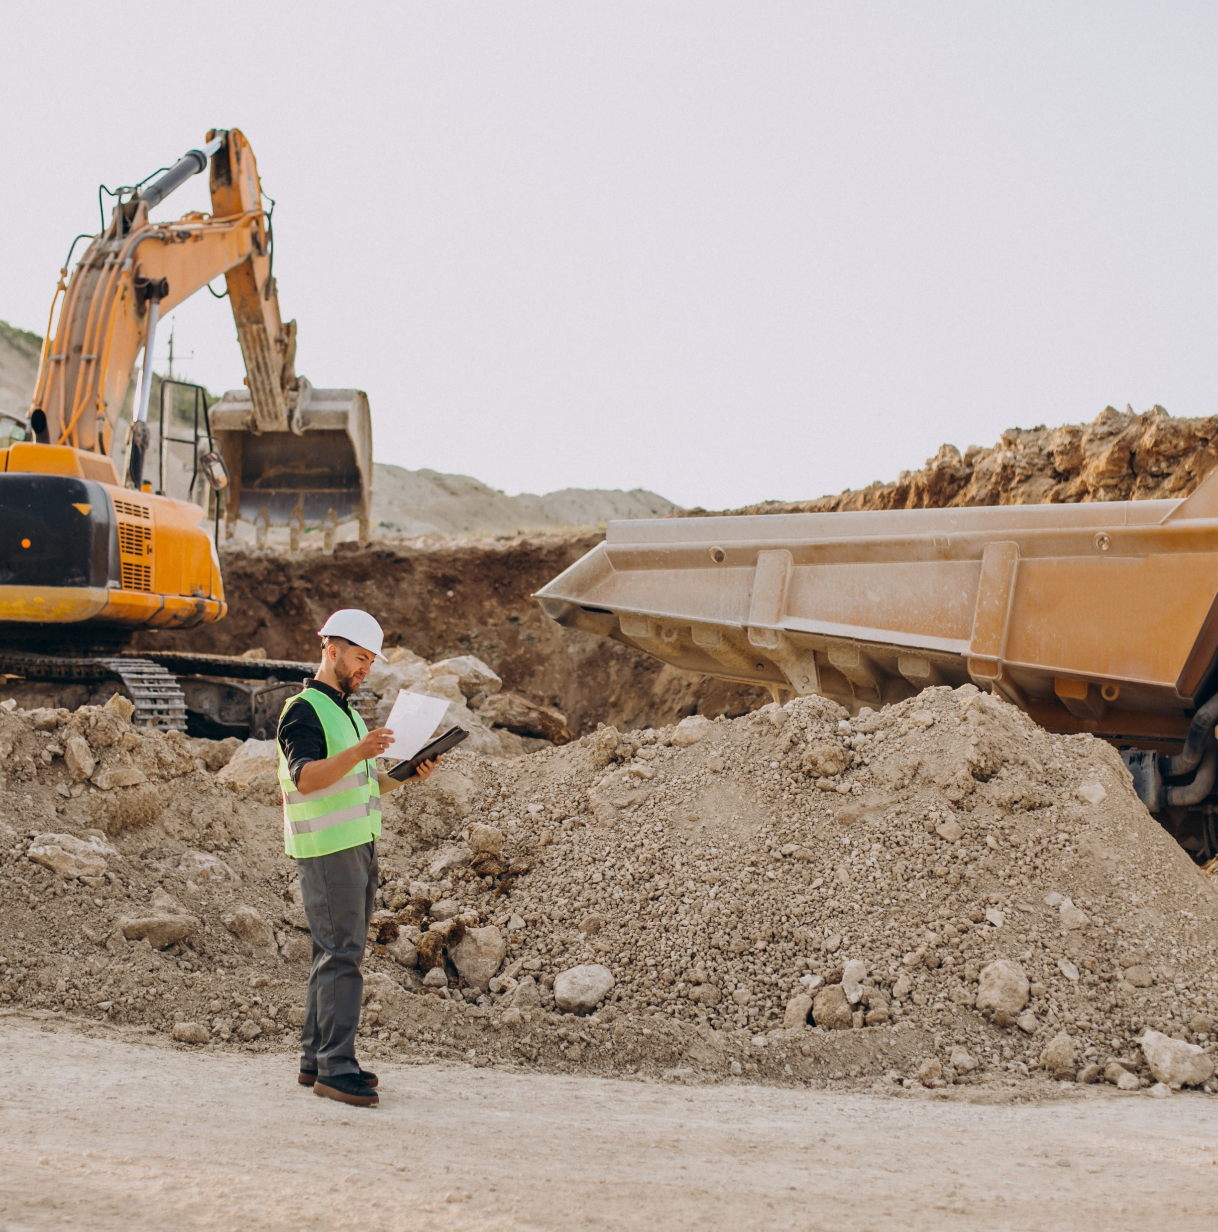

ABOUT US
WHAT WE DO
CONTACT US
02
FINANCIAL ADVISORY
Strategic Financial Advisory for the Gold Mining Industry
Unlocking Capital. Driving Growth. Navigating Complexity.
At AURA CAPITAL PARNERS, we specialize in financial advisory solutions tailored to the unique needs of the gold mining sector. With deep industry knowledge and strong relationships across global capital markets, we help mining companies raise capital, structure private equity deals, navigate public listings, and manage corporate restructuring.
Whether you're an early-stage explorer or a mid-tier producer, we deliver strategic, practical, and investor-aligned advice to support your growth and
long-term success.

Slide 6
ABOUT US
WHAT WE DO
CONTACT US
Our Services:
01
02
03
04
05
Capital Raising:
Private Equity Advisory:
Mergers & Acquisitions Advisory
Public Listings (IPO/RTO):
Board Representation:
We connect mining projects with the right investors—equity, debt, or hybrid—to fund exploration, development, or expansion
From structuring to deal execution, we guide clients through private equity transactions with aligned strategies and trusted investor networks.
We provide end-to-end M&A advisory services tailored to the mining industry, with a focus on identifying value, mitigating risk, and executing strategic transactions that strengthen our clients’ portfolios.
Comprehensive listing support, including exchange selection, regulatory readiness, and capital market positioning.
Representing investors on board of public or private mining companies .

Slide 7





ABOUT US
WHAT WE DO
CONTACT US
Why Choose Us
Sector Focused:
05
Our team based in Toronto, Abu Dhabi and Mauritius:
100% dedicated to gold mining and natural resources
01
Toronto is leading the gold industry for financing and capital market activities. Abu Dhabi became during the last decade the investment place for the mining industry in the Middle East. Mauritius is positioned as a financial hub for the African mining industry
05
04
Global Reach:
Access to capital and partners across North America, Australia, Africa, and beyond
Proven Experience:
Track record of successful deals, listings, and strategic outcomes
03
Trusted Network:
Strong relationships with institutional investors, PE firms, and capital markets professionals

Slide 8


ABOUT US
WHAT WE DO
CONTACT US
03
RESTRUCTURING AND OPERATION
01
Gold Mining Operational Capacity
We bring deep operational expertise across the full mining lifecycle—from exploration and feasibility through to production and closure. Our team has hands-on experience managing open-pit and underground gold mining operations in diverse jurisdictions, ensuring efficiency, safety, and compliance at every stage.
We work closely with technical teams, engineers, and geologists to assess assets, optimize production, and align operations with investor and stakeholder expectations. Whether supporting a ramp-up to commercial production or improving operating margins at producing sites, we deliver value through practical, results-driven guidance.
Capabilities include:
Operational assessment and diagnostics
Production planning and optimization
Cost control and efficiency programs
Environmental, social, and regulatory compliance
CapEx and OpEx planning for project scalability

Slide 9
ABOUT US
WHAT WE DO
CONTACT US
02
Restructuring & Turnaround Capabilities
We specialize in strategic and financial restructuring for gold mining companies facing operational or financial challenges. Our approach combines industry-specific insight with capital market acumen, allowing us to design and implement turnaround strategies that stabilize businesses and position them for sustainable growth.
From distressed asset evaluations to recapitalization strategies, we provide comprehensive advisory services that align creditors, investors, and management toward common recovery goals.
Capabilities include:
Financial and operational restructuring
Balance sheet optimization and debt advisory
Asset divestitures and portfolio rationalization
Crisis management and interim support
Stakeholder negotiation and strategic communications

Slide 10
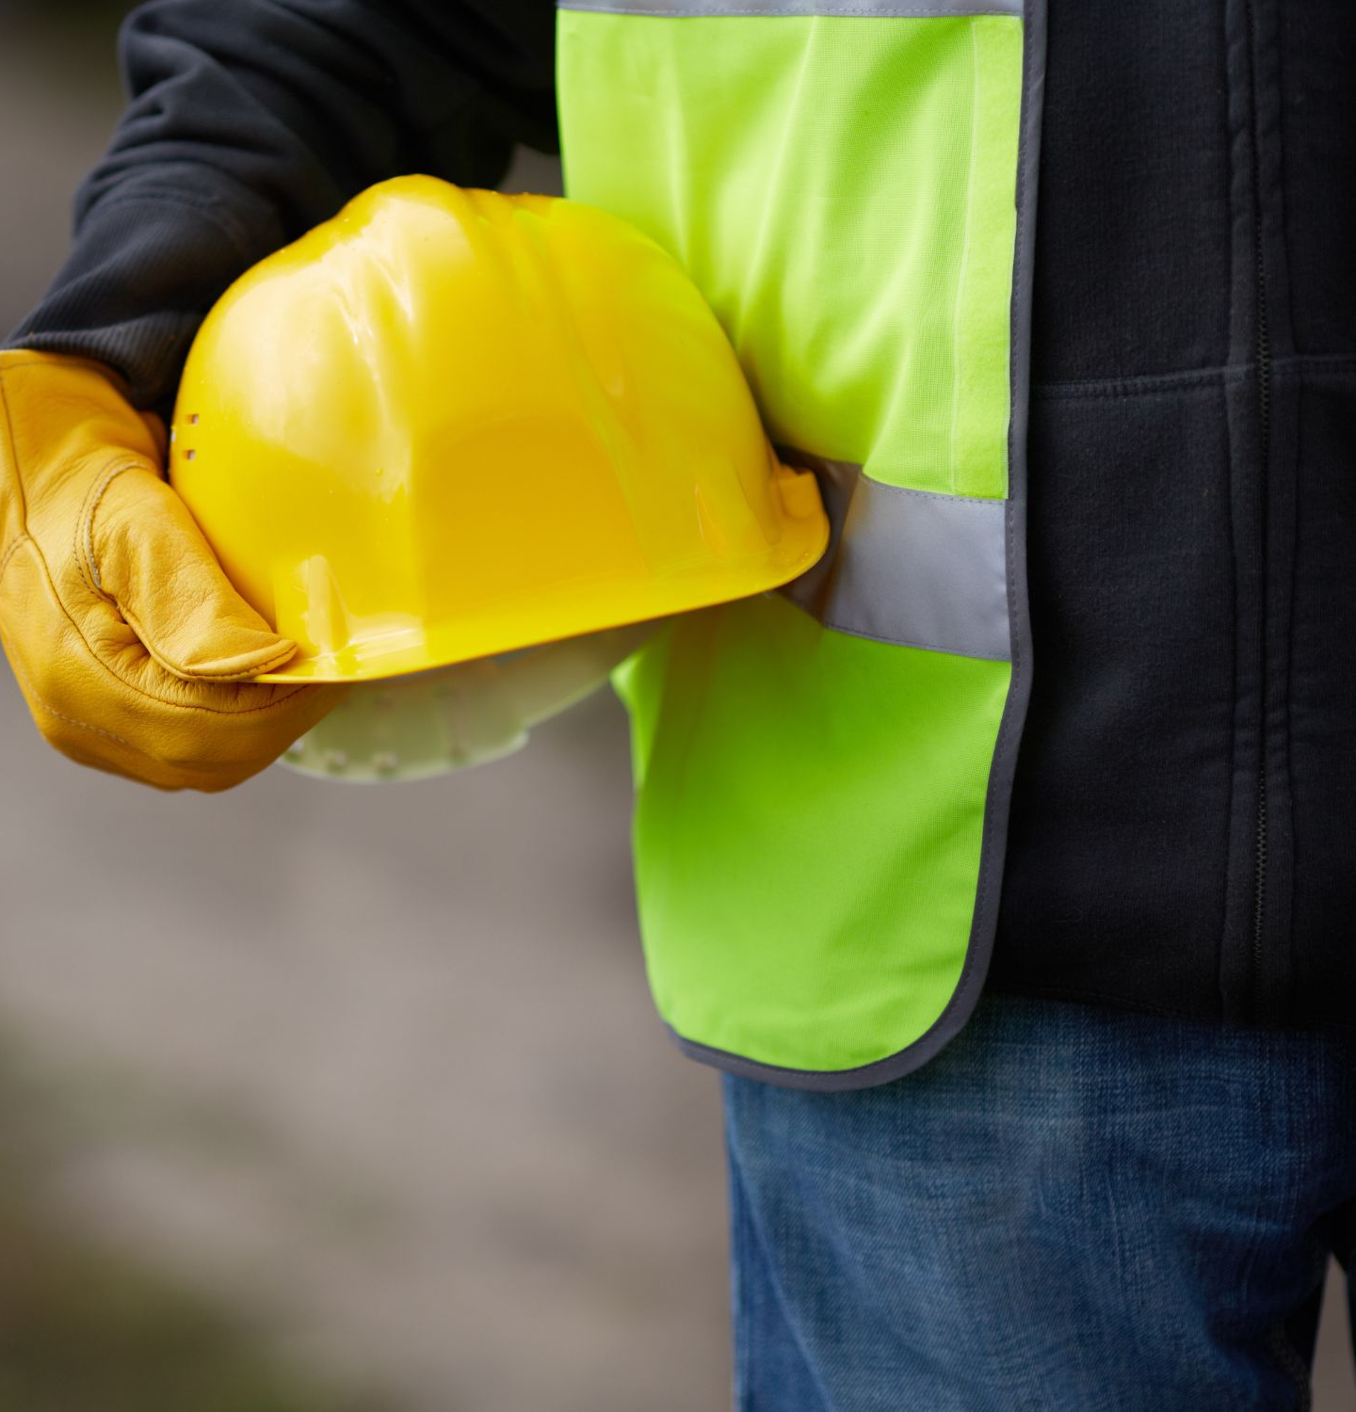
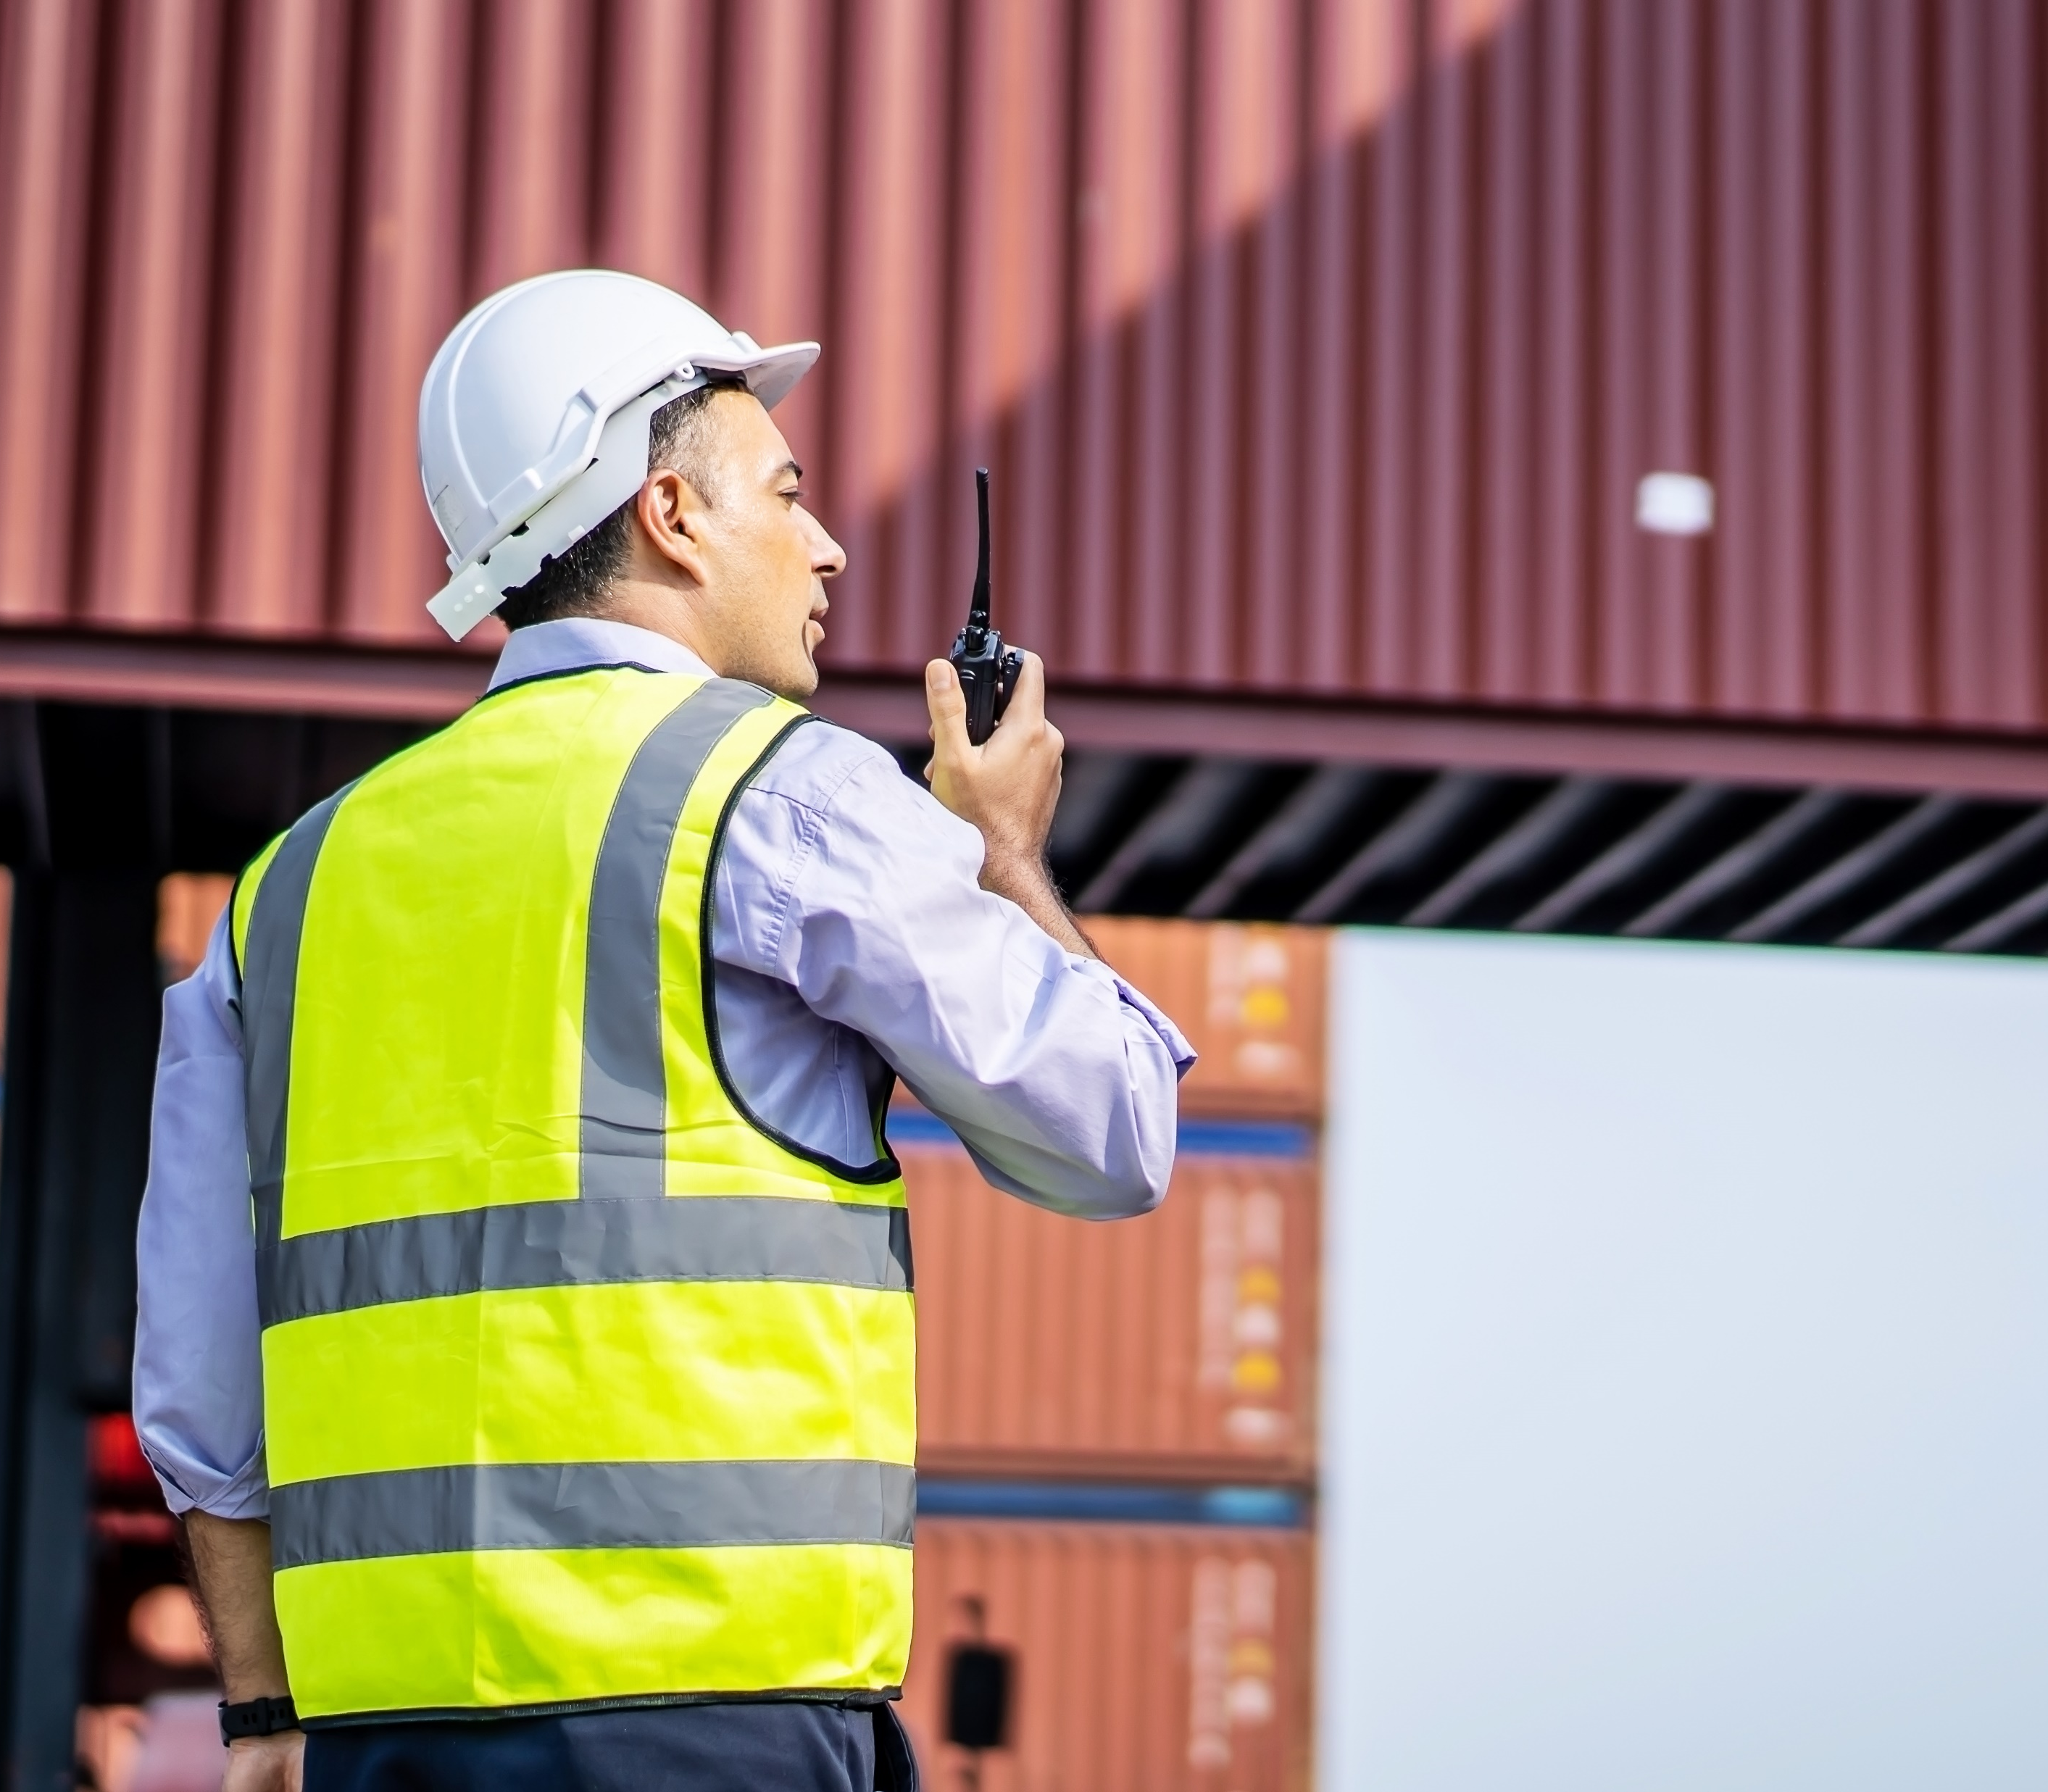
ABOUT US
WHAT WE DO
CONTACT US
04
LOGISTICS
Our subsidiary Markam Group provides contract mining solutions and dry and wet lease of equipment for mining operations.
With operations in Africa and South America, Markam can provides the best solution to your logistics challenge in Mining operations
www.markam-group.com

Slide 11

ABOUT US
WHAT WE DO
CONTACT US
CONTACT US
100 King Street West
Toronto, Ontario M5X 1C7
CANADA
310 Barkly Wharf
Le Caudan Waterfront
Port Louis
MAURITIUS
info@aura-cp.com

