Slide 1

Loose guide/proposal/inspiration for this project:
Logo is for a golf tournament, conducted around Halloween called “The Spooky Cup”.
2025 will be our 6th Annual tournament.
Our original logo pictured here and others on subsequent pages.
Theme for this year “Save The World”
Crucial that:
Phrasing “Spooky Cup” and “2025” are included somewhere on the logo
“Save The World” also included
Ghost should be the focal point
Other considerations:
Not limited to black and white; feel free to use some color
I would like the main feature to be a ghost (ideally the one pictured here, but not mandatory) “saving the world” or emerging from / sitting outside a world in chaos. Open to and seeking creative ideas?
  World is burning behind the ghost?
  Ghost has the entire world on it’s back?
  Very open to other ideas here !
Ideally will include “The World Famous” in this font at top – it is a connection to a logo we have used for other events (see next page). But not mandatory if too crowded.

Slide 2

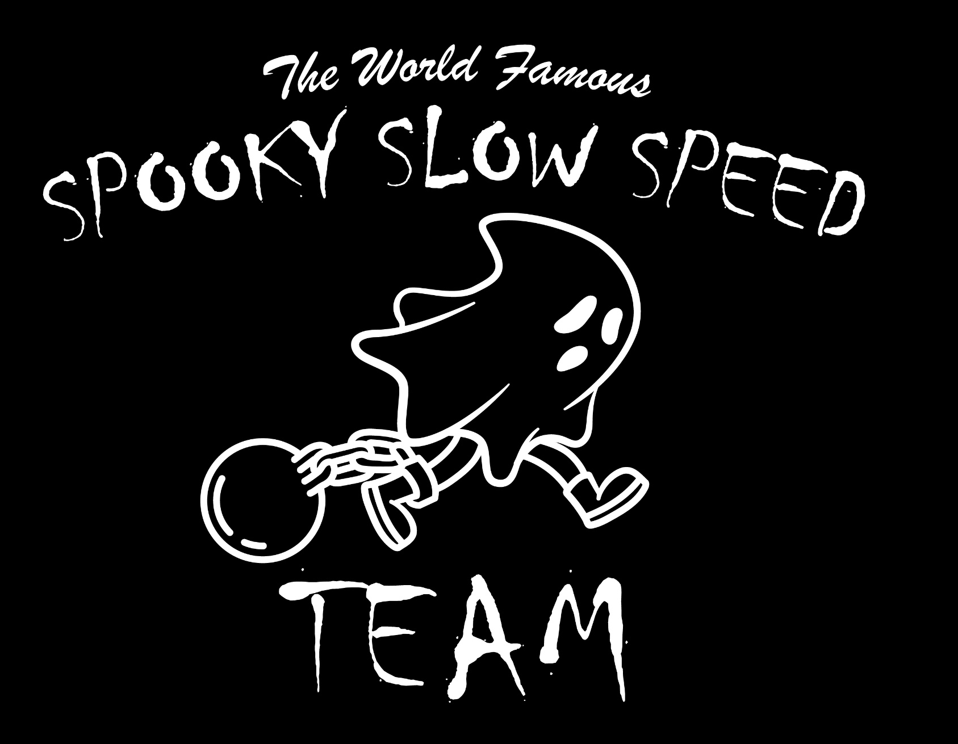
Previous logos (for reference / inspiration)
Creative logo from when we went to a college football game
Creative logo from when we ran a road race

Slide 3
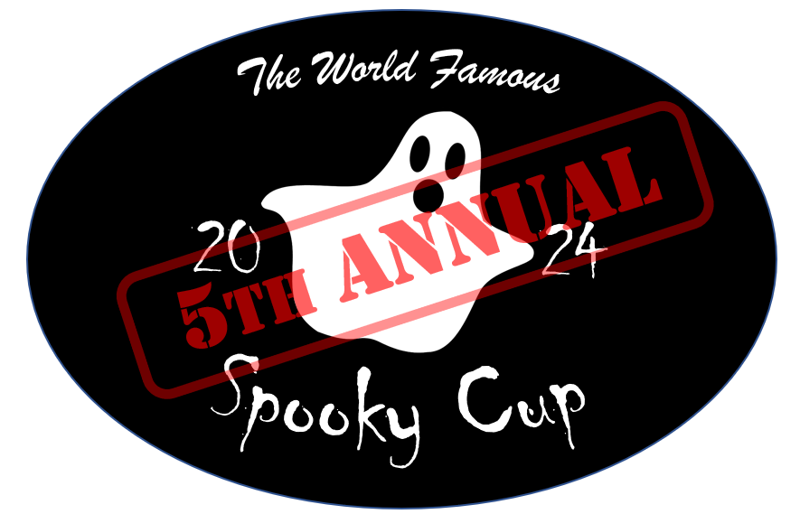

Previous logos (for reference / inspiration)

