Slide 1



1. Create a cover of the document containing:
Our logo
AI Discovery Workshop (as main title)
Customer Name (editable)
Customer logo (use Coca-cola logo as an example)
Date (editable)
Use our corporate style
(see our webpage www.dataguru.clud
and our corporate presentation)

Slide 2
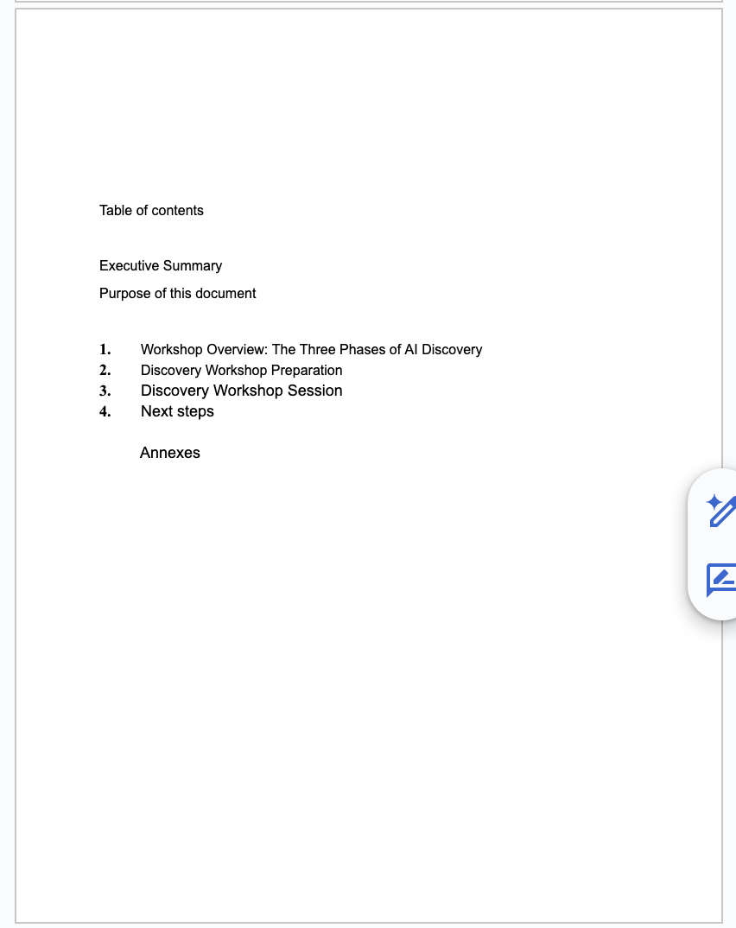
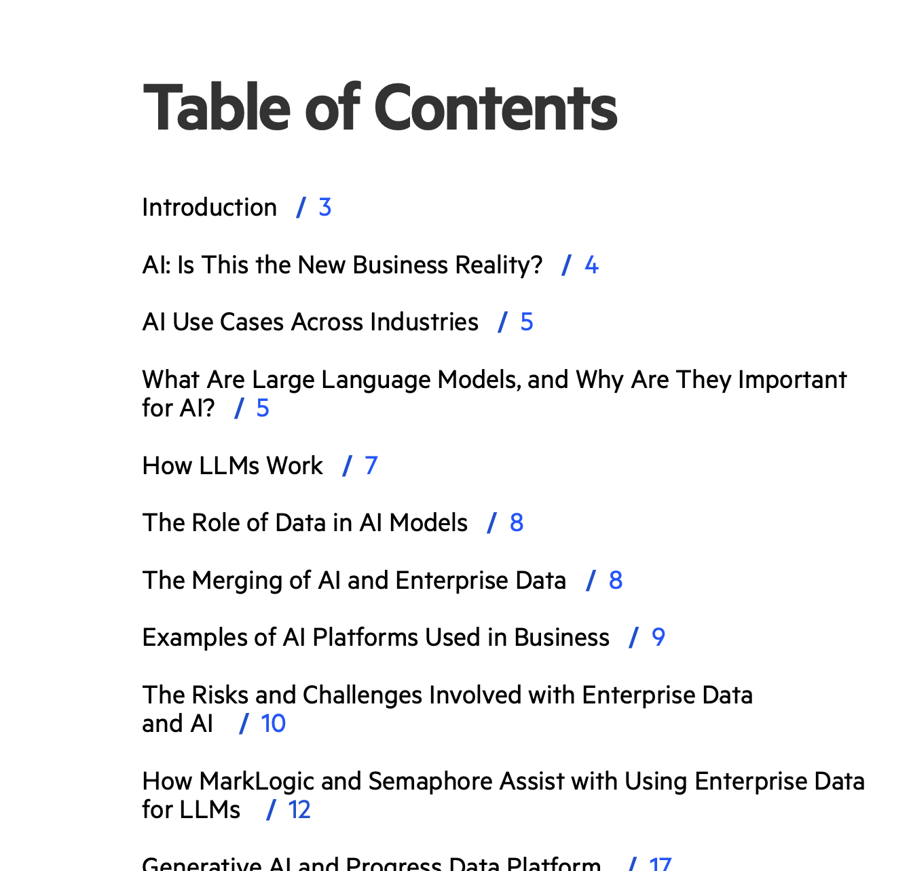
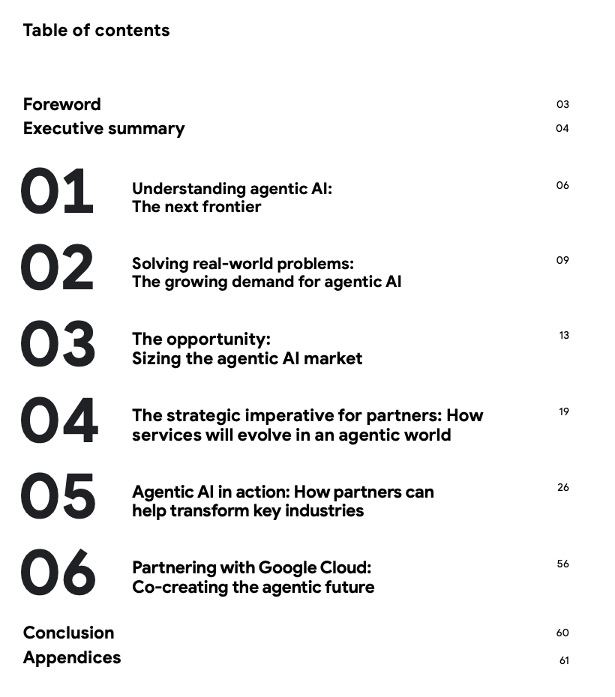
2. Create a table of contents with numbers and pages
There is an example below but be creative here.
The look should be very professional

Slide 3
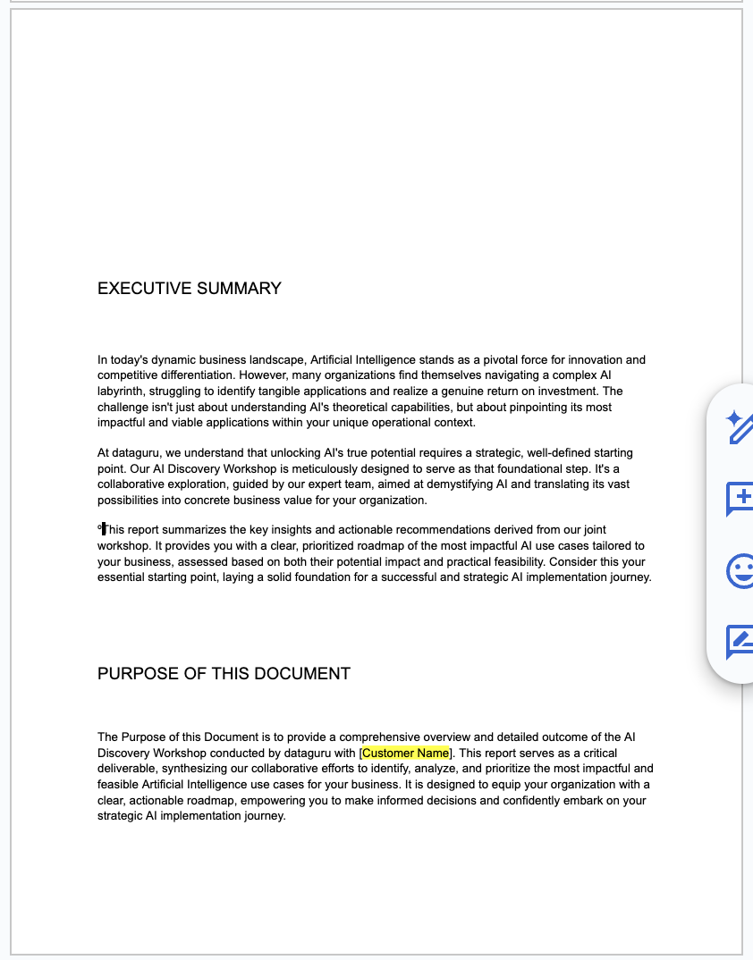
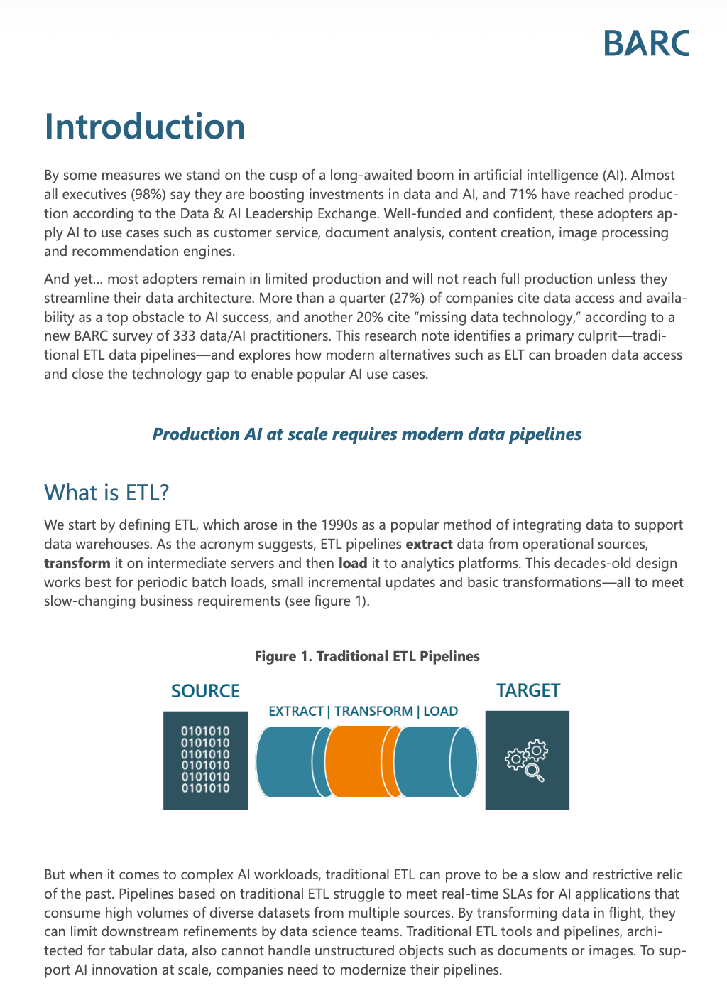
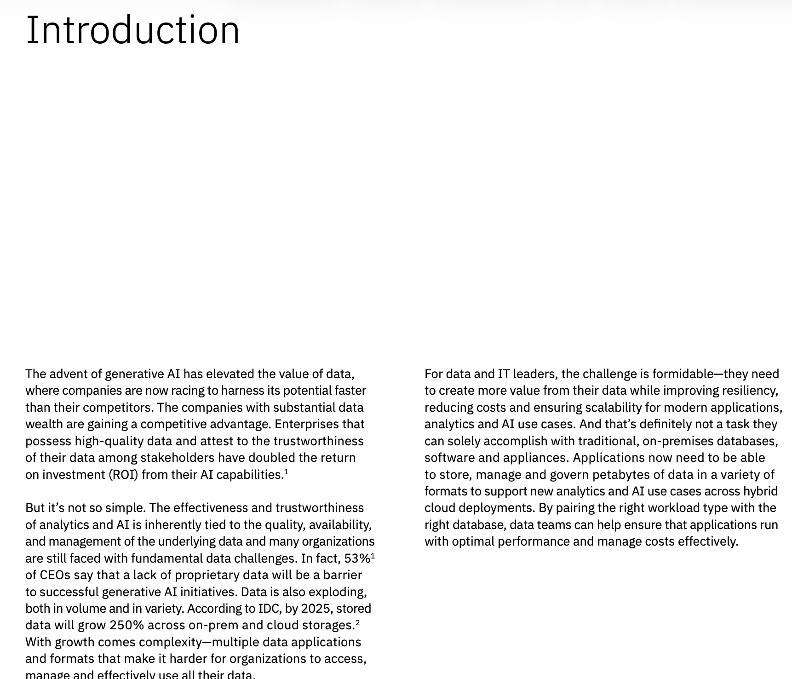
3. Create a page with the executive summary and purpose of this document
I give you a couple of examples as references but be creative and profesional here.
Customer name should be easily editable for the entire document

Slide 4
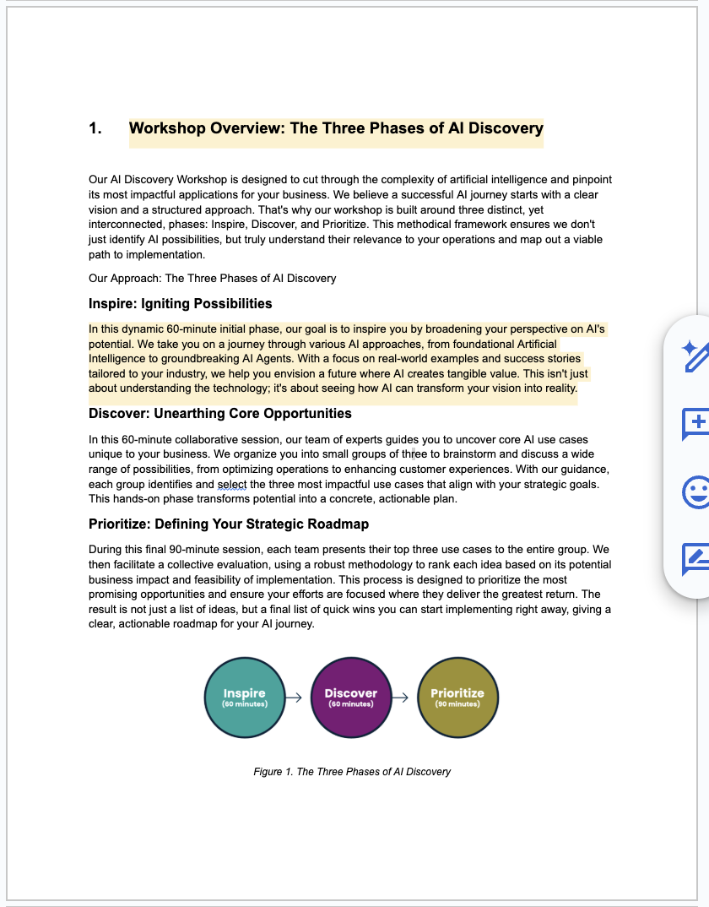
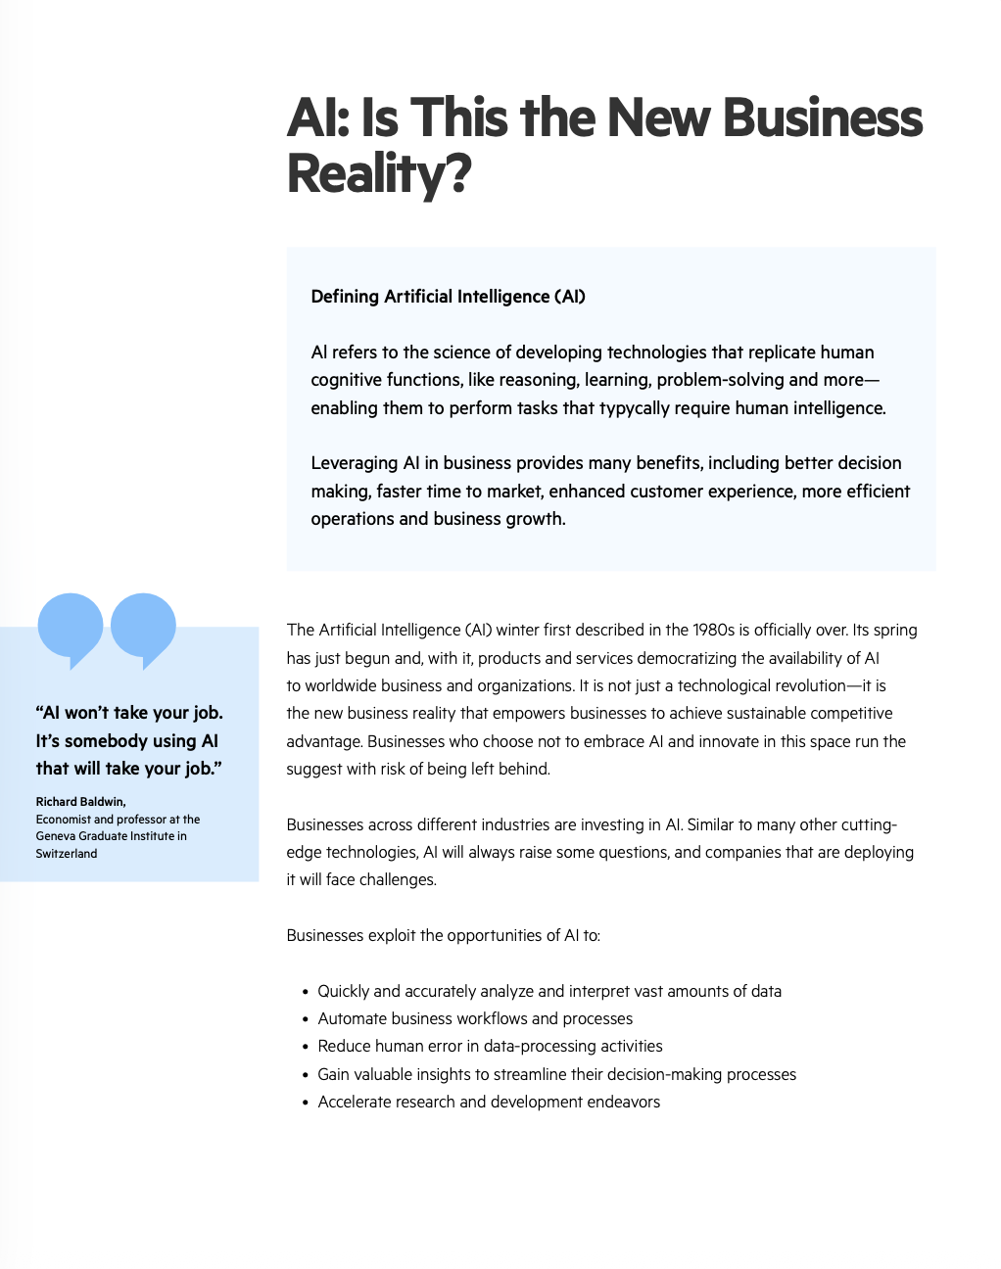

3. Create this section
Use the Figure as it is (you Will find it also in the AI Discovery Workshop presentation)
Use a professional style using for example, large fonts and our corporate colors the titles, etc.
For the rest of the document, consider a footer with our logo, name of the document (AI Discoivery Workshop for [Customer Name]) and page (see below an example, but be creative here)

Slide 5
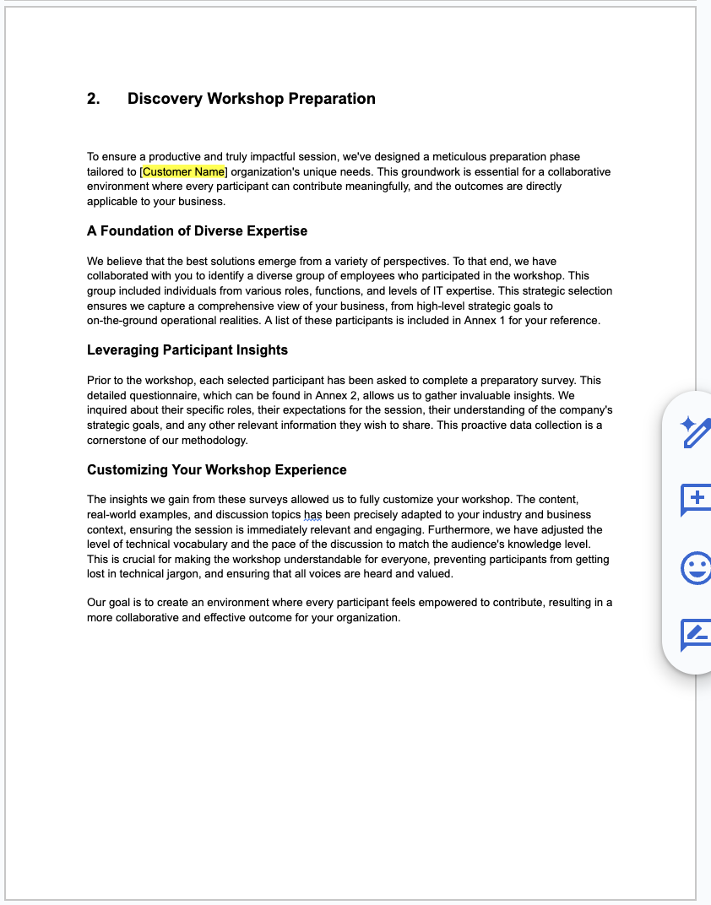
The same format as previous one
Customer name should be easily editable for the entire document

Slide 6
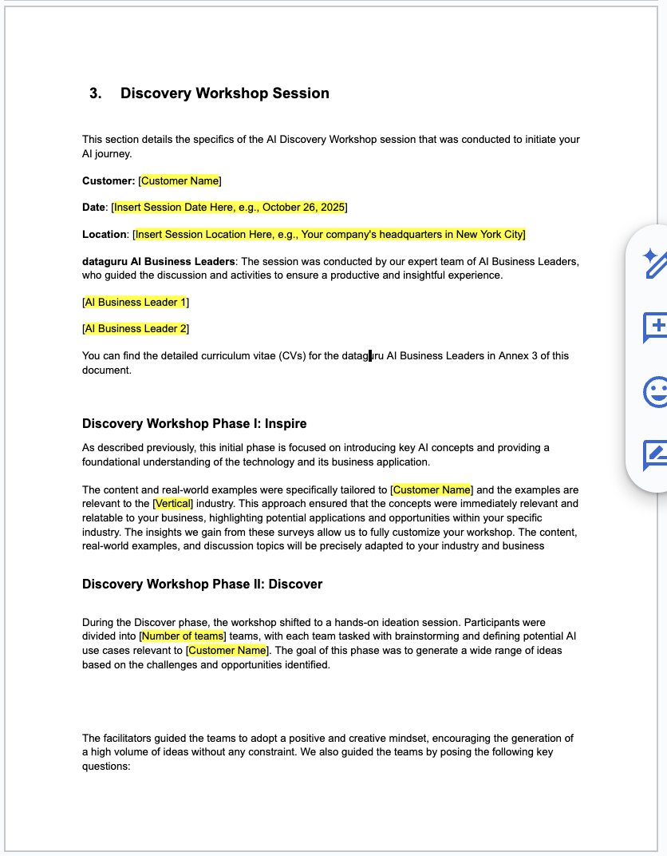
The same format as previous one
Customer name, date, vertical, etc should be easily editable for the entire document

Slide 7
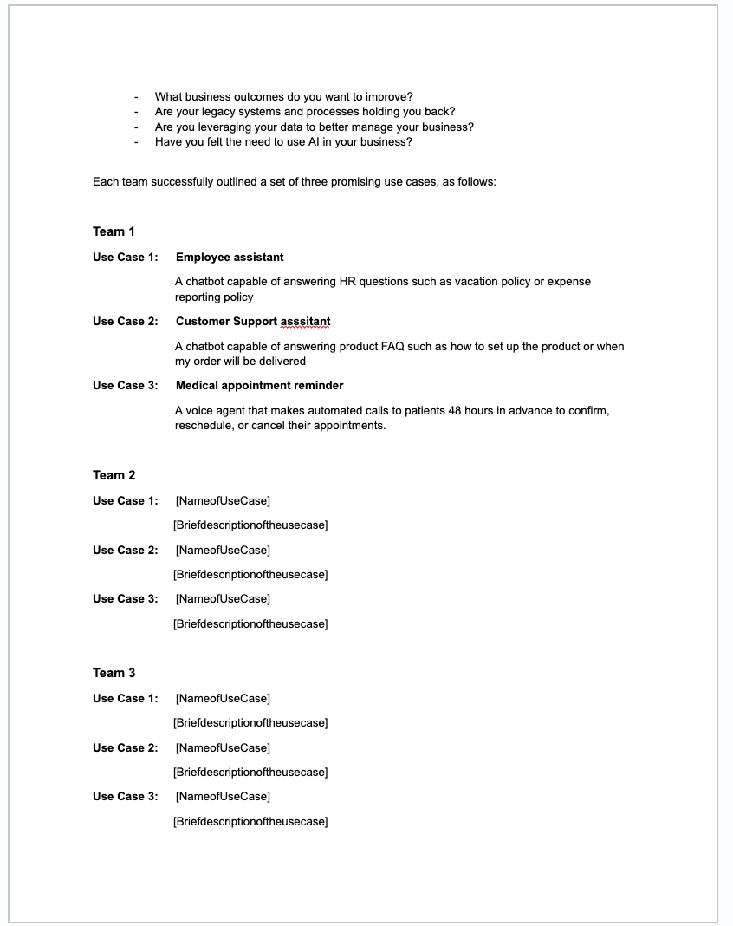
The same format as previous one
This section contains five editable tables, one for each team. The first table is pre-filled as an example..

Slide 8
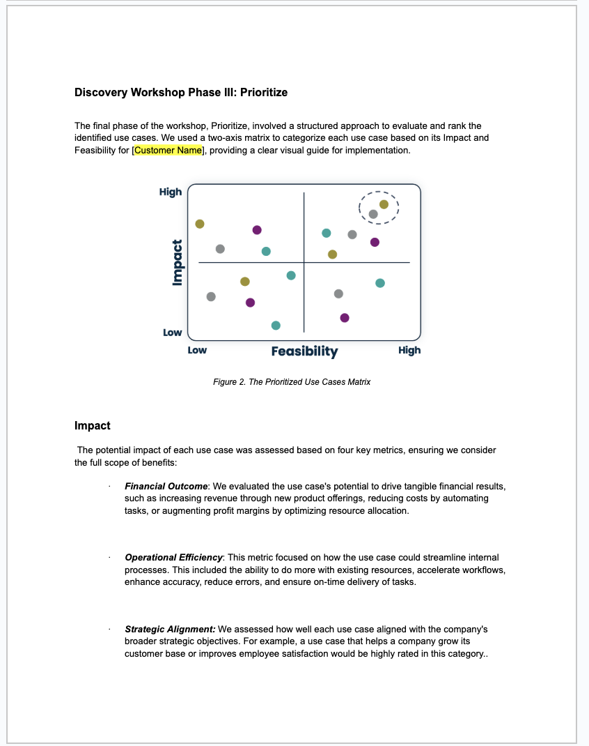
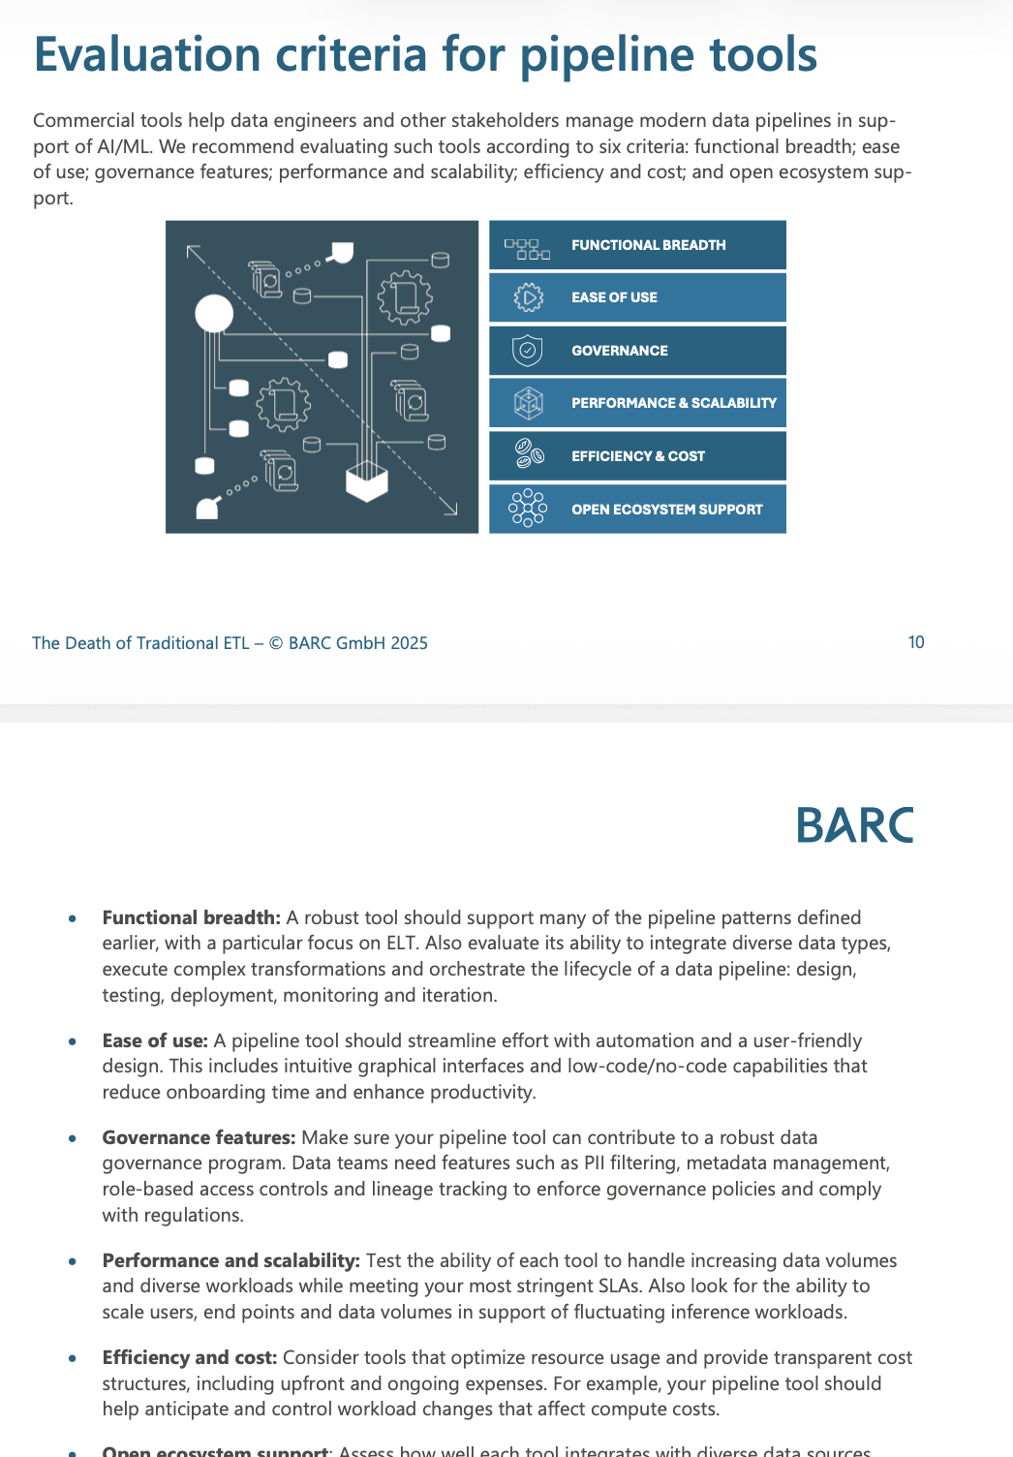
The same format as previous one

Slide 9
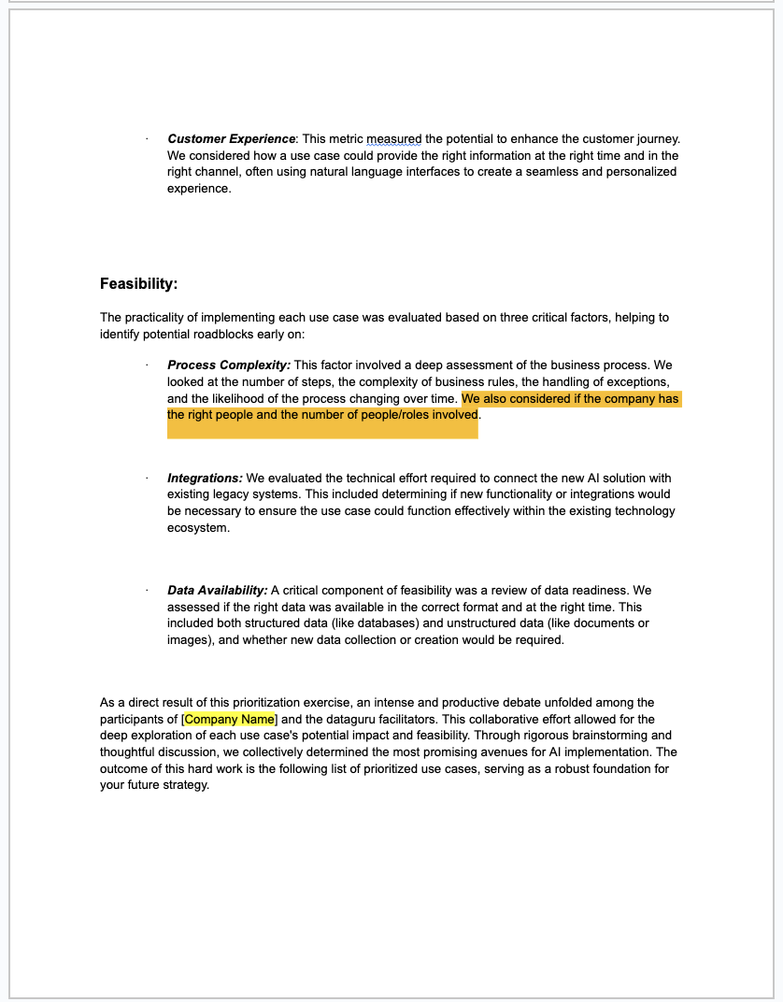
The same format as previous one

Slide 10
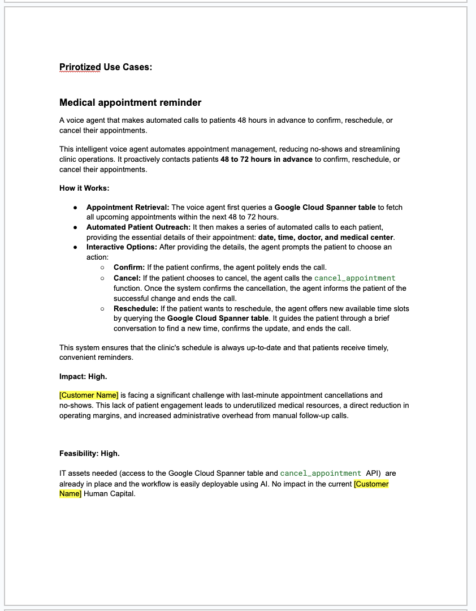
We will have 3 prioritized use cases, and each use case will have its own page inside the document
.
The first use case is pre-filled as an examplefor you to use when building the document
Use your own creativity to have a profesional look.

Slide 11
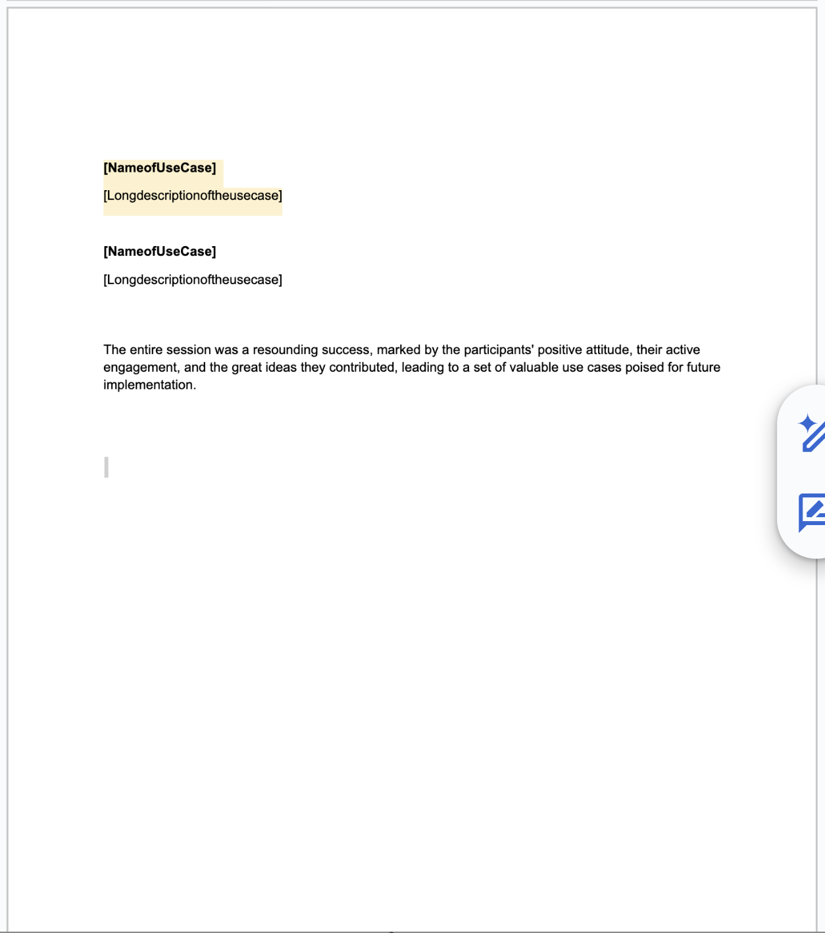
After the last use case there is a final paragraph

Slide 12
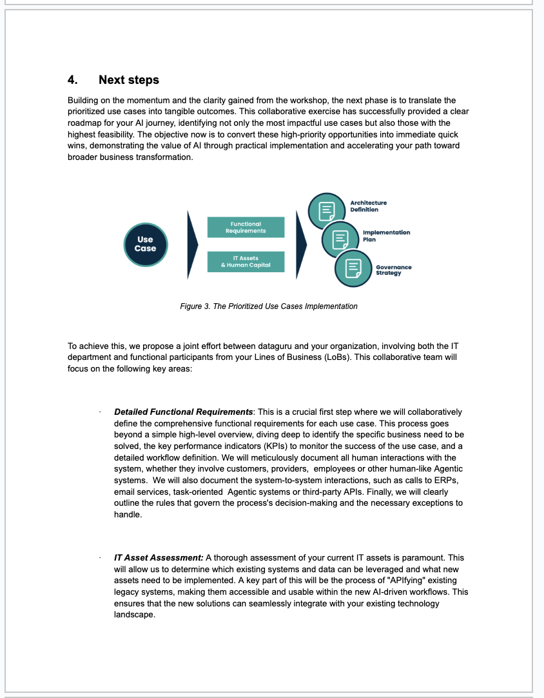
The same format as previous ones

Slide 13
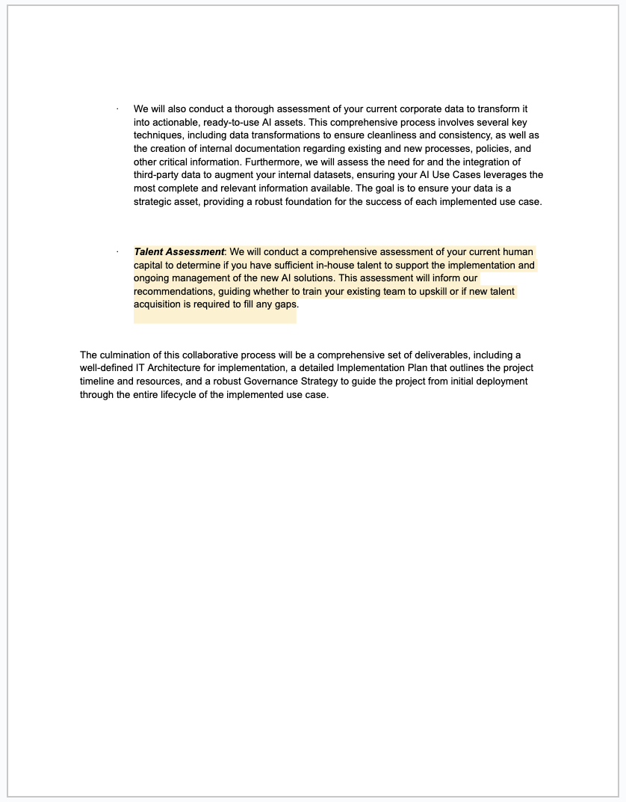
The same format as previous one

Slide 14
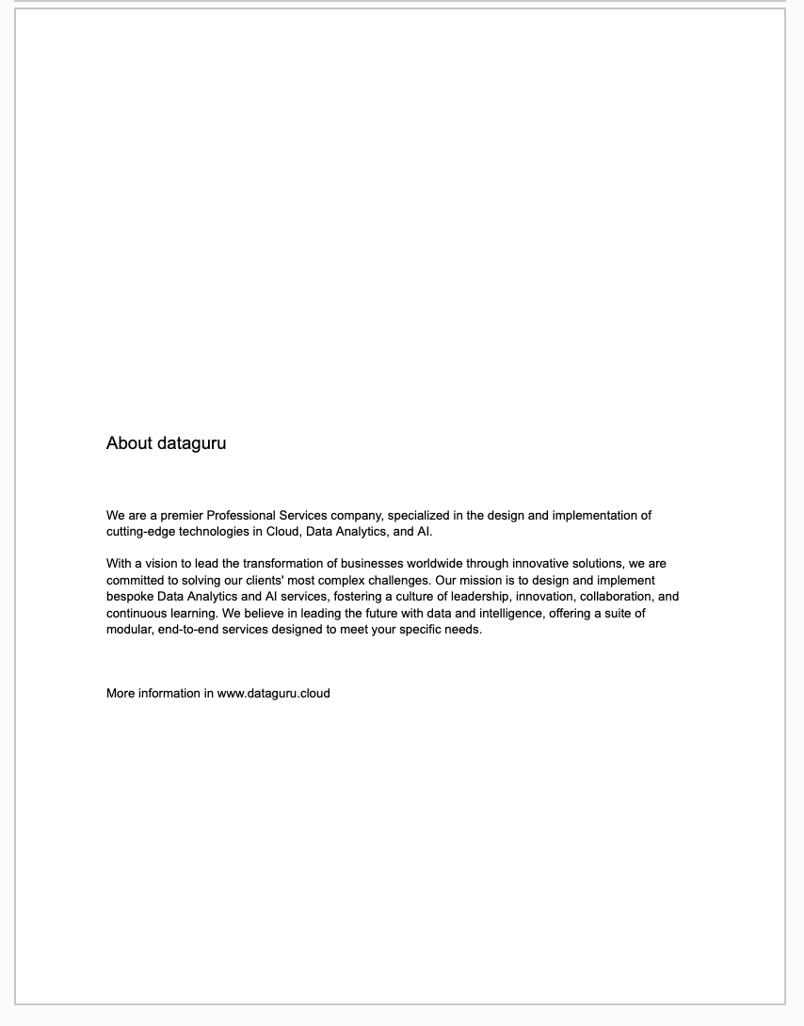
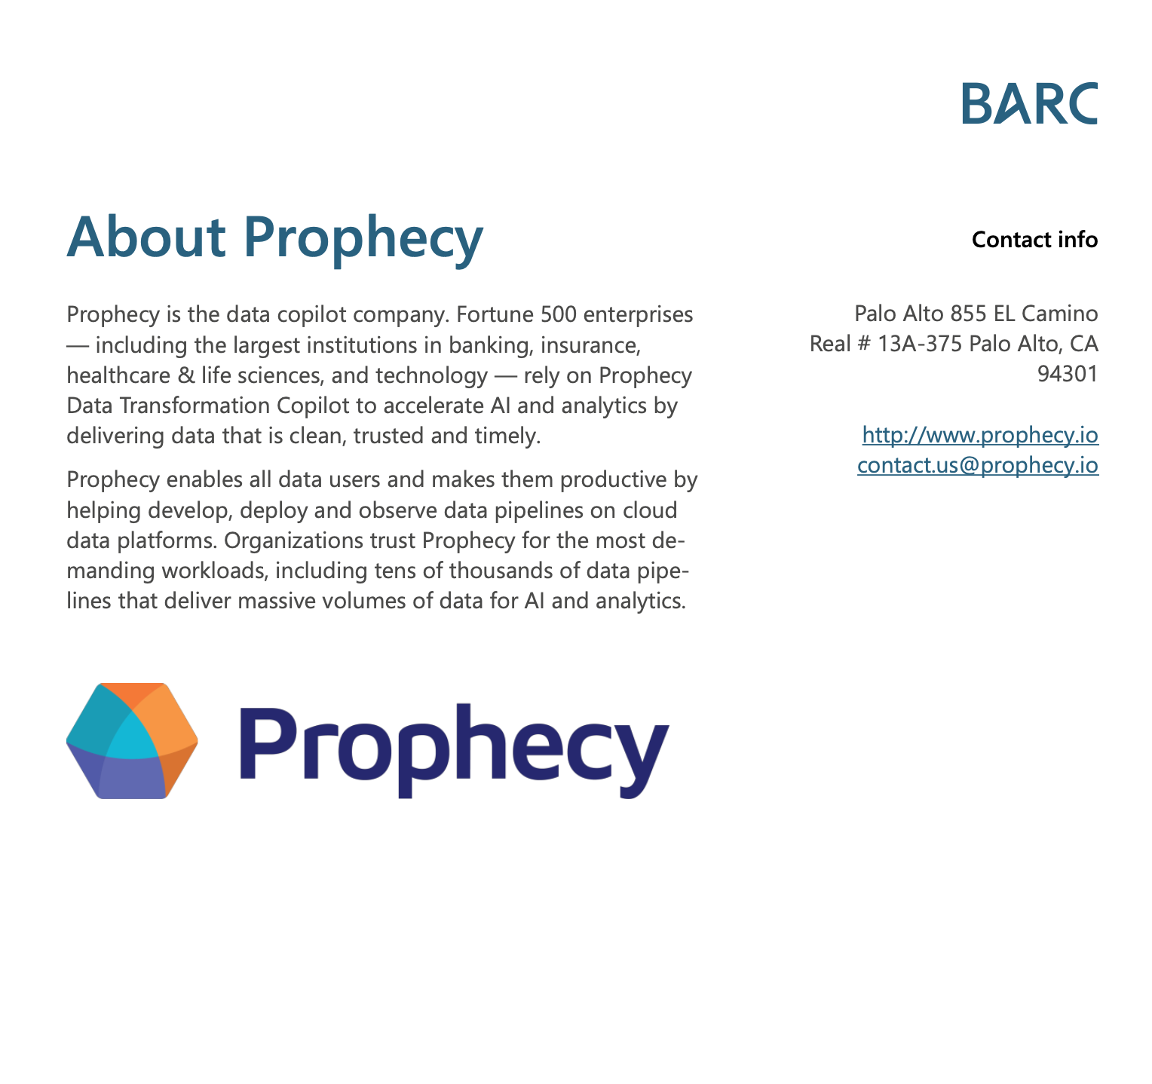
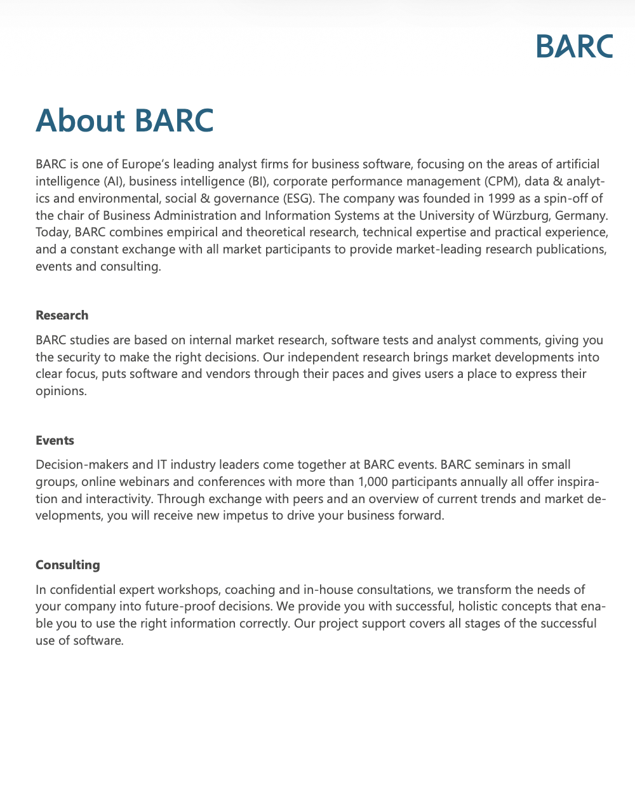
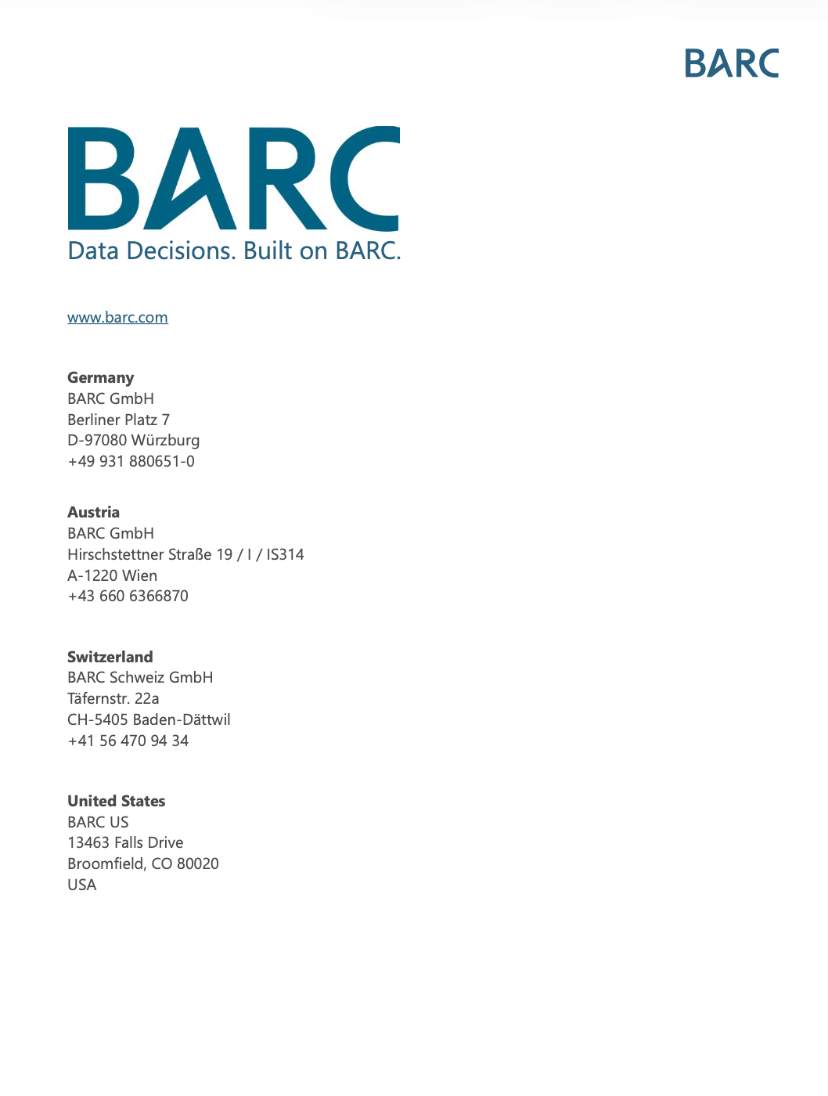
1 o 2 páginas

Slide 15
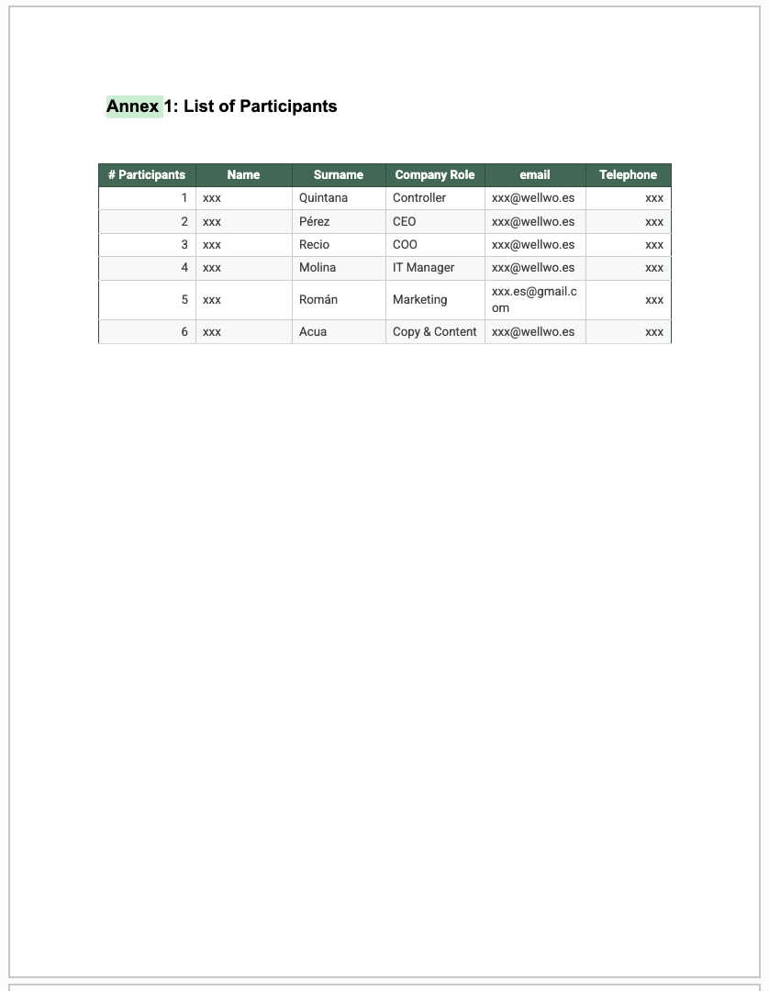
The same format as previous ones.
Add a professional editable table format

Slide 16
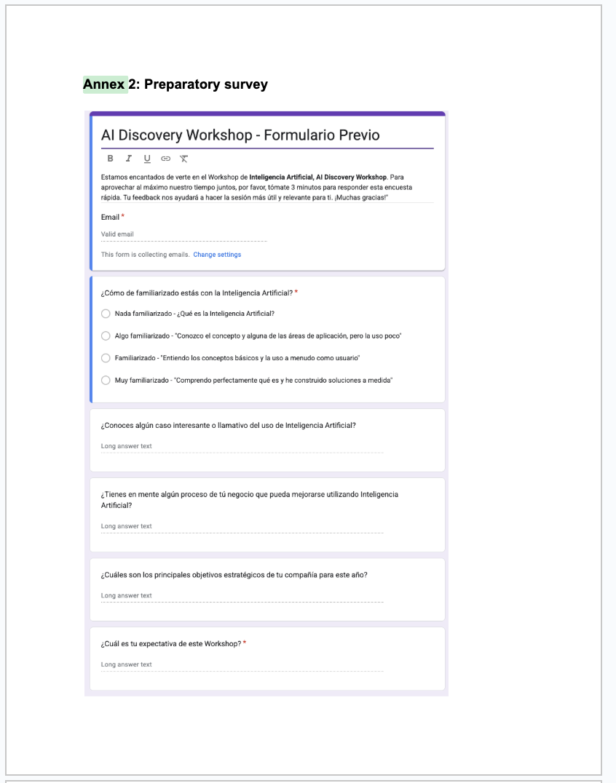
The same format as previous one. The survery is just an image

Slide 17
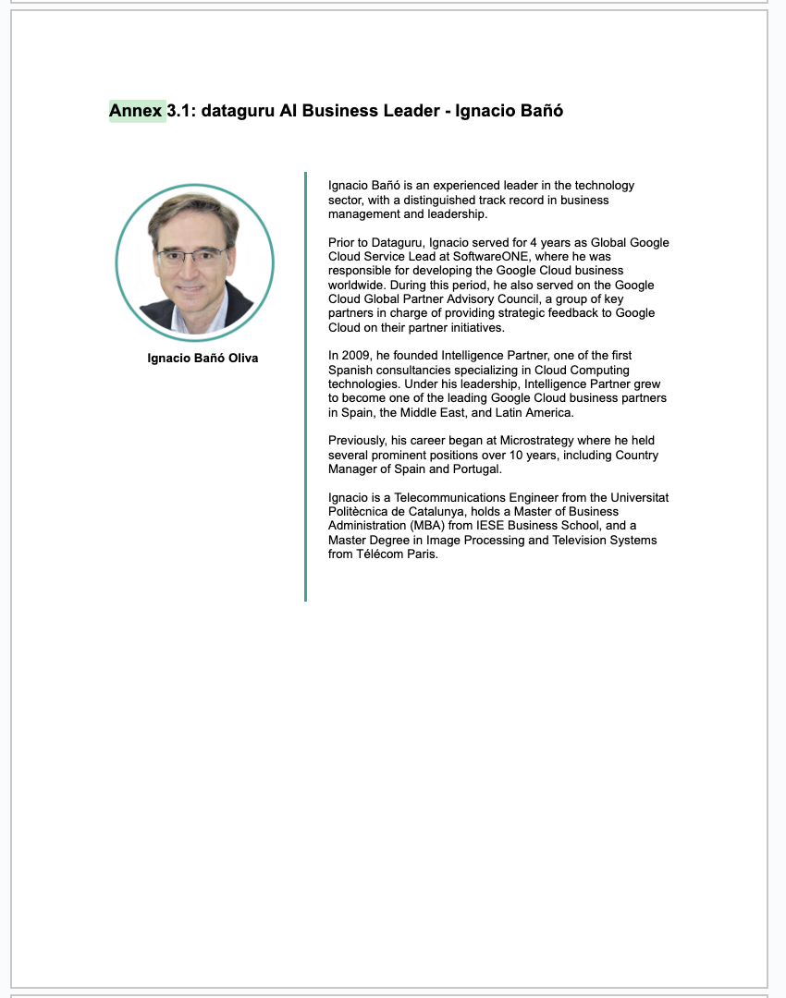
There are 3 Annex 3. Use your creativiy for the CV so they look professional

