Slide 1

Welcome to Rekindled Retreats
Nervous System Recovery Journey
  The 8-week journey is designed to help participants achieve nervous system regulation and greater resilience.
Supportive Growth Environment
  Participants benefit from a nurturing environment focused on personal growth, healing, and emotional well-being.
Purposeful Pathway to Well-being
  The program offers a structured pathway to lasting well-being, guided by an experienced leader.
Notes:
Image source: Microsoft 365 content library
Join our 8-week Nervous System Recovery Journey, designed to guide you toward regulation, resilience, and reconnection. Experience a supportive environment focused on personal growth and healing. Led by Natalie Newgent, Founder & Guide, this program offers a purposeful pathway to lasting well-being.

Slide 2

What to Expect: Course Overview
Weekly Live Sessions
  The program includes live sessions each week, creating a consistent space for interactive learning and active engagement.
Daily Somatic Practices
  Daily somatic practices promote embodiment and personal growth, helping participants integrate learning into their lives.
Personalized Self-Reflection Tools
  Participants receive tailored tools to support self-reflection and deepen their individual development between sessions.
Supportive Group Environment
  A safe, supportive group fosters meaningful connections and shared experiences, enhancing collective and personal growth.
Notes:
Image source: Microsoft 365 content library
This 8-week program features weekly live sessions and integration homework to reinforce learning. Daily somatic practices are incorporated to support embodiment and growth. Participants receive personalized tools for self-reflection, all within a safe group environment that fosters meaningful connections and shared experiences.

Slide 3
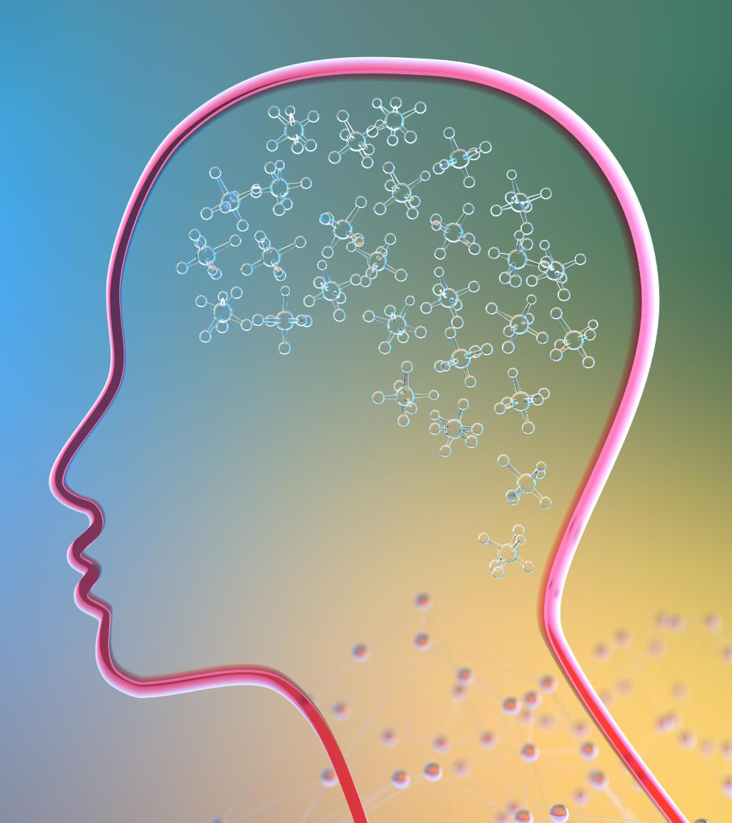
Mapping Mind & Body
Exploring the Nervous System
  We begin by understanding the nervous system and how it impacts our emotions and daily energy levels.
Identifying Triggers and Patterns
  Guided mind-mapping helps you recognize emotional triggers and recurring patterns in thoughts or behaviors.
Window of Tolerance Concept
  Learn about the Window of Tolerance to recognize and manage your stress responses more effectively.
Homework and Practice Tools
  Daily tracking, journaling, and color-coded mind maps support your learning about the mind-body connection.
Notes:
Image source: Microsoft 365 content library
In Week 1, we explore the nervous system to understand how it affects emotions and energy. Through guided mind-mapping, you'll identify triggers and patterns. Learn the concept of the Window of Tolerance, helping you recognize stress responses. Homework includes a daily nervous system tracker, a 'parts check-in' journal, and creating a color-coded mind map.

Slide 4

Identifying Core Values
Reconnecting With Core Values
  Reconnecting with your core values is essential for fostering deep personal growth and authenticity in everyday life.
Impact of Trauma on Values
  Trauma can disrupt value alignment and lead to self-betrayal, making it harder to trust personal decisions.
Values as Decision Anchors
  Using core values as anchors can guide decision-making and help maintain integrity and resilience.
Notes:
Image source: Microsoft 365 content library
Explore how reconnecting with your core values fosters personal growth. Understand the impact of trauma on value alignment, often leading to self-betrayal. Learn to use values as anchors for decision-making. Homework includes completing a core values inventory, reflecting on past misalignments, and practicing somatic grounding when choosing alignment.

Slide 5
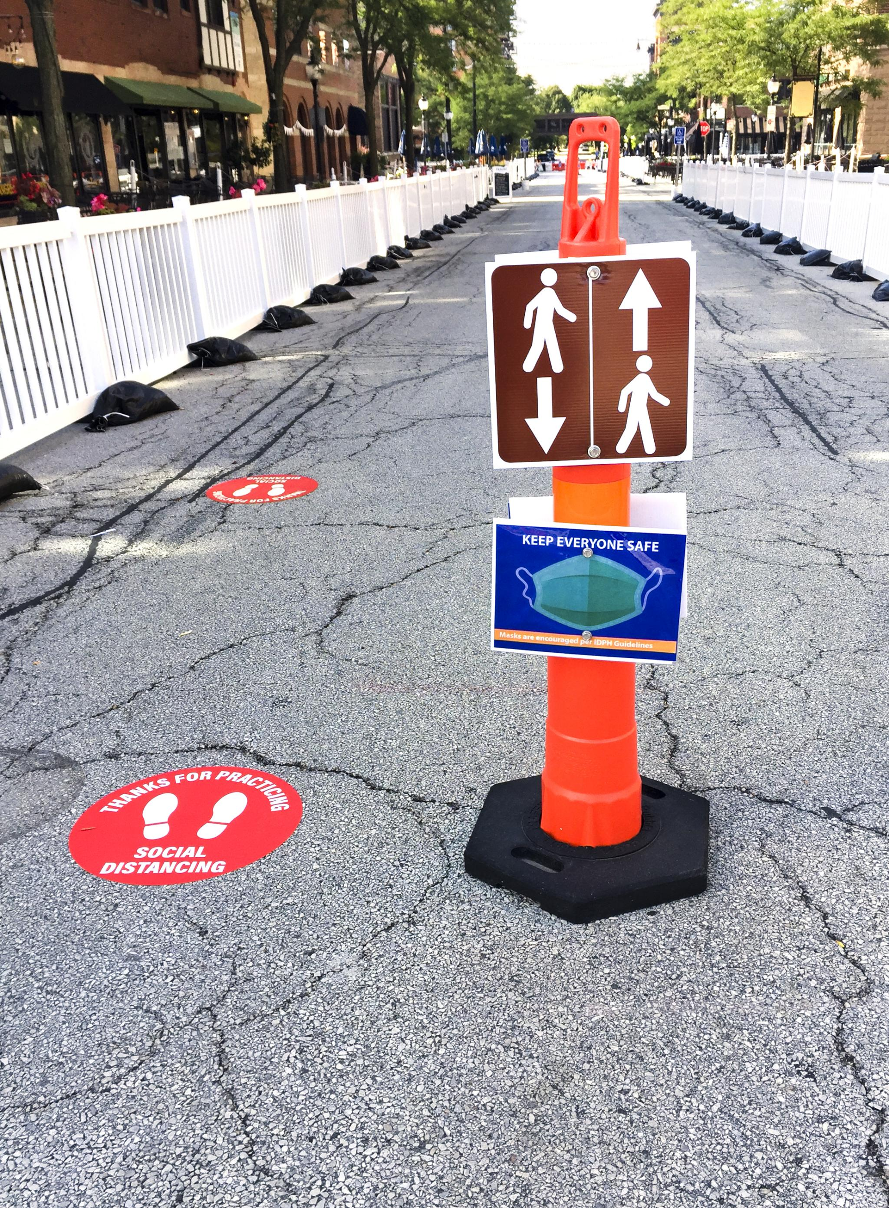
Exploring Boundaries & Safety
Understanding Different Boundaries
  Boundaries can be emotional, physical, digital, or energetic, and are necessary for personal safety and well-being.
Boundaries Foster Well-Being
  Boundaries are regulation tools that support mental and emotional health, rather than creating disconnection.
Practical Boundary Tools
  Activities include mapping safe versus unsafe spaces, practicing boundary-setting scripts, and journaling about overextension.
Notes:
Image source: Microsoft 365 content library
Week 3 focuses on building safety by establishing emotional, physical, digital, and energetic boundaries. Boundaries are regulation tools that promote well-being, not barriers to connection. Expect to visualize a 'Safe vs. Unsafe' map, practice using boundary-setting scripts, and journal about situations where you tend to overextend yourself.

Slide 6
Rebuilding Daily Routines
Designing Supportive Environments
Consider environment, food, digital input, and noise when planning daily routines to support nervous system regulation.
Balanced Daily Activities
Explore routines around meals, sleep, and work to promote a healthy daily rhythm and well-being.
Practical Homework Tools
Complete a 5 senses environment scan, a meal check-in, and a 24-hour rhythm template as homework exercises.
Notes:
Image source: Microsoft 365 content library
Week 4 focuses on creating routines that support nervous system regulation. Design an ideal daily rhythm by considering environment, food, digital input, and noise. Explore routines around meals, sleep, and work. Homework includes a 5 senses environment scan, a 'nervous system nourishment' meal check-in, and a 24-hour rhythm template.

Slide 7

Rebuilding Routines for Regulation
Designing a Supportive Daily Rhythm
  Establish routines that nurture your nervous system by balancing meals, sleep, and work for optimal well-being.
Influence of Environment and Choices
  Be mindful of how your environment, food choices, digital input, and noise impact your nervous system.
Practical Tools for Regulation
  Try activities like a five senses scan, a meal check-in, and utilizing a 24-hour rhythm template for self-regulation.
Notes:
Image source: Microsoft 365 content library
Design your ideal daily rhythm by exploring routines that support your nervous system, focusing on meals, sleep, and work. Consider how environment, food choices, digital input, and noise levels affect your well-being. Try homework like a 5 senses environment scan, a 'nervous system nourishment' meal check-in, and using a 24-hour rhythm template.

Slide 8

Somatic Toolbox for Calm
Daily Regulation Techniques
  Utilize breathwork, ball rolling, and acupressure to promote daily calm and nervous system balance.
Nervous System Resets
  Practice orienting and vagus nerve stimulation activities to support self-regulation and relaxation.
Self-Tracking Homework
  Try two techniques daily, monitor before and after sensations, and choose top self-regulation tools for continued use.
Notes:
Image source: Microsoft 365 content library
Experience hands-on techniques for daily regulation, including breathwork, ball rolling, acupressure, and nervous system resets. Practice activities focus on orienting and vagus nerve stimulation. For homework, try two techniques daily, track your before/after sensations, and identify your top three 'go-to' tools for ongoing self-regulation.

Slide 9
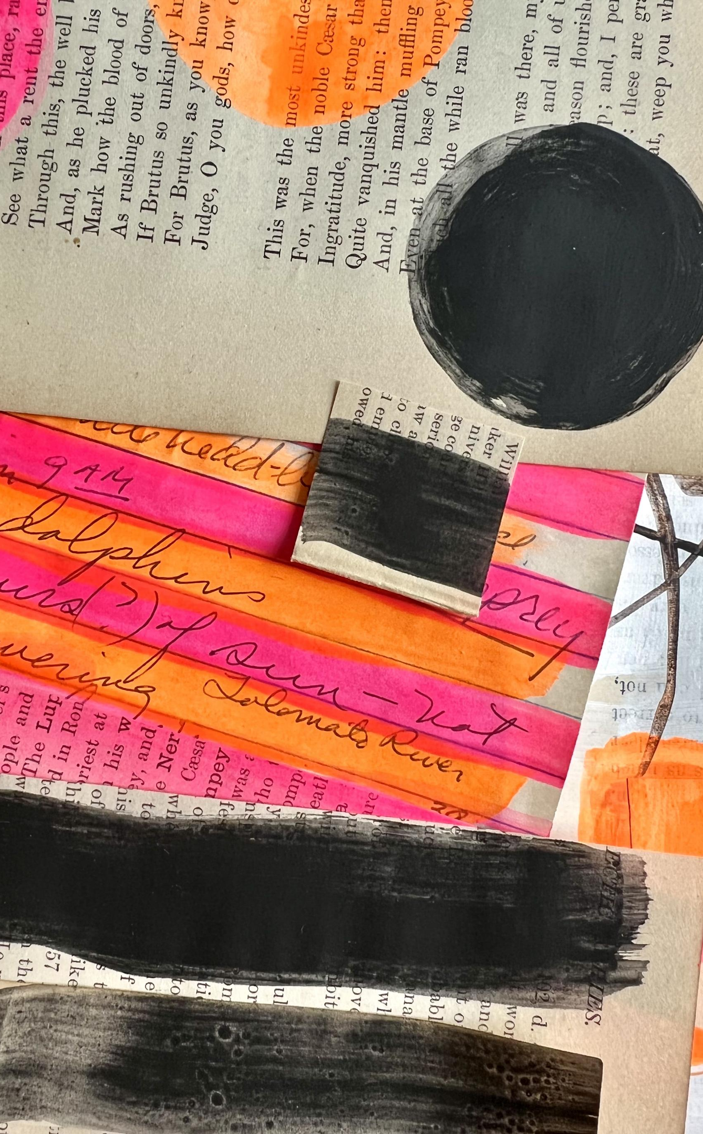
Reclaiming Joy & Expression
Creative Tools for Expression
  Engage with art, movement, voice, and stillness as methods to regulate your nervous system and express yourself fully.
Rediscover Inspiring Activities
  Reconnect with the activities that inspire and energize you, enhancing your daily sense of vibrancy and joy.
Joyful Homework Practices
  Make a collage, journal or sketch your feelings, and plan a ritual that fills your week with joy.
Notes:
Image source: Microsoft 365 content library
Explore creative tools—art, movement, voice, and stillness—to support nervous system regulation and self-expression. Rediscover activities that inspire and energize you. For homework, try making a 'What brings me alive' collage, express yourself through journaling or sketching, and plan one joy-filled ritual for the week.

Slide 10

Integrating Growth & Rituals
Reflect on Your Progress
  Review your Resilience Map and Nervous System Journal to notice your personal growth and changes over time.
Establish Sustainable Rhythms
  Plan your next steps by developing routines that support ongoing resilience and personal well-being.
Create a Closing Ritual
  Celebrate your growth by designing a meaningful ritual, marking the end of this journey and new beginnings.
Homework for Integration
  Complete the Integration Reflection, develop a 30-day Resilience Plan, and optionally write a letter to your future self.
Notes:
Image source: Microsoft 365 content library
Week 8 focuses on establishing sustainable rhythms and planning your next steps. Review your Resilience Map and Nervous System Journal to reflect on progress. Create a meaningful closing ritual to celebrate your growth. Homework includes completing the 'Integration Reflection,' developing a 30-day Resilience Plan, and optionally writing a letter to your future self.

Slide 11

Bonus Tools and Support
Valuable Learning Resources
  Access a somatic audio library, breathwork recordings, and practical worksheets to support personal growth and self-care.
Personalized Coaching Support
  Enhance your journey with optional one-on-one coaching sessions for individualized guidance and encouragement.
Creative and Immersive Experiences
  Engage in art therapy sessions or immersive deep dive retreats designed to foster creativity and deep personal transformation.
Notes:
Image source: Microsoft 365 content library
Access valuable resources like the somatic audio library, breathwork recordings, and practical worksheets and templates to enhance your journey. For additional support, consider optional next steps such as 1:1 coaching with Natalie, engaging art therapy sessions with Amy, or immersive deep dive retreats for personal growth.

Slide 12
Thank You—Keep Moving Forward
Wellness Beyond 'Fine'
You deserve to thrive and feel truly well, not just 'fine.' Embrace a journey towards genuine wellness.
Nervous System Support
Your nervous system needs a sense of safety and attentive care for true healing, not fixing.
Start Your Wellness Journey
Visit our website for information, consultation booking, and details about our next retreat to begin your transformation.
Notes:
Image source: Microsoft 365 content library
Remember, you deserve more than just feeling 'fine.' Your nervous system isn’t broken—it simply needs safety and care. Visit our website for information and booking. Don’t miss our next Rekindled Retreat! Book a free consultation or refer a friend today to start your journey toward wellness.

