Slide 1

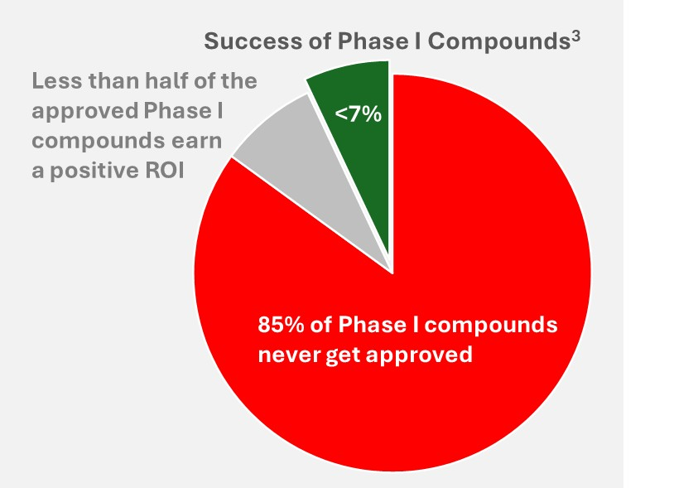
NewCo
A Novel Solution Supporting Biotechs in Their Quest to ‘Go it Alone’ – and Beating the Odds of Achieving In-Market Success
Designing a product that incorporates the commercial perspective to meet the needs of all critical stakeholders … from day 1
First Launch Commercial Success: A Coin Toss
With improved access to venture capital, talent, and the advent of outsourced full service commercial organizations, biotechs are increasingly choosing to ‘go it alone’: over half of anticipated blockbuster drugs are expected to be launched by first-time commercializing biotechs.*¹
Yet, chances of commercial success are slim: even after clearing the monumental hurdle of FDA approval, financial success remains elusive. Research on over 2,000 Phase I compounds shows that fewer than 15% are ever approved*² and of those, fewer than half launched by a first-time commercializing biotech deliver a positive ROI*³
15%
Science Drives Discovery, but Market Success Requires Foresight and Planning
Launch success depends on early expert understanding of a complex customer ecosystem—physicians, patients, payers, regulators, and others—each with unique needs that must be reflected in the target product profile (TPP).
Early commercial insights are required to identify and translate those needs into product requirements to align clinical, regulatory, manufacturing and medical efforts before critical TPP decisions are locked in. Since formulation, target indication, and endpoints are often set before Phase I, it is vital to invest in market insights before the product enters the clinic.
Why Making Early Investments into Commercial Insights is Challenging
Given scarce resources, early-stage biotechs all too often delay investments in early commercial insights. ‘Kicking the (commercial) can down the road’ is often the result of 3 beliefs:
  An optimistic view that the groundbreaking discovery will ‘sell itself’ – which is rarely true
  The belief that “Commercialization issues can be dealt with when the science has demonstrated success” – why invest scare resources early when only 15% of assets ever reach the market?
  Investor pressure to focus resources on scientific development – reaching the next clinical milestone will often trigger another round of funding or enable an early exit for investors.
The real reason for delaying commercial investments, however, is “not knowing what you don’t know” - the founding team may (mistakenly) feel capable of answering basic business questions such as ‘what is the size of the market?’, ‘what competition will we have?’, ‘how are competitor therapies priced?’, etc. Often lacking in-depth commercial experience, the team will likely miss important product attributes and nuanced market dynamics … and ultimately underestimate what is required to win in the real world.
Footnotes:
Harputlugil E., Hayton S., Merrill, J., Salazar, P.: ‘First-Time Launchers in the Pharmaceutical Industry’, McKinsey February 2021
Schuhmacher, A., Hinder, M., Brief, E. Gassmann, O., Hartl, D.: ‘Benchmarking R&D success rates of leading pharmaceutical companies: an empirical analysis of FDA approvals (2006–2022)’, Drug Discovery Today, Volume 30, Issue 2, 2025, 104291.
Hauser, M.: Light the Candle or Hand Over the Reins? Biotech’s Tough Decision to Launch or Exit. NewCo Working Paper, 2025
For more information, contact us at info@cogent-hc.com

Slide 2
NewCo
The Fractional Commercial Team
Not consultants, not individuals, but an experienced, flexible team
For early-stage biotechs, there are three traditional – but imperfect –
options to incorporate the commercial perspective early.
Option 1 – having scientific founders manage market planning in their
“spare time” after attending to their already long list of responsibilities.
This approach often leads to superficial insights and costly missteps.
Option 2 – initiating external consulting engagements. Doing it right, however, requires someone to have the ‘wisdom’ to engage the right consultants at the right time to solve a variety of salient commercial questions, and provide the necessary continuity and context that are often lost between one-off projects.
Option 3 – hiring a full-time Commercial Lead. This is a major financial commitment (locking in expenses incl. a big severance package when clinical trials fail) and difficult to justify at the pre-Phase I stage. Finding an experienced executive, covering the necessary breadth of expertise AND willing to bet on a high-risk biotech at an early stage can also be challenging – thus often leading to bringing in commercial expertise far too late.
3 traditional Options
‘Do-it-yourself’
Engage external consultants
Hire a full-time commercial lead
A Fresh Alternative: The Fractional Commercial TEAM
NewCo offers a new solution: An integrated team of experienced, fractional executives – with a mandate to generate market insights, help define a marketable, differentiated product profile (TPP), work cross-functionally to align development efforts, and articulate the compelling go-to-market strategy for the Board of Directors and investors – all of which evolve as the business learns and grows.
Advantages of the Fractional Team:
Multidisciplinary expertise including strategy, pricing and market access, market research, business development & licensing, stakeholder analysis, competitor intelligence, and more
Extensive experience and a network of biopharma experts … to provide foresight and resolve challenges before they impede progress
The flexibility to shift focus as company needs change without re-negotiating contracts or managing multiple consultants with overlapping remits
Fresh, independent perspectives – a ‘sound sounding board’ and an antidote to internal echo chambers
Continuity and context that evolve with the company, reducing the need for repetitive onboarding or redundant rework
Alignment with long-term value creation—retained team is invested in success, not just deliverables
Minimized exit costs – avoid breaking long-term commitments and severance costs when clinical progress fails to materialize
Hiring a fractional commercial team combines continuity and commitment of a Chief Commercial Officer / team with the breadth of expertise and flexibility of hiring 3rd party consultants … but without the disadvantages of traditional options.
For more information, contact us at info@cogent-hc.com

