Slide 1
Briefing 4page Flyer
Torson Injex AG

Slide 2
Project Description
The flyer will be set up in Englisch
The winning design will be asked to translate to a German version.

Slide 3
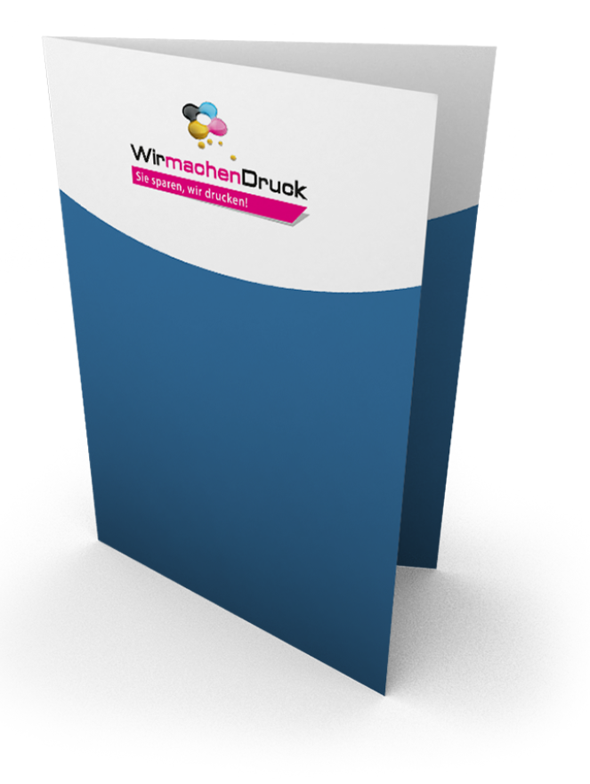
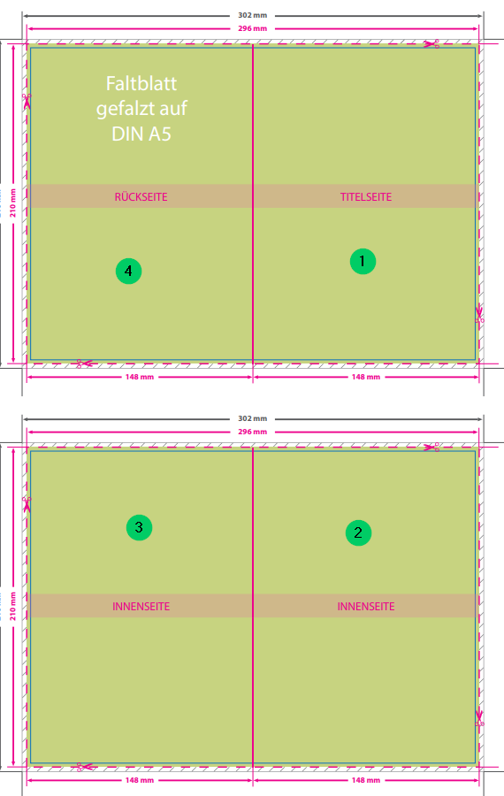
Flyer Specs
4 pages
  1. Frontpage
  2. Content – Technology Range
  3. Content – Service
  4. About Us / USPs
Size (folded): 14.8x21.0cm
Size printfile: 30.2x21.6cm
Min.300dpi

Slide 4
File Format
We would like to be able to edit the Flyer (at least the text content) even after the project. We see the following options, but are open to suggestions
  Word or Powerpoint
  .svg

Slide 5
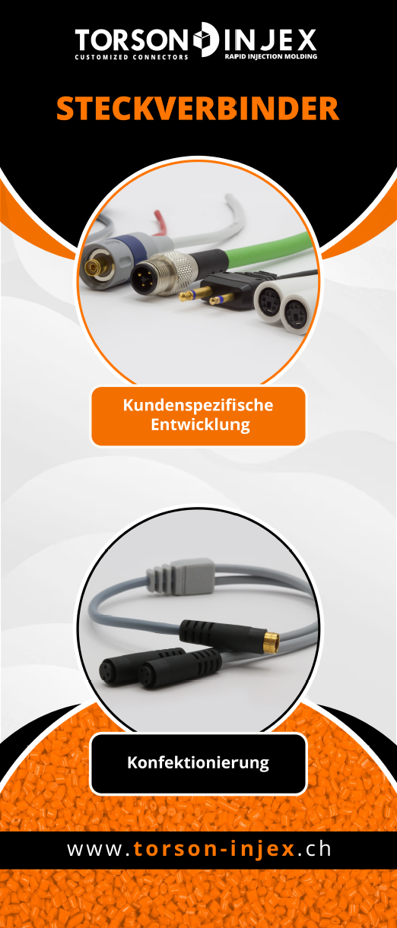
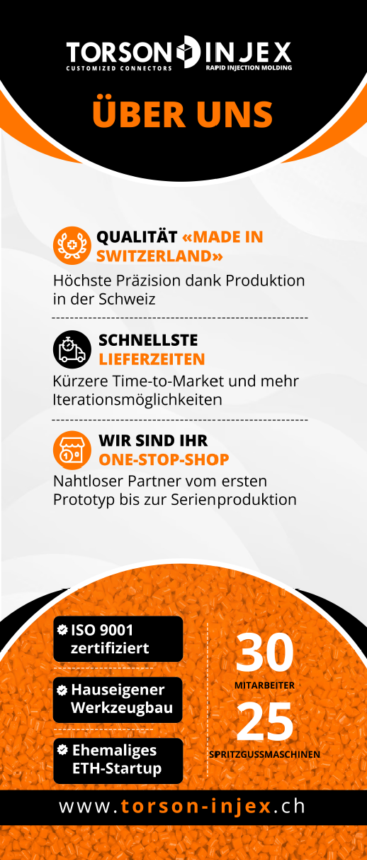
Style
We just redesigned our exhibition stand and would like the flyers in a similar (but not identical) style
Corporate Design:
  Color: #FF7500
  Font: Open Sans
Exhibition LED Panel Design

Slide 6
About Us
Torson Injex AG is a Swiss specialist in high-precision injection molding. We develop and produce complex plastic parts, customized connector elements or overmolded electronics. Our customers value:
Very short lead times
Customized solutions
Swiss-made quality
Reliability and innovation
Website: www.torson-injex.ch

Slide 7
Content
On the following slides the titles and some text-content is defined for each page
  This is not fixed, feel free to add or subtract if needed
For each page there is a folder with pictures. Feel free to use what works best.

Slide 8




1. Page - Frontpage
Intent: This should be the eye-catcher and quickly summarize our service
Content:
Logo
Title/Slogan: «SWISS INJECTION MOLDING EXPERTS»
Short Text:
Your partner for complex plastic solutions:
    Injection molded prototypes within a few days
    (Micro) injection molding with in-house toolmaking
    Overmolding and custom solutions
    Connectors and cable assemblies
USPs:

Slide 9
2. Page – Technology Range
Intent: We have a wide variety of services and applications. This page should give an overview and help the customers to identify, if we are the right supplier for them
Title: «Technology Range»
  Injection molded prototypes
    Speed – prototypes in the original material within a few days
    Material selection – over 600 materials in stock: from PP to PEEK, from TPEs to silicone
    Flexibility – we injection mold small series of 1–100 pieces on specially developed prototype machines
  (Micro) injection molding
    Toolmaking – We produce complex molds in-house, including slides, polished and eroded surfaces
    Capacity – We manufacture series of 100 to 1,000,000 pieces in our modern machine park
    Precision – Tolerances in the hundredths range and component weights below 0.1 grams are part of our everyday business
  Overmolding and custom solutions
    Material connections – Overmolding of glass, ceramic, metal, or plastic parts
    Integration – Reliable embedding of electronics, sensors, or LEDs directly into the injection molded part
    Protection & function – Special processes ensure stability, tightness, and long service life
  Connectors and cable solutions
    Customized – development of individual connectors tailored to your requirements, even for small series
    Everything from a single source – cable assembly and overmolding completely in-house in Zurich
    Reliability – robust, tight, and durable solutions for the most demanding environments

Slide 10
3. Page – Service
Intent: This page sould show the customer how we can support them along the journey from the first idea to series production. Pictures in the folder can be used but are optional. Other design ideas welcome.
Title: «Service»
  Idea
    Engineering and design – We support you from the initial idea onwards with our many years of experience in design and optimization
    Material selection – With over 600 materials in stock and expertise from 1,000 applications, we help you select the right plastic
  Evaluation
    Prototyping – Using a rapid tooling process developed at ETH Zurich, we can implement your ideas in near-series production within a very short time
    Iterations – Variants and design ideas can be tested quickly and easily until the optimal solution is found
  Pre-series
    Toolmaking – Thanks to our in-house toolmaking facility, high-precision components can be produced and tested in the shortest possible time
    3D printing – For prototypes or small series, we use additive processes as a flexible supplement to injection molding
  Production
    100% Made in Switzerland – All our products are produced and tested entirely in-house in Zurich. With quality that is ISO 9001 certified
    Broad industry support – Thanks to our customers, we are familiar with the requirements of a wide range of industries. These include the mechanical and electrical engineering industries, the pharmaceutical industry, medical and laboratory technology, aviation, and many more

Slide 11
4. Page – About Us
Intent: This back-page should give the customer some more reasons to work with us and provide all necessary information to get in touch with us.
About us
  30 employees
  25 injection molding machines
  In-house toolmaking
  ISO 9001 certified
  Former ETH startup
Your benefits
  Quality «Made in Switzerland»
  Highest Precision thanks to Swiss production
  Fastest delivery times
  Shorter time-to-market and more iteration options
  One-Stop-Shop
  Seamless partner from the first prototype to series production
Reference
  (Customer Logos and Names see Folder)
Contact
  Torson Injex AG | Gubelstrasse 37 | 8050 Zurich | Switzerland
  torson@injex.ch | +41 44 244 08 44
  QR Code to Website
  SM Icons (Linkedin, Instagram)

