Slide 1

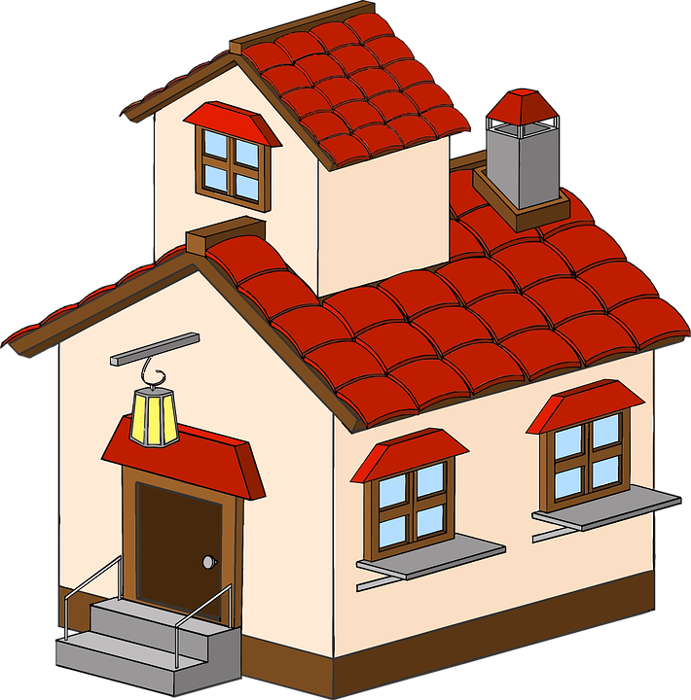
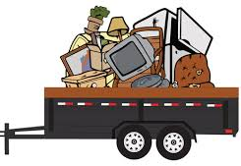
I was thinking something like this, but better. The two sides
separated by a lightening bolt or something like that. On the left
would be the Handyman aspect and on the right would be
the junk removal aspect.
Wrench and Rubble
Handyman & Junk Removal

