Slide 1
Princess Pickleball
Style/Apparel

Slide 2
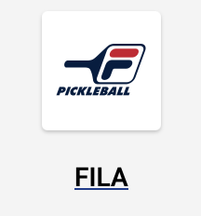
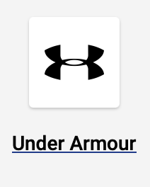
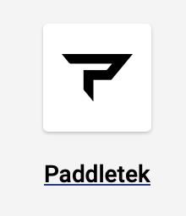


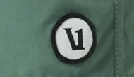

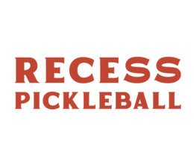
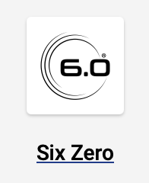
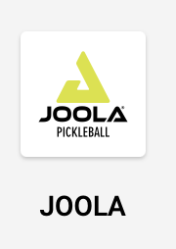
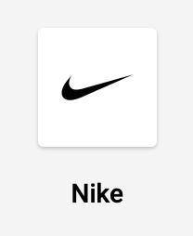


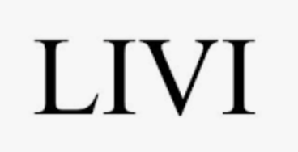



Athleticwear Brands/Logos

Slide 3
Appendix
Competition & Trends

Slide 4
Dedicated Pickleball Brands (apparel-specific or full-range)
These brands are known for pickleball-specific clothing lines:
Selkirk Sport – They have expanded into premium apparel (performance tees, hats, hoodies).
Pickleball Bella – Very popular for women’s skirts and patterned tops.
Franklin Pickleball – Apparel and gear at accessible price points.
Skechers Pickleball – Originally shoes, now pushing branded apparel with pro players.
Babolat Pickleball – Apparel designed for racquet sports with pickleball lines.
Vatic Pro – Emerging brand with minimalist, athletic styles.

Slide 5
Lifestyle & Performance Brands Popular with Pickleball Players
Not only pickleball, but very popular on the courts:
Nike – Tennis and training lines adapted for pickleball; endorsed by many pros.
Adidas – Tennis/padel cross-over clothing used heavily in pickleball.
Fila – Classic court skirts, polos, and retro-inspired sets.
Lululemon – Super popular for women’s skirts and men’s shorts.
Vuori – Trendy with a casual-technical aesthetic.
Athleta – Women’s skirts, tanks, dresses.
Outdoor Voices – Casual, fun colorways used for pickleball.
Yonex – Racquet sport heritage brand with clean, durable designs.

Slide 6
Pickleball-Specific Boutiques & Newcomers
Often sold online or in pro shops:
EleVen by Venus Williams (Pickleball line) – Sporty, stylish court wear.
Dinkers & Bangers – Pickleball-inspired lifestyle apparel.
Rally Republic – Sporty-casual, made for pickleball culture.
Court Life – Premium lifestyle brand with a pickleball focus.
The Picklish – Fun graphic tees and courtwear.

Slide 7
Footwear-Driven Brands Expanding Into Apparel
K-Swiss – Big pickleball push, adding clothing lines.
Asics – Well-known for shoes, also making lightweight pickleball-ready tops/shorts.
Sketchers

Slide 8
Trends
Short skirts with ball pockets for women
Breathable performance polos for men
Graphic tees with pickleball humor/logos
“Athleisure” lines for off-court wear
Retro/tennis-inspired color blocking

