Slide 1
Test Capabilities
At aHV.Solutions

Slide 2
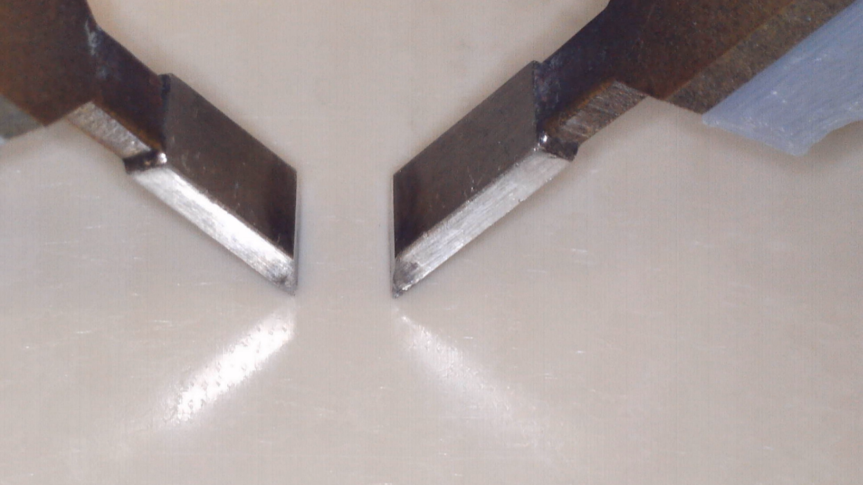
Purpose: Used to support the choice of creepage distances in electrical systems
Sample Type: Plastic sheets (typically 3mm thick)
Test Method: Conductive solution dropped onto a 4mm gap between two platinum electrodes energised at a specific voltage. One drop every 30s
Test Outcome: CTI value is voltage at which excess current does not flow after 50 drops. Multiple tests have to be carried out to establish the CTI value.
Comparative Tracking Index (CTI) Testing

Slide 3
Purpose: To evaluate the suitability of creepage distances within the aerospace environment
Sample Type: aerospace component, typically terminal blocks but has a wide range of application
Test Method: simulating multiple ascent / descents in an reduced pressure and increased humidity environment. The test object usually being cooled to ensure the control of the location where it is depositing the most condensation.
Test Outcome: Testing can indicate the number of cycles at a specific voltage until failure or can identify the level of voltage required for a specific leakage current to flow.
Creepage Testing

Slide 4
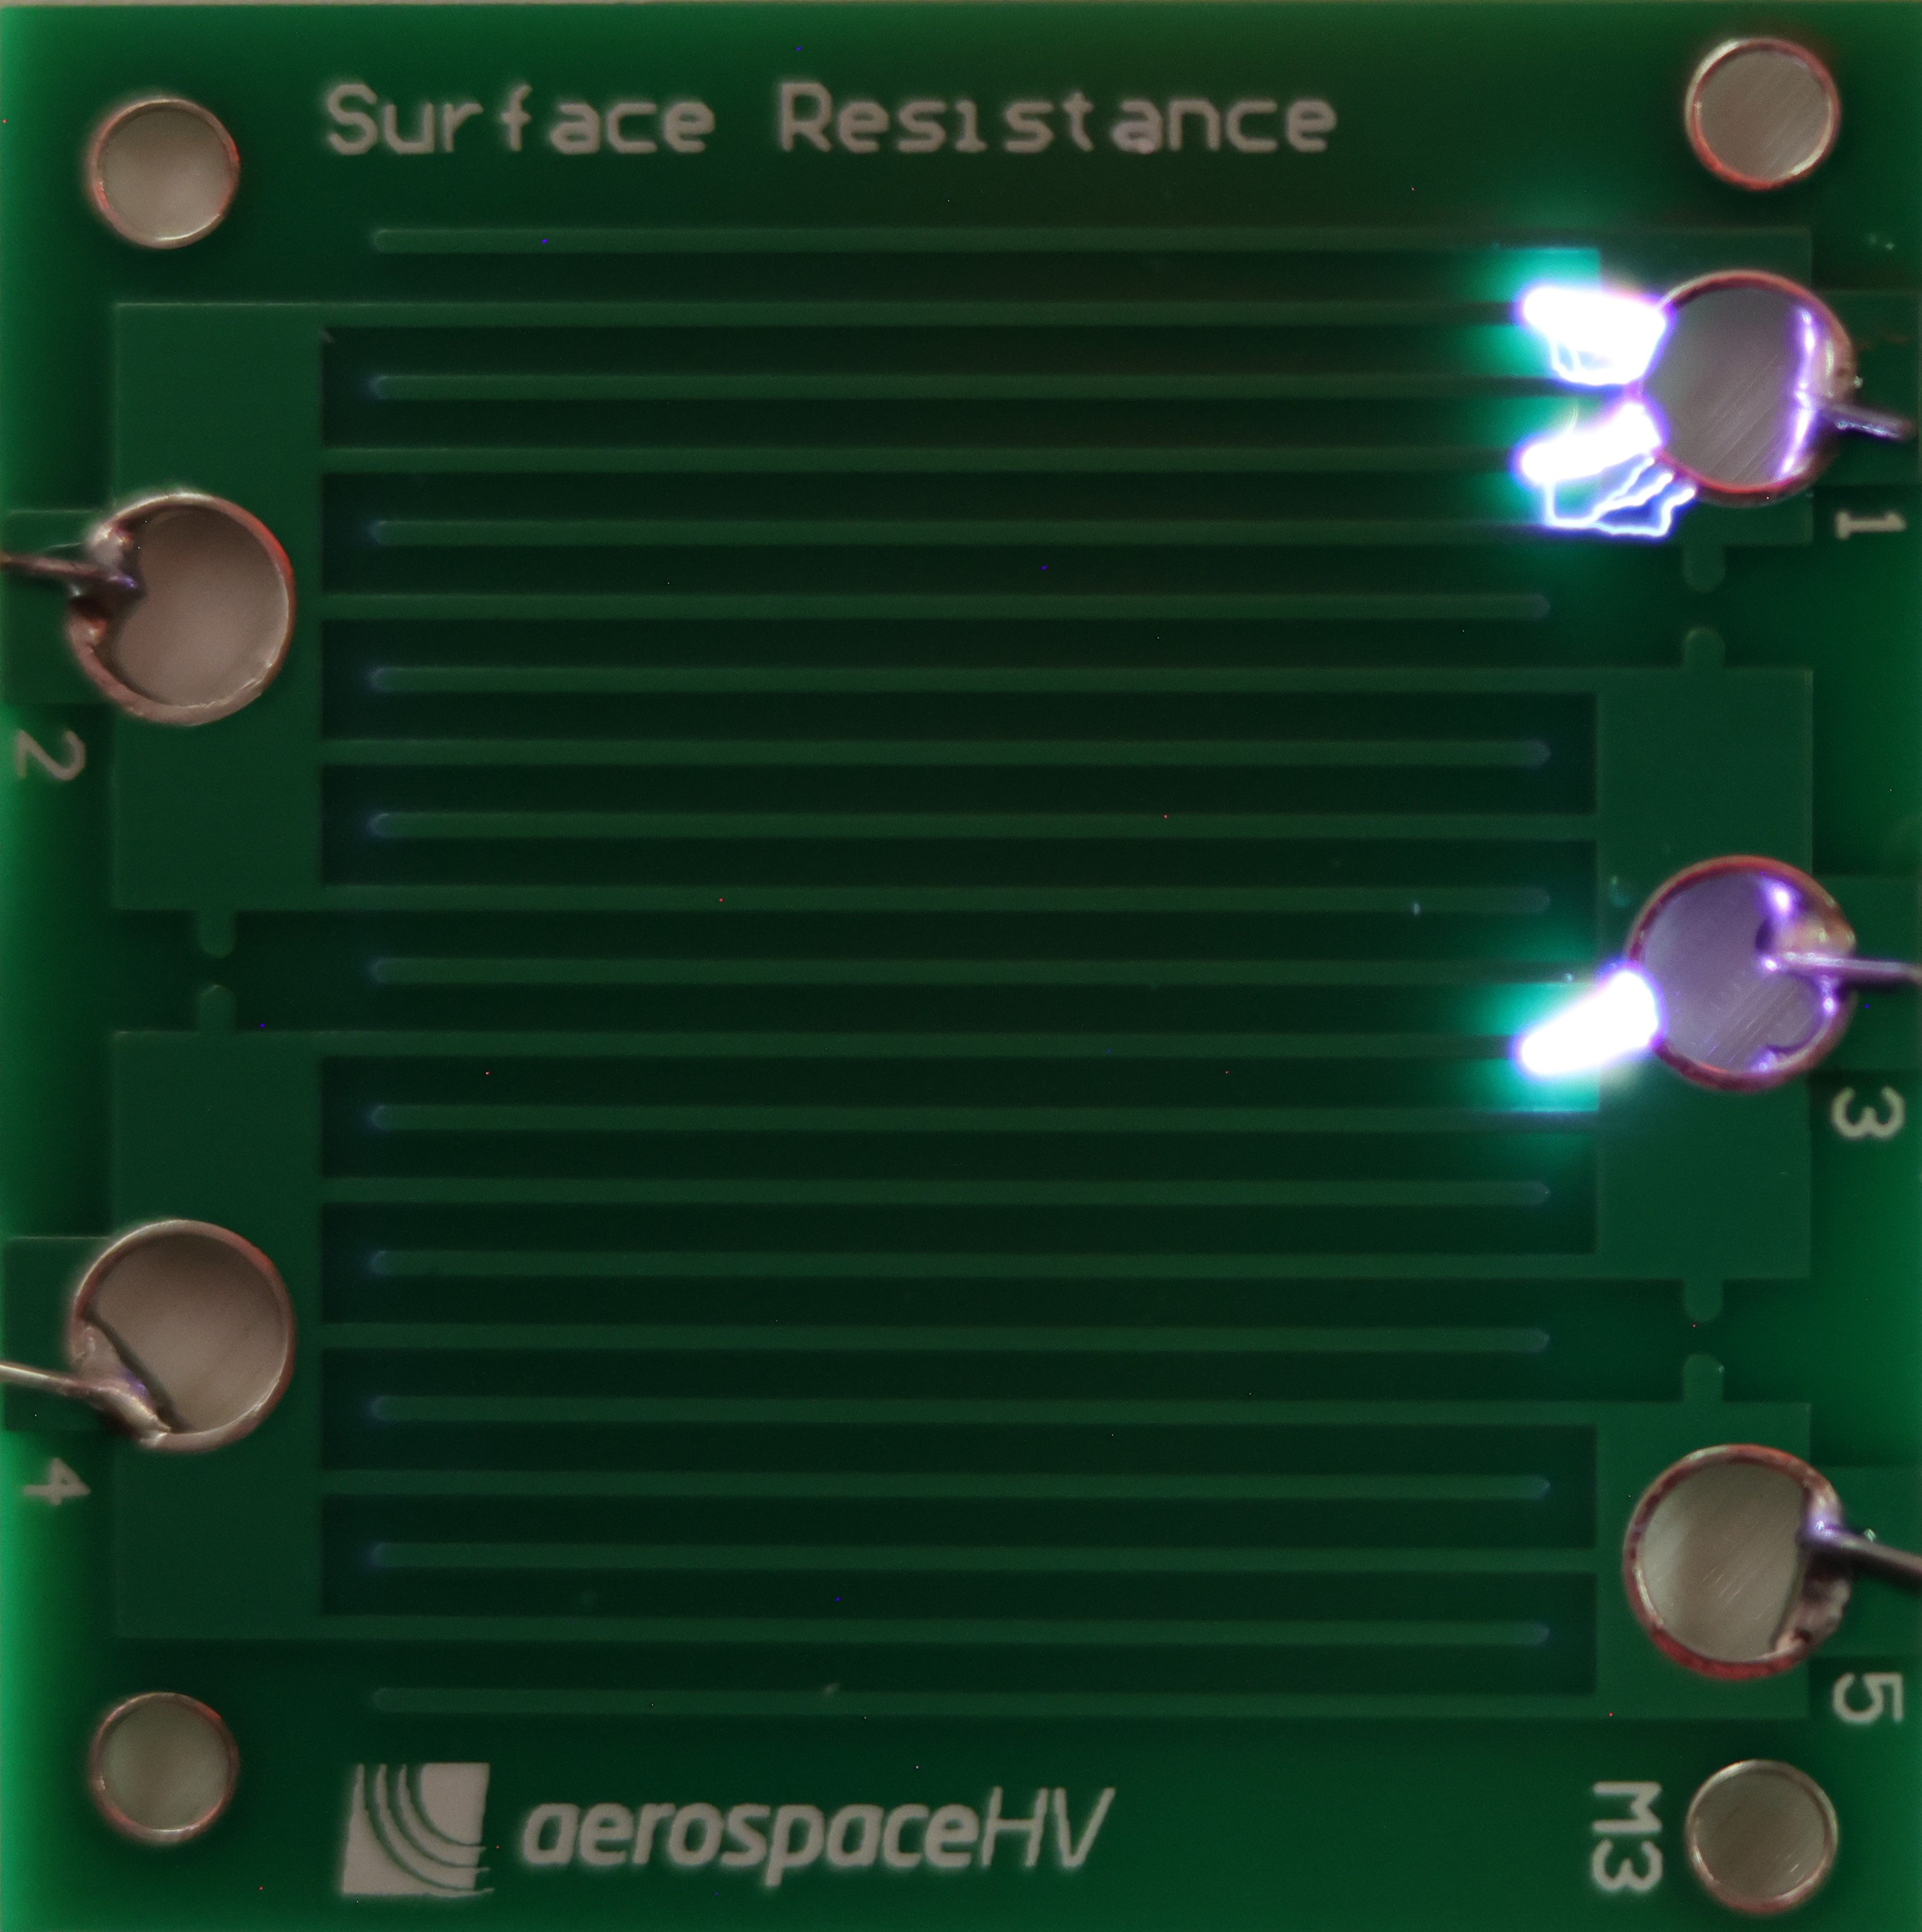
Purpose: to determine the minimum distance and conditions at which flashover occurs between conductive parts, ensuring compliance with safety standards and design requirements
Sample Type: any representative components or assemblies such as PCBs.
Test Method: the voltage applied across two electrodes is increased at a steady ramp rate (usually 50 V/s) until flashover occurs.
Test Outcome: determines the flashover voltage and clearance distance, supplying data to confirm insulation design, evaluate material performance, and verify safe separation distances
Clearance/Flashover Testing

Slide 5
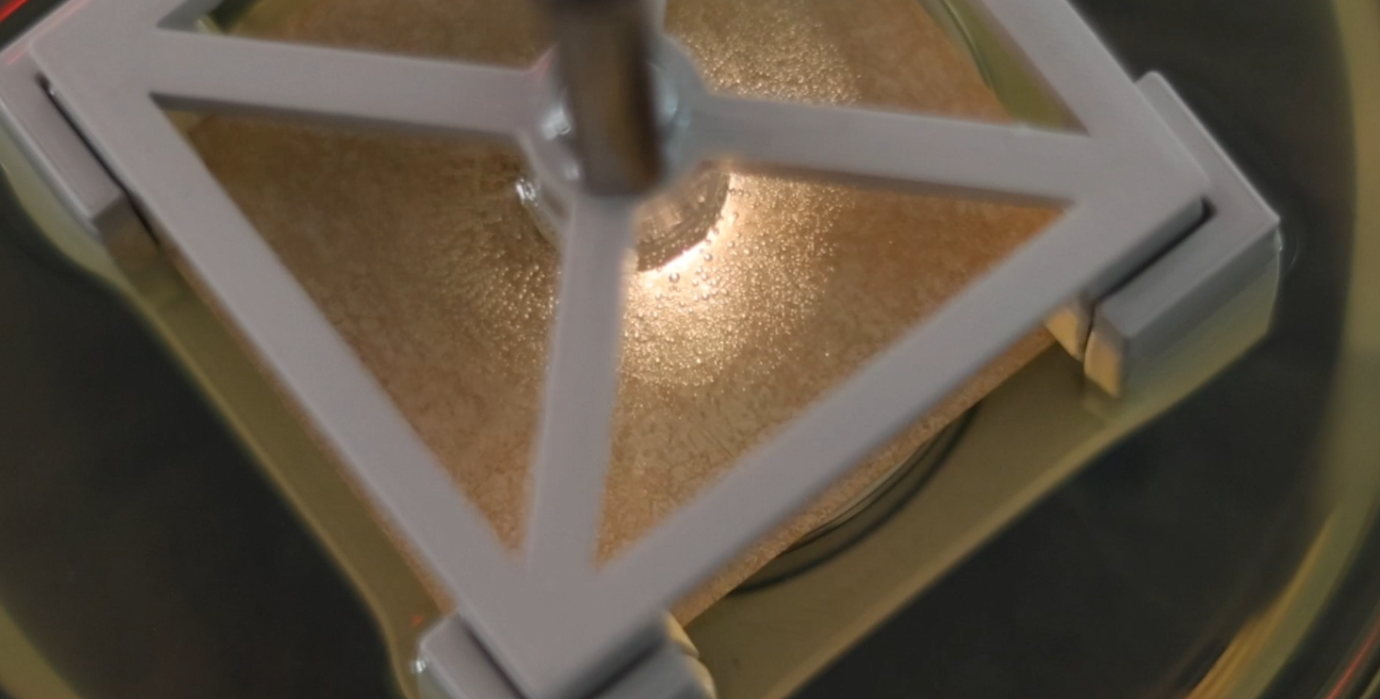
Purpose: To determine the voltage threshold at which insulation will fail and the nature of that failure if required.
Sample Type: Insulation Paper, Plastic insulation from coils.
Test Method: Manual and automated breakdown voltage testing where a sample is energised with a ramping voltage until the sample fails, or a predefined limit is reached.
Test Outcome: Testing usually results in the failure of the test object and many samples may be required to provide statistically significant data about a material or product choice.
Breakdown Voltage Testing

Slide 6
Purpose: Ensuring systems avoid, or are resilient to electrical degradation in all operational environments?
Sample Type: Testing a range of test object configurations from twisted wires through to full dyno installed systems
Test Method: aHV PD testing according to IEC 60270 allows for measurements using AC frequencies up to 2kHz and measurements with DC (what conditions?).
Test Outcome: Understanding of PD performance either to inform design process, validate final prototypes or perform production QA.
Purpose: PD testing according to IEC 60270 and particularly suitable for off-line systems.
Sample Type: Multiple samples are often required to provide statistically significant PDIV and PDEV test data.
Test Method: PD testing according to IEC 60270 and particularly suitable for off-line systems. Testing is more sensitive at lower levels of frequency (e.g. 400 Hz) but our capability allows for measurements using AC frequencies up to 2kHz and measurements with DC.
Test Outcome:
AC & DC Partial Discharge Testing

Slide 7
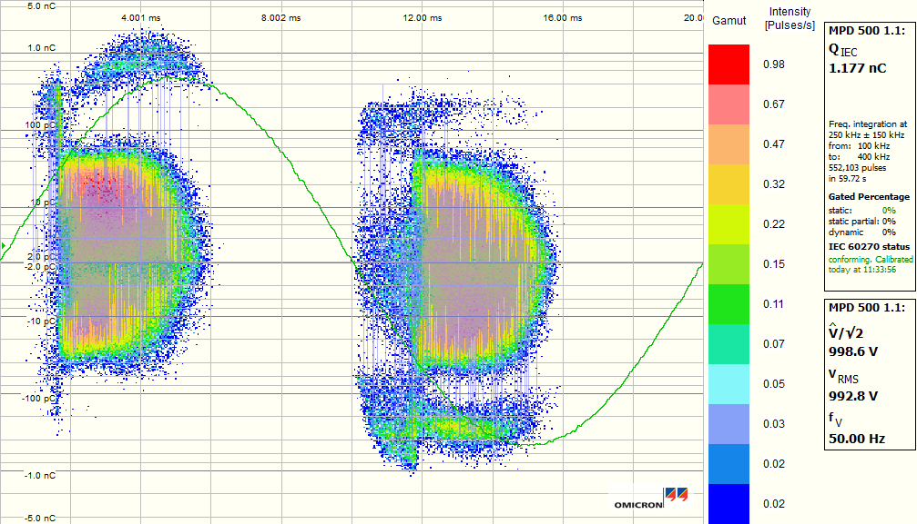
Purpose: Evaluating the characteristics of partial discharge for insulation systems.
Sample Type: A range of test object from twisted wires through to full dyno installed systems
Test Method: Our PD testing according to IEC 60270
allows for measurements using AC frequencies up to 2kHz and with DC voltages. Adjustable environmental parameters is also feasible to simulate field operation.
Test Outcome: A series of PDIV and PDEV results allowing for an average and range to be determined, and corresponding PRPD data to analyse discharge performance.
AC & DC Partial Discharge Testing

Slide 8
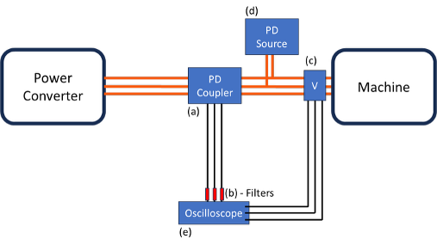
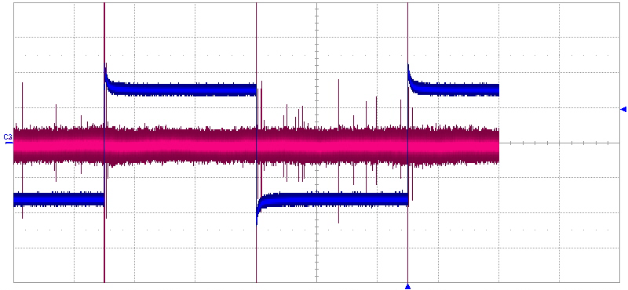
Purpose: PD testing using antenna based detection methods according to IEC 61934 and provides an ability to measure PD in systems energised by power electronic converters. The fast rise times of these converters render conventional partial discharge detection equipment unusable owing to high levels of noise.
Sample Type: Electric machines
Test Method: Custom designed antenna (developed in project with NPL) detection system. Voltage sources can be provided by aHV.solutions (up to 6 kV at 20 kHz or 24kV at 100kHz) or supplied by the customer. Capability to measure PD in operating power converter.
Test Outcome: A series of PDIV and PDEV results allowing for an average and range to be determined.
Online Partial Discharge Testing

Slide 9
Purpose: Assessing the temperature rise of components as high current passes through them is often essential and with the increasing use of high frequencies, the consideration of the skin effect or proximity effect is vital.
Sample Type: Cables and connectors
Test Method: Up to 1000 A DC and 500A AC frequencies between 400 Hz and 2 kHz at low voltage. (depending on the nature of the test object)
Test Outcome: AC Resistance increases with higher frequencies, validation of current/frequency operational ratings and the temperature at steady state as well as rise time.
Temperature Rise Testing

Slide 10
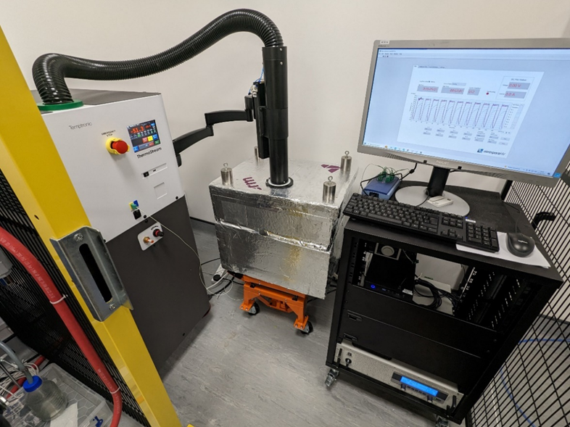
Purpose: Accelerated life testing that ages components to understand expected durability under a given thermal duty cycle.
Sample Type: Stators, motorettes, insulation paper, insulated wires.
Test Method: Capable of rapid thermal cycling between –50°C to 300°C . Temperature raises by passing high current through test samples and decreases by blowing cold dry air at -45°C and 18 SCF. The cycle repeats the necessary number of times.
Test Outcome: Samples are inspected for cracks in every 100 cycles and thermal ageing / cycling can be combined with partial discharge and breakdown testing to understand the impact of ageing on the electrical performance of the test object.
Thermal Cycling Testing

Slide 11
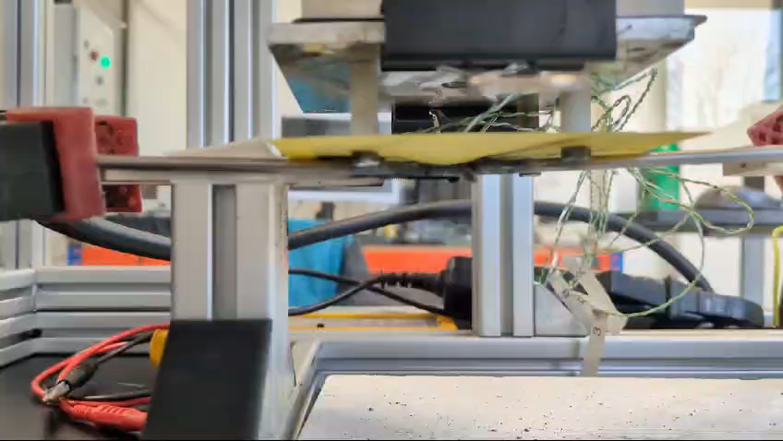
Purpose: to characterise the arcing behaviour under specific conditions and assess the resistance of different insulating materials to arcing. The results can also be used to support the investigation of distinctive arc features that could assist in the development of arc detection methods.
Sample Type: various metals may be used for electrode manufacturing, and different insulation materials can be applied for material assessment.
Test Method: arc initiation is achieved by separating contacts using a linear actuator. Testing is typically conducted under ambient conditions; however, bespoke tests at specific temperatures and pressures can be arranged.
Test Outcome: current and voltage waveforms, series-parallel arc transition time, burn-through duration for material assessment, arc feature extraction for detection.
Arc Testing

Slide 12
Purpose: Complex and simple systems can be coated at a known pollution level.
Sample Type:
Test Method: According to the type of the pollution level:
Class 1: Low pollution severity
Class 2: Moderate pollution severity
Class 3: High pollution severity
Class 4: Very high pollution severity.
Insulation material selection, creepage distance and pollution performance are required.
Test Outcome:
Pollution Testing

Slide 13
Purpose: Determine the dielectric constant of an insulating material.
Sample Type: Typically wires or sheets of insulation material
Test Method: Capacitance measurements along with dimensional measurements allow us to model the electric field distributions in the insulation systems and can determine the dielectric constant of the material.
Test Outcome: The equipment is able to measure the frequency range (20 Hz to 300 kHz) specified in the standard or required by the test.
Dielectric Constant Testing

Slide 14
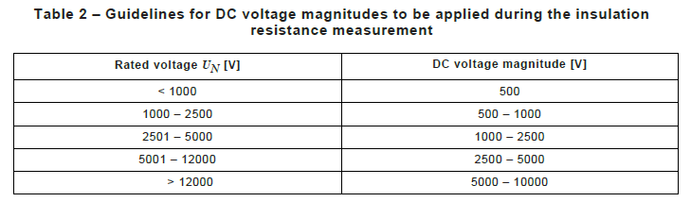
Purpose: The insulation resistance and dielectric withstand tests are used to determine electrical properties of the insulation from the leakage current measured. However often the tests are used as an initial electrical test of the insulation to find pinholes or defects and exclude outliers from the batch of samples.
Sample Type: Stators, Motorette, Insulation paper, insulated wires.
Test Method: Dielectric Withstand tester with testing voltages up to 5 kV AC 22 mA and insulation resistance up to 4 kV DC 6mA.
Test Outcome: Pass and fail list of samples based on rating of the machine, It can also be done in combination with thermal aging and thermal cycling to determine insulation reliability through cycling.
Taken from: IEC CD 60034-27
Insulation Resistance / Dielectric Withstand Testing

Slide 15
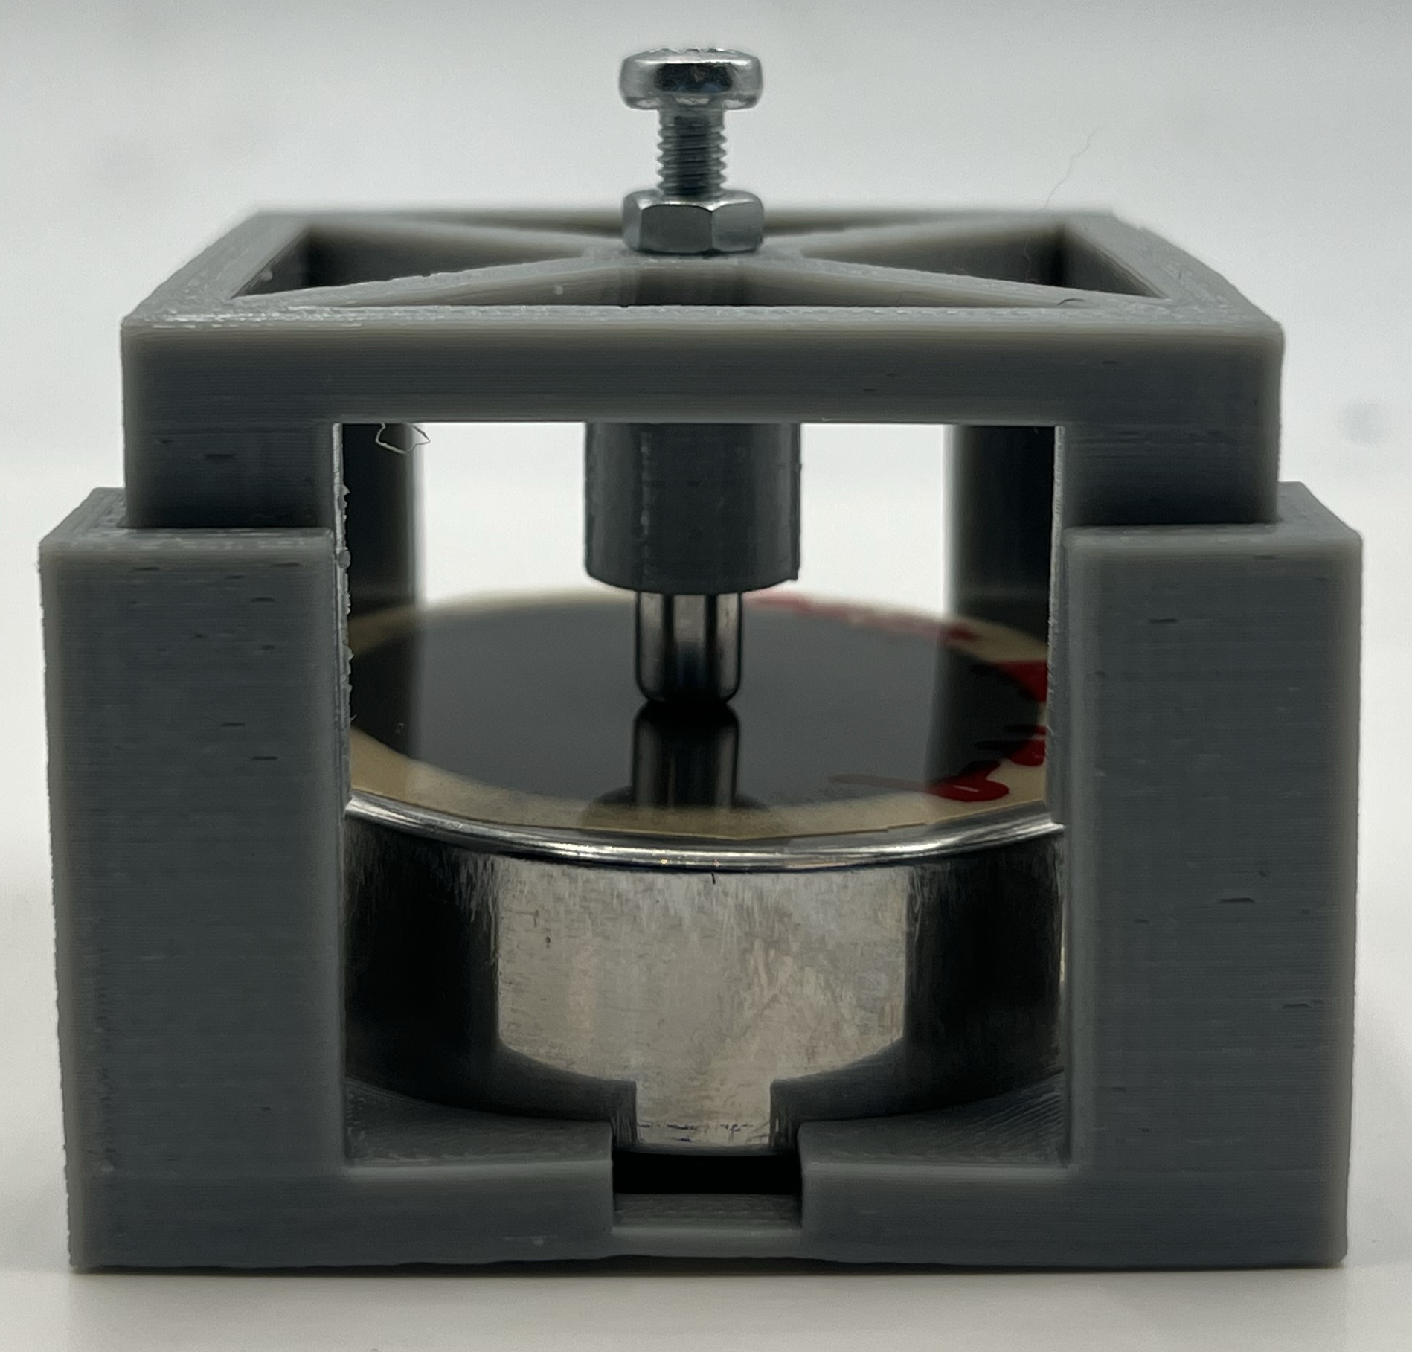
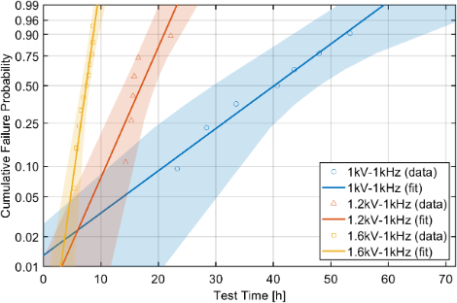

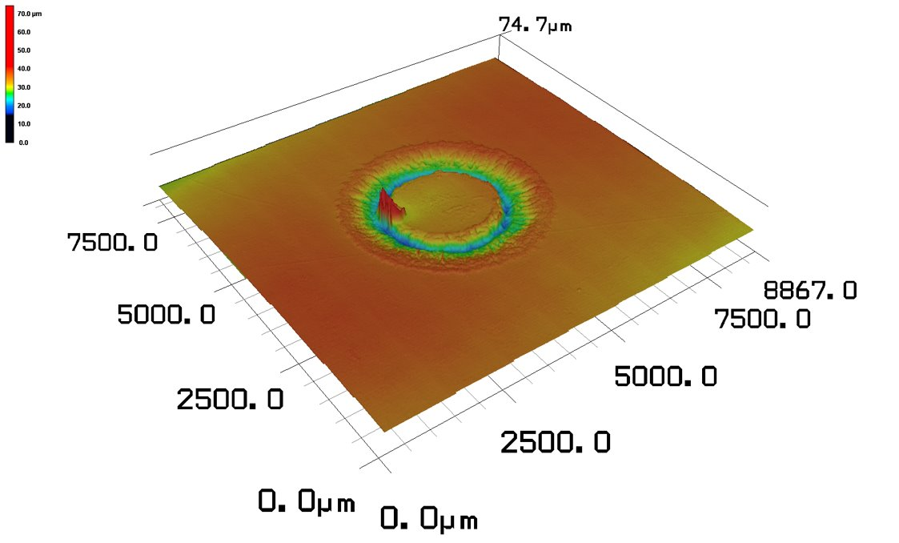
Purpose: Analyse the lifetime of insulation systems at HV
(following IEC 61252, IEC 60674, IEC 62539)
Sample Type: Insulation film/sheet, Enamelled wire
Test Method: Generally testing up to 10 samples in parallel (depending on capacitance), our electrical endurance tests allow the time to failure of components to be measured when they are stressed with HV. Leakage current monitoring is used to highlight any specific degradation that takes place during the test. Testing can take a few hours through to a few weeks / months depending on the nature of acceleration applied to the sample. This test can be applied at different source conditions (voltages, frequencies, waveforms), and environments (temperature, pressure).
Test Outcome: Our testing reveals the lifetime of insulation materials — the period they can reliably withstand repeated PD before failure — giving our partners the confidence to design for safety, performance, and durability.
Electrical Endurance Testing

Slide 16
Purpose: This test is used to determine the weight loss from a wire specimen when subjected to vacuum and temperature. Some preconditioning might be required.
Sample Type:
Test Method: Operation should be submitted to temperature and vacuum to reach 44.4 mbar or lower and a specific temperature up to 250 ° C.
Test Outcome:
Weight Loss Under Temperature and Vacuum Testing

Slide 17
Purpose: This test determines the ability of the insulation to resist degradation due to exposure to a high temperature.
Sample Type: Stators, motorettes, insulation paper, insulated wires.
Test Method: Test sample shall consist of one continuous length of at least 24 feet (for inside the oven) and an additional length to attach to the current source outside the test oven.
Test Outcome:
High Temperature Endurance Testing

Slide 18
Purpose: Used to evaluate the corrosion resistance of materials or surface coatings via exposure to concentrated salt fog.
Sample Type: Insulated cables, coated wires, connectors and couplings that are likely to face corrosive environments
Test Method: aHV salt fog tests are in accordance with EN60068-2-11:1999. Exposure periods vary but are at a minimum 24 hours long.
Test Outcome: Results can determine failure mechanisms of components (such as cracks forming in the insulation), suitability of components in potentially corrosive environments and provide an estimation of the products lifetime.
Salt Fog Testing

Slide 19
Purpose: To ensure liquid coolant / insulation systems are fully compatible with electrical system. Testing is more representative than traditional oil submersion tests
Sample Type: Bespoke designed Sub-sections of stator cores (motorettes / formettes) to represent complete, liquid cooled, insulation system.
Test Method: Machine winding wires are joule heated to c. 250C and passed with temperature-controlled oil <150C for a specified duration.
Test Outcome: Initial, periodic and Final electrical diagnostic testing helps determine if degradation beyond specified limits has occured
Insert photo of test rig
Insert graph of temperature cycling
Oil Flow Testing

Slide 20
Purpose: Understanding of sample performance in application given material properties of the insulation.
Sample Type: Wire or sheet of insulation
Test Method: Wire samples are potted in epoxy and polished to give a cross section of sample. A microscope can then be used to determine conductor and insulation dimensions. Micrometers are used to measure sheets of insulation material.
Test Outcome: Measurements of insulation thickness.
Insulation Dimensional Measurements Testing

Slide 21
Purpose:
Sample Type:
Test Method: Vibration shaker capable of sinewave or random testing. Generally used as stand-alone system following thermal ageing testing of insulation as part of lifetime analysis campaign.
Test Outcome:
Shaker Testing

Slide 22
Purpose: This test is to be used to measure or calculate the DC resistance per unit length of a conductor at 20 °C (68 °F).
Sample Type: cable sections representative of the intended application.
Test Method: the test is conducted using the 4-wire method, where two wires supply the current and the other two measure the voltage drop across the cable section
Test Outcome: provides DC resistance measurement and confirms whether the resistance is within the expected limits (especially after any form of aging mechanisms)
Conductor Resistance Testing

Slide 23
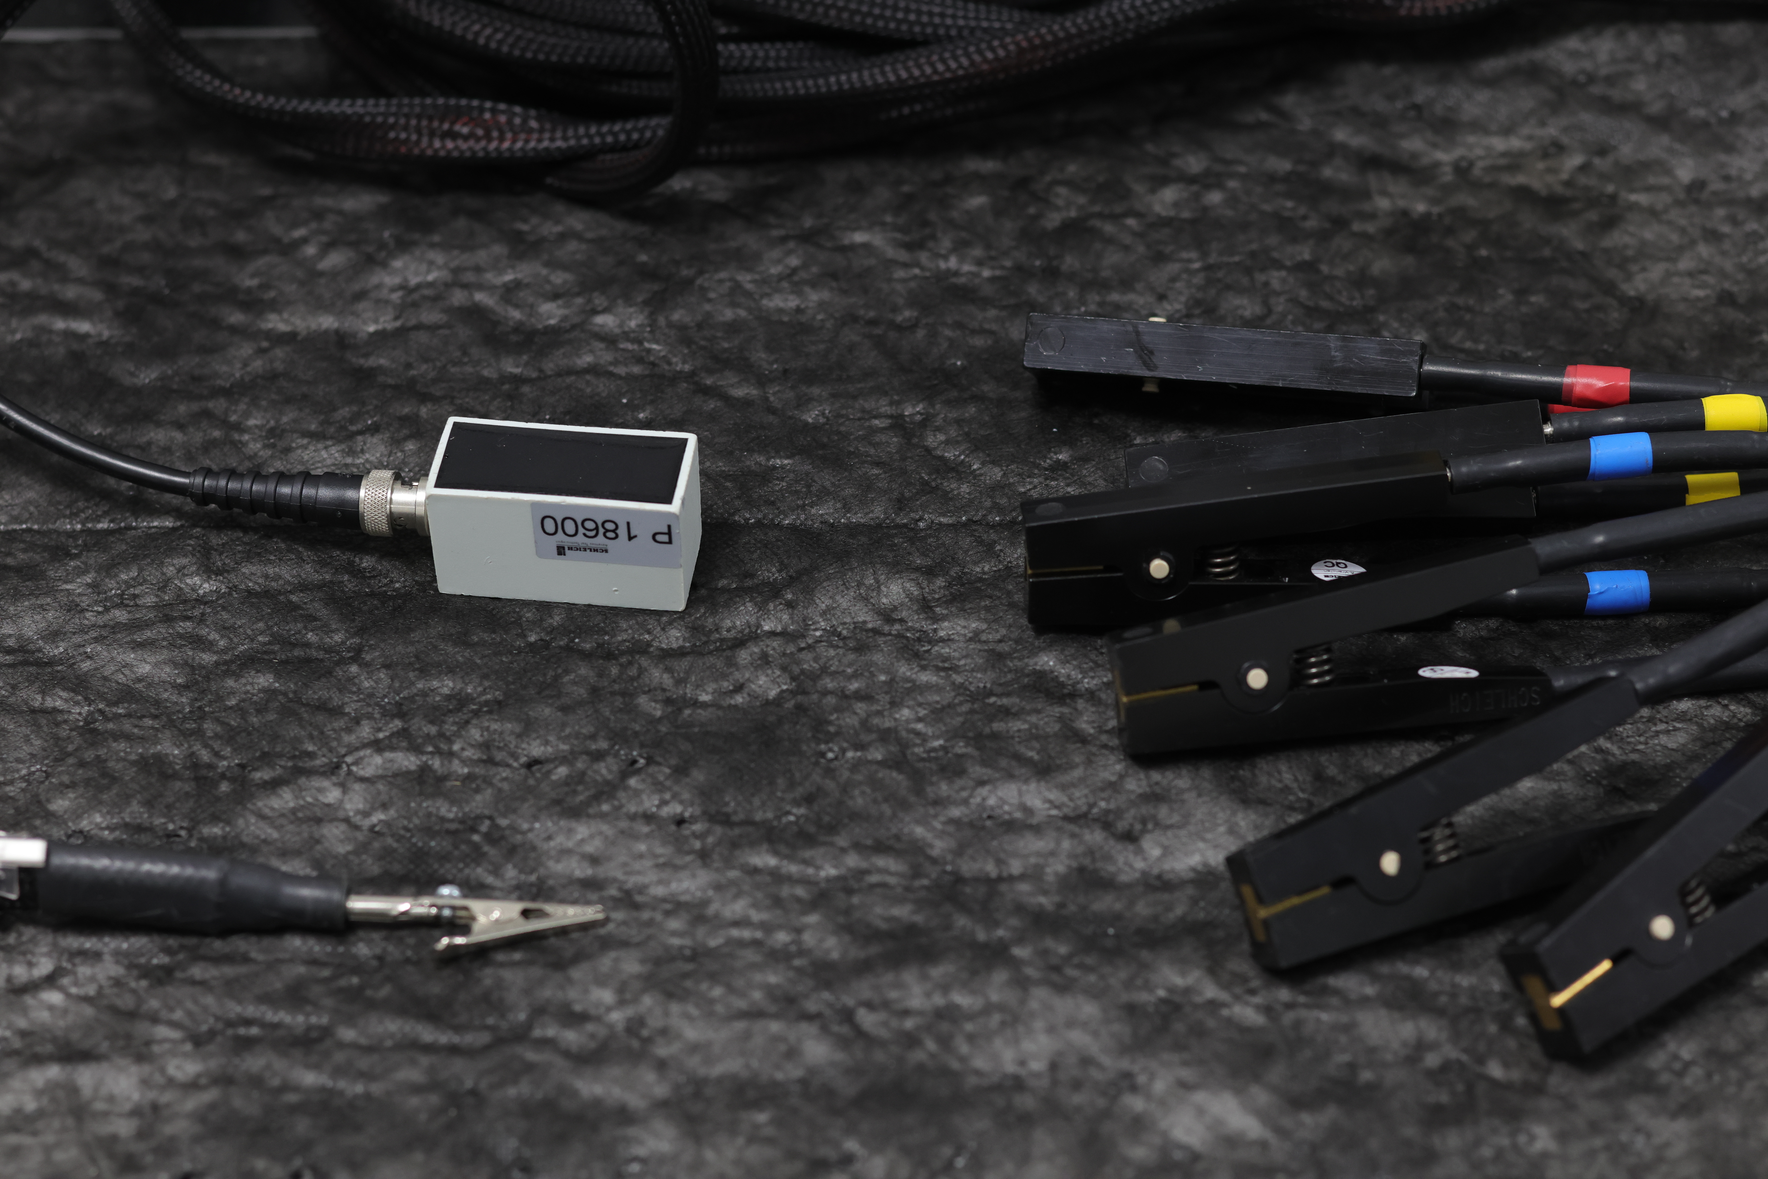
Purpose: To test for partial discharge when the connections of the sample have continuity between each other.
Sample Type: Samples with continuity between test points. Typically, devices in the star topology.
Test Method: A fast fronted waveform is injected into the test sample. Using a set level, the charge from any partial discharge is measured and determined to be noise or PD. A number of shots (usually 10) are injected into the sample. RPDIV and RPDEV are determined when 50% of the shots show PD events or not respectively. PDIV and PDEV are noted when PD first and last occurs.
Test Outcome: The values for PDIV, RPDIV, RPDEV and PDEV are outputted at the end of each test. Parameters for the outputs can be assigned so that the test can run in a pass/fail capacity.
Surge (Schleich) Testing

