Slide 1
Full Circle 360 Turbine
Solutions Limited
Welcomes the opportunity to present our profile
To
XXXXXXXXXX

Slide 2

Full Circle 360 Turbine Solutions Limited
July
2025
Contact Person
Denis McGrath
Managing Director
Phone
+353 25 86207
+353 87 6209665

Slide 3
Statute of the Company
360 Turbine Solutions is a Limited company registered and incorporated in Ireland under Company Registration number 760364.
360 Turbine Solutions Limited trades under the trade name 360 Turbines

Slide 4
360 Turbines
Vision Statement
The vision of 360 Turbines is to be the preferred provider of high quality services to the Oil, Gas and Power generation industry.
Our commitment to our customer is to deliver excellent services with integrity in a legal, ethical and with environmental considerations.
We strive to use local labour directed by our specialist engineers and managers bring value and knowledge to the local economy

Slide 5
360 Turbines: Company Leadership
Denis McGrath, Managing Director :
35 years of experience across a number of different industries.
Results driven managing approach
Lean six sigma black belt, proven professional
He has a dynamic and driven personality making business relationships seamless and transparent.
Brings his industrious experience to give 360 Turbines a competitive advantage over the competition;
  Worked with the hot section repair business for many years
  Formed good business relationships
  Partnered with the world’s most experienced turbine operators.
  Harnessing the use of local expertise adding value and knowledge to the local economy

Slide 6
360 Turbines: Company Affiliates
Maintenance Partners – Belgium
Bogerhaus Engineering Limited - Ghana
Turbine Technology Services (TTS) for construction in USA and South America
AMANA International Consulting and Business Development Renewable Energy and Business Development in the Middle-East and Africa.
Euroturbine (Netherlands) hot section component manufacture and supply
Mitsubishi Heavy Industries – turbine overhaul and rotor repair. (Hitachi, Pratt & Whitney)
MTU On Site Energy

Slide 7
360 Turbines; Clients
Advanced Turbine Solutions
ALBA
Allied Power Group
Alstom
Ansaldo Thomassen
ATC Oil & Gas
BHEL (India)
Combustion Parts Inc
Corrtech
Chromalloy
Dresser Rand
DEWA
Eiffel Industries (France)
GDF SUEZ
GECOL
H-Int
Maintenance Partners
Masood John Brown (UAE)
Mitsubishi (Japan)
NDPHC (Nigeria)
Nigeria Agip Oil Company (NAOC)
National Thermal Power Corporation
Petroleum Development Oman
ProEnergy
Reliance (India)
SEWA (UAE)
Standard Aero
Sulzer
Thomassen Middle East
Turbine & Parts Solutions Inc
Turbocare
Wabash Power
Wamar
Wood Group GTS

Slide 8

Our Partner in Generator and Compressor Rehabilitation

Slide 9
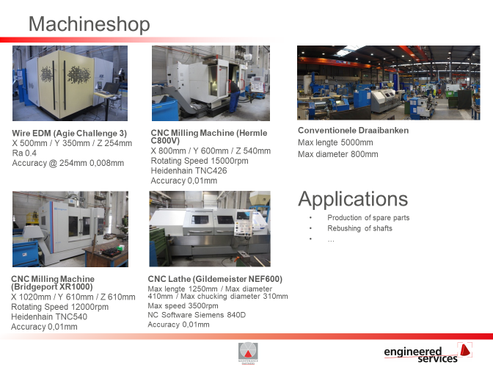
Maintenance Partners Shop
Capabilities include reverse engineering of obsolete parts and design improvement where required

Slide 10
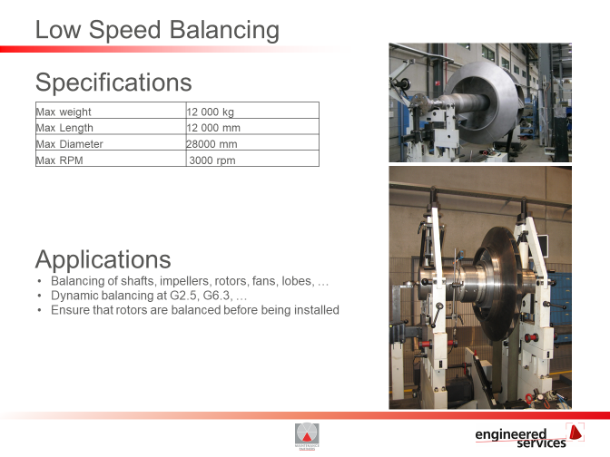
Maintenance Partners Rotor Repair/Overhaul
Full capability to refurbish all makes of rotors, Compressors. Turbines and generators all carried out in house

Slide 11
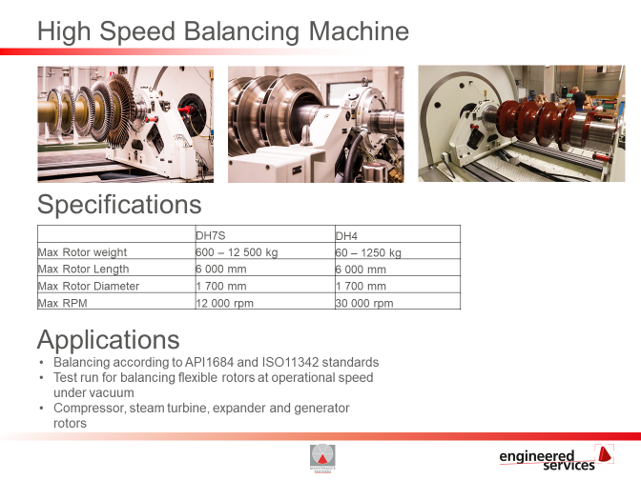
Maintenance Partners Balancing Capability
One of the few facilities in Europe to have high and low speed balancing under one roof

Slide 12
360 Turbines: Company Activities
Offer The ultimate “One Stop Shop” in full turnkey new power plants PROJECT, Operation and Maintenance, refurbishment of all elements of power plants, and in gas turbine relocation and decommissioning
Whether it is 5MW or 5,000MW you require , 360 Turbines and its associated companies has the ability and expertise to meet and exceed your requirements and expectations.
Offer Complete package includes:
  Project Management, Engineering, Procurement and Sourcing, both new and decommissioned turbines, Transportation, Erection, O&M, and training.
360 Turbines has global presence in offices in Ireland, Egypt, Bahrain, Dubai, Saudi Arabia, The Americas, Canada, Nigeria, India, Jordan, UAE, China, and the UK and still growing.

Slide 13
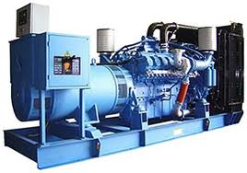
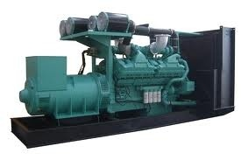
Reciprocating Power Solutions

Slide 14
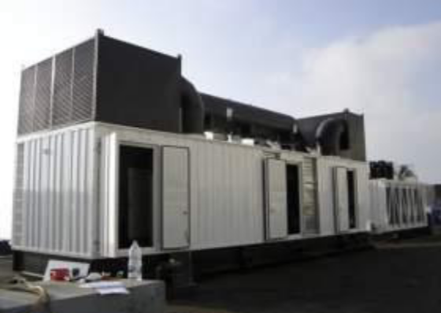
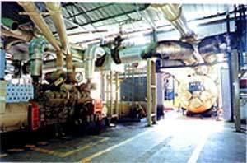
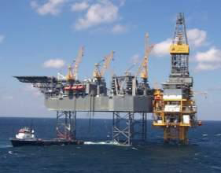
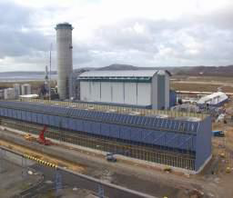
Power Solutions
Stationary Power
Co-Generation
Applications
The perfect solution for every type of diesel power generation application
Oil and Gas
Standby

Slide 15
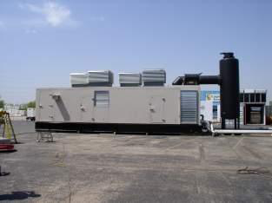
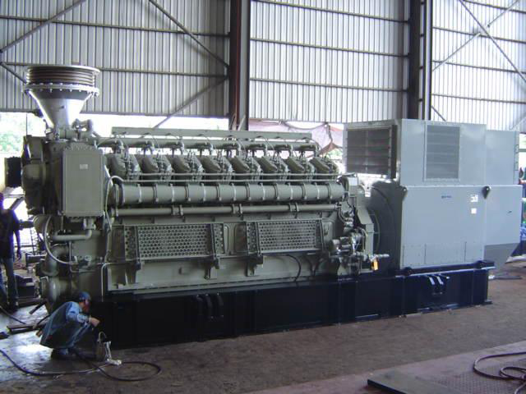
Genset Types
Solutions for every type of operating need and environment
Enclosed
Skid Mounted
Official Representative
agreement with
Mitsubishi
Contained self-sufficient unit
Skid Mounted Genset
Robust design for extreme environments
Varying scope of supply based on customer needs
Flexible designs that can operate in any environment

Slide 16
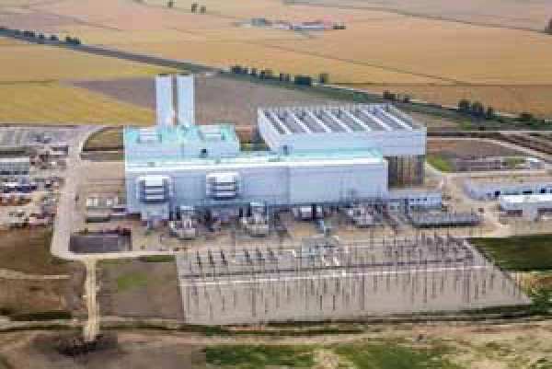
Typical Frame 9E Site Installation

Slide 17
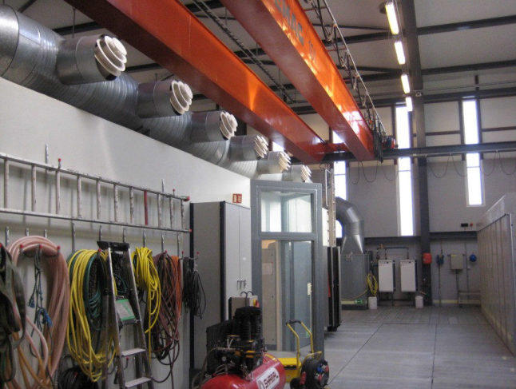
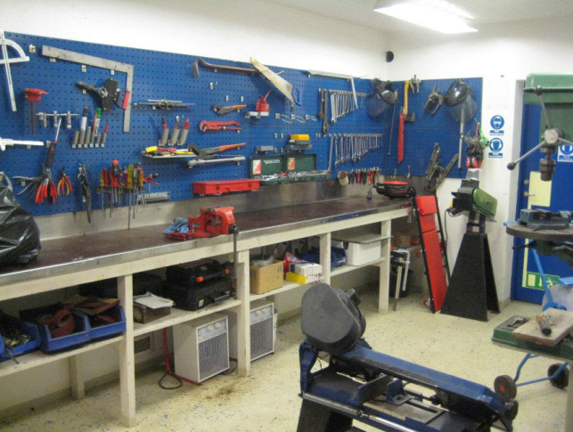
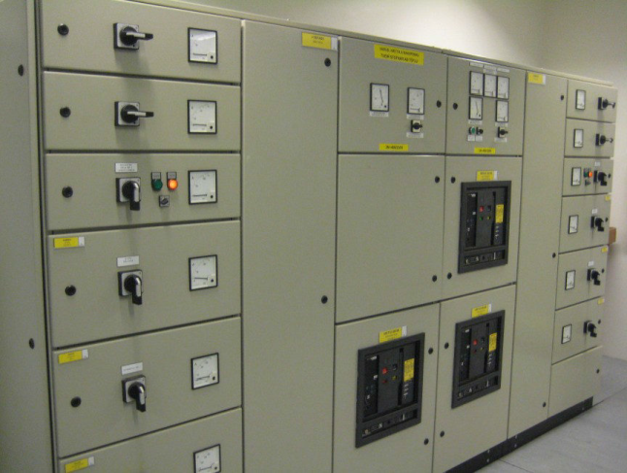
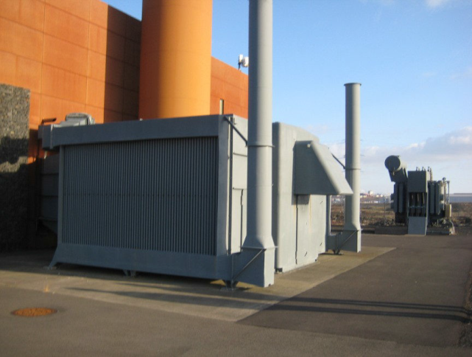
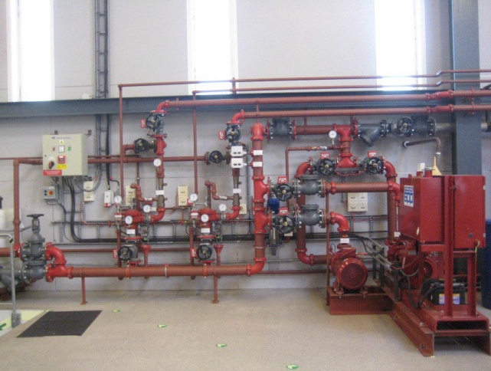
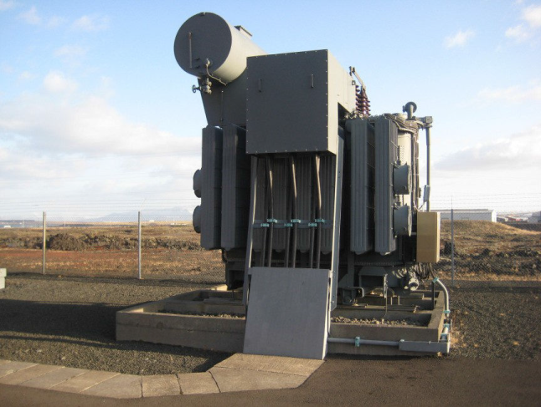
Provide Complete Power Plant Installation
Maintenance Room
Workshop
Main Switchboard
Air Intake
Safety System
Power Transformer

Slide 18
360 Turbines
Supply of overhaul services
Supply of replacement turbines
Supply of Performance Testing
Supply of replacement components
Supply of consultancy services
Supply of supervision services
Supply of temporary mobile power units

Slide 19
Supply of Overhaul Services
360 Turbines supplies the full range of overhaul services to bring aging fleets back to optimum output
In our inventory a number of Turbines are available that can be quickly installed and commissioned.
Provides experienced personnel who can be mobilized at very short notice

Slide 20
Your “One Stop Shop” Power Provider
Prepare and review project concepts and general information to determine project feasibility .
Prepare site selection studies to determine optimum plant locations.
Provide fuel supply studies to determine optimal source and type of fuel or blend.
Provide transmission system and relay studies to determine the interconnection of equipment and software for integration of a generating project into an existing network.
Provide water supply studies to establish cooling water sources and necessary treatment for boiler and turbine requirement.

Slide 21
Your “One Stop Shop” Power Provider
Provide engineering consultations, advice and assistance to the client in negotiations and drafting contracts & agreements for power supply and energy delivery.
Assist in preparing business case & financial analysis and forecasts.
Prepare/coordinate all project development and planning activities, engineering design, cost estimates, schedules, cash flow analysis and total project plan..
Provide turnkey construction services, Supervision and coordination of construction activities, field engineering services, field inspections, construction progress reports, utility interfacing and grid impact studies.
Provide complete Operations and Maintenance Services including spare parts, control hardware and software back-up.
Design and implement Scada systems to allow “On Line” support of engineers to the project personnel on all plant capabilities?

Slide 22
LTSA Model
The starting point for figuring out the recommended maintenance intervals for any site is to start with assuming a base loaded unit running 8,000 hours per year and with no “extendor” components. For these unit the recommended intervals are
8,000 hours: Combustion Inspection.
16,000 hours: Combustion Inspection.
24,000 hours: Hot Gas Path Inspection
32,000 hours: Combustion Inspection
40,000 hours: Combustion Inspection
48,000 hours: Major Inspection

Slide 23
What we provide
360 Turbines and associate companies have many years of experience
We can provide full turnkey projects including civil work
We can provide full overhaul services
We provide supervision utilizing and overseeing local labour

Slide 24
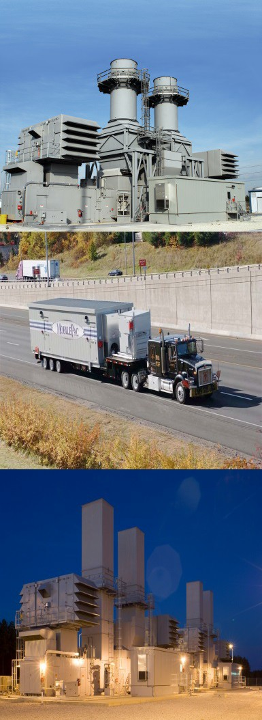
Temporary Power Solutions
FT8 MOBILEPAC
Capable of operating on gas or liquid fuels at 60 Hz or 50
ISO base rating –
  @50Hz 30,500 (KW)
  @60HZ 30,941 (KW)
Efficiency –
  @50Hz 36.4%
  @60Hz 36.7%

Slide 25
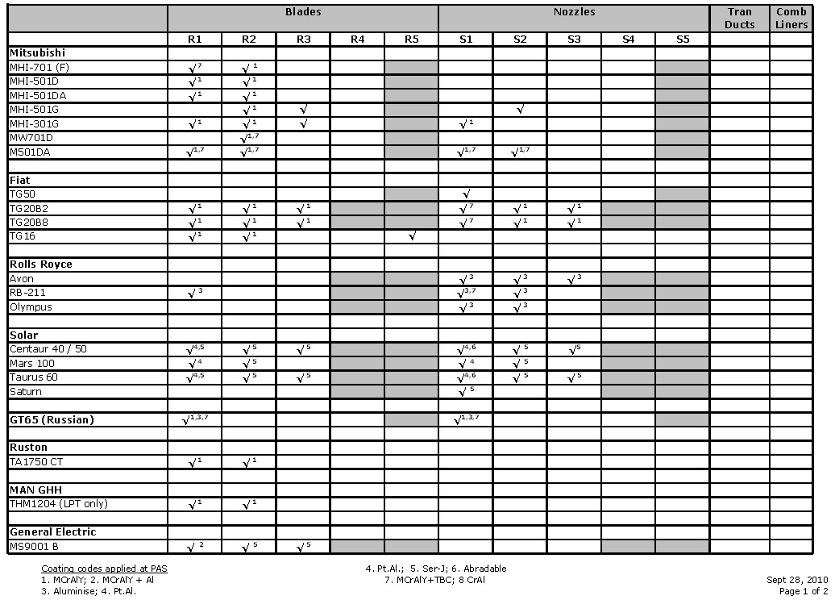
Hot Section Repair Capability

Slide 26
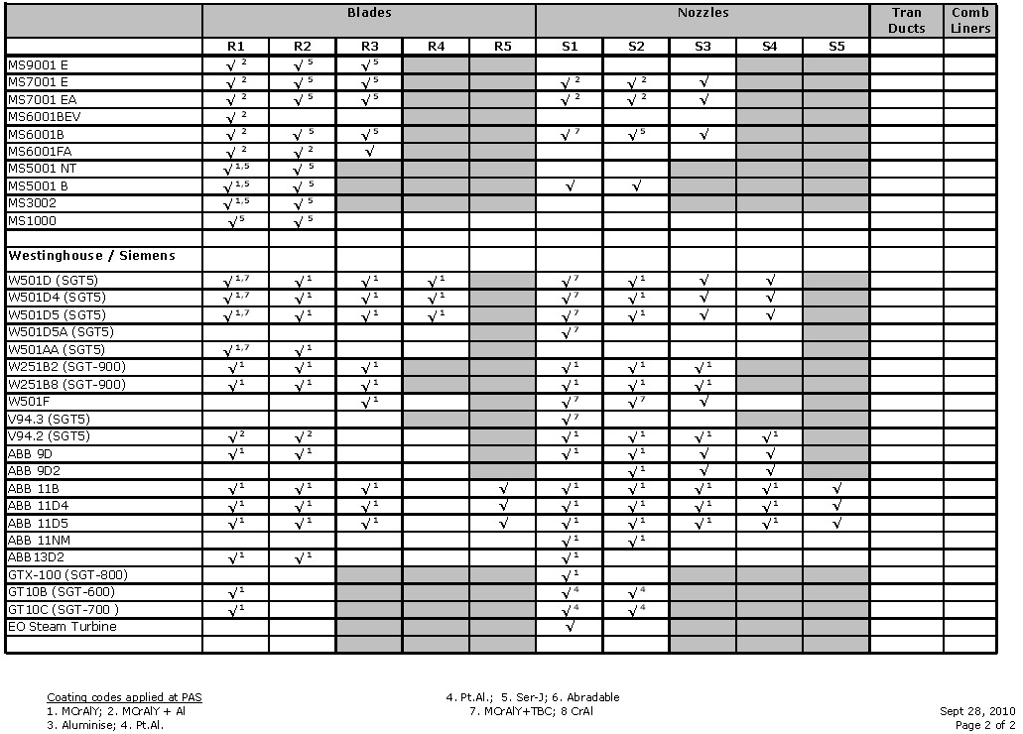
Hot Section Repair Capability Contd.

Slide 27
EXPERIENCE IN AFRICA
Supply of Combustion Hardware for GE Frame 9E
Supply of Combustion Hardware for GE Frame 6B
Supply of Combustion Hardware for GE Frame 5P
Supply of Speedtronic Mark V & VIE electronic cards and components
Supply of Air Filtration and Oil Mist Eliminators Filters and Components
Supply of all various instrumentation devices on GE gas turbines
Technical Direction on Outages for GE Frame 9E
Manpower Support for Outages for GE Frame 9E
Electrical & Generator Testing for Alstom & Brush Generators
Repair and refurbishment of Combustion Hardware for GE Gas Turbines

Slide 28
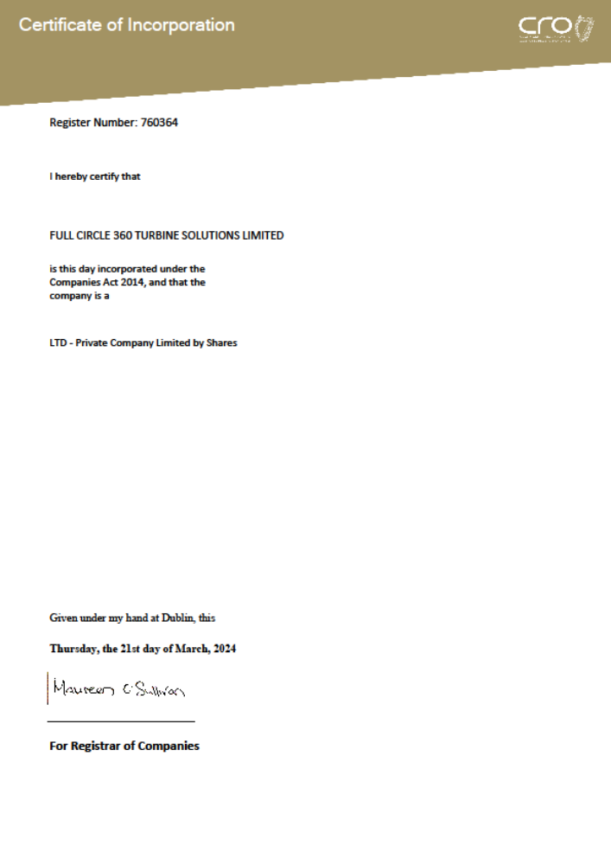
Certificate of Incorporation

Slide 29
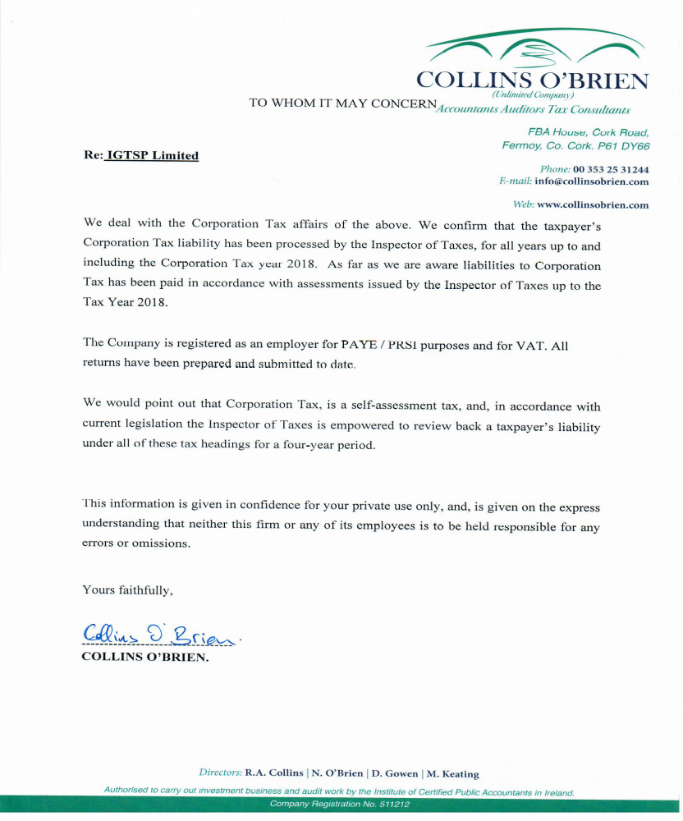
Auditors Reference

Slide 30
Contacts
Denis McGrath
Managing Director 360 Turbines
Email: dmcgrath@360turbines.com
Web: www.360turbines.com
Tel Work: +353 25 86207
Tel Mobile: +353 87 6209665
Walid Nassar
Saudi Arabia Director of Operations
T:+966 55 336 6472
Email: walid@360turbines.com
Bidemi Saliu
360 Turbines Nigeria
Admin & HR Manager
Suite 101
MIDEL Centre
Off Oladipo Diya Way
Gudu District
Abuja- FCT
T: +234 8147810504
turbinesng@360turbines.com
Jordan Office
Mohammed Obeidallah
mohamad@amanaicbd.com
+962 795252463
Post Code 11195
PO Box 17662
Building 12
Um Uthayna
Amman,HKJ
Iraq Office
Dr. Saad Abdulrazak Noaman
Commercial Director
+ 964 7807953253
Street 69
Zone 913
Aljadriya
Bagdad,
Iraq
Ponniah Kanapathipillai
Malaysia Office
Technical Director
Turbine Global Parts & Service
6277, Taman Kg. Gelam
71000 Port Dickson
Negeri Sembilan
T: +60 12 399 9974
turbineglobal@gmail.com

