Slide 1
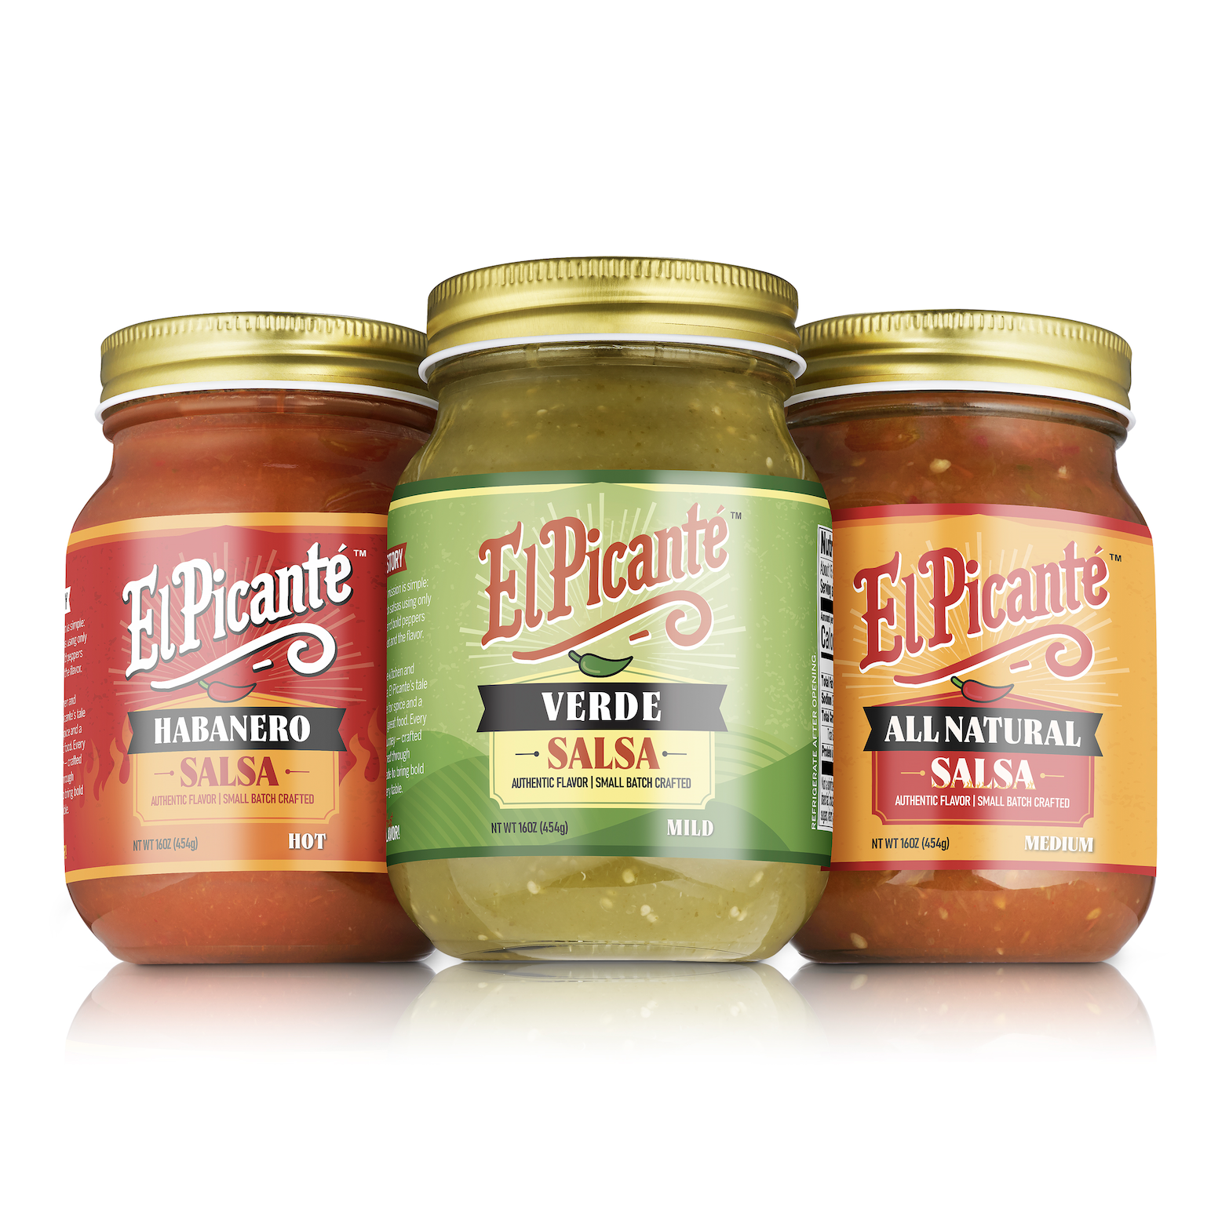
El Picante – The Story Behind the Spice
Born from a lifelong love of bold, real flavor
Founder Scot Reinke’s vision: Authentic, Tex-Mex salsa done right
Handcrafted in Texas using small-batch methods
Family-owned and operated with pride
Clean ingredients, deep flavor — no shortcuts

Slide 2
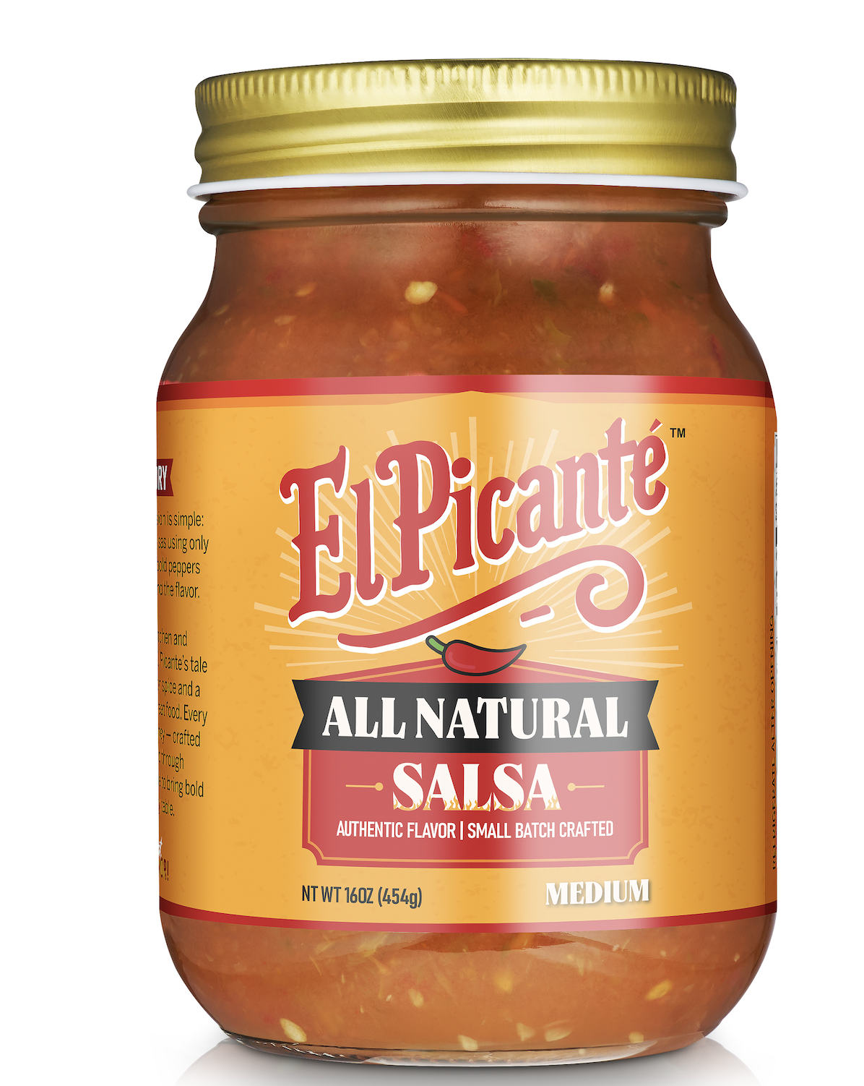
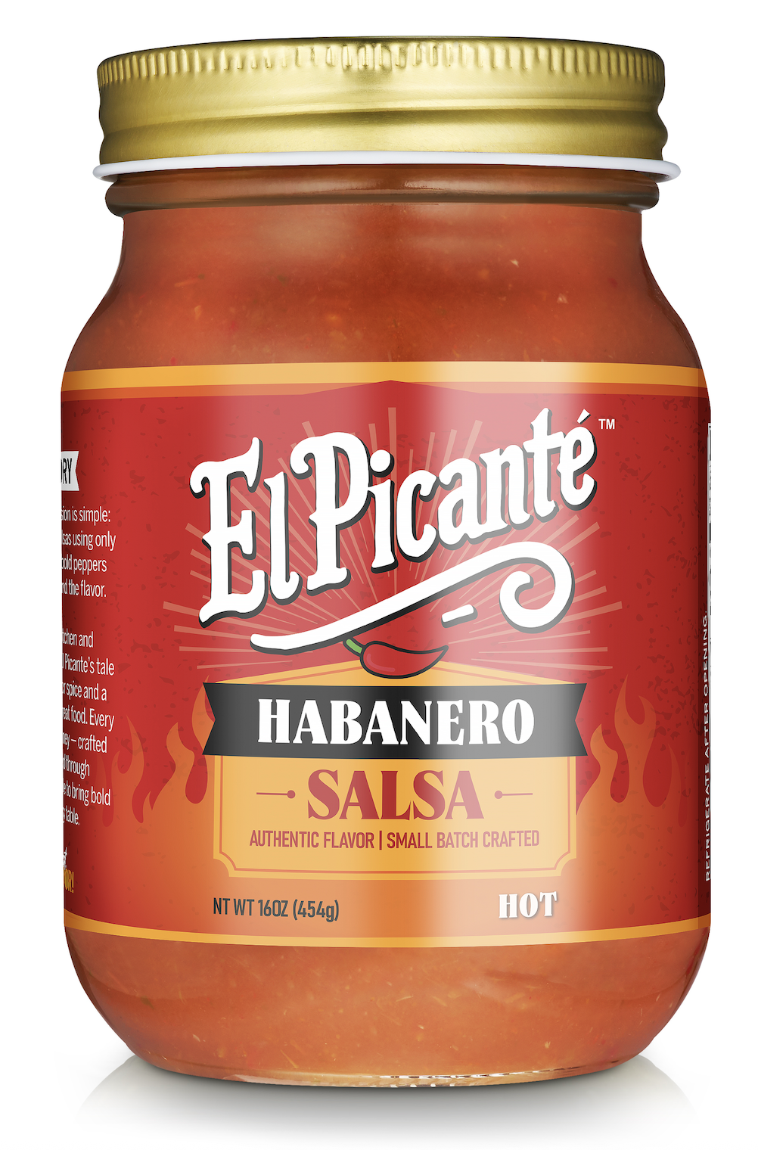
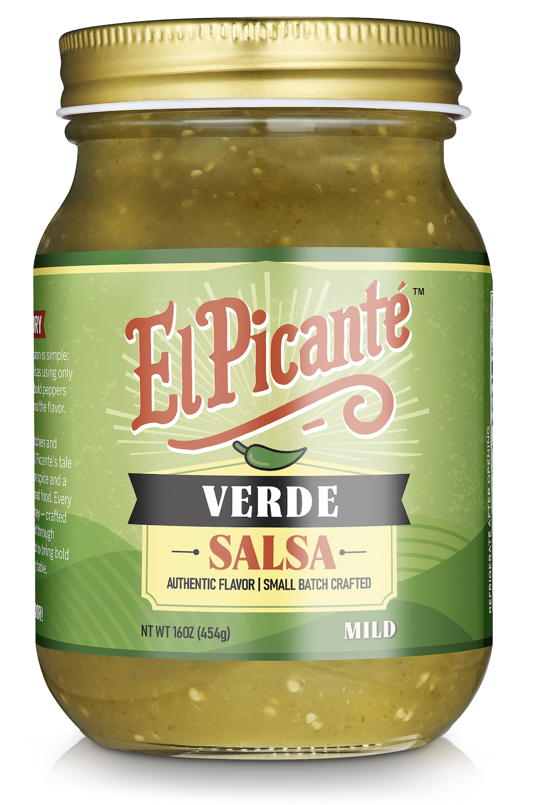
El Picante Product Line
Bold Flavor in Every Jar
All Natural
Habanero
Verde
Mild–Medium Heat
Balanced tomato, poblano, jalapeño
Hot & Bold
Intense serrano heat layered with bright habanero flavor
Tangy & Fresh
Tomatillo, jalapeño, bell pepper
Shelf-stable, clean label
Shelf-stable, clean label
Shelf-stable, clean label

Slide 3



Packaging and Shelf Life
Jar Size: 16 oz (glass jar with tamper-evident lid)
Case Pack: 6 jars per case
Shelf Life: 12-18 months (ambient storage)
Case Dimensions: 10” L x 8” W x 4.5” H
UPC Codes: Unique per variety
Habanero
All Natural
Verde

Slide 4
Pricing and Order Information
Retail Pricing Tiers:
El Picante delivers clean-label, bold-flavored salsa that stands out on the shelf—without compromising retailer margins. Each product is packed in 6-jar cases (16 oz jars) and priced to offer strong value and solid profitability.
Product Flavor | Case Size | MSRP (Per Jar) | Wholesale Price (Delivered)
All Natural (Medium) | 6 × 16 oz | $4.49 | $18.84 ($18.24 Pickup)
Habanero (Hot) | 6 × 16 oz | $4.49 | $18.84 ($18.24 Pickup)
Verde (Mild) | 6 × 16 oz | $4.49 | $18.84 ($18.24 Pickup)
• 1–10 cases: $18.84 per case
• 11–50 cases: $18.28 per case (3% discount)
• 51+ cases: $17.90 per case (5% discount)
Estimated Retail Margin: ~30% at $4.49 MSRP
El Picante is competitively priced to move, with premium positioning that supports confident shelf placement and repeat purchase velocity.”

Slide 5
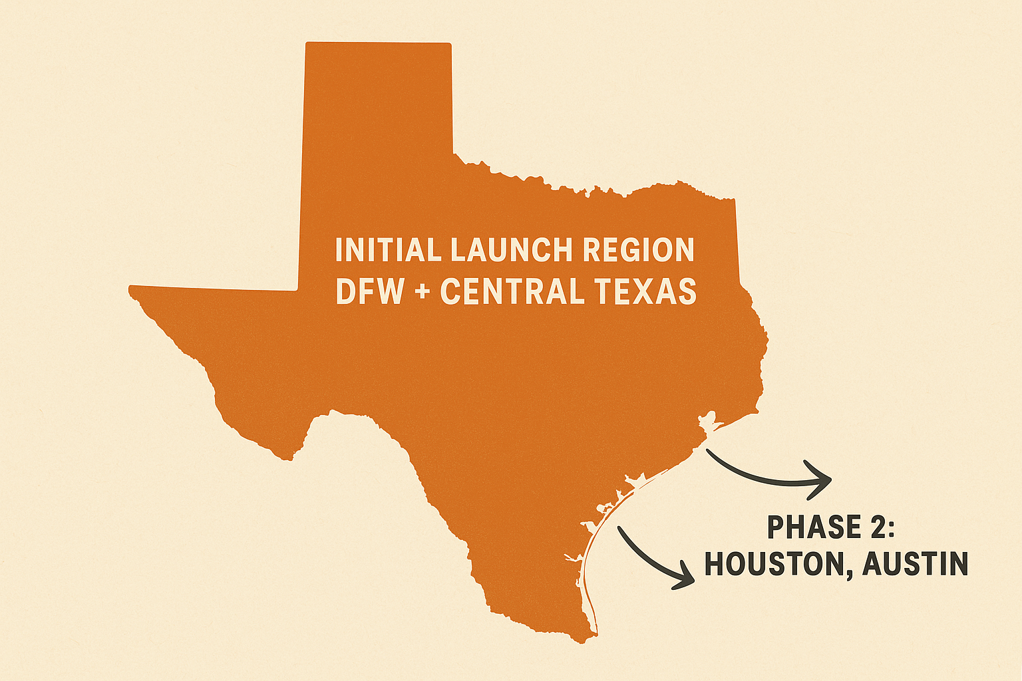

Distribution and Availability
Coming soon to North Texas
Co-packer: Waco Bottling Company (Texas-based)
Delivery: Freight terms available state-wide
Inventory: Ready to support 4,000+ units per batch
Reorders: Triggered when 2-month supply runs low

Slide 6
Marketing and Promotion Plan
Demo Schedule & Budget
  • In-store sampling rollout begins Fall 2025
  • Targeting top-performing locations for weekend demos
  • Budget: $3,500 allocated over first 6 months
Local Marketing Campaigns
  • Social media campaigns with geo-targeted ads (DFW focus)
  • Paid influencer partnerships with local food accounts
  • Branded content: Reels, unboxing, taste test videos
In-Store Promo Support
  • Branded shelf signage and limited-time coupons
  • El Picante table tents and “Try Me” displays
  • Retail-hosted tasting events & product education
Food Blogger Partnerships & Giveaways
  • Collaborations with top regional food bloggers
  • Monthly giveaways (Instagram, Facebook)
  • Cross-promotion with local foodie pages

Slide 7
Social Proof and Brand Momentum
Instagram Engagement
  • Handle @elpicantesalsa
  • Growing following with high engagement on reels & stories
Giveaways and Instagram Mentions
  • Collaborative giveaways with local food bloggers
  • Tagged by DFW influencers with 10K–130K followers
  • Shared by foodie accounts and loyal customers
Consumer Feedback
  • Blind taste testing earned 4.2 out of 5 stars
  • 80% of participants said they would buy El Picante at retail
Early Recognition
• Featured in multiple DFW foodie stories and comments
• Building grassroots support through local collaborations

Slide 8

The Founder
Scot Reinke, Founder & CEO
With a background in senior corporate leadership and a lifelong love for bold flavors, Scot launched El Picante to bring small-batch, high-quality salsa to local Texas shelves. His hands-on approach—from recipe testing to retailer relationships—reflects his passion for the product and the people who enjoy it.
Mission Statement
At El Picante, our mission is to deliver bold, honest flavor using real ingredients and no shortcuts. We believe great salsa should taste homemade, feel authentic, and bring people together—one jar at a time.

Slide 9

Let’s Work Together
Why El Picante Belongs on Your Shelf
  • Bold, authentic Tex-Mex flavor that stands out
  • Clean-label, shelf-stable, and competitively priced
  • Aligned with growing demand for premium local brands
What We Bring to the Table
  • Reliable inventory and responsive service
  • Demo support, marketing partnerships, and flexibility
  • Focused on building long-term retail relationships
Ready to Get Started?
  • Contact: Scot Reinke | sreinke@summit-food.com
  • Website: www.elpicantesalsa.com
  • Scan the QR code for our website

