Slide 1


Turnkey
Renewable Energy Partners

Slide 2


Who are ENER-G Renewable Solutions?
Ener-g Renewable Solutions Limited (ERS) is a family-owned business which has evolved from its founding company Hormell Engineering Limited.
Originally formed in 2004, from then onwards ERS set the pace and chose to focus on providing a unique, turnkey service for the design, supply and installation of ground source systems for numerous projects ranging from prisons, hospitals and schools to exclusive private dwellings.
As a result of its success, it was acquired by the Ener-g Group in 2008. ERS was relaunched in 2019 following the sale of the Ener-g group to Centrica.
Today ERS has grown to become a market leading solar EPC contractor providing turnkey renewable energy solutions for large scale commercial projects including EPC Contracts.

Slide 3
Our People, Our Aims, Our Objectives
O u r Pe o ple
O ur Ai ms
O u r O bj e cti ves
Our management team have over 60 years combined experience and co-ordinate their expertise to provide the technical know how.
IN HOUSE DESIGN TEAM ACCREDITED GEO & PV DESIGNERS AND CAD TECHNICIANS.
NEBOSH, IOSH, & PRINCE2 PROJECT MANAGERS
Enabling us to design a highly efficient and compliant renewable energy systems using the latest industry software.
Our installation team consist of:
NVQ Level 2 Operatives
Mechanical & Electrical Engineers SMSTS & SSSTS Site Managers
CPCS Plant Operators
Qualified First Aiders
INT E G R IT Y
TRANSPARENCY, FAIRNESS AND RESPECT.
INNO V A T I O N
KEEPING UPDATED WITH THE LATEST PRODUCTS, MATERIALS AND METHODS TO DELIVER THE MOST COST EFFECTIVE AND ON TIME SOLUTION.
S U S T A I NA B IL IT Y
WORKING WITH OUR SUPPLY CHAIN AND OPERATIONS TO DELIVER THE MOST SUSTAINABLE SOLUTION POSSIBLE.
S A FE TY
OUR NUMBER ONE PRIORITY
D I VER S I T Y
FOSTERING A CULTURE OF INCLUSION INTO ALL AREAS OF THE BUSINESS
To deliver a highly efficient renewable energy system
Supporting local authorities communities and groups to realise their net zero targets.
Upskilling the generation with renewable energy training.

Slide 4
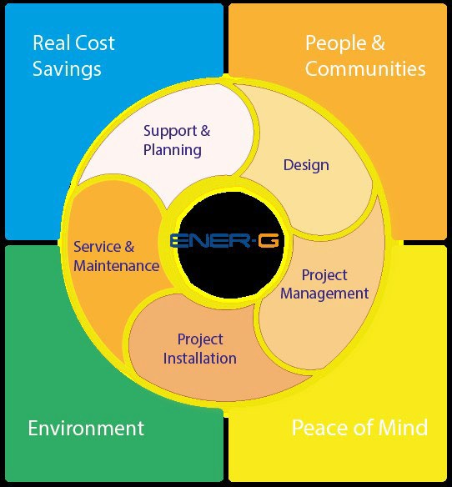

The ERS Turnkey Model
Your project is unique, we would like to make it outstanding
ENER-G is a Solar EPC Contractor. One of the main benefits of using an EPC contractor, is that it can significantly streamline the project process.
Here at ENER-G, experience has told us that this does not go far enough. With over 30 years of experience working with renewable energy projects, we have developed a Turnkey Solution, that from start to finish that has you covered.
Whilst EPC covers the main stages of your solar installation, our Turnkey Solution means you are supported from day one with feasibilty and planning and on project completion we are there with service and maintenance packages. We take responsibility for all aspects of work undertaken, giving you the client not just cost savings but also peace of mind.

Slide 5
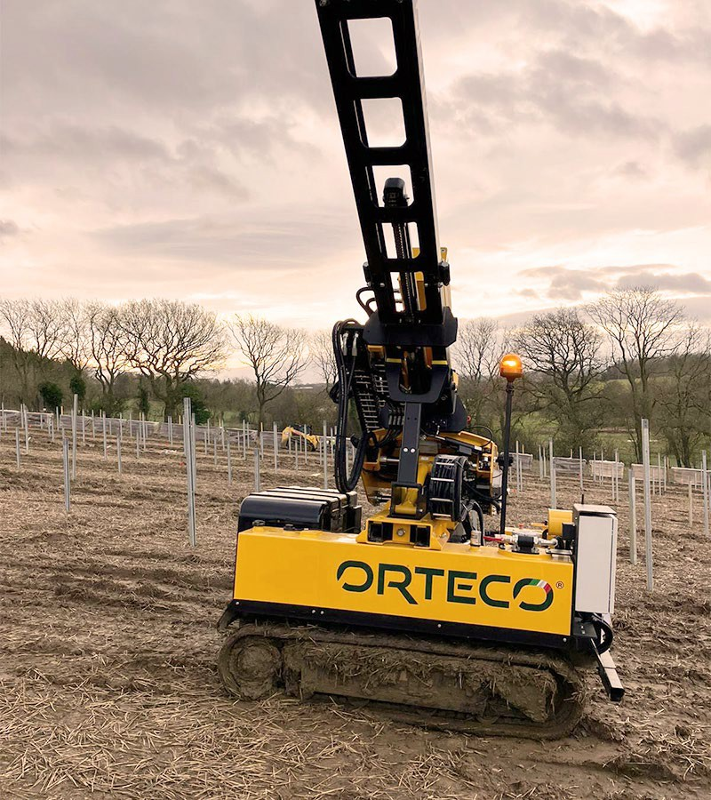
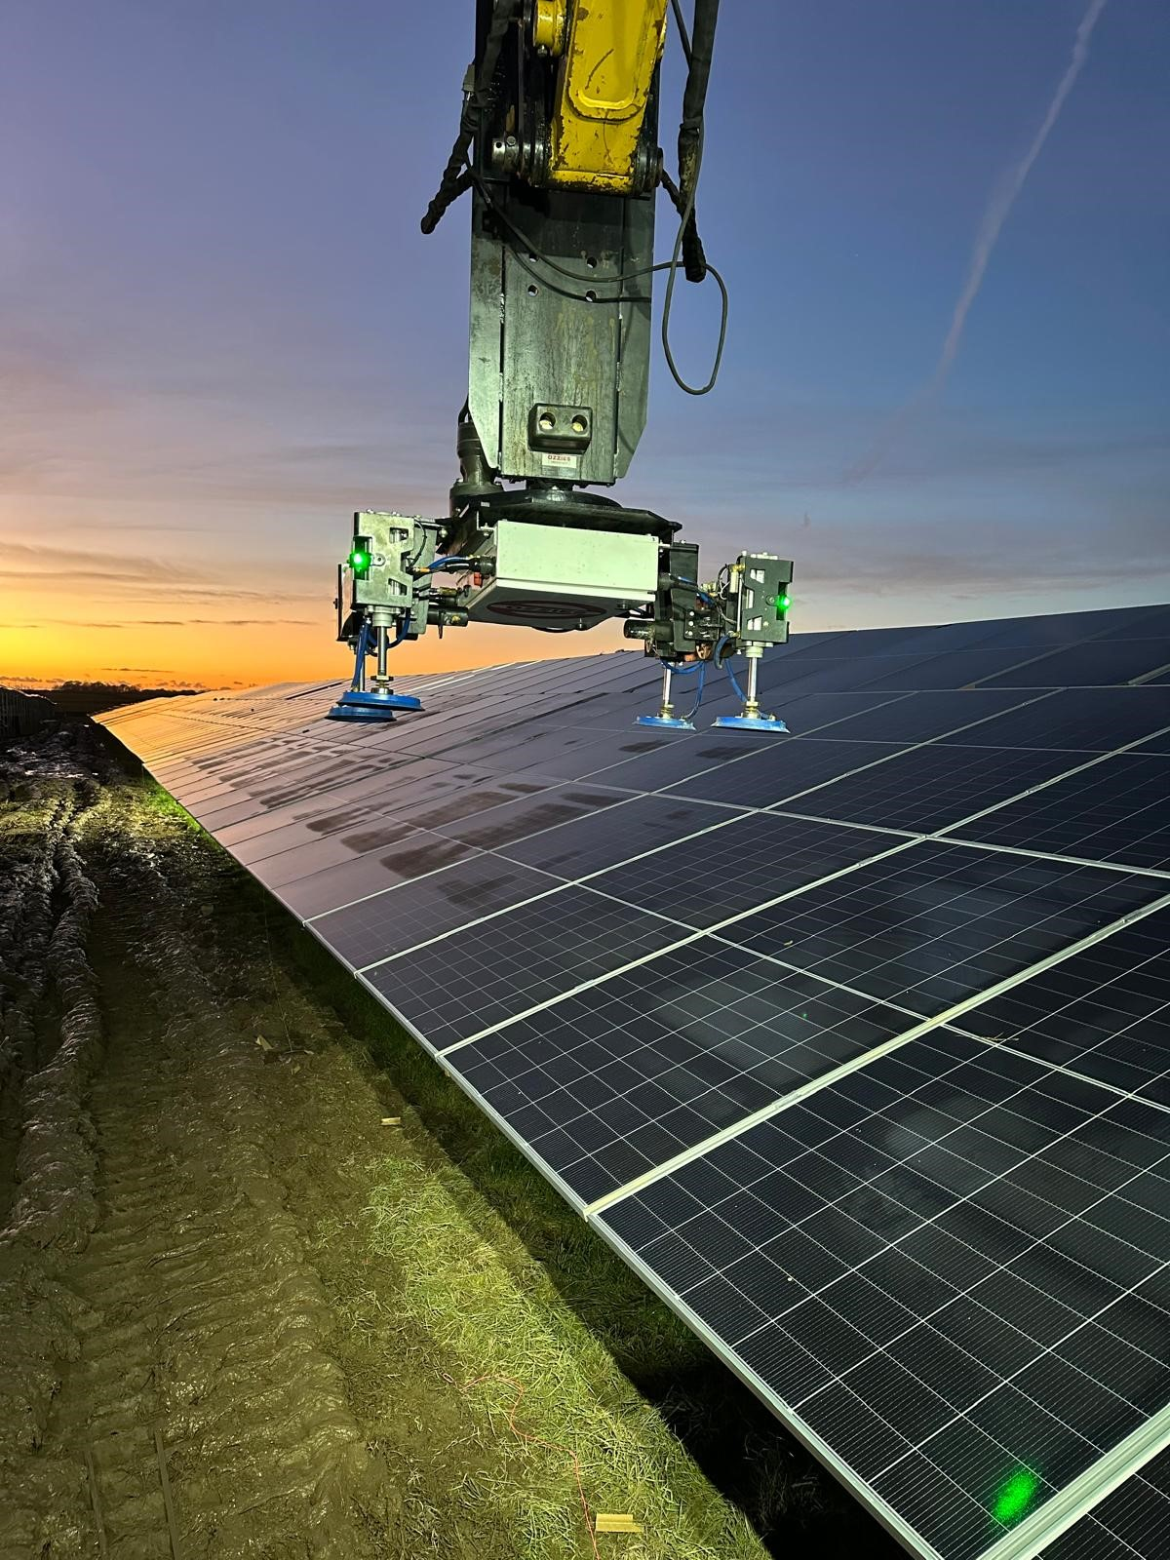
Project Installation
Our people focus approach means we invest in highly trained staff and equip them with the knowledge and expertise to ensure a quality install to the highest industry standards.
Our Plant and Equipment
Our business and the quality of our service depends on our machinery that we own and use.
We commission individually designed equipment tailored to the specific requirements of our business, enabling us to deliver fast, efficient, effective, and clean projects often in challenging locations.
We have invested in the latest solar installation technology available to date.
Our plant portfolio includes:
Solar Plant Piledrivers
Panel – Module Lifters
Panel Rotator
Excavators
Tracked Loaders,
Tractors
Cable Pullers

Slide 6
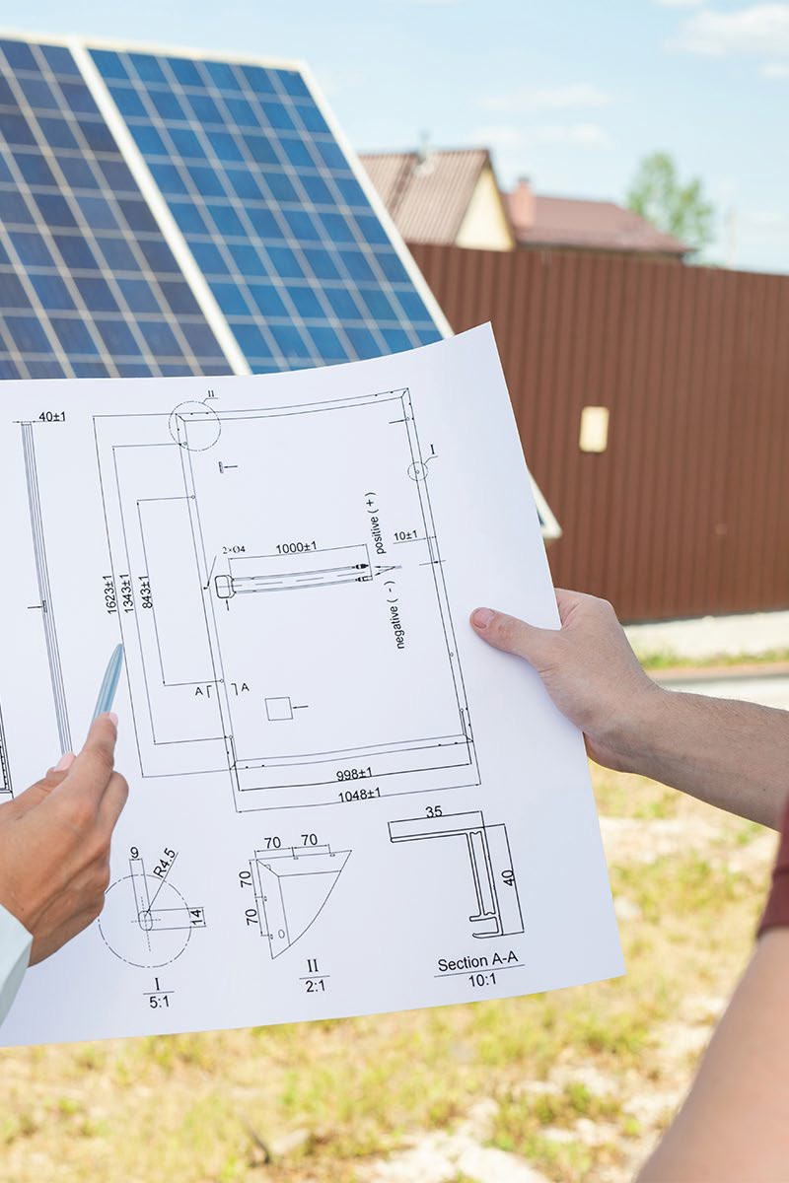
Design
Our in-house design team of certified and accredited designers and Cad technicians enable us to design a highly efficient and compliant system using the latest industry software.
With the information gathered from the planning stage we can provide a bespoke system proposal which offers the versatility to incorporate multiple renewable technologies into an integrated solution giving maximum efficient and cost saving benefits.
Bespoke system design
Site Plans and schematics
Plant room schematics
GNSS location mapping
Drone surveillance

Slide 7
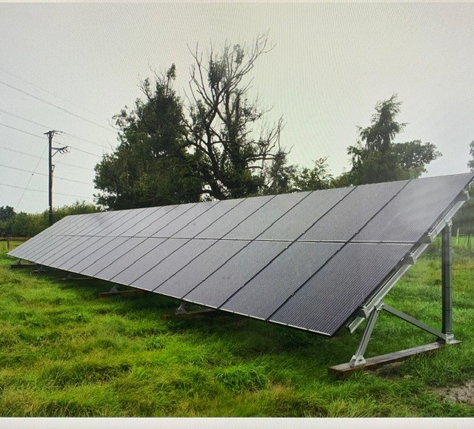

Project Management
Your project is safe in our hands.
ERS will guide your project from its initial conception to successful completion, ensuring that it delivers value throughout the process..
We will accomplish this by proactively identifying and managing risks, optimising our resources and budget, and fostering transparent communication across all teams. This approach ensures not only timely and cost-effective execution but also prioritises safety and excellence in every aspect of our work..
Dedicated Prince 2 Practitioner - Project Managers.
Site management by qualified SMSTS & SSSTS site managers and supervisors.
H&S management – NEBOSH and IOSH

Slide 8
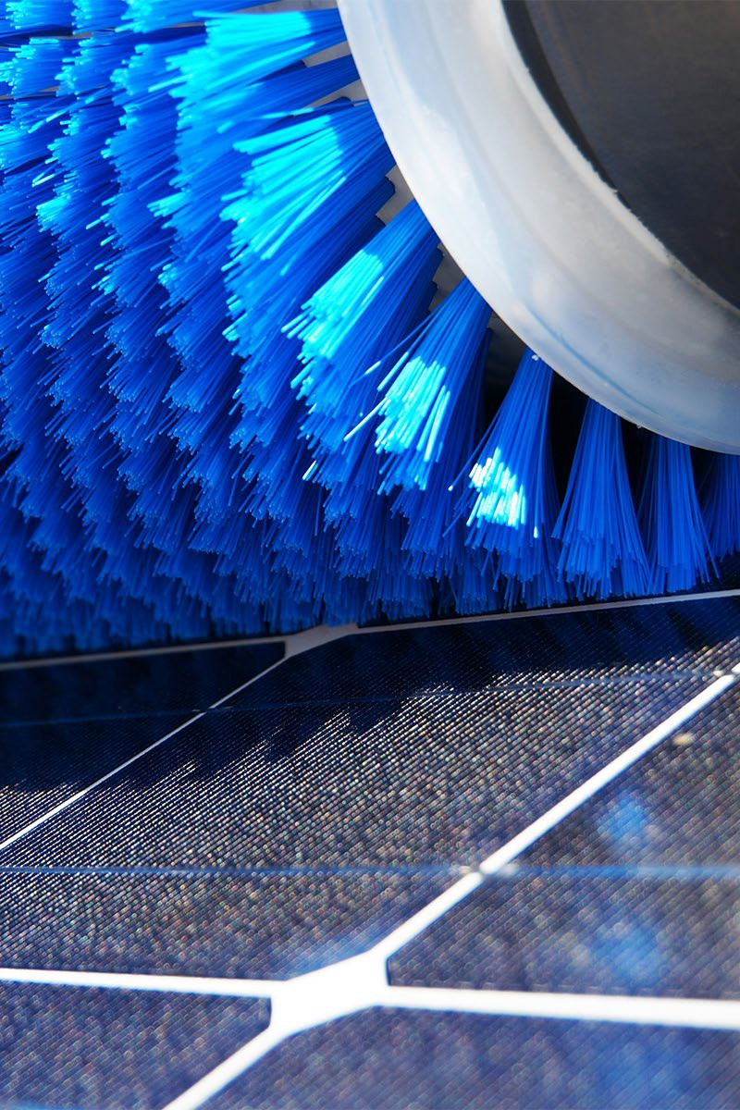
Service and Maintenance
We are here to look after your renewable technology project for its lifetime.
We provide maintenance packages including inspections, servicing and remote monitoring to ensure you’re getting the absolute best out of your project, and it is operating at maximum efficiency..
We aim to make your experience with us as easy and trouble free as possible and our ‘people first’ approach means we aim to continue to provide support.

Slide 9
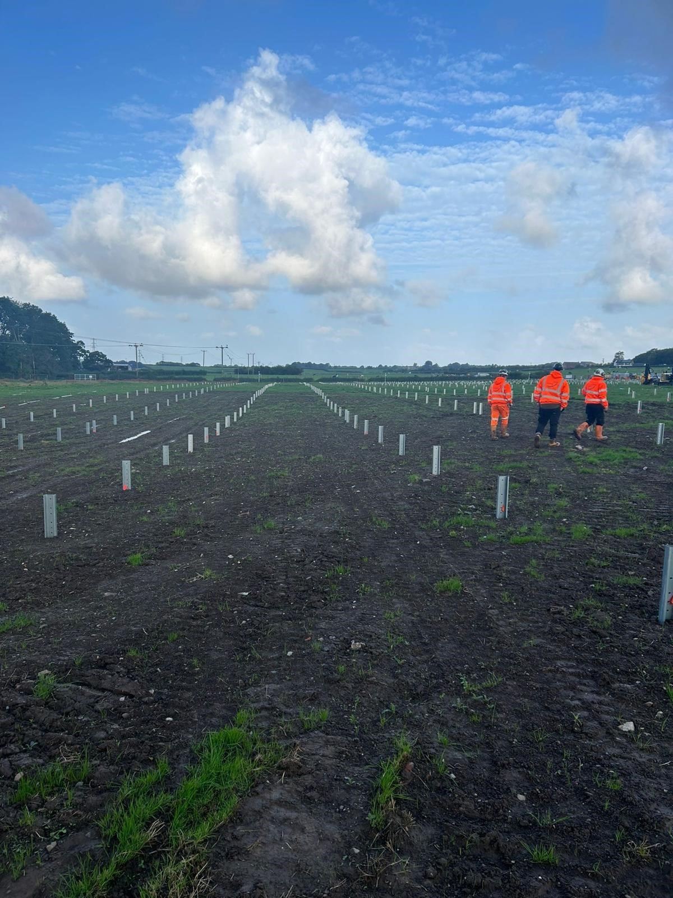
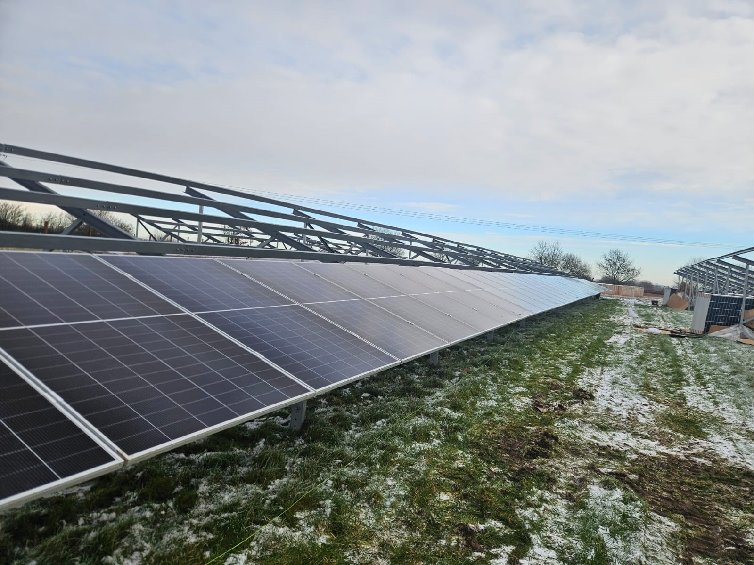
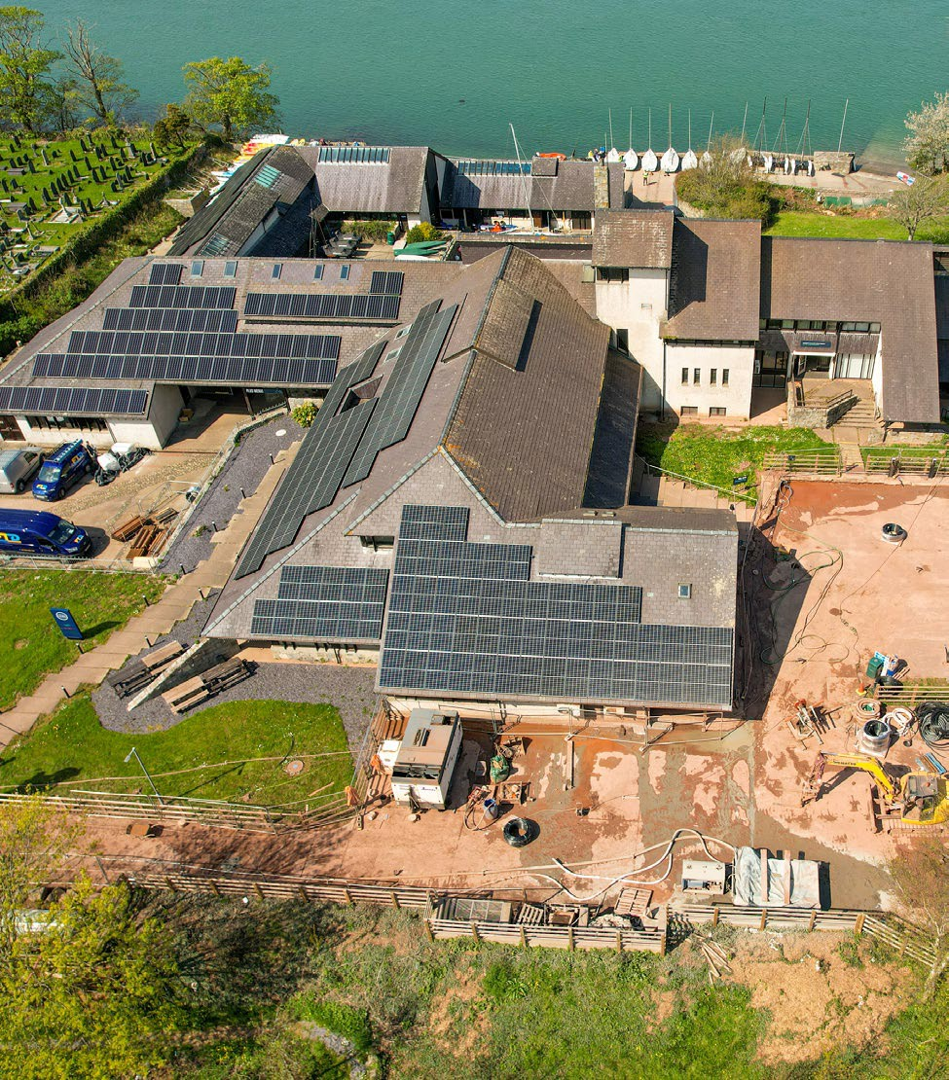
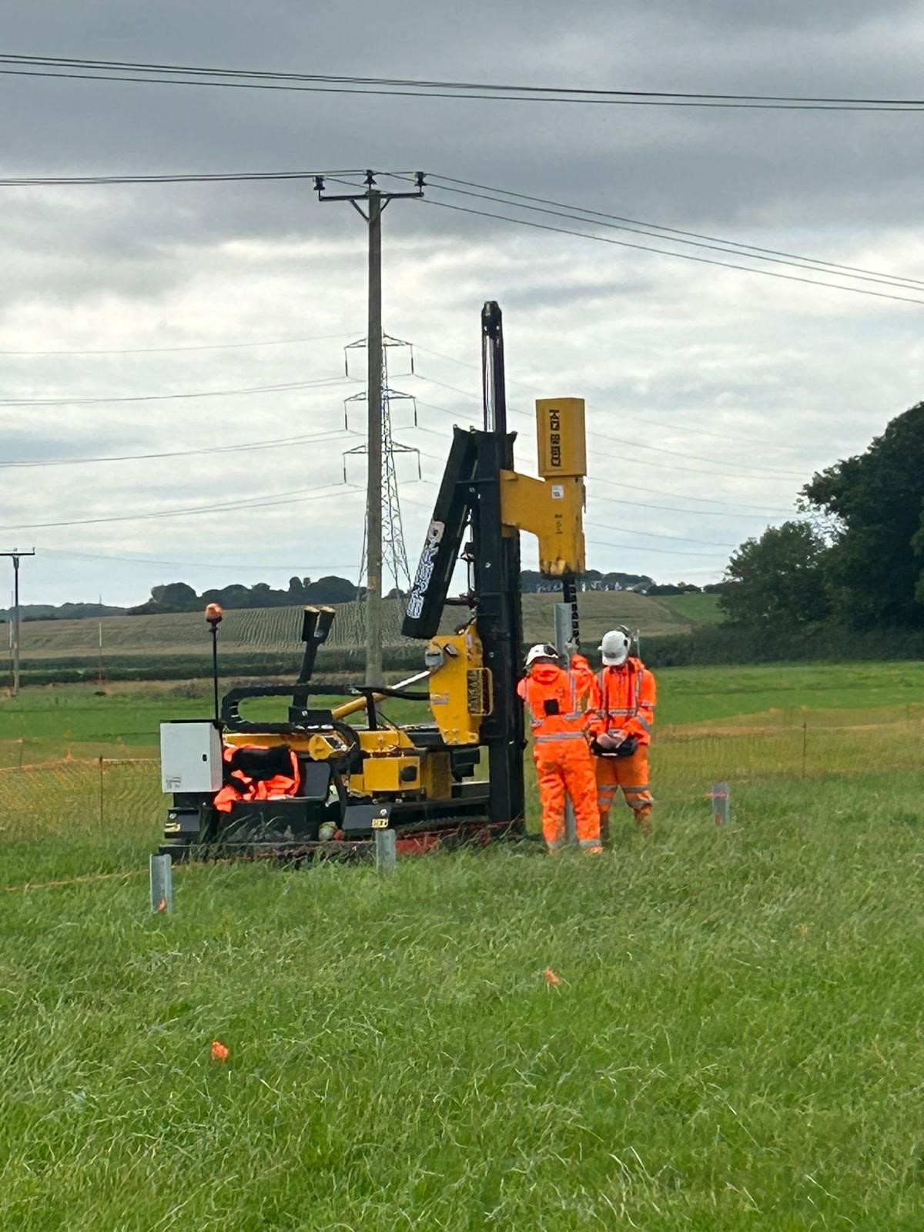
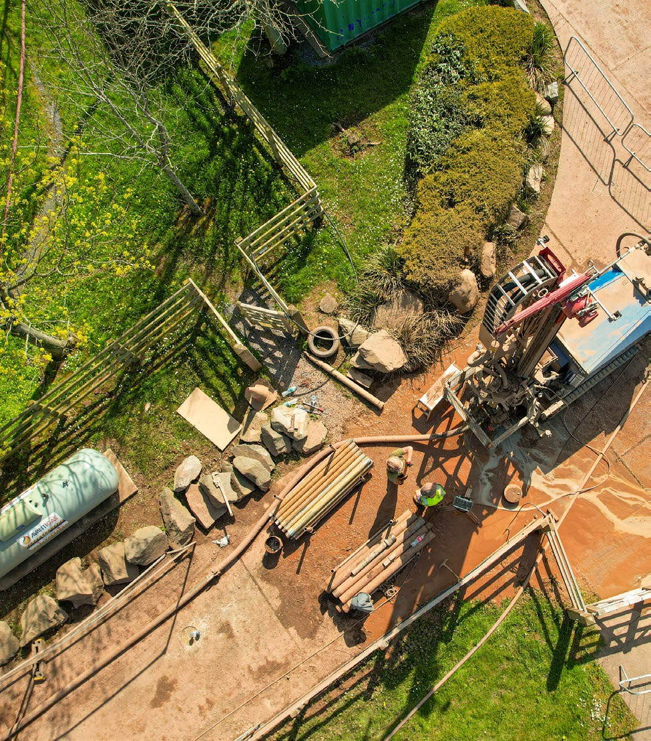
9.63 Mw Solar Farm
Working as Principal Contractor on this £5,000,000 Solar Farm.

Slide 10
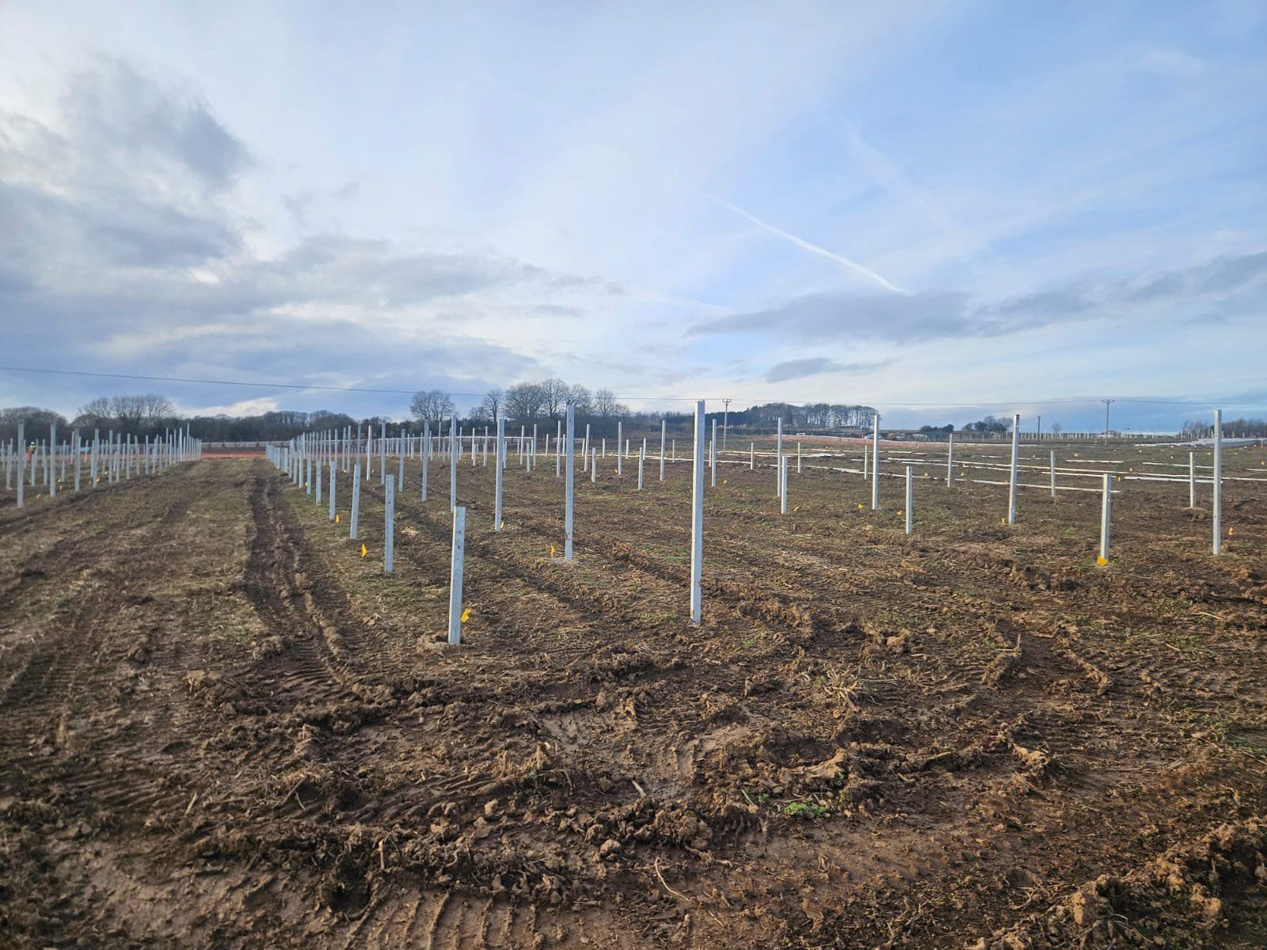
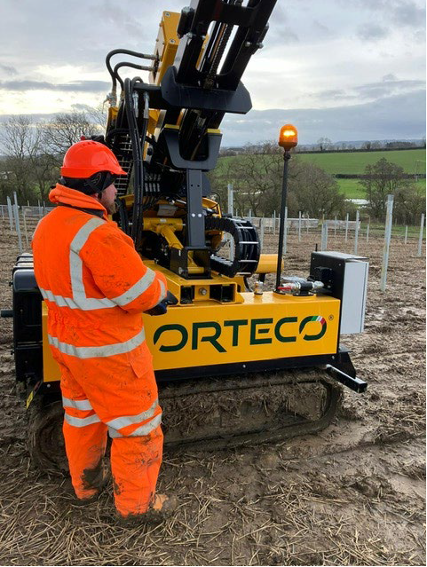
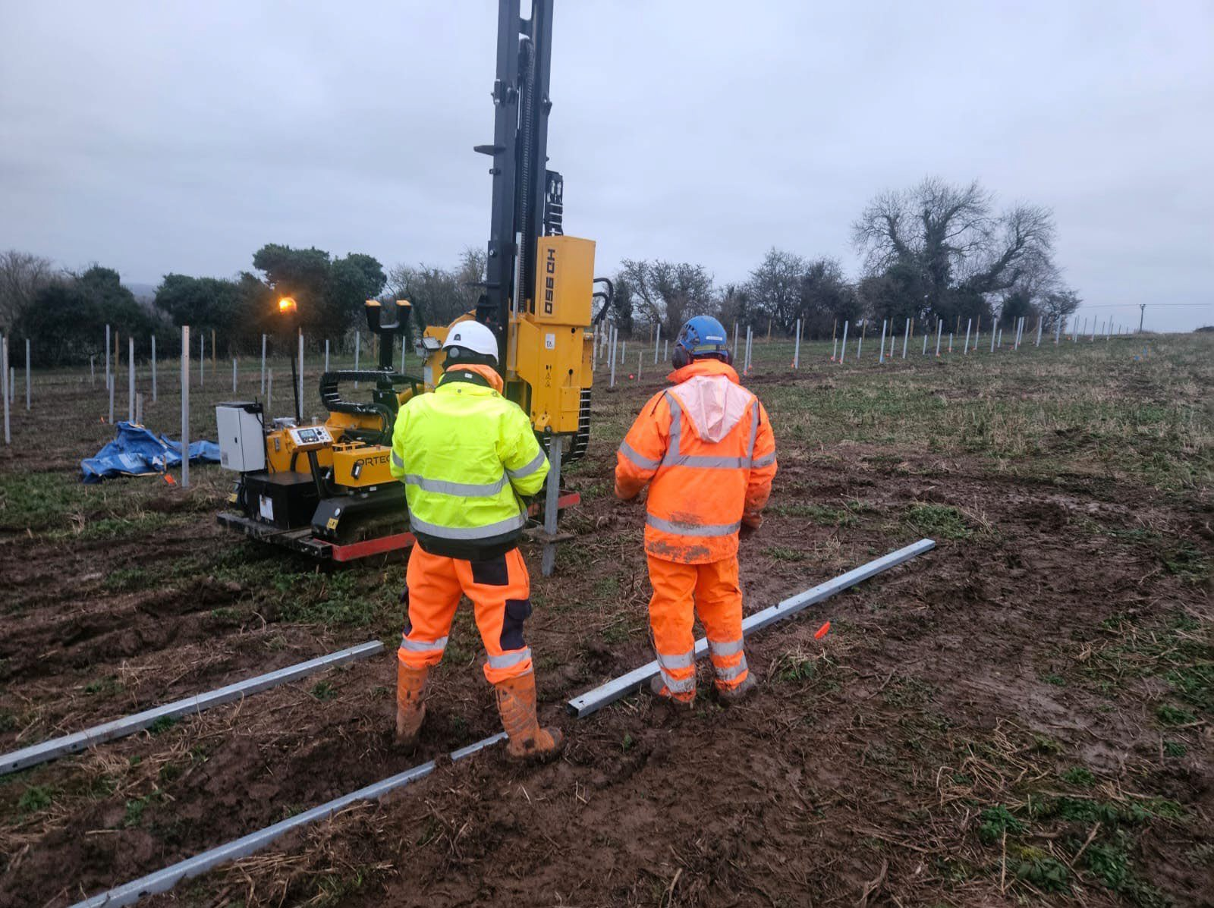
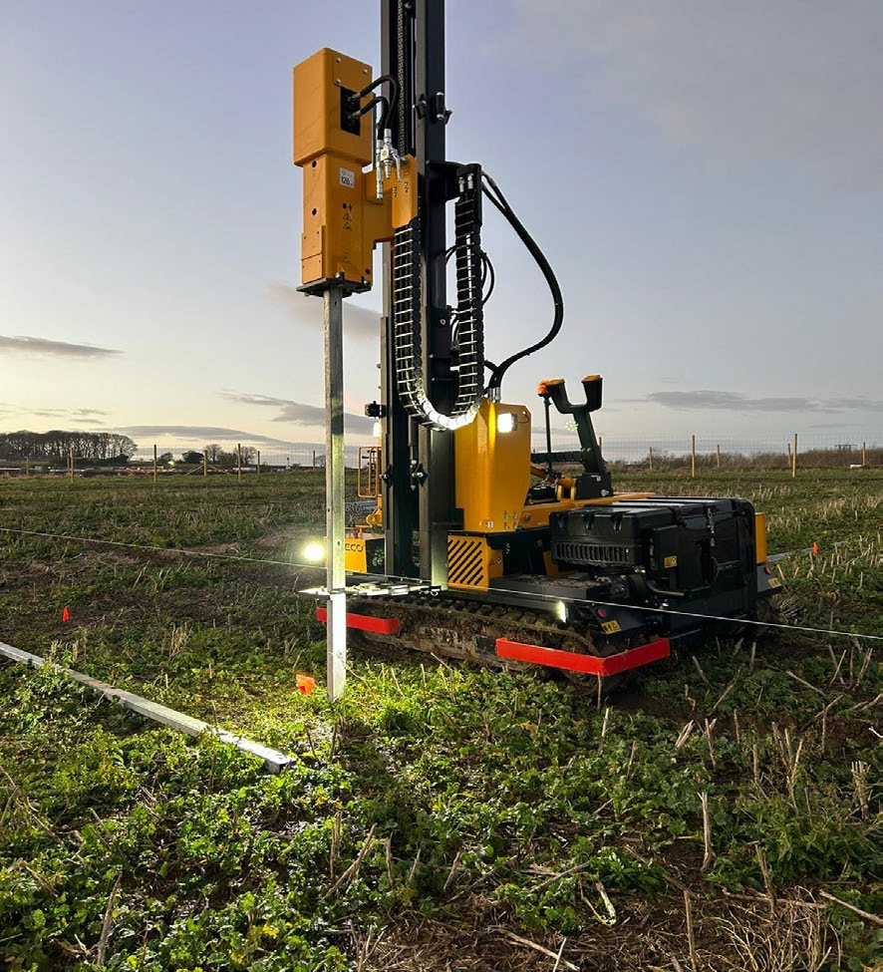
55 MW Solar Farm
ERS deployed 3 drilling rigs and 2no ramming machines to one off the largest Solar farms in the North East some 55MW. Our scope of works was to predrill a minimum of 4900 holes on the side of the site where the rock was outcropping and ramming wasn’t viable. ERS’s method was to utilise the down the hole hammer drilling at various diameters to match the C section piles to be installed/rammed.
Our 2no ramming machines were deployed to assist in the installation of some 30,000.00 ramming across the 200 acre site including the 4900 pre drilled holes

Slide 11
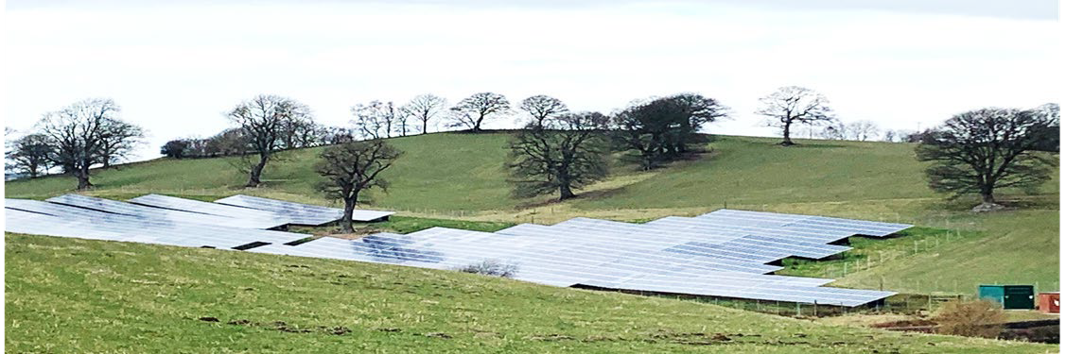
Tyn Y Wern Solar Park
Project Details
Location:
North Wales
Solar Panels:
4753 Winaico 260w
Inverter:
SMA
Mounting:
Krinner screw driven
ground mount system
Expected Generation:
1,084,889 kwh pa
The Challenge
The Rhug Estate were looking for an installer to work with them on delivery of a 1-Megawatt solar park. The estate already had planning permission and more importantly grid connection prior to our involvement. The estate were keen to install a system suited to the challenging landscape and to be as aesthetically pleasing as possible.
The Solution
Our solar engineers visited the site and spent time reviewing the geology, the expected weather conditions, and the
available area before proposing a solution. Due to the land conditions and the winter installation window, we specified a ground screw system which we knew would be best for the client. Our choice of panel was the 260w Winaico, due to their quality and because they were *Tier 1 panels. SMA was the chosen manufacturer due to quality and reliability. The build took approximately three months, and we undertook the full install including the substation build and HV connection. We are pleased to say that we met the deadline set by the estate. The scheme passed the rigorous Scottish Power testing and is generating well despite the UK weather conditions.
*Tier 1 means that the Solar Panel manufacturer must show that 6 different finance houses have backed projects of over 1.5MWp of solar within the last 2 years using their panels.

Slide 12
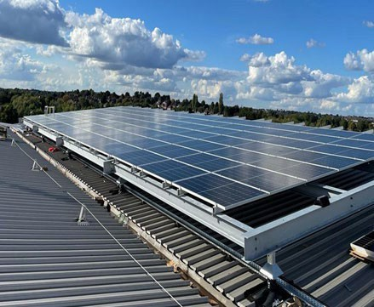
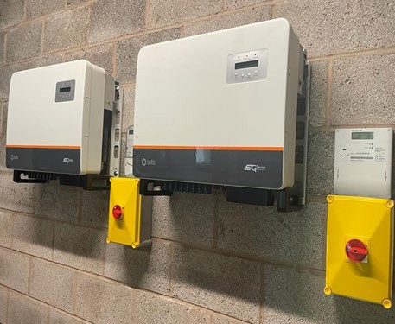
Blake House
Project Details
The Challenge
With the impact of increases in electricity prices on business overheads, we were approached by the owners of Blake House in Birmingham. This is a large commercial building with a high energy use. There was a large amount of roof space with a south facing aspect which was ideal for solar panels. Unfortunately, when we surveyed the roof, it was not strong enough to withstand the additional loads.
Location: Birmingham
Solar Panels:
217 Sharp 410w
Inverter:
Solis
The Solution
We worked closely with structural engineers to come up with a solution
that did not put extra load on to the roof. We installed a metal frame which we fixed to the structural joists in the building. This allowed the transfer of the solar panel loading on to the large steel joists and not the roof. Once the frame was secured to the building our panel installers used a standard solar frame system to mount the panels. The panels stretched across two aspects of the roof, so we utilised two separate inverters to ensure the most efficient system. Once installed we commissioned the system and set up remote monitoring for the landlord so they can visualise the solar panels producing energy and the savings being made.
Expected Generation:
85,813kwh pa

Slide 13
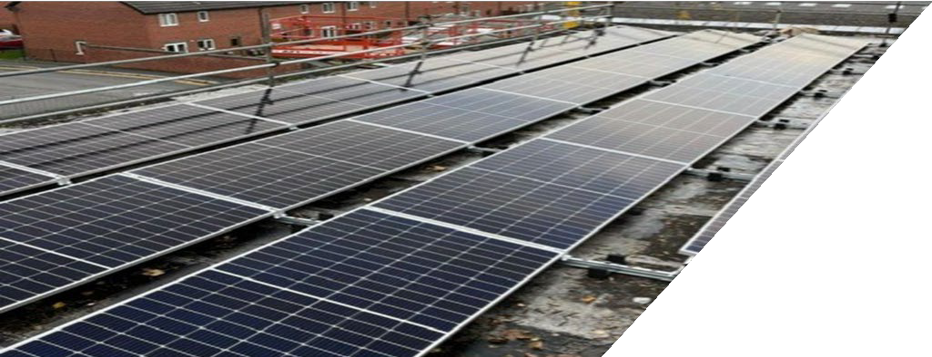
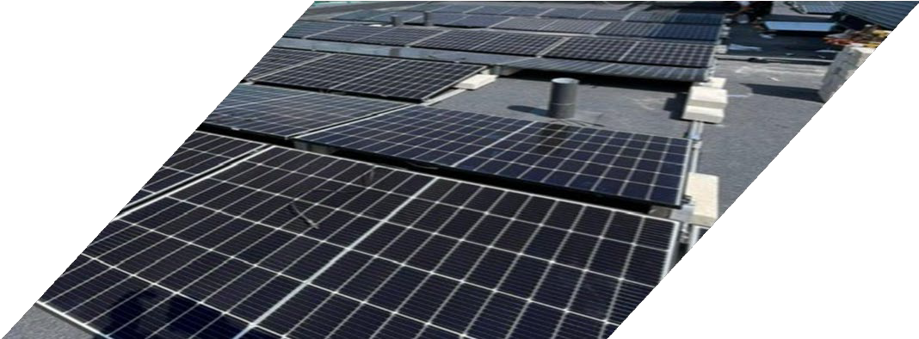
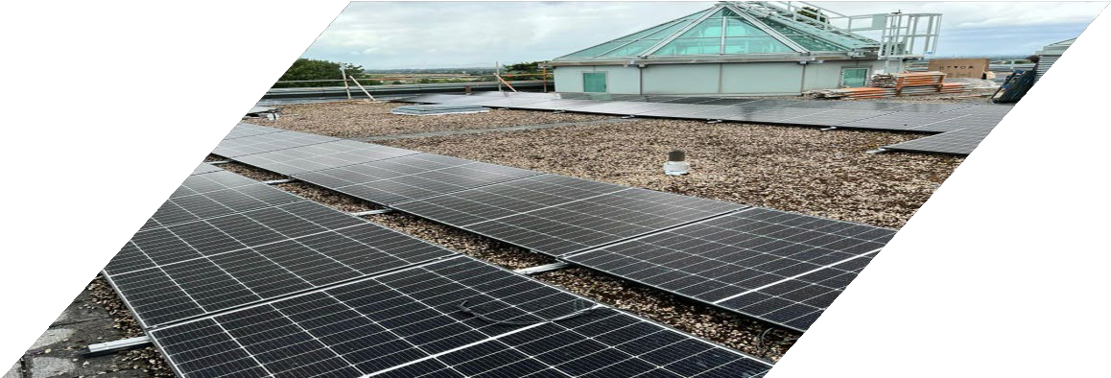
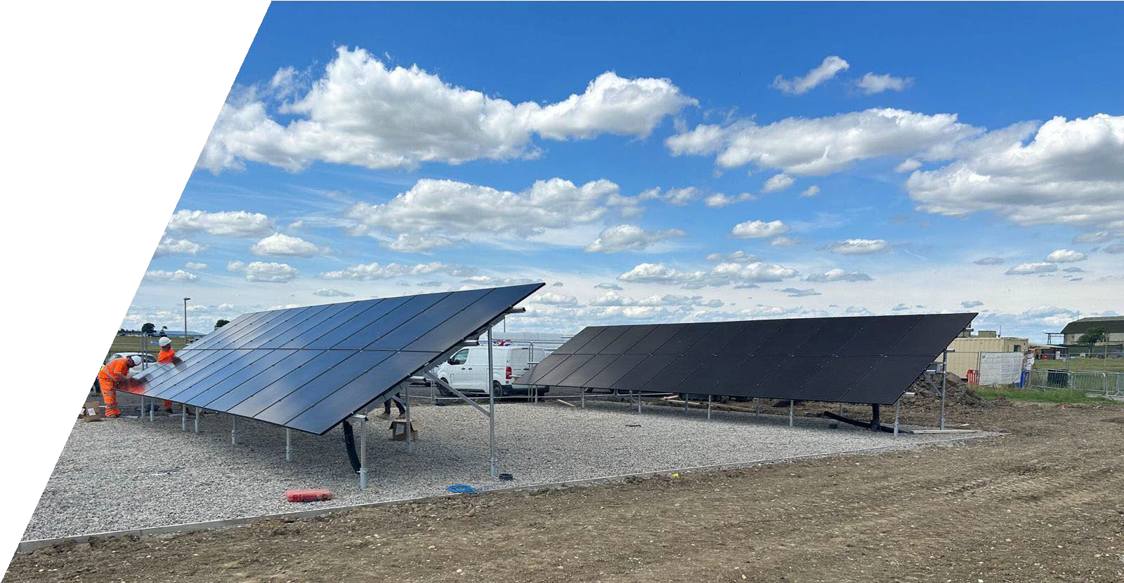
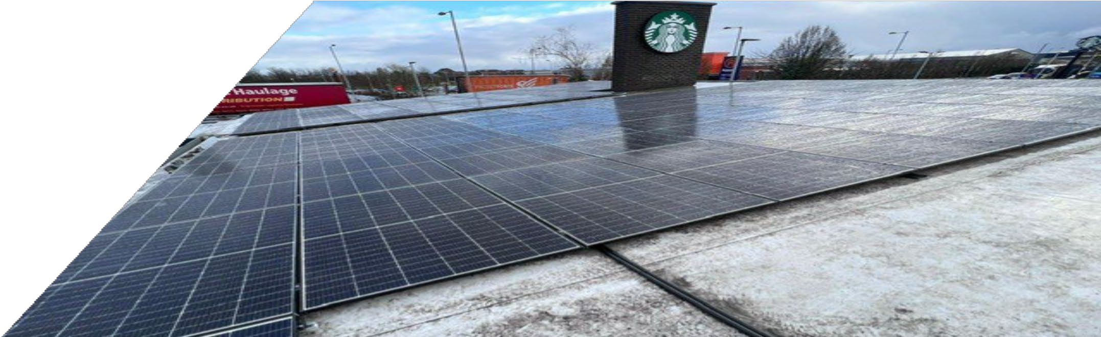
Shrewsbury Hospital Apartment Block
Zurich Offices
Raf Leeming Starbucks

Slide 14
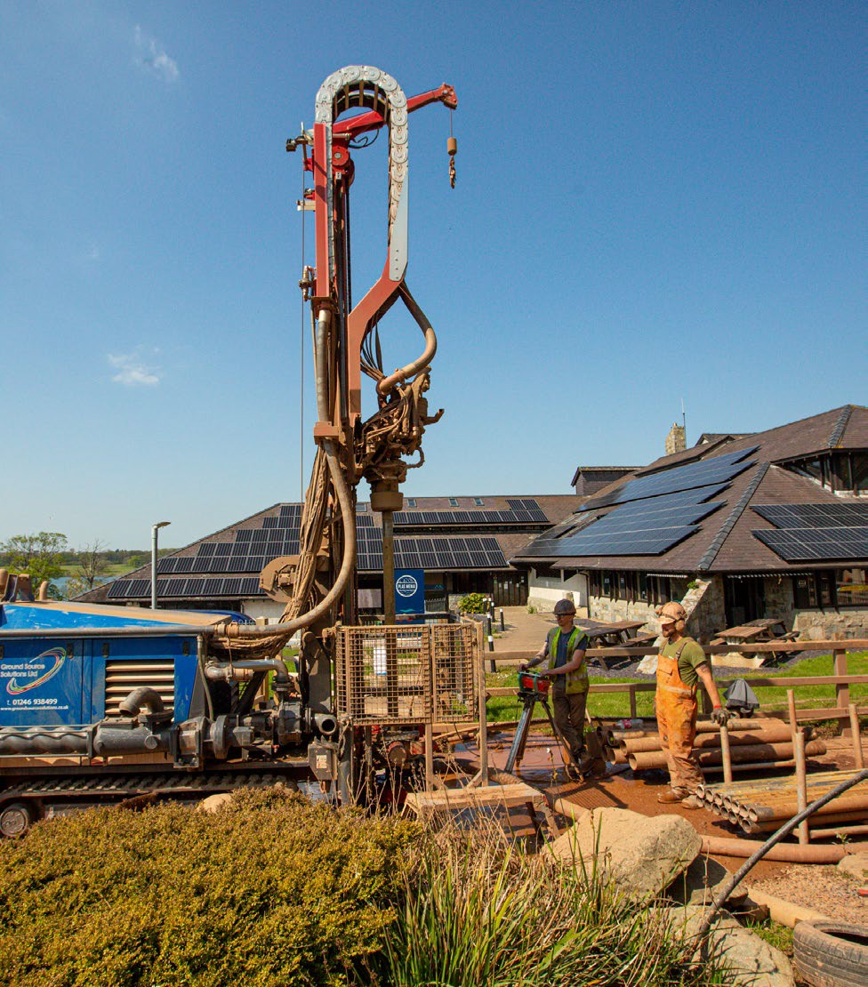
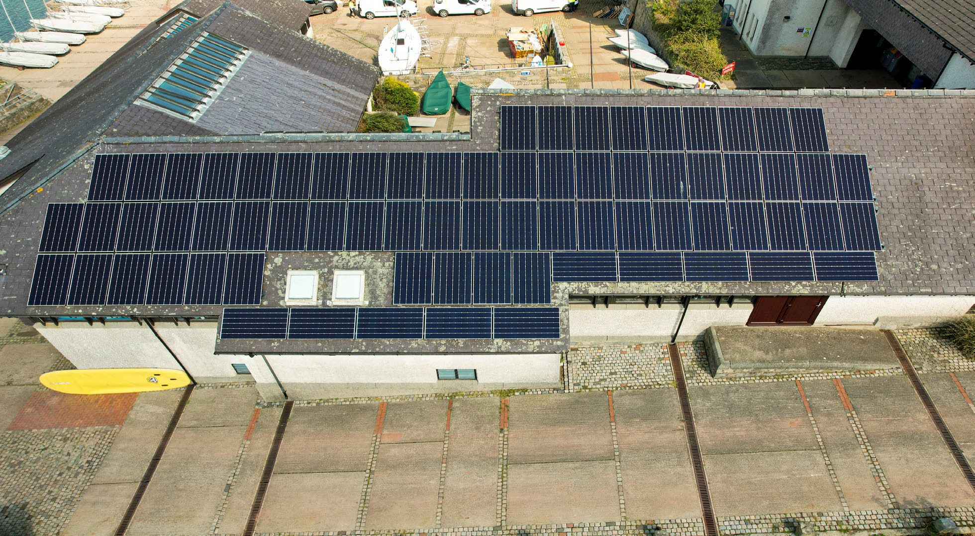
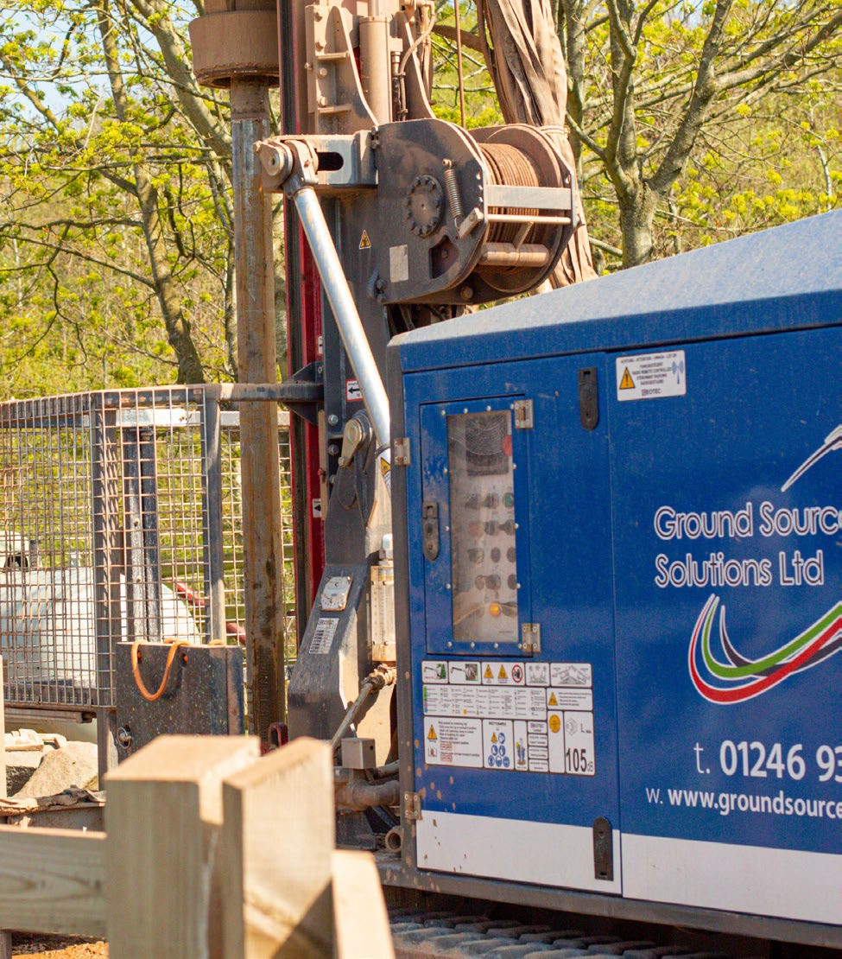
Plas Menai National Outdoor Centre
Working as Principal Contractor on this £2,000,000 decarbonisation project.
Design, supply & installation of a multi technology renewable energy solution incorporating ground source and air source heat pumps and roof mounted solar PV.

Slide 15
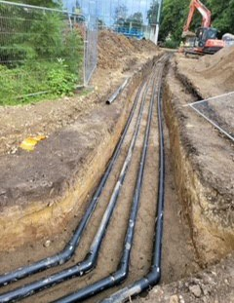
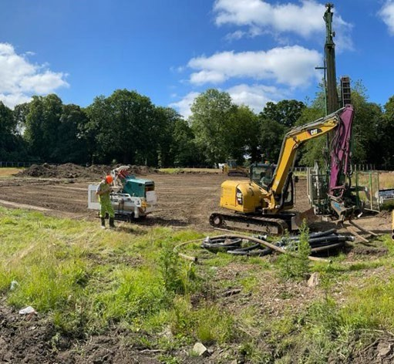
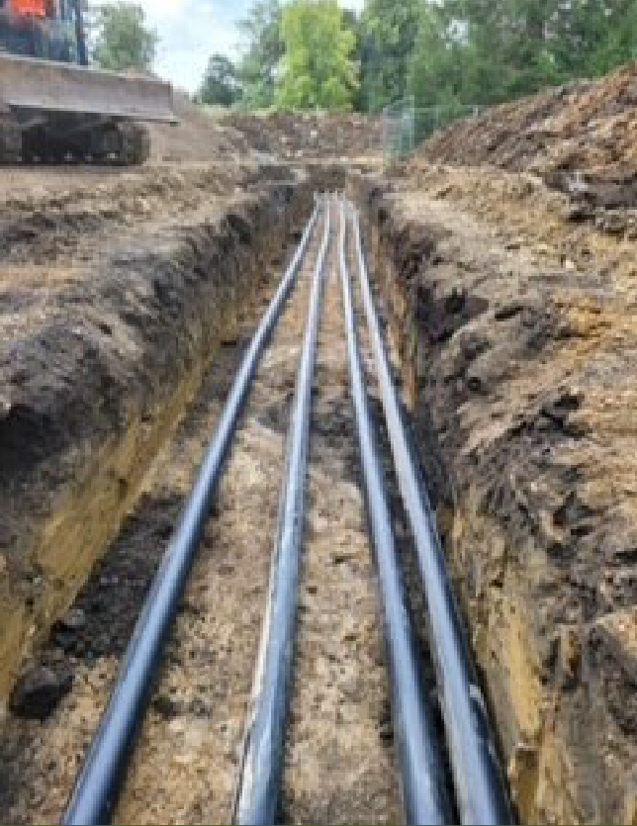
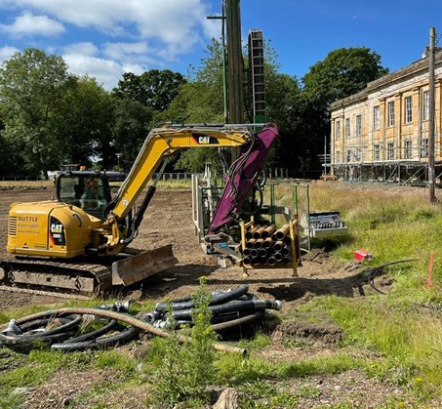
Durham History Centre
Design, supply and installation of a 300kW GSHP system.
60 boreholes to a depth of 87m
Borehole field designed for mine- working avoidance.
Contract Value: £600,000 Principal Contractor

Slide 16

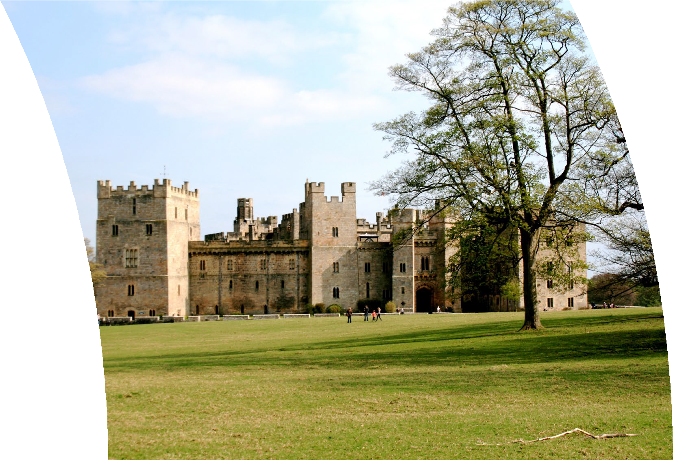
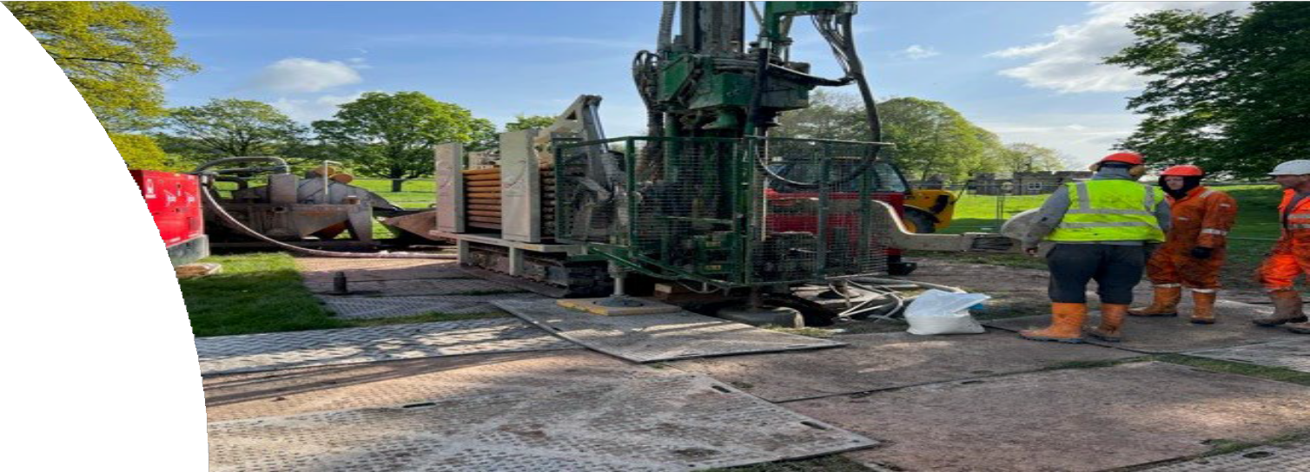
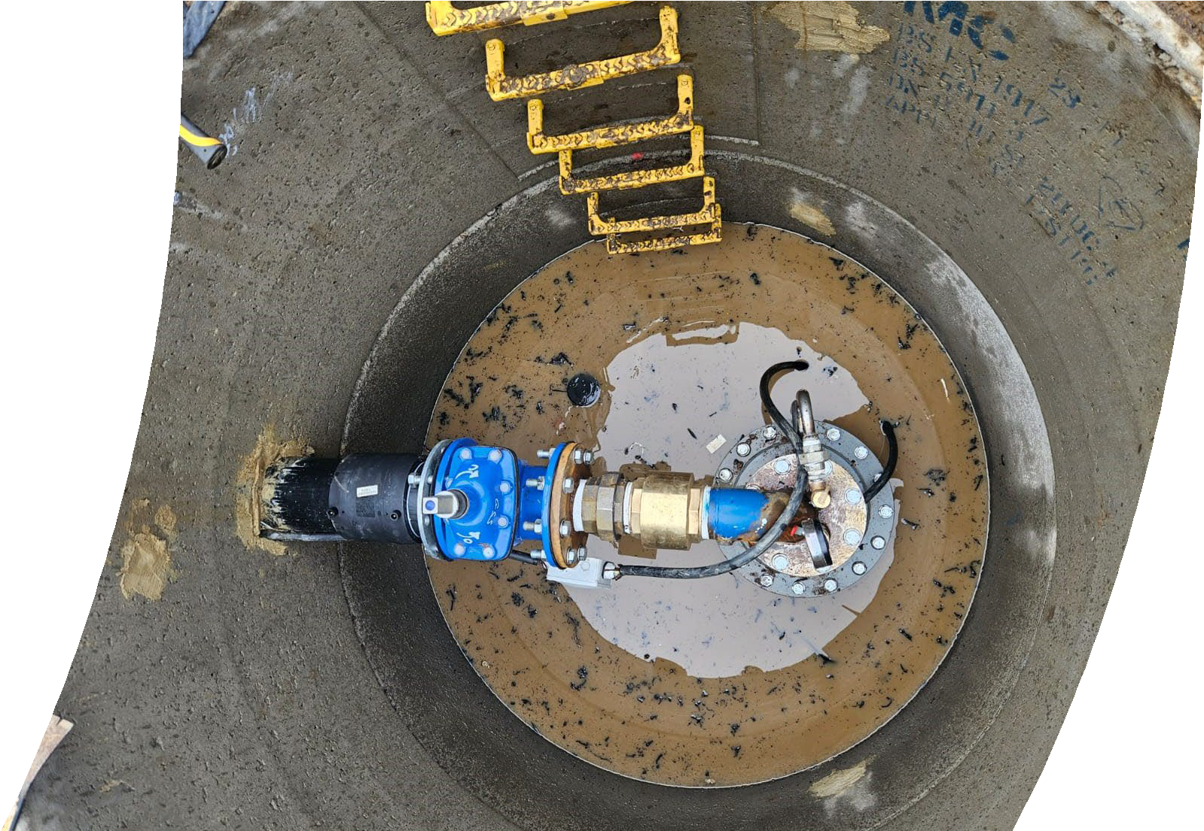
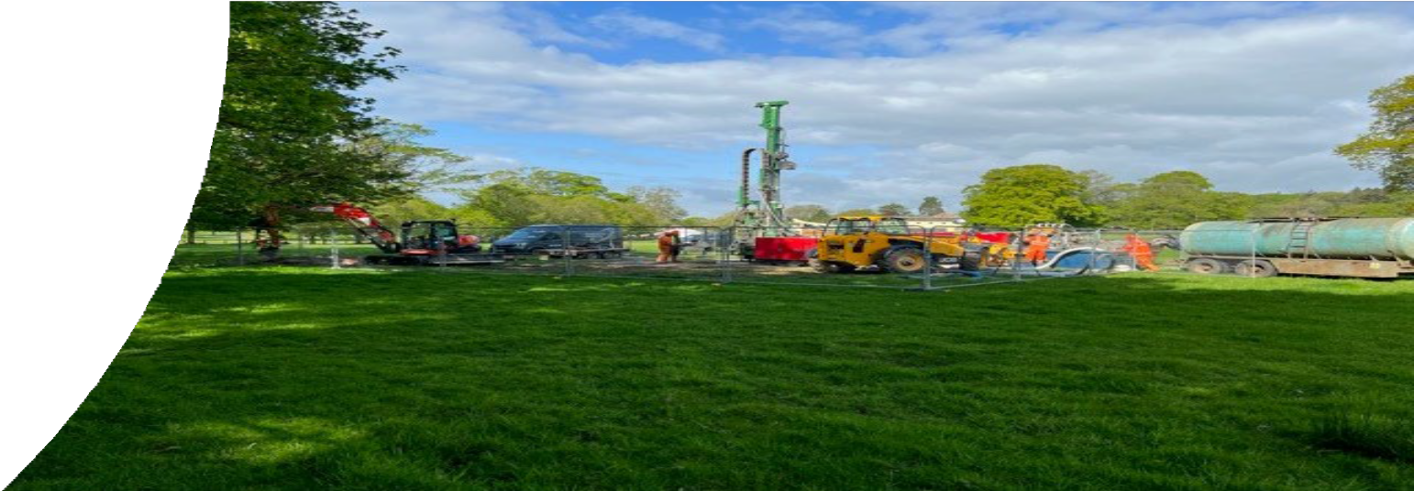
Raby Castle Estate
Open loop system consisting of 1 Abstraction borehole and 1 re-injection borehole delivering 36 litres per second. 600 kW of energy.
Flow and return pipework from each borehole to the Energy Centre. Testing & commissioning
Contract Value: £400,000 Principal Contractor

Slide 17

Client Testimonial
Neil Borrill-Carroll
“ENER-G have conducted themselves professionally throughout delivery of the
contract and have always acted in accordance with H&S best practice guidelines,
resulting in a very safe and controlled workplace.
They have liaised effectively and efficiently with the clients engineering services team, to ensure integration of the asset on the customers HV Infrastructure…”
Development Director, Ampyrde

Slide 18

Client Testimonial
Bradley Martin
“ ERS consistently demonstrated professionalism, technical expertise, and a commitment to delivering high-quality results. The team displayed a proactive approach to problem-solving and worked effectively within the project timeline and budget constraints…
Based on their performance and the outcomes achieved, ERS are now installing similar sized projects as a EPC Contractor
and I am confident in recommending ENER-G Renewable Solutions Limited for similar project… “
Director, Murphy Technologies Ltd

Slide 19

Client Testimonial
Ener-g Renewable Solutions acted as main contractor for a circa £2m decarbonisation project at Plas Menai.
Sports Wales commissioned Rybka to develop a low/ zero carbon heating system design for the existing Plas Menai Sports Facility building. The existing listed 1980s constructed building which utilized oil boilers as its main thermal energy source was upgraded to achieve the Sports Wales aspirations to have a low carbon facility at Plas Menai. Rybka investigated various heat generation system options which included water source heat pumps, ground source heat pumps, air source heat pumps and biomass heating. After detailed client consultation and a in depth appraisals exercise working alongside ERS’s ground source heat pumps were considered the most viable low carbon heat source for the site.
Working in conjunction with ERS we have developed a design for the new heating system which has included close liaison with specialists to determine the characteristics of the sites complex ground conditions, locations, quantities, and depths of bore holes, sizes of heat pumps and hydraulic interfaces with the buildings existing heating systems. ERS took the lead role in this specialist design package.
ERS have successfully installed over 70 boreholes at the site despite challenges associated with high water tables, the building not being connected to the public sewer network and material shortages due to supply chain issues during the construction period. ERS have performed professionally, proactively when dealing with complex technical challenges associated with the site and collaboratively which all stakeholders involved in other phases associated with this project.
Kind regards
Amit Sharma
Regional Director

Slide 20




Address:
Energy House Meadows Drive, Ireland Industrial Estate Staveley,
Chesterfield, S43 3LH
Contact Numbers:
01246 938 499
07540 635 766
Email Addresses: enquiries@renewable-enery.eco lee@renewable-energy.eco

