Slide 1
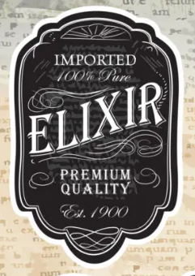
Label Art Specification
The Original
World’s Worst Charcuterie
Board
Dimensions
No more than 1.125” (28mm) high
No more than 13.5” (340mm) length
Use font and style as shown in the “ELIXR” label image sample
Ignore the background in the image
One color “Light on Dark” and “Dark on light” versions requested

Slide 2
