Slide 1
Briefing Project LED Panels
Torson Injex AG

Slide 2
Project Description
We are looking for a bold, professional design for five large LED display panels (size: 1m x 2.5m each) that will be the visual centerpiece of our exhibition stand. The panels will showcase our expertise in precision injection molding and customized connector technology. The design should be clean, modern, and eye-catching from a distance.
For each panel there will be a German and an English version.

Slide 3
Panel Specs
Quantity: 5 pcs (each panel has to work as a stand-alone)
Each panel in two languages, i.e. 10 Designs total
Size: 1000 mm wide x 2500 mm high
Printing size: 1050 mm x 2550 mm
Format: PDF 1.6 x4, EPS, PSD, TiFF, Ai, JPG
Resolution: 120 ppi
→ More information in the documents «led-budget-100-250-produktblatt-productsheet.pdf» and «Messewand LED Budget 100-250.pdf»

Slide 4
About Us
Torson Injex AG is a Swiss specialist in high-precision injection molding. We develop and produce complex plastic parts, customized connector elements or overmolded electronics. Our customers value:
Very short lead times
Customized solutions
Swiss-made quality
Reliability and innovation
Website: www.torson-injex.ch

Slide 5
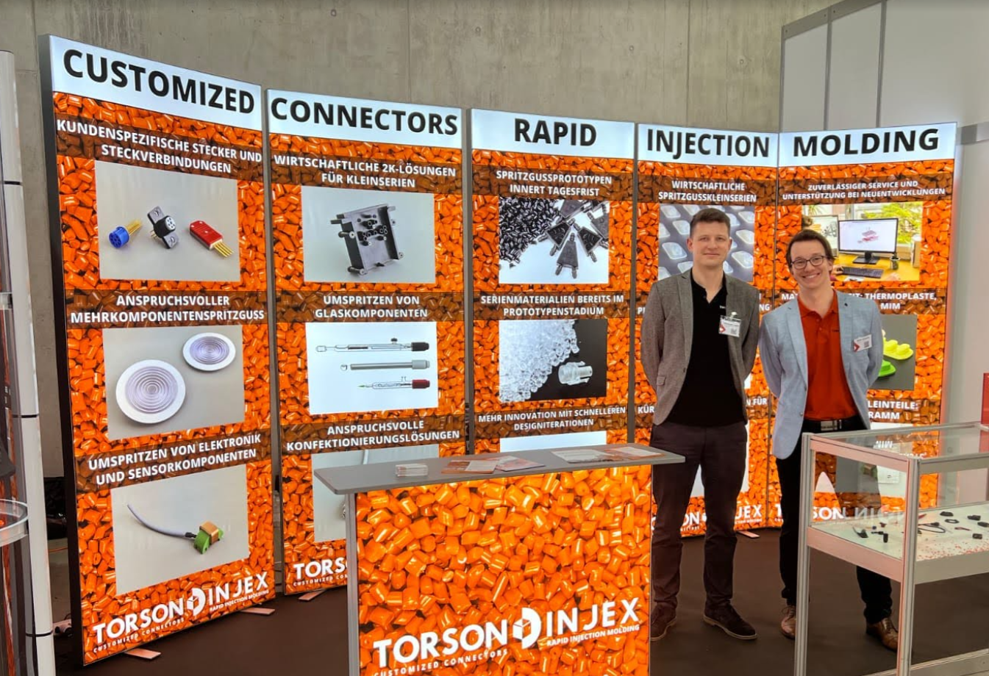
Style
On the right you see the previous panel-designs
We would like to keep the orange-pellets as an eye-catching design element
Corporate Design:
  Color: #FF7500
  Font: Open Sans

Slide 6
Content
For each panel we will define:
  Titel
  Picture 1 and Text 1
  Picture 2 and Text 2
  Titel and Text will be in German and English -> each panel in two versions! (see next slide)
  Pictures could be changed during design
  Panel 5 will be different

Slide 7
Panel 1
Panel 2
Panel 3
Panel 4
Panel 5
Titel English
[Picture 1]
Text 1 – English
[Picture 2]
Text 2 - English
Titel English
[Picture 1]
Text 1 – English
[Picture 2]
Text 2 - English
Titel English
[Picture 1]
Text 1 – English
[Picture 2]
Text 2 - English
Titel English
[Picture 1]
Text 1 – English
[Picture 2]
Text 2 - English
Titel English
USPs – English
Infos – English
English Panels
Titel German
[Picture 1]
Text 1 – German
[Picture 2]
Text 2 - German
Titel German
[Picture 1]
Text 1 – German
[Picture 2]
Text 2 - German
Titel German
[Picture 1]
Text 1 – German
[Picture 2]
Text 2 - German
Titel German
[Picture 1]
Text 1 – German
[Picture 2]
Text 2 - German
Titel German
USPs – German
Infos – German
German Panels

Slide 8
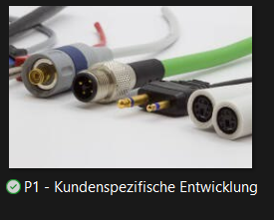
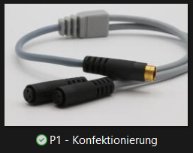
Panel 1
 | Titel – English | Titel - German
 | Connetors | Steckverbinder
Picture | Text – English | Text - German
 | Customized Solutions | Kundenspezifische Entwicklung
 | Cable Assembly | Konfektionierung

Slide 9
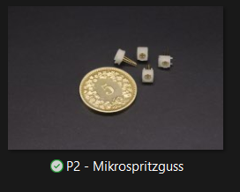
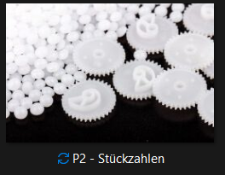
Panel 2
 | Titel – English | Titel - German
 | Injection Molding | Spritzguss
Picture | Text – English | Text - German
 | Micro Injection Molding | Mikrospritzguss
*Picture could be changed yet | Quantities: 1 – 1 mio+ | Stückzahlen: 1 - 1 mio+

Slide 10
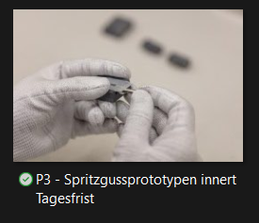
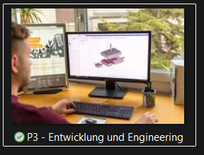
Panel 3
 | Titel – English | Titel - German
 | Prototyping | Prototyping
Picture | Text – English | Text - German
 | Injection Molded Prototypes within Days | Spritzgussprototypen innert Tagesfrist
 | Engineering | Engineering

Slide 11
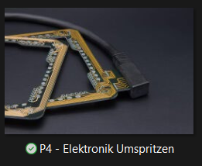
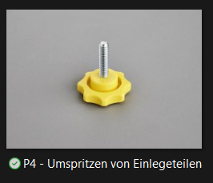
Panel 4
 | Titel – English | Titel - German
 | Special Solutions | Sonderlösungen
Picture | Text – English | Text - German
 | Overmolding Electronics | Elektronik Umspritzen
 | Insert Molding | Umspritzen von Einlegeteilen

Slide 12
Panel 5 (bring this info in a nice looking way on a panel)
Titel – English | Titel - German
About Us | Über uns
USPs – English | USPs - German
Quality «Made in Switzerland» Highest precision thanks to Swiss production Fastest delivery times Shorter time-to-market and more iteration options One-Stop-Shop Seamless partner from the first prototype to series production | Qualität «Made in Switzerland» Höchste Präzision dank Produktion in der Schweiz Schnellste Lieferzeiten Kürzere Time-to-Market und mehr Iterationsmöglichkeiten One-Stop-Shop Nahtloser Partner vom ersten Prototyp bis zur Serienproduktion
Infos – English | Infos - German
30 employees 25 injection molding machines In-house toolmaking ISO 9001 certified Former ETH start-up | 30 Mitarbeiter 25 Spritzgussmaschinen Hauseigener Werkzeugbau ISO 9001 zertifiziert Ehemaliges ETH-Startup

