Slide 1
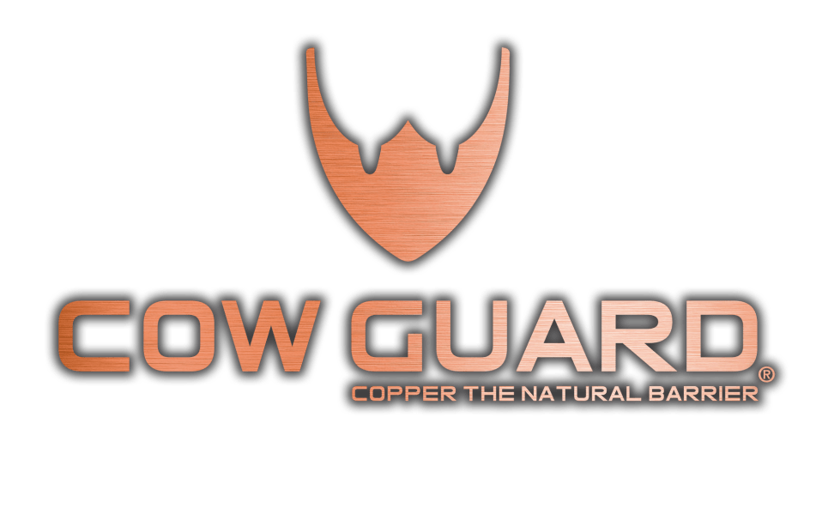
The first copper-based organic in the world.

Slide 2

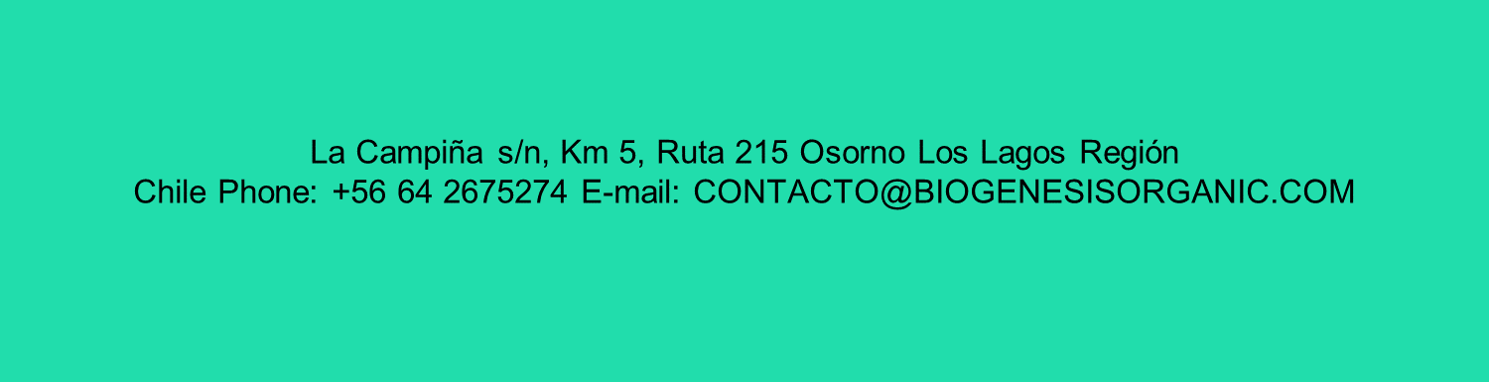

Slide 3
Formulation
Teat protectors

Slide 4

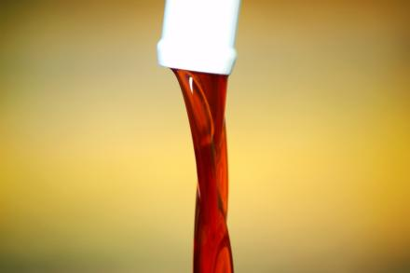
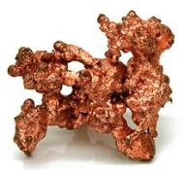
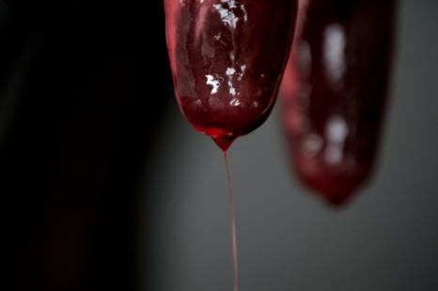
Formula Cow Guard
Active principle
100%
Copper nanoparticles..
mixer in a liquid base

Slide 5
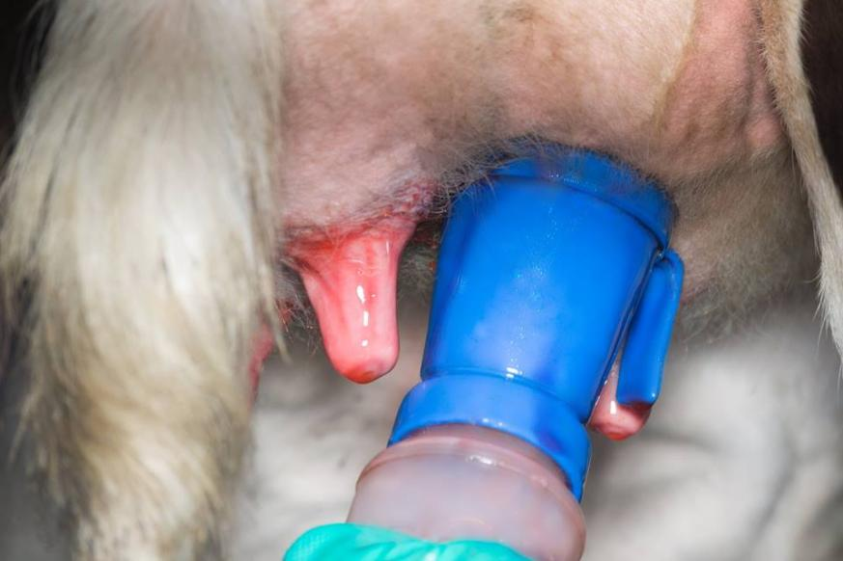
Aplication form

Slide 6
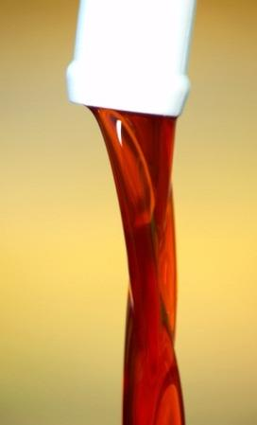
Fórmula Cow Guard
1st and only in the world whose active ingredient is 100% copper
1st and only in the world certified for use in organic agriculture (100% organic)
With scientific studies (U. de Chile, U. Austral de Chile and INTA Argentina)
Unique in Chile with scientific publications (Paper: Frontiers of Microbiology)
Unique in Chile and the world with patented intellectual property (Patented as original innovation)

Slide 7



Cow Guard Formula
Produced under standardized processes
ISO certification
ISO 9001-2015

Slide 8
SAG classification (Agriculture Minister of Chile)
Brand | Tipe of Product | Active principle classification | Clasificación del producto por el SAG | Does require SAG Registration (as pharmacological product) to be used in PABCO dairy farms?
 | Protector de pezón | Mineral | Organic/ Cosmetic | Does not require
Other products | Dipping/ Disinfectant | Disinfectant | Drug/ Medicine | Require

Slide 9
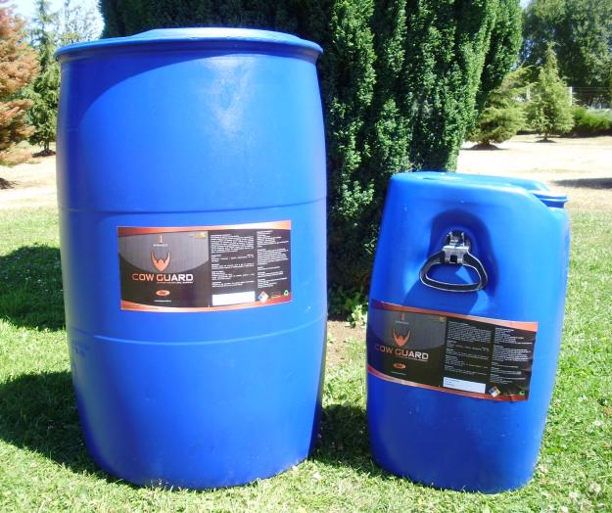
Presentations
220 Kg
60 Kg

Slide 10
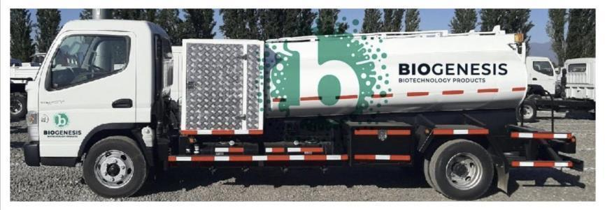
Distribution to Milking Parlors
Refilling of 220 kg drums or 1000 kg bins directly in the dairy parlor.
Accurate discharge through flow meter gun.
Avoid contamination with accumulation of plastics (Drums).
Better supply.

Slide 11
Cow Guard Line

Slide 12
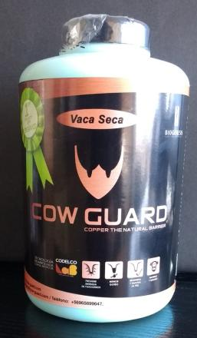
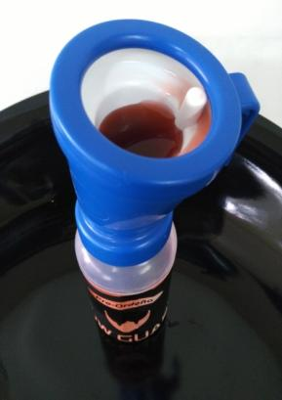

Cow Guard Dry Cow
2.500 ppm Copper
Barrier former (film)
Duration:
3 weeks
Use: Dry period

Slide 13
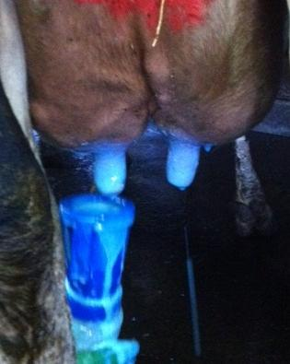
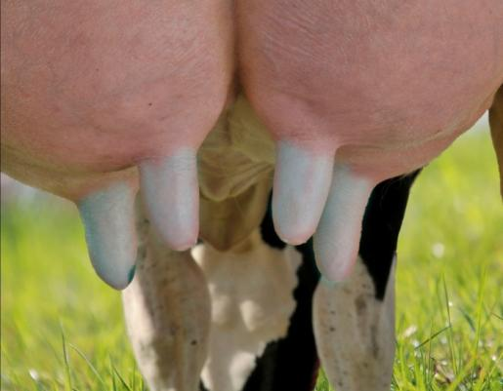
Cow Guard Dry cow

Slide 14
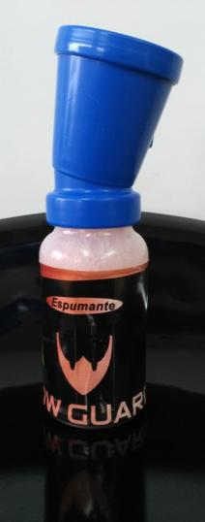
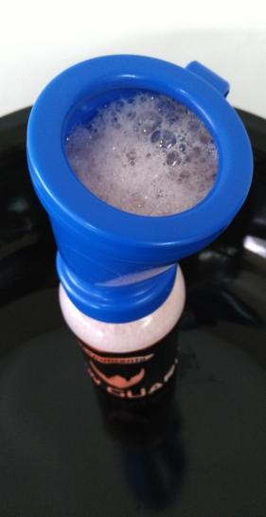
Cow Guard Foam
1.500 ppm Copper
Uso: Before milking

Slide 15
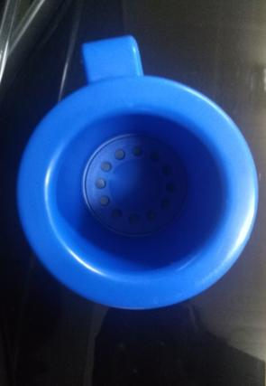
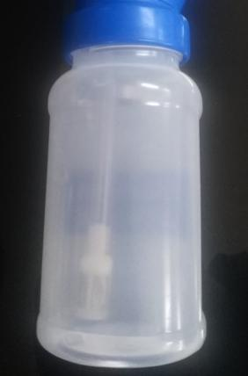
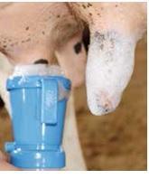
Cow Guard Foam

Slide 16
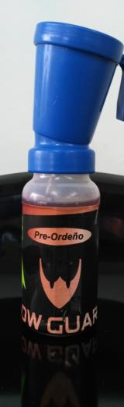
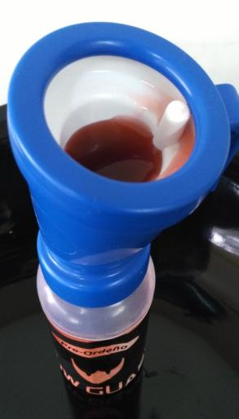
Cow Guard Pre-milking
2.500 ppm Copper
Use: Before milking

Slide 17
Cow Guard Pre-milking

Slide 18
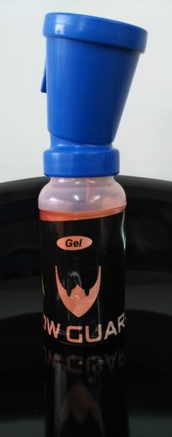
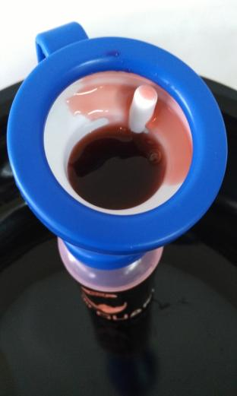
Cow Guard Gel
5.000 ppm Copper
Use: After milking

Slide 19
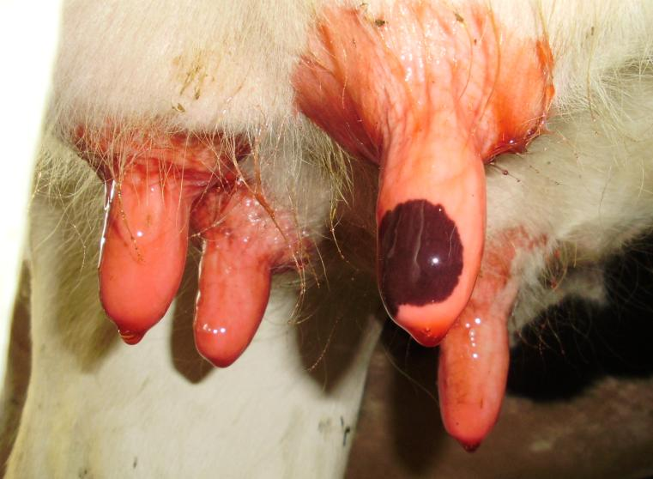
Cow Guard Gel

Slide 20
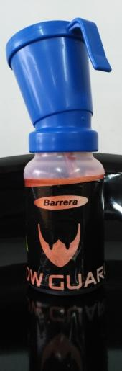
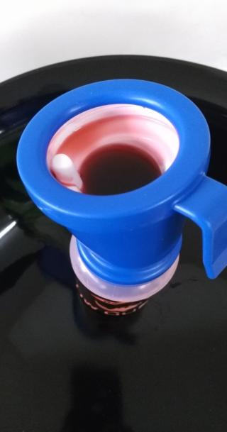
Cow Guard Barrier
5.000 ppm Copper
Barrier former (film)
Duration:
Until next milking

Slide 21
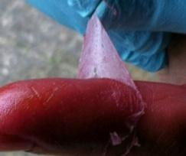
Cow Guard Barrier (theat sealant)

Slide 22
High performance
High viscosity
High adhesion to teat
Low drip
Average spending
Cow/milk | 8,2 mL
Cow/day (2 milkings/day) | 16,4 mL
Cow/month (2 milkings/day) | 500 mL

Slide 23
Origin

Slide 24
Dairy farms problems:
Low efficacy other active ingredients:
Iodine
Bacterial resistance other active ingredients:
Iodine
Clorhexidine, Lactic acid, hydrogen peroxid, others
Bacterial antibiotic resistance:
Poor efective of antibiotics
Poor teat condition:
Skin: Cracks, wrinkles
Sphincter: Parakeratosis
Excessive use of anitbiotics
Clorhexidine, Lactic acid, hydrogen peroxid, others
Notes:
Cow Guard: Resolviendo problemas de la industria lechera

Slide 25
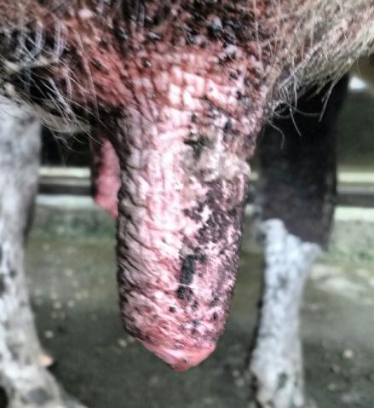
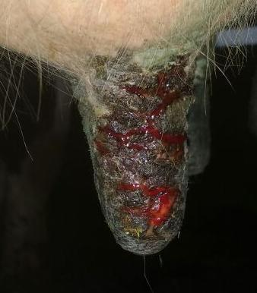
Poor teat condition
Notes:
Cow Guard: Resolviendo problemas de la industria lechera

Slide 26
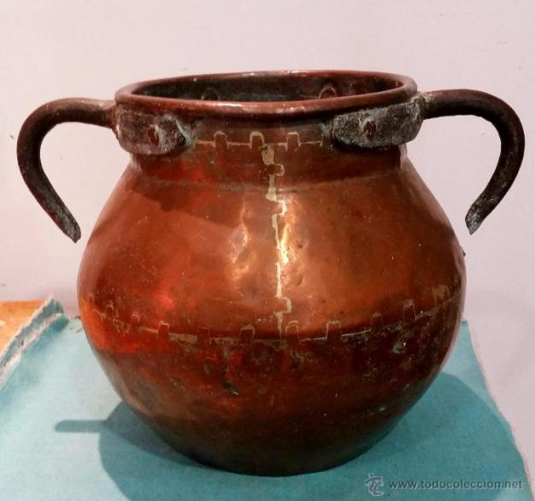
Use of copper in ancient times
Notes:
Cow Guard: Resolviendo problemas de la industria lechera

Slide 27
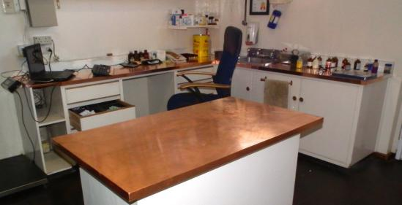
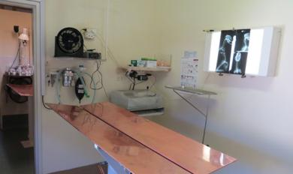
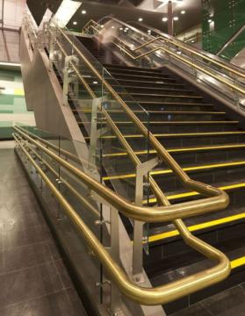
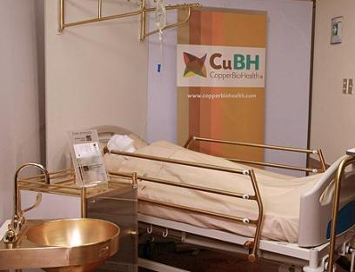
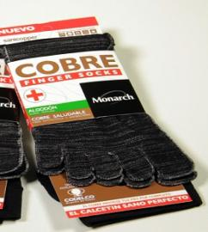
Use of copper today
Notes:
Cow Guard: Resolviendo problemas de la industria lechera

Slide 28
Characteristics of copper
Regenerates tissues and heals wounds
Bactericide
Bacteriostatic
Attacks Bacteria, Viruses, Fungi, Algae
It is not inactivated in the presence of organic matter

Slide 29
Cow Guard Scientific Studies
CITUC - INTA - U. de Chile
Guillermo Figueroa G.
U. Austral de Chile
Miguel Salgado A.
INTA Argentina
Luis Calvinho
Financed by government founds (FIA):, Cow Guard winner of inovation competition 2012
Supported by CODELCO Lab (1 year)
Supported by CODELCO Lab (6 months)
Study 5: Mastitis control In-vivo> efficiency
Study 1: Formula development > Stable formulas
Industrial test: Analysis comparison of productive results between cows treated with Yodo and Cow Guard (6,000 cows in milking) > Cows with Cow Guard had lower incidence of clinical mastitis and higher daily production
Study: Comparative analysis between Cow Guard and other products of the Argentine market > Cow Guard generates much greater control of major mastitis-causing bacteria compared to other proven products
3 years of studies (NMC C Protocol):
Study 2: Bacteria control In-vitro > High effectiveness
Study 3: Animal welfare > Regenerates tissues and heals wounds (high power)
Study 4: Food safety > Non-harmful milk for consumption

Slide 30
Cow Guard benefits

Slide 31

Protects the environment
100% Organic
100% Biodegradable
100% Safe
It does not contaminates the environment

Slide 32
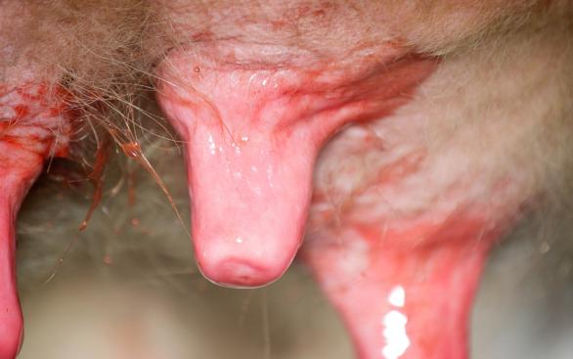
Does not generate copper waste in milk
Safe milk
Safe milk for human consumption
Milk free of toxic substances and Nonylphenol/N ethoxylate (NP/NPE).

Slide 33
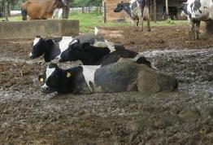
Does not inactivate with organic matter
Iodine
Cow Guard
Active only
0,5 to 2 hours
It is never inactive

Slide 34
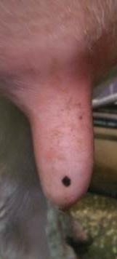
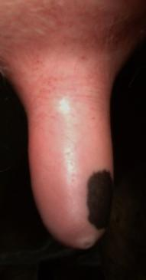
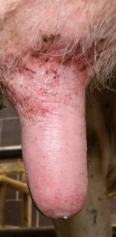
Smooth, healthy and functional
Skin and Sphincter

Slide 35
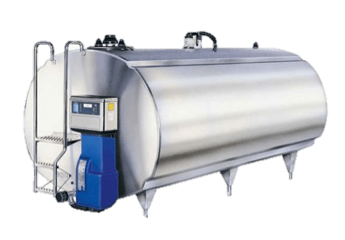

Healthy teat, skin and sphincter
Milks without pain
Higher milk drop
Higher production and lower mastitis
Easier
teat cleaning
Shorter teat preparation time
Shorter milking time

Slide 36
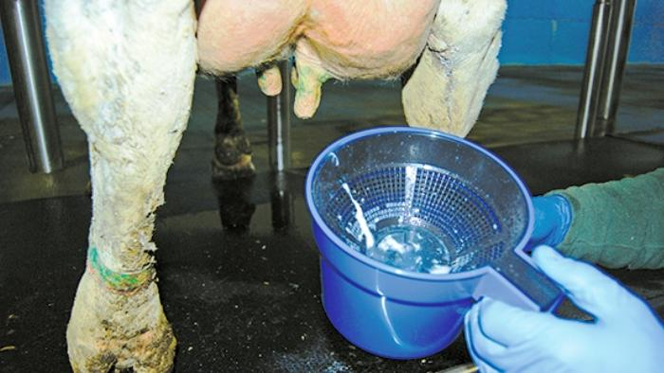
Clinical mastitis control
New cases clinical mastitis

Slide 37
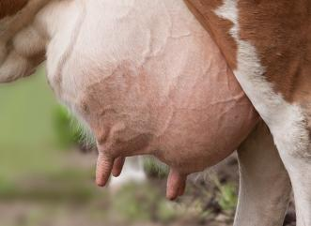
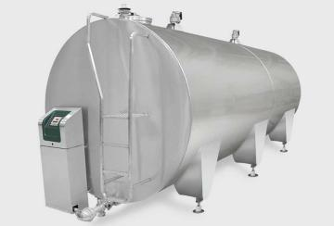
Decrease in individual somatic cell count
CCS in cow
CCS in tank

Slide 38
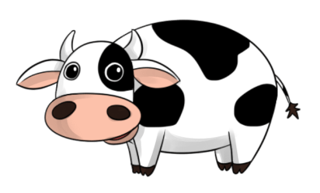
Cows with higher production
Iodine
Lactation
Cow Guard
Lactation
Cow guard cows produce more milk
1,14L/day
347,7L/season(10 months)
(Industrial Pilot study_Year 2016_6000 M.C.)

Slide 39
Longer life of cows
Iodine
Years/Lactations
Cow Guard
Years/Lactations

Slide 40
More benefits
Cost
Benefits
Low expenses tretmeant
Low Milk discard
More Production
More value added
Low Working time

Slide 41
Benefits
Higher profitability of dairy production
Improvement of animal welfare and protection of the environment
Improvement of the welfare of workers and owners

Slide 42
Results

Slide 43
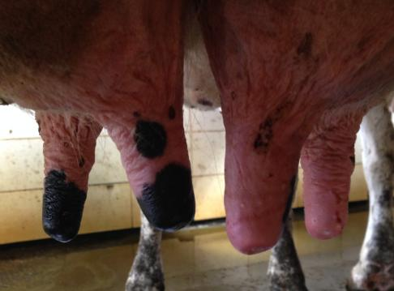
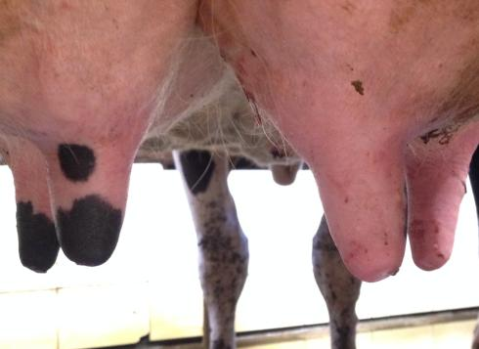
Day 0 Day 5
Tissue regeneration
*Cow Guard Barrera

Slide 44
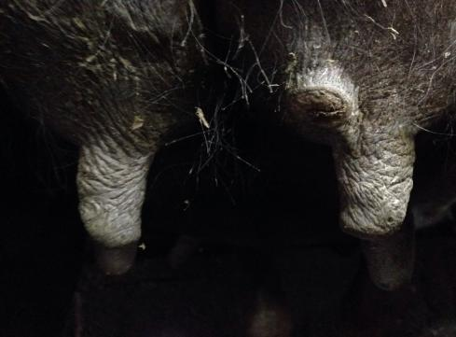
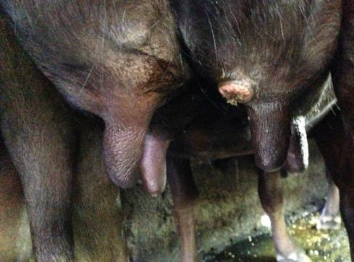
Day 0 Day 5
Tissue regeneration
*Cow Guard Barrera

Slide 45
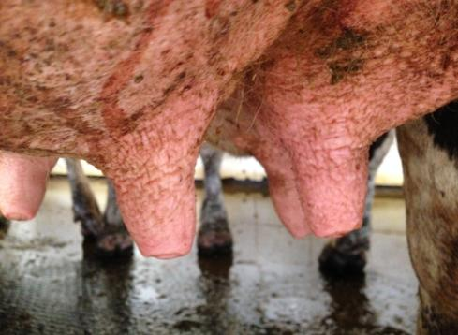
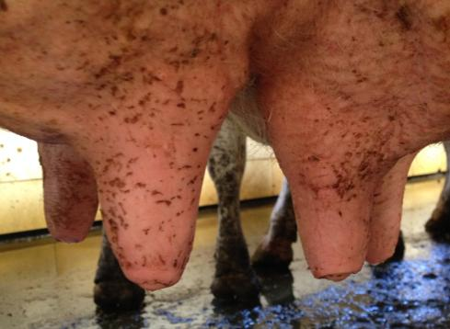
Day 0 Day 5
Tissue regeneration
*Cow Guard Barrera

Slide 46



Level Regeneration of the skin.

Slide 47
Evolution
Initiation
Previuos day
Day
0
Day
3-15
Change of skin
The crease clinical mastitis
RCS decrease

Slide 48
Chronic mastitis
Chronic clinical mastitis
Subclinical mastitis
Cow Guard does not deal with these cases since:
Cow Guard does not enter the mammary gland
Cow Guard is a preventative teat shield,
not a treatment.

Slide 49
95%
less
Clinical mastitis incidence
86%
less
Mastitis treatment expenses
85%
less
Losses due to death and culling of cows due to mastitis
80%
less
100%
less
Discarding of milk
Loss of milk quality bonus
Our clients have achieved...

Slide 50
Industrial pilot...Cow Guard vs Iodine 5000
Cows Cow Guard
Cows Iodine
Dif. 83,73%
Proportions test with two-tailed Z statistic:
P <0,05 (P<0,00000000)
Significant difference
Source: Universidad Austral de Chile

Slide 51
Industrial pilot...Cow Guard vs Iodine 5000
Cows Cow Guard > 1 MM Cows Iodine > 1 MM
Dif. 39,86%

Slide 52
Industrial pilot...Cow Guard vs Iodine 5000
Parlor with Cow Guard Parlor with Iodine
Dif. 39,86%

Slide 53
Industrial pilot...Cow Guard vs Iodine 5000
Test: GLIMM (Generalized lineal mixed model), variable rebaño y número de parto como variables aleatorias (random effect).
3.18 (IC 95% 1.47-6.88)
Diferencia significativa
Reference: Universidad Austral de Chile

Slide 54
Industrial pilot...Cow Guard vs Iodine 5000
Cow Guard improvement:
Clinical mastitis incidence: 83,73% lower
Milk losses by clinical mastitis: 84,64% lower
Milk tank CCS: 18,21% lower
8,46% more healthy cows (RCS<200.000)
39,86% less cows with severe subclinical mastitis
6,56% higher production

Slide 55
Industrial pilot...Cow Guard vs Iodine 5000
Prevention spending cow/season:
Cow Guard US$ 14,54/cow/season
Iodine US$ 12,59/cow/season
Higher production with Cow Guard:
1,14L /cow/day
347,7L/cow/season
US$ 103,05/cow/season
US$ 618.16,54/6.000 Cows/Season
Higher Inversion: US$ 1,95/cow/season
For each dólar spended in Cow Guard, above iodine product, enter US$7,09 extra

Slide 56
Industrial pilot...Cow Guard vs Iodine 5000
Cows Cow Guard < 200.000 Cows Iodine < 200.000
Dif. 8,46%

Slide 57
History
2011 Start of trials
2012 Innovation Project Government FIA
2012 Start of scientific validation
2012 Start of invention patent
2014 Codelco Lab – Biogenesis Animal Health Ltda.
2015 Scientific validation finished
2015 Invention patent finished
2016 National certification: Organic product
2016 Scientific validation INTA Argentina ( NMC C Protocol)
2016 Scientific validation: Industrial trial
2017 Internacional certification ISO 9001-2008
2017 International certification Organic producto
2022 Aplication in 60.000 dairy cows in Chile.

Slide 58
Annexes

Slide 59


Patented formula as an innovation

Slide 60

Patented formula as an innovation

Slide 61

Innovation Project Winner 2012-2013

Slide 62

CINUT-INTA Scientific Study

Slide 63

Food safety scientific study

Slide 64

Food safety scientific study

Slide 65


Industrial scientific study
Scientific study:
industry comparison
Iodine-Cow Guard
6,000 O.V, Year 2016.

Slide 66
Industrial scientific study
Estudio científico:
Comparación industrial
Yodo-Cow Guard
6.000 V.O.
Año 2016

Slide 67

Scientific Study 1st Scientific publication (paper)

Slide 68

Scientific Study 1st Scientific publication (paper)

Slide 69


INTA Argentina Scientific Study

Slide 70

INTA Argentina Scientific Study

Slide 71

Authorization SAG
Resolution SAG 2011
Resolution SAG 2012
Certificate SAG 2016
Certificate SAG 2017
Certificate SAG 2018
Certificate SAG 2019
Certificate SAG 2020
Certificate SAG 2021

Slide 72

SAG Inputs approved for national organic agriculture, Chile.

Slide 73

SAG Inputs approved for national organic agriculture, Chile.

Slide 74

Certification ISO 9001-2015

Slide 75


Certified by Kiwa BCS Öko-Garantie GmbH;, Nuremberg, Germany, use in organic farming.compatibilidad para el uso en agricultura ecológica, 2017

Slide 76
The world's first copper-based organic teat shield.

