Slide 1
Situational Overview
Fiberr USA is the exclusive distributor in North America for Fiberr Fiber Reinforced Resins Composite Technologies of Turkey.
Product portfolio includes:
  Fiber Reinforced Plastic (FRP) Grating.
  FRP Laminated Sheet.
  FRP Pultruded Shapes.
  FRP Compression Molded Shapes.
All products are manufactured at the Fiberr factory near the Port of Izmir, Turkey.
Fiberr Turkey is wholly owned by Mr. Engin Yesil.
Fiberr USA is jointly owned by Engin Yesil and Chris Pernicano.
The U.S. business plan is being executed in two phases:
  Phase 1 – Market Intelligence
    Proven product-market fit with 4 large recurring customers.
    Gained deep understanding of the U.S. and Americas market.
    Identified and addressed testing & certification requirements.
    Specified custom tooling to meet U.S. standards.
    Developed a full set of sales & technical materials in imperial units.
    Identified clear competitive differentiators.
  Phase 2 – Growth
    Now preparing to fund and scale the business.

Slide 2
US FRP Market Overview
US Market Size (2024): Estimated at $24.03 billion, with projections to reach $43.67 billion by 2032, reflecting a Compound Annual Growth Rate (CAGR) of 7.6%.
Key Growth Drivers:
Automotive Sector: Increasing demand for lightweight, fuel-efficient vehicles is driving the adoption of FRP composites.
Aerospace Industry: FRP materials are favored for their high strength-to-weight ratio, contributing to improved aircraft performance.
Construction & Infrastructure: FRP's corrosion resistance and durability make it ideal for bridges, pipelines, and building reinforcements.
Marine Applications: FRP's resistance to moisture and chemicals enhances its suitability for shipbuilding and offshore structures.
Recent Developments:
Infrastructure Investments: The U.S. government's focus on infrastructure modernization is boosting the demand for FRP materials in construction projects.
Sustainability Initiatives: There's a growing emphasis on developing recyclable and bio-based FRP composites to meet environmental regulations.
Technological Advancements: Innovations in manufacturing processes, such as resin transfer molding (RTM) and pultrusion, are enhancing production efficiency and product quality.

Slide 3
Fiberr Market Advantages
Factory-Direct Distributor – Improved pricing flexibility.
Unusually Broad FRP Product Line – “One-stop Shop”
Stable and Transparent Pricing – Allows for online ordering with no need for “Request a Quote”
Dual Channel Sales – Wholesale (by cargo container) & Retail (small lots)
U.S. Market Presence – Clients often reference superior customer service
Cost Advantage from Turkish Supply Chain Advantages – Competitive costs with China and India competitors
Favorable U.S. Tariff Position – Superior position to China competitors
Lower fixed costs – Automate & leverage AI to reduce the need for staff.

Slide 4
Business Plan Overview
Address South Florida Market to Prove Operations – Focus on construction industry.
Strong Web Presence – Google ads, Google Storefront, Amazon Storefront, etc.
Strong Technological Base – Online store provide real time pricing (almost all large competitors require request a quote), integrated inventory control and accounting.
Inventory & Warehouse– Begin with inventory focused on key products and scale to match market demand. Lease warehouse to support scaled inventory.

Slide 5
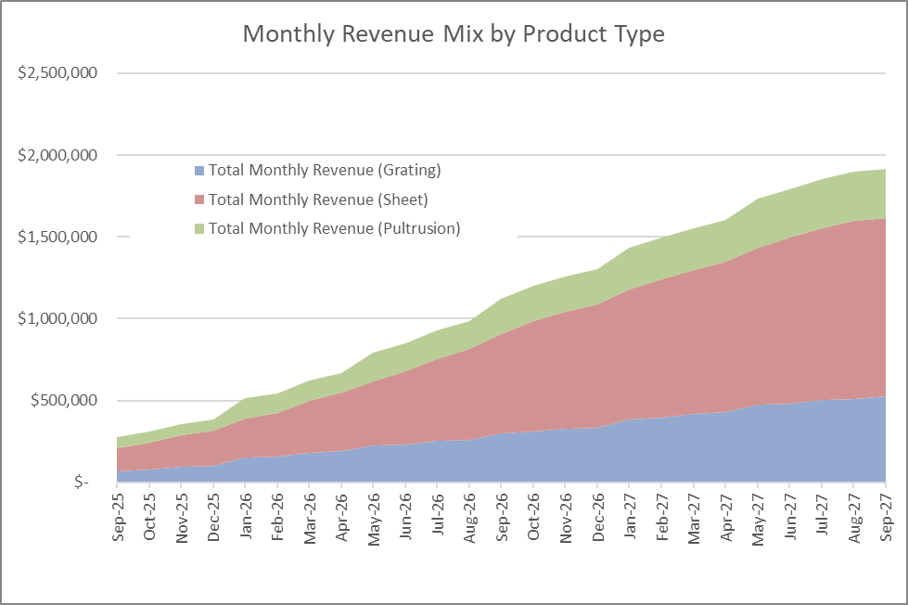
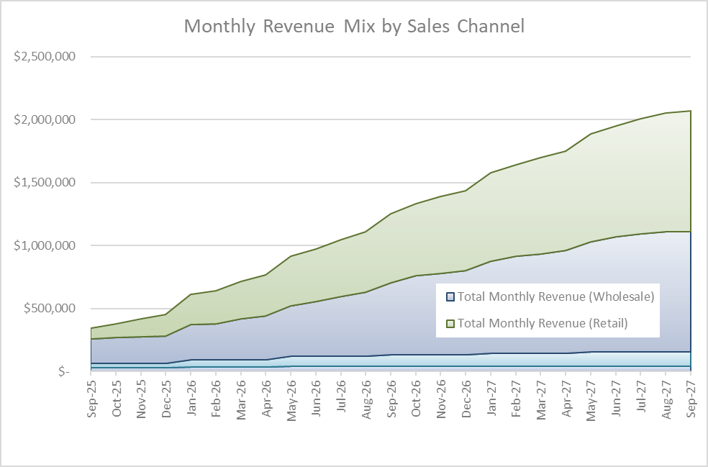
Revenue Forecast
Revenue Growth to $1M/Month ($12M/year) over one year.
Revenue Growth to $1.9M/Month ($23M/year) over two years.
Sales mix approximately 34% Grating, 57% Sheet (coil & pallet), 8% Pultrusion.
Sales mix approximately 33% Wholesale, 67% Retail.

Slide 6
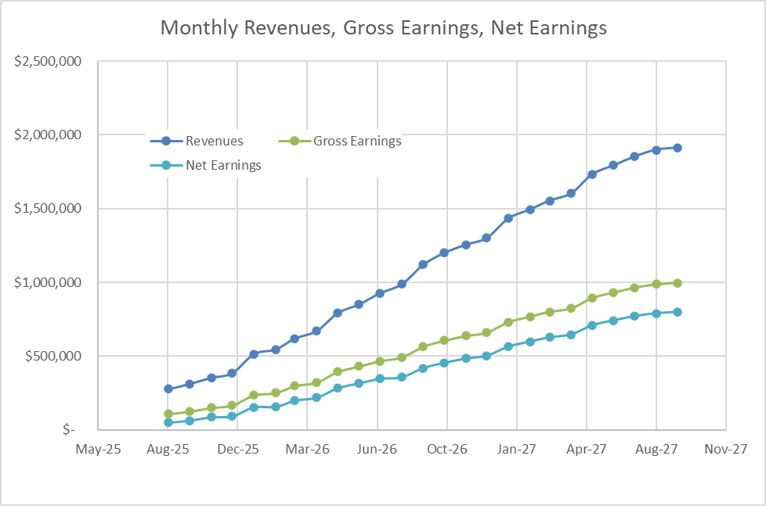
Cost Model & Profit
Gross earnings 52% at end of year 2.
Net earnings 42% at end of year 2.
Net earnings $350K/month at end of year 1
Net earnings $790K/month at end of year 2
Accumulated earnings $2.3M at end of Y1.
Accumulated earnings $10.4M at end of Y2.

Slide 7
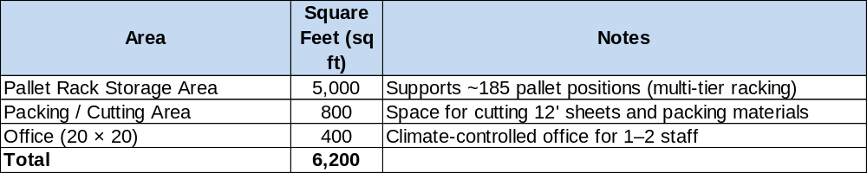
Warehouse Overview
Capacity: 185 pallets (approx. 40% of Full Inventory)
Assumptions:
Using multi-tier steel racking and narrow aisle forklift access
Pallets are stacked 2–3 levels high in racks
Each pallet is up to 5 ft wide × 12 ft long
4 ft aisles are included for forklift maneuverability
The 5,000 sq ft racking area includes a 25% buffer for access and circulation
Approx. 50 spare pallets stored outside.

Slide 8
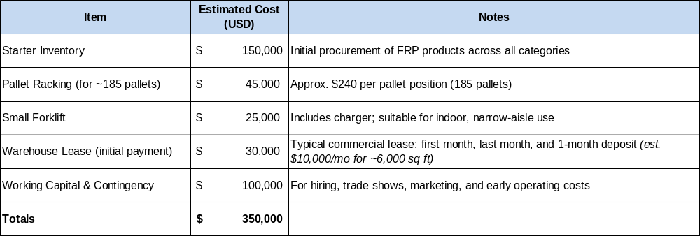
Cash Needs

