Slide 1

Independent Boutique Corporate Advisory Services
Introductory Credentials
May 2025

Slide 2
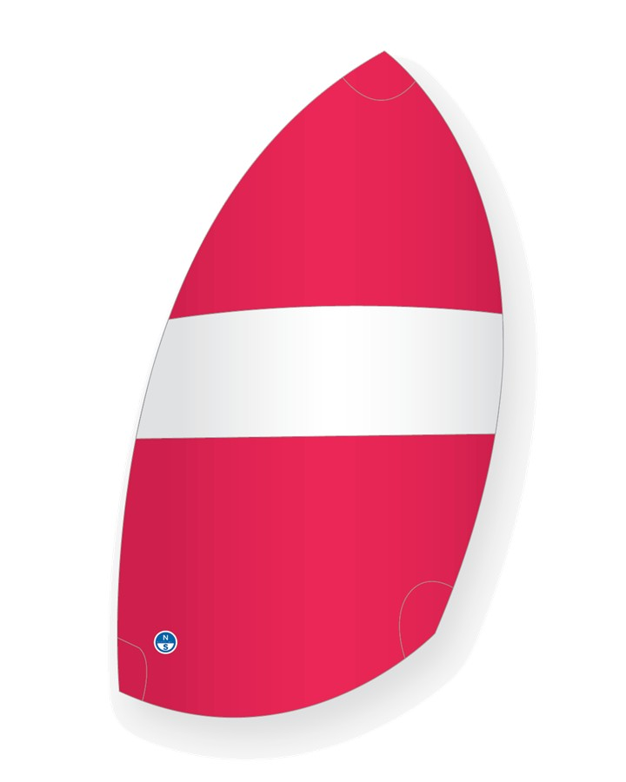
SYMMETRY
CAPITAL

Slide 3
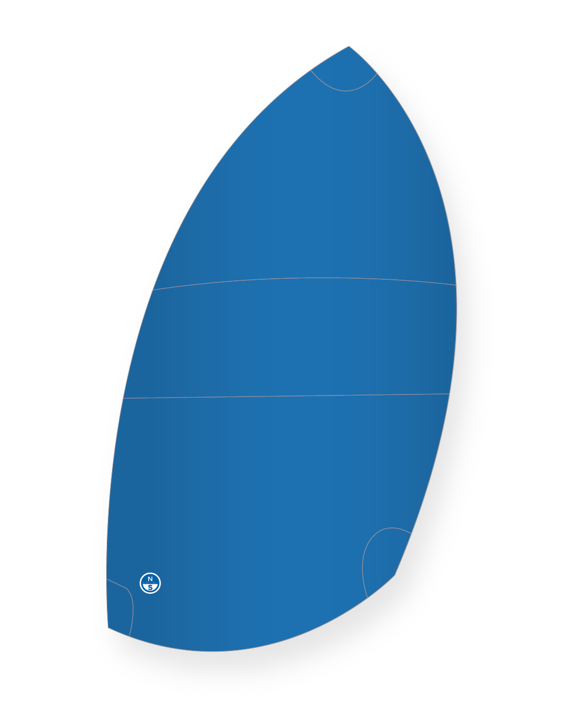
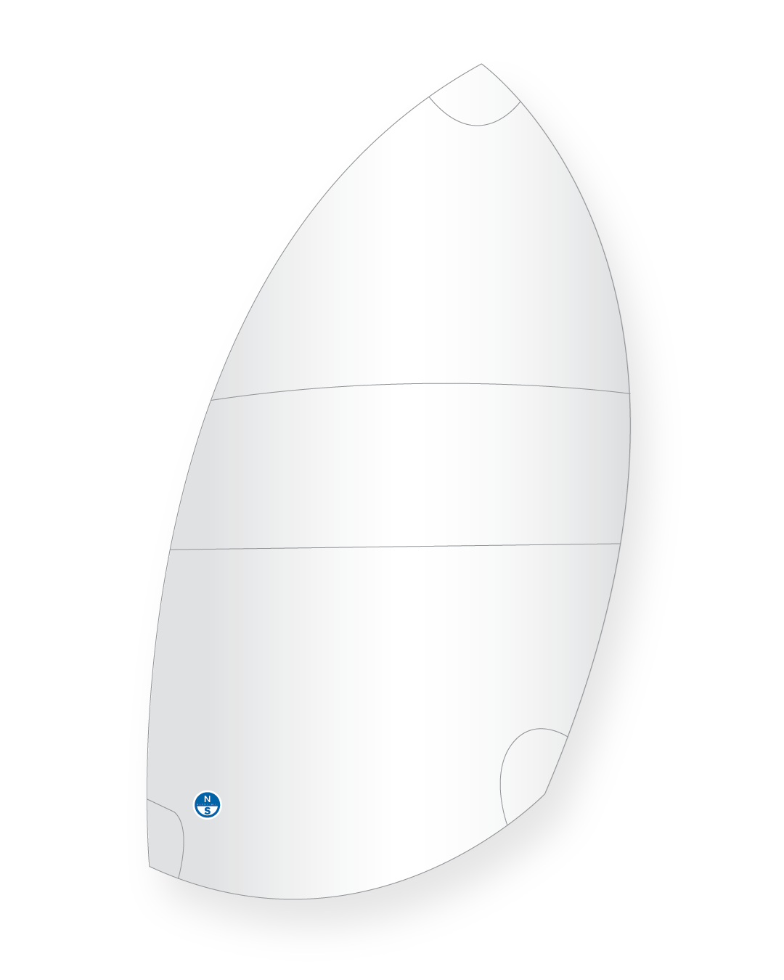
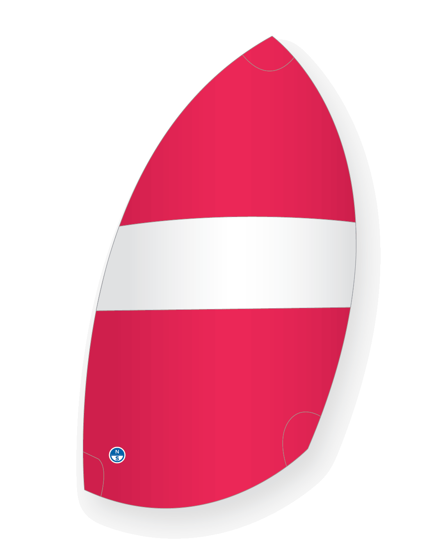
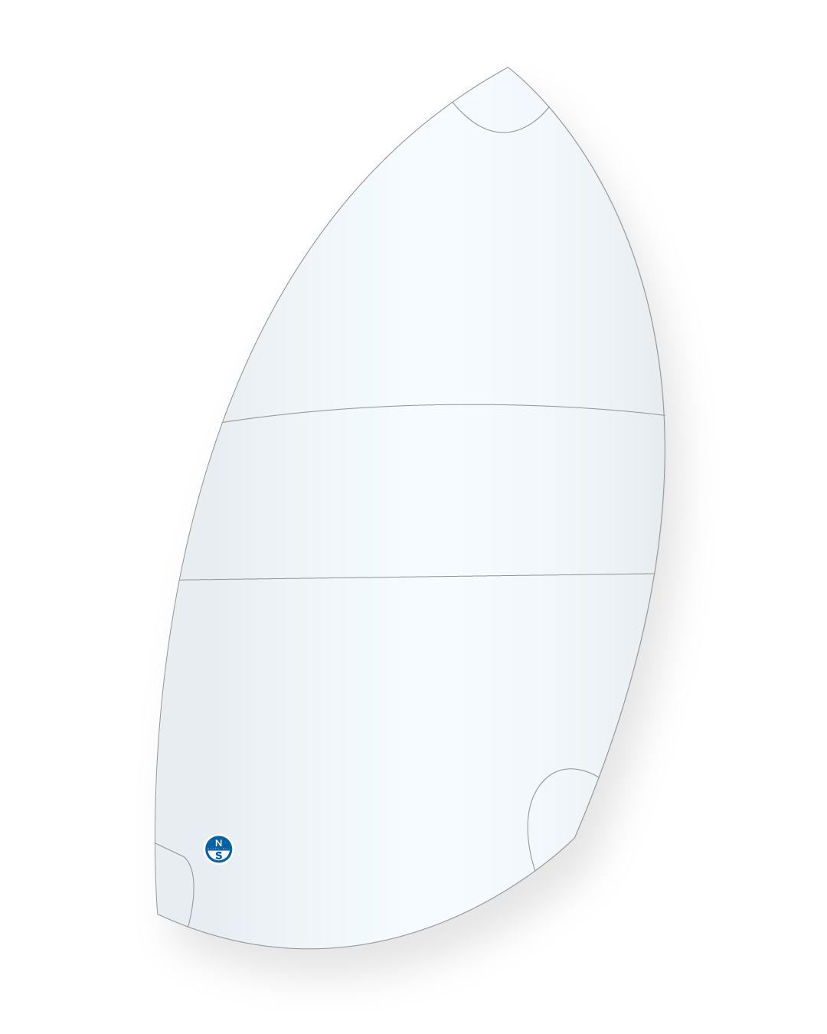
SYMMETRY
CAPITAL

Slide 4



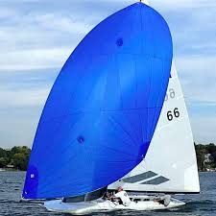


SYMMETRY
CAPITAL

Slide 5
SYMMETRY
CAPITAL

Slide 6
SYMMETRY
CAPITAL

Slide 7
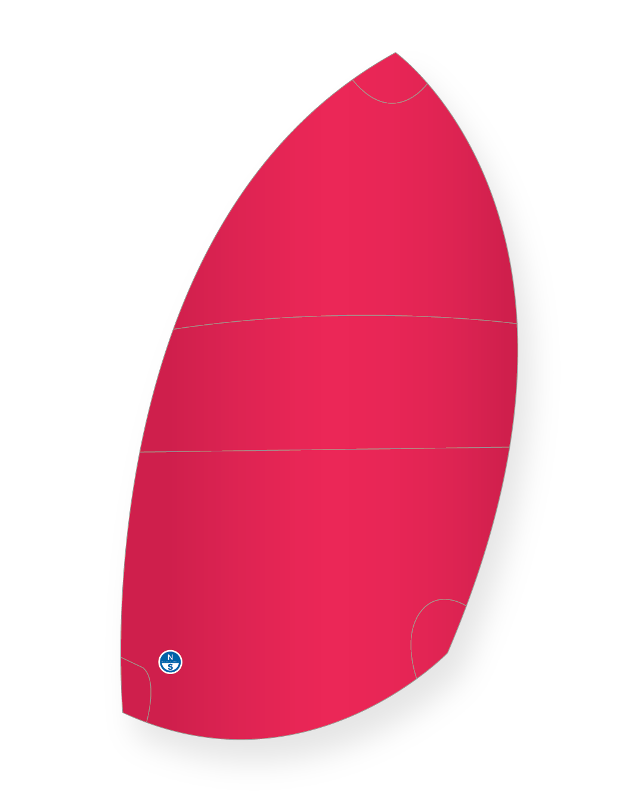
SYMMETRY
CAPITAL

Slide 8
[Key page title goes here]
[Sub-heading goes here]
SYMMETRY
CAPITAL

Slide 9
Introducing Asymmetry Capital
An independent boutique corporate advisory firm focussed on senior attention to detail and execution excellence
SYMMETRY
CAPITAL

Slide 10
Transaction experience
Extensive sellside M&A, buyside M&A and capital raising experience
SYMMETRY
CAPITAL

Slide 11
Broad sector experience
Insights and relationships spanning private equity, financial services, industrials and services
SYMMETRY
CAPITAL

