Slide 1
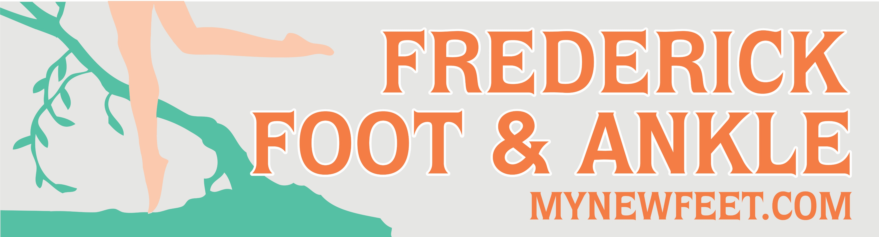
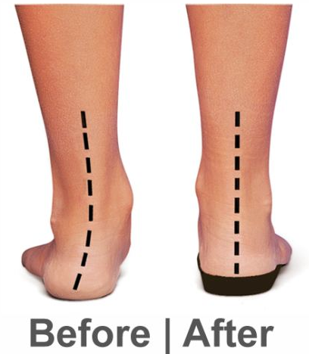
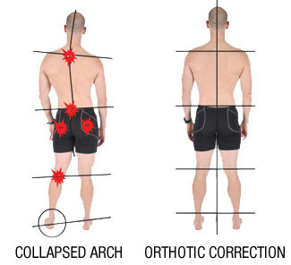


Offering Custom Orthotics
Why are Custom Orthotics Used?
Off-loading painful areas of the foot
Correct an abnormal walking pattern
Support the foot arch
Re-align foot posture
Help alleviate lower back pain
Bring knees back into alignment
Decrease minor limb length discrepancy
Support flat feet
Custom Orthotics can be made with many variations:
Metatarsal pads
Heel Cups
Lateral Flange
Scaphoid Pad
Heel Spur Cut Out
Rear Foot Posting
Frederick Office: Now Open Saturdays
(unless attached to a holiday)
Frederick Office
141 Thomas Johnson Dr. Suite 170
Frederick, MD 21702
Urbana Office
3430 Worthington Blvd. Suite 201
Urbana, MD 21704
Martinsburg Office
123 Health Care Lane
Martinsburg, WV 25401

