Slide 1

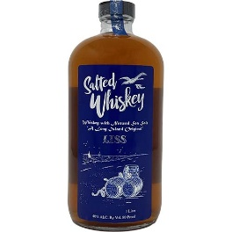
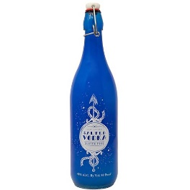
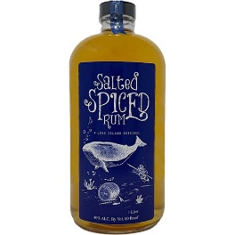



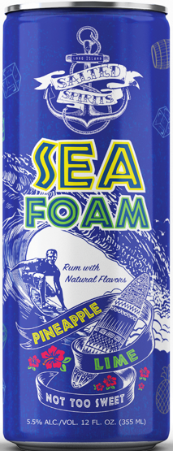
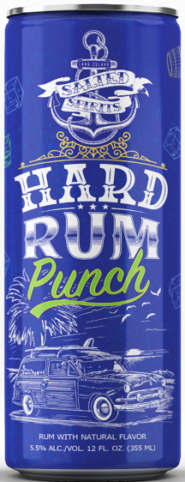
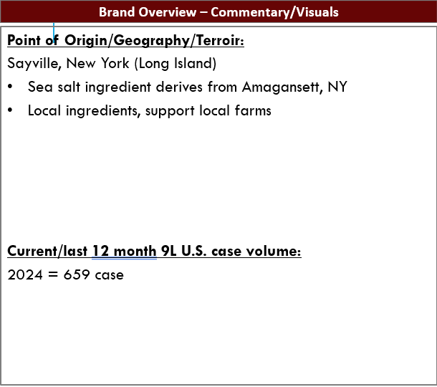
Brand Overview – Commentary/Visuals
Brief brand description and overview:
Long Island Salted Spirits, is nautical rooted within the manufacturing process and the brands experience. By utilizing locally made sea salt out of the Atlantic Ocean, as part of our flavoring and aging process.
Subcategory (i.e. bourbon, whiskey, vodka, wine):
Whiskey
Vodka
Spiced Rum
RTD’s (hard lemonade (vodka), hard unsweetened iced tea (vodka), hard half and half (vodka), Seafoam Pineapple lime (rum)
Liquor bottles only no RDT’s

Slide 2
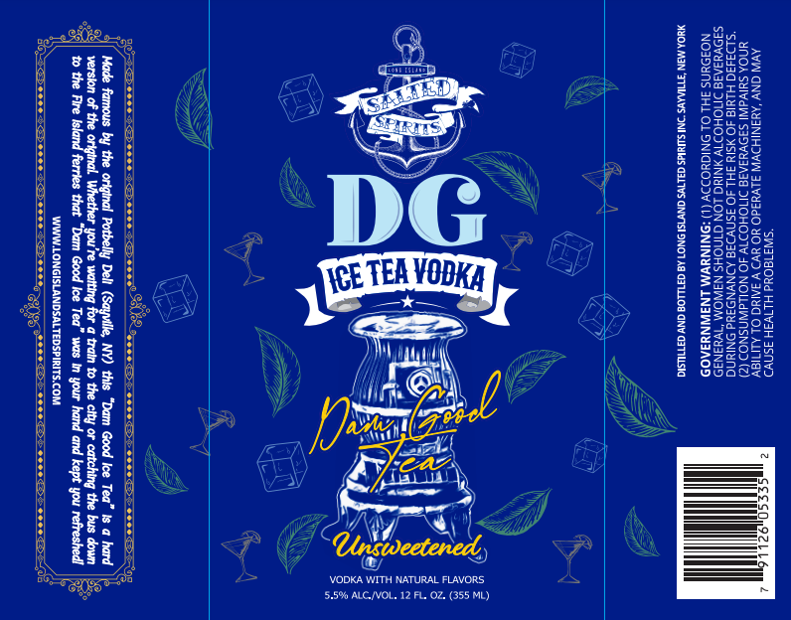
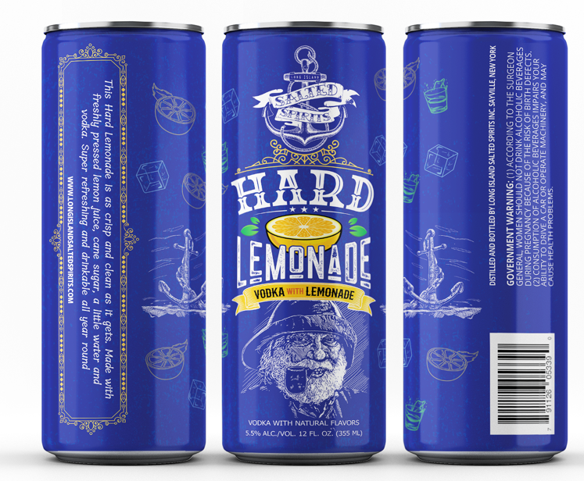
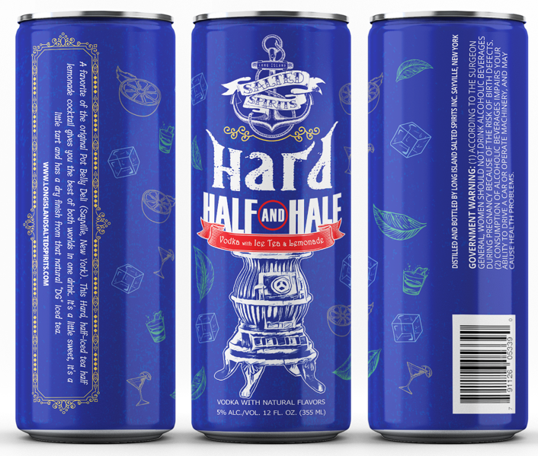
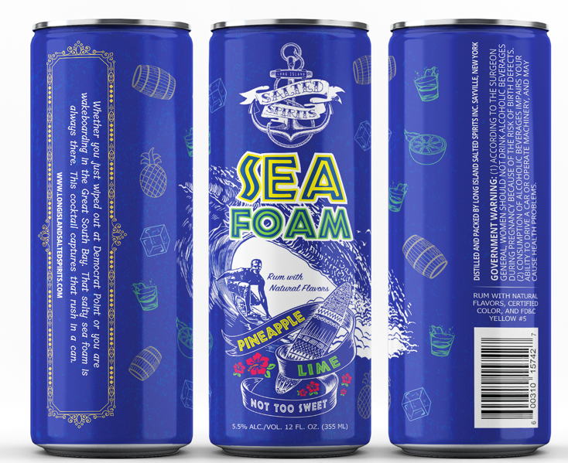
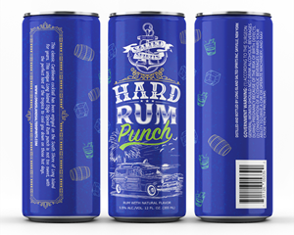
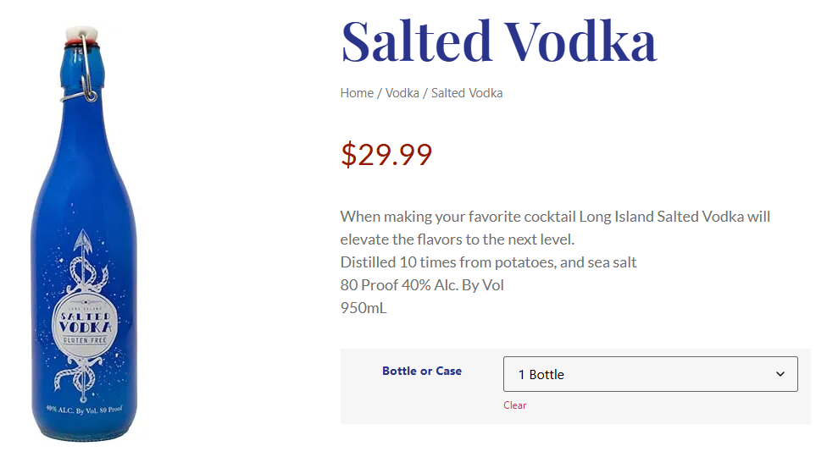
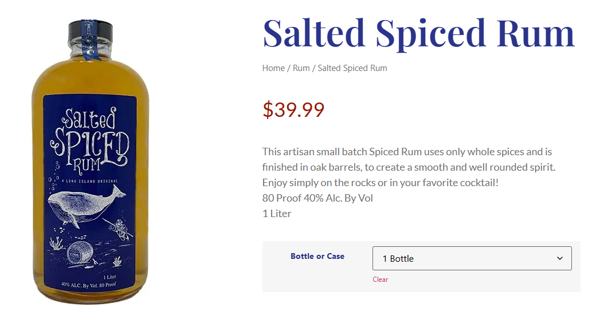
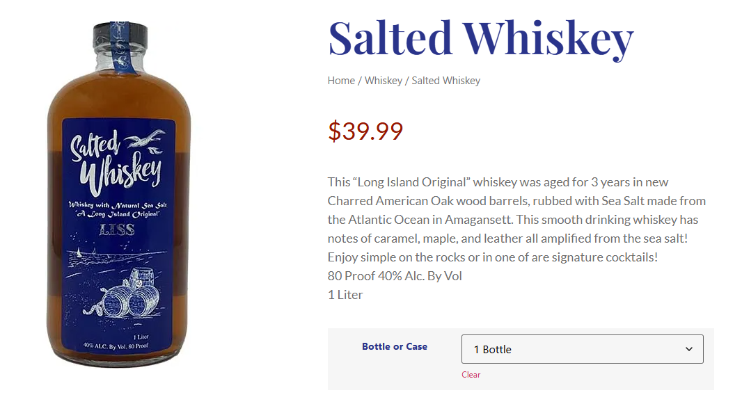
Brand Visuals – Post pictures here
Pricing (Units/Case, Packs/Case, Units/Pack/Retail Facts
BOTTLE/PRODUCT. Please click on image to resize it for r reading
DELIVERED PRICING All cans 6/4PK (24 cans)= $45.90 Salted Vodka 1liter/6PK= $96.95 case Salted Spiced Rum 1liter/6PK= $165 case Salted Whiskey 1liter/6PK= $169 case SUGGESTED RETAIL PRICE (WHAT THE CONSUMER PAYS): all cans 6/4PK (24 cans)= $77.94 (12.99 4pk) Salted Vodka 1liter/6PK= $179.94 case ($29.99 bottle) Salted Spiced Rum 1liter/6PK= $239.95 case ($39.99 bottle) Salted Whiskey 1liter/6PK= $239.95 case ($39.99 bottle) SHELF LIFE: RTD 2 years
2

Slide 3
Brand Overview – Commentary/Visuals
Brand size formats/Case Pack:
RTD’s - 12 oz sleek cans packed qty. six-4pks. per case
Spirits- 1 liter glass bottles. packed 6 per case
What is your ongoing minimum order requirement? Ex. Do we have to buy pallets?
Yes
RTD is one pallet each (117 case)
Salted Vodka 1 pallet (50 case)
Salted Spiced Rum pallet (50 case)
Salted Whiskey pallet (50 case)
Annual Volume Expectations (9L Cases): All TRD cans= 10,000 case for all four flavors together Salted Vodka= 800 case Salted Spiced= 500 case Salted Whiskey= 500 case Marketing Investment (Annual spend): $45,000 Marketing Tools In store tastings, print media, Taste of NY sponsorship, social media, our tasting room events, industry events, TV commercial’s Shelf talkers (off-premise) Table menu’s/tents (on-premise)
3

Slide 4
Distributor Support – Commentary/ Visuals
Brand Positioning – Commentary/Visuals
The Digital Space?
Instagram, Facebook, membership emails
Does your brand leverage social media?
Yes , With posts to engage with our customer base.
Social Media Link - Below
https://www.facebook.com/Longislandsaltedspirits
https://www.instagram.com/li_salted_spirits/
What makes your brand unique? (Elevator pitch)
RTD’s- easy drinking with a fresh finish.
Iced tea unsweetened only ingredients are orange pekoe black tea and vodka.
lemonade uses fresh lemon juice, sugar, water, and vodka
Half and half is perfect blend of tea and lemonade without being too sweet.
SeaFoam, is a unique blend of pineapple, lime and hint of rum and a fizzy finish.
Salted Whiskey- This “Long Island Original” whiskey was aged for 3 years in new Charred American Oak wood barrels, rubbed with Sea Salt made from the Atlantic Ocean in Amagansett. This smooth drinking whiskey has notes of caramel, maple, and leather all amplified from the sea salt mellowing process.
Salted Spiced Rum-This artisan small batch Spiced Rum uses only whole spices curded in sea salt to extract the essential oils into the rum. Then finished in virgin oak barrels, to create a smooth and well-rounded spirit.
Salted Vodka- When making your favorite cocktail LI Salted Vodka will elevate the flavors to the next level. Distilled 10 times from potatoes, and sea salt #saltyourcocktails
4

Slide 5
Distributor Support – Commentary/ Visuals
Brand Positioning – Commentary/Visuals
Brand Objectives
To bring great drinks to great people. Whether the customer is a world class mixologist or a customer that is looking for an easy to drink refreshment with clean ingredients. We have something for everyone.
Target audience/Consumer profile
RTD’s- ages 21-55 active people fun loving
Spirits- for people who love cocktails and want to try something unique. Mixologist for on-premise sales. Small batch craft customers
Programming/Activations Calendar
Whisky fest in Brooklyn
Summer cocktail fest NYC
Long Island Whiskey festival
Full Calander of events at the tasting room as well.
5
5

Slide 6
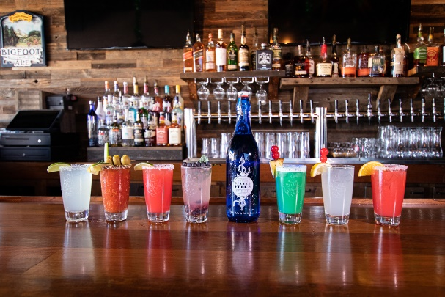
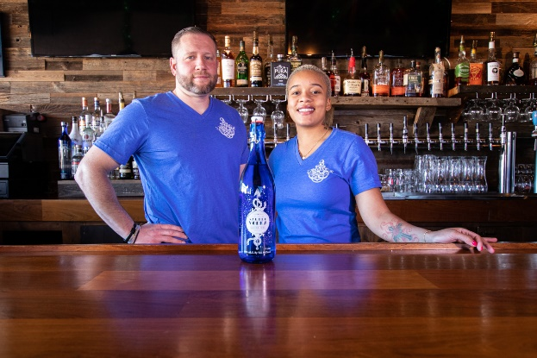
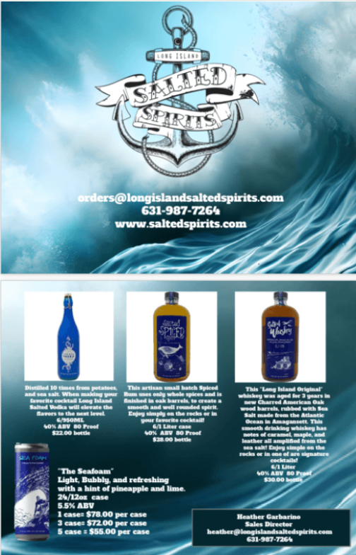
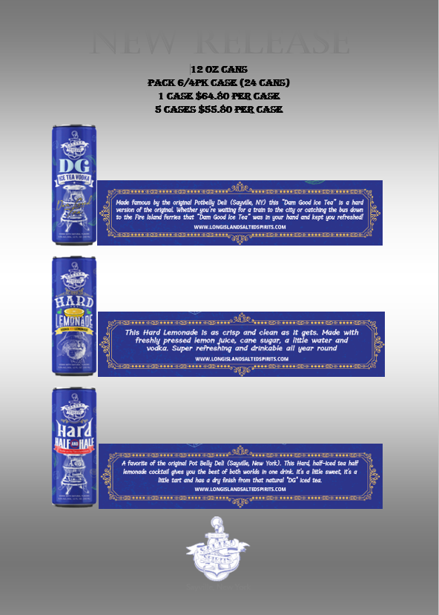
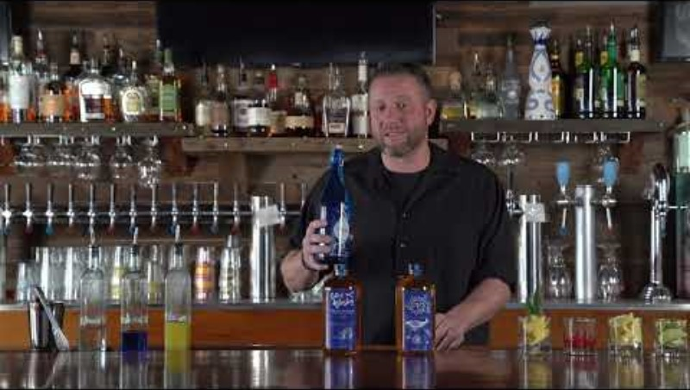
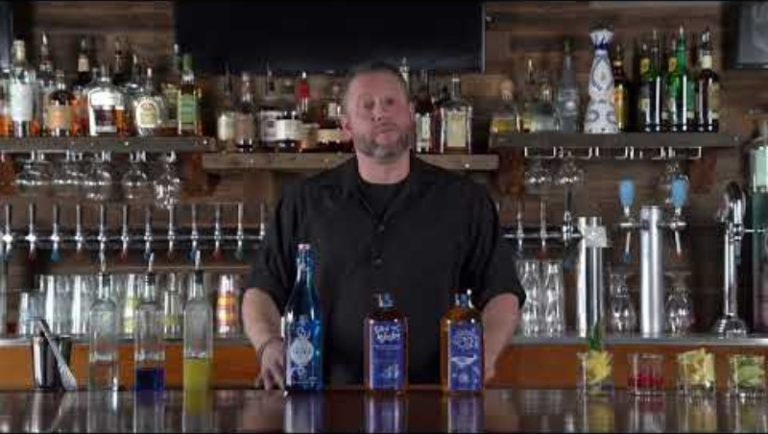
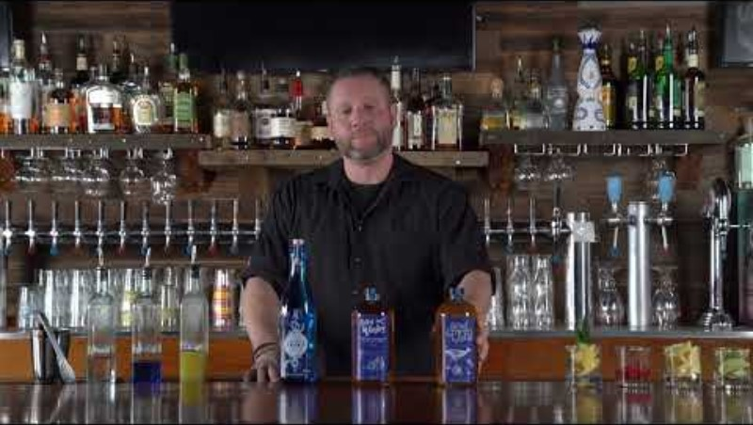
POS or Digital Advertising
Reviews & Accolades – Commentary/ Visuals
Salted Vodka Salted Whiskey Salted Spiced Rum
Salted Vodka
Salted Spiced Rum
Click to Play
Salted Whiskey
6

