Slide 1
Examples of slides for new template

Slide 2
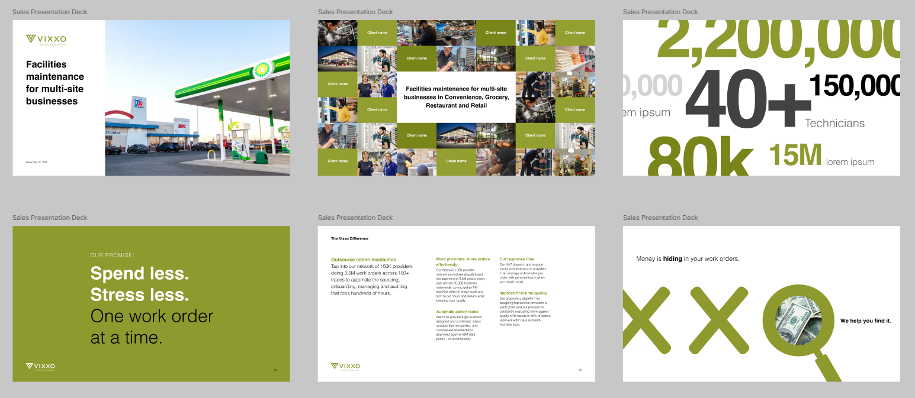

Slide 3
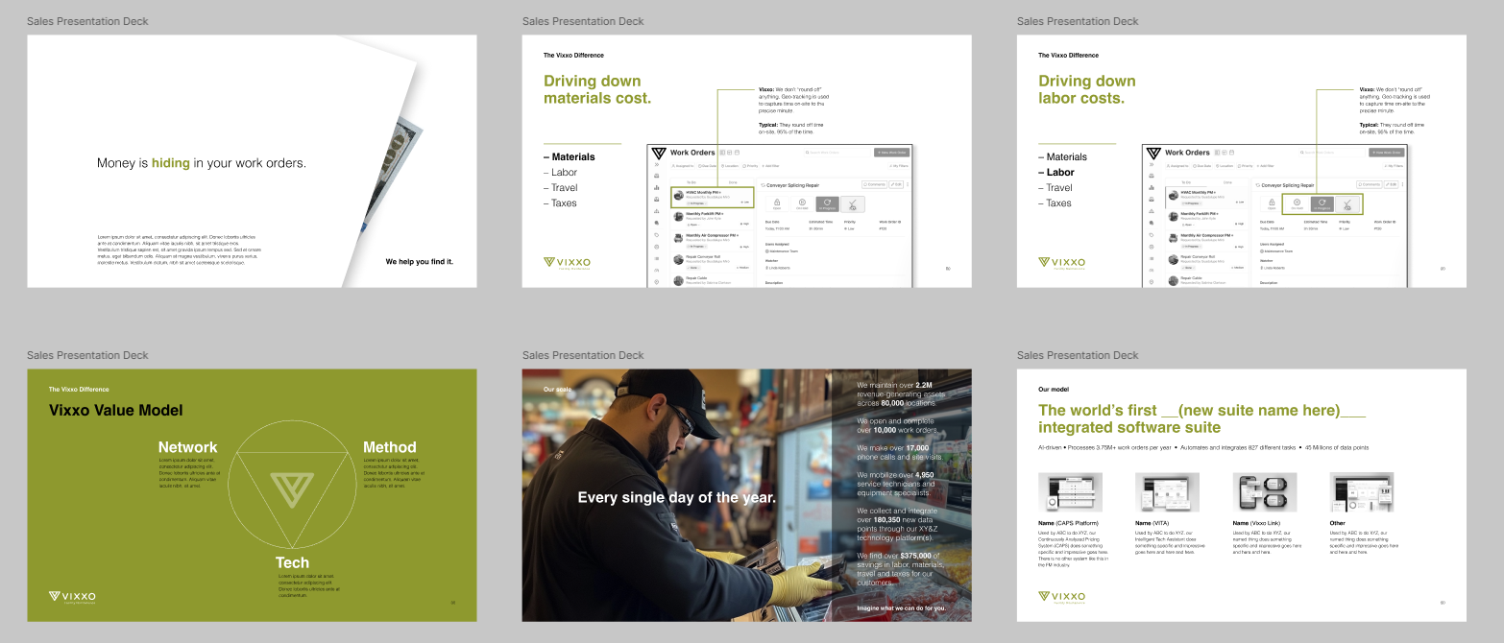

Slide 4


