Slide 1
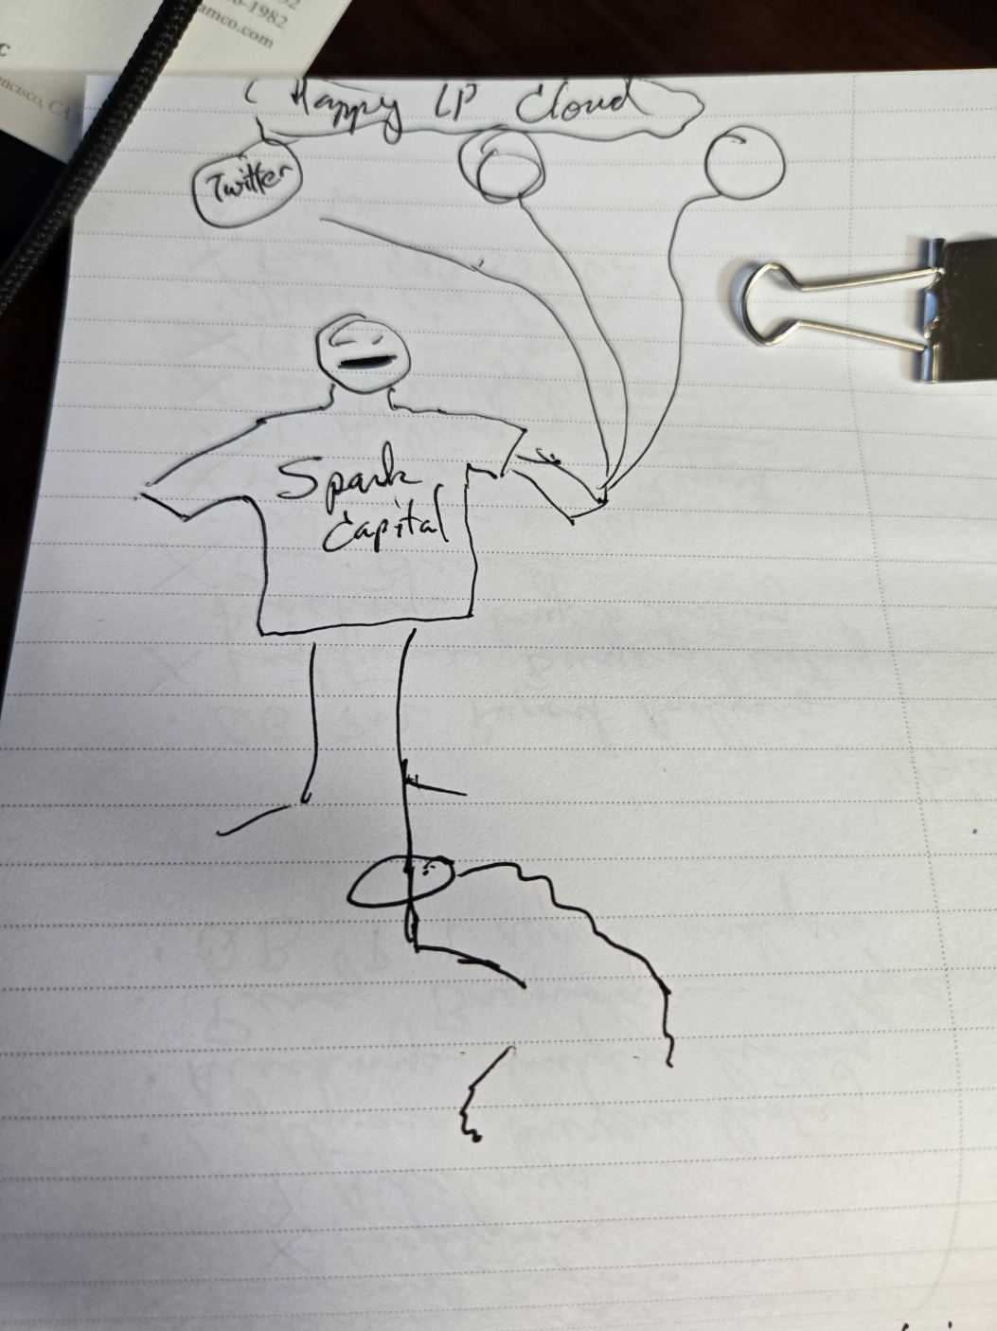
Concept:
A venture capitalist gets to float away into the Cloud of Happy LPs unless the VC is held back by the “ball and chain” or “zombie” representing a long-term, long-held portfolio company. The imagery is designed to communicate that our firm can set them free.

Slide 2
Version Ball and Chain
Cloud of Happy LPs
Encircled Logos for
Twitter
Slack
Oculus
Versions:
1 male, 1 female
“Spark Capital
A prominent multi-stage VC firm”
(On the T-Shirt)
A ball and chain #1 (broken) with a circle with the “Menara Networks” logo. As if the chain were broken, giving the person the ability to float to the clouds
The Alden Advisors Rising Logo between the 2 parts of the chain
A ball and chain #2 (attached) with an empty cicle

Slide 3

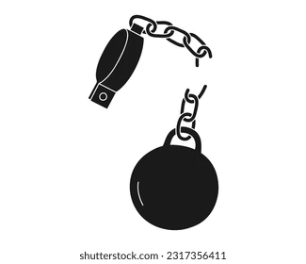


Slide 4


The Alden Advisors Rising Logo between the 2 parts of the chain
(Something like this, but with 100x better design)

Slide 5
Version Zombie hand
Cloud of Happy LPs
Encircled Logos for
Twitter
Slack
Oculus
Versions:
1 male, 1 female
“Spark Capital
A prominent multi-stage VC firm”
(On the T-Shirt)
Zombie grip #1 (broken) with a circle with the “Menara Networks” logo. As if the chain were broken, giving the person the ability to float to the clouds
The Alden Advisors Rising Logo somehow used to demonstrate that AA was responsible for the hand’s release
Zombie grip #2 (attached)

